Slide 1
Finance Data Analysis
RAGHAV KANI K
February 2022

Slide 2
Outline
Scope and Goals
Data Description
Requirements
Specification, Hypotheses, Visualization
Derived Insights
Preliminary Insights
Core Insight
Discussion
Links to Code
Conclusion

Slide 3
Scope
The point of the project is to analyze finance analysis based on their revenue, securities account, and other factors.
We'll look at how Personal Loans are determined by income in this financial examination.
We'll figure out what a 'CD Account' is, as well as what a 'Personal Loan' is, and so on. It was investigated in a variety of methods.
In this 'Analysis,' we used Python and MS EXCEL.
For analyzing data from the provided table, Python-spyder in 'Finance Analyze' is essential.
It lets us analyze a specific table or column from a table, as well as merge multiple tables into one.
Tables and charts are used to visualize the individual ID derived data using Spyder-python and MS Excel.

Slide 4
Goals
The goal of the project is to evaluate individual financial data based on historical performance utilizing the data provided.
Through this technique, we were able to get new data for a single ID from existing data.
We use Python and various queries in this project to extract the most important facts from the given data.
Spyder and MS Excel are also used to exhibit the data in the shape of tables and charts.
A pivot table's main aim is to compare different ID from various perspectives.
As a result of this analysis, we were able to see how each particular ID performed.

Slide 5
Data Description

Slide 6
Data available in DB
What that data is about?
Schema.
(e.g., Age, Income, Personal Loan, Securities Account , CD Account , etc.)
Basic statistics
In total, there are two records.
Each field/column:
E.g., Segment: two segments (Age, Income)
Age (Experience, Education, etc.)
Income (Personal Loan, Credit Card, etc.)

Slide 7
What that data is about?
The project is organized around a single table with a primary key of 'ID.'
There are various columns in the data including ID, age, income, education, and so on.
The information allows us to evaluate the personal loan based on the information provided.
Using Python's required queries, we can generate the required data.
Depending on the requirements, the extracted data might be represented as a table or a chart.
This data relates to the past performance of an individual ID in this 'Finance Analyze' project.

Slide 8
Schema, Tables and Column
A "schema" is a collection of tables with rows and columns, and, like databases, each schema can have its own query.
The 'Finance Analyze' was done in Python, and one of the key aspects is 'Schema,' which is used to put the data (Table and Column) in the correct order.
We may use the schema and the right query to find the required data and extract it.
The information in the 'Data Base' is organized in a table format (Rows & Column).
Using the query, we can extract the relevant data and store it in the new database.
The Pivot Table compares data from various IDs and presents it in tables and charts so that the desired two or more data can be cleverly visualized and analyzed.

Slide 9
Basic statistics
What is the total number of records
Using the required query, a mono table is generated from the database. The three unique studies of the graduates, including the proportion of account holders, greater income, and so on.
Each field/column contains the data:
ID: Age and experience, income and credit card, mean value of same-age group, income of personal loan customers, and so on.

Slide 10
Requirements

Slide 11
Preliminary Insights
The project's preliminary goal is to analyze loans based on their income, age, education, and other factors.
The 'Data Base' contains data that is structured in a table fashion (Rows & Column).
We may extract the necessary data and store it in the new database using the query.
Based on the requirements, we utilize Python-spyder and MS Excel to show the data in a table and chart.
e.g., for such analysis
We found that persons who have a personal loan have a higher income than those who do not.
Personal Loans have been taken out by those who have a large mortgage value, i.e. more than 400k.

Slide 12
Core Insights
In this project, each ID is classified into categories such as high income, experience, income, and so on. Personal Loan, Securities Account, CD Account, Online, and Credit Card are just a few of the categories that are utilized to examine the accounts. Based on the necessity, these are utilized to evaluate and extract the relevant data.
The project's hypotheses are that each ID will be analyzed based on prior data.
In Python-spyder and MS Excel, the representations 'Table' (Rows and Columns) and 'Chart' (Column Chart, Line Chart, Pie Chart, Doughnut Chart, Bar Chart, Area Chart, and so on) are two of the most frequent ways to view data. The 'Pivot Table' in Microsoft Excel is used to compare two sets of data and present the findings in tables and charts.

Slide 13
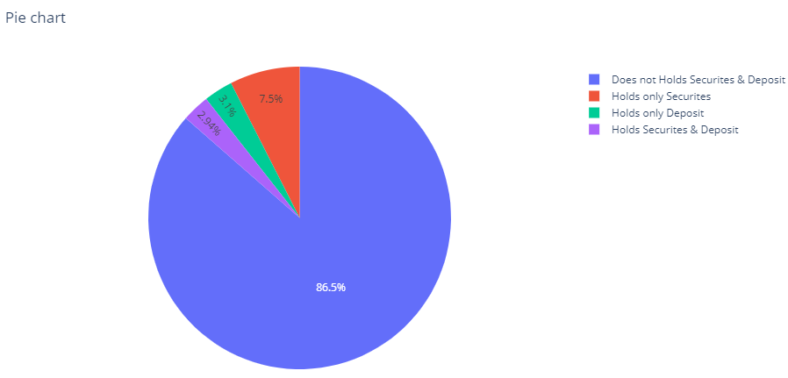
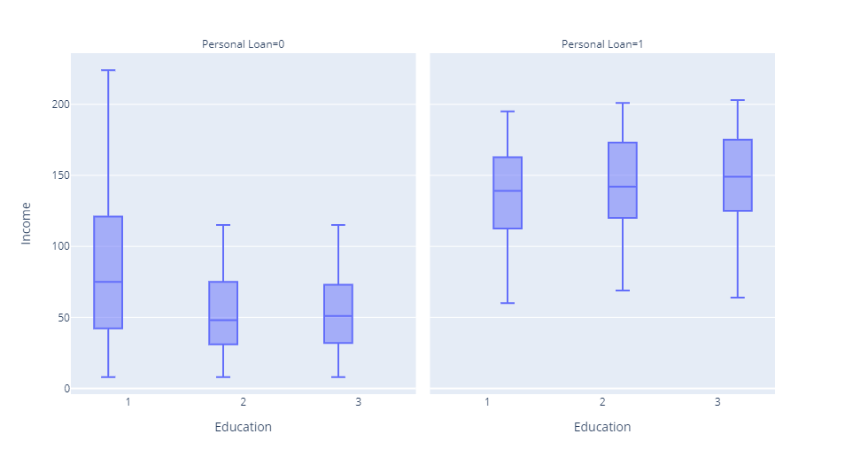
Visualization of A/C holder & Personal loan
Securities & Deposit
Personal loan

Slide 14
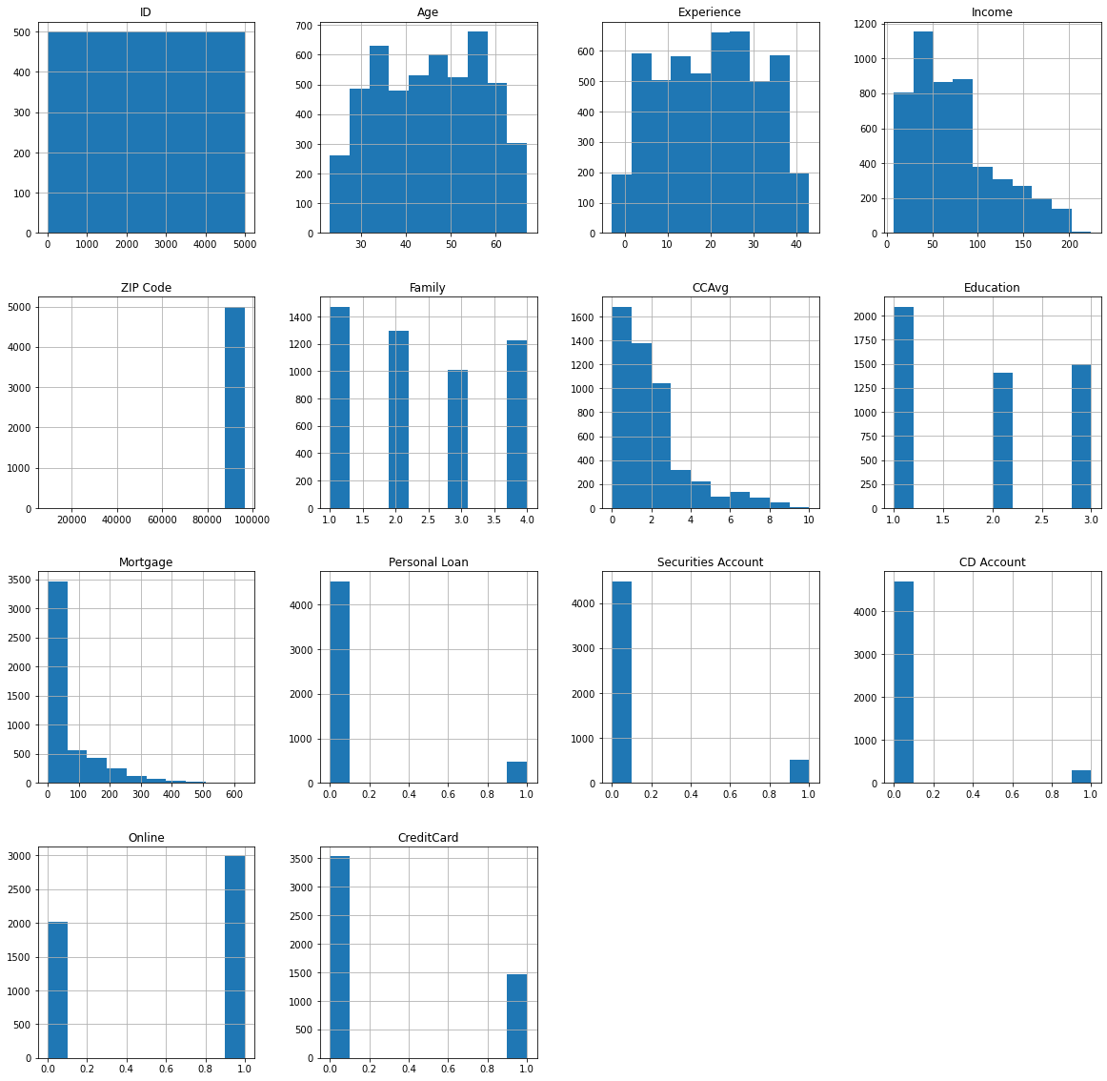
In a chart, the whole data is visualized.

Slide 15
Specification, Hypotheses, Visualization

Slide 16
Specification, Hypotheses, Visualization
The 'Finance Analytics' requirements for the project is to evaluate individual IDs and provide separate statistics based on several categories. Other data are evaluate and compare the statistics of each participant.
The hypotheses of the analysis are the relationships between each age, experience, and so on. Based on the prior data, compare the performance of each individual ID. We can assess and compare data using numerous searches and receive different findings.
Following analysis, we move on to visualization, where we use spyder and MS Excel to see the analyzed data in a table and chart.
The 'Pivot Table' is mostly used to compare and view the obtained data.

Slide 17
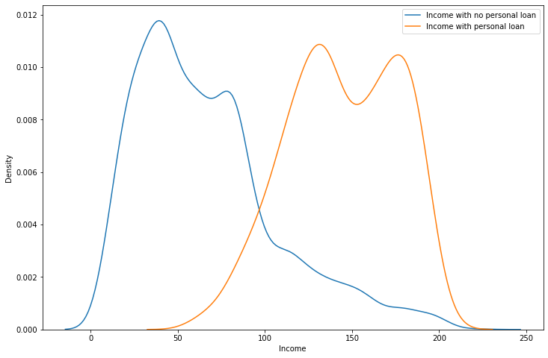
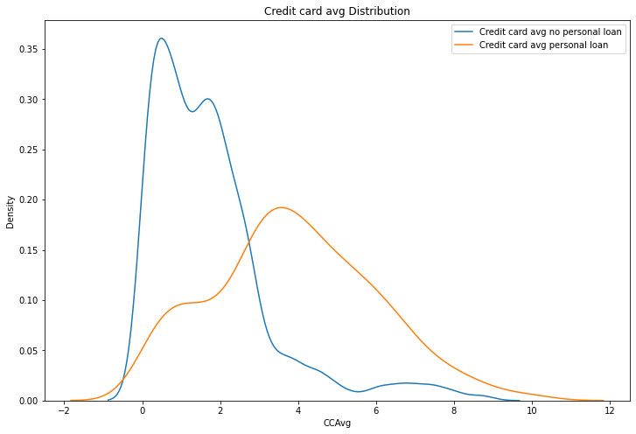
Comparison of ID
Income
Credit card

Slide 18
Derived Insights
Preliminary Insights (PI)
Core Insights (CI)

Slide 19
Preliminary Insights (PI)
The preliminary findings of each ID analysis, as well as an analysis based on their performance, were analyzed and visualized using a range of technologies such as Python and MS Excel.
Python-spyder: We can analyze the ID performance using spyder's. We can extract the data and generate new data by using the proper code.
Spyder and MS EXCEL: Using MS Excel, we can view the data in table and chart format. We may also compare the results and depict them with a chart for easier comprehension. We can partition data into rows and columns with it.

Slide 20
Core Insights (CI)
The project's Core Insights looked into the analysis of individual ID. We compared each ID's performance in this study and derived fresh statistics based on the many categories.
For example, we analyze each ID's data based on their income, education, and other factors. These are the results of our project's research.
These figures were obtained using 'Python-spyder' and 'MS Excel‘. In spyder, we use the proper command to generate the relevant data. MS Excel is used to organize data into tables and visualize the results in various charts for easy comprehension.

Slide 21
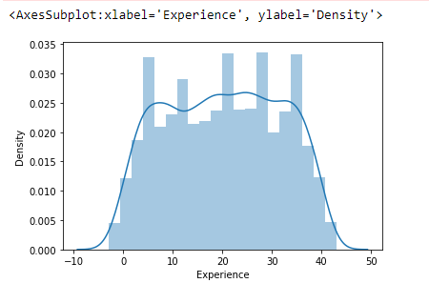
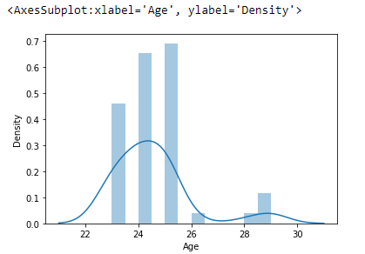
Performance trends
Experience
Age

Slide 22
Discussion
The goal of the project is to use the data provided to evaluate, compare, and visualize each ID.
We utilized 'Python-spyder' and 'MS Excel' for analysis and visualization.
From the given data, we derived data such as income, personal loan, and so on.
We were able to calculate each ID's individual performance as a 'Income,' 'education,' and so on using this data.
In a bar chart, we can show the leading income and mortgage, which is simple to understand without explanation.
Using the analysis, we may compare each derived data and view them according to our choices.

Slide 23
Links to Code
Open code using 'Github‘, click – URL
Data Link:
Spreadsheet ‘Finance data’ click - URL

Slide 24
Conclusion
What did we performed in this project?
This project was completed using two tools: 'Python-spyder' and 'MS Excel.' Both of these tools proved to be really beneficial throughout the process.
The 'Finance Analyze' project entailed analyzing each individual ID's past data.
The ID analysis of things like high income, personal loans, and mortgages, among other things.
These data were generated with Python-spyder, and we used MS Excel's 'table & chart' tool to visualize them.
We derived data by Income of a person has significant impact on availing Personal Loan or not.

