Slide 1
Heart Diseases Prediction
By: Raghwendra Mahato

Slide 2
Introduction
Cardiovascular disease (CVD) is a series of diseases involving the circulatory system, including angina pectoris, myocardial infarction, coronary heart disease, heart failure, arrhythmia and else, which is generally related to atherosclerosis. CVD is the leading cause of death worldwide and a major public health concern.
An estimated 17.9 million people died from CVDs in 2019, representing 32% of all global deaths.
CVD prediction is one of the most effective measures for CVD control.

Slide 3
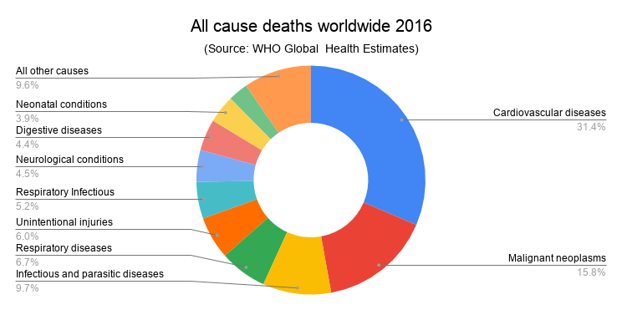
CVD as a dominant cause of death globally
Source: Ulster University

Slide 4
Project Highlights
Data provided by Datamites contained only 180 instances. Hence, new data extracted from UCI website.
Descriptive analysis is performed and insights were drawn.
Predictive analysis is performed by employing different ML algorithms.
These ML algorithms were evaluated using several metrices.
It is intended to use least codes so as to automize the program as far as possible.

Slide 5
Dataset Info
Shape: (303,14)
Total Features: 13
Target: 0 for No Heart Diseases and 1 for Heart Diseases
Balanced Dataset: Heart Diseases=165 and No Heart Diseases= 138

Slide 6
ML Algorithms Employed
Logistic Regression
Support Vector Machine
KNN
Decision Trees
Random Forest
Naïve Bayes
XG Boost
ANN

Slide 7
Metrices evaluation
Accuracy Score
Confusion Matrix
Precision and Recall
Classification Report
Type 1 and Type 2 Error

Slide 8
Libraries Used
Pandas
Numpy
Matplotlib
Seaborn
Scipy
Sklearn
Xgboost

Slide 9
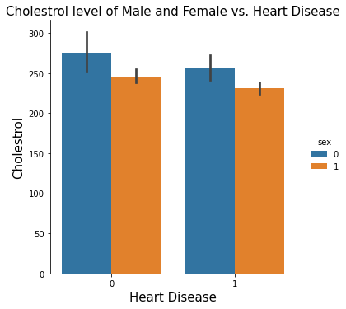
EDA
It is seen that cholesterol of heart patient female is higher than male. It is also seen that cholesterol level of heart diseases patient is lower than healthy heart patients, which is suspicious.

Slide 10
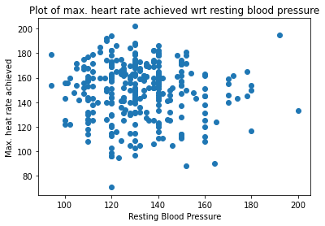

Slide 11
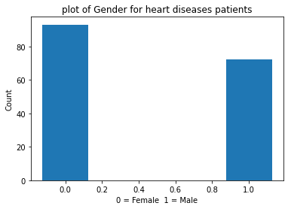
More Females is seen to have heart diseases than males.

Slide 12
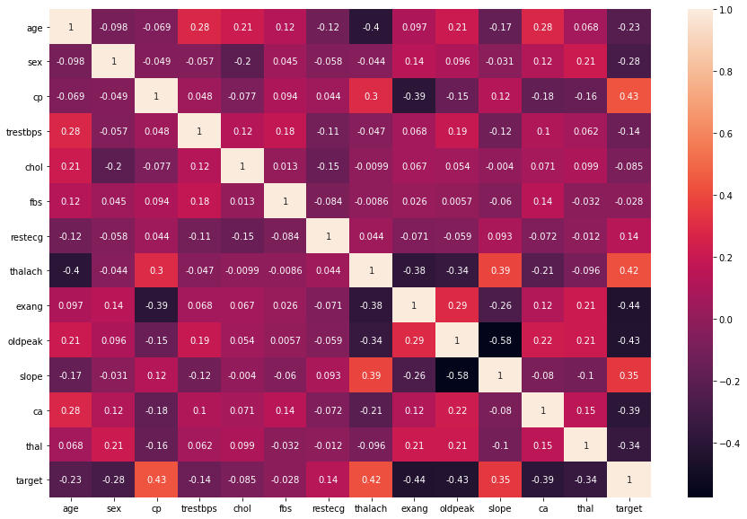
Correlation between features and with target

Slide 13
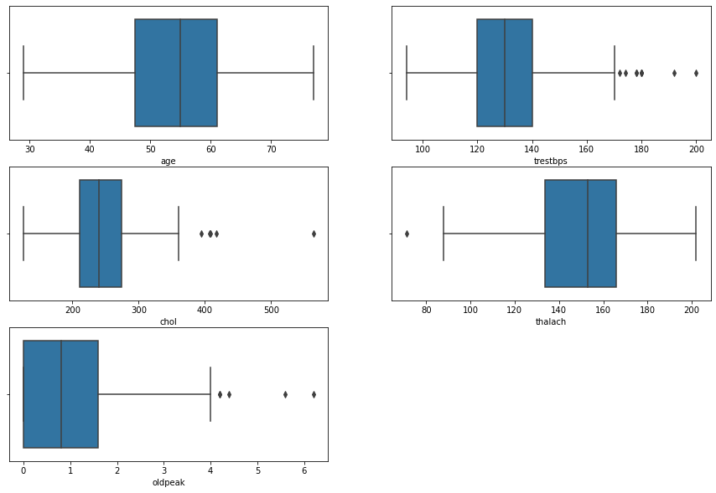
Outliers Removed

Slide 14
Data Processing
Encoding for categorical features
Scaling for Continuous features

Slide 15
Splitting the Data
X = df1.drop('target', axis=1)
y = df1.target
from sklearn.model_selection import train_test_split
X_train, X_test, y_train, y_test = train_test_split(X,y, test_size=0.2, random_state=10)

Slide 16
Automizing: Training, Predicting and Evaluation Metrics
from sklearn.metrics import accuracy_score, classification_report, confusion_matrix
Result = pd.DataFrame(columns=['Model','Accuracy_score', 'precision_0','precision_1','recall_0','recall_1','Type 1 Error','Type 2 Error'])
def metrics_evaluation (model, model_name):
model.fit(X_train, y_train)
y_predict = model.predict(X_test)
Accuracy_score = accuracy_score(y_test, y_predict)
print('\n The accuracy score of ' +model_name, 'is:', Accuracy_score)
C_matrix = pd.crosstab(y_test, y_predict)
print('\n The confusion matrix of '+model_name, 'is:\n\n', C_matrix)
C_report = classification_report(y_test, y_predict)
print('\nThe classification report of '+model_name, 'is:\n\n', C_report)
precision_1 = C_matrix[1][1]/(C_matrix[1][0]+C_matrix[1][1])
precision_0 = C_matrix[0][0]/(C_matrix[0][0]+C_matrix[0][1])
recall_0 = C_matrix[0][0]/(C_matrix[0][0]+C_matrix[1][0])
recall_1 = C_matrix[1][1]/(C_matrix[0][1]+C_matrix[1][1])
print('\n The precision of 1 is:',precision_1)
print('\n The precision of 0 is:',precision_0)
print('\n The recall of 1 is:',recall_1)
print('\n The recall of 0 is:',recall_0)
fp = C_matrix[1][0]
fn = C_matrix[0][1]
print('\n The False Positives i.e. type 1 error is:', fp)
print('\n The False Negatives i.e. type 2 error is:', fn)
return(model_name, Accuracy_score, precision_0,precision_1,recall_0,recall_1,fp,fn)

Slide 17
Minimal coding required for modelling an Algorithm
from sklearn.linear_model import LogisticRegression
model3 = LogisticRegression(max_iter=5000)
Result3 = pd.Series(metrics_evaluation(model2, 'Logistic Regression with 5000 iteration'), index=Result.columns)
Result = Result.append(Result3,ignore_index=True)
Result

Slide 18
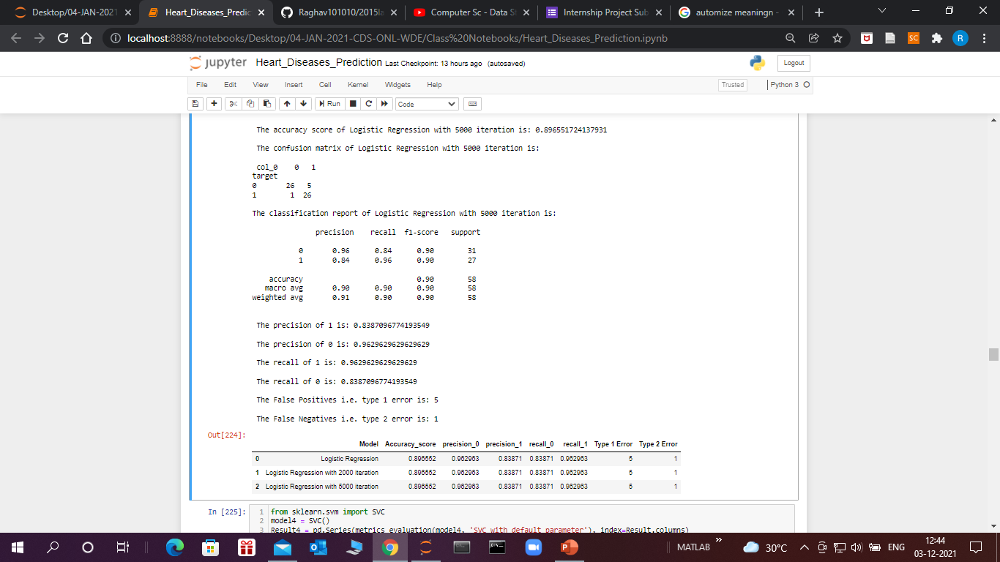
Sample Output

Slide 19
Hypertuning with GridSearchCV
from sklearn.model_selection import GridSearchCV
parameters = {
'kernel' : ['rbf', 'linear'],
'C' : [1,10,20,50,100],
'gamma' : [0.01, 0.1, 0.5, 0.75, 1]
}
grid_model = GridSearchCV(SVC(), parameters, verbose=2)
grid_model.fit(X_train, y_train)

Slide 20
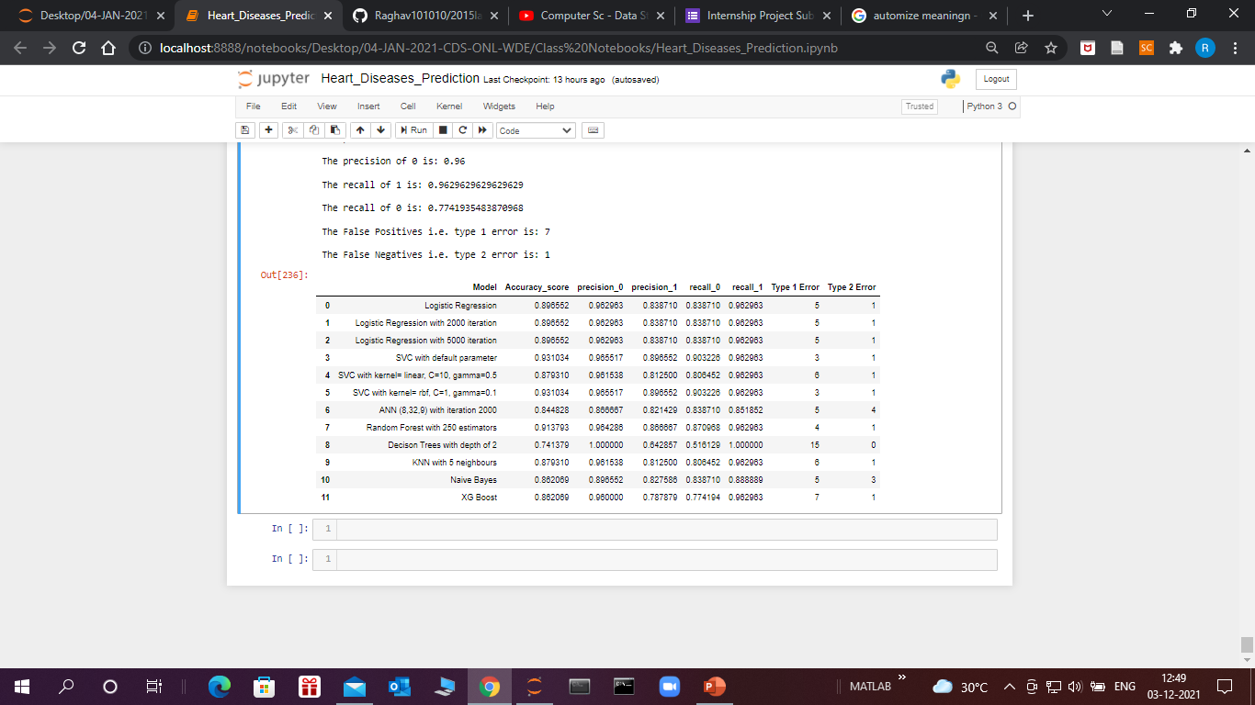
Final Output

Slide 21
Conclusion
The maximum accuracy score achieved is 93% with SVC using parameters obtained by hyper tuning.
Others Algorithms have accuracy score between 87-90%
Type 1 and Type 2 errors are also least in SVC.
Decision Trees with the depth of 2 is Type 2 error free but at the cost of 15 Type 1 error which is maximum.

Slide 22
Further…
AUC Score and ROC Curve can be plotted to further optimize the models.
Hyper tuning can be done on other models too to further optimize the models.
We can try Decision Trees model feeding unscaled data to see if the score is improved.
Ordinal Encoding techniques can be used to encode ordinal categorical data to see if the score is improved.
We can also try to collect more data as the data is not enough.

Slide 23
Thank you

