Slide 1
Savitar
JSON Transformation

Slide 2
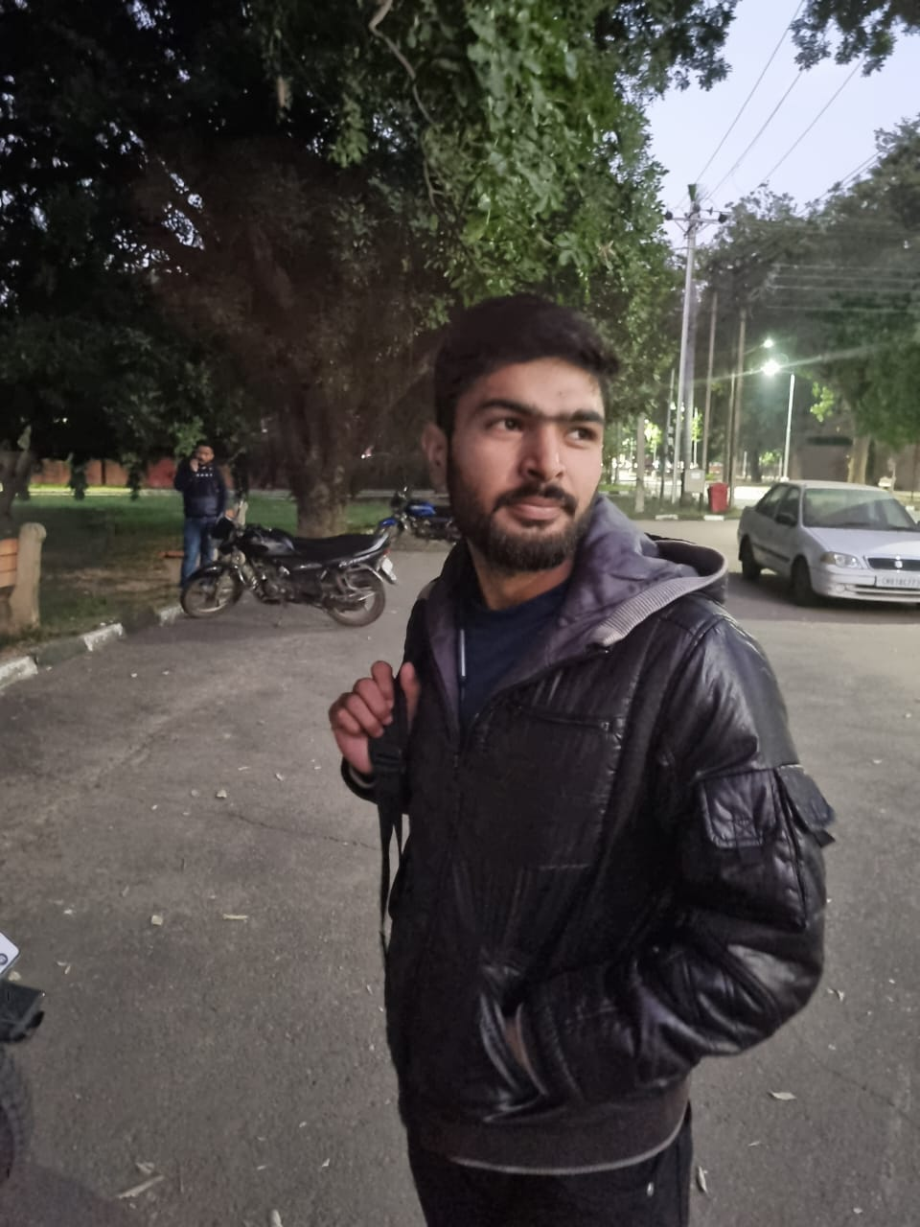
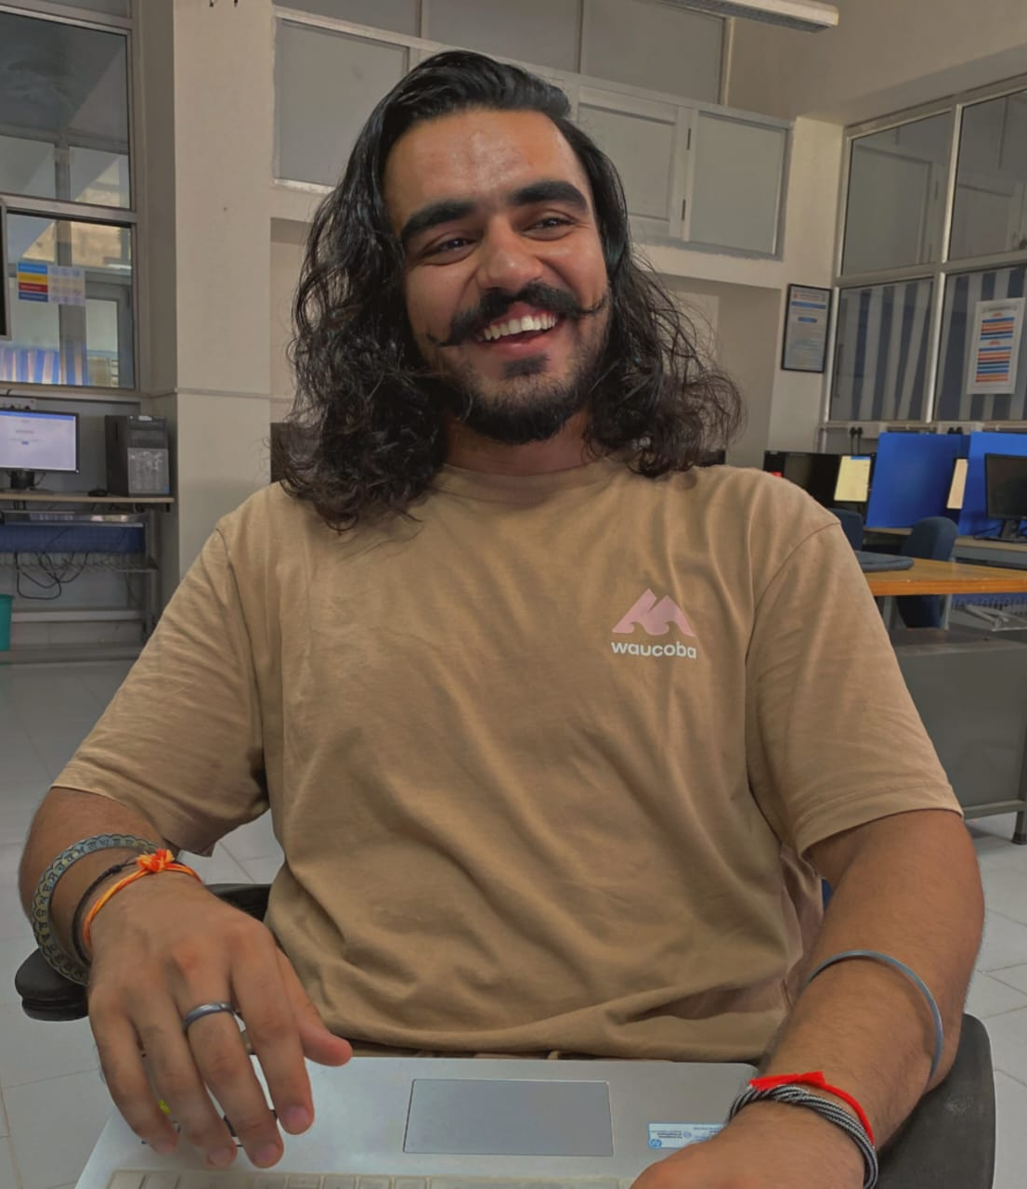
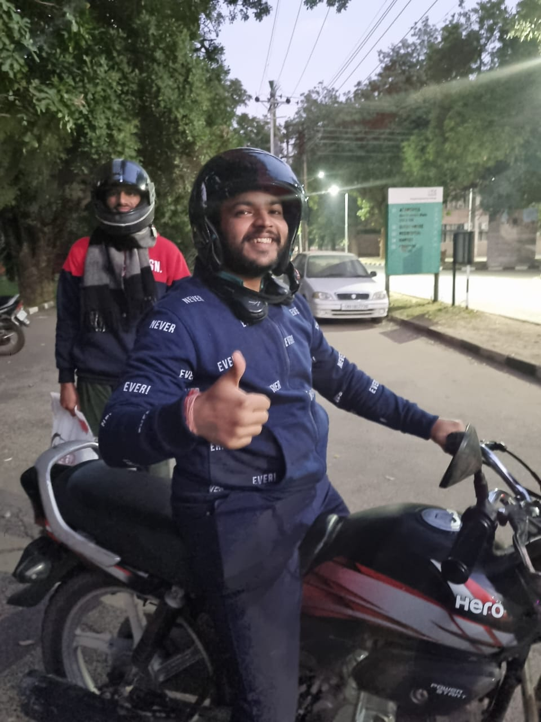
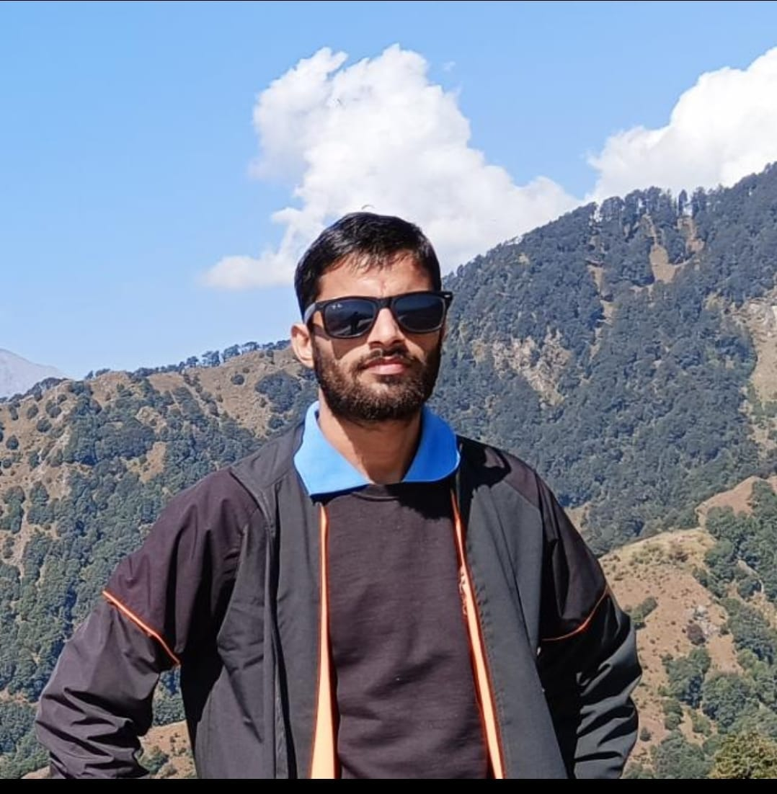
Team
Raghav Watts
wraghav6761@gmail.com
9356733000
Rahul Singh
kundlasrahulsingh@gmail.com
8894067703
Suresh Rao
sureshrao100000@gmail.com
7876634855
Sahil Pathak
21316.sahil.cse@gmail.com
9478049029

Slide 3
Technology Stack
Express
NodeJs
Bootstrap
HTML, CSS,JS

Slide 4

Thank You

