Slide 1
Cyclistic Bike Share Behavioral Analysis
Unlocking rider patterns, usage differences, and strategic conversion pathways between casual riders and annual members.
PRIMARY METRIC
CORE OBJECTIVE
DATASET SCOPE
6.04M Total Rides
Casual to Member Conversion
12-Months Wide Data

Slide 2
Key Performance Indicators
Wide Volume & Engagement
TOTAL ANNUAL RIDES
CASUAL RIDES
MEMBER RIDES
AVERAGE DURATION
6.04M
2.15M
3.89M
15.55mins
Wide adoption across all stations
35.63% share in total rides
64.37% of share in total rides
Average trip time

Slide 3
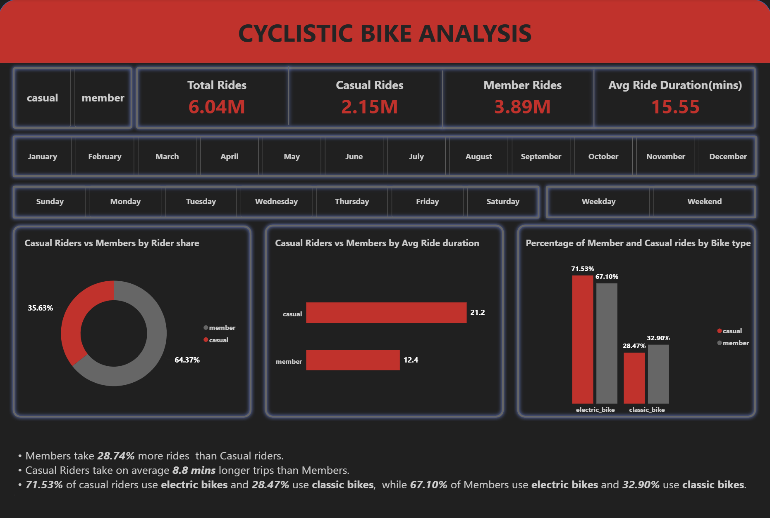
DASHBOARD REVEAL
Rider Share and Fleet Allocation
Ride Share Split
Members comprise 64.37% of trips; casual riders represent 35.63% of all volume.
8.8 Minute Duration Gap
Casual trips average 21.2 minutes vs. 12.4 minutes for members.
Dominance of Electric Bikes
71.53% of casual riders and 67.10% of members prefer electric bikes.

Slide 4
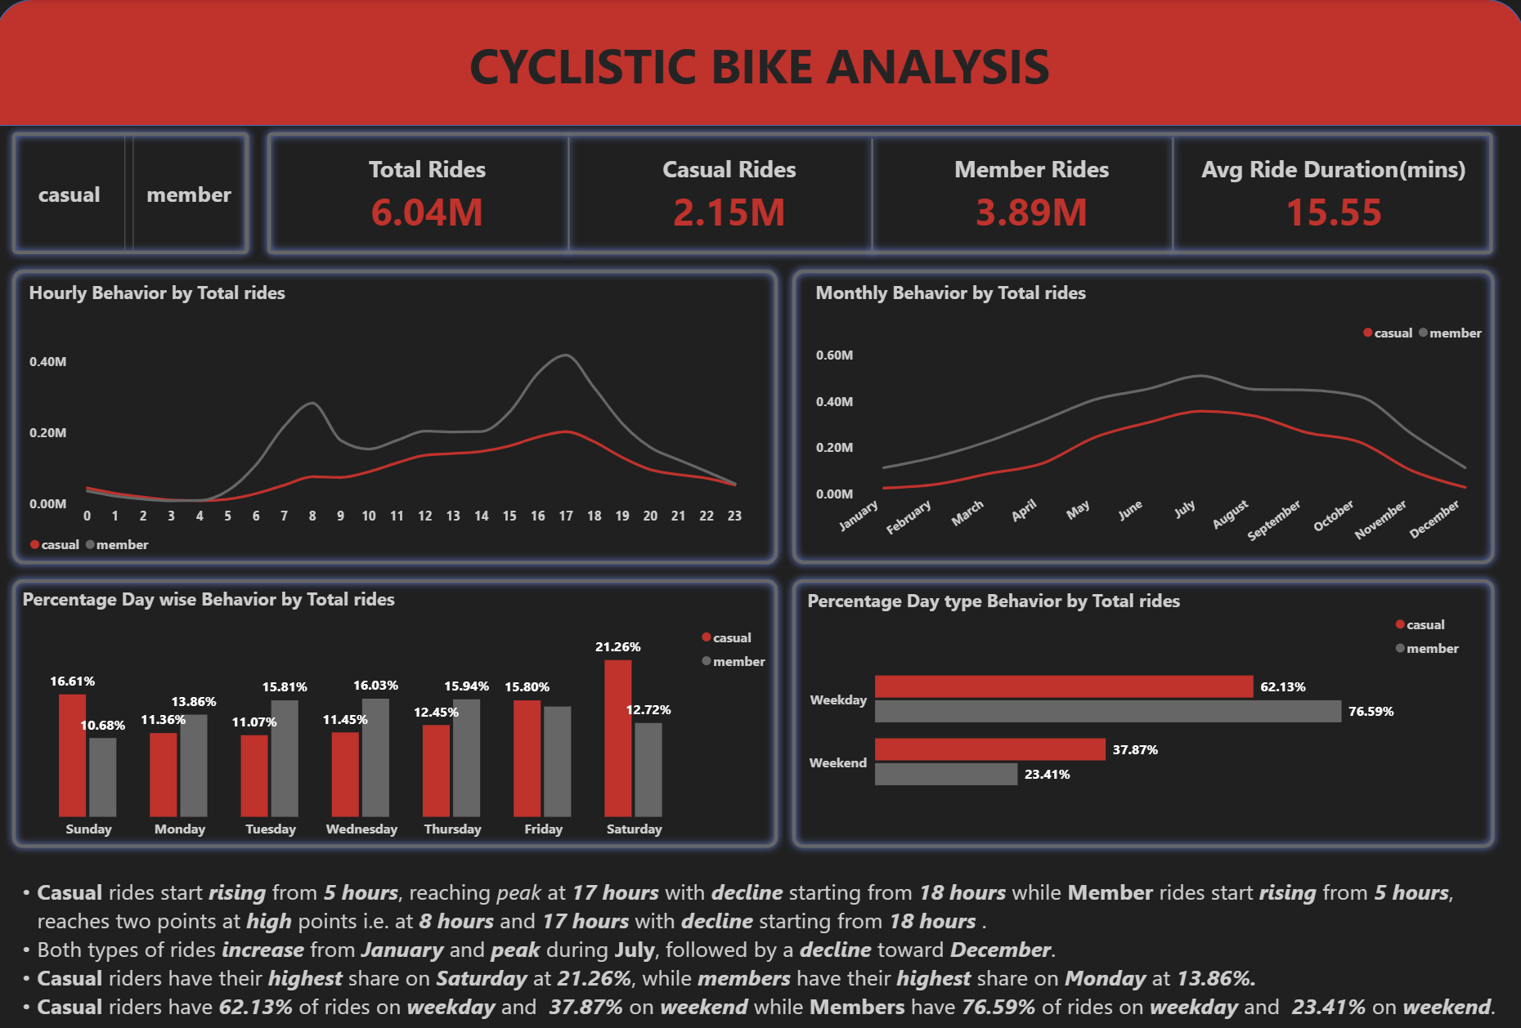
TEMPORAL ANALYSIS
Usage Cycles Across Days and Seasons
Peak Hours
Member rides peak at 8:00 AM and 5:00 PM; casual demand climbs gradually to 5:00 PM.
Weekend vs. Weekday Patterns
Casual activity spikes on Saturday (21.26%), while member rides lead on Monday (13.86%).
Mid-Year Summer Crest
Both segments crest in July before experiencing a steady decline into December.

Slide 5
WEEKDAY VS WEEKEND
Weekly rides & Schedule Divergence
Weekday Share
Weekend Share
Hourly Distribution
Member Volume
Casual Volume
Member Bimodal Surge
76.59%
37.87%
8 a.m. & 5 p.m.
Casual Volume: 62.13%
Member Volume: 23.41%
Casual Peak: 5:00 PM (17hours)
Members utilize bikes heavily for regular Monday–Friday.
Casual weekend share increases significantly with Saturday peaking at 21.26%.
Members shows morning and evening surge; casual volume shows single late-afternoon surge.

Slide 6
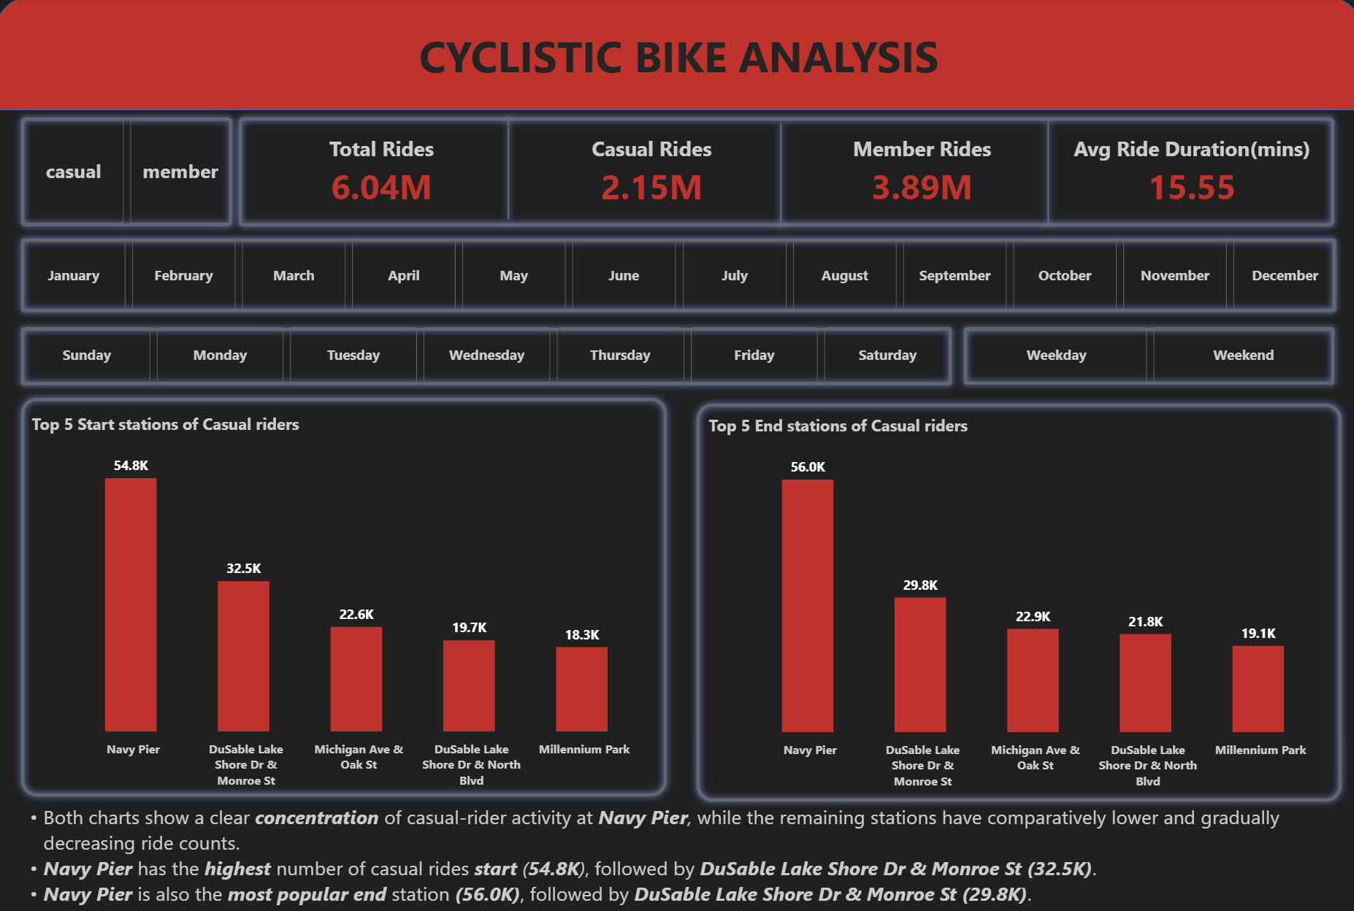
GEOGRAPHIC CONCENTRATION
Casual Station Hotspots & Shoreline Density
Navy Pier Leads
Generates 54.8K starts and 56.0K ends, outperforming all other casual hubs.
Symmetrical Trip Flow
Start and end station rankings align closely, indicating round-trip routes.

Slide 7
TOP 5 CASUAL STATIONS
Origin & Destination Volume Leaderboard
Station Location | Start Rides | End Rides
Navy Pier | 54.8K | 56.0K
DuSable Lake Shore Dr & Monroe St | 32.5K | 29.8K
Michigan Ave & Oak St | 22.6K | 22.9K
DuSable Lake Shore Dr & North Blvd | 19.7K | 21.8K
Millennium Park | 18.3K | 19.1K

Slide 8


EQUIPMENT ADOPTION
Clear Preference for Electric Bikes
Electric Bikes
Classic Bikes
Dominant across both rider categories
Casual Riders
71.53%
Annual Members
32.90%
Annual Members
67.10%
Casual Riders
28.47%

Slide 9
Cyclistic Rider Personas
Casual Rider
Member
Timing: Weekend peaks (21.26% on Sat)
Timing: Weekday peaks at 8 AM and 5 PM
Duration: Longer rides (21.2 min average)
Duration: Shorter rides (12.4 min average)

Slide 10



DATA-DRIVEN ACTION PLAN
Strategic Recommendations for Rider Conversion
Peak-Window Summer Campaigns
Navy Pier Promotions
Extended-Trip Value Messaging
Execute targeted promotions during July and August on weekends between 15:00 and 18:00, capturing casual riders at their absolute peak usage volume.
Deploy on-site promotion campaigns at Navy Pier to leverage the heavy concentration of casual rider starts (54.8K) and ends (56.0K).
Highlight membership value or convenience for longer durations, directly appealing to casual riders whose trips average 21.2 minutes vs 12.4 for members.

Slide 11

Thank You!
Cyclistic Bike Share Data Analysis & Conversion Strategy
Member Conversion Focus

