Slide 1
CREDIT RISK STRATEGY
Loan Default Risk Analysis
Pinpointing high-default borrower segments and making decision for manual review.
DEFAULT RATE
11.94% (268K)

Slide 2
Business Questions
QUESTION 01
QUESTION 02
Which customer segments have the highest loan default probability?
Which applications should the credit team manually review?

Slide 3
OVERVIEW
Loan Volume & Baseline Performance
TOTAL APPLICATIONS
DEFAULTED LOANS
OVERALL DEFAULT RATE
AVERAGE RISK SCORE
2.24M
268K
11.94%
12.82
Total volume
Total default accounts
Portfolio-wide default frequency
Portfolio-wide average risk score

Slide 4
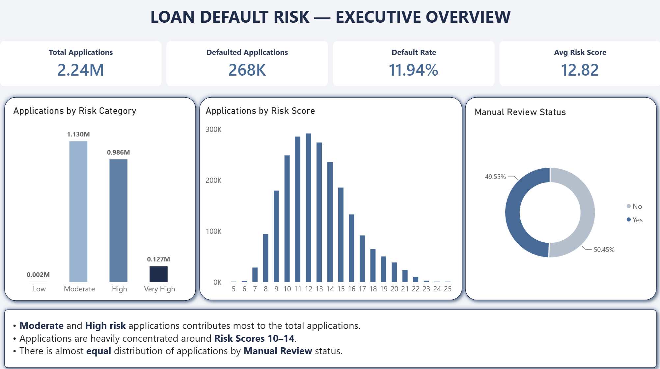
BUSINESS QUESTION 1
Executive Overview

Slide 5
BUSINESS QUESTION 1
Customer Segments with Highest Default Probability
Credit Grade F & G
High Interest rate (>20%)
60-Month Loan Term
35.0% – 38.2%
24.7%
16.2%
Over 11x default rate of Grade A (3.3%).
Default jumps 5x compared to <10% Interest rate tier.
1.6x higher default rate than 36-month terms (10.2%).
High-Risk Purpose
FICO 612–669
Annual Income <$40K
19.0% – 20.8%
17.1%
14.4%
Educational (20.8%) & Small Business (19.0%).
5.5x higher default probability than 800+ tier (3.1%).
Over 2x default rate of $250K+ earners (6.7%).

Slide 6
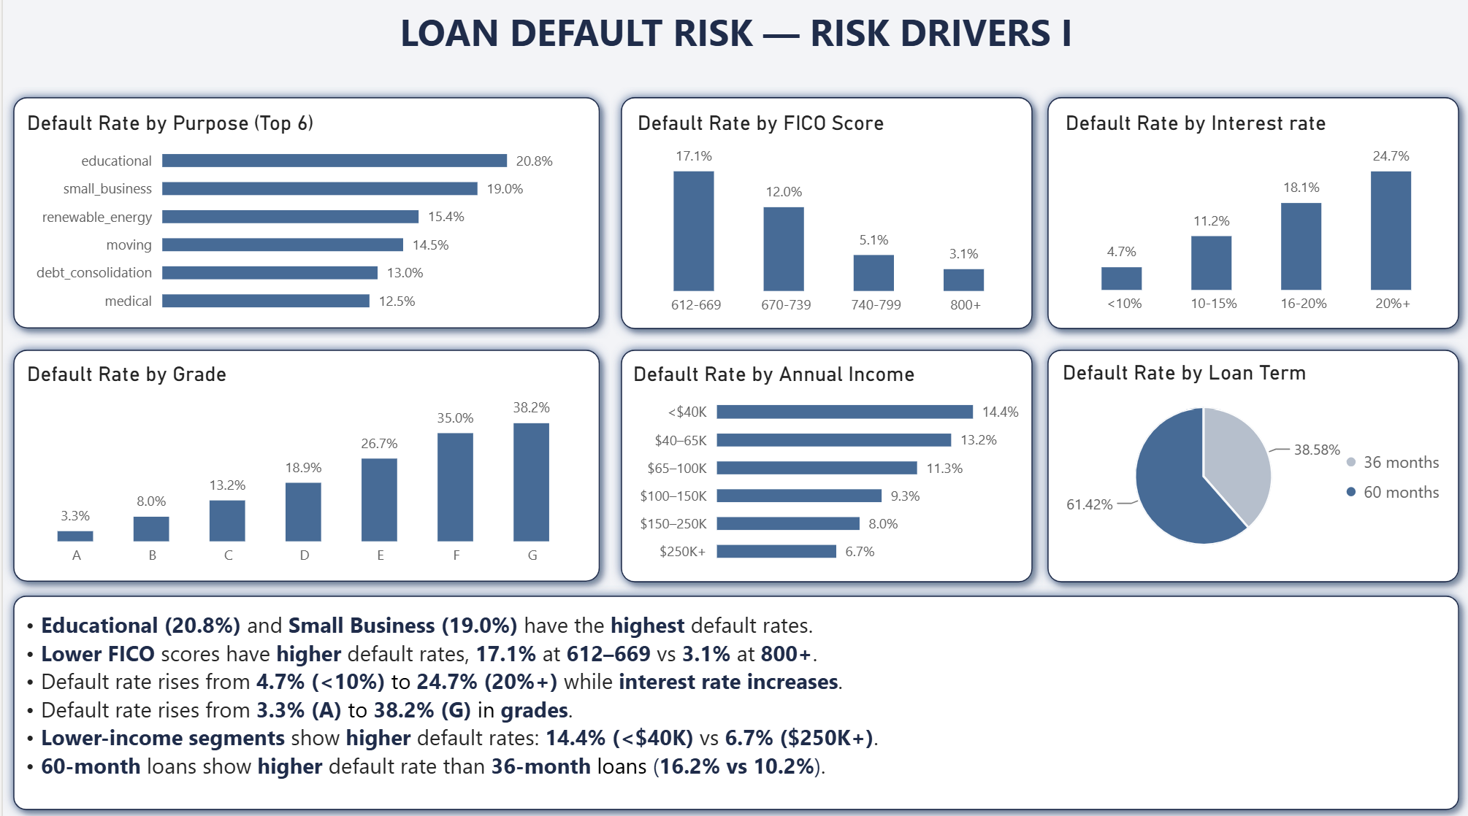
BUSINESS QUESTION 1
Risk Drivers

Slide 7
BUSINESS QUESTION 1
Customer Segments with Highest Default Probability
Peak DTI Inversion
Home Ownership Gap
Verification Bias
15.1%
13.9%
15.9%
Defaults peak at 36–44% DTI. Higher ratios drop to 5.8%.
Renters experience higher defaults than mortgage (10.4%); "Other" peaks at 21.7%.
Verified loans default at 15.9% vs 8.1% unverified.
Employment Length (Flat)
Loan Amount
11.8% – 14.6%
10.4% – 13.2%
Default stays virtually flat across all reported tenure years (11.8% for <1 yr vs 11.1% for 10+ yrs). Unknown tenure peaks at 14.6%.
Default rates show minimal variance across loan amounts: $0–10K (10.4%), $10–20K (13.0%), $20–30K (13.2%), and $30–40K (11.7%).

Slide 8
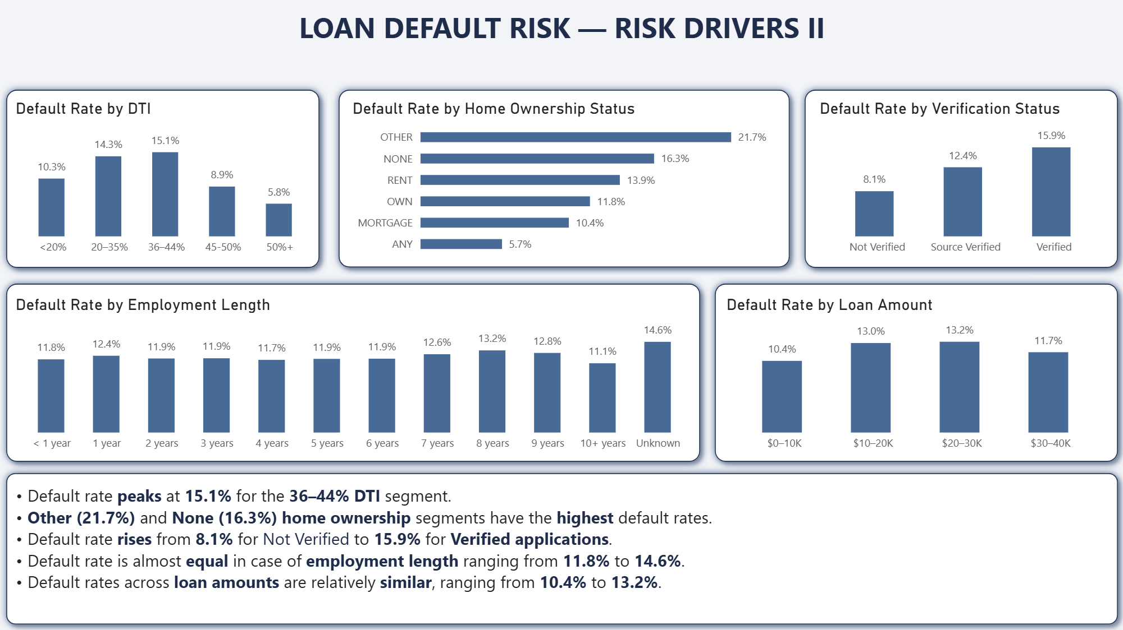
BUSINESS QUESTION 1
Risk Drivers

Slide 9
BUSINESS QUESTION 2
Manual Review Decision
Risk Score Slab | Risk Tier | Manual Review | Portfolio Volume
0 – 6 | Low Risk | NO MANUAL REVIEW | 0.002M (0.1%)
7 – 12 | Moderate Risk | NO MANUAL REVIEW | 1.130M (50.3%)
13 – 18 | High Risk | MANDATORY REVIEW | 0.986M (44.0%)
19 – 25 | Very High Risk | MANDATORY REVIEW | 0.127M (5.6%)

Slide 10
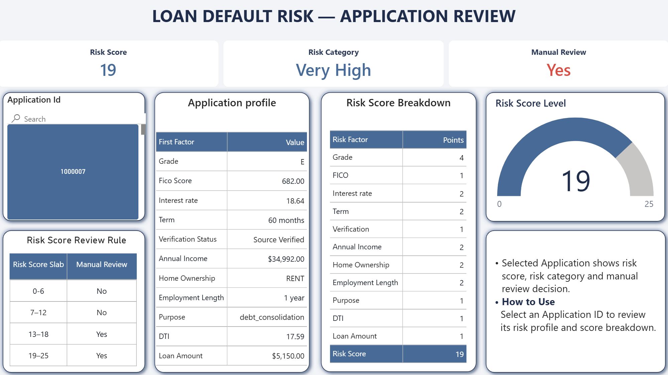
RISK SCORING DASHBOARD
Application Scoring & Manual Review Decision
Point Factor Weighting
Grade E contributes 4 points; Term, Income & Rent add 2 points each.
Individual Score Threshold
Sample Application 1000007 scores 19 points, requiring manual review.
Manual review decision
Transparent point breakdown ensures full regulatory fairness and traceability.

Slide 11
Manual Review
Manual Review
No Manual Review
49.55%
50.45%
1,113,000 Applications
1,132,000 Applications
Credit team should review applications scoring 13–25.
Credit team can move forward with applications scoring between 0-12 without manual review.

Slide 12

Thank You!
Loan Default Risk Analysis

