Slide 1
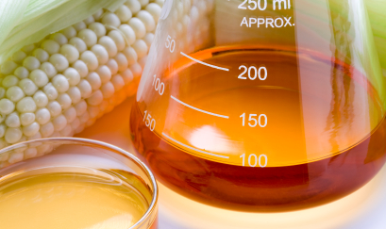

INFO/CS 2300 Final Project
Raghav Batra | Spencer Weiss | Ryan Yoon

Slide 2
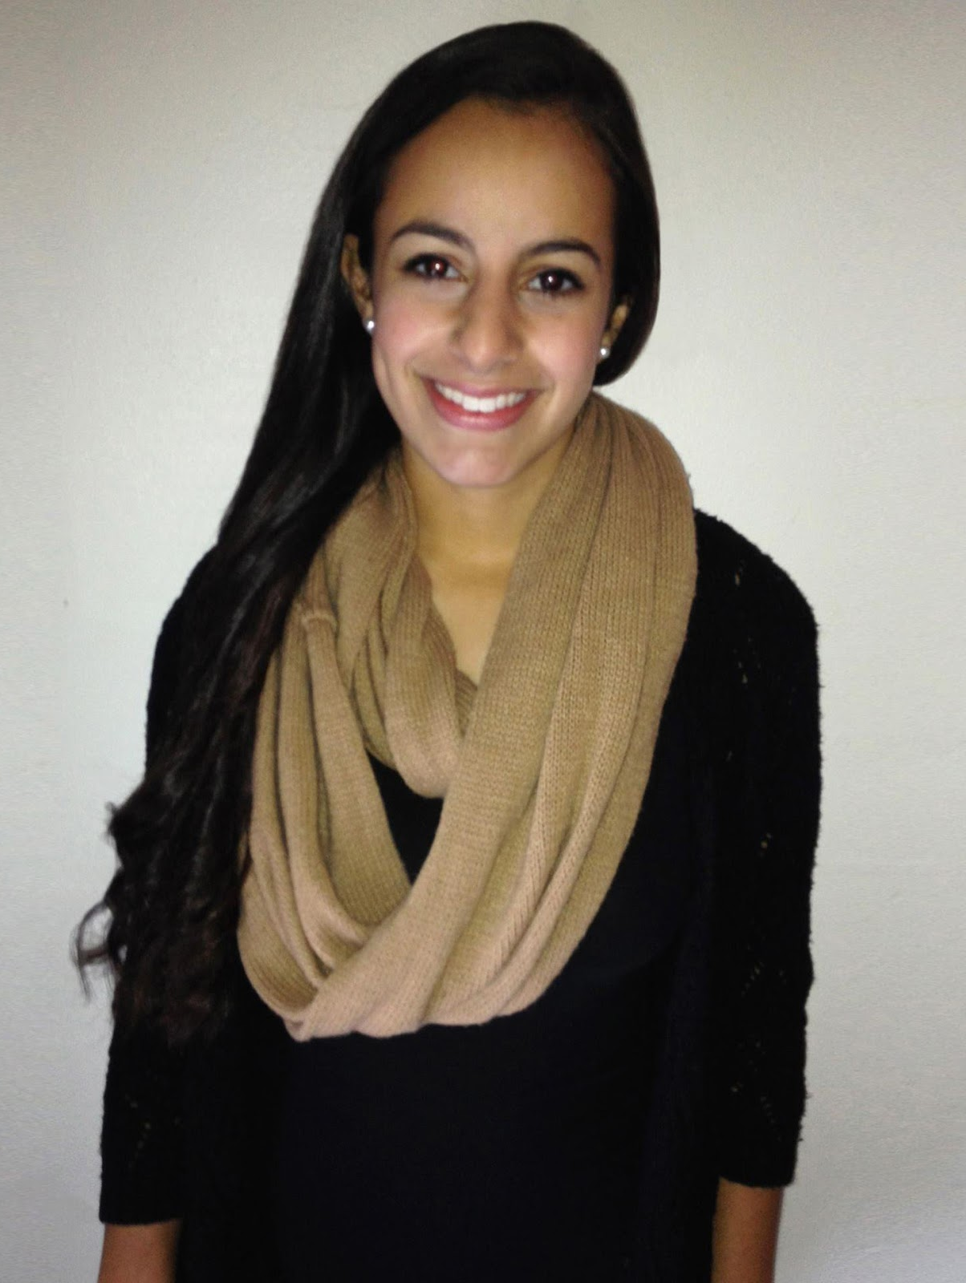
The Client
Halle Bershad
Food Science Major ‘17
President of the Cornell Food Science Club
Interested in a centralized website dedicated to distributing information to current members, as well as helping to attract new ones

Slide 3

The Client’s Needs
An interactive calendar that displays events and event details
Catalog of club photos
General information about the club
Ability to contact the club’s admins
Integration with the club’s Facebook page
Ability for admins to update/modify the site’s content

Slide 4
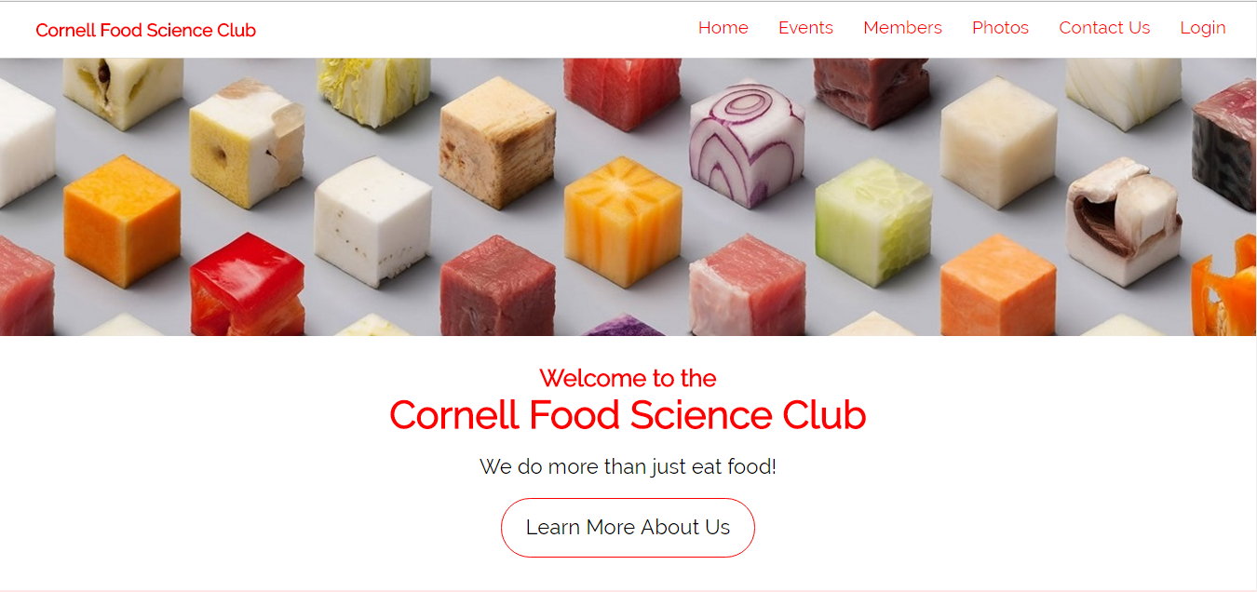
The Site – An Overview

Slide 5

Home
Aesthetically pleasing home page attracts viewers
Displays general information about the club clearly
Allows viewers to subscribe to the club listserv and admins to login
Links to social
Working on:
Pop up login dialog
More introductory information

Slide 6

Events
Calendar view or list view of events
Selecting events provides additional details about the events
Currently working on:
More interactivity with the standard calendar

Slide 7

Members
Displays profiles of the club executives and members
Selecting a profile provides an enlarged picture and displays additional description

Slide 8
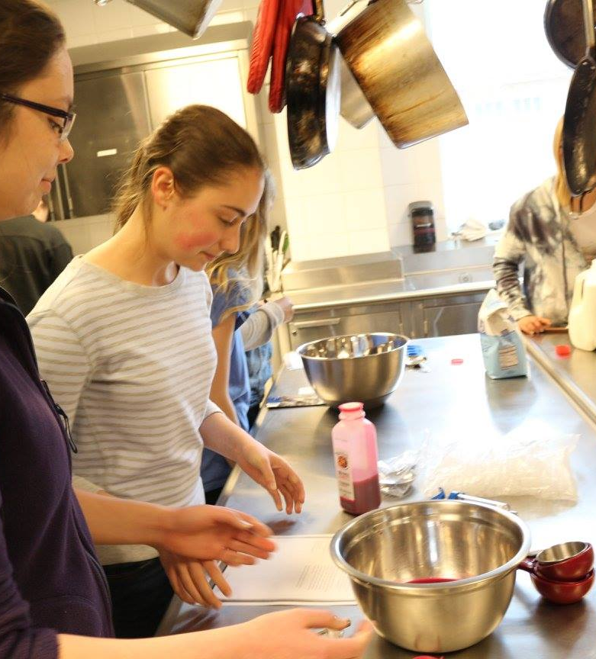
Photos
Album view organized by events
Selecting an album displays the images within each album
Much like P3

Slide 9


Contact Us
Simple form that allows users to contact the club admins by email
Additionally provides link to Facebook group

Slide 10
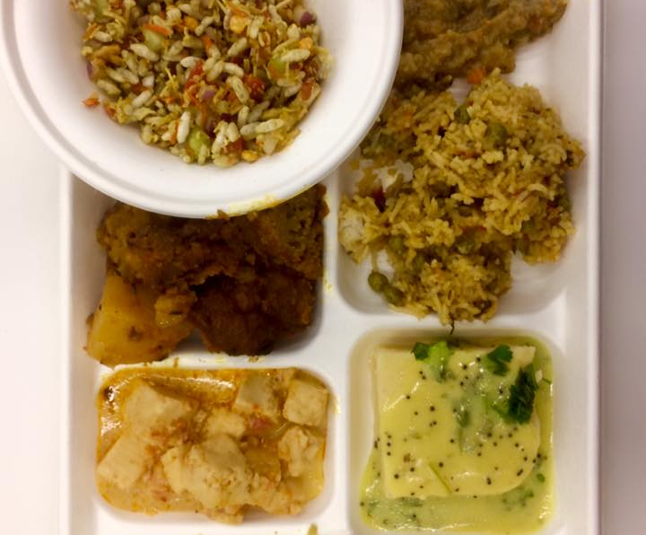
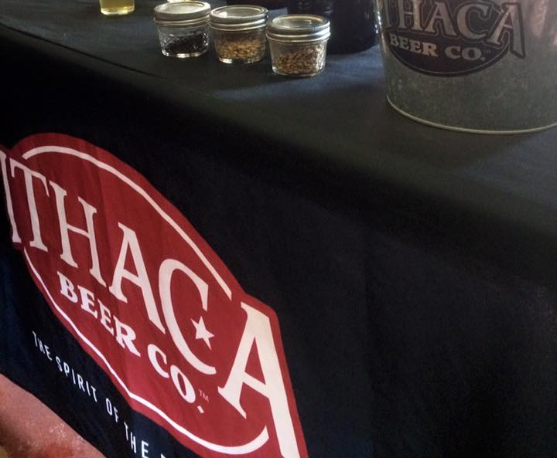
A Quick Demo

Slide 11
Questions?

Slide 12
THANK YOU!

