Slide 1

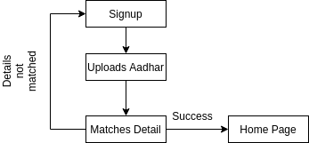
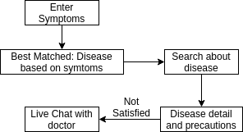
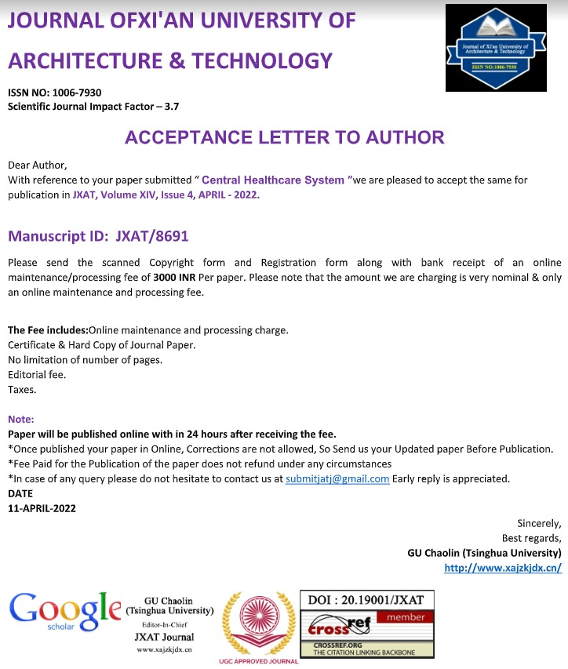
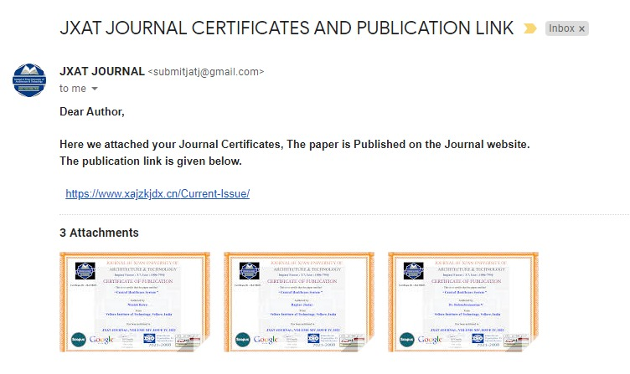
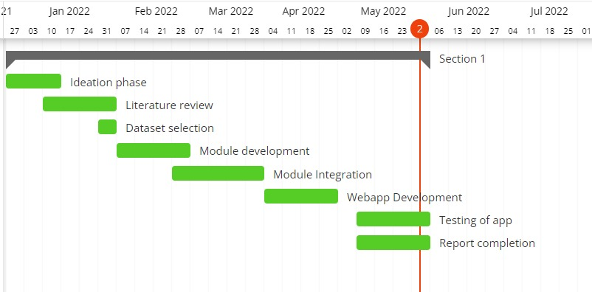
CENTRAL HEALTHCARE SYSTEM
Raghav Jindal & Nimish Batra| Dr. Balasubramanian V | SCOPE
Introduction
Results
In today’s time of crisis, hospitals have become really crowded and patients and their families are at the suffering end. To automate the process and to help patients know about the status of availability and to help them with medicinal information we are creating this centralised healthcare system so as to save people’s time and the lives of their loved ones.
Our product is providing everything under one roof. There are many products in the market providing most of our services but individually or with lesser or complex features. Starting with our login module the facial recognition library being used by us only requires 1 photo whereas other products in the market require more than 100 photos per person to train the module properly, which is more of a traditional method. The aadhar OCR that we are using no such open source system exists. One of the most common competitors of our chatbot is rasa nlu, and even a few more traditional training based chatbots but the biggest problem with these is they are not useful for particular domain related work. Our chatbot allows the patient or its family member to talk and get a solution and if they aren’t satisfied they can even get to talk to a doctor and get the desired medication or cure.
The prescription OCR that has been made by us no such open source system exists. Incase of OCR we have used google vision API and we find our competitor to be pytesseract.
Our main reason behind choosing google vision was its speed, google vision is much faster than pytesseract and its even much more accurate.Coming onto the part where scanning happens in case of pytesseract some of the unwanted elements are scanned whereas in case of google vision no more unwanted elements are recognized.
Motivation
This project is directed in such a way that the patient has been given maximum priority in every possible manner. We have taken up this project to solve the issue that has bothered a lot of patients and their families.
SCOPE of the Project
Our primary objective is to provide a central healthcare system which would avoid last minute chaos.
Our second objective is providing a face-recognition login and aadhar verification that would help us in preventing identity theft and misuse of people’s personal information.
Thirdly, we are going to provide a chatbot service. This service will be provided to all the patients at the first step.
The 4th objective is to help patients reach the nearest hospital at the earliest.
Methodology
Technology Stack
1. Flask 2. Dialog Flow 3. Google Maps API Integration 4. Google Vision 5. Node Js 6. Python 7. Python Libraries like OpenCV,pandas,numpy,etc. 8. PHP 9. SQL
TECHNIQUES
1. Natural Language Processing 2. Machine Learning 3. Web Scraping 4. Database Management 5. Computer Vision 6. Blockchain
DEPLOYMENT OF MODULES
Login: Modules used are Facial Recognition library (only requires 1 photo). Competitor: Traditional training methods (requires more than 100 photos to train per person) In this module when the user registers on our website, they take a snapshot of theirs.
Aadhar OCR: In this module, the user uploads their Aadhar card image and our system verifies the name and date of birth of the user from the Adhar card and the details provided.
Chatbot and Live Chat: : In this module, for chatbot, we have used chatterbot and for a live chat, we have used socket.io to talk directly with the doctor. In chatbot, we have trained our data for symptoms of 40,000 diseases and have with the details of 41 diseases in our chatbot and if the user is not happy with the results of the chatbot we are giving the option to chat with the doctor in which we have used socket.io for live chat with doctors.
SMS: We are using this module to send SMS to the registered mobile numbers of users to inform them about any emergencies or information regarding their health. We are using the Twilio API to do so.
Web Scraping: This module is being used to scrape data off a website to gather the information required to create a database. Over here we are scraping the name of the medicine and its price in the Indian market to create a database for all the medicines present in India. This database would then be used to create the e-commerce part of our project. Modules used here are requests and BeautifulSoup.
Blockchain: This module will help us to detect whether the medicines that we are getting are original or not, i.e, whether they are fake or expired and have been restamped. The value of this module represents: Fighting Drug Forgery, Data Integrity, Enhanced Traceability and Elevated compliance regulatory.
Hospital API: This API fetches data of Hospitals from different cities of India. This API displays data like Id, State, City, Name, Category, Medicine, Add., Website, Specialization. We have developed a Django Rest API for getting the list of hospitals and we have taken the data from data.gov.in which is an Indian government data website.
Conclusion
We come to the following conclusion that with the help of the modules in order to successfully run this project. Under the Aadhar OCR, once the user attempts to signs up with certain details such as user name, email ID, Date Of Birth etc, these details are then further matched with the information available on their Aadhar card. If it matches, then the user is able to sign up. The prescription OCR enables users to scan their own prescriptions to find their medicines online and also look out for their substitutes based on the salt composition of the prescribed medication. This will help them find out the alternatives of their medication in case of unavailability of their prescribed medicines. The chatbot is set up with a trained data strength of 40,000 symptoms. It is able to respond accurately to the 41 diseases it has been trained in. The ambulance button enables the user to send their live location to the driver who can access and reach the user’s location easily.
References
Islam, Noman & Islam, Zeeshan & Noor, Nazia. (2018). A Survey on Optical Character Recognition System. ITB Journal of Information and Communication Technology.

