Slide 1

Comparing Image Classification Models
PRML Project: Final Presentation
Raghav Juyal
EP20BTECH11018

Slide 2
Aim
Comparing performance metrics of various image classification models on medical image datasets.
The aim is to gain a better intuition on which models perform better on image classification tasks.
This can help us spend more time fine tuning a good model rather than spending the time search for the suitable model.

Slide 3
Performance Metrics
For each model, we will be looking at their:
Time taken to train
Total accuracy
Total precision
Total recall
F1 Score

Slide 4
Models
The main models we will be considering are
Logistic Regression
Convolutional Neural Network
Vision Transformer(DeiT model)
Other pretrained models (ResNet 50, GoogLeNet, VGG19, DenseNet and EfficientNet)

Slide 5
Data
Here we will be mainly considering 2 datasets and could try more if time permits
Chest X-ray classification
Has 4077 training images, 1165 validation images and 582 test images, each with dimensions 640x640.
It contains x ray scans of the chest of people with or without pneumonia.
NIH Chest X-Ray dataset
Has 86,524 training images and 25596 test images, each with dimensions 1024x1024
It contains images of x ray scans of the chest of people with either one of Atelectasis, Consolidation, Infiltration, Pneumothorax, Edema, Emphysema, Fibrosis, Effusion, Pneumonia, Pleural_thickening, Cardiomegaly, Nodule, Mass and Hernia or having none(15 classes)

Slide 6
Specific Objectives
Understand which models have better performance(time, accuracy, etc) on what type of image data.
Gain a better understanding of these classification models

Slide 7
Specific Objectives
Understand which models have better performance(time, accuracy, etc) on what type of image data.
Gain a better understanding of these classification models

Slide 8
Problem Description
Input: Image
Models: CNN, Logistic Regression, DeiT, ResNet 50, GoogLeNet, VGG19, DenseNet, EfficientNet
Output: Class Label

Slide 9

Methodology

Slide 10
On dataset 1, all models will be used. For pretrained models, required preprocessing( Resize to 256, CenterCrop(224) and normalize) are done.
On dataset 2 the only pretrained models are used(with required preprocessing).

Slide 11
Logistic Regression
Applied on dataset 1
Grid search done on
Batch size: 16, 32, 64
Epochs: 10, 20, 30
Learning Rate: 0.0001, 0.001, 0.01, 0.1, 1
Optimizer: SGD(stochastic gradient descent), Adam
Loss function was cross entropy loss

Slide 12
CNN from Scratch
First convolution layer had 3 input channels, 128 output channels and 5x5 filter
Other convolution layers had 128 input and output channels and 5x5 filter
Pooling layers were Max pooling with kernel size = 2 and stride = 2
Number of layers varied from 2 to 7. However, due to very large time to train, only 3 layer and 4 layer networks were trained 100%. The other models were trained for 1 epoch (6.25%).
Batch size was 8, learning rate = 0.001, 16 epochs, cross entropy loss and Adam optimizer

Slide 13
Deit (for dataset 1)
Applied on dataset 1
Grid search done on
Epochs: 10, 20, 30
Learning Rate: 0.0001, 0.001, 0.01, 0.1, 1
Optimizer: SGD(stochastic gradient descent), Adam
Default and custom normalization parameters
Loss function was cross entropy loss and batch size was 8

Slide 14
DeiT (for dataset 2)
Applied on dataset 2
Froze pretrained weights and added
Linear layer from number of output of previous last layer to 512
ReLU
Dropout 0.3 of the nodes
Linear from 512 to 15
Batch size was 32, learning rate was 0.0001, epochs was 6, loss function was cross entropy loss, optimizer was Adam and transform type was custom.

Slide 15
Other Models (for dataset 1)
Applied on dataset 2
Froze pretrained weights and added
Linear layer from number of output of previous last layer to 512
ReLU
Dropout 0.3 of the nodes
Linear from 512 to 2
Batch size was 8, learning rate was 0.0001, epochs was 16, loss function was cross entropy loss, optimizer was Adam and transform type was custom.

Slide 16
Other Models (for dataset 2)
Applied on dataset 2
Froze pretrained weights and added
Linear layer from number of output of previous last layer to 512
ReLU
Dropout 0.3 of the nodes
Linear from 512 to 15
Batch size was 32, learning rate was 0.0001, epochs was 6, loss function was cross entropy loss, optimizer was Adam and transform type was custom.

Slide 17
Experimental Results
Qualitative results in GitHub python notebooks

Slide 18
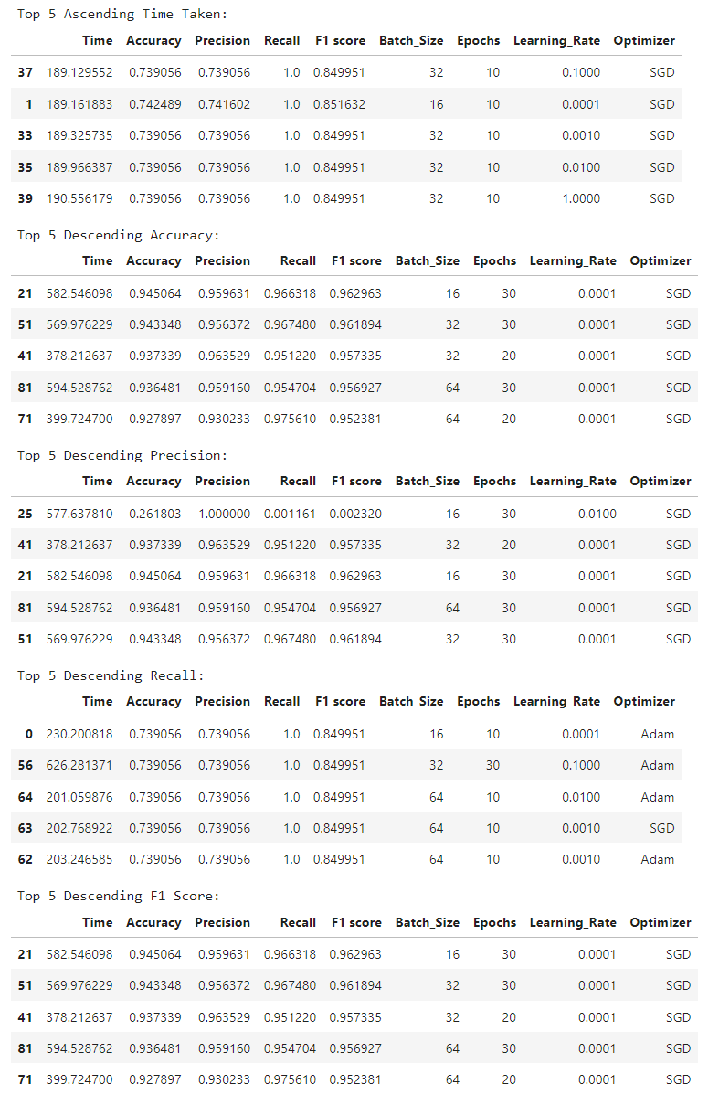
Logistic Regression Comparision

Slide 19
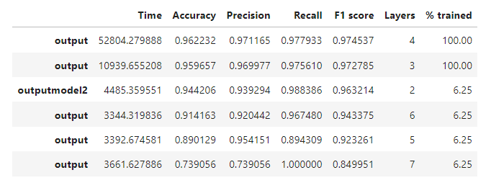
CNN from scratch Comparison

Slide 20
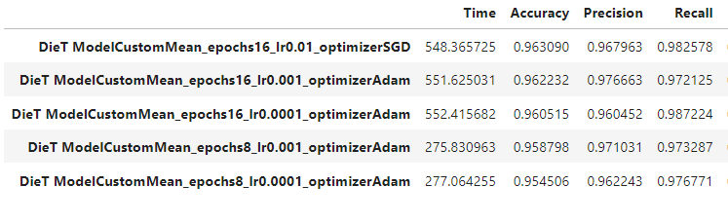
DeiT Comparison

Slide 21
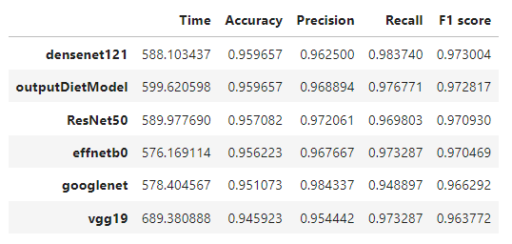
PreTrained Models (Dataset 1)

Slide 22
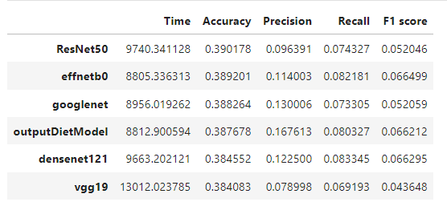
PreTrained Models (Dataset 2)

Slide 23
Conclusion

Slide 24
Learning Outcomes
Learnt how to train various models on image data.
Built a better intuition on which models perform better and which hyperparameters have more impact on the outcome for these datasets.
Improved skills in handling large amounts of image data.
Improved data visualizing and analyzing skills.

Slide 25
Future Works
Try more models with more grid searches to find better solutions.
Implementing a way to handle one image belonging to multiple classes.
With the help of segmented data and diagnosis, try to make a model that can explain why a person is diagnosed with something.

Slide 26
Conclusion
In this project, we explored various models and saw how these models performed on the two medical image datasets.
Further study in this area can help reveal better models and maybe even the reasoning behind why these models perform better.
This can then help us avoid wasting time searching for good models and allow us to focus on tuning hyperparameters for suitable models.

Slide 27
References
Dataset 1
Dataset 2
DeiT
ResNet 50
GoogLeNet
VGG19
DenseNet
EfficientNet

Slide 28

Thank You
Raghav Juyal
EP20BTECH11018

