Slide 1
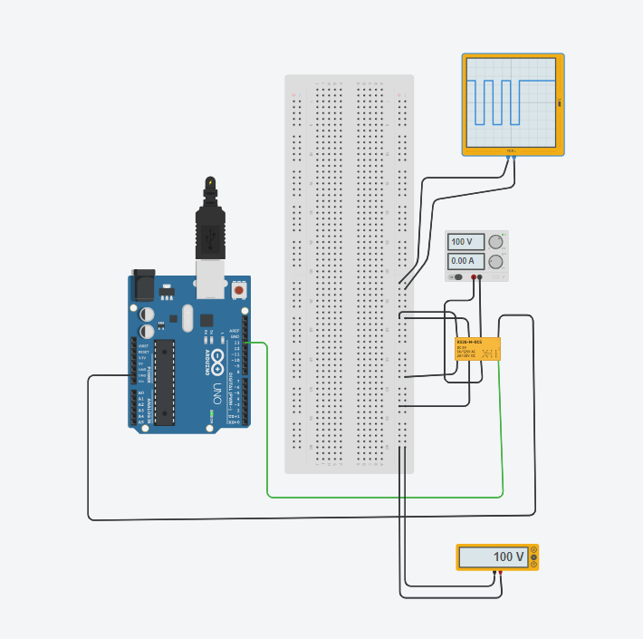
Electronic commutator using a relay
KS2E-M-DC5 relay
Max switching voltage:- 150V

Slide 2
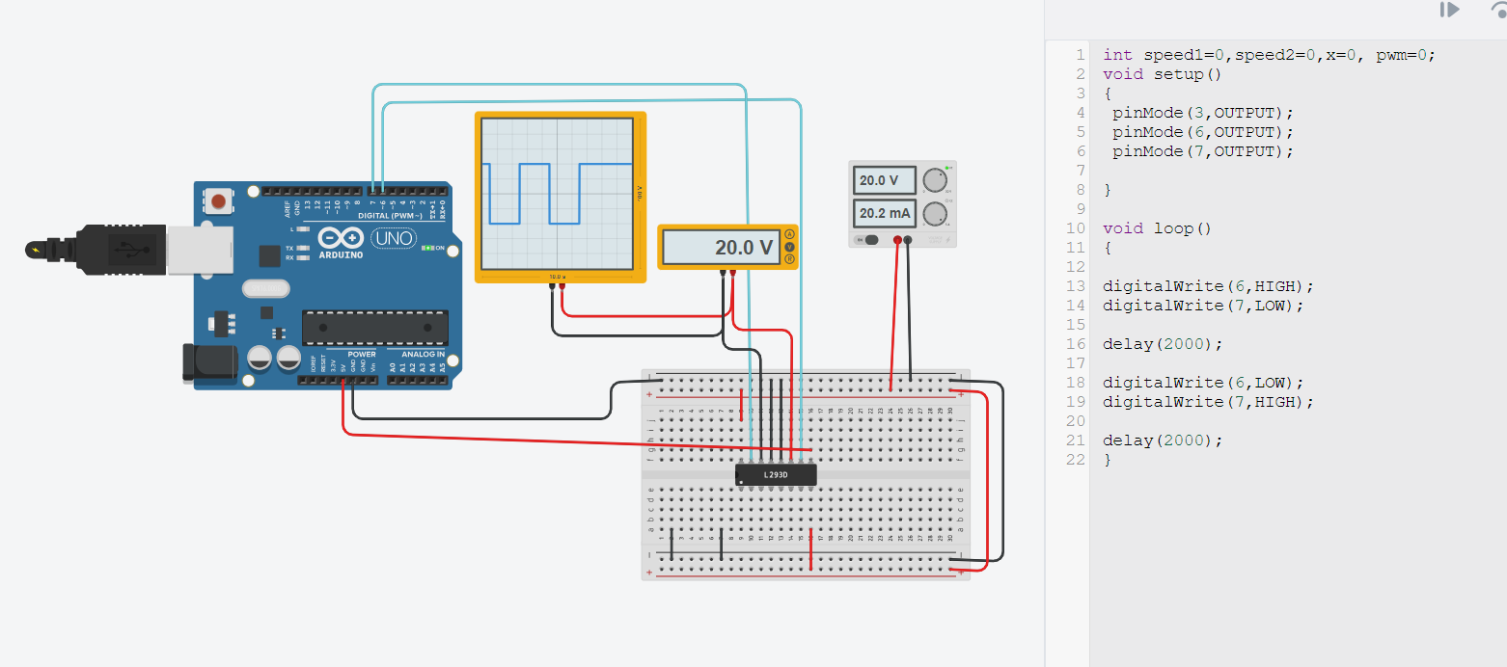
Electronic commutator(H-bridge) controlled using Arduino (L293D)
Max switching voltage:36 V

Slide 3
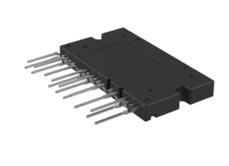
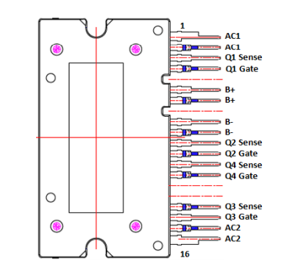
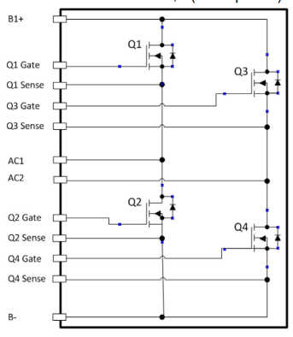
NXV65HR82DS1-H bridge with switch voltage of 650V
V_{T}= 3V-5V (minimum gate-source voltage to turn on MOSFET)
Maximum V_{DS}=650V

Slide 4
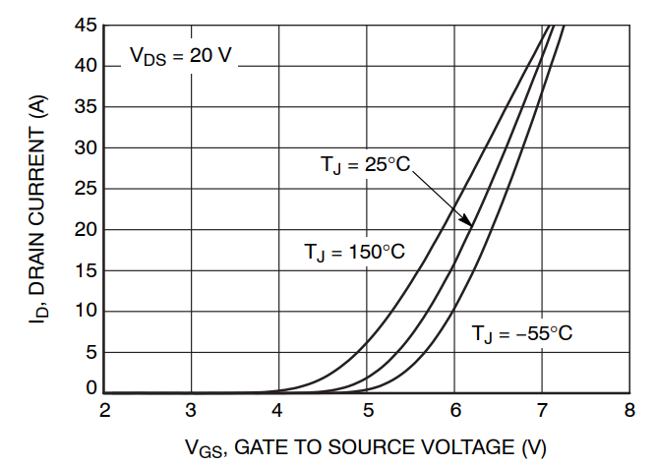
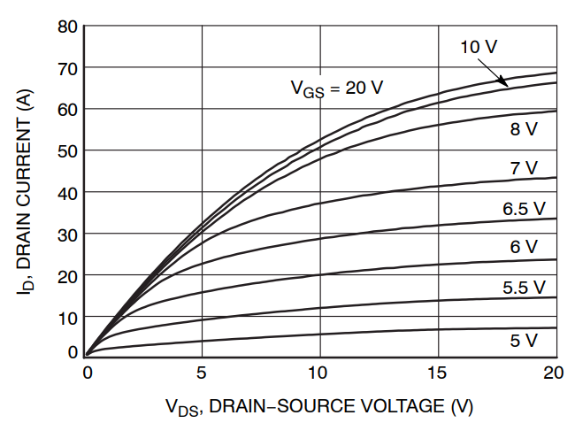
Characteristic of MOSFETS

Slide 5
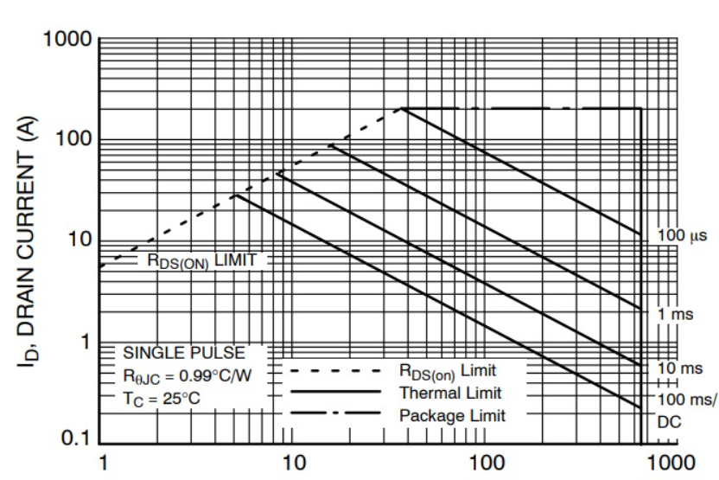
Safe region of operation

