Slide 1
Automation of Millikan apparatus with computer vision and electronically controlled commutator
Arduino uno can be used to provide a control signal to a relay/H-bridge/set of MOSFETs which can be used as a commutator.
The 5-voltage pins of Arduino are sufficient to control the MOSFET/H-bridge by controlling the gate-source voltage
Since the commutator capparatus is connected to a capacitor, we also do not need any high current carrying capacity in the MOSFETs.

Slide 2
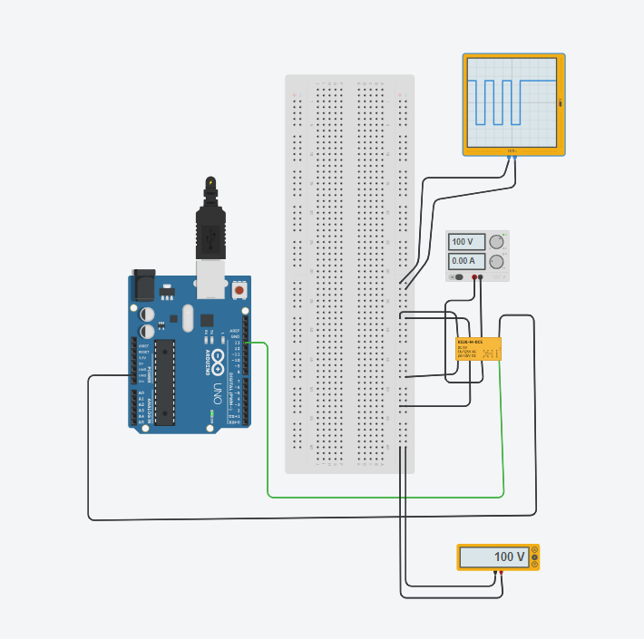
Electronic commutator using a relay
KS2E-M-DC5 relay
Max switching voltage:- 150V

Slide 3
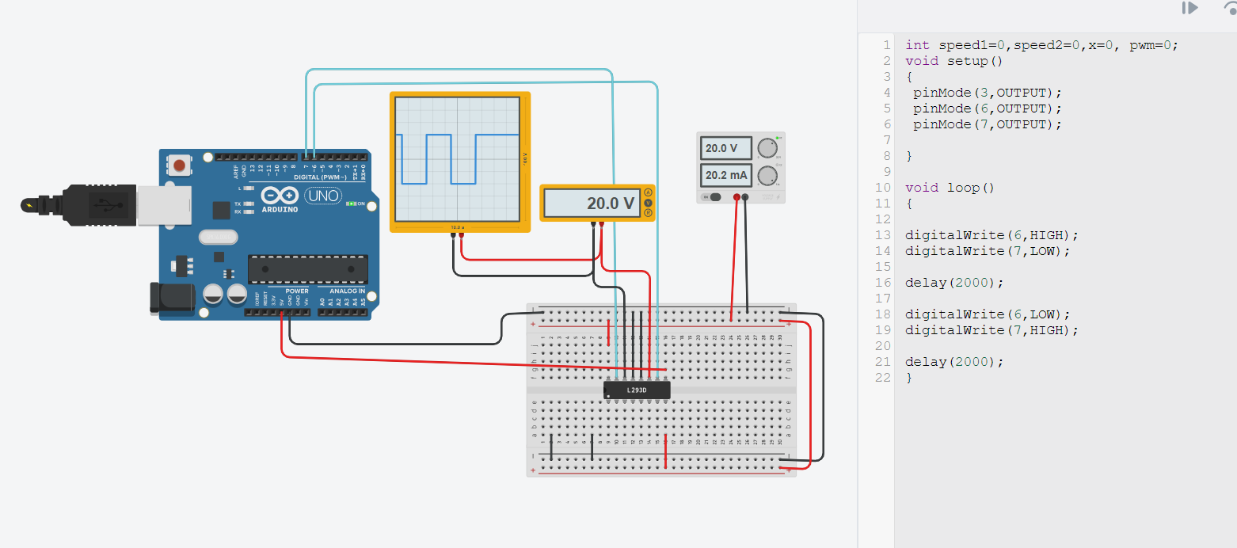
Electronic commutator(H-bridge) controlled using Arduino (L293D)
Max switching voltage:36 V

Slide 4
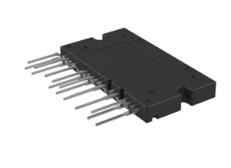
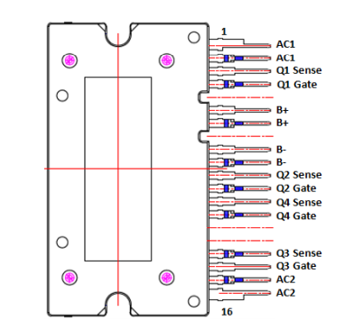
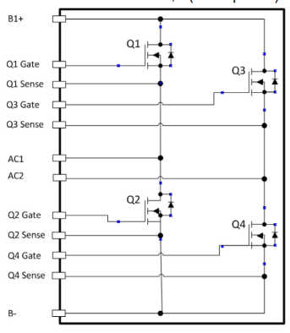
NXV65HR82DS1- H bridge with switch voltage of 650V
V_{T}= 3V-5V (minimum gate-source voltage to turn on MOSFET)
Maximum V_{DS}=650V
https://www.digikey.in/en/products/detail/onsemi/NXV65HR82DS1/14005246

Slide 5
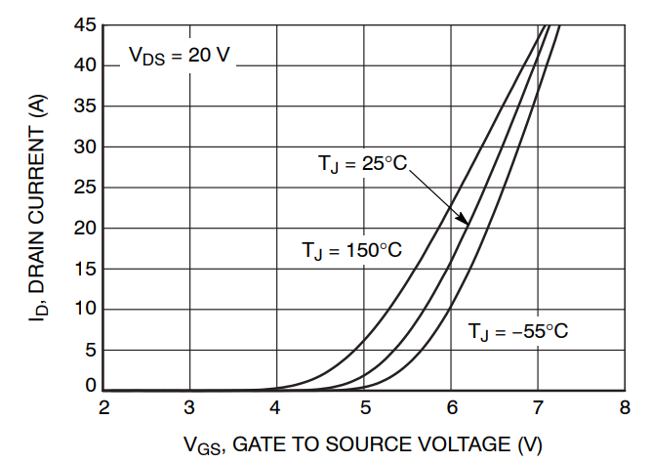
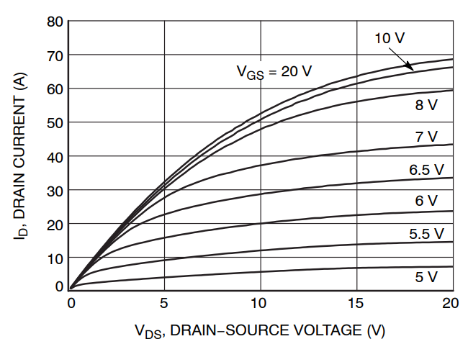
Characteristic of MOSFETS in the H-bridge

Slide 6
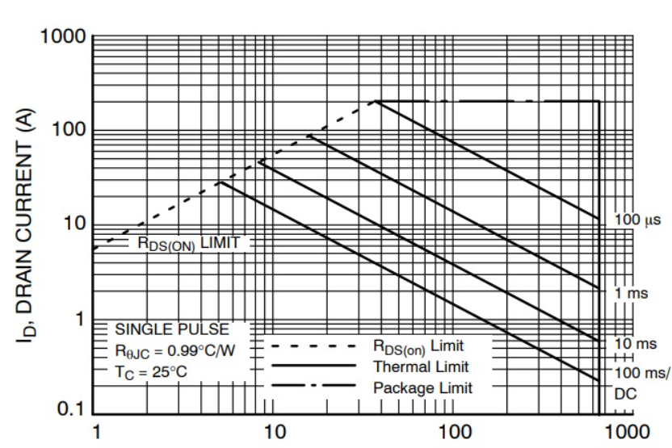
Safe region of operation

Slide 7
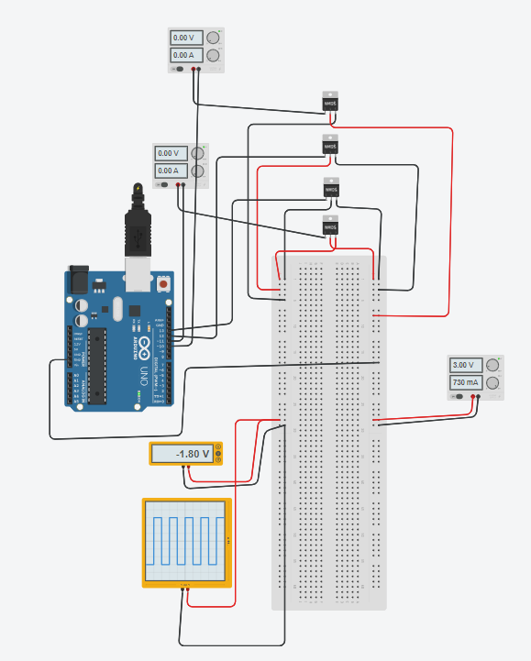
Simulation of H-bridge with MOSFET
Maximum value of V_{DS}=3V
We can use a power MOSFET with much higher drain-source breakdown voltage

Slide 8
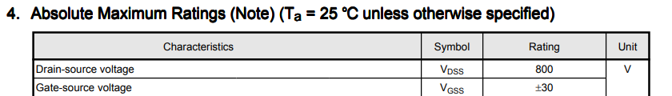

Creating a H-bridge directly using MOSFETs
SIHD5N80AE-GE3
V_{DS(max)}=800V , V_{T} = 4V: https://toshiba.semicon-storage.com/info/TK3P80E_datasheet_en_20140917.pdf?did=14695&prodName=TK3P80E
TK3P80E,RQ
V_{DS(max)}=800V , V_{T} = 4V : https://toshiba.semicon-storage.com/info/TK3P80E_datasheet_en_20140917.pdf?did=14695&prodName=TK3P80E

