Slide 1
PDEBench-Lang
Does Notation Format Shape Neural Reasoning About PDEs?
Natural Language · LaTeX · Prefix · Postfix
NLP Final Project — 2026

Slide 2
The Central Question
Notation is just formatting — or does it change what the model learns?
PDEs can be written in radically different ways. Does the format a model is trained on affect how well it reasons about equation structure?
Natural Language
LaTeX
Prefix
Postfix
The second time derivative of u equals c² times the second spatial derivative of u.
u_{tt} = c^{2} \, u_{xx}
=(d(d(u,t),t), *(^(c,2), d(d(u,x),x)))
u t d t d c 2 ^ u x d x d * =
Same equation — Wave PDE (u_tt = c²u_xx) — four representations
We train one T5-small model per dialect and measure: accuracy, cross-dialect transfer, and zero-shot generalisation.

Slide 3
Dataset Design
10,000 training instances · 3 held-out families · 4 dialects each
Training Families (5 × 2,000 = 10,000)
Held-Out Families (zero-shot test only)
Heat
u_t = α u_xx
diffusion
KleinGordon
u_tt − u_xx + m²u = 0
wave + mass term
Wave
u_tt = c² u_xx
wave propagation
ReactionDiffusion
u_t = D·u_xx + r·u·(1−u)
Burgers
u_t + u·u_x = ν u_xx
nonlinear transport
diffusion + logistic growth
Laplace
u_xx + u_yy = 0
steady-state
Beam
u_tt + b·u_xxxx = 0
wave + 4th-order space
Advection
u_t + c·u_x = 0
pure transport
⚠ Models never see these during training — used only for zero-shot evaluation
Output format per instance: family: Heat | operators: exp, polynomial | reasoning: Contains first-order time derivative…

Slide 4
Model Setup
Four independent T5-small models — one per dialect
Input (one dialect)
T5-small Fine-tuned 60M params
Output family: Wave operators: sin, cos, polynomial reasoning: Second-order in time…
→
→
▸ Base model: google/t5-small (60M parameters)
▸ Training: 3 epochs · batch size 16 · learning rate 3×10⁻⁴
▸ Split: 80% train / 10% val / 10% test (same split reused across all 4 models)
▸ Inference on CPU to avoid MPS beam-search issues on Apple Silicon
Everything else is identical — only the training dialect changes.

Slide 5
Experiment 1 — In-Dialect Baseline
Train on dialect X, test on dialect X
Natural
LaTeX
Prefix
Postfix
100%
100%
98.5%
98.2%
family accuracy
family accuracy
family accuracy
family accuracy
What this tells us
▸ All four models saturate at ~100% — T5-small easily learns each dialect.
▸ Trash score = 0% across all dialects: when the family label is correct, reasoning is also correct.
▸ ROUGE-L ≈ 44% despite 100% accuracy — the model outputs a different valid reasoning template, not the exact ground-truth sentence.
▸ Problem: a 100% ceiling tells us nothing about which dialect is better.
▸ Solution → test each model on dialects it has never seen.

Slide 6
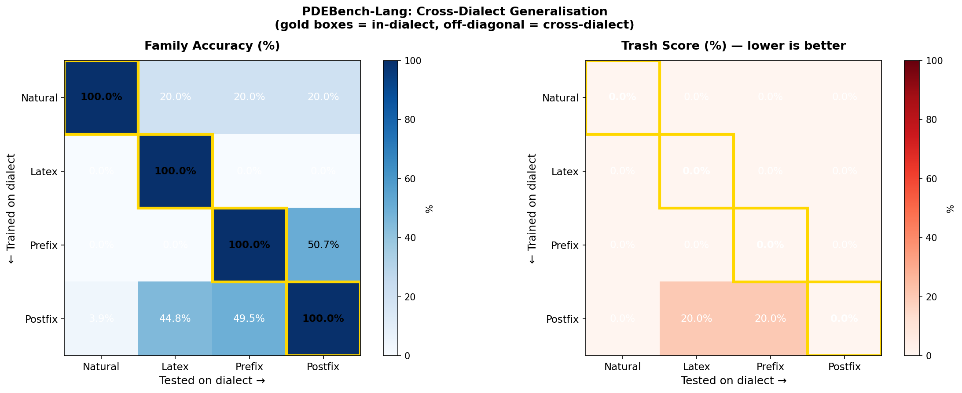
Experiment 2 — Cross-Dialect Generalisation
Train on one dialect, test on all four → 4×4 accuracy matrix

Slide 7
Cross-Dialect: What the Numbers Mean
A Heat equation — tested on a model trained on Postfix
Input given to the model (LaTeX dialect — model was trained on Postfix):
\frac{\partial}{\partial t} u(t,x) = 1.42 \frac{\partial^{2}}{\partial x^{2}} u(t,x)
Postfix model (78% cross-dialect accuracy on LaTeX)
Natural model (20% cross-dialect accuracy on LaTeX)
Predicted family: Heat
Predicted family: Wave
Reasoning: "A single time derivative balanced against a second spatial derivative scaled by 1.42 identifies this as diffusive transport."
Reasoning: "Contains a second-order time derivative and second-order spatial derivative, indicating wave propagation."
✓ Correct
✗ Wrong
Postfix learned PDE structure well enough to transfer across notation. Natural language model overfits to surface phrasing.

Slide 8
Cross-Dialect: Key Findings
Trained on
Natural
LaTeX
Prefix
Postfix
Avg off-diag
Natural
100%
20%
20%
20%
20.0%
LaTeX
0%
100%
0%
0%
0.0%
Prefix
0%
38.7%
98.5%
68.9%
35.9%
Postfix
5.7%
78.1%
77.9%
98.2%
53.9%
Gold cells = in-dialect (diagonal)
▸ Postfix is the best cross-dialect generaliser (avg 53.9% off-diagonal)
▸ LaTeX completely fails cross-dialect (0.0%) — memorised LaTeX token patterns
▸ Prefix → Postfix = 68.9% and vice versa 77.9% — symbolic dialects transfer to each other
▸ Natural → anything = 20% (random) — surface language doesn't transfer symbolically

Slide 9
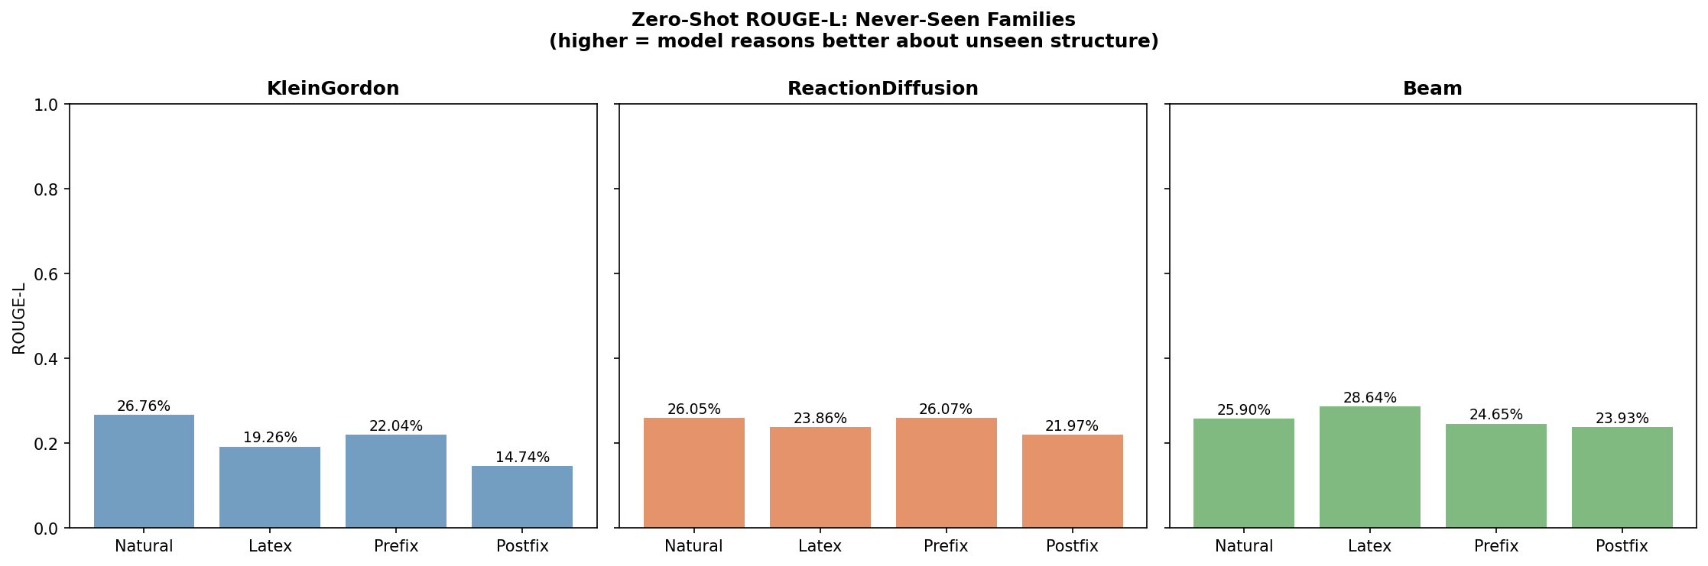
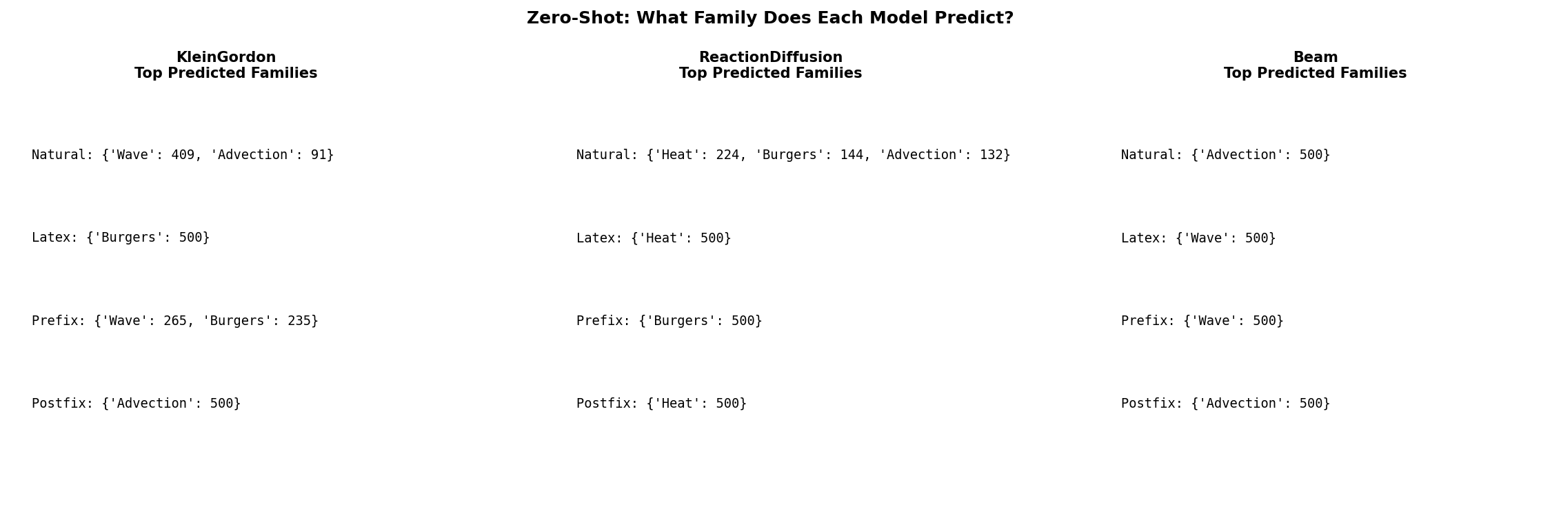
Experiment 3 — Zero-Shot Generalisation
All 4 models tested on 3 PDE families never seen during training

Slide 10
Zero-Shot: The Beam Equation — A Stress Test
u_tt + b·u_xxxx = 0 (4th-order spatial derivative — completely new structure)
Same equation, four dialects:
Natural ✗
LaTeX ✓~
u_tt plus 0.71 times the fourth derivative of u w.r.t. x equals zero.
\partial^2/\partial t^2 u + 0.71 \partial^4/\partial x^4 u = 0
→ Predicts: Advection
→ Predicts: Wave
"fourth" never seen in training → ignored
Sees \partial^2 in time → calls it Wave (close enough)
Prefix ✓
Postfix ✗
=(+(*(0.71, d(d(d(d(u,x),x),x),x)), d(d(u,t),t)), 0)
0.71 u x d x d x d x d * u t d t d + 0 =
→ Predicts: Wave
→ Predicts: Advection
Counts 4 nested d() calls in x → recognises depth
Token repetition misread as first-order

Slide 11
The Big Reversal
Postfix wins cross-dialect. Prefix wins zero-shot. Why?
Cross-Dialect Generalisation
Zero-Shot Generalisation
Same equation, different notation
Never-seen PDE families
Best: Postfix 53.9%
Worst: LaTeX 0.0%
Best: Prefix 3/3 families
Worst: Postfix 1/3 families
Postfix encodes operator order as a left-to-right token sequence. This surface ordering is easy to re-match across notation styles. It generalises because it learned to recognise token patterns that are consistent across different dialects.
Prefix encodes operator depth as explicit nesting: d(d(u,x),x) = 2nd order. d(d(d(d(u,x)…),x),x) = 4th order. The model learns to count nesting depth — which is exactly what determines PDE structural family.
Different notations encode different inductive biases. There is no single "best" dialect — the right choice depends on what kind of generalisation you need.

Slide 12
Key Takeaways
1
Notation format matters.
All four models hit 100% in-dialect. The ceiling hides the real differences. Cross-dialect and zero-shot tests reveal that what the model actually learned is very different depending on dialect.
2
Postfix → best cross-dialect generaliser (53.9% avg off-diagonal).
Symbolic token order is robust across notation styles. Prefix transfers to postfix and back. Natural and LaTeX each create isolated "notation islands".
3
Prefix → best zero-shot generaliser (3/3 unseen families correctly mapped).
Nested function calls encode derivative order explicitly. Postfix fails on Beam and KleinGordon because repeated tokens look first-order. Structure-encoding beats pattern-matching for unseen equations.

Slide 13
Future Work & Limitations
Break the 100% ceiling
Bigger model
Add ReactionDiffusion to training — gives the model a 6th family to distinguish, making in-dialect accuracy non-trivial and revealing dialect-specific weaknesses.
Repeat with T5-base (250M) or BART-base. Does scale change the cross-dialect gap? Does a larger model close the postfix zero-shot failure on Beam?
Multiple seeds
Intermediate representations
Run each training 3× with different random seeds to add error bars. Confirm that the prefix vs postfix zero-shot gap is statistically significant.
Train on a mix of two dialects (e.g., 50% prefix + 50% postfix). Does exposure to both symbolic forms further improve generalisation?
Limitation: T5-small may not be powerful enough to fully exploit structural cues — a stronger baseline model is needed before drawing firm conclusions.

