Slide 1
ProveNFix - Extended
Automated Repair Guided By Under-Approximation

Slide 2
Introduction and Background

Slide 3
Introduction and Background
Modern software systems are highly complex and prone to bugs, with their detection and repair posing a major challenge for developers.
Recent advances, such as ProveNFix, have demonstrated the potential of using over-approximation techniques to find and repair bugs through temporal guided formal reasoning.
ProveNFix generates specifications (specs) over multiple program states and synthesises patches based on spec inference and checks for spec inclusion.
However, the use of over-approximation techniques can lead to a significant number of false positives, overwhelming developers with non-issues that hinder practical bug detection and repair.

Slide 4
Introduction and Background
In contrast, Incorrectness Logic (IL) provides a framework that focuses on under-approximation, concentrating only on concrete incorrect behaviors in program executions.
This makes it more pragmatic for identifying real bugs without the noise of false positives.
This proposal aims to develop a new methodology that leverages under-approximation techniques to both detect and repair bugs with higher precision.
We propose adapting the ProveNFix framework to work with incorrectness logic to create a system capable of generating specs for under-approximate reasoning and automatically repairing bugs based on these ”true” error paths.

Slide 5
Research Objectives

Slide 6
Research Objectives
Develop a bug detection framework based on under-approximation techniques inspired by Incorrectness Logic, aiming to reduce the noise of false positives.
Spec inference using under-approximation, which will focus on concrete incorrect behaviours rather than covering all possible program states.
Investigate how under-approximation can affect the process of automated bug repair, with a focus on synthesising patches based on an under-approximation of program paths that can be taken starting from a presumed set of states.
Compare the effectiveness of this methodology with over-approximation-based systems like ProveNFix in terms of both bug detection accuracy and the quality of synthesised repairs.

Slide 7
Research Objectives
Additionally, these bugs can be either "latent" or "manifest" depending on the definition of "local" blocks (say, function-scope = local)
For Latent bugs: As their manifestation depends on further context, for example the subtree of the control flow with this function as the root (or the function trace), or the parent callers, we propose the creation of "Repair Conditions" that can be used to synthesise patches when these bugs do manifest.
For Manifest Bugs: No matter if this is a bug that manifests after further context or is manifest in the local scope, repairs can be synthesised directly.

Slide 8
Proposed Methodology

Slide 9
System Overview
The primary goal of this methodology is to adapt the ProveNFix framework to incorporate under-approximation techniques for bug detection and repair. We propose a two-phase system:
Bug Detection: Develop an under-approximation-based specification inference engine to find concrete incorrect behaviours in a program, reducing false positives. -> Extend Facebook's Infer tool
Automated Program Repair: Use the identified incorrect paths to synthesise targeted patches that address the actual bugs, ensuring that the repairs do not introduce new bugs.
Repair Conditions: This is done for "Latent" bugs, there is some literature for discovering these kinds of bugs, but there needs to be a way to figure out a bug's manifestation in the program paths, and then the possibility of generating a patch further back in the trace where this latent bug first was observed.

Slide 10
Evaluation

Slide 11
Evaluation Plan
The methodology will be evaluated by comparing the effectiveness of under-approximation-based bug detection and repair with existing over-approximation-based methods like ProveNFix. We will focus on:
Precision of Bug Detection: Evaluating the system’s ability to detect real bugs with fewer false positives.
Quality of Synthesised Patches: Measuring the correctness and minimality of the synthesised repairs.
Scalability: Assessing the system’s ability to handle large codebases with frequent updates.
Repair Efficiency: Evaluating how quickly and effectively the system can generate patches for detected bugs.
Case studies will be performed on real-world open-source projects with known bugs to demonstrate the effectiveness of the methodology.

Slide 12
Expected Contributions
This research is expected to make the following contributions:
A novel under-approximation-based bug detection and repair methodology that improves on existing over-approximation methods by reducing false positives.
A framework for spec inference using under-approximation that can efficiently detect and repair bugs with minimal impact patches.
Creation of "Repair Conditions" that can be used to generate patches for latent bugs when they manifest along a "concrete" path
Insights into how under-approximation can be pragmatic in automated bug detection and repair, making it more scalable for large, dynamic codebases.

Slide 13
Sample Runs - Default

Slide 14
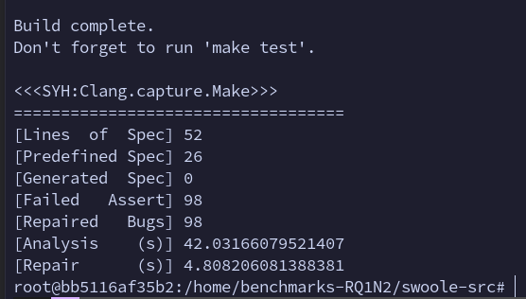
Artefact Reproduction - Report

Slide 15
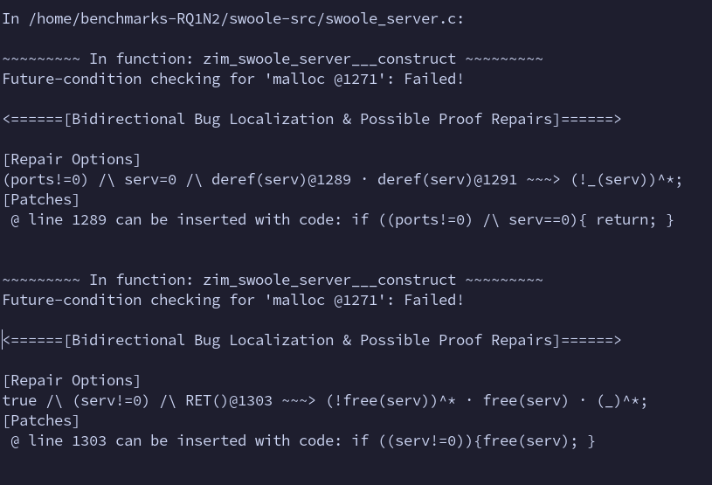
Artefact Reproduction – "Possible" Proof Repairs

Slide 16
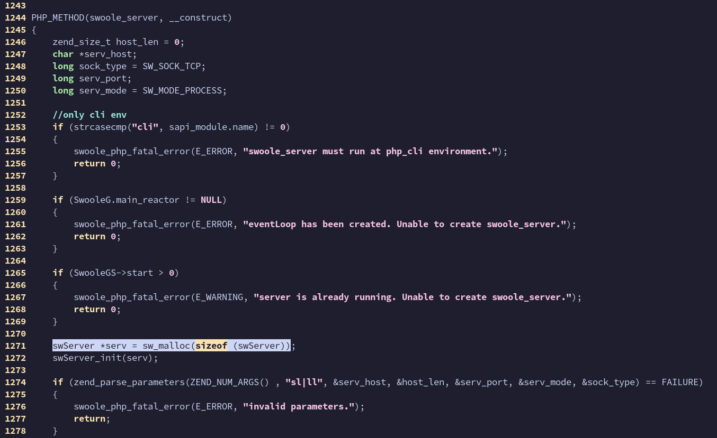
Artefact Reproduction - Code Sample - "Error"

Slide 17
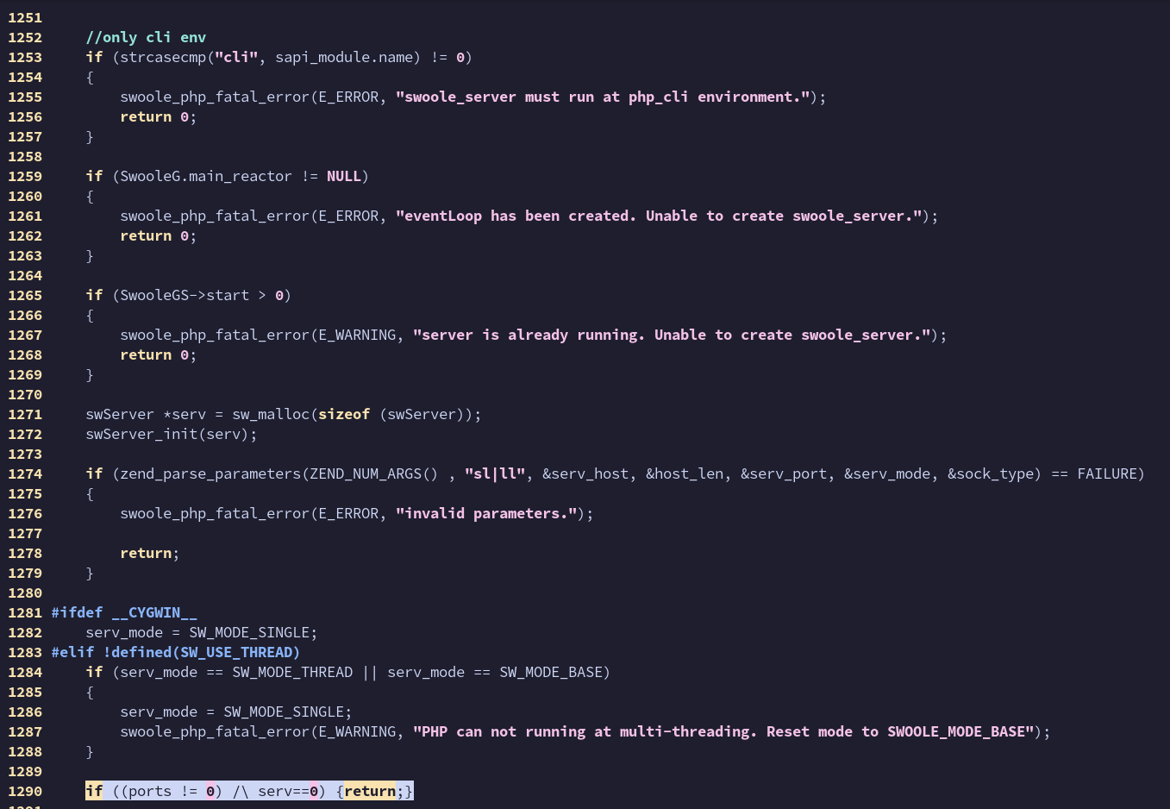
Artefact Reproduction - Code Sample – Suggested Fix

Slide 18
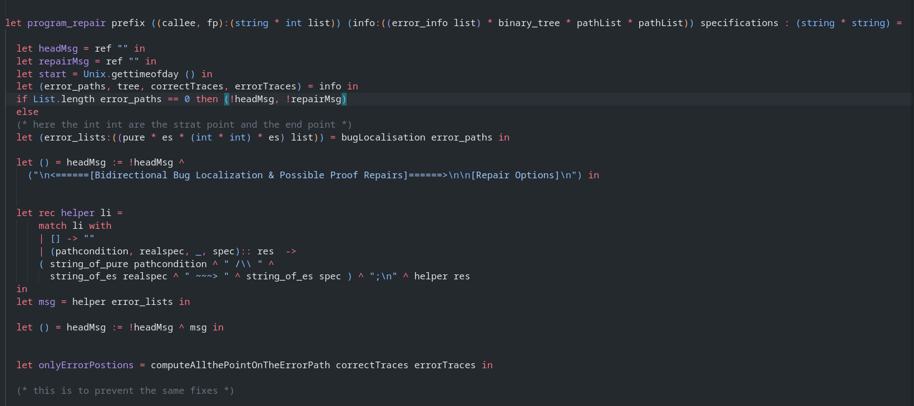
Artefact Reproduction – Repair func

Slide 19
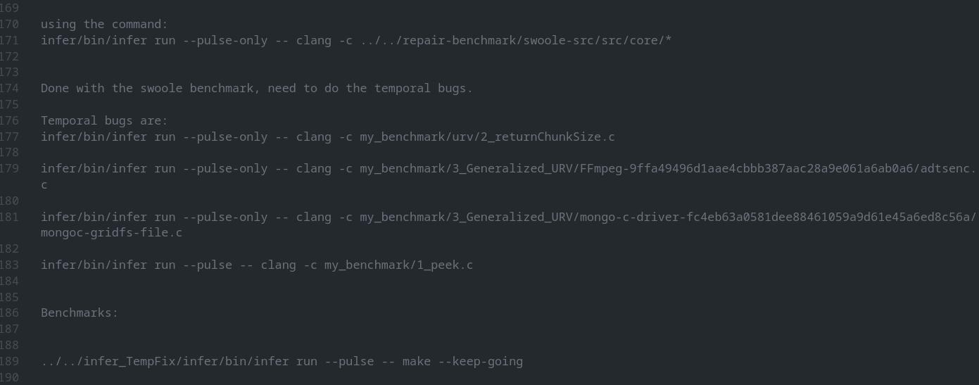
Some Comments found in README

Slide 20
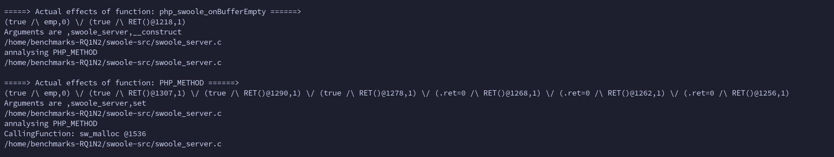
Artefact Reproduction – Pulse-Only Run

Slide 21
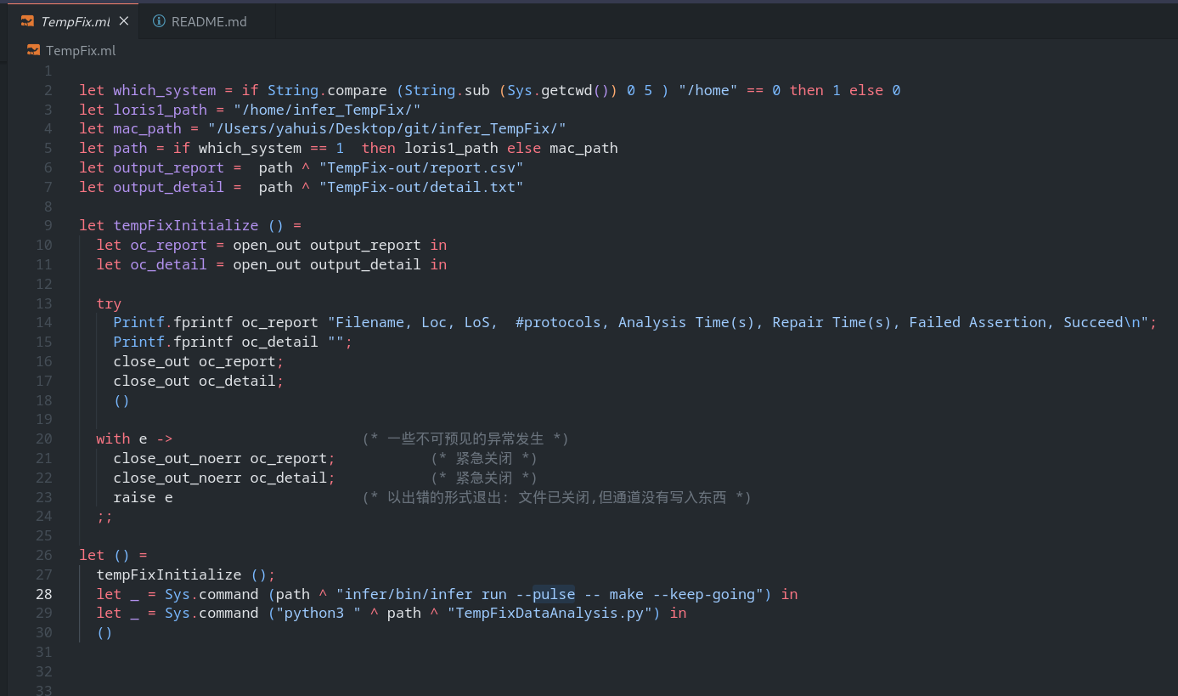
Initialised TempFix with Pulse Already?

Slide 22

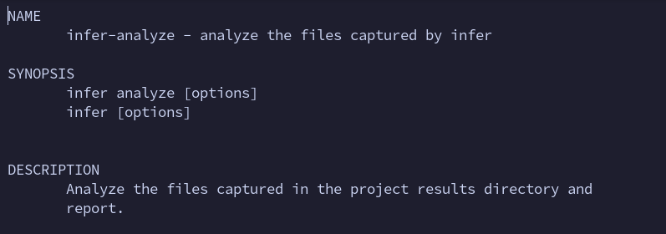
Initialised TempFix with Pulse Already?

Slide 23
How Infer finds bugs –
Over/Under Approximate
(single file example)

Slide 24
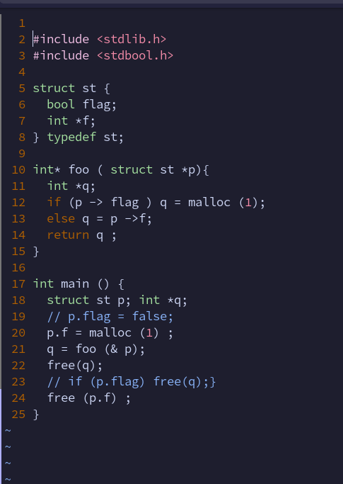
Example Program

Slide 25
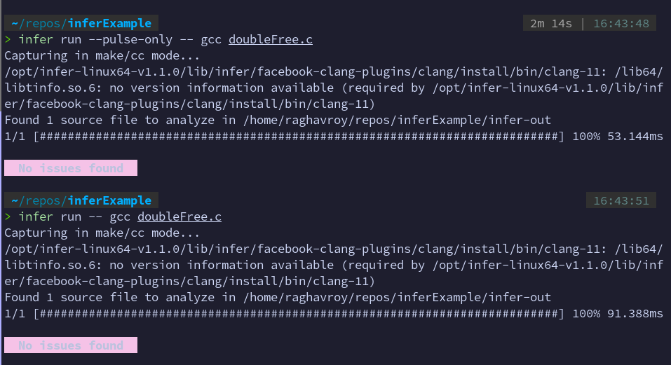
Infer runs (with and without Pulse)

Slide 26
How tempFix finds bugs –
Over/Under Approximate

Slide 27
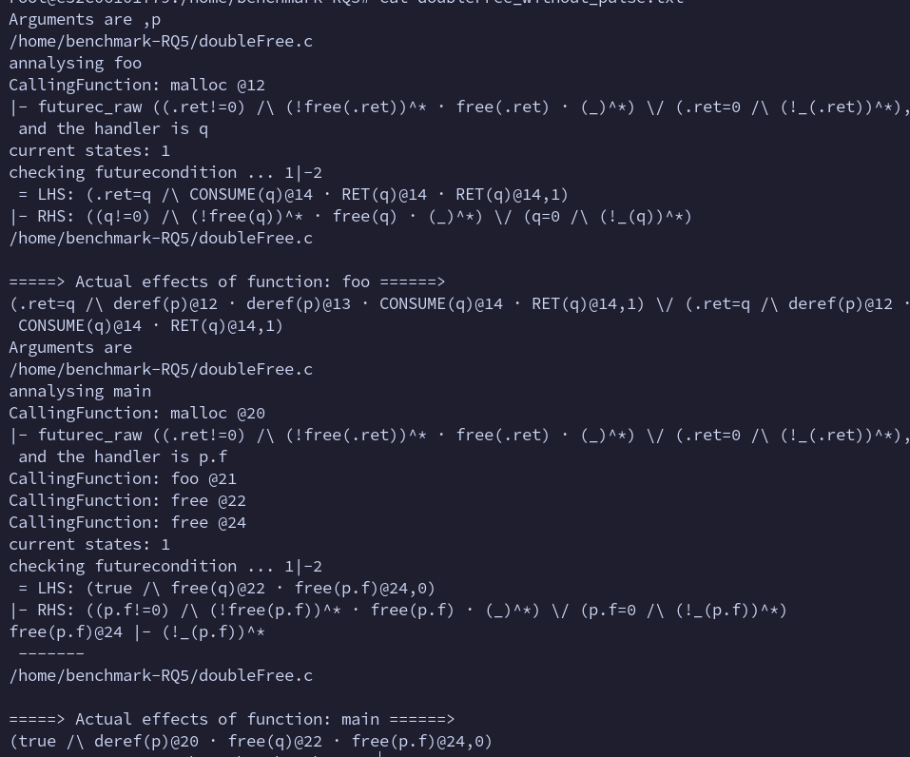
TempFix Pulse run

Slide 28
TempFix non-Pulse run (no difference)

Slide 29
What TempFix seems to be doing

Slide 30
Explanation (Program used for analysis)
1
2 #include <stdlib.h>
3 #include <stdbool.h>
4
5 struct st {
6 bool flag;
7 int *f;
8 } typedef st;
9
10 int* foo(struct st *p){
11 int *q;
12 if (p -> flag ) q = malloc(1);
13 else q = p ->f;
14 return q ;
15 }
16
17 int main () {
18 struct st p; int *q;
19 // p.flag = false; // This line has no effect on tempFix, but Infer detects a potential double free with Pulse
20 p.f = malloc(1) ;
21 q = foo(& p);
22 free(q); // BUG: free(q) before initialization
23 // if (p.flag) free(q); (repair from paper) OR if (!p.f) return; (repair from tempFix)
24 free(p.f) ; // POTENTIAL BUG: double-free (detected by infer)
25 }

Slide 31
Explanation
Main Observations:
p.flag is uninitialized:
This is critical because the program's behavior depends on its value in foo. The lack of initialization means p->flag can hold an arbitrary value, leading to undefined behavior.
Double free risk:
If p.flag is true, foo calls malloc(1) and returns the allocated pointer to q. The first free(q) is correct, but the second free(p.f) does not interfere in this case.
  If p.flag is false, foo assigns p->f to q. Here, both free(q) and free(p.f) refer to the same memory, leading to a double-free error.

Slide 32
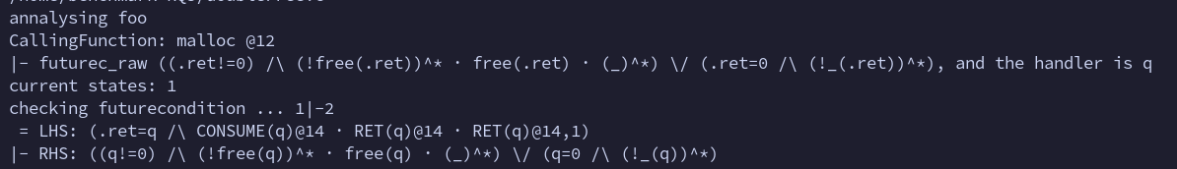
Explanation
1. Analysis of foo
futurec_raw describes the expected behavior for the memory allocated by malloc:
  If allocation succeeds (.ret != 0), the memory should eventually be freed (indicated by free(.ret)).
  If allocation fails (.ret == 0), there should be no operations (!_(.ret)) on the null pointer.
LHS (Observed Behavior):
  The tool observes that q is returned (RET(q)) and consumed (CONSUME(q)), indicating that q is used appropriately within the function.
RHS (Expected Behavior): Matches futurec_raw. It expects either:
  The allocated memory (q) is freed eventually if q != 0, or
  No operations are performed if q == 0.
The observed behavior matches the expected behavior, so no issues are flagged in foo

Slide 33
Explanation
1. Actual Effects of foo
deref(p): Indicates that p is dereferenced at lines 12 and 13.
CONSUME(q): Represents q being consumed by the function.
RET(q): q is returned. The function behaves correctly.

Slide 34
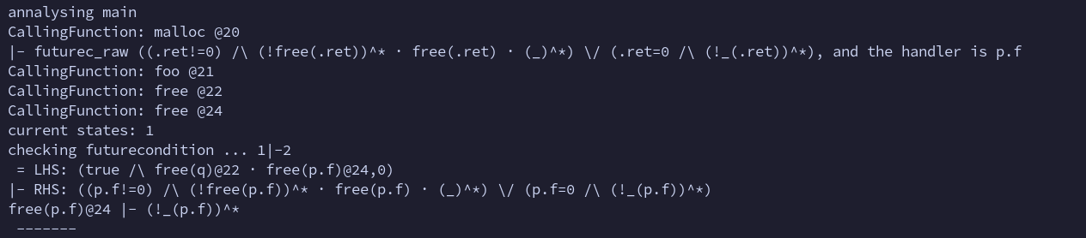
Explanation
2. Analysis of main
At Line 20 (malloc):
  The memory allocation for p.f is analyzed similarly to the one in foo. The tool expects the memory to be eventually freed if the allocation succeeds.
At Line 21 (foo):
  foo is called with &p, and the tool tracks the returned pointer q.
At Line 22 (free(q)):
  The tool observes free(q), marking q as freed.
At Line 24 (free(p.f)):
  The tool sees free(p.f) and checks if it violates any of the expected conditions.

Slide 35
Explanation
2. Analysis of main (continued)
LHS (observed behaviour): (true /\ free(q)@22 · free(p.f)@24,0)
The observed behavior is that both q and p.f are freed.
RHS (expected behaviour): ((p.f!=0) /\ (!free(p.f))^* · free(p.f) · (_)^*) \/ (p.f=0 /\ (!_(p.f))^*)
The tool expects that:
  If p.f is not null, it is freed only once, and no operations follow after freeing. OR
  If p.f is null, no operations should be performed on it.
Violation Detected: free(p.f)@24 |- (!_(p.f))^*
At Line 24, p.f is freed after it has already been freed at Line 22 (via q, when p.flag is false). This violates the expected behavior of memory management, as double-free errors are undefined behavior.

Slide 36
Explanation (Overall)
Potential Double-Free (free(p.f)):
  The tool detects that p.f may be freed twice
  Once in foo if p->flag is false (q = p->f).
  Again in main at line 24 (free(p.f)).
  This is flagged as a violation of the future condition for p.f.
The tool effectively analyzes the program by:
  Propagating specifications (future conditions) for malloc and free.
  The lack of p.flag initialization makes this behavior nondeterministic, but the tool's formal analysis assumes all feasible paths, detecting the violation regardless. This identifies a double-free error in the program.

Slide 37
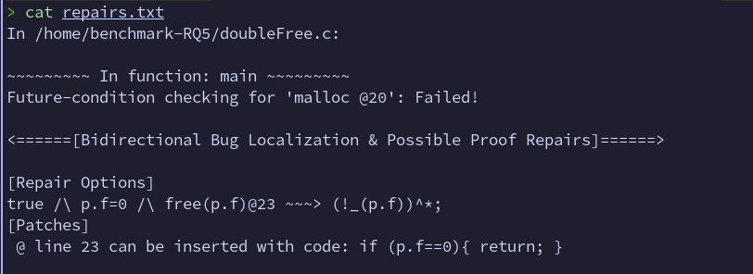
Repairs Suggested by TempFix

Slide 38
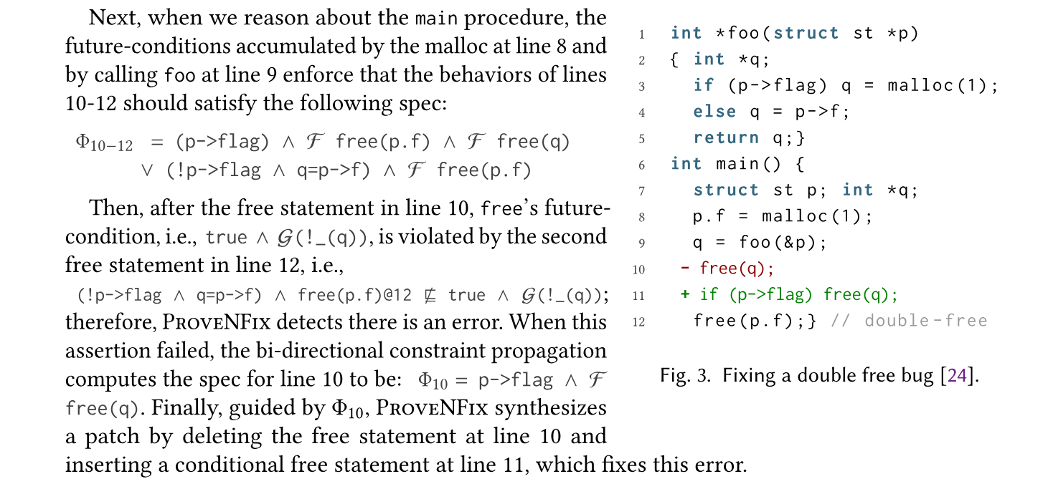
Repairs Suggested in Paper (Different)

Slide 39
Introduction of the Imaginary Paper

Slide 40
Introduction
Modern static analysis tools have made significant strides in detecting bugs in software systems, yet they still face challenges in balancing precision and scalability. ProveNFix, a static analysis tool, employs an under-approximation approach to address these challenges.
By dropping infeasible paths and selectively unrolling loops, and using future conditions (specifications describing permissible program behaviors), ProveNFix attempts to reduce false positives.
Despite its successes, ProveNFix's dependence on manually curated specifications and its lack of flexibility in specification inference have highlighted opportunities for further innovation.

Slide 41
Introduction
ProveNFix relies on a core set of 17 primitive specifications for C APIs, which are used to infer project-specific specifications. However, as observed during its evaluation, ProveNFix generated far more specifications than Infer, leading to a higher number of reported bugs.
These additional reports included potential true positives as well as false positives, but no definitive baseline existed to distinguish between the two. //this bit is a claim made by the authors - unverified
To enable fair comparisons with Infer, the authors manually curated project-specific specifications from the broader set inferred by ProveNFix. This labor-intensive process limited ProveNFix's scalability and positioned it more as a bug-finding tool reliant on input specifications than as an automated specification inference tool.

Slide 42
Introduction
In this paper, we propose an extension to ProveNFix that addresses these limitations by incorporating incorrectness logic to enhance its bug detection and repair capabilities. Unlike ProveNFix's reliance solely on future conditions to reduce false positives, our approach generates repair conditions based on manifestly buggy computation (MBC) paths.
These repair conditions enable ProveNFix to systematically reason about program behaviors that violate correctness and synthesize program repairs when such violations are detected. This extension transforms ProveNFix into a more robust tool capable of both finding and repairing bugs with minimal manual intervention.

Slide 43
Motivating Example
To illustrate, consider a program with the following fragment:
struct st {
bool flag;
int *f;
};
int* foo (struct st *p) {
int *q;
if (p->flag) q = malloc(1);
else q = p->f;
return q;
}
int main() {
struct st p; int *q;
p.f = malloc(1);
q = foo(&p);
free(q) <--------------
free(p.f); <--------------
}

Slide 44
Motivating Example
Here, the function foo potentially introduces a double-free error depending on the value of p->flag. ProveNFix, in its current form, may struggle to fully automate the detection and repair of this bug due to limitations in specification inference.
By introducing incorrectness logic, our extension identifies under-approximated paths leading to manifestly buggy states (e.g., double-free errors) and generates repair conditions (RCs) that guide modifications to eliminate these bugs.

Slide 45
Motivating Example
Formally, given an MBC path, the tool synthesizes a repair condition of the form:
MBC path: (q = foo(&p); free(p.f);)
Repair condition (RC): Ensure p->flag is true when q is freed, preventing double-free scenarios.
Our tool synthesizes these conditions by examining the semantics of API calls (e.g., malloc, free) and propagating incorrectness constraints across program paths.

Slide 46
Contributions
The contributions of this paper are as follows:
Enhanced Specification Inference: We improve upon ProveNFix's specification inference process by incorporating incorrectness logic, generalising the inference process. //Incomplete - need more info
Manifestly Buggy Computation (MBC) Detection: We formalize a framework for detecting under-approximated paths leading to buggy states and synthesize repair conditions (RC) to address them.

Slide 47
Contributions
Automation and Scalability: By automating the inference of project-specific specifications, our approach reduces manual effort and positions ProveNFix as a robust specification inference and bug-fixing tool.
Empirical Evaluation: We evaluate our extended tool on a diverse set of benchmarks, demonstrating its ability to detect and repair complex bugs with high precision and recall.

Slide 48
Outline of the paper
The rest of this paper is organized as follows:
Section 2 provides a detailed background on ProveNFix, including its use of future conditions and limitations in specification inference. Section 3 introduces our incorrectness logic framework and formalizes the concepts of MBC and RC.
Section 4 describes the implementation of our extended tool and its integration with ProveNFix.
Section 5 presents an empirical evaluation across multiple benchmarks, comparing our tool's performance to Infer and the original ProveNFix. Finally,
Section 6 discusses related work, and
Section 7 concludes with future directions.

Slide 49
Outline of the paper
By addressing ProveNFix's limitations in specification inference and introducing repair-oriented logic, our work paves the way for scalable, automated static analysis tools capable of both detecting and repairing bugs with minimal manual intervention.

Slide 50
Thank you!

