Slide 1
Data Acquisition and Remotely Logged Home Automation System
Sai Raghavendra Sankrantipati
Vishal Vishnani

Slide 2
Description
A multithreaded home automation system in which, BeagleBone(BBG) is used as a remote logger system while TIVA acts as a sensor hub. The sensor hub collects data values from different sensors and sends them to BBG over UART communication.

Slide 3
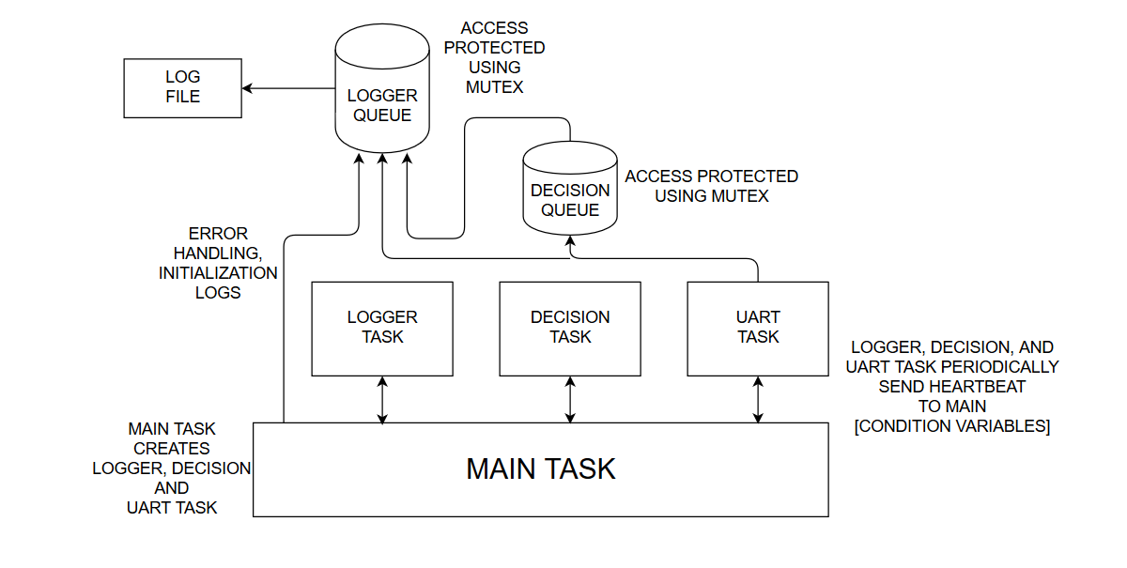
Architecture: BBG

Slide 4
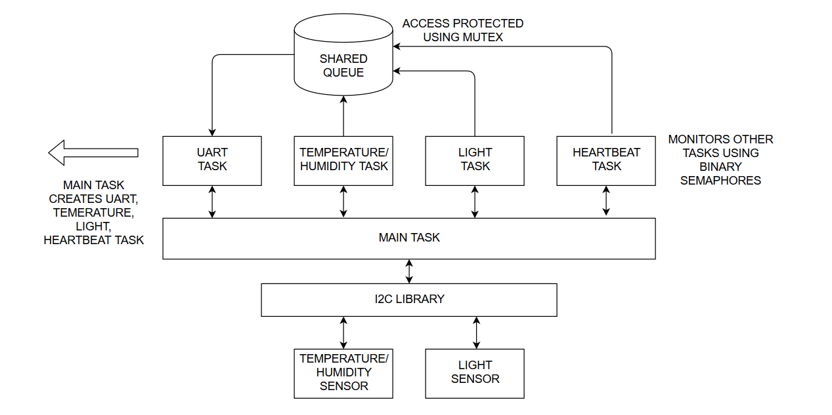
ARCHITECTURE: TIVA

Slide 5
Features
Periodic sensor readings
API calls, BBG and TIVA
Heartbeat using Binary semaphores and Conditional Variables
Error Handling
Logging to a file

Slide 6
Communication
Inter Task Communication: Message API, Semaphores
Inter Board Communication: UART

Slide 7
Hardest PART: Sockets on TIVA
No proper example for LWIP on Free RTOS and Driver Lib for TM4C1294XL.
Tough time in getting LWIP as a third-party in project.
Hard luck with freertos_demo of TM4C129X.
Should have tried FreeRTOS + TCP
Sending Structure over UART

Slide 8
Learning points
FREE RTOS
TIVA DRIVER LIBRARY
SYNCHRONISATION
QUEUES

Slide 9
DEMO

