Slide 1


Title: Web Scraping and Exploratory Data Analysis of TMDB Data

Slide 2
About Us:
Sai Deepak Vanga - B.Tech CSE
Govardhan Yapamanu - B.Tech CSE
Pothula Raghavendra Reddy – B.Tech ECE

Slide 3
Introduction:
Movies generate massive global audience data across platforms like OTT,
Theaters, Social Media, and Review Sites.
Understanding movie performance is important for production houses, streaming
platforms, and marketing teams.
TMDB (The Movie Database) is one of most reliable public sources for movie metadata, ratings, and user popularity metrics.
This project extracts real world movie data using the TMDB API instead of
unreliable manual web scraping ensuring accuracy.
The goal is to analyze trends in ratings, popularity, genres, languages, and release years among top-rated movies.
Insights from this dataset help identify audience preferences, content performance patterns, and long-term rating behaviour.
All analysis is based on 2000+ movies, cleaned, structured, and visualized to draw data-driven conclusions.

Slide 4
Problem Statement:
The goal of this project is to analyze top-rated movies from The Movie Database
(TMDB) to uncover the key factors that drive movie quality (ratings) and audience
engagement (popularity).
By exploring trends across genres, languages, and release years, we aim to understand how audience behavior and movie attributes correlate, helping content platforms, producers, and marketers make data-driven decisions.

Slide 5
Objectives:
Primary Objectives :To perform EDA on top-rated movies from TMDB.
To identify trends in genres, languages, and release years.
To understand the factors affecting movie ratings and popularity.
Analytical Objectives :To clean and preprocess movie metadata.
To explore numerical feature distributions (ratings, vote count, popularity).
To analyze correlations and derive insights for content recommendations.

Slide 6
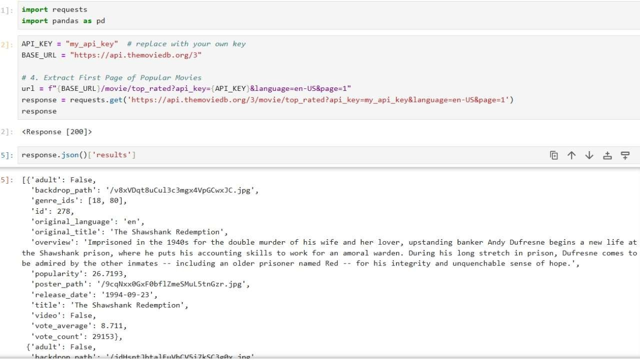
Web Scraping:
Generated API key
Pulled paginated API JSON data
Converted JSON to DataFrame
Cleaned, parsed genres, handled strings & date formats

Slide 7
DATA OVERVIEW:
The dataset contains 2000+ top-rated movies, collected using the TMDB API.
It includes 11 key features covering movie metadata such as:
Title & Original Title
Overview (movie description)
Genres (list format)
Release Date & Release
Year Original Language
Vote Average (rating)
Vote Count (audience engagement)
Popularity Score
Overview Word Count

Slide 8
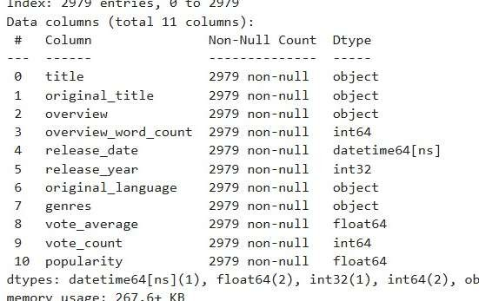
11 cleaned and structured features including genre, year, rating, popularity, and language.
No missing values; genres stored as multi- label lists.
Dataset covers films from 1902–2025 with strong distribution across languages and genres.

Slide 9






Tools Used:

Slide 10
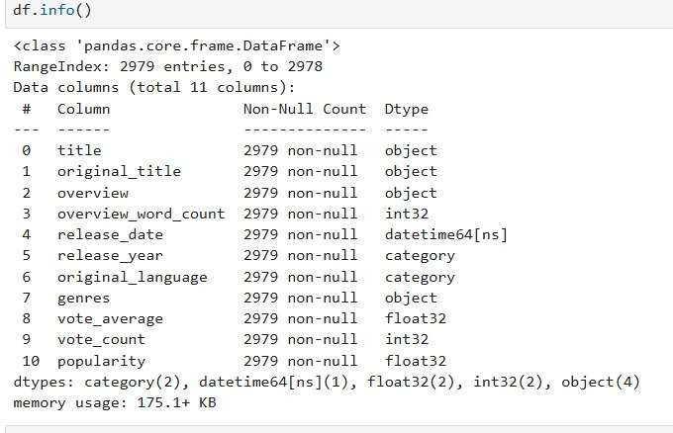
Data Cleaning Steps:
Removed unwanted columns
Fixed datatypes (date, numeric fields)
Parsed genres into list format
Filled missing descriptions/titles
Cleaned language labels
Removed duplicate rows

Slide 11
Univariate Analysis:
Analyzing a single variable to understand its distribution and behavior.
Languages : to identify the most common languages among top-rated movies.
Genres : to understand which genres appear most frequently.
Release Years : to observe movie production trends over time.
Ratings (vote_average) : to study how top-rated movies are distributed in quality.
Popularity Scores : to understand engagement levels across movies.
Vote Counts : to analyze audience interaction levels.
Overview Word Count : to understand typical description lengths.

Slide 12
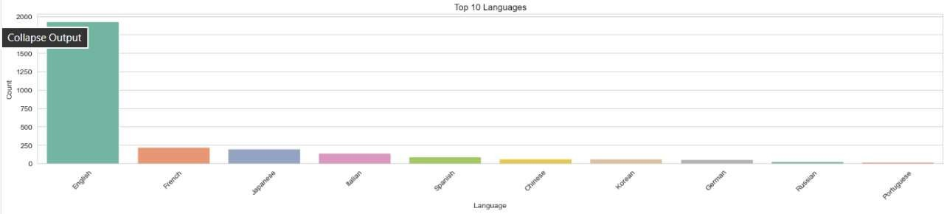
​Languages ​
Language Analyzed the count of movies by original language.
English dominates the dataset, followed by French, Japanese, and Italian.
Shows global diversity but strong English-language influence.

Slide 13
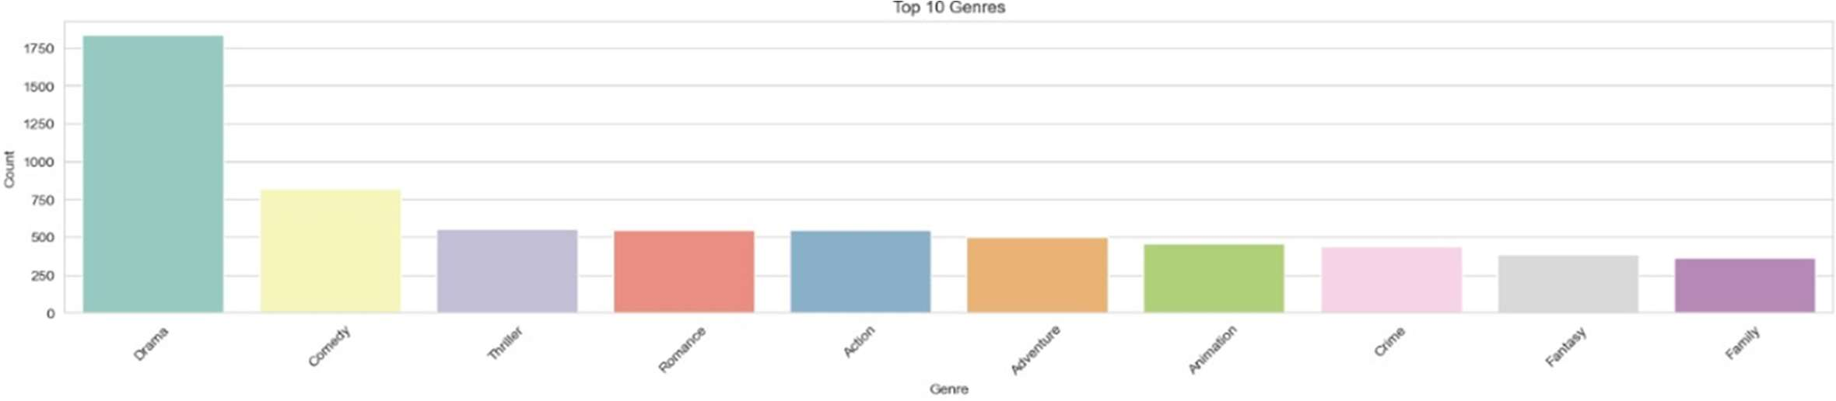
Genres
Genres Exploded the genre column and counted occurrences.
Drama is the most common genre, followed by Comedy, Adventure, and Action.
Highlights dominant storytelling themes among top-rated movies.

Slide 14
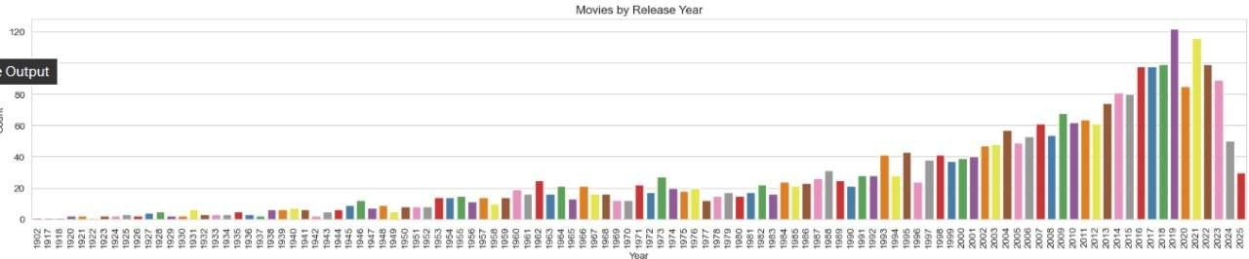
Release Year
Release Year Analyzed the number of movies released each year.
Sharp increase in top-rated films after 2000.
Peak period: 2010 –2020.
Very few high-rated movies from early decades.

Slide 15
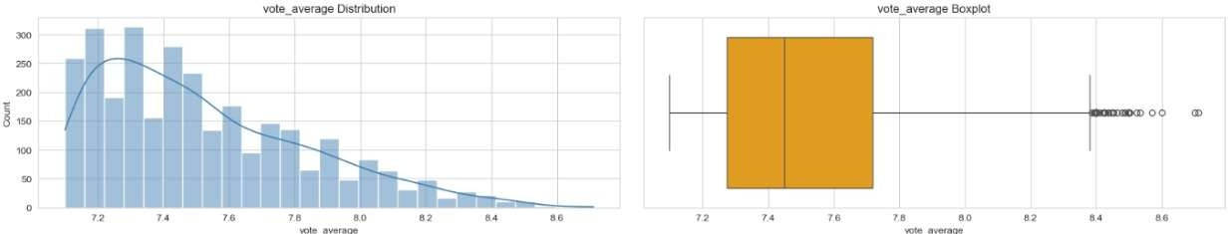
Vote Average
Vote Average Ratings range from 7.1 to 8.5 with a strong cluster around 7.5.
KDE curve shows a narrow, concentrated distribution.
Very few movies achieve extremely high ratings (> 8.5).

Slide 16
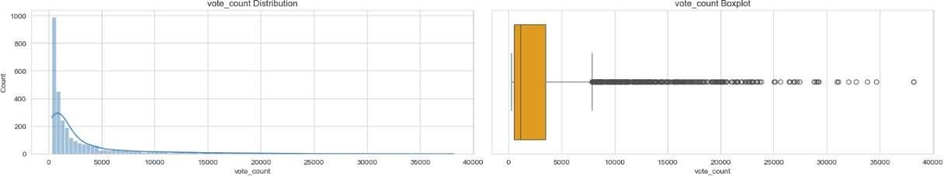
Vote_Count
Vote Count : Vote counts are right-skewed with most movies receiving < 5,000 votes .
A small number of films have extremely high engagement (> 30,000 votes).
Shows wide variation in audience interaction levels.

Slide 17
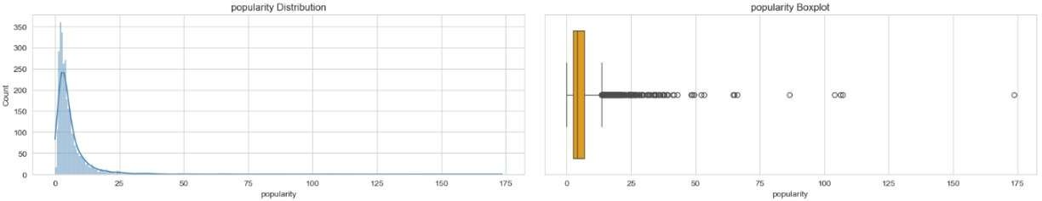
Popularity
Popularity : Popularity scores are right-skewed, with most movies in the 0–10 range .
Very few movies show extremely high popularity (>100).
Indicates that only select top-rated films gain massive public attention.

Slide 18
Bivariate Analysis
Popularity and vote count are strongly correlated more votes = more popularity.
Vote average (ratings) shows weak correlation with vote count critically high-rated movies don’t always have many votes.
Action and Adventure movies have high popularity, while Drama and Crime have high ratings.
Popularity increases with release year, indicating that newer movies trend more on TMDB.
English films dominate in both popularity and vote counts, but some non-English films (Japanese, Korean, French) score high in ratings.
These relationships show how audience engagement (popularity, votes) and critical response (ratings) behave differently across genres and years.

Slide 19
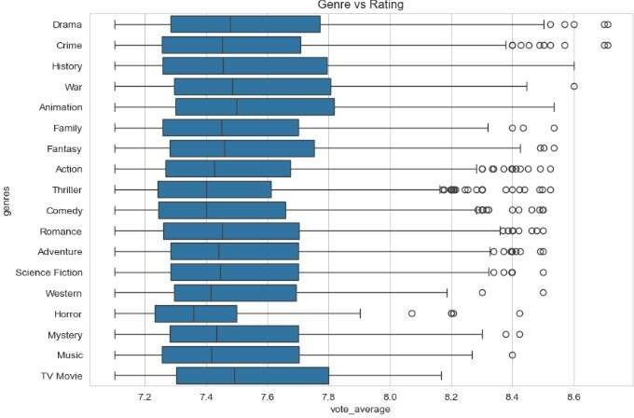
Genre vs Rating :
Drama, Animation, and Documentary have higher rating medians.
Action and Horror show wide variability in ratings.
Genre plays a significant role in movie quality trends.

Slide 20
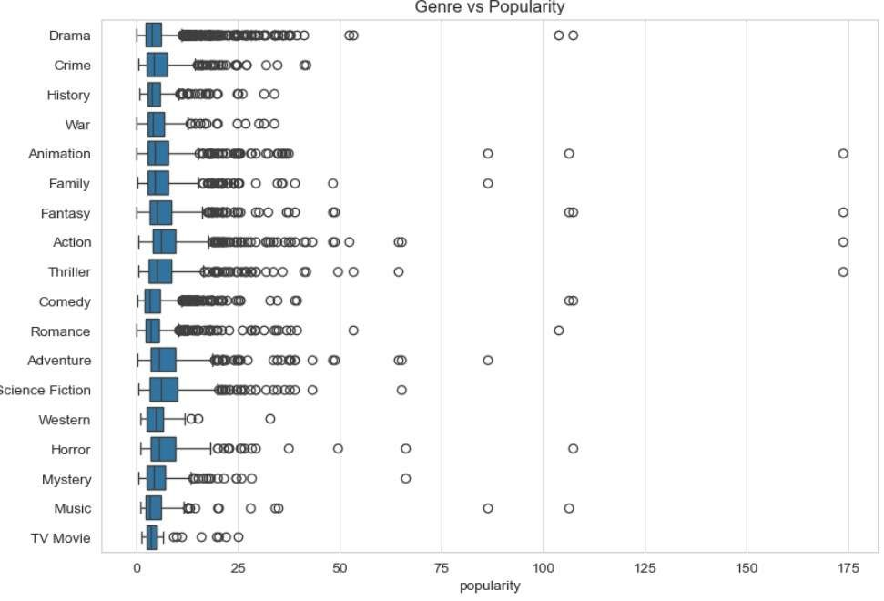
Genre vs Popularity:
Action, Adventure, and Sci-Fi have the highest popularity .
Drama is consistent but moderately popular .
Some genres (Documentary, History) show low popularity.

Slide 21
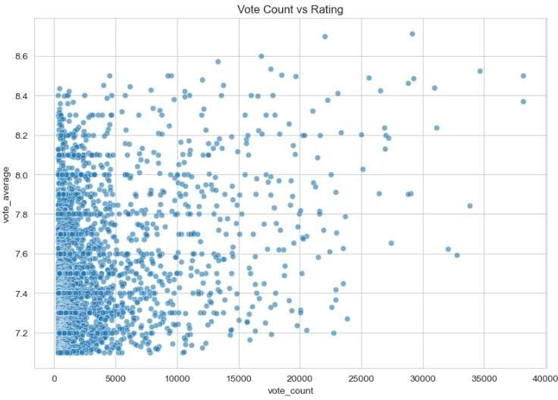
Vote Count vs Rating :
Weak relationship between vote count and rating.
Movies with many votes do not always have the highest ratings.
High-rated movies appear across all vote count levels.

Slide 22
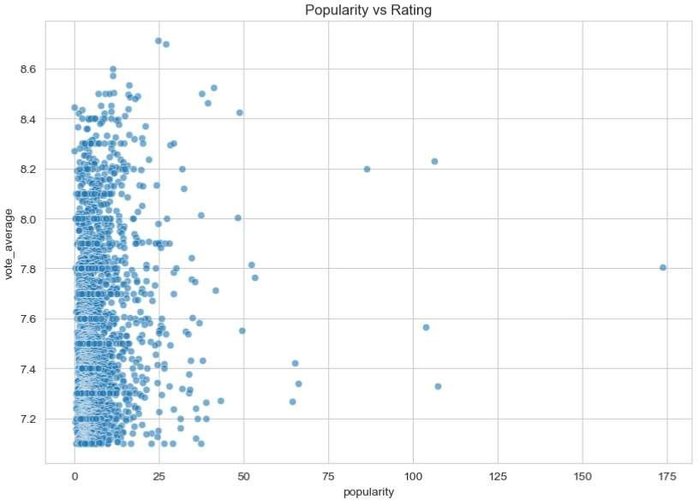
Popularity vs Rating:
No strong relationship between popularity and rating.
Many popular movies have only moderate ratings.
Highly rated movies are not always widely popular.

Slide 23
Multivariate Analysis
Popularity is highly correlated with vote count, confirming audience interaction drives visibility.
Ratings remain independent, showing that critical quality doesn’t depend on votes or popularity.
Drama and Crime genres achieve high ratings but moderate popularity, while Action and Adventure lead in popularity.
Popularity has increased in recent years, while ratings remain stable, showing streaming-era visibility growth.
Overall, genre, language, and audience engagement jointly define movie success patterns.

Slide 24
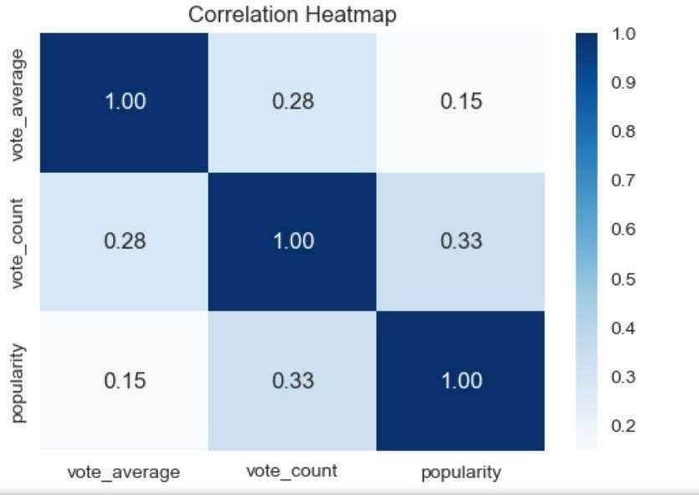
The heatmap shows the correlation between rating, popularity, and vote count.
Popularity is closely linked to vote count but does not guarantee higher ratings.
This highlights that audience engagement and movie quality are separate factors.

Slide 25
Key Business Insights
Ratings and popularity do not correlate :
quality and audience reach are separate KPIs.
Drama delivers highest-quality films, ideal for premium and curated collections.
Action/Sci-Fi dominate popularity, ideal for marketing, traffic growth, and trending sections.
Popularity is driven by exposure, not film quality :
franchise advantage.
Classics retain long-term value, supporting library retention strategies.
Some genres offer high quality but low exposure, representing strategic content growth areas.

Slide 26
Recommendations:
Maintain separate Quality and Popularity recommendation models.
Promote Drama for premium audiences and curated lists.
Use Action/Sci-Fi for mass engagement and homepage visibility.
Leverage classics for long-term library value.
Invest in undervalued high-quality genres (Animation, Mystery).
Boost discovery of high-rated lesser-known movies.
Use year-based analysis to create balanced content mixes.

Slide 27
Conclusion:
Movie quality, popularity, and audience reach are driven by
different factors.
Drama leads in ratings, Action/Sci-Fi lead in engagement, and
classics retain long-term value.
A balanced content strategy combining high-quality films, mass-
appeal genres, and hidden gems ensures the best viewer experience.

Slide 28
Q&A:
What is the main insight from your analysis?
How does this project help OTT platforms or businesses?
Which genres performed the best in ratings and popularity?
What trend did you observe across release years?
What did the correlation heatmap reveal about the dataset?
Why did you retain outliers instead of removing them?
What challenges did you face during data cleaning?
What key steps did you take to prepare the dataset for EDA?
How do ratings differ from popularity?
What future improvements can be added to this project?

Slide 29
Experience– Web Scraping & Data Analysis:
Scraped TMDB data from multiple websites using Python (Api’s, pandas).
Cleaned and standardized data .
Created visualizations showing trends and top 10 movies.
Learned end-to-end data workflow: scraping → cleaning → analysis → visualization.

Slide 30
Challenges – Web Scraping & Data Analysis:
JSON nested structure parsing
Genre list exploded mapping
Handling API pagination
Duplicate titles in different languages
Ensuring visuals were readable & clean

Slide 31


