Slide 1
HR ANALYTICS PROJECT
Workforce Dashboard
& Insights
18,285
active employees
Employee distribution • Hiring trends • Diversity • Workforce structure
Based on HR.csv
Prepared for Tableau / Power BI style presentation

Slide 2
01 • OVERVIEW
Project Scope & Objectives
1
Connect / prepare the HR dataset
Load and clean employee records for analysis.
2
Build three KPIs
Employee count, work location split, and average age.
3
Visualize workforce trends
Hiring trend by year and employee distributions.
4
Derive insights & recommendations
Translate patterns into actions for the company.
HR Analytics • Data-driven workforce insights

Slide 3
02 • METHODOLOGY
Data Preparation & Definitions
22,214
Total records in HR.csv
Analysis rules
•
Active employee = record with blank termdate.
18,285
•
Work location split = Headquarters vs Remote among active employees.
Active employees used for workforce KPIs
•
Average age = mean Age of active employees.
•
Hiring trend = count of hire_date by year across all records.
3
Core KPI measures
•
State / Department / Race charts = active employees only.
HR Analytics • Data-driven workforce insights

Slide 4
03 • KPI SNAPSHOT
Executive Workforce Dashboard
ACTIVE EMPLOYEES
REMOTE WORKFORCE
HEADQUARTERS
AVERAGE AGE
18,285
25.0%
75.0%
38.5
82.3% of all records
4,575 employees
13,710 employees
Years
Immediate takeaways
• Workforce is predominantly office-based, with 1 in 4 employees remote.
• Average employee age is about 38.5 years, indicating a mixed-experience workforce.
• Active employee population is concentrated in a small number of states and departments.
HR Analytics • Data-driven workforce insights

Slide 5
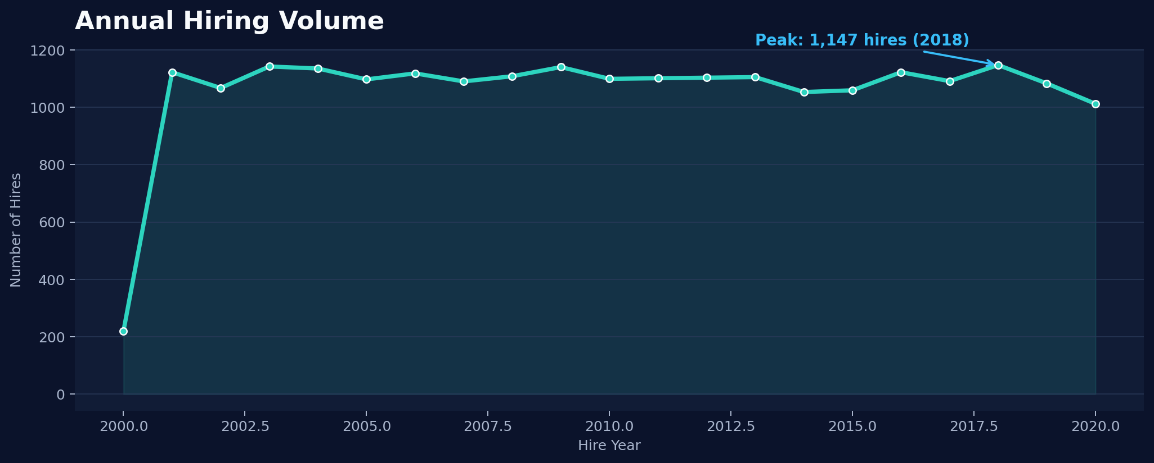
04 • HIRING
Hiring Trend by Year
Peak: 1,147 (2018)
HR Analytics • Data-driven workforce insights

Slide 6
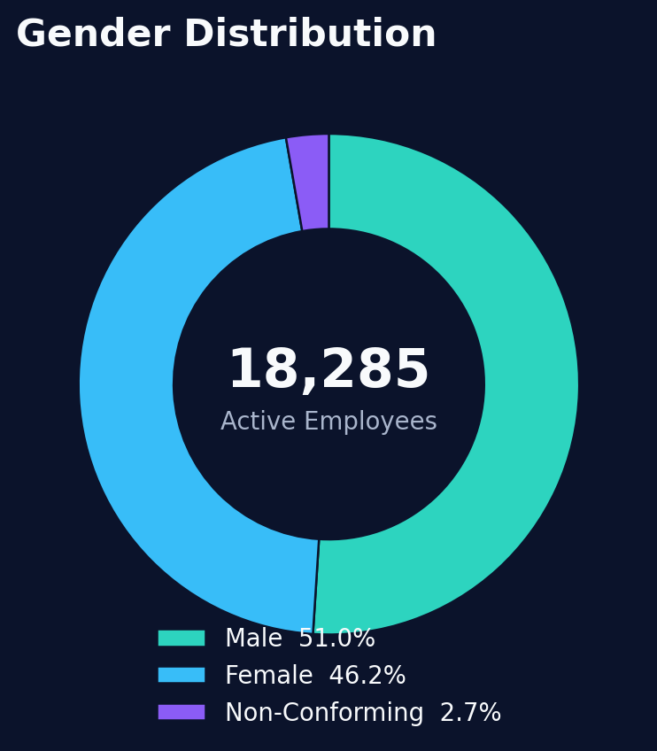
05 • DEMOGRAPHICS
Gender Distribution
What the chart says
Male
9,328 • 51.0%
Female
8,455 • 46.2%
Non-Conforming
502 • 2.7%
The distribution is relatively balanced across male and female employees, with a smaller non-conforming segment.
HR Analytics • Data-driven workforce insights

Slide 7
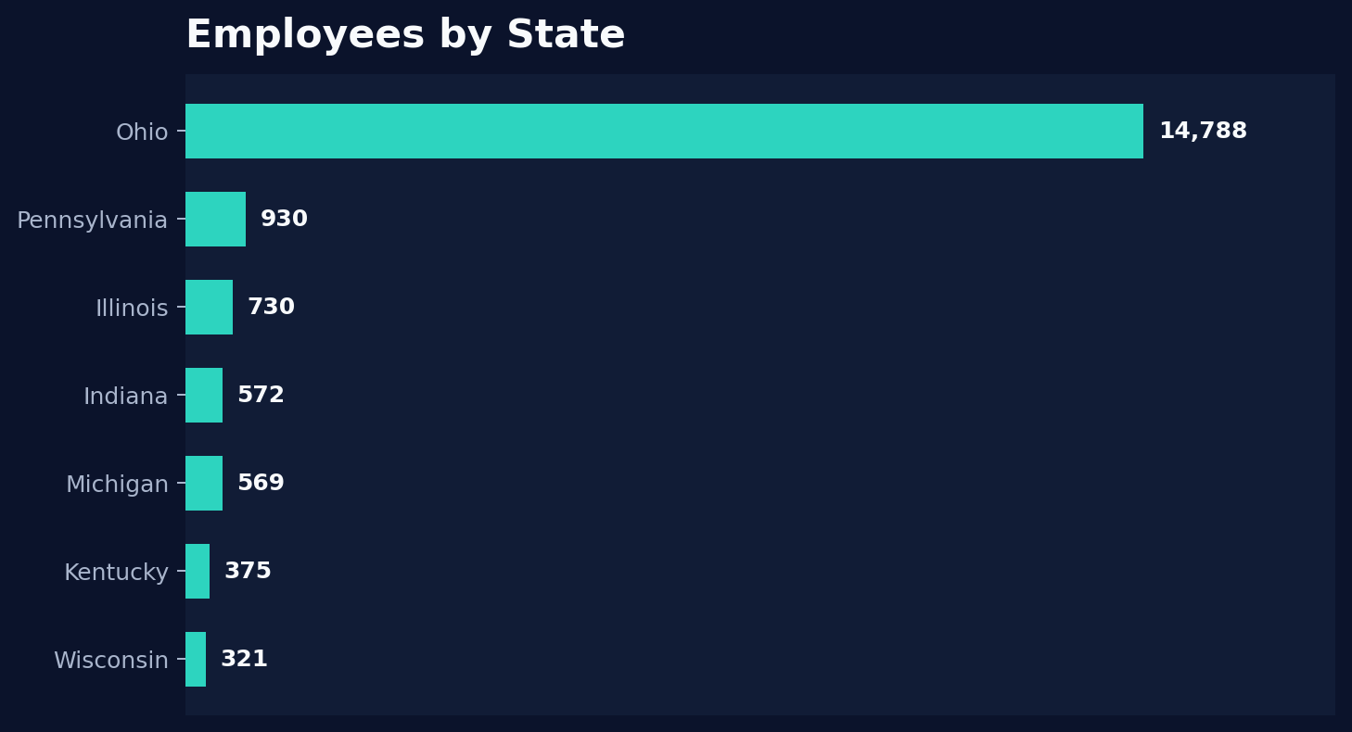
06 • GEOGRAPHY
Employees by State
Geographic insight
Ohio dominates the workforce
14,788 active employees
(80.9% of active workforce)
The workforce is heavily concentrated in Ohio, while Pennsylvania, Illinois, Indiana, Michigan, Kentucky and Wisconsin form the next tier.
HR Analytics • Data-driven workforce insights

Slide 8
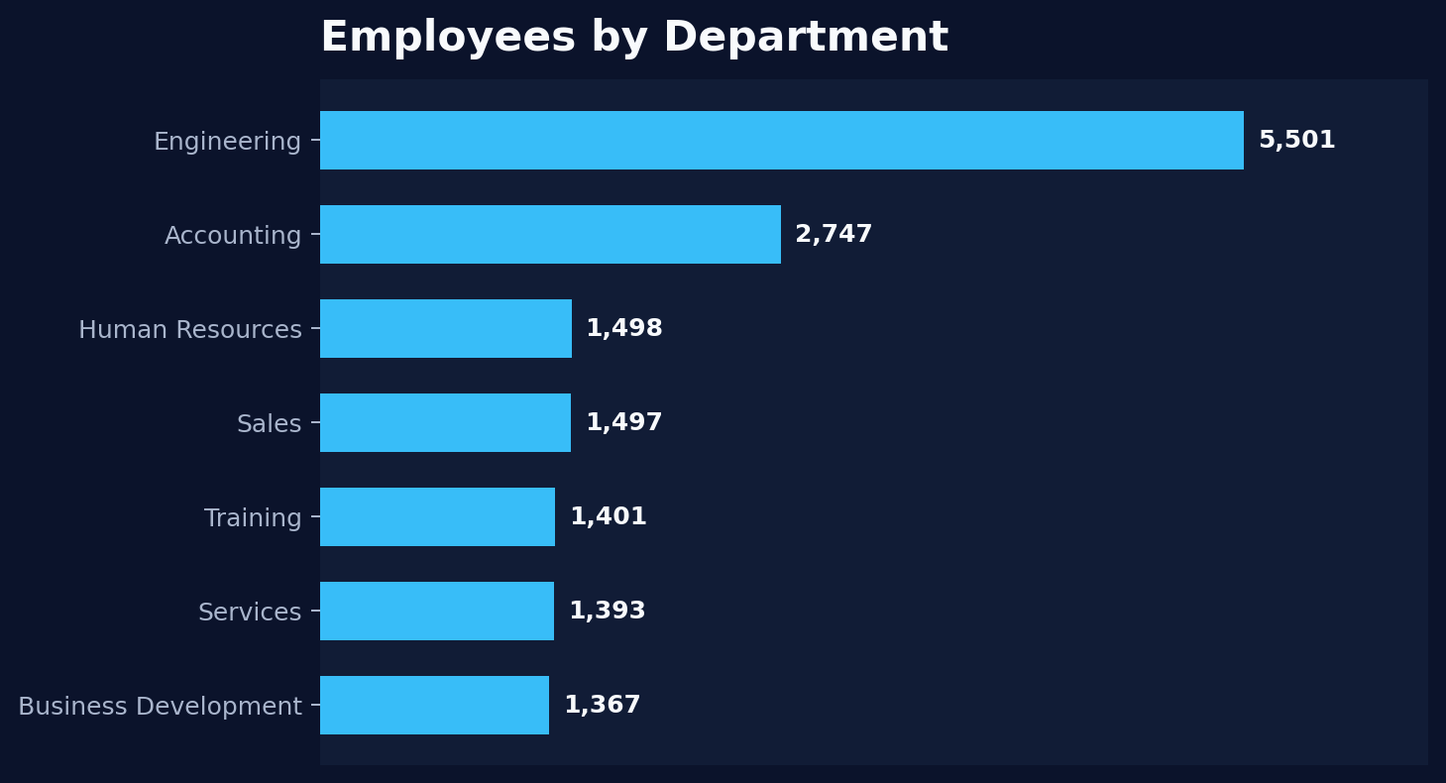
07 • ORGANIZATION
Employees by Department
Department insight
Engineering is the largest function
5,501 active employees
(30.1% of active workforce)
Accounting is the second-largest group, followed by HR, Sales, Training and Services.
HR Analytics • Data-driven workforce insights

Slide 9
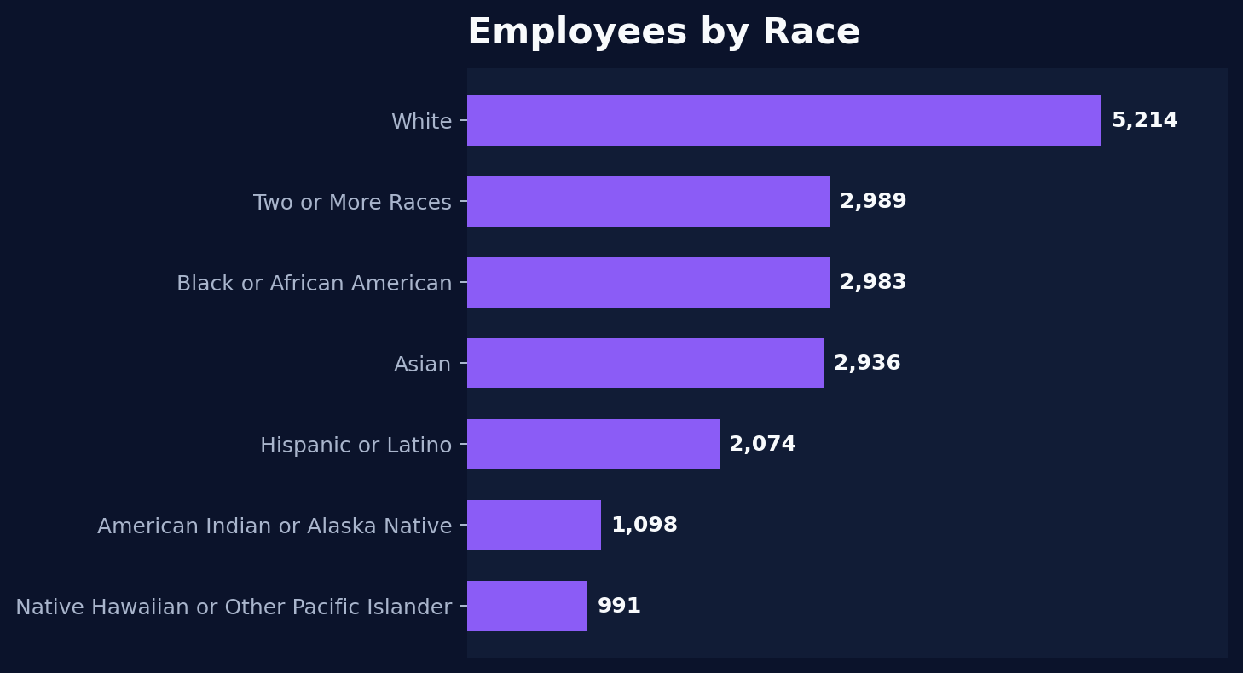
08 • DIVERSITY
Employees by Race
Diversity insight
White is the largest single group
5,214 employees
(28.5%)
The remaining workforce is distributed across six additional race categories, providing a broad mix of backgrounds.
HR Analytics • Data-driven workforce insights

Slide 10
09 • ANALYSIS
Cross-Feature Insights
Remote work
25.0% of active employees are remote.
Opportunity to review remote-work productivity, retention and engagement against HQ staff.
Workforce concentration
80.9% are located in Ohio.
Location concentration may create operational resilience and recruiting dependency.
Functional mix
Engineering represents 30.1% of active staff.
Hiring and retention strategies should prioritize technical talent and engineering capacity.
Hiring stability
Annual hires stay around 1,000–1,150 for most years.
Recruitment volume is relatively stable, suggesting a consistent talent pipeline.
HR Analytics • Data-driven workforce insights

Slide 11
10 • ACTION PLAN
Recommendations to the Company
01
Remote-work governance
Track productivity, engagement and turnover separately for Remote vs Headquarters teams.
02
Engineering talent strategy
Prioritize engineering recruitment, internal mobility and retention programs.
03
Geographic diversification
Evaluate hiring expansion beyond Ohio to reduce concentration risk.
04
Diversity & inclusion
Monitor representation trends across gender and race groups at team and leadership levels.
05
Recruitment planning
Use historical hiring patterns to forecast annual recruitment needs and staffing budgets.
HR Analytics • Data-driven workforce insights

Slide 12
11 • SUMMARY
Conclusion
The HR dataset shows a large, predominantly headquarters-based workforce with strong concentration in Ohio and Engineering.
18,285 active employees analyzed for core workforce KPIs.
25.0% Remote / 75.0% Headquarters.
38.5 years average age.
Engineering is the largest department; Ohio is the largest state.
Annual hiring volume is relatively stable across the observed years.
Thank You
HR Analytics • Data-driven workforce insights

