Slide 1

SMART INDIA HACKATHON 2026
TITLE PAGE
Problem Statement ID: SIH26167
Problem Statement Title: An Interactive Vision-Language Assistant for Multimodal Remote Sensing Image Analysis through Text Queries
Theme: Space Technology
PS Category: Software
Team ID:
Team Name: MCS

Slide 2
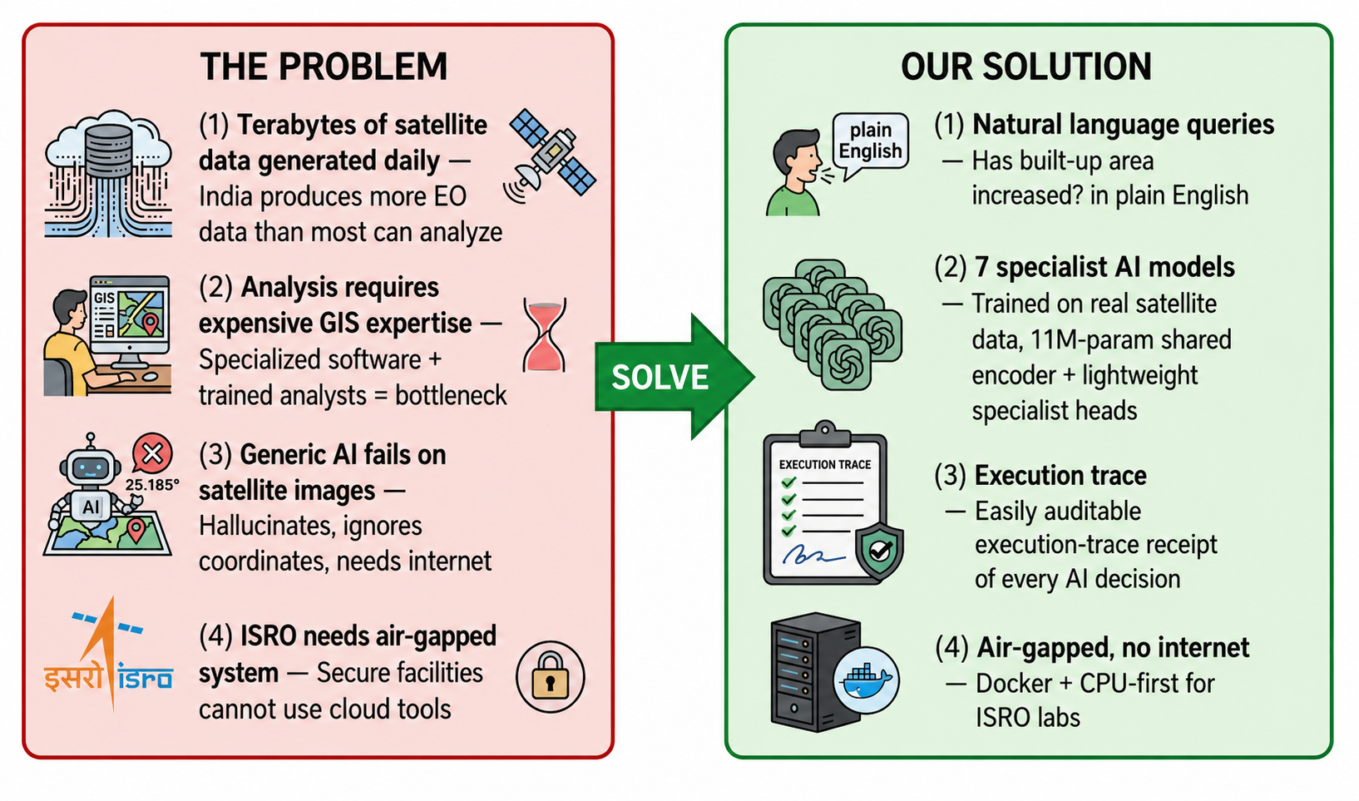
ANVESHA
Team MCS
Satellites send down terabytes of imagery
daily, but every question still needs a GIS expert,
expensive software, and days of manual analysis
Ask in plain English, get evidence, not text
Our agent routes every query to specialist models
and returns answers with confidence scores,
highlighted map overlays not paragraphs
Reliability: Every answer comes with a trail
Each decision → task chosen, model used,
parameters bound, time taken recorded in
auditable execution trace, so an analyst can
defend any finding months later
Security: Built for secure facilities, not the cloud
CPU-only inference, zero internet :
it runs entirely inside an air-gapped lab, with compact int8 models

Slide 3
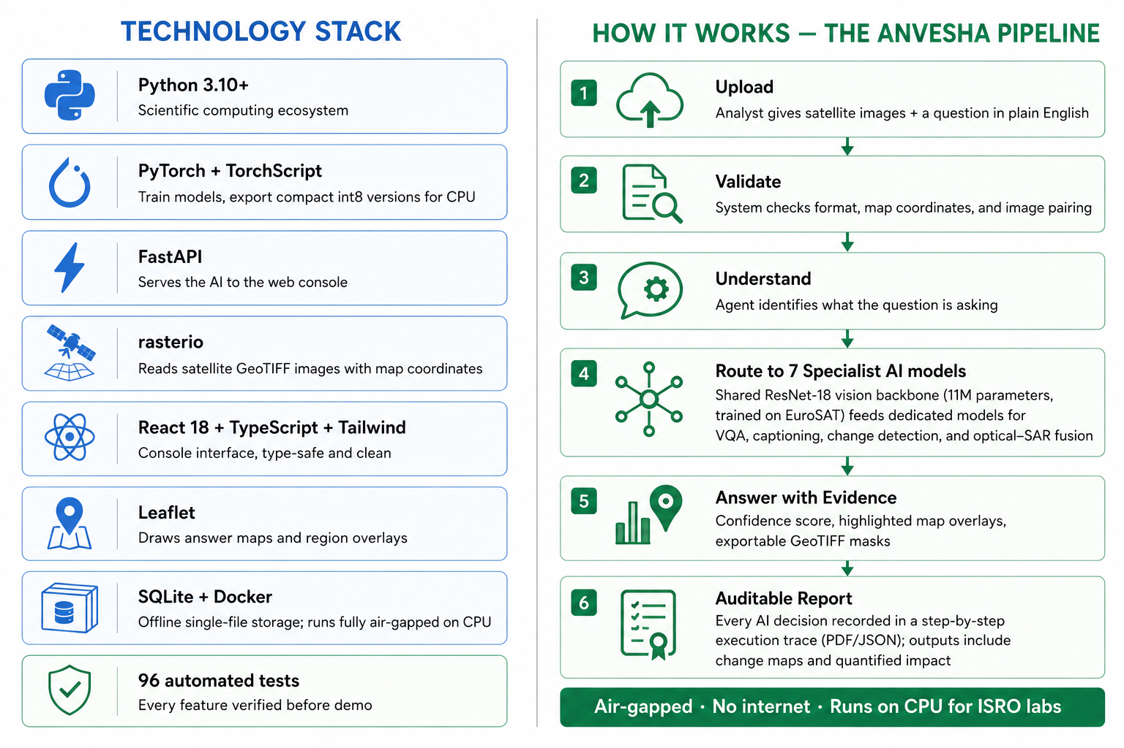
TECHNICAL APPROACH
Team MCS

Slide 4
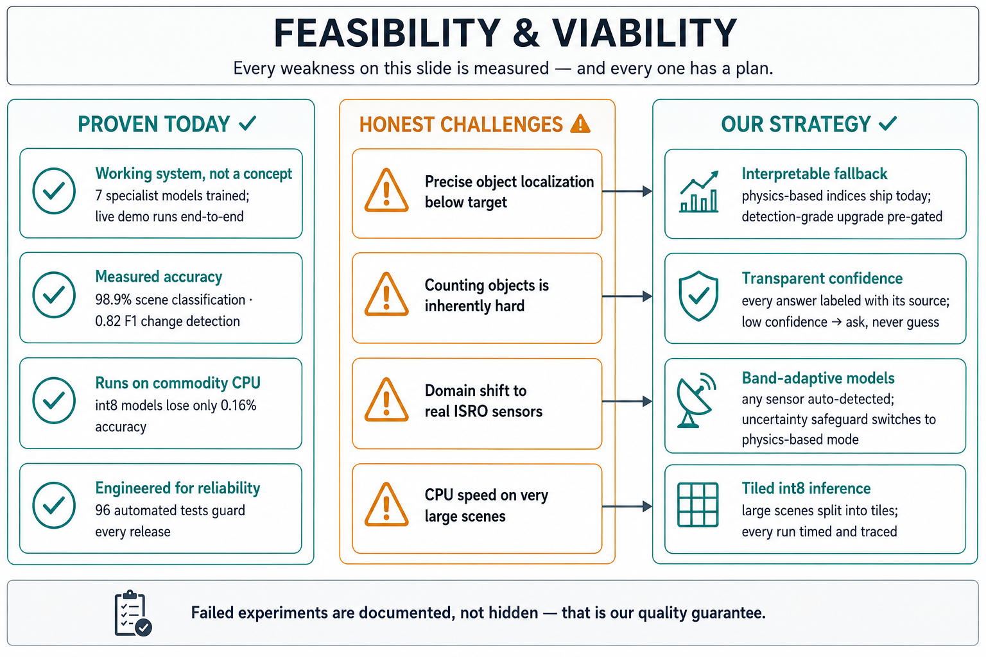
Team MCS

Slide 5
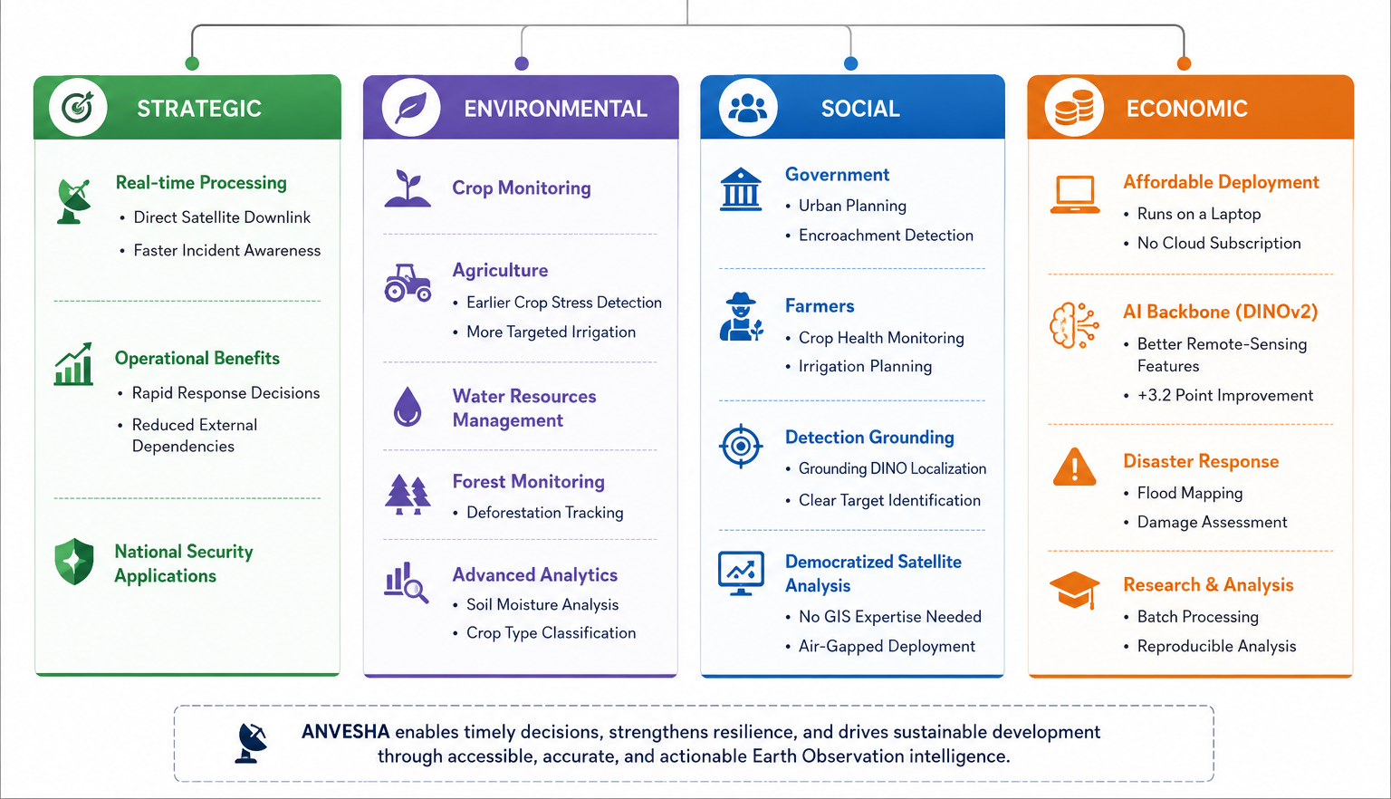
IMPACT AND BENEFITS
Team MCS

Slide 6
RESEARCH AND REFERENCES
Team MCS
github Repository Link:
https://github.com/Raghavapranav3443/Anvesha
Benchmark Datasets Used for Training and Evaluation
- EuroSAT (land cover classification, Sentinel-2)
Dataset: https://zenodo.org/records/7711810
Paper: https://arxiv.org/abs/1709.00029
- RSVQA-LR (low-resolution VQA triplets)
Dataset: https://zenodo.org/records/6344333
- LEVIR-CD (bi-temporal building change detection)
https://justchenhao.github.io/LEVIR/
- CDVQA (change detection VQA)
Repository: https://github.com/YZHJessica/CDVQA
Paper: https://arxiv.org/abs/2112.06343
- BigEarthNet v2 / reBEN (Sentinel-1 + Sentinel-2 pairs for optical–SAR fusion)
Dataset: https://zenodo.org/records/10891137
Paper: https://arxiv.org/abs/2407.03653
- BigEarthNet.txt (captions and reference boxes for captioning)
https://huggingface.co/datasets/BIFOLD-BigEarthNetv2-0/BigEarthNet.txt
Foundational Research Papers
- ResNet (scene encoder backbone)
CVPR 2016
https://arxiv.org/abs/1512.03385
- Feature Pyramid Networks (FPN) (change detection decoder)
CVPR 2017
https://arxiv.org/abs/1612.03144
- Transformer (caption decoder)
NeurIPS 2017
https://arxiv.org/abs/1706.03762
- RSVQA (visual question answering on satellite images)
IEEE TGRS 2020
https://arxiv.org/abs/2003.07333

