Slide 1

ONLINE CHESS GAME
Project Supervisor: Ms.R.Aishwarya
Name of the Student:Raghavee E M
Register Number: 39110822
9 April 2022
Department of CSE

Slide 2
Presentation Outline
Introduction
Objective
System Architecture / Ideation Map
Module Implementation
Project - Hardware Software Requirements
Project – Modules
Methodology
Result and Discussion
Conclusion & Future work
References
9 April 2022
Department of CSE

Slide 3
Introduction
Chess is a game that has been developed to play offline i.e., it
can be played against a computer or a human present at the
same physical location. However, when the game is played
online the opponent can be at any geographical location and
may be totally unknown to the player. For the online game, the
player has to register himself and a unique identification
number will provided on the successful registration along with
a password for further usages. The administrator handles the
registration procedures and also checks on the duplicity of the
users. The main portal comprises a normal lookalike
chessboard providing two sided panel. The game can be
played and is saved upon completion for future references.
The players has to wait till the completion of the move of the
opponent. The player can also redo a move with permission of
the opponent and also forfeit a game after or before the
commencement of the match. There is also a facility of
communication between the players with the help of text, so
that it can benefit both the players. After completion or
stoppage of each game a log is saved about the game, so that
for each game can be resumed after a certain interval of time.
There is also provision about learning about the game of chess
through various tutorials. The registered users can also play
with the computer to improve their skills as well as learn new
tricks. The users can also visit the history page for referring
different games that has been played earlier to detect their
mistakes in certain tournament
9 April 2022
Department of CSE

Slide 4
Objective
Objective of the Project :-
The main objective of this work was to design an online portal
for the game of chess, where various users can register
themselves as players. By using artificial intelligence (AI)
approach, the functionalities of the special moves for each
components of the game can be managed. Here, the users can
not only play the game but also learn the nitty-gritties of the
game using various tutorials and free online games at the
beginners level. Advanced or professional players can also be
a part of tournaments organized online
.
Scope of the Project :-
1)Improves problem solving technique.
2)Improves logic and reasoning skills.
3)Increases patience and persistence.
4)Improves decision making skills.
9 April 2022
Department of CSE

Slide 5
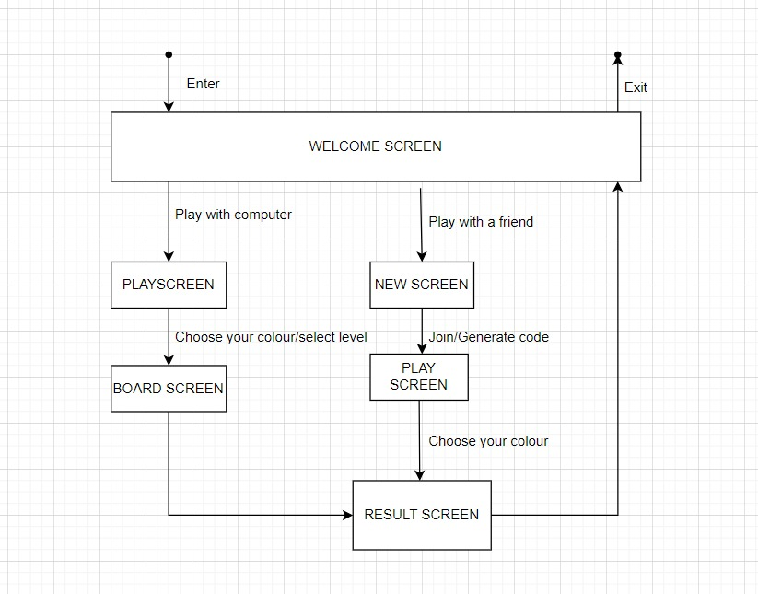
System Architecture / Ideation Map
9 April 2022
Department of CSE

Slide 6
Module Implementation
The movements associated with the pieces has some
policies related to them.
The profile of the players must be done through a
proper registration process.
All registered must be entitled for watch the
previously played matches.
Rating of players was done with evaluation
algorithm.
Tournament activities must be managed properly.
Game must be having forfeit, save and resumption
options.
Online chat between players during the play.
9 April 2022
Department of CSE

Slide 7
Project - Hardware Software Requirements
Hardware Requirements:-
A Computer with good amount of RAM and ROM
Software Requirements:-
Intellij IDEA
Guava19.0
9 April 2022
Department of CSE

Slide 8
Project – Modules
Modules Used
IntellijIDEA
MAC OS
9 April 2022
Department of CSE

Slide 9
Methodology
Methodology of Online Chess game:-
The logic for the terminal based game and the UI is essentially the same:
Instantiate a pieces class. This is the board of the game, and contains all of the pieces.
Select a piece and select a coordinate. If the destination coordinate is a valid coordinate for your given piece, and its the piece's colour turn to move, then make a move.
this is represented by changing pieces.
the piece's key changes from its origin to its destination coordinate
if a piece from the opposite colour was occupying the coordiante, that piece is eliminated
Check if its check mate. If so, the game ends. Otherwise, it is the turn of the other colour.
ID
Used as an identifier for a piece. The types of pieces are:
KING
QUEEN
ROOK
BISHOP
KNIGHT
PAWN
COLOUR
Used as a colour identifier for a piece. These are:
B (a black piece)
W (a white piece)
This enum also contains 2 toString() methods, albeit these are barely used (mainly only for tests). The most important method is the not(COLOUR) method. It is used to return the opposite colour to the argument it takes. Hence, COLOUR.not(COLOUR.B) would return COLOUR.W. This is extremely useful, for example when handling the turn of play, or calculating when a move leads to check.
BOARD
Used to contain the dimensions of the board. These are determined by 4 constants:
FIRST_FILE('a')
LAST_FILE('h')
FIRST_RANK(1)
LAST_RANK(8)
There are 4 key classes that sustain this project: Coordinate, Piece, Pieces and Move. The first 3 are used to create objects to represent the chess board and its pieces. They all contain getters, setters, alongside functionality to create deep copies of its instances. This is paramount, as will be explained later. The methods toString(), equals(Object o) and hashCode() have all been overridden. The last class, Move simply contains methods that are essential for the correct functioining of the project.
9 April 2022
Department of CSE

Slide 10
Methodology
Printing the Interface:
The interface is mainly made through the superposition of JPanels. To create the chess board, I created a 2D array of JButtons, each of alternating colours. I used a nested for loop to print the whole chess board. I also used this to assign coordinates to each JButton square, which allowed me to display a picture representing a piece on top of the square. Then, with each move, I executed the for loop again, but with pieces updated to reflect the current game. I also created an area to the right of the board that contained a section to see the moves played, alongside a button for saving a game, and an area displaying the outcome of a game (a draw, stalemate or win).
Handling movements
To make a move, the user needs to select a piece, and then select a destination square. I created a flag that would allow me to check whether the user has clicked twice, as this would represent a move. When the user clicks a square (JButton), I looped through the array of JButtons until I found the JButton that had been clicked. I then turned this information into a Coordinate, which then allowed me to find the Piece occupying the square. This then made it so the squares corresponding to the potential moves of the piece got illuminated. It also set the flag to true. Once there was a second click the program checked to see if the selected square corresponded to one of the potential moves of the piece. If so, the move was executed and the board was updated, resetting the flag. Otherwise, the potential moves of the selected piece would be shown.
- Saving a Game ♛
The FileIO class is used to handle game saving. In order to save a game, we create a txt file containing the moves, as per pgn (portable game notation) format (albeit without additional information, such as the date, location, players involved, etc ...). FileIO contains a method that handles the creation of Strings representing sets of moves. The user can then introduce the name of the file to be saved.
9 April 2022
Department of CSE

Slide 11
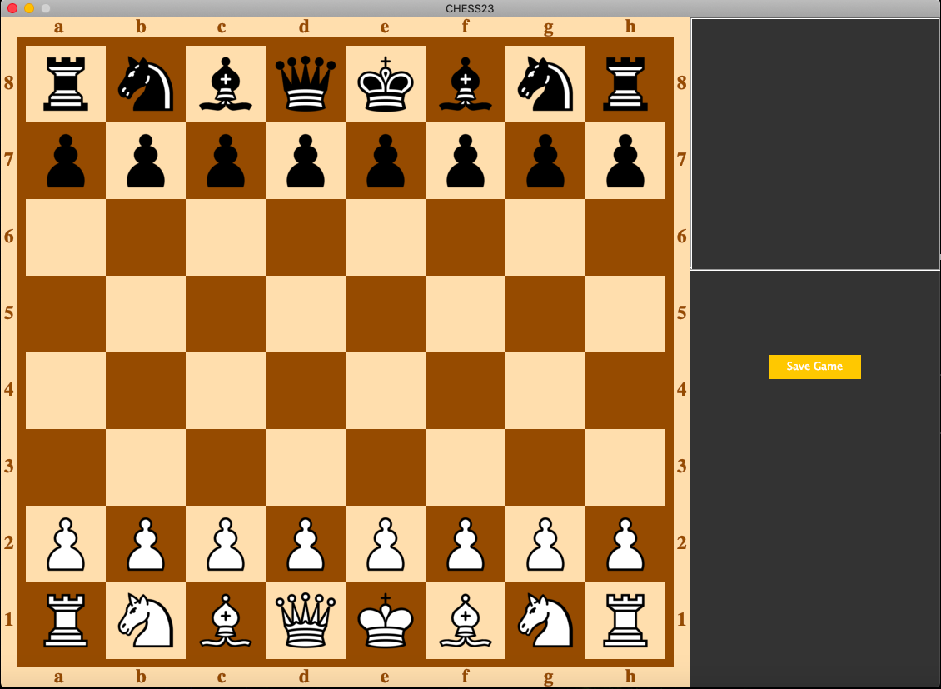
Result and Discussion
9 April 2022
Department of CSE

Slide 12
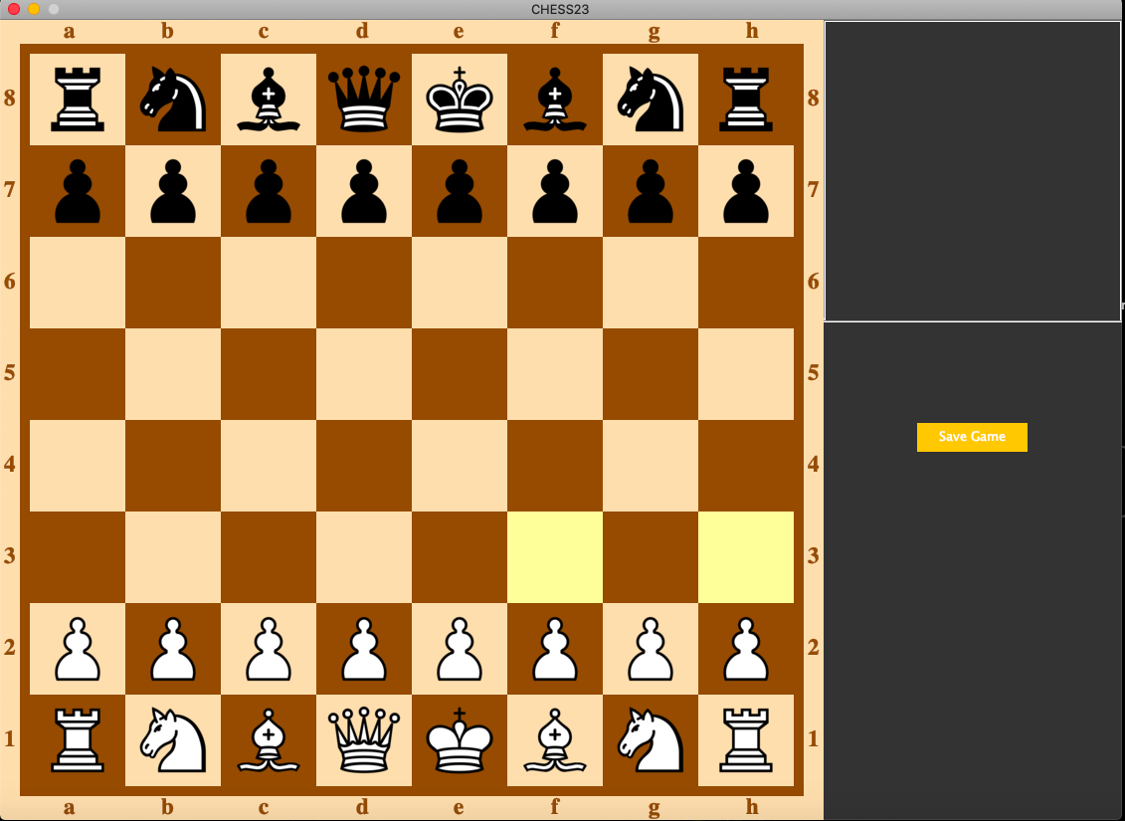
Results and Discussion
9 April 2022
Department of CSE

Slide 13
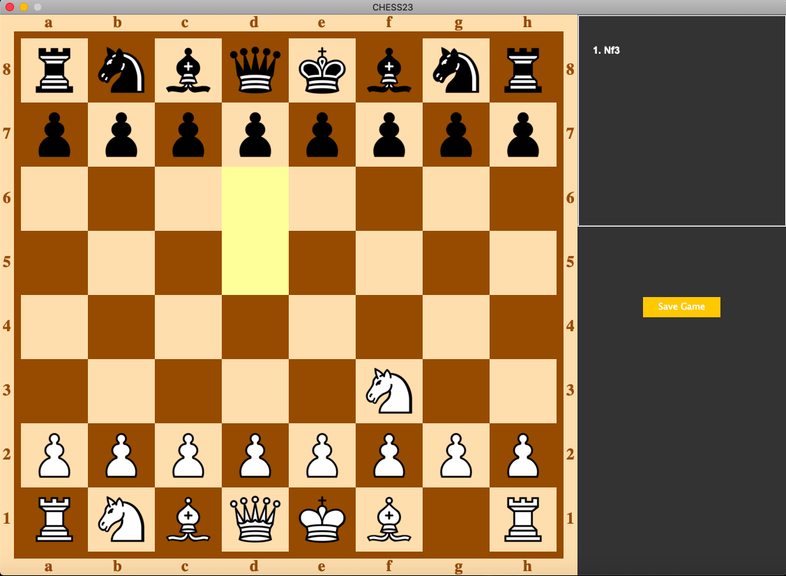
Results and Discussion
9 April 2022
Department of CSE

Slide 14
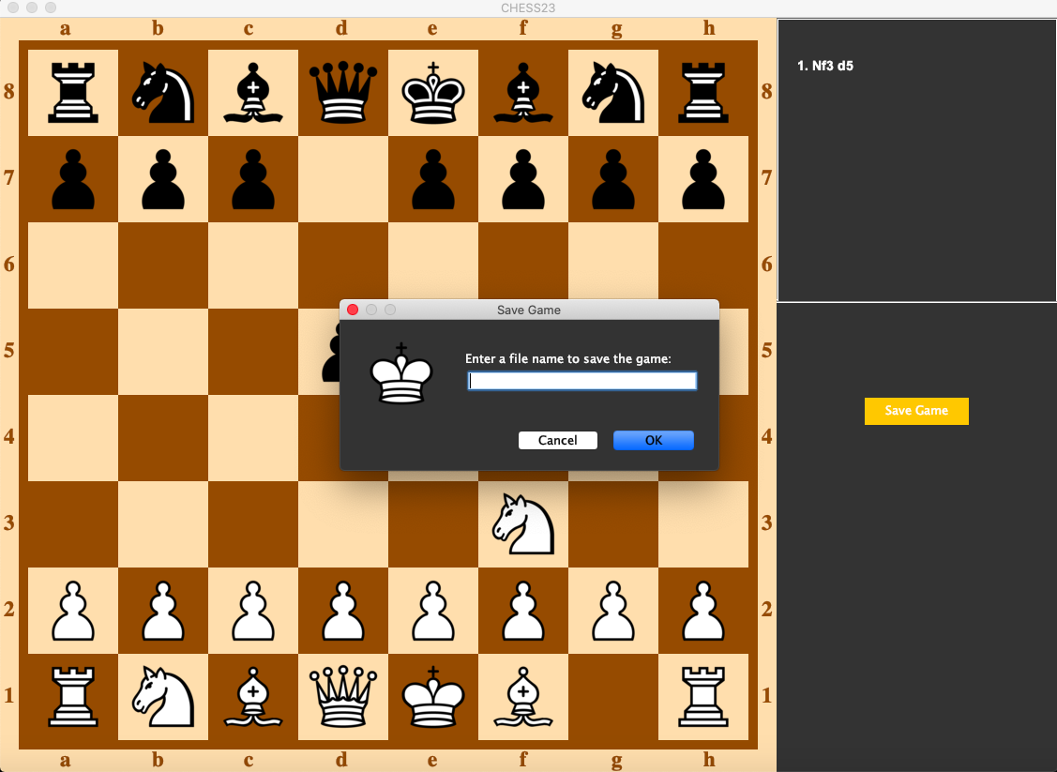
Results and Discussion
9 April 2022
Department of CSE

Slide 15
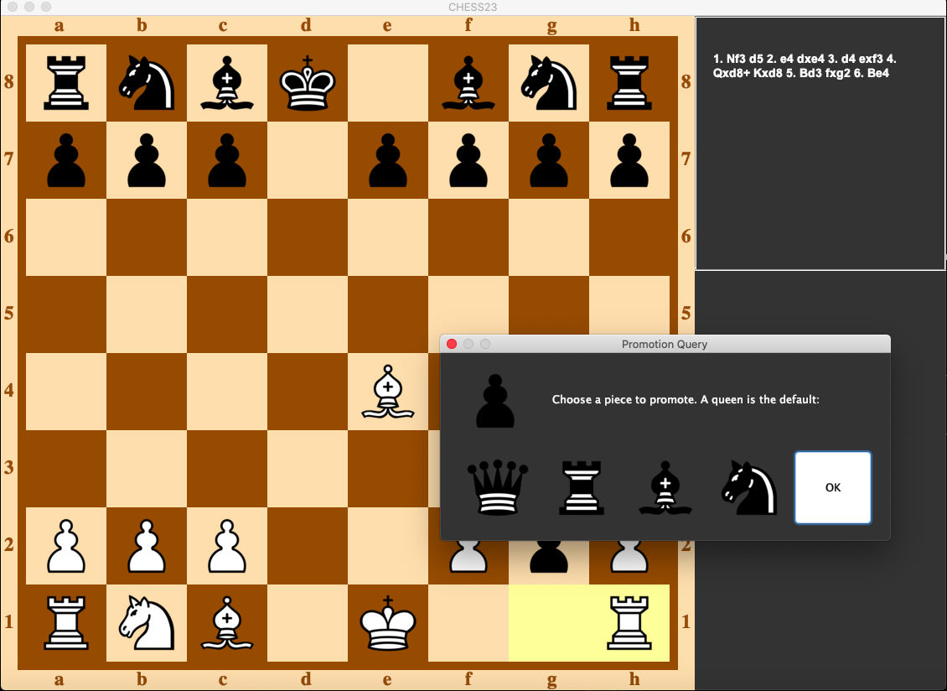
Results and Discussion
9 April 2022
Department of CSE

Slide 16
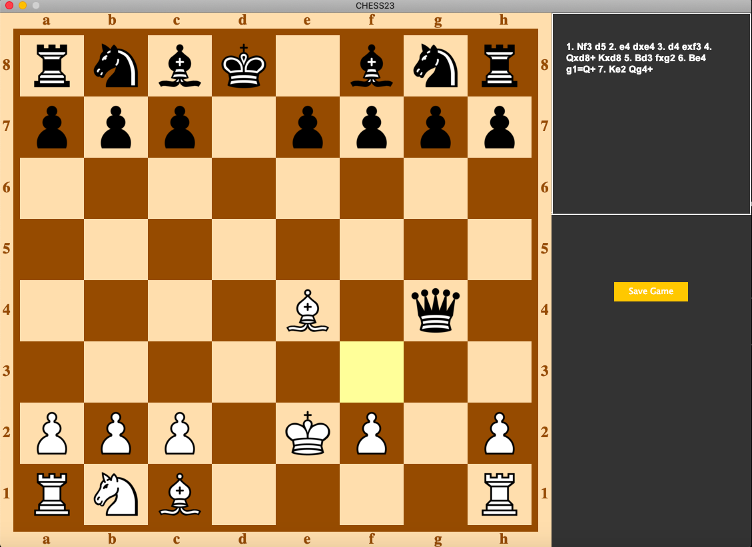
Results and Discussion
9 April 2022
Department of CSE

Slide 17
Results and Discussion
9 April 2022
Department of CSE

Slide 18
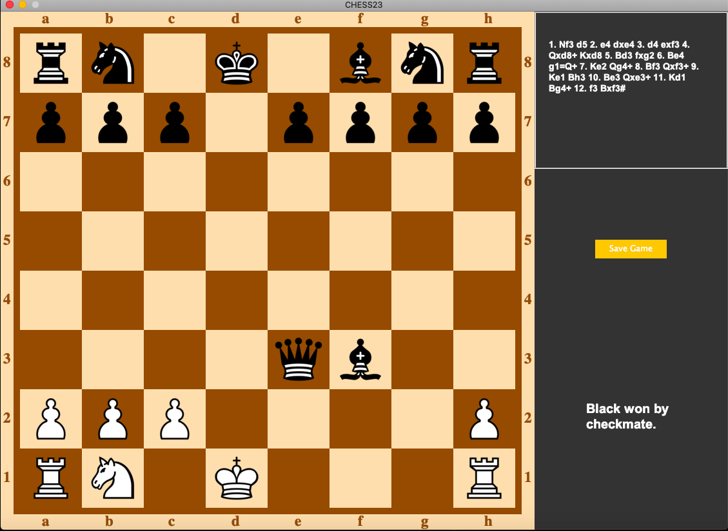
Results and Discussion
9 April 2022
Department of CSE

Slide 19
Conclusion
The main purpose of this work was to design a model for
chess game which runs on the web. By, using the above portal
system one can learn the various aspects of the game of chess.
This will help in understanding the complete design and
implementation of the functionalities in the online chess
portal. This will help to reach all the chess enthusiast all over
the globe to learn as well as play against each other. Thus,
help to create an online world wide championship. This will
also be economically viable, as players doesn’t have to travel
to attend a tournament or play a match. The log in the database
will help new registered players to learn the tricks of the
game, as by watching the old games from repositories and thus
develop his/her standard of the game
9 April 2022
Department of CSE

Slide 20
References
[1] Adelson-Velskiy, G. M., Arlazarov, V. L., and Donskoy, M. V.
(1975). Some methods of controlling the tree search in chess
programs. Artificial Intelligence, 6(4), 361–371.
http://doi.org/10.1016/0004-3702(75)90021-1
[2] Atherton, M., Zhuang, J., Bart, W. M., Hu, X., and He, S.
(2003). A functional MRI study of high-level cognition. I. The
game of chess. Cognitive Brain Research, 16(1), 26–31.
http://doi.org/10.1016/S0926-6410(02)00207-0
[3] Bratko, I., Kopec, D., and Michie, D. (1978). Pattern-based
representation of chess end-game knowledge. The Computer
Journal, 21(2), 149–153. Retrieved from
http://comjnl.oxfordjournals.org/content/21/2/149.full.pdf
[4] Chase, W. G., and Simon, H. A. (1973). Perception in chess.
Cognitive Psychology, 4(1), 55–81. http://doi.org/10.1016/0010-
0285(73)90004-2
[5] Ginsburg, M. (1974). Chessgames Services LLC Web design
and database developmen. Retrieved March 15, 2016, from
http://www.chessgames.com/player/mark_ginsburg.html
[6] Hajari, P., Iyer, R., and Patil, A. (2014). Implementation of
Artificial Intelligence for Best Moves using Chessboard, 5(3),
3142–3144.
[7] Kiesel, A., Kunde, W., Pohl, C., Berner, M. P., and Hoffmann, J.
(2009). Playing chess unconsciously. Journal of Experimental
Psychology: Learning, Memory, and Cognition, 35(1), 292–298.
http://doi.org/10.1037/a0014499
[8] Levinson, R., Hsu, F., Schaeffer, J., Marsland, T. A., and
Willkins, D. E. (1991). Panel: The Role of Chess in Artificial
Intelligence Research. In International Joint Conference on
Artificial Intelligence (Vol. 84, pp. 547–552). Retrieved from
http://www.ijcai.org/Proceedings/91-1/Papers/084.pdf
[9] Newell, A., Shaw, J. C., and Simon, H. A. (1958). Chess-Playing
Programs and the Problem of Complexity. IBM Journal of
Research and Development. http://doi.org/10.1147/rd.24.0320
9 April 2022
Department of CSE

