Slide 1

POC Analytics Model for OH&S
June 2018

Slide 2
OH&S – Analytics model
Problem Statement
Analyse OH&S data to identify common incidents & hazards in Mirvac properties. Build a predictive model to foresee the repetitive incidents probability and advise accordingly.
Business Challenges/Outcomes
There are thousands of ohs incidents happens every year in MIRVAC sites which get recorded. Segmentation and clustering of this incident is a hard task but valuable to identify repetitive accidents and incidents. Mirvac needs to build a solution to analyse these accident and incidents and put predictive model on top of it to prevent future occurrence.

Slide 3
Technical Solution Success Factors
Capability to analyze data in its native form
Identify use case for most valuable insights
Scale up capability for new data source
Users Success Factors
Pre-defined reports
Able to connect multiple source at the same time for adhoc analysis

Slide 4
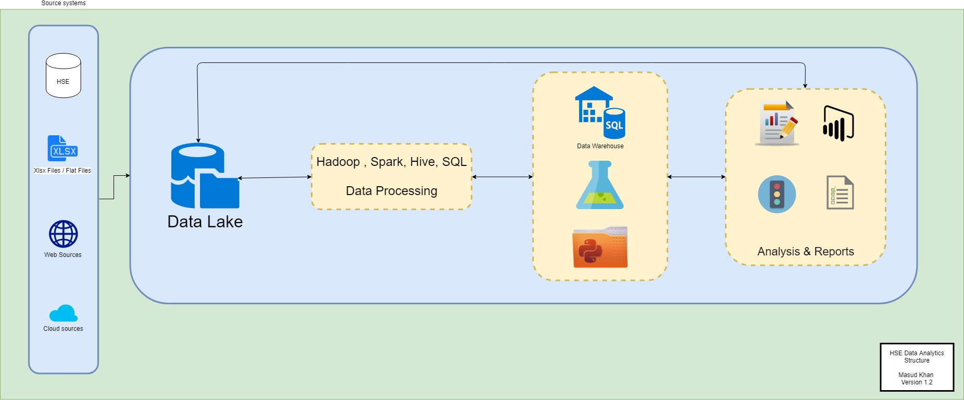
Solution Architecture

Slide 5
Roles
Project Manager / Solution Architecture
Data Engineer
HSE SMEs
Data Scientist
HSE Data Access : 3rd August 2018
Azure Environment Setup : 17th August
Initial Project Scoping : 24th August
Development : 5 weeks (28th September)
UAT Testing : 3 Weeks (19th October)
Showcase : 2nd November 2018
Key Dates

