Slide 1
API Testing Using Postman

Slide 2
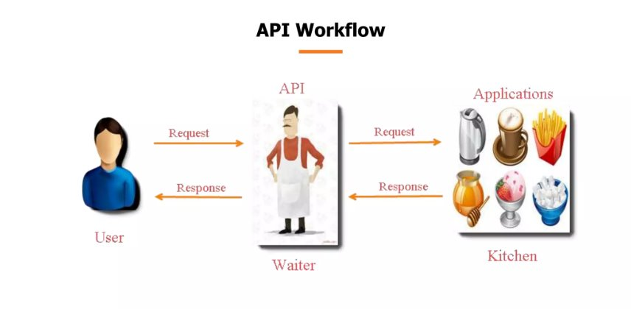
What is API?
API (Application Programming Interface) allows communication between different applications.

Slide 3

Types of APIs
SOAP (Simple Object Access Protocol):
Based on XML
Strict standards for communication
Better suited for enterprise-level secure transactions
REST (Representational State Transfer):
Relies on HTTP
Lightweight and faster
Supports multiple data formats (JSON, XML)

Slide 4
Why REST API Over SOAP?
1. Simplicity
2. Scalability
3. Flexibility
4. Performance

Slide 5
Types of API Requests
1. GET - Retrieve data
2. POST - Create data
3. PUT - Update data
4. DELETE - Remove data
5. PATCH - Modify data

Slide 6
HTTP Response Codes
1. 2xx - Success
2. 3xx - Redirection
3. 4xx - Client Errors
4. 5xx - Server Errors

Slide 7
Authorization in Postman
Definition of Authorization: Authorization is the process of granting or denying access to resources based on the identity and permissions of the requester.
Types of Authorization in Postman:
No Auth: No authentication is required.
API Key: A unique key passed in the request header or query parameter.
Bearer Token: A token used to access protected resources.
Basic Auth: Uses a username and password encoded in Base64.
Digest Auth: A more secure version of Basic Auth, using encryption.
OAuth 1.0 & 2.0: A widely used authorization method for web applications.
Hawk Authentication: A cryptographic authentication scheme.
AWS Signature: Used for authentication with AWS APIs.
NTLM Authentication: Used in Microsoft environments.
Example: Sending a GET request with a Bearer Token for accessing a protected API.

Slide 8
Installing Postman
Step 1
Download from official website
Step 2
Install on Windows, Mac, or Linux
Step 3
Setup and Start Using
https://www.postman.com/downloads/

Slide 9
Request and Response in APIs
Request:
Sent by the client to request information or perform an action.
Components include method (GET, POST, PUT, DELETE), headers, body, and URL.
Response:
Sent by the server containing the requested information or a status.
Components include status code (e.g., 200 OK, 404 Not Found), headers, and body.

Slide 10
Pre-request and Post-response in Postman
Pre-request Script:
Executes before the API request is sent.
Useful for setting environment variables, logging information, or making pre-request calculations.
Post-response Script:
Executes after receiving the API response.
Useful for testing response data, extracting information, and chaining requests.
Example: Pre-request script setting an environment variable; Post-response script verifying status code.

Slide 11
Newman in Brief
What is Newman? Newman is a command-line collection runner for Postman, used to automate and integrate API testing.
Key Features:
Supports running Postman collections directly from the command line.
Provides detailed test reports.

Slide 12


