Slide 1
CarVerse Mobility Technologies
Dealership Gamification Hackathon
Build a Game for a Real Dealership
PRESENTING
DealerVerse AI
Level Up Your Dealership
A gamification platform that turns real dealership work into a game — employees earn XP, ranks, missions and team bonuses just by doing their jobs. Built end-to-end on the real 170,162-event dataset. No fake numbers.
7 Departments gamified
≤20 scoring actions
Anti-gaming by design
Full C2B2C buy/sell loop
React · Vite · Tailwind · Framer Motion · Recharts · Zustand · 16 live screens

Slide 2
THE BRIEF
The Challenge
“Design a game that motivates people at a car dealership to perform better at their jobs, using real activity data — a game people will actually want to play while doing their job.”
WHAT WE MUST DO
HARD CONSTRAINTS
— Motivate individuals & teams to move enquiries → bookings → delivery faster.
— Separate signal from noise reward real progress, not data edits.
— Encourage collaboration across departments through the lifecycle.
— Be un-gameable repeating an action 50× must not pay 50×.
— Max 20 actions may be used for scoring — force real prioritisation.
— Map to real workflow the actual booking → delivery pipeline.
— Sustainable for months must survive a live dealership, not just a demo.
— Key message “if your game rewards the wrong behaviour, it will fail.”
DealerVerse AI
01

Slide 3
SCORED AGAINST
Judging Criteria → How DealerVerse Answers
Criterion
Weight
Our Answer
Game Design Quality
30%
Full loop: XP → levels → ranks → missions → badges → leaderboards, per department.
Real-world relevance
25%
Every point is computed from the real 170k-event log; 7 real departments.
Anti-gaming robustness
20%
Once-per-booking scoring; 77.6% of events earn 0; outcomes >> updates.
Team collaboration
15%
Team-bonus mechanic pays every dept that moved a delivered car (+25 XP each).
Creativity
10%
A playable app + a full C2B2C buy/sell marketplace layered on the workflow.
Every weighted criterion maps to a concrete, shipped mechanic — nothing is aspirational.
DealerVerse AI
02

Slide 4
OUR SOLUTION
One Platform, Real Work Becomes a Game
Employees log in and do their normal jobs. DealerVerse reads the dealership event stream, scores only the milestones that move a car forward, and instantly turns that into XP, ranks, missions and team bonuses.
1
2
3
4
Do the work
Earn instantly
Level & rank up
Compete & collaborate
A booking is created, a loan cleared, a car inspected, a gatepass issued.
Meaningful milestones award XP to the real person who did them.
XP fills your level; per-department ladders promote you Rookie → Legend.
Leaderboards, daily missions, streaks, and cross-dept team bonuses.
The gameplay loop is short, honest, and repeats every working day — that is what keeps it fun.
DealerVerse AI
03

Slide 5
GROUNDED IN REALITY
Built on the Real Dataset
170,162
Real events
May–Jun 2026
3,800
Bookings tracked
location + enquiry
305
Active players
with live XP
41
Locations
branch network
SIX CORE FIELDS PER EVENT
THREE REAL SOURCE FILES
— USER · who performed the action
— DEPARTMENT · which of the real teams
— ACTION · 3,347 distinct action types
— BOOKING · location_code + enquiry_no
— TIME · timestamp for streaks & weekly series
— LOCATION · branch, for league standings
— z_event_log_may_june_2026.csv — 170,162 rows of raw activity.
— z_employees.csv — names, departments, designations, managers, branch.
— z_locations.csv — location codes → branch names.
Processed once by scripts/build-data.mjs into a compact JSON the app loads instantly.
DealerVerse AI
04

Slide 6
ANTI-GAMING · PRINCIPLE 1
Signal vs Noise: 77.6% of Events Earn Zero
The dataset is dominated by trivial, repeatable events. Rewarding them would break the game. We reward only what moves a booking forward.
NOISE — SCORED AT 0 XP
SIGNAL — REWARDED MILESTONES
High-frequency action
Count
— Update vs Progress FINANCE_INFO_UPDATED = 0; FINANCE_CLEARED = 60.
— Repeated vs One-time notes = 0; INVOICE_APPROVED scores once.
— Granular vs Meaningful single doc uploads = 0; full DOCUMENT_SET = 30.
— Effort vs Outcome commitments = 0; delivery-driving steps score high.
USER_LOGGED_IN
27,764
DISCOUNT_UPDATED
9,188
PDI_INFO_UPDATED
8,428
PAYMENTS_UPDATED
7,816
FINANCE_INFO_UPDATED
5,588
Logins, edits, notes and repeat uploads → 0 XP.
DealerVerse AI
05

Slide 7
THE XP ENGINE
17 Milestones + Team Bonus — Under the 20 Cap
Milestone
Dept
XP
Milestone
Dept
XP
Booking Created
SALES
20
Registration Processed
EDP
25
Discount Approved
SALES
30
Registration Filed
RTO / Regn
40
Invoice Signed (Sales)
SALES
25
Insurance Approved
CUST. CARE
40
Registration Approved
SALES
25
Delivery Coordinated
CUST. CARE
20
Loan File Opened *
FINANCE
10
Gatepass Cleared (CCM)
CUST. CARE
20
Finance Cleared *
FINANCE
60
Inspected & Dispatched
PDI
20
Payment Credited
ACCOUNTS
45
RTO Registration
PDI
20
Gatepass Issued
ACCOUNTS
100
Document Set Completed *
PDI
30
Invoice Finalized
EDP
45
Team Bonus (co-op)
ANY DEPT
+25
* Derived milestones — not a single log row but computed from the booking's history. XP weight = business impact: a Gatepass (100) and Finance Cleared (60) dwarf a status update (0).
DealerVerse AI
06

Slide 8
BEYOND RAW LOGS
Derived Milestones: Scoring What Isn't Logged
The real signal often isn't a single event. We reconstruct true milestones from each booking's event history, then credit the person who completed them.
Loan File Opened · 10 XP
First finance touch on a booking — the loan work begins.
Finance Cleared · 60 XP
Booking had finance work AND advanced past the finance stage (ABNR+).
Document Set Completed · 30 XP
All 7 required docs present (PAN, Aadhaar, VIN, 4 photos) → credit the finisher.
Team Bonus · +25 XP each
A delivered car that ≥2 departments moved pays every contributor.
This is how we “gamify the completion, not the pieces” — exactly as the brief asks.
DealerVerse AI
07

Slide 9
ANTI-GAMING · THE FULL STRATEGY
Six Rules That Make It Un-Gameable
Once per booking
Cancelled = zero
Outcomes over effort
Every milestone scores exactly once per car. Repeating an action does nothing.
Cancelled bookings never score, so churning fake deals is worthless.
Delivery-driving steps carry 3–10× the weight of any update.
Noise floored to 0
Credit the real actor
≤20 scoring actions
The five most frequent actions — 58k+ events — all pay nothing.
XP lands on whoever actually performed the step, in their real dept.
A hard whitelist; everything outside it is invisible to the score.
“If users repeat an action 50 times, they get 50× points?” → No. In DealerVerse, they get 1×, once.
DealerVerse AI
08

Slide 10
TEAM COLLABORATION DESIGN
Cars Get Delivered by Teams — So Teams Score
A delivered car is a relay. When two or more departments moved the same booking to delivery, every contributing department earns a +25 XP Team Bonus — collaboration literally pays.
1,508
Team bonuses awarded
on delivered cars
+25
XP per dept, per car
every contributor
7 / 7
Departments collaborating
Sales → Customer Care
THE RELAY — ONE CAR, MANY HANDS
Sales
›
Finance
›
Accounts
›
EDP
›
PDI
›
Cust. Care
›
RTO / Regn
Each hand-off that helps deliver the car is rewarded — no one can hoard the win.
DealerVerse AI
09

Slide 11
EVERY TEAM, NOT JUST SALES
All 7 Departments Gamified — Live Standings
Department
Players
Total XP
Milestones
ACCOUNTS
13
256,675
2,979
SALES
241
199,015
6,747
EDP
16
178,565
3,999
CUSTOMER CARE
17
160,960
4,608
PDI
3
130,445
4,143
FINANCE
14
129,220
3,647
RTO / REGN TEAM
1
51,965
841
Note the fairness win: PDI has 3 people yet out-scores 241 in Sales — per-department ranks let small teams compete on their own scale.
DealerVerse AI
10

Slide 12
PROGRESSION
Per-Department Rank Ladders — Rookie → Legend
SALES
Rookie
Lead Hunter
Negotiator
Deal Closer
Sales Champion
Dealership Legend
FINANCE
Finance Trainee
Loan Expert
Approval Master
Finance Hero
Finance Ace
Finance Legend
ACCOUNTS
Ledger Rookie
Payment Verifier
Credit Controller
Accounts Ace
Revenue Guardian
Accounts Legend
EDP
Data Rookie
System Operator
Invoice Master
Backend Ace
Ops Architect
EDP Legend
CUSTOMER CARE
Care Trainee
Support Specialist
Insurance Pro
Care Champion
Customer Hero
Care Legend
PDI
Inspection Rookie
Quality Checker
Dispatch Pro
PDI Ace
Delivery Master
PDI Legend
RTO / REGN TEAM
Filing Rookie
Registration Clerk
RTO Specialist
Compliance Pro
Registration Master
RTO Legend
6 tiers × 7 departments = 42 named ranks. Thresholds are computed from each department's real XP distribution, so every ladder is earned.
DealerVerse AI
11

Slide 13
THE FULL GAME LOOP
Levels · Missions · Badges · Streaks
Ranks & Levels
Daily Missions
Achievements
Streaks & Growth
— 6-tier ladder per department
— Rank ring shows % to next rank
— Top earner always reaches Legend
— 2 department-specific quests/day
— Progress from real 'today' counts
— + Team-bonus & streak missions
— First Booking, Centurion, Team Player
— Sharpshooter, Fast Approver, Gatekeeper
— Veteran, Legend, 7-Day Streak 🔥
— Consecutive active-day streaks
— Weekly XP delta (up/down %)
— Most Improved & Fastest Growing
Short-term (missions) + mid-term (ranks) + long-term (season leaderboard) goals keep it fun for months.
DealerVerse AI
12

Slide 14
ENGAGEMENT ENGINE
Daily Missions & the AI Coach
DAILY MISSIONS (examples)
🧠 AI COACH (deterministic insights)
🚗 Create 5 bookings
Sales · 100 XP
“You're only 340 XP from Deal Closer — keep clearing key milestones.”
✅ Clear 3 loans
Finance · Loan Hero badge
“Your XP is up 24% vs last week (1,120 XP in your last 7 active days).”
🛡️ Issue 4 gatepasses
Accounts · 150 XP
☂️ Approve 4 insurances
Cust. Care · 120 XP
“2 to go on 'Clear 3 loans' — finish it to grab the Loan Hero badge.”
📝 File 5 registrations
RTO · 150 XP
“Strong teamwork — 18 collaboration bonuses. You're carrying your squad.”
🤝 Earn a Team Bonus
Any · 25 XP + badge
🔥 Keep your streak alive
Any · streak multiplier
“5-day streak going. One more active day keeps your multiplier climbing.”
100% computed from the player's real data — no LLM, no guesswork.
DealerVerse AI
13

Slide 15
THE BIG DIFFERENTIATOR
A Full C2B2C Buy / Sell Loop, Gamified
Beyond scoring history, DealerVerse runs a live end-to-end used-car flow: a customer sells a car to the dealership, which reconditions, prices and re-sells it to a buyer — every step scored.
① ACQUISITION — customer sells to dealership
Seller posts car
›
PDI inspects
›
Sales offers
›
Seller accepts
›
Accounts pays out
›
Listed to inventory
Customer
+20 XP
+40 XP
—
+50 XP
auto-priced
② SALE FULFILMENT — buyer purchases (each stage owned by a department)
Reserved
›
Loan Approved
›
Payment Cleared
›
Invoice Generated
›
Ownership Transferred
›
Delivered
Sales · 20
Finance · 60
Accounts · 50
EDP · 25
RTO · 30
Cust.Care · 60
BUILT-IN ECONOMICS
Reconditioning
4% of acquisition price
Retail margin
12% dealership markup
Auto-retail
(acq + recon) × 1.12, rounded
Override
Sales/Supervisor can re-price
DealerVerse AI
14

Slide 16
ACCESS MODEL
Four Roles, Department-Gated Actions
Employee
Logs in with a 4-digit PIN + department. Sees their dashboard, missions, rank, leaderboard. Can advance sale stages owned by their department.
Supervisor
An employee flag that unlocks every workflow gate — can inspect, offer, pay out and advance any stage. For managers running the floor.
Seller (Customer)
Posts a car to sell, tracks the acquisition offer, and accepts or declines the dealership's price.
Buyer
Browses the marketplace of certified inventory, reserves a car, and watches its sale progress to delivery.
PINs are derived deterministically from the employee ID (client-side, no backend) — every one of 6,037 staff has a unique login.
DealerVerse AI
15

Slide 17
THE PRODUCT
16 Live Screens — A Complete Playable App
Login
Dashboard
Activity Feed
Pipeline
PIN + dept, or Buyer/Seller
XP, rank ring, level, missions
Live milestone stream
Booking-race lifecycle board
Evaluate
Customer Portal
Marketplace
My Purchases
PDI inspects trade-ins
Seller posts a car
Buyer browses & reserves
Buyer tracks delivery
Missions
Career
Achievements
Leaderboard
Daily quests + progress
Rank ladder progression
Badge collection
Overall & per-dept ranks
Department
Manager
AI Coach
Profile
Team standings & stats
Weekly charts, most improved
Personalised insights
Player card & history
DealerVerse AI
16

Slide 18
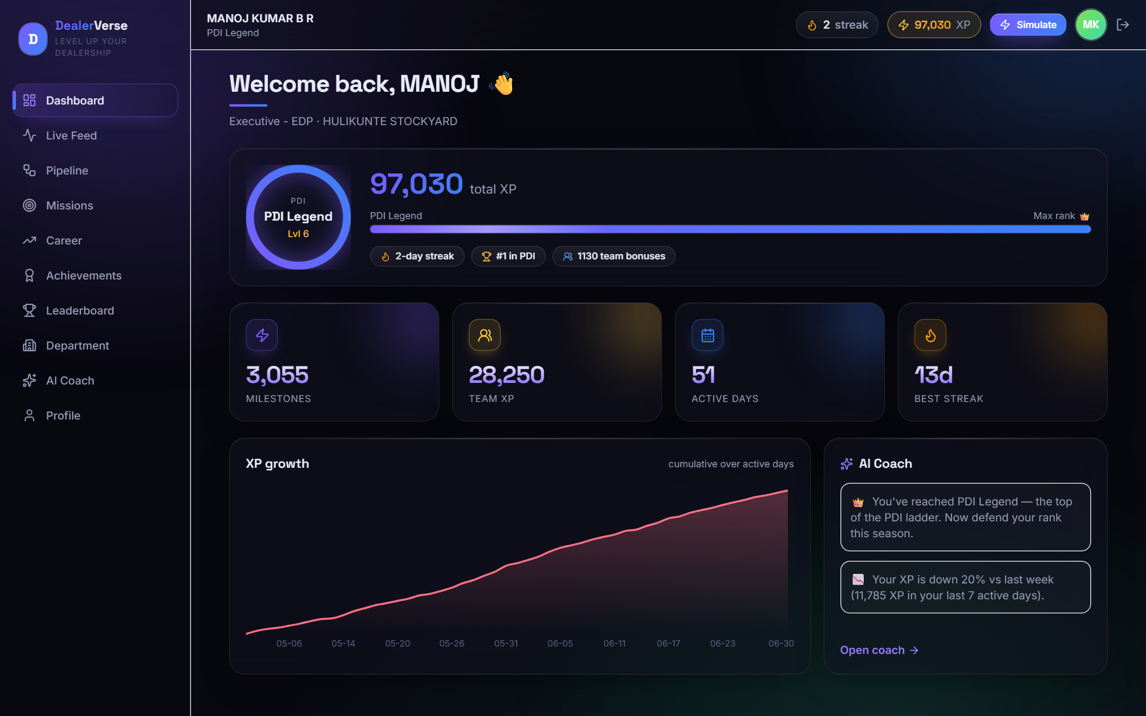
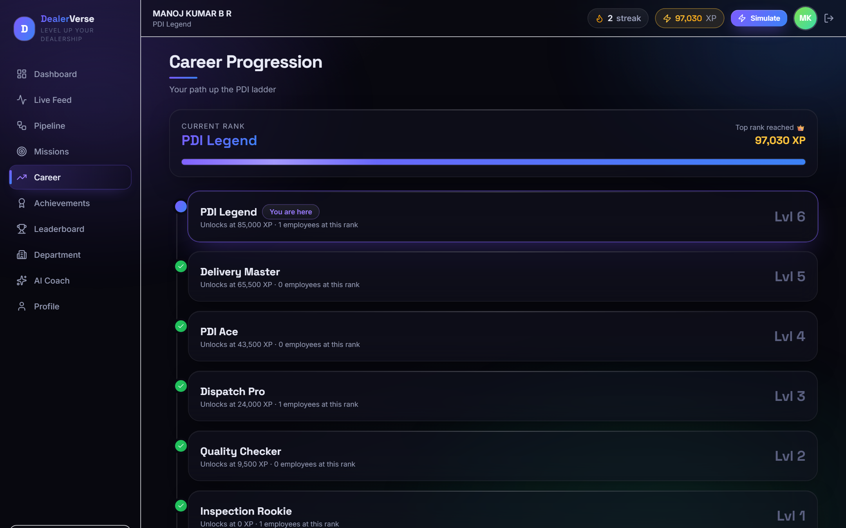
LIVE APP · PLAYER EXPERIENCE
What a Player Sees Every Day
Personal Dashboard
Rank ring, total XP, streak, XP-growth chart & AI-Coach teaser — real numbers.
Career Progression
The full department rank ladder with 'You are here' and per-rank headcount.
DealerVerse AI
17

Slide 19
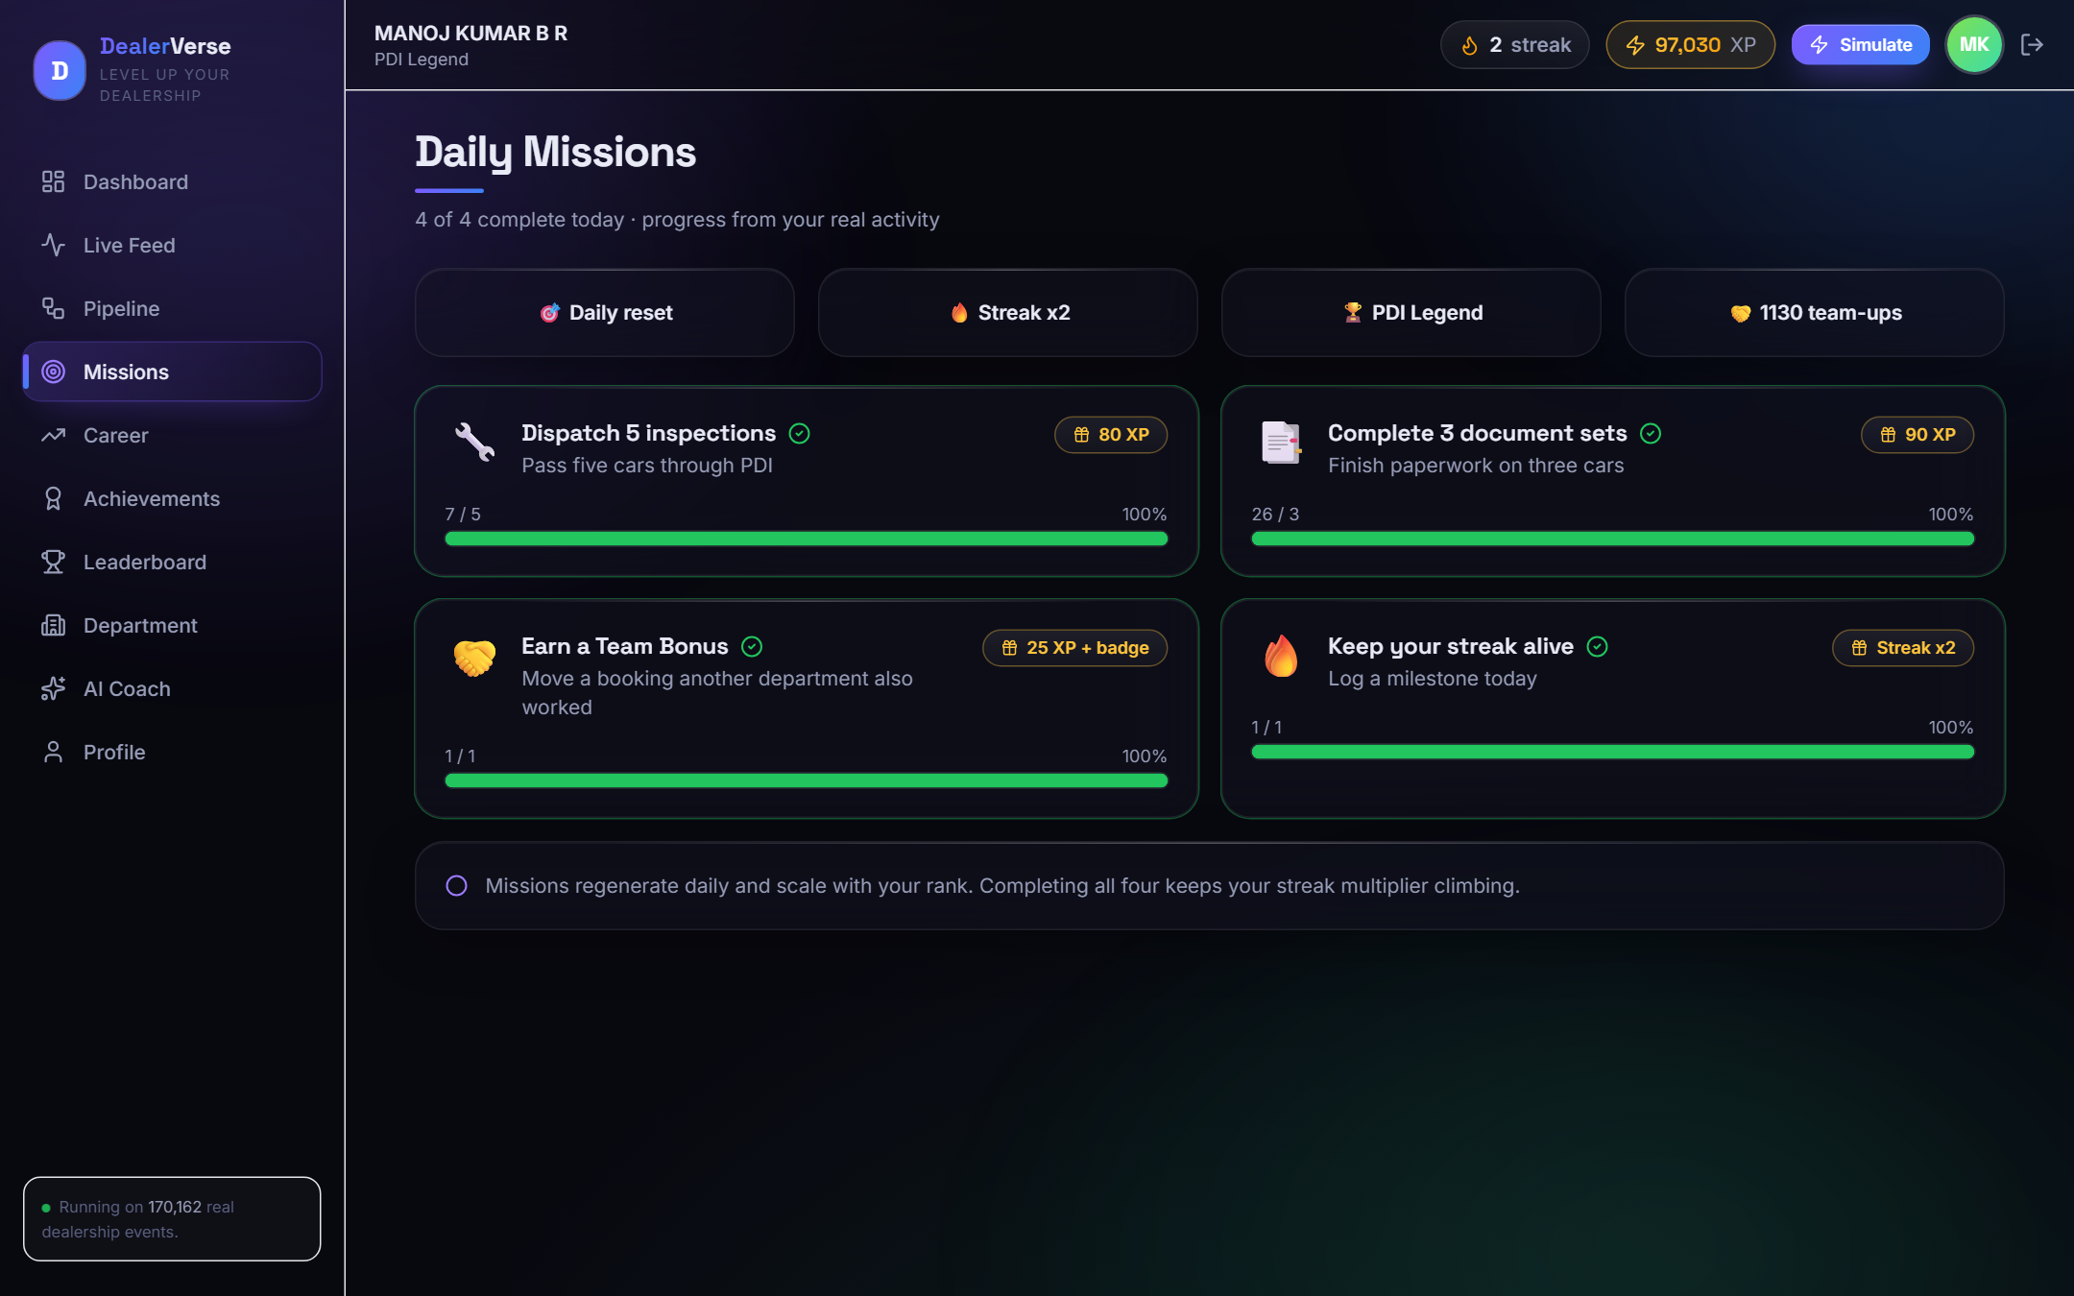
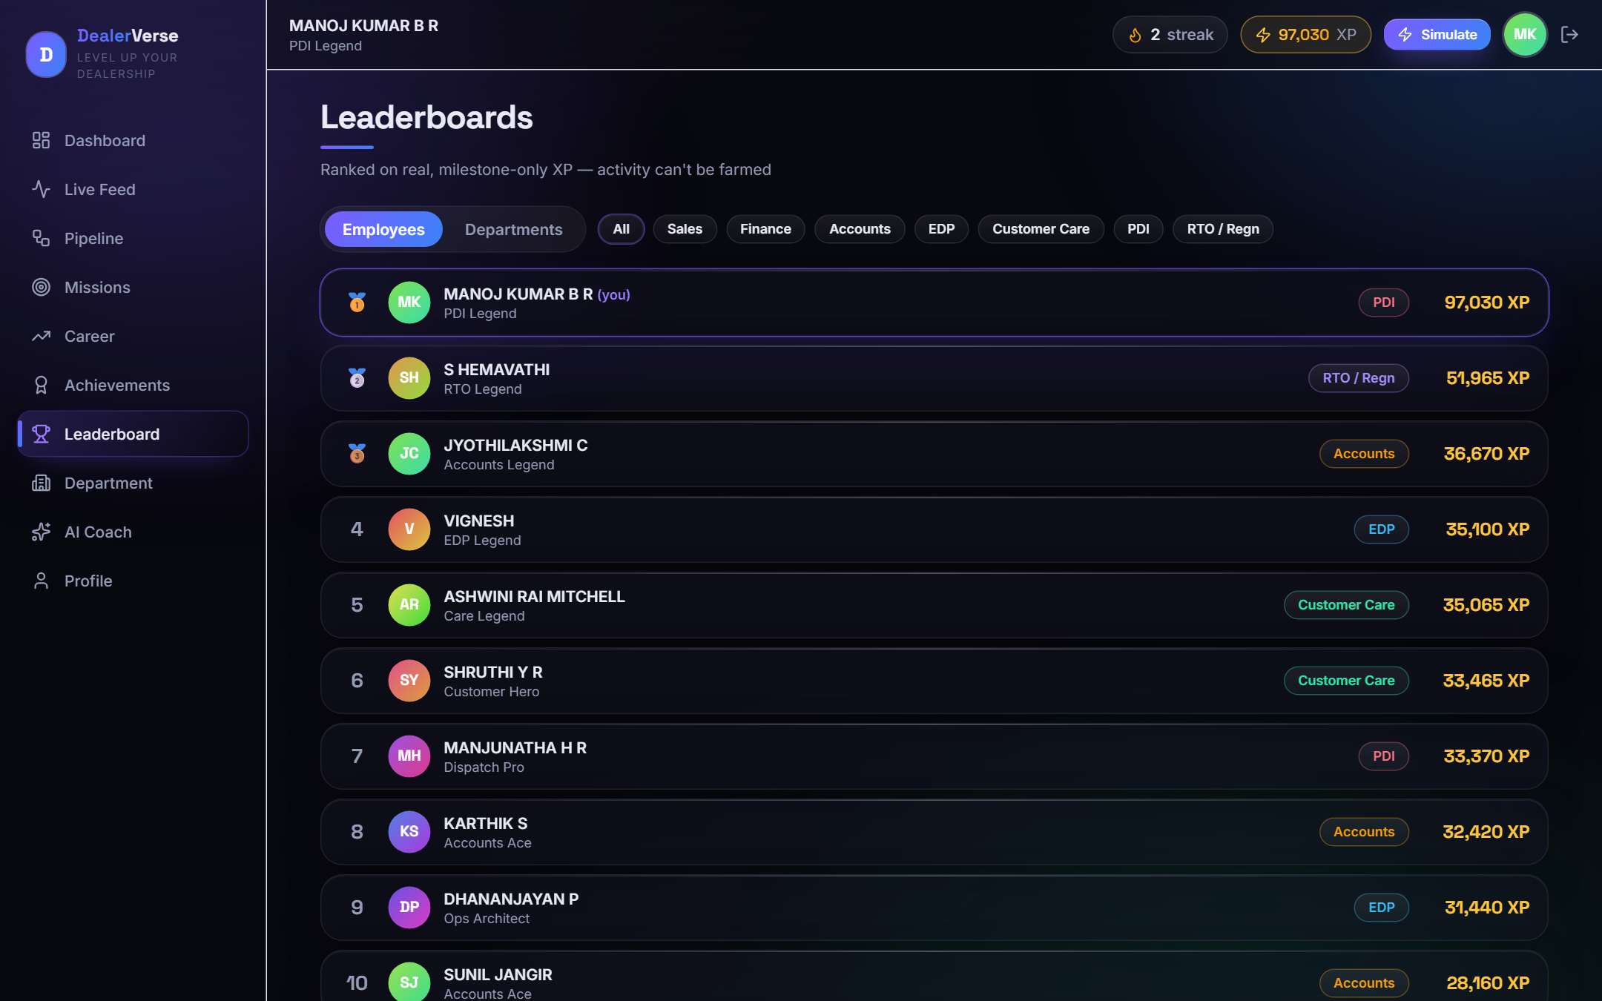
LIVE APP · ENGAGEMENT
Missions, Coaching & Competition
Daily Missions
Department quests with live progress bars from real 'today' activity.
Leaderboard
“Ranked on real, milestone-only XP — activity can't be farmed.”
DealerVerse AI
18

Slide 20
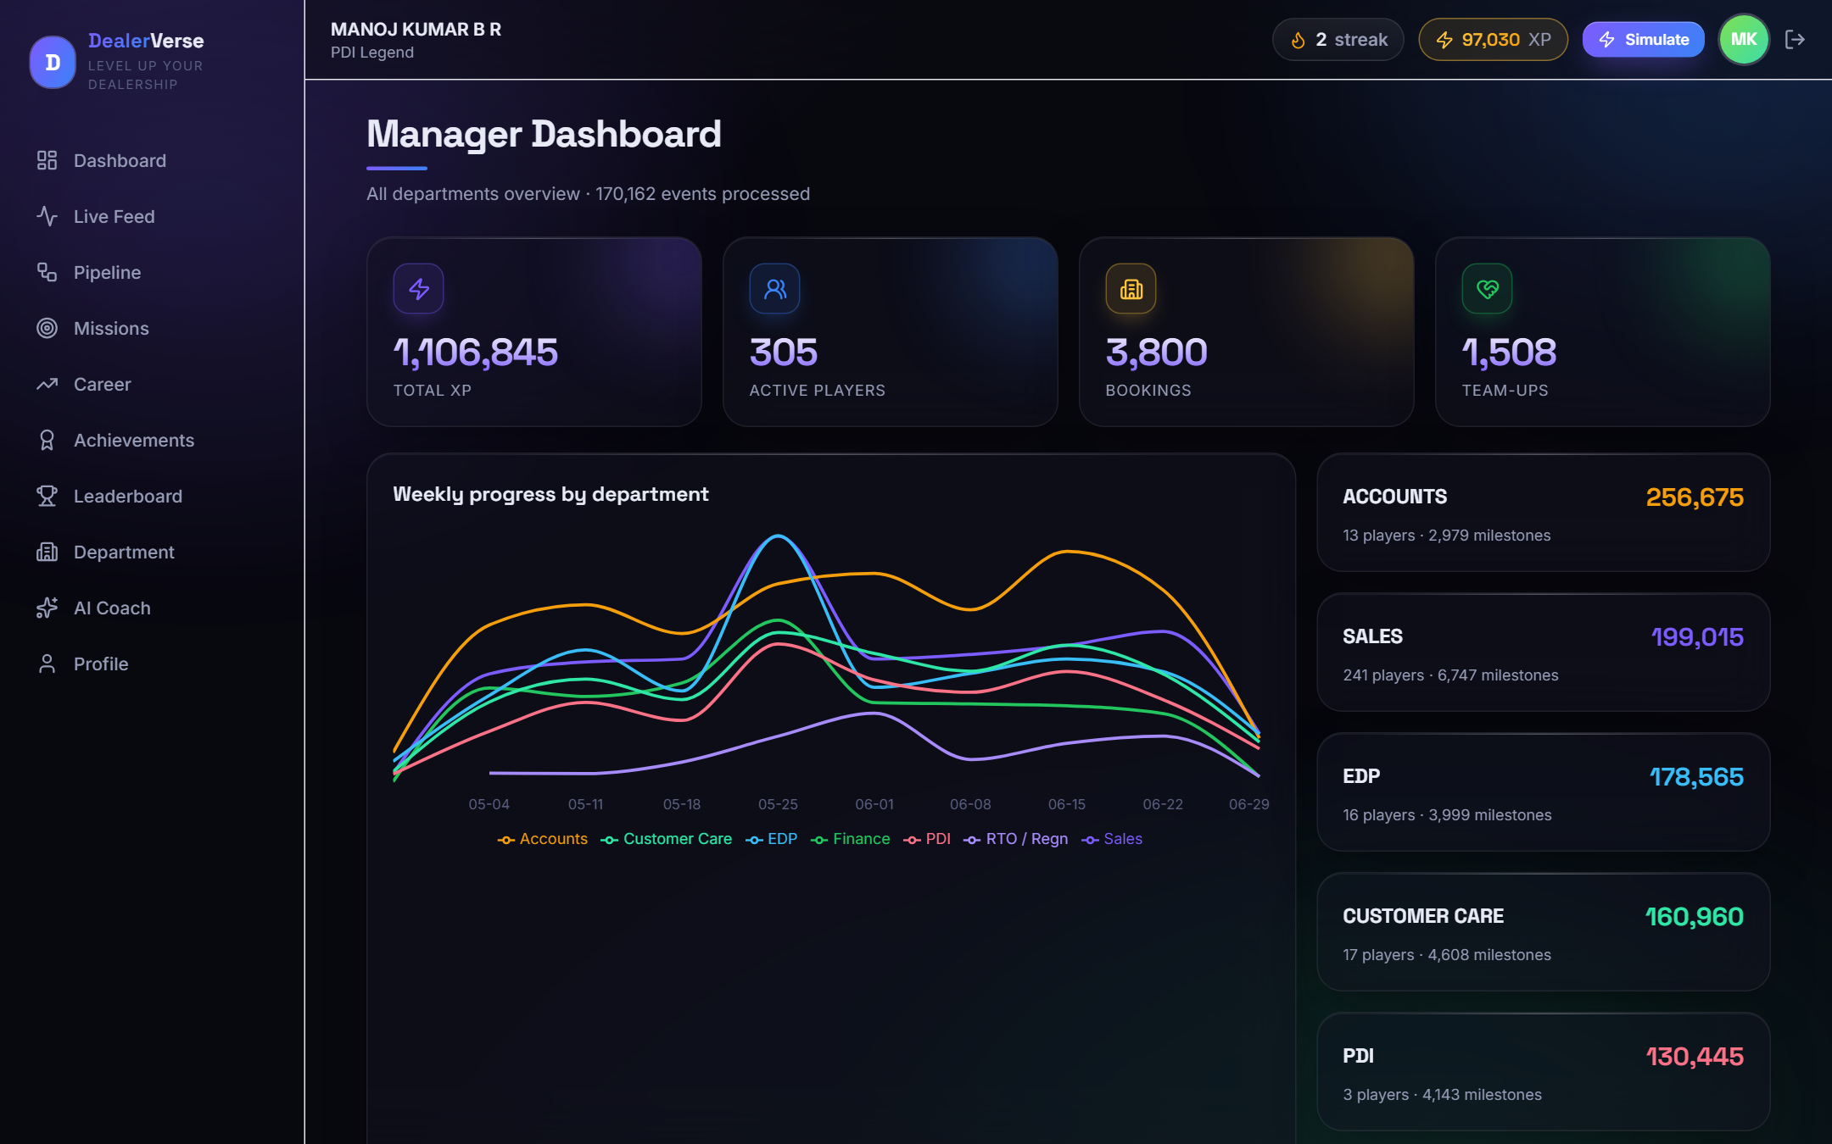
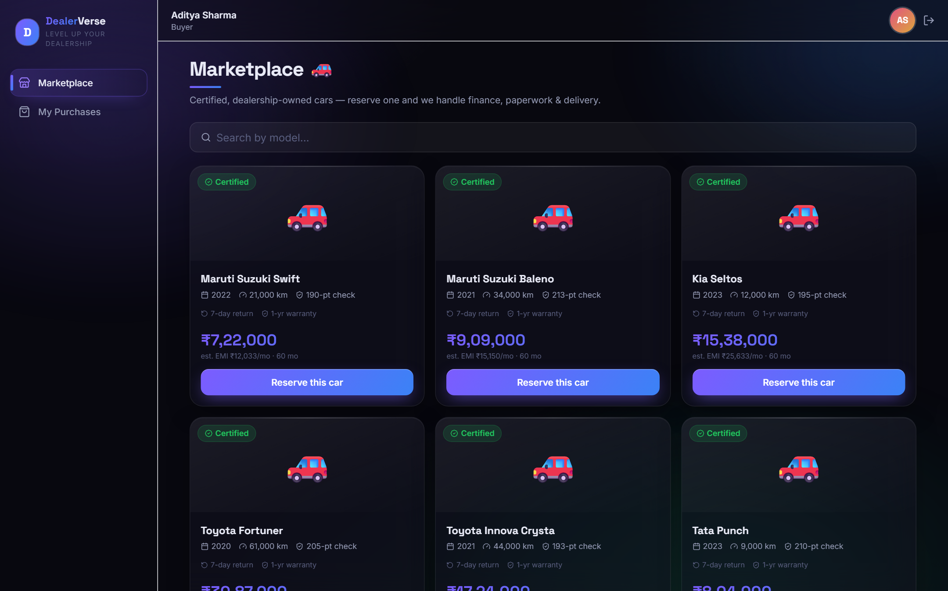
LIVE APP · OPS & MARKETPLACE
Manager Analytics & the Live Marketplace
Manager Dashboard
1.1M XP across 305 players; weekly momentum line per department.
Buyer Marketplace
Certified inventory with N-pt check, warranty, price & est. EMI — reserve to buy.
DealerVerse AI
19

Slide 21
IT ACTUALLY RUNS
Live Leaderboard — Real People, Real XP
#
Player
Department
XP
Rank
1
MANOJ KUMAR B R
PDI
97,030
PDI Legend
2
S HEMAVATHI
RTO / Regn
51,965
RTO Legend
3
JYOTHILAKSHMI C
Accounts
36,670
Accounts Legend
4
VIGNESH
EDP
35,100
EDP Legend
5
ASHWINI RAI MITCHELL
Customer Care
35,065
Care Legend
Every name, department and XP total is computed from the real event log — the app is fully seeded and playable.
305 players ranked · 1,508 team bonuses · 3,800 bookings · live activity feed of 800 recent milestones.
DealerVerse AI
20

Slide 22
UNDER THE HOOD
Architecture & Tech Stack
3 real CSVs
›
build-data.mjs
›
dealerverse.json
›
React app
170k events
score + derive
compact precompute
instant load
FRONTEND STACK
DESIGN DECISIONS
— React 19 + Vite SPA, hash-routed, 16 screens
— Tailwind CSS dark design system
— Framer Motion animations & confetti
— Recharts manager & department charts
— Zustand identity + workflow state (persisted)
— PapaParse CSV parsing in the pipeline
— Precompute, don't recompute 170k rows scored once, offline.
— Two zustand stores identity.v1 + workflow.v2, localStorage-persisted.
— No backend needed fully client-side; deploys as static files.
— Deterministic everything PINs, coach insights, thresholds — reproducible.
— Real actor crediting XP maps to the true person & department.
DealerVerse AI
21

Slide 23
WHY IT WINS
From Activity Log to Behaviour Change
Rewards the right behaviour
Outcomes and hand-offs score; noise and edits don't. The game can't push people to game it.
Fair to every department
Per-department ladders mean a 3-person PDI team competes as hard as 241 in Sales.
Collaboration is structural
Team bonuses make helping another department the fastest way to earn — 1,508 already paid.
Actually built & playable
Not slides — a 16-screen app running on real data, plus a full buy/sell marketplace.
Sustainable for months
Once-per-booking + whitelist keeps the economy stable; missions & seasons refresh engagement.
DealerVerse AI
22

Slide 24
WHAT'S NEXT
Roadmap
Now — Shipped
Next — Live pilot
Later — Scale
— 7 depts gamified
— ≤20-action XP engine
— Ranks, missions, badges
— Full C2B2C loop
— PIN login, 16 screens
— Stream events in real time
— Branch-vs-branch leagues
— Weekly 'boss battle' challenges
— Manager reward controls
— Multi-dealer tenancy
— Mobile app + push streaks
— Configurable scoring per group
— Analytics & churn insight
The scoring engine is a whitelist + weights table — new milestones or seasons are a config change, not a rebuild.
DealerVerse AI
23

Slide 25
DEMO IT YOURSELF
Thank You
DealerVerse AI — real dealership work, turned into a game people want to play.
RUN IT
SAMPLE LOGINS (dept · PIN)
cd dealerverse-ai
npm install
npm run data # build JSON (once)
npm run dev # open the app
Sales · AJEYA GOWDA
9183
Finance · SANTOSH K SHETTY
3596
PDI · MANOJ KUMAR B R
9774
Accounts · JYOTHILAKSHMI C
6064
Or log in as a Buyer / Seller to try the marketplace.
CarVerse Dealership Gamification Hackathon · Built on 170,162 real events

