Slide 1
Technical Club Portal
PRASANNA K 3BR21CS118
RAGHAVENDRA 3BR21CS125
SAMPATH KUMAR 3BR21CS137
SANGAM S SUNKANUR 3BR21CS140
GUIDE: PROF. SHWETHASHREE A
SS

Slide 2
CONTENTS :
ABSTRACT
VISION AND MISSION
INTRODUCTION
LITERATURE SURVEY
SCOPE
PROBLEM STATEMENT
FUNCTIONAL REQUIREMENTS
NON-FUNCTIONAL REQUIREMENTS
CONCLUSION
REFERENCES

Slide 3
ABSTRACT:
The Technical Club Portal is a web-based platform that promotes technical learning and collaboration among members. It offers a variety of features to create an engaging and dynamic learning environment. The portal includes quizzes, assessments, and a learning platform, to help users evaluate their understanding and track progress, with adaptive learning techniques providing a personalized experience. It integrates YouTube to offer curated video-based classes, catering to various technical topics and skill levels. Additionally, the platform features a discussion forum where members can participate in interactive conversations, share ideas, and solve technical challenges. Combining self-paced learning with collaborative tools, the Technical Club Portal empowers members to enhance their technical skills, foster creativity, and build a strong, innovative community. This project serves as a hub for continuous learning and networking, addressing the evolving demands of technical education in the digital age.

Slide 4
VISION AND MISSION :
VISION :
To empower students and tech enthusiasts worldwide by providing an accessible, engaging, and comprehensive platform for continuous learning and skill development in technical fields.
MISSION :
To deliver a robust and secure web-based learning platform that offers high-quality educational content, interactive assessments, and skill-building opportunities.

Slide 5
INTRODUCTION TO TECHNICAL CLUB PORTAL :
The Technical Club Management web portal is an innovative solution designed to streamline and enhance the management of technical club activities. This platform offers a comprehensive suite of tools to facilitate the organization and execution of various events, including quizzes, assessments, and other club activities. With a focus on user-friendly interfaces and efficient functionality, the portal enables administrators to easily schedule events, manage participant registrations, and track performance metrics.
EXISTING SYSTEM:
The existing system for the Technical Club Portal offers basic features for member communication and event management but lacks advanced tools for learning, collaboration, and personalized engagement.
PROPOSED SYSTEM :
The proposed system for the Technical Club Portal will integrate advanced learning resources, collaboration tools, and personalized engagement features to enhance member experience and innovation.

Slide 6
LITERATURE SURVEY :
Patel Utsav, et al. [1] developed the Technical Club Portal which will integrate advanced learning resources, collaboration tools, and personalized engagement features to enhance member experience and innovation.
Mukthashree B et al.[2] developed the Campus Club Management System Application to promote the fluent execution of events conducted by the respective clubs. The work is structured so that different stages of an event from the beginning to the conclusion can be easily handled by the user.
Mohd. Shukri et. al[3] developed the information technology club management system has been built to assist the IT staff of the information technology team in managing the club systematically and more effectively. The objective of this system is to develop and develop an online information technology club management system.
Mohamed N.A. Abdelhakim et. al[4] developed the Quality Evaluation of University Web Portals with a student perspective for the evaluation of web pages is a mature discipline with well-established assessment protocols and regulatory mechanisms. it focuses on issues of usability and content.

Slide 7
Kamal Sharma R et al. [5] developed the Centralised Portal for Student Support based on Web Application. It focuses on each institution has a preferred application for evaluating the physical activities in the digital platform.
Malavika Hariprasad et al. [6] developed the College Club activity management system. This system organises and manages various aspects of student clubs, including membership, events, communication, and records. It can help streamline administrative tasks and improve the club's overall efficiency and effectiveness.
Wenlu Qi [7] developed the Design and Implementation of the University Club Management System based on the WeChat Applet. This helps to solve the problems of delayed work processes and redundant content in the management of the university clubs.
Shreyika Sandip Sahasrabuddhe [8] developed the Database System for Sports Club Management. This helps to build a database that can be used to store information on sporting groups.
K Senthur Kumaran et al.[9] developed Integrating blockchain, the internet of things, and cloud for secure healthcare. This shows a decentralized healthcare architecture using the integration of Internet of Things (IOT), blockchain, and cloud to improve speed up tuple broken security as well as scalability.

Slide 8
Chengliang Zhang [10] developed A Quantitative Analysis on Network Communication. This focus on communication becomes popular gradually along with the upsurge of new media, and turns into a new communication field.

Slide 9
SCOPE :
The main limitation of our project is that it only allows engineering college students to register for the portal and access its features. Students can only access quiz tests, assessments, template creation, blogs, etc. They cannot create their account in the admin portal.

Slide 10
PROBLEM STATEMENT :
Create a web platform for students and tech enthusiasts to learn, practice, and showcase their skills through interactive quizzes, assessments, and technical challenges. The platform should include role-based access, enabling admins to manage content and students to engage in activities.

Slide 11
KEY FUNCTIONAL REQUIREMENTS :
User Registration and Login:
Students and admins should be able to create an account and log in securely using their credentials
Role-Based Access Control:
- The platform should distinguish between admin and student roles and grant appropriate permissions:
- Admins can create, edit, and manage quizzes, assessments, and other activities.
- Students can participate in quizzes and view their results.
Result Tracking:
- The platform should track and store student results.
- Students should be able to view their results after completing a quiz or activity.
Automated Email Notifications:
The system should send automated emails to students with their results and any relevant updates (e.g., new quiz availability).
Security Features:
- The system should securely store user credentials, encrypt passwords, and ensure secure session management

Slide 12
NON-FUNCTIONAL REQUIREMENTS:
Usability:
- The platform should have an intuitive, user-friendly interface that is easy to navigate for both students and admins
Performance:
- The system should respond quickly to user inputs, ensuring minimal delays when loading quizzes, submitting answers, or fetching results.
Scalability:
The platform should be scalable to handle increasing numbers of users, quizzes, and activities without significant performance degradation
Reliability:
- The system should be highly available and reliable, with minimal downtime, ensuring that students and admins can access the platform whenever needed.
Compatibility:
- The platform should be compatible across modern browsers (e.g., Chrome, Firefox, Safari) and responsive on both desktop and mobile devices.
. Accessibility:
- The platform should be accessible to users with disabilities, following web accessibility standards (e.g., WCAG 2.0) for features like text-to-speech, high-contrast UI, and keyboard navigation.

Slide 13
HARDWARE REQUIREMENTS :
Server:
Processor: Dual-core Intel or AMD processor, 2.0 GHz or higher.
RAM: 4 GB or more.
Hard Disk: 50 GB of free disk space or more.
Network Interface Card (NIC) for network connectivity.
Desktops/Laptops:
Processor: Intel Core i3 or AMD Ryzen 3 or higher.
RAM: 4 GB or more.
Storage: SSD recommended for better performance.
SOFTWARE REQUIREMENTS:
OS:WINDOWS OPERATING SYSTEM
PLARFORM:Vs code
FRONT END:HTML,CSS
MIDDLE WARE: NODE.JS
BACK END:JAVASCRIPT
DATABASE: MYSQL

Slide 14
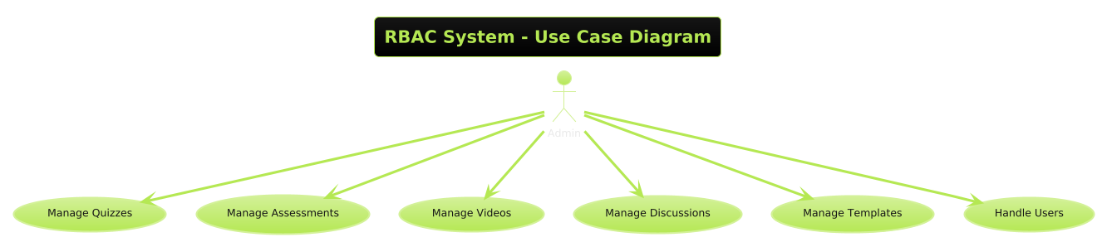
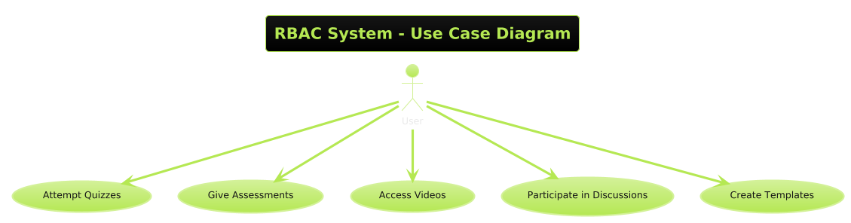
Use case diagram of Admin
Use case digram of User

Slide 15
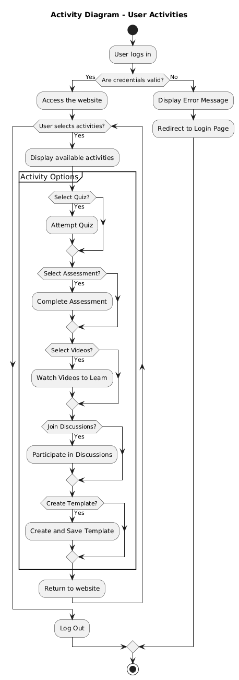
Activity Diagram

Slide 16
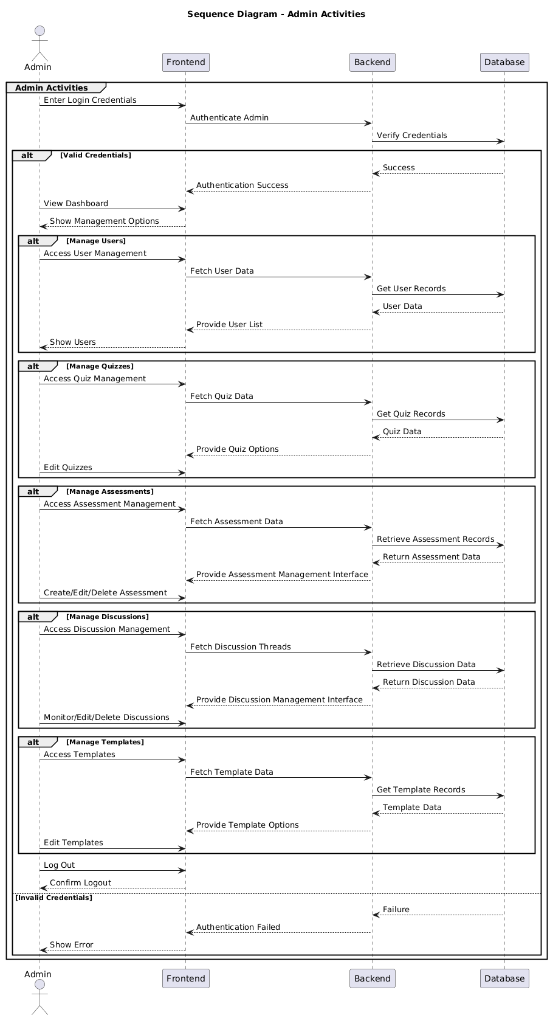
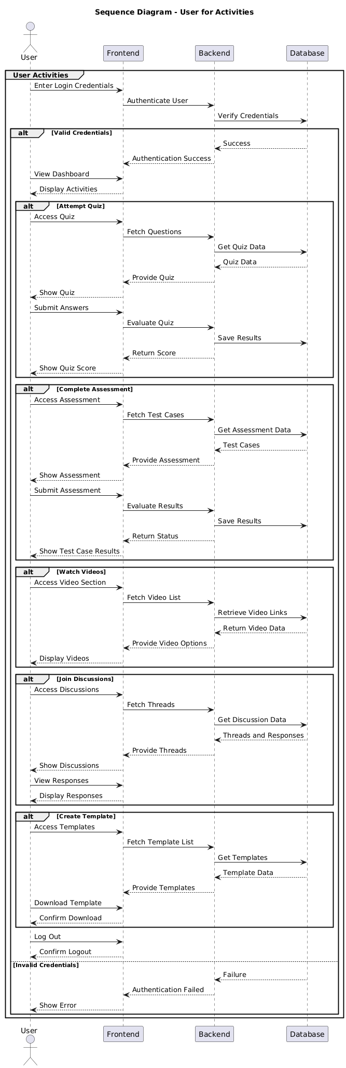
Sequence Diagram - Admin
Sequence Diagram – User

Slide 17
CONCLUSION:
The Technical Club Portal will streamline event management, improve communication, and ensure accurate tracking and reporting of technical club activities. With user-friendly interfaces, robust security, and comprehensive reporting tools, the portal will enhance organization, increase participation, and create a more engaging environment for technical events in educational institutions and organizations.

Slide 18
REFERENCES:
[1] Patel Utsav, Patel parth, Patel kirtesh, prof. Ajaykumar T.shah "Technical Club Management" International Journal of Advanced Research in Computer Science, ISSN:2395-1052, Volume 7, Issue 3, March 2021.
[2]Muktashree B, Manasi N S, Chinmayee k g, Amrutha G, Manjuprasad B “Campus Club Management System Application”, International Journal of Engineering Research and Technology ,ISSN:2278-0181, volume 10,Issue 12,2022.
[3]Mohd Shukr Ibrahim, Shahareen Kasim, Rohayanti Hasan, Hairunizam Mahadin,” Information Technology Club Management System”, ISSN:2590-4043, January 2018.
[4] Mohamed N.A Abdelhakim, James N. Carmichal , Sayed Sayeed Ahmad, “Quality Evaluation of University Web Portals: A Student Perspective”, International Journal of Information and Operations Management Education, vol. 4, pp.229-243, March 2011.

Slide 19
[5] Kamal Sharma R, Dr. R. M. Gomathi, Yahya Ibrahim Imtiyaz “ A Centralised Portal for a student support system”, ISBN: 978-1-6654-8328-5,March 2022
[6] Malavika Hariprasad, Neha N, Nimisha Dey, Dr. Pratiba D, Dr. Ramakanth Kumar P “College Club activity management system”, ISBN: 979-8-3503-4314-4, March 2023.
[7] Welnu Qi, “ Design and Implementation of University Club Management System based on WeChat Applet”, Journal of Computing and Electronic Information Management, ISSN: 2413-1660, Vol. 13, No. 1, 2024.
[8] Shreyika Sandip Sahasrabuddhe, “ The Database System for the Sports Club Management”, September 2023.
[9] K Senthur Kumaran, Ganesh Khekare, Thanu Athithya M, Aakash Arulmozhivarman, Arvind Pranav M, Hiritish Chidambaram N “ Integrating Blockchain, internet of things, and cloud for secure healthcare”, Indonesian Journal of Electrical Engineering and Computer Science, ISSN: 2502-4752, Vol. 37, 2 February 2024.
[10] Chengilang Zhang “ A Quantitative Analysis on Network Communication”, Ludong University, Asain Social Science, Vol. 4, No. 12, December 2008.

