Slide 1
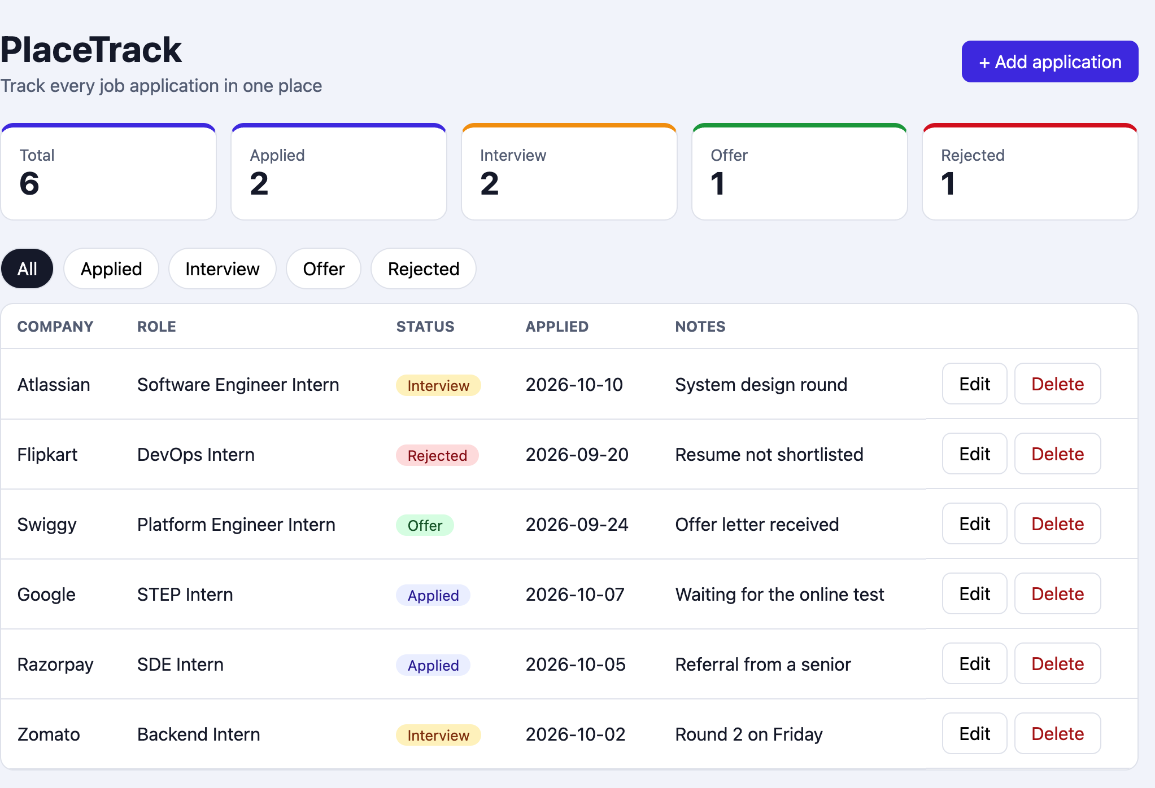
PlaceTrack
Track every job application in one place
DevOps Final Capstone
Raghavendra | 24BCS10250
Notes:
Hi, I'm Raghavendra. This is PlaceTrack, a small app that keeps track of job and internship applications, and the DevOps work I built around it for the final capstone. I will go through it in the same order as the course flow: the app, git, the pipeline, Docker, the security scan, the registry, Terraform, Kubernetes, Helm, ingress, autoscaling, monitoring and troubleshooting. At the end I will make a small change, push it, and watch it reach the cluster.

Slide 2
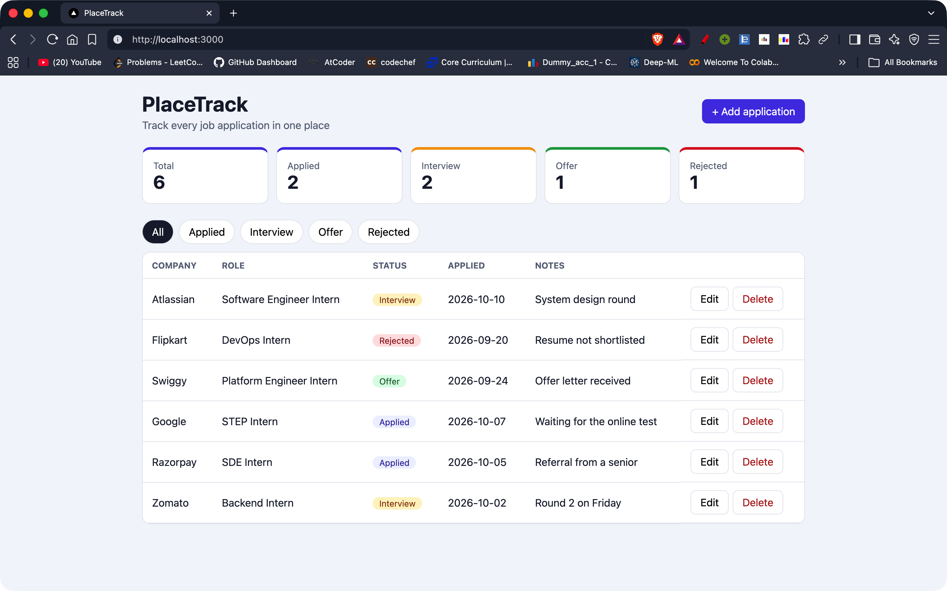
Why I built PlaceTrack
I was applying for internships.
My spreadsheet turned into a mess: which company, which round, what next?
So I built a tracker. Add a company and a role, then move it through four stages.
Applied
Interview
Offer
Rejected
The app is simple on purpose. The DevOps around it is the project.
React frontend and FastAPI backend, running with Docker Compose at localhost:3000
Notes:
I built PlaceTrack because I was applying for internships and my spreadsheet got messy. I kept losing track of which company was at which stage. Now I add a company and a role, and move it through applied, interview, offer or rejected, with counts at the top and a filter for each status. The app is simple on purpose. I wanted most of my time to go into everything around it: tests, containers, the pipeline, the cloud, Kubernetes and monitoring. This screenshot is the app running with Docker Compose at localhost:3000.

Slide 3
How it all fits together
BUILD AND SHIP
GitHub Actions
Kubernetes (minikube)
Code
React, FastAPI, Dockerfiles, Helm chart
pytest
GHCR
images tagged with the commit SHA
Ingress
placetrack.local
git push
frontend build
push
docker build x2
frontend
2 replicas
backend
2 replicas + HPA
Trivy scan
deploy job
INFRASTRUCTURE
Helm
helm upgrade --install
Postgres
Terraform
VPC + EKS as code
AWS, ap-south-1
VPC, 2 subnets, EKS 1.35, 2 nodes. Destroyed after I checked it.
Prometheus + Grafana
scrape the backend /metrics
Notes:
This is the whole picture. I push code to GitHub, and GitHub Actions runs the tests, builds both images and scans them with Trivy. If everything passes, the images go to GHCR tagged with the commit SHA, and Helm deploys that exact tag into Kubernetes. I ran Kubernetes on minikube on my laptop to keep the AWS bill low, with an Ingress, two replicas each for the frontend and backend, an autoscaler and Postgres. Prometheus and Grafana watch the backend. Terraform is a separate lane: it built the VPC and the EKS cluster on AWS, I checked them in the console, and then I destroyed them.

Slide 4
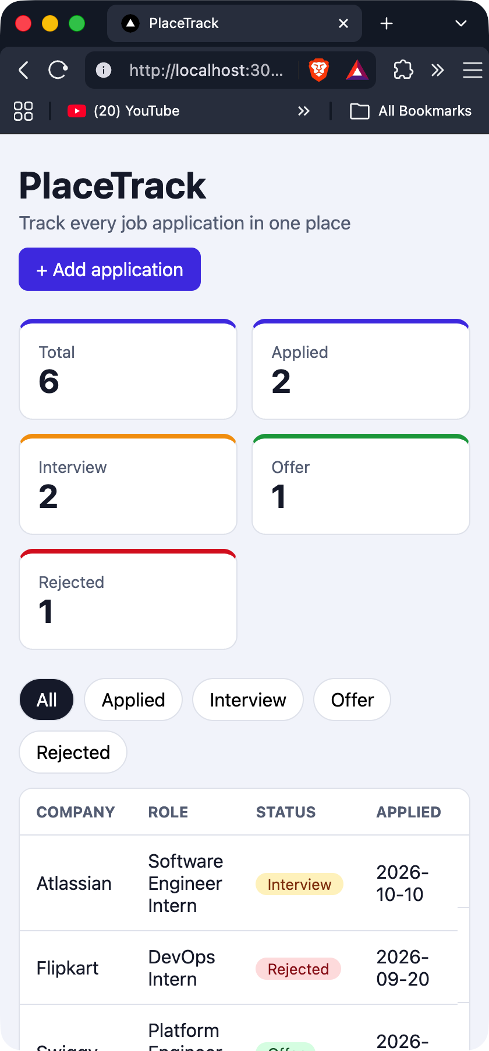
The app: API, database, UI
REST API (FastAPI)
React + Vite
table, filters, counts at the top
GET
/api/jobs
POST
/api/jobs
calls /api
GET
/api/jobs/{id}
FastAPI + SQLAlchemy
validation, 404s, probes, metrics
PUT
/api/jobs/{id}
DELETE
/api/jobs/{id}
GET
/api/jobs/stats
PostgreSQL
jobs table created by an Alembic migration
For Kubernetes and Prometheus
/health
/ready
/metrics
Same page at phone width
Notes:
The backend is FastAPI with SQLAlchemy and Postgres. These are the endpoints I wrote: list and create jobs, get, update and delete one job, and a stats endpoint that feeds the counters at the top of the page. There are also health, ready and metrics endpoints for Kubernetes and Prometheus, and the ready endpoint checks the database, which turned out to matter later. The jobs table is created by an Alembic migration so the schema is versioned instead of being created by hand. The frontend is React with Vite. I made sure the UI is usable on a small screen, and that is the phone-width screenshot on the right.

Slide 5
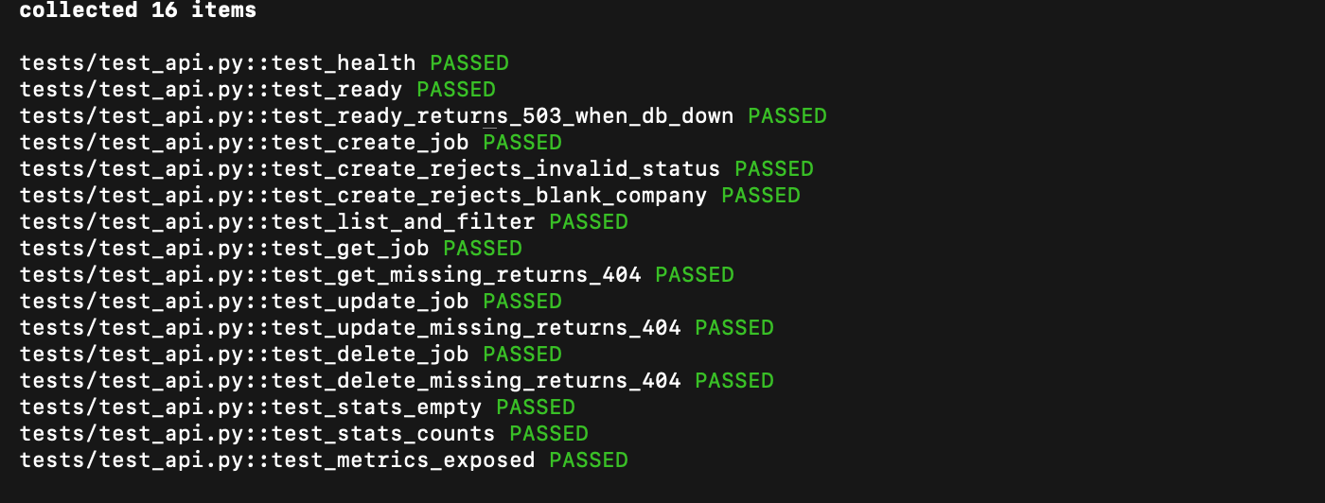
Tests: 16 pytest tests
16
tests, all passing
Every endpoint, bad input and missing ids (404)
/ready returns 503 when the database is down
In-memory SQLite, so the tests never touch Postgres
Settings in backend/pytest.ini
pytest -v, run from backend/
Notes:
I wrote 16 pytest tests. They cover every endpoint, bad input, missing ids that should return 404, the metrics endpoint, and that the ready check returns 503 when the database is down. The tests use an in-memory SQLite database through a dependency override, so they never touch the Postgres database. The settings are in pytest.ini. The line at the bottom says 16 passed. These tests are the first gate in the pipeline, so a failing test stops everything after it.

Slide 6
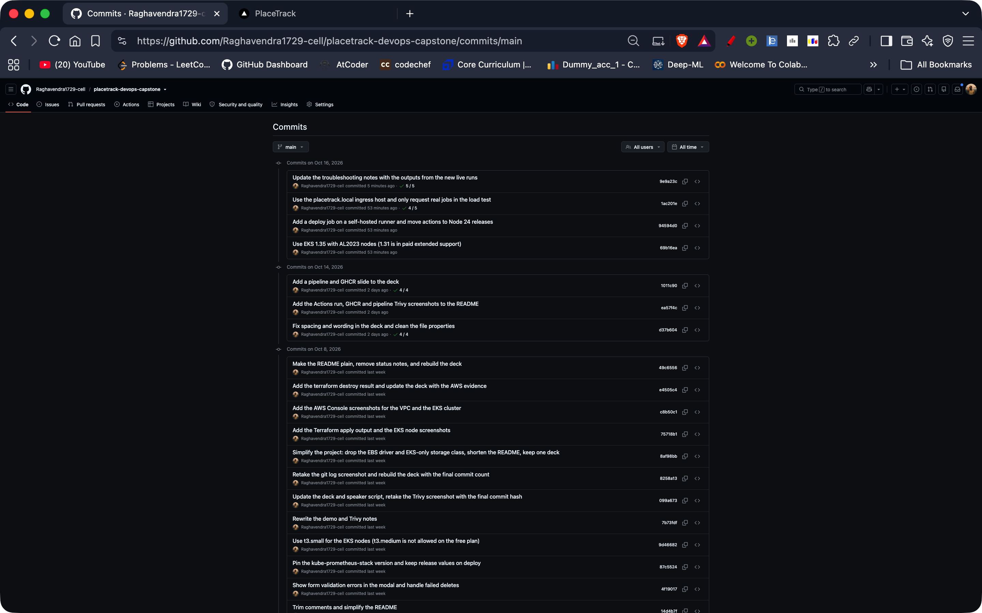
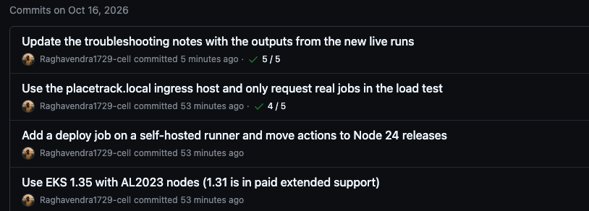
Git: small commits, no secrets
THE LATEST COMMITS, ZOOMED
Small commits. Each message says what changed.
.gitignore. .env, __pycache__, node_modules, .venv and the Terraform state stay out of the repo.
No secrets. Gitleaks over the whole history found nothing.
The short hash on each commit is the same SHA used as the image tag later.
Notes:
I worked in small commits and tried to write what each commit changes in the message, so the history reads like a log of the project. The zoomed part shows the latest messages, for example adding a deploy job on a self-hosted runner. The gitignore keeps env files, pycache, node modules, the virtual environment and the Terraform state out of the repo. I also ran Gitleaks over the whole history and it found no secrets, and the AWS value for my IP lives in terraform.tfvars, which is not committed. Keep the short commit hashes in mind. The image tags in the registry later are the same commit SHAs.

Slide 7
CI pipeline: GitHub Actions
RUNS ON EVERY PUSH TO MAIN
test
pytest -v
image x2
backend + frontend
Trivy scan
both images
push
to GHCR
deploy
helm upgrade
frontend
npm ci, npm run build
Tests and the frontend build run in parallel. If either fails, nothing else runs.
A matrix job builds both images and tags them with the commit SHA.
Fails the job on a fixable HIGH or CRITICAL finding, so nothing risky is pushed.
Only from main. Tag is the commit SHA, never latest.
Self-hosted runner on my laptop, helm upgrade with that SHA.
Image name
ghcr.io/raghavendra1729-cell/placetrack-<service>:<commit SHA>
The deploy job is skipped unless DEPLOY_ENABLED is set, so a push never needs my laptop on.
Notes:
This is the pipeline in .github/workflows/ci-cd.yml, and it runs on every push to main. First pytest and the frontend build run in parallel. If both pass, the backend and frontend images are built and Trivy scans them, and a fixable HIGH or CRITICAL problem fails the job so nothing is pushed. Then the images go to GHCR with the commit SHA as the tag, not latest, so I always know which code is running. The last job is a deploy on a self-hosted runner on my laptop that does the Helm upgrade, and I only turn it on with a repository variable when my laptop is ready. I also pinned the third-party actions to commit SHAs.

Slide 8
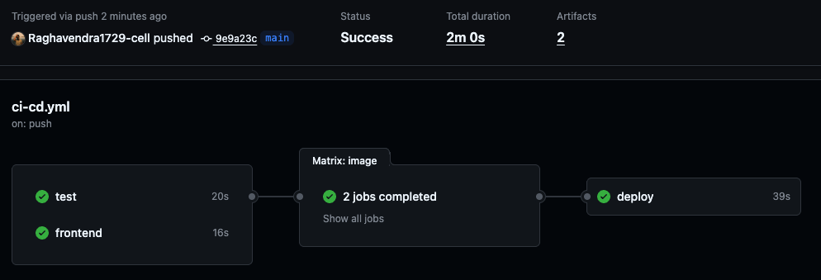
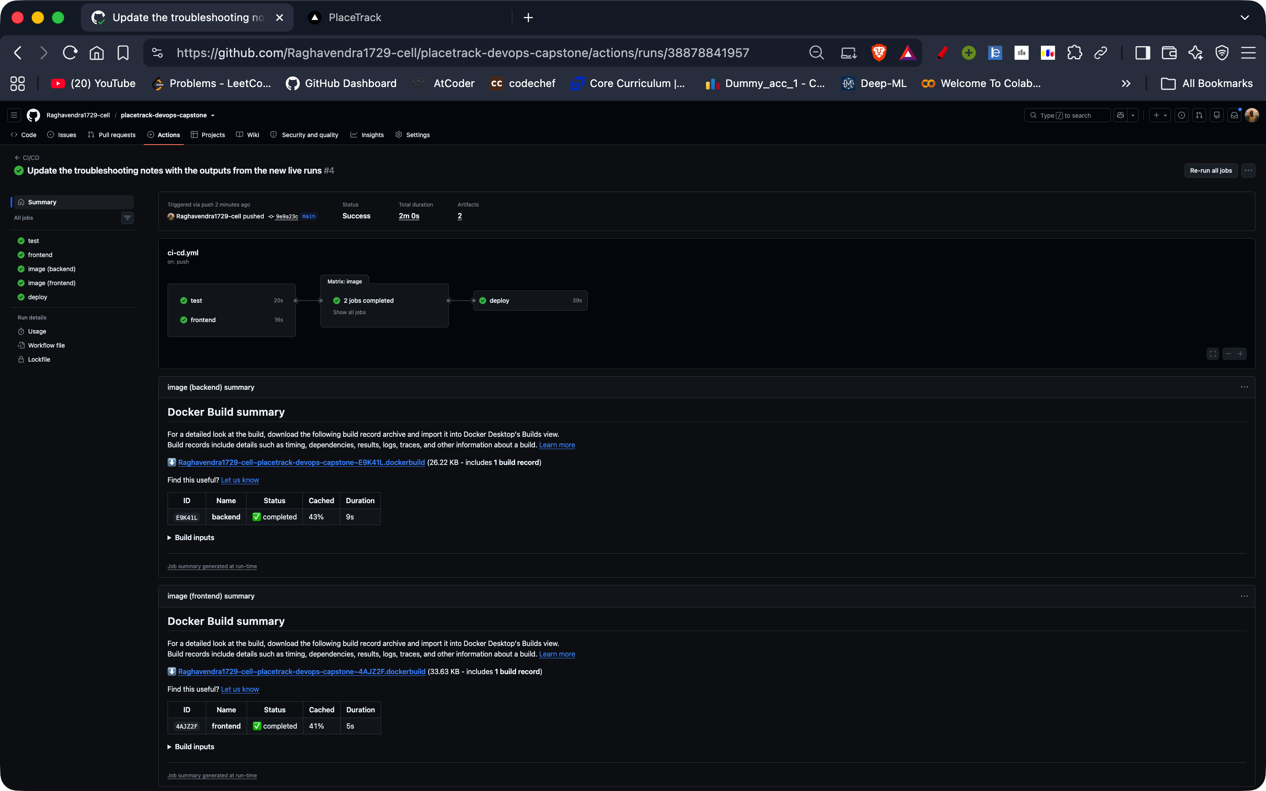
The pipeline run, all green
Status, total duration and the job graph
Run page: actions/runs/38878841957
All five jobs passed, 2m 0s in total
test
frontend
image (backend)
image (frontend)
deploy
20s
16s
43s
51s
39s
Notes:
This is the run of that pipeline from the Actions tab, and all five jobs are green, including the deploy job. The zoomed part shows the status as Success and the total time as 2 minutes. Test took about 20 seconds, the frontend build 16 seconds, and the deploy 39 seconds. The two image jobs are the matrix, one for the backend and one for the frontend, and each includes the build, the Trivy scan and the push. The commit that triggered it is 9e9a23c, the same one at the top of the git log and in the registry tags.

Slide 9
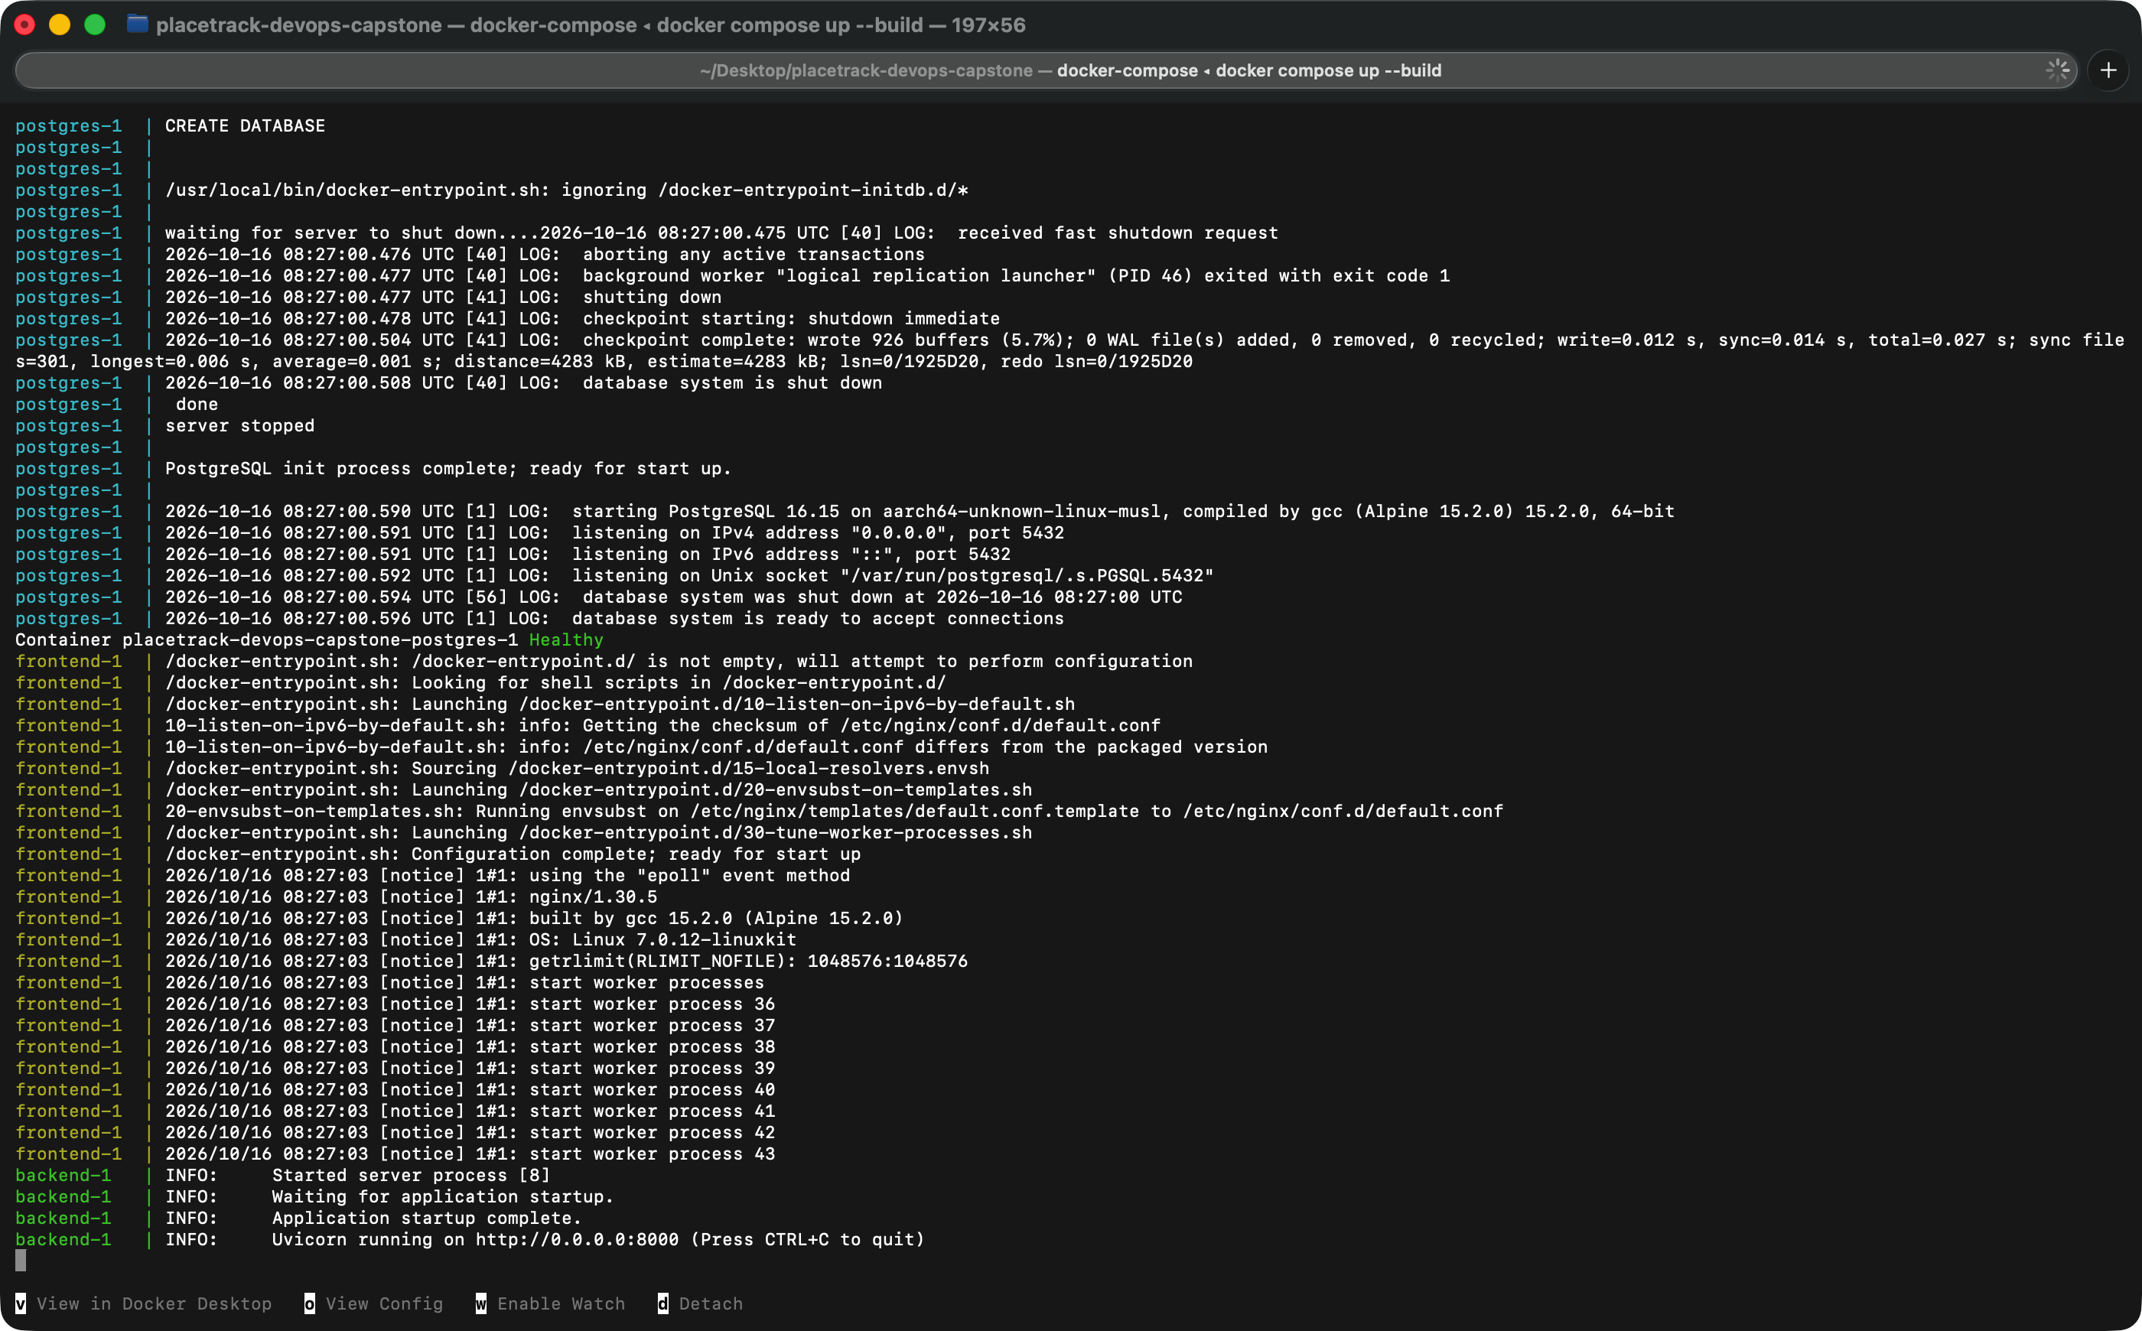
Docker: two images, one command
Frontend image
Stage 1
node:20-alpine builds the React app
Stage 2
nginx-unprivileged serves only the build
Runs as user 101, not root
Backend image
python:3.12-slim, runs as user 10001
docker compose up --build
Starts postgres, backend and frontend. The app is on localhost:3000.
Postgres healthy first, then the backend runs its migration and starts Uvicorn
Notes:
Both images run as a normal user instead of root. The backend is python 3.12 slim and runs as user 10001. The frontend Dockerfile has two stages: Node builds the React app, and only the built files are copied into an unprivileged nginx image that runs as user 101, which keeps build tools out of the final image. With Docker Compose, one command starts Postgres, the backend and the frontend. The backend waits for Postgres to be healthy, runs the Alembic migration and then starts Uvicorn, which is the zoomed part under the log. The pipeline builds these same two Dockerfiles.

Slide 10
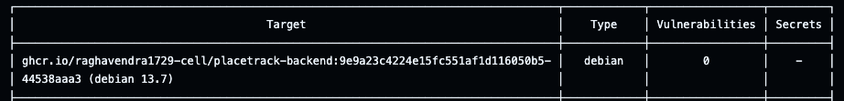
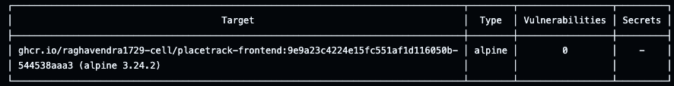
Security scan: Trivy
Backend image
Frontend image
3
0
42
0
HIGH findings
HIGH and CRITICAL findings
Starlette 0.41.3, for example CVE-2025-62727: crafted Range headers can be used for a denial of service.
The old Alpine nginx base had problems in OpenSSL, libexpat and libxml2.
Fix: upgraded FastAPI, which pulled in a newer Starlette.
Fix: moved to nginx-unprivileged:1.30.5-alpine.
In the pipeline: severity HIGH,CRITICAL, ignore-unfixed, exit-code 1. A fixable finding fails the job.
Notes:
Trivy scans both images in the pipeline and fails the job on fixable HIGH or CRITICAL findings. My first scan failed, and I fixed what it found. The backend had 3 HIGH findings in Starlette 0.41.3, for example CVE-2025-62727, where specially crafted Range headers can be used for a denial of service, and I upgraded FastAPI, which pulled in a newer Starlette. The frontend's old Alpine nginx image had 42 HIGH and CRITICAL findings in OpenSSL, libexpat and libxml2, so I moved to nginx-unprivileged 1.30.5. Now both tables show 0 vulnerabilities. A clean result only means nothing fixable was known on that day, which is why the scan runs on every build.

Slide 11
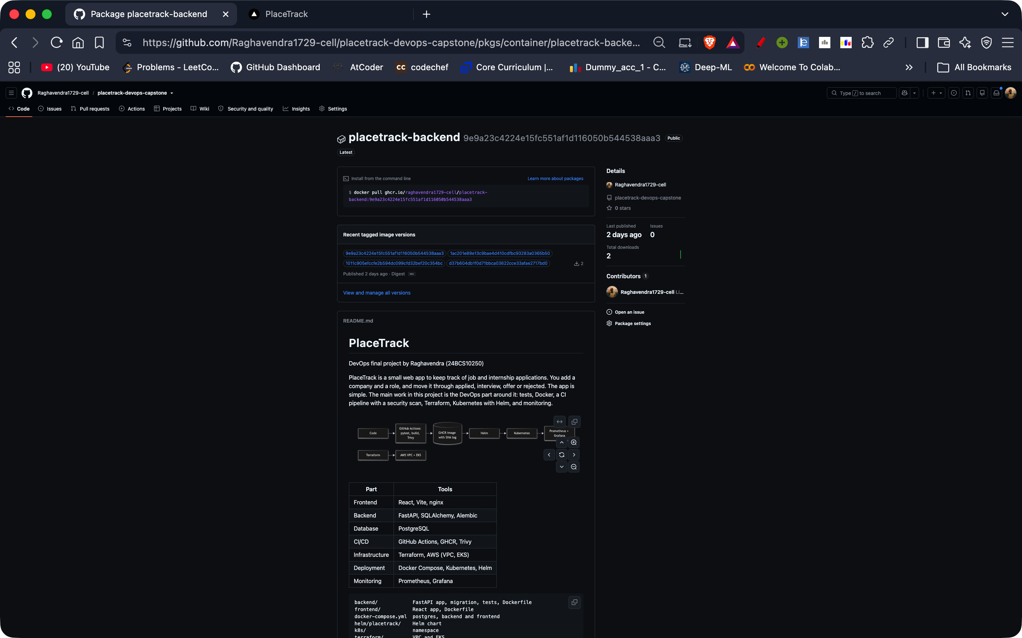
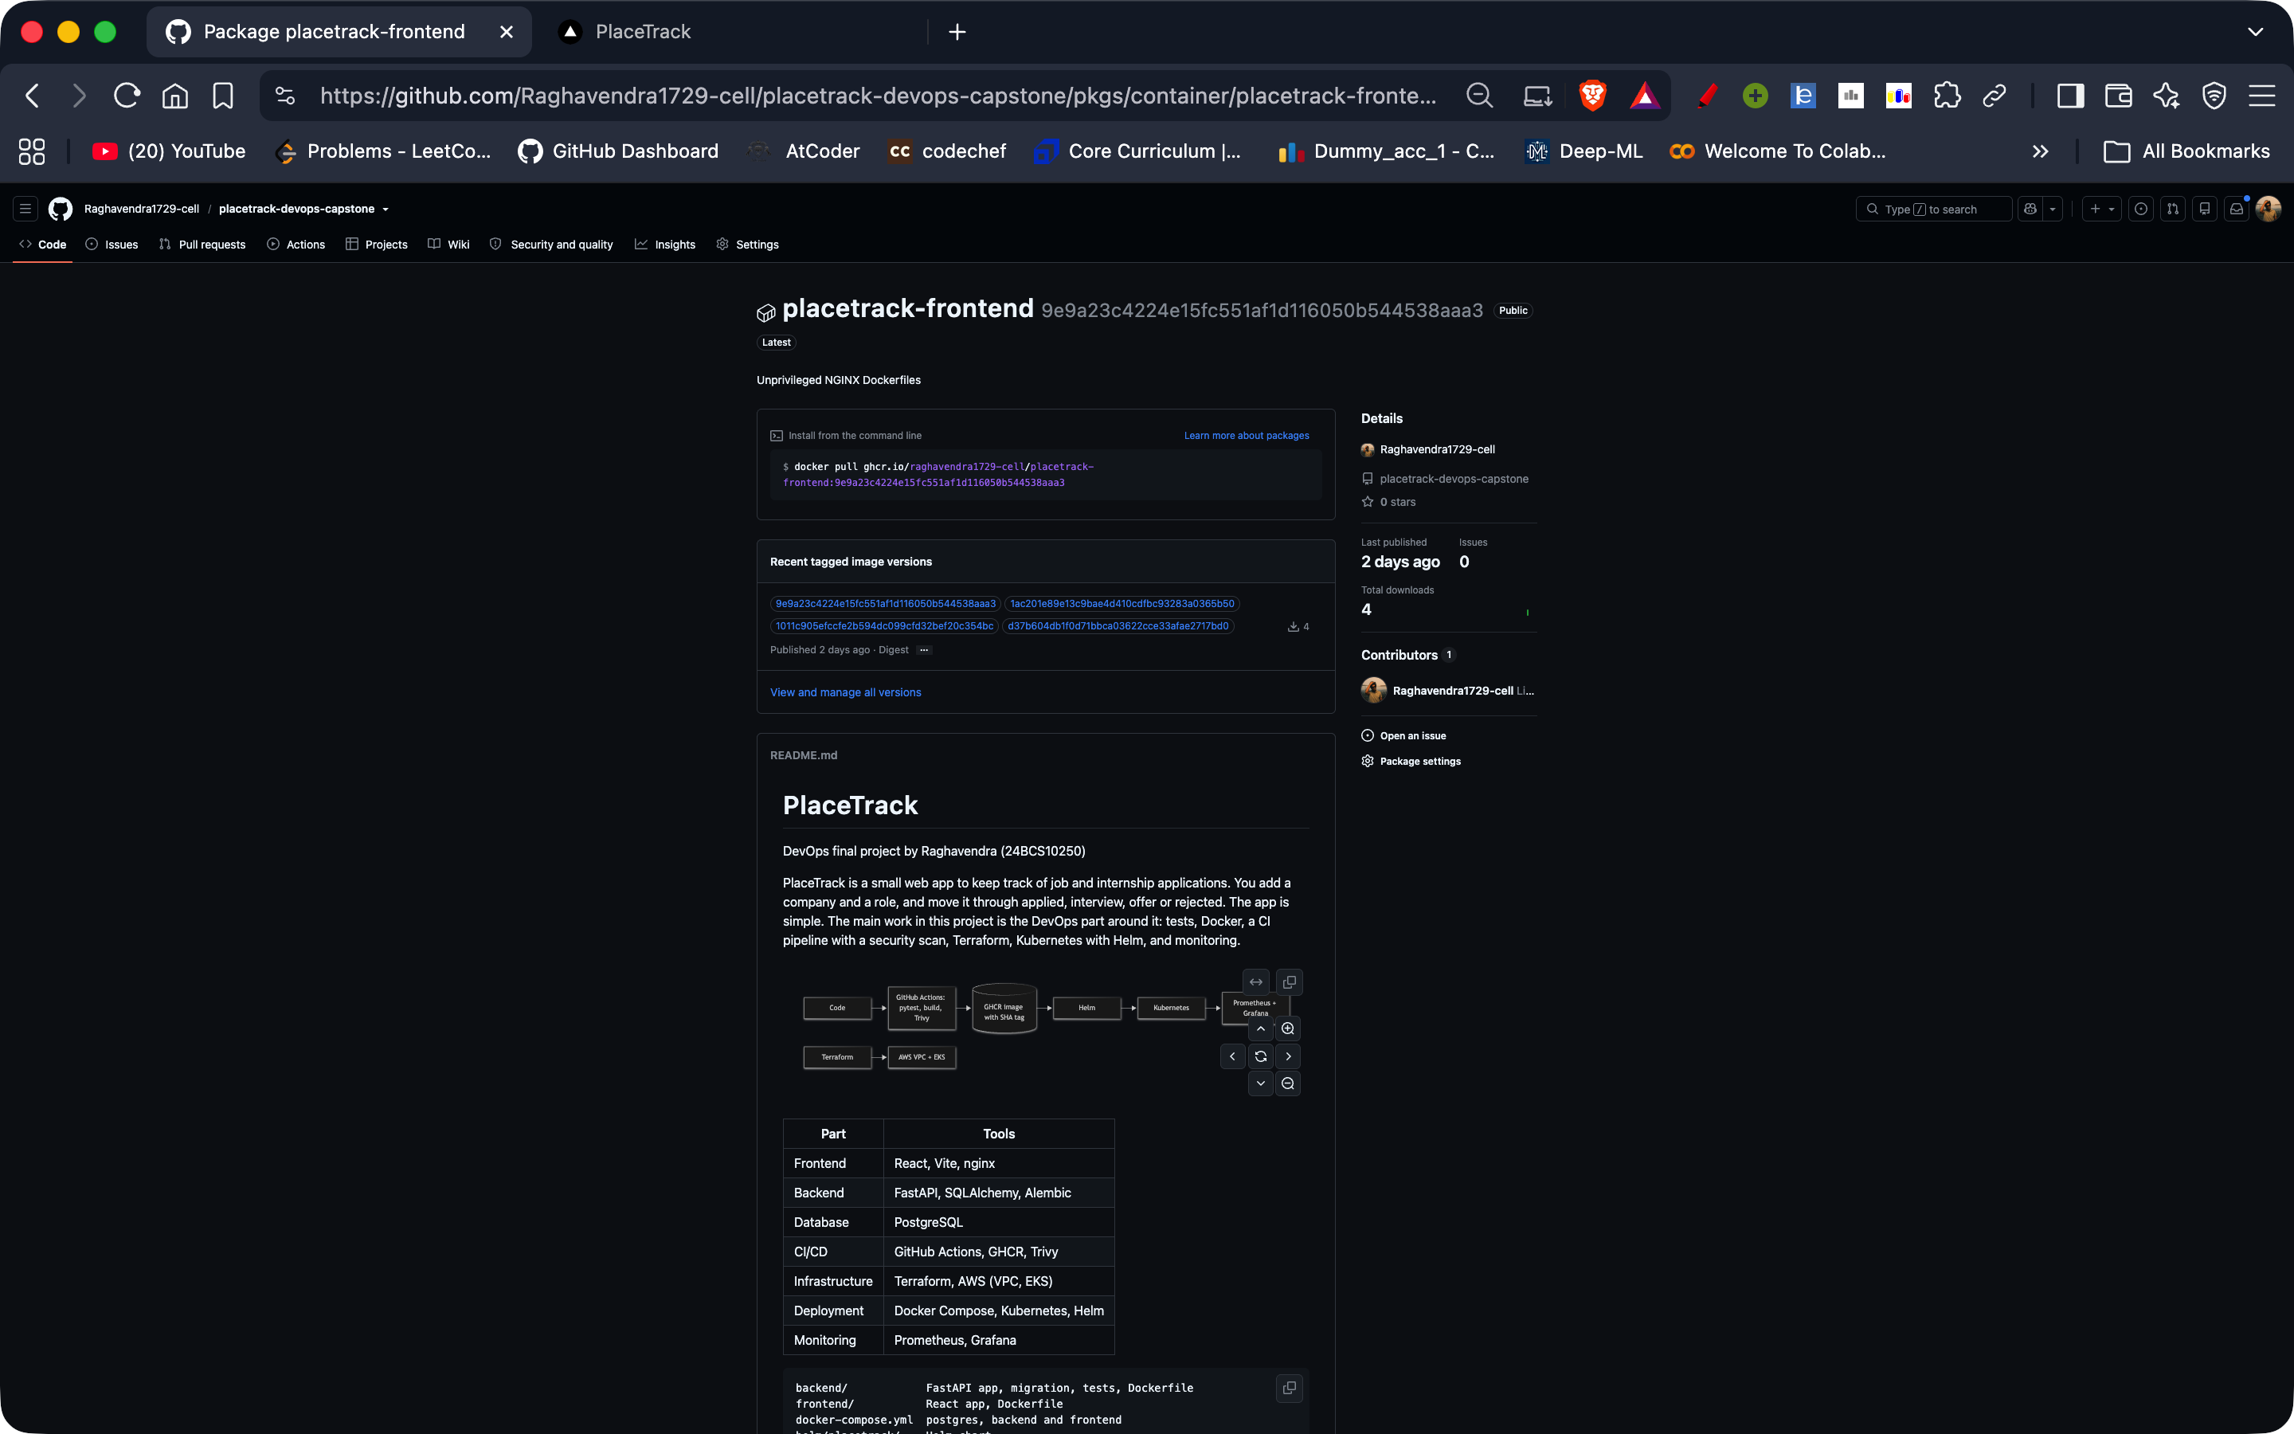


Registry: GHCR, tagged with the commit SHA
ghcr.io/raghavendra1729-cell/placetrack-backend:<commit SHA>
ghcr.io/raghavendra1729-cell/placetrack-frontend:<commit SHA>
Notes:
After the scan passes, the pipeline pushes both images to GitHub Container Registry. Both packages are public. The tag is the full commit SHA, and the recent tags in the zoomed part are the same commits as in the git log, starting with 9e9a23c. I do not use latest, because latest does not tell me which code is running. If a deploy goes wrong, I can point Helm back at an older SHA and I know exactly what that contains.

Slide 12
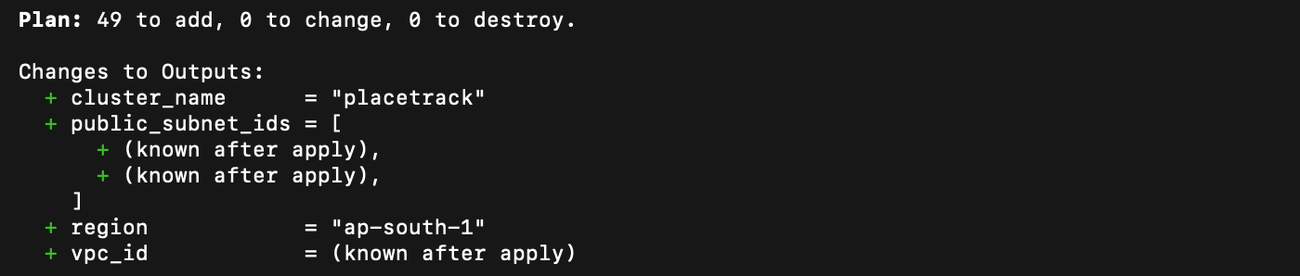
Terraform: VPC and EKS on AWS
49
TERRAFORM PLAN
resources: planned, applied, destroyed
VPC with 2 public subnets in 2 zones
EKS 1.35, 2 x t3.small nodes
Region ap-south-1
Cluster API open only to my IP
terraform/main.tf and variables.tf
vpc: cidr "10.0.0.0/16", public_subnets 10.0.1.0/24 and 10.0.2.0/24
eks: cluster_version "1.35", t3.small, desired_size 2
TERRAFORM DESTROY, THEN A CHECK THAT NOTHING IS LEFT
Notes:
The Terraform code describes a VPC with two public subnets in two availability zones, and an EKS 1.35 cluster with a node group of two t3.small nodes, in ap-south-1. Only my own IP is allowed to reach the cluster API, and that value lives in terraform.tfvars, which is not committed, next to a tfvars example file without values from my account. The plan wanted to create 49 resources, you can see that line in the zoomed output. I applied it and checked the result in the console, which is the next slide. Then I ran terraform destroy and all 49 resources were removed. The check at the bottom shows no cluster, no VPC and an empty state, because EKS costs money every hour.

Slide 13
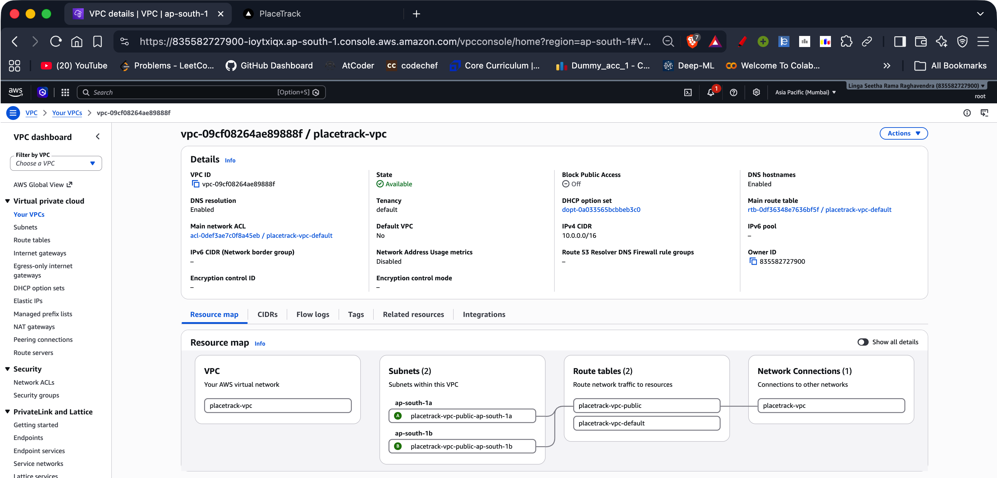
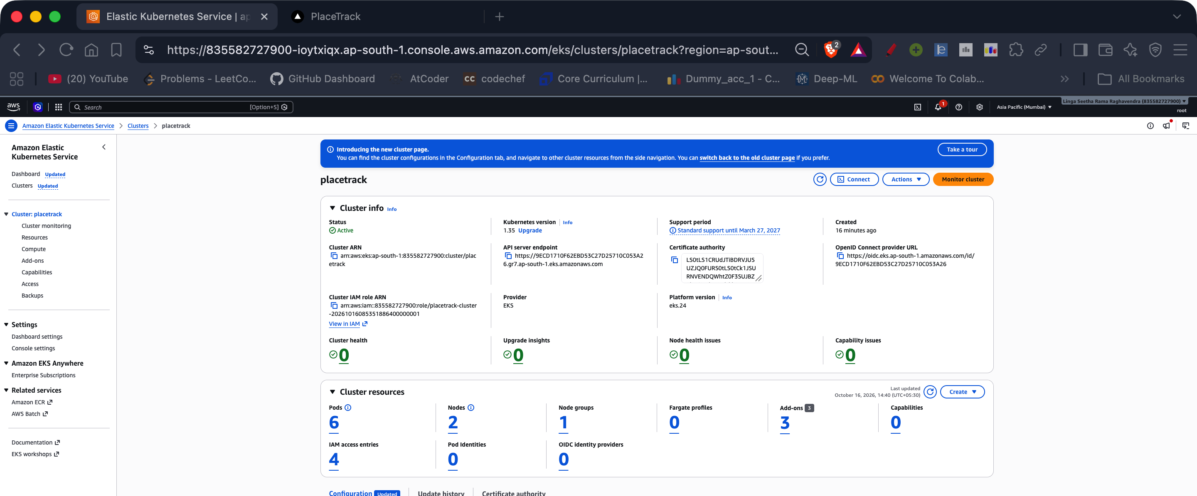
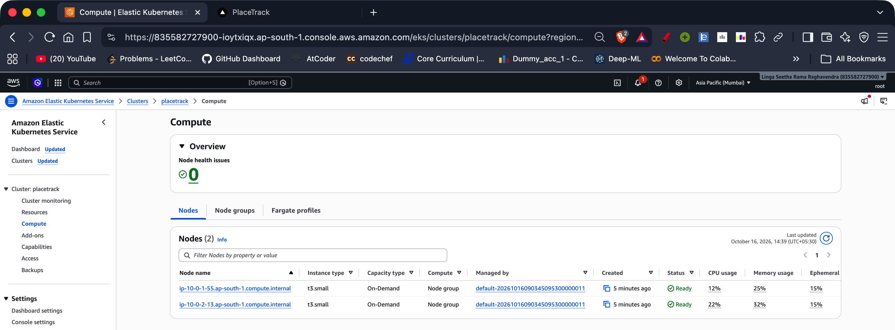
AWS console: VPC, cluster, nodes
EKS cluster placetrack: Active, Kubernetes 1.35
10.0.0.0/16
2
Mumbai
VPC placetrack-vpc
public subnets, one in each of 2 zones
region ap-south-1
Two t3.small nodes, both Ready
Notes:
After terraform apply I checked everything in the AWS Console, in the Mumbai region. The VPC placetrack-vpc has two public subnets, one in ap-south-1a and one in ap-south-1b. The EKS cluster is Active on Kubernetes 1.35, and the node group has two t3.small nodes, both Ready. I destroyed all of it right after, as you saw on the previous slide.

Slide 14
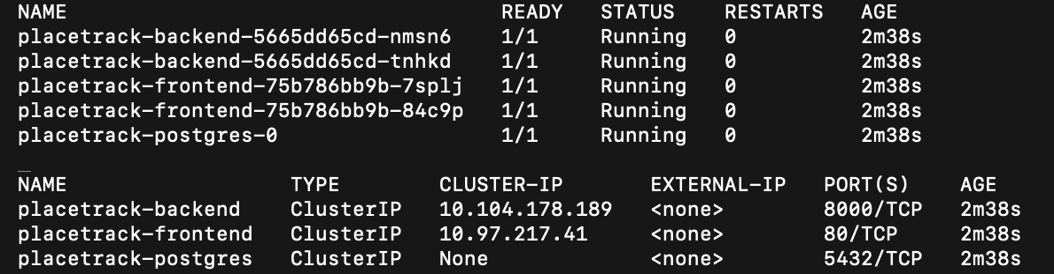
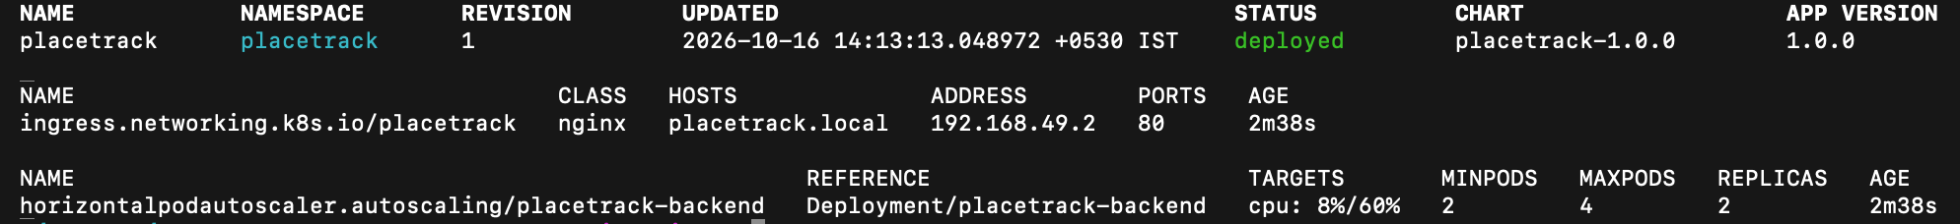
Kubernetes deployment with Helm
kubectl get pods and svc -n placetrack
helm/placetrack/
Chart.yaml
chart info
values.yaml
replicas, host, HPA
backend.yaml
2 replicas, ClusterIP
frontend.yaml
2 replicas, ClusterIP
postgres.yaml
database and volume
migrate-job.yaml
runs the migration
hpa.yaml
backend autoscaler
helm upgrade --install placetrack helm/placetrack -n placetrack --set image.tag=<SHA> --wait
ingress.yaml
placetrack.local
secret.yaml
database password
2 + 2
5 of 5
deployed
servicemonitor.yaml
Prometheus scrape
backend and frontend replicas
pods Running
Helm release, revision 1
Notes:
To keep the AWS bill low I ran the Kubernetes part on minikube on my laptop, using the images the pipeline pushed to GHCR. The Helm chart in helm/placetrack creates the backend and the frontend with 2 replicas each, ClusterIP services, Postgres, a Job that runs the migration, an HPA for the backend, a ServiceMonitor and an Ingress. One helm upgrade install command with the image tag deploys all of it, and the namespace comes from k8s/namespace.yaml. In the zoomed output you can see five pods all Running with no restarts, three ClusterIP services, and the Helm release in the deployed state.

Slide 15
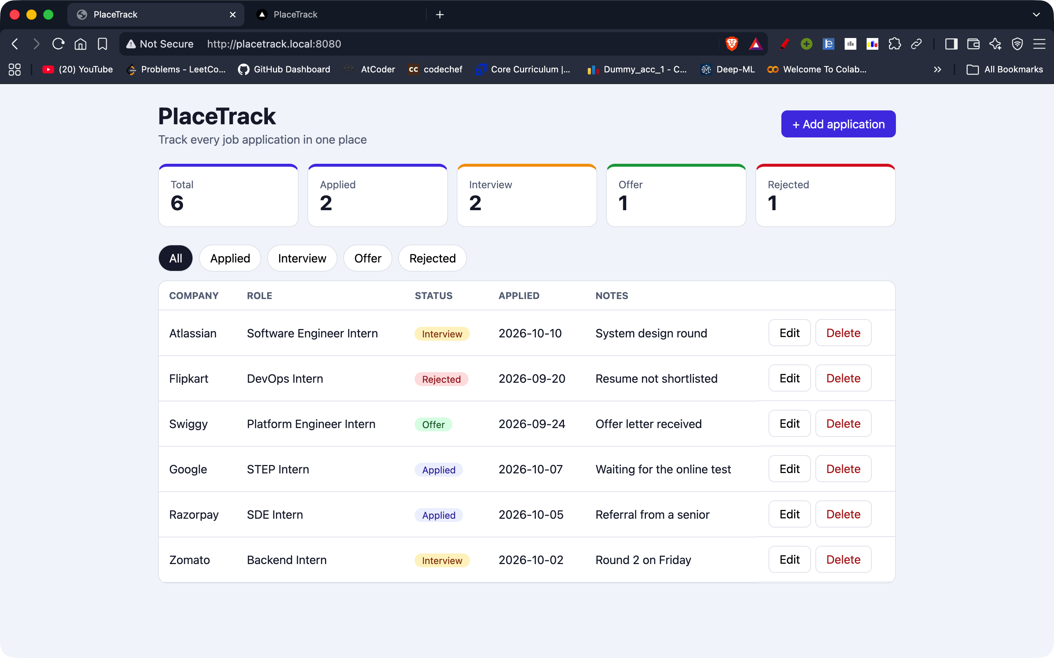
Ingress: placetrack.local
Browser
placetrack.local:8080
Ingress (nginx)
host placetrack.local
/
/api
frontend
ClusterIP :80
backend
ClusterIP :8000
On minikube
port-forward ingress-nginx to 8080, and 127.0.0.1 placetrack.local in /etc/hosts
Served from the cluster, from the images in GHCR
Notes:
The Ingress handles traffic for the host placetrack.local. Slash goes to the frontend service and slash api goes to the backend service, and both are ClusterIP services inside the cluster. On minikube I port-forward the ingress controller to port 8080 and added placetrack.local to my hosts file, so the address in the browser is placetrack.local:8080. This is the same app you saw at the start, but now it is served from the cluster, through the ingress, from the images in GHCR.

Slide 16
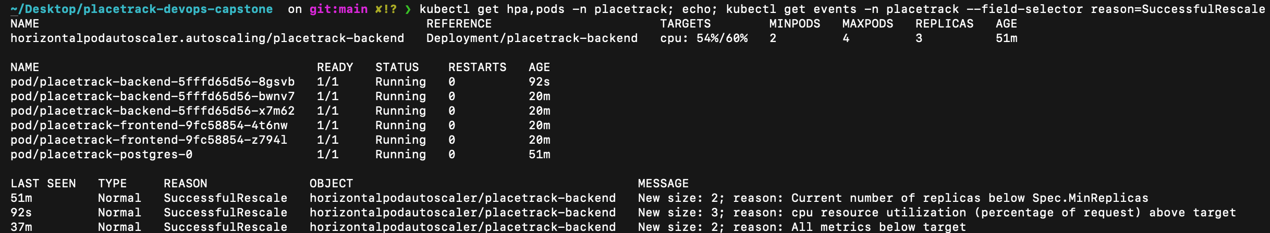
Autoscaling: the HPA adds a pod
2
4
60%
3
minimum backend pods
maximum backend pods
CPU target
backend pods after the load test
Event: New size: 3, because cpu resource utilization (percentage of request) is above target
Notes:
The backend has a Horizontal Pod Autoscaler with a minimum of 2 pods, a maximum of 4, and a target of 60 percent CPU. When I ran the load test script, CPU went above the target and the HPA added a third backend pod. The events at the bottom show it: new size 3, because CPU utilization is above target. The same event list shows it going back to 2 when all metrics were below target. This works because the pods have CPU requests set in the chart, and the minikube metrics-server addon is enabled.

Slide 17
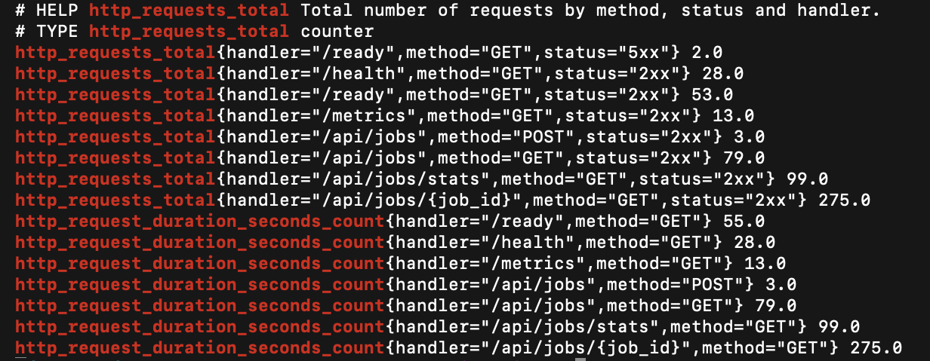
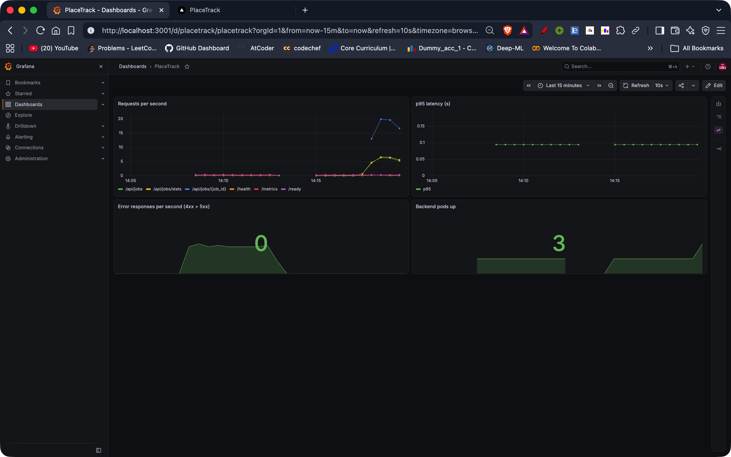
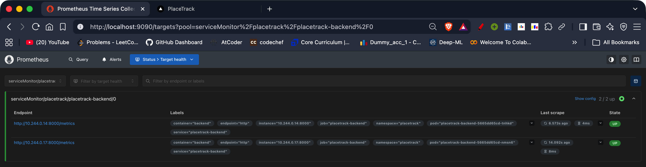
Monitoring: Prometheus and Grafana
1. The backend exposes /metrics
3. A small Grafana dashboard
2. Prometheus scrapes both pods: 2 / 2 up
0
error responses per second
3
backend pods up, after the HPA scaled
Notes:
The backend exposes slash metrics in Prometheus format. The first screenshot shows the request counters per endpoint, with method and status. The ServiceMonitor in my chart tells Prometheus to scrape the backend pods, and the targets page shows both pods up, 2 of 2. I made a small Grafana dashboard with requests per second, p95 latency, error responses and the number of backend pods. At this moment it shows 0 errors, and 3 pods because the HPA had just scaled up. So monitoring and autoscaling connect to each other.

Slide 18
Troubleshooting: two broken manifests
1. Bad image tag
2. Service selector mismatch
Symptom
Pod 0/1, status ErrImagePull
Symptom
Pod Running, but the Service has no endpoints (<none>)
Cause
The manifest uses tag does-not-exist, which is not in GHCR
Cause
Service selects app=tb-service, the pod is labelled app=tb-svc
Fix
kubectl set image to the commit SHA tag the pipeline pushed
Fix
kubectl patch svc to select app=tb-svc
Verify
New pod 1/1 Running, old pod Terminating
Verify
Endpoint 10.244.0.23:80 appears
kubectl -n placetrack set image deploy/tb-image app=ghcr.io/raghavendra1729-cell/placetrack-backend:<commit SHA>
kubectl -n placetrack patch svc tb-svc -p '{"spec":{"selector":{"app":"tb-svc"}}}'
Notes:
I broke two things on purpose to practise finding problems, and I used the same steps each time: identify, investigate, root cause, fix, verify. First, a bad image tag: the pod was stuck in ErrImagePull because the tag does-not-exist is not in GHCR, so the container never started. I fixed it with kubectl set image to a SHA tag that exists in GHCR, and the new pod went to 1 of 1 Running. Second, a service with no endpoints: the pod was Running, but the Service selector was app equals tb-service while the pod label was app equals tb-svc. A Service only sends traffic to pods whose labels match exactly, so I patched the selector and the endpoint 10.244.0.23 appeared. The full write-up is in the troubleshooting folder of the repo.

Slide 19
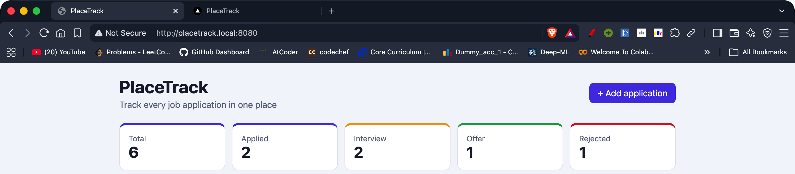
Live demo: change, push, deploy
1
Edit the subtitle
START FROM HERE
in frontend/src/App.jsx, the line under PlaceTrack
2
Commit and push
git commit, then git push to main
WATCH THE PIPELINE
3
The pipeline runs
GitHub, Actions tab, workflow CI/CD
test, frontend build, images, Trivy, push to GHCR
WATCH THE ROLLOUT
4
The deploy job runs
kubectl -n placetrack get pods -w
kubectl -n placetrack rollout status deploy/placetrack-backend
scripts/deploy.sh <SHA>, a helm upgrade on my laptop
5
Refresh the browser
placetrack.local:8080 shows the new subtitle
Notes:
For the demo I start with the app open at placetrack.local:8080. I change the subtitle in frontend/src/App.jsx, the line under the PlaceTrack heading, then git commit and git push to main. In GitHub Actions the pipeline runs: test, frontend build, then the two images with the Trivy scan and the push to GHCR. When that is green, the deploy job runs scripts/deploy.sh with the commit SHA on my laptop, which does the helm upgrade, and I watch the pods change with kubectl get pods -w. Then I refresh the browser and the new subtitle is there. That is one commit going all the way to the running cluster without me touching Kubernetes.

Slide 20
What I learned
Passing is not safe
nginx and DNS
Trivy failed my first images even though every test passed.
nginx looks up the backend name once and ignores the Kubernetes search domains. I got a 502 until I used the full service name.
Running is not Ready
Secrets and volumes
My backend pods stayed at 0/1 until they could reach Postgres, because /ready checks the database.
The database Secret has to survive helm uninstall, because the volume keeps the old password. Cluster passwords are generated at install, never committed.
Thank you
Raghavendra | 24BCS10250
github.com/Raghavendra1729-cell/placetrack-devops-capstone
Notes:
A few things I learned. A build that passes can still be insecure: Trivy failed my first images even though every test was green. nginx looks up the backend name only once when it starts and ignores the Kubernetes search domains, so I got a 502 until I used the full service name. A pod can be Running but not Ready: my backend stayed at 0 of 1 until it could reach Postgres, because the ready endpoint checks the database. The database password Secret has to survive helm uninstall because the Postgres volume still has the old password, and the cluster passwords are generated at install time and never committed. Thank you for listening, and I am happy to take questions.

