Slide 1
PlaceTrack
From a laptop to a monitored Kubernetes cluster
DevOps Final Capstone
Raghavendra | Enrollment 24BCS10250
Notes:
Hello, I am Raghavendra. This is my DevOps capstone: PlaceTrack, a job application tracker. The app is small on purpose. The project is everything around it: testing, containers, CI/CD, security scanning, Terraform, Kubernetes with Helm, and monitoring.

Slide 2
What I built
APP
PlaceTrack tracks job applications through applied, interview, offer and rejected. Every change travels the same path:
Code
React + FastAPI + Postgres
GitHub Actions
test, build, scan
GHCR
SHA-tagged images
Terraform
VPC + EKS
Helm
Kubernetes release
Prometheus + Grafana
live metrics
→
→
→
→
→
Ten graded modules, one repository. Every screenshot is a real capture; the GitHub run and AWS apply evidence are added once they are run.
Notes:
PlaceTrack lets me track every job application. Code goes through GitHub Actions for tests, builds and a security scan, images go to a registry tagged with the commit, Terraform builds the AWS network and cluster, Helm deploys, and Prometheus and Grafana watch it. Every screenshot in this deck is a real capture.

Slide 3
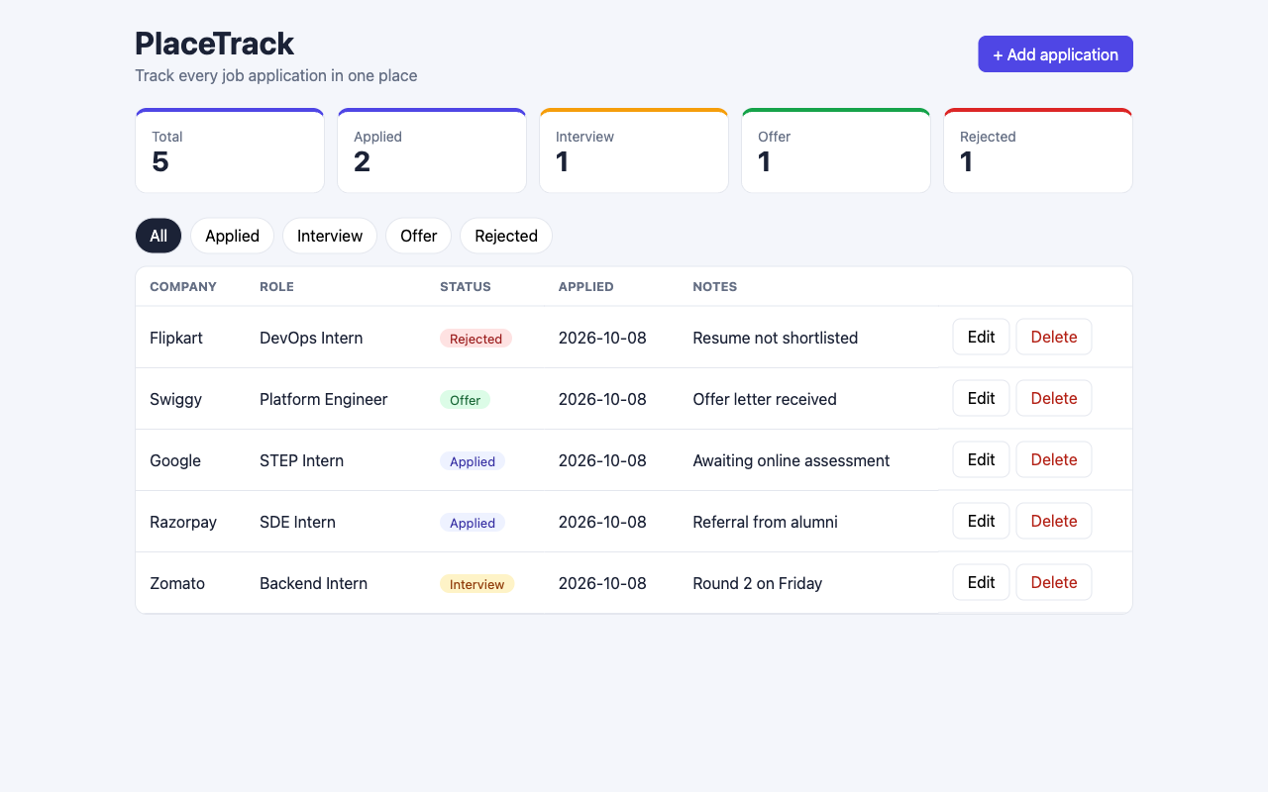
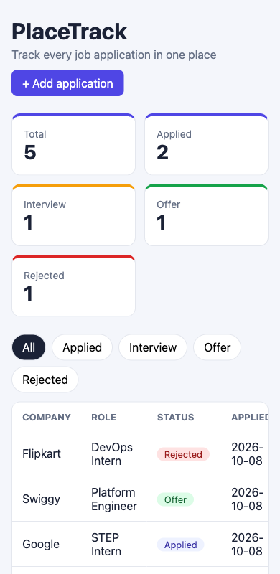
Application
M1
6
REST endpoints under /api, plus health, ready, metrics
1
Alembic migration (jobs table)
FastAPI + Postgres behind a responsive React dashboard
Notes:
The backend is FastAPI with SQLAlchemy and an Alembic migration that creates the jobs table in PostgreSQL. It has full create, read, update, delete endpoints plus a stats endpoint, and health, ready and metrics endpoints for Kubernetes and Prometheus. The React dashboard shows counts, filters and an add and edit form, and it reflows to phone width, as you can see on the right.

Slide 4
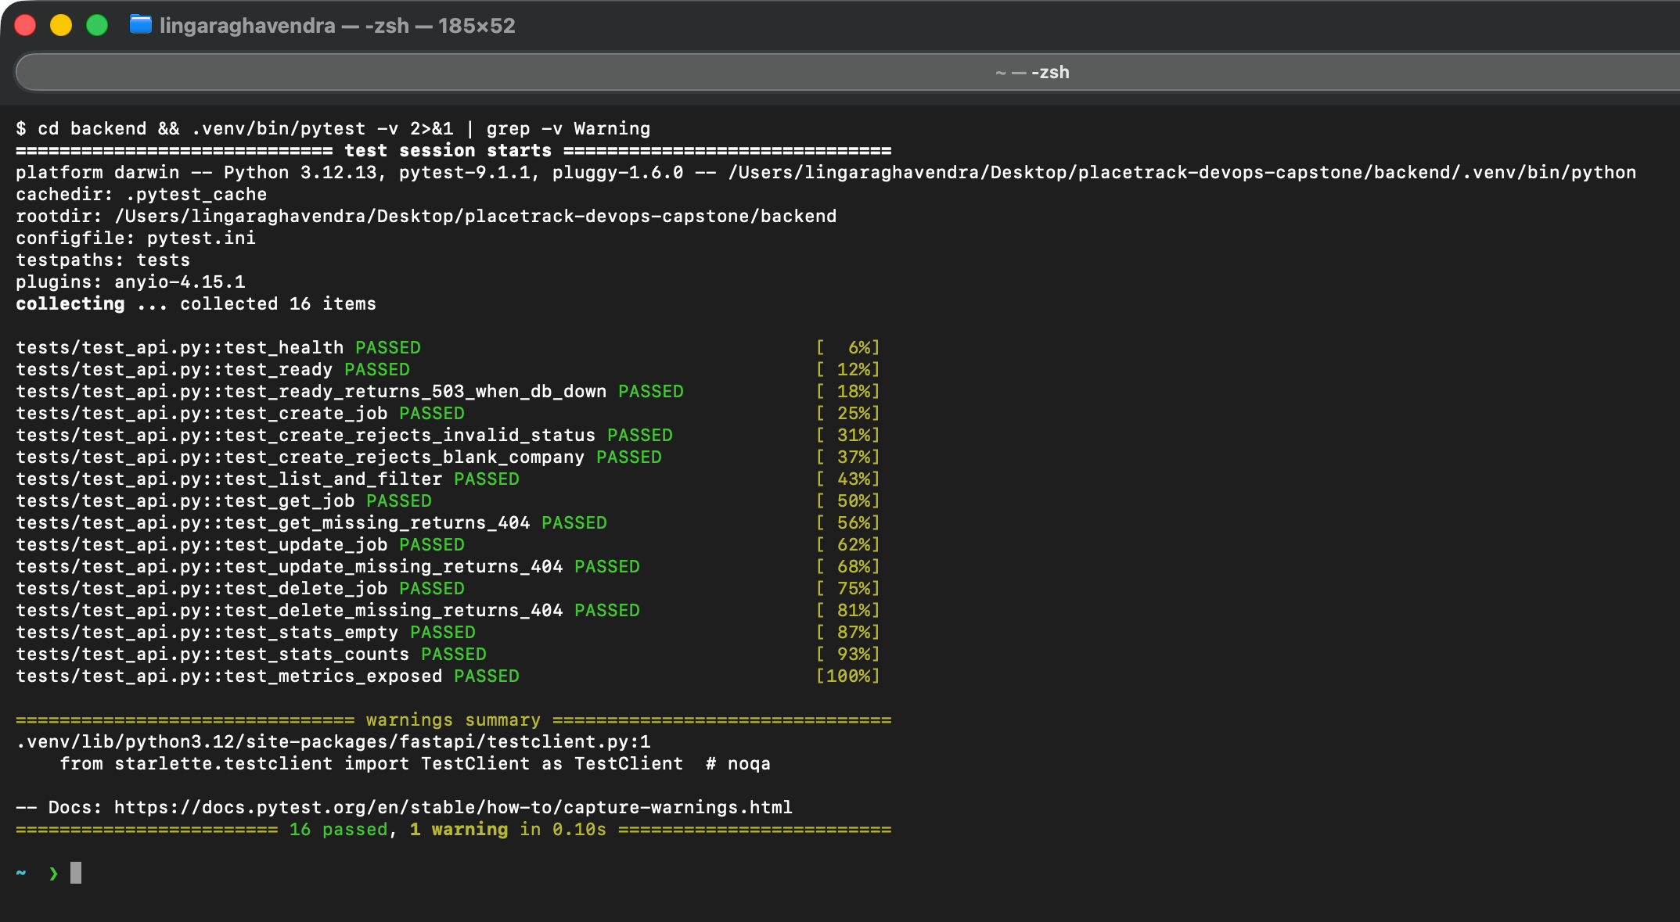
Tests
M2
16
pytest cases, all passing
Test database: in-memory SQLite via dependency override
Covers CRUD, 404, 422 and /metrics
/ready returns 503 when the database is down
pytest.ini in backend/
Notes:
There are sixteen pytest tests. They never touch the real database: FastAPI's dependency override swaps in an in-memory SQLite database. They cover every endpoint, the 404 and validation errors, the metrics endpoint, and the readiness check returning 503 when the database is unavailable. This is the real pytest output from my machine.

Slide 5
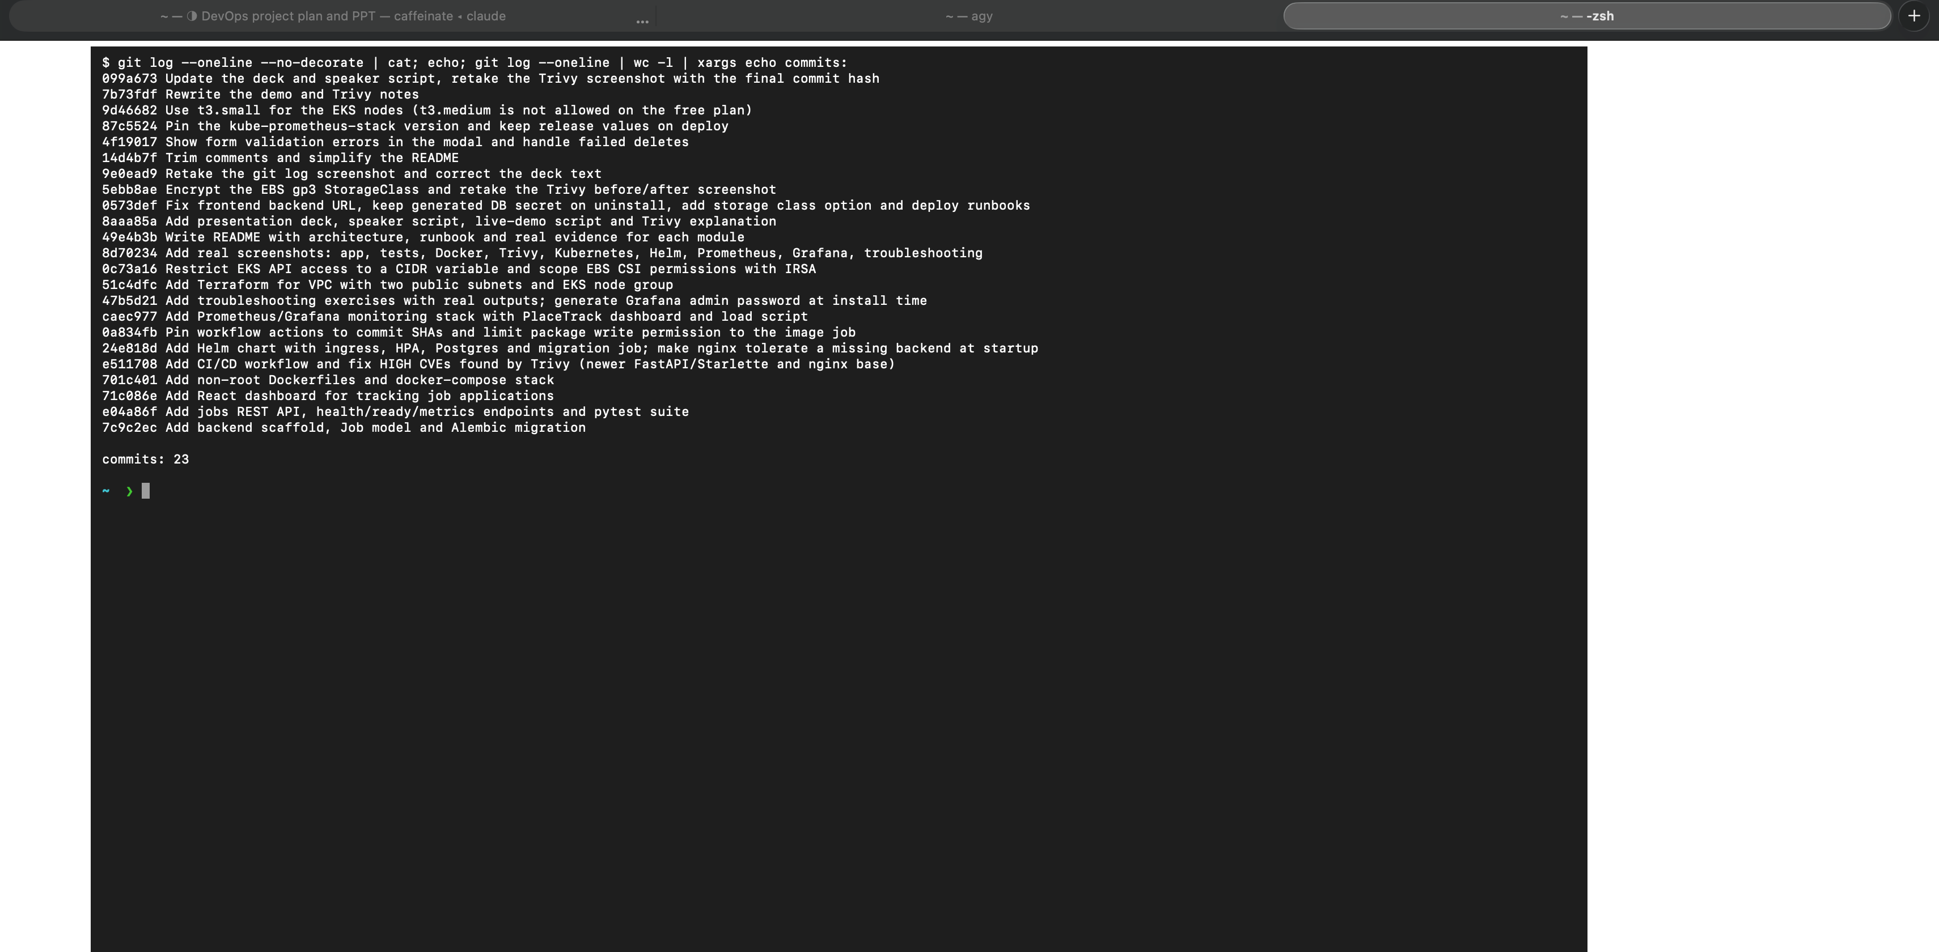
Git and GitHub
M3
23
Imperative, descriptive messages
.gitignore: .env, __pycache__, node_modules, .venv, tfstate, tfvars
Gitleaks: no secrets in history
meaningful commits so far
Notes:
Version control is small, descriptive commits. The gitignore keeps environment files, caches, node modules, virtual environments and Terraform state out of the repository, and Gitleaks confirms there are no secrets anywhere in the history.

Slide 6
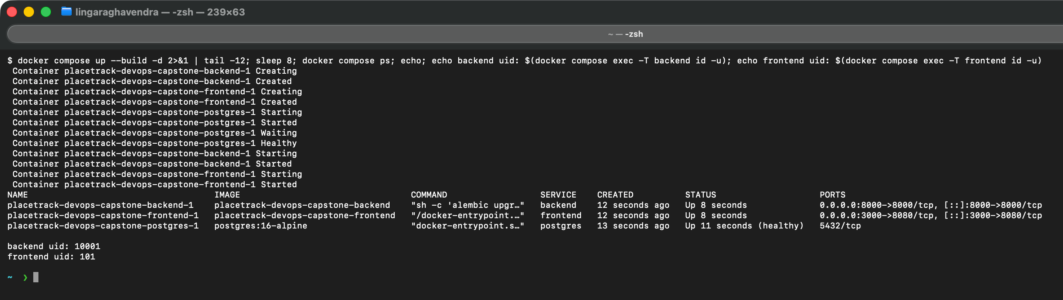
Docker
M4
Backend image: python:3.12-slim, user 10001
Frontend: multi-stage, Node builds, nginx-unprivileged serves, user 101
docker compose up --build starts postgres, backend, frontend
Migrations run before the API starts
Notes:
The backend and frontend images both run as non-root users. The frontend Dockerfile is multi-stage: Node builds the bundle, and an unprivileged nginx image serves it. One command, docker compose up with build, starts Postgres, the backend with its migrations, and the frontend. The screenshot shows all three services up and the user IDs inside the containers.

Slide 7
CI/CD pipeline
M5
pytest
frontend build
docker build x2
Trivy gate
push to GHCR
→
→
→
→
Runs on every push to main (and on pull requests)
A failing test or a HIGH/CRITICAL CVE stops the pipeline
Images tagged with the commit SHA, never latest
Actions pinned to commit SHAs; write access only on the image job
Status: every step was run locally (pytest, build, Docker, Trivy, Gitleaks). Nothing is pushed yet, so the Actions run link and GHCR page get added after the first push.
Notes:
The workflow runs on every push to main. It runs pytest, builds the frontend, builds both Docker images, scans them with Trivy, and only then pushes them to GitHub Container Registry, tagged with the commit SHA instead of latest. If a test fails or Trivy finds a fixable high or critical vulnerability, nothing is published. The actions are pinned to exact commits and only the image job can write packages. I have not pushed the repository yet, so I ran each of these steps locally; the live run link comes after the first push.

Slide 8
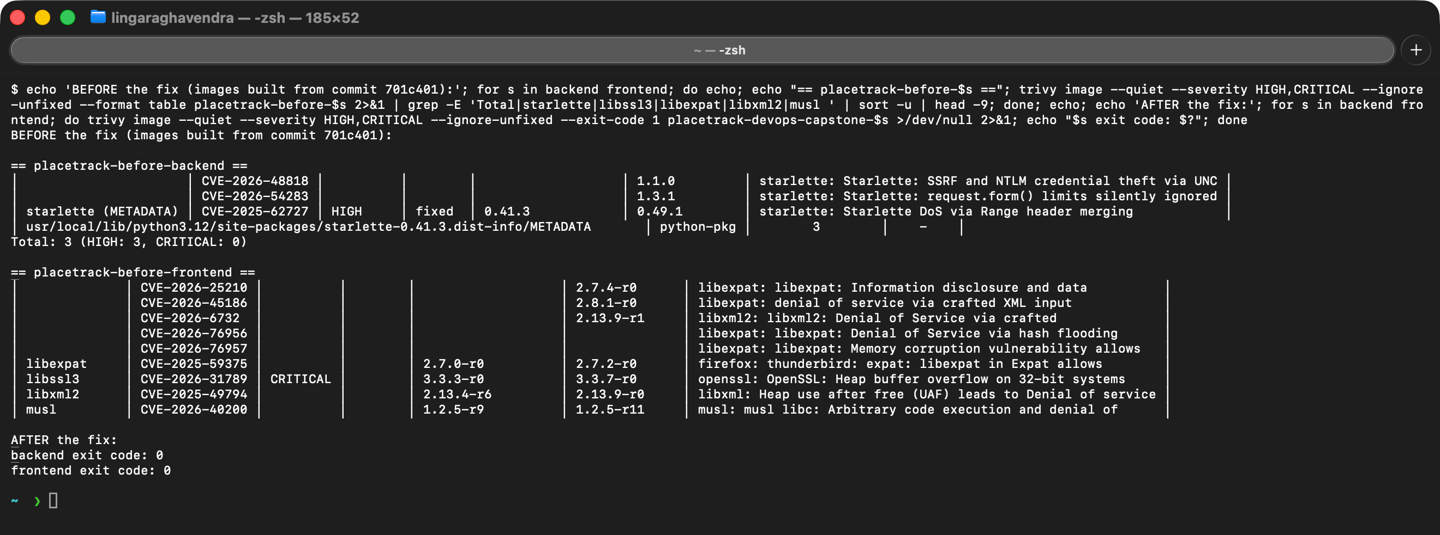
Security scan
M6
3 → 0
backend HIGH findings (Starlette)
42 → 0
frontend HIGH + CRITICAL (Alpine libs)
Example: CVE-2025-62727, Starlette denial of service through crafted Range headers. Fixed by upgrading FastAPI and the nginx base image, then scanning again: exit code 0.
Notes:
Trivy scans both images for fixable high and critical vulnerabilities and fails the pipeline if it finds any. My first scan failed: the backend had three high findings in Starlette, for example CVE-2025-62727, where crafted Range headers can cause denial of service, and the old nginx base image had forty-two high and critical findings in system libraries such as OpenSSL. I fixed them by upgrading FastAPI, which brings a patched Starlette, and moving to a current nginx image. Both scans now exit with zero. A clean scan means no fixable high or critical vulnerability exists in the image at scan time, which is why it runs on every build.

Slide 9
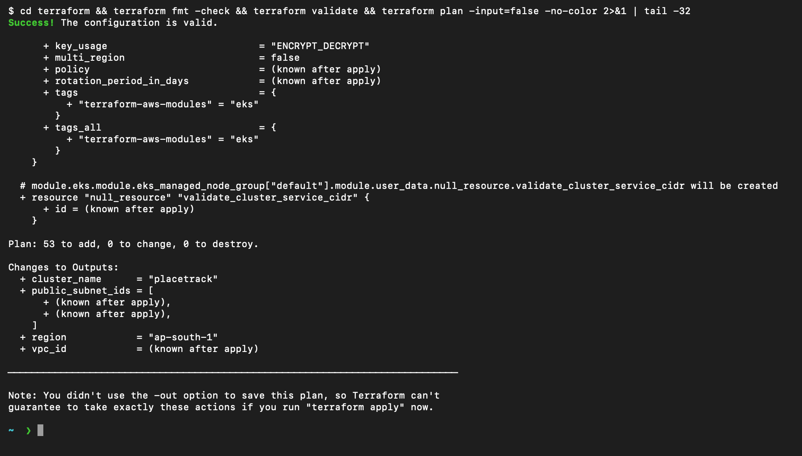
Terraform on AWS
M7
VPC with 2 public subnets in 2 availability zones
EKS cluster + managed node group, 2 x t3.small
EBS CSI driver with its own IRSA role
API endpoint restricted to my IP; no secrets in code
plan: 53 to add, 0 to change, 0 to destroy
Status: init, validate and plan are done. Apply, the AWS Console screenshots and destroy are added after the cluster is created, then destroyed to stop billing.
Notes:
Terraform builds a VPC with two public subnets in two availability zones and an EKS cluster with a managed node group of two nodes. I restricted the cluster API to my own IP address, and gave the EBS storage driver its own narrowly scoped role instead of attaching a policy to every node. The plan shows fifty-three resources to add and nothing to change or destroy. Applying creates billable resources, so the apply, the console screenshots and the destroy are the remaining evidence for this module.

Slide 10
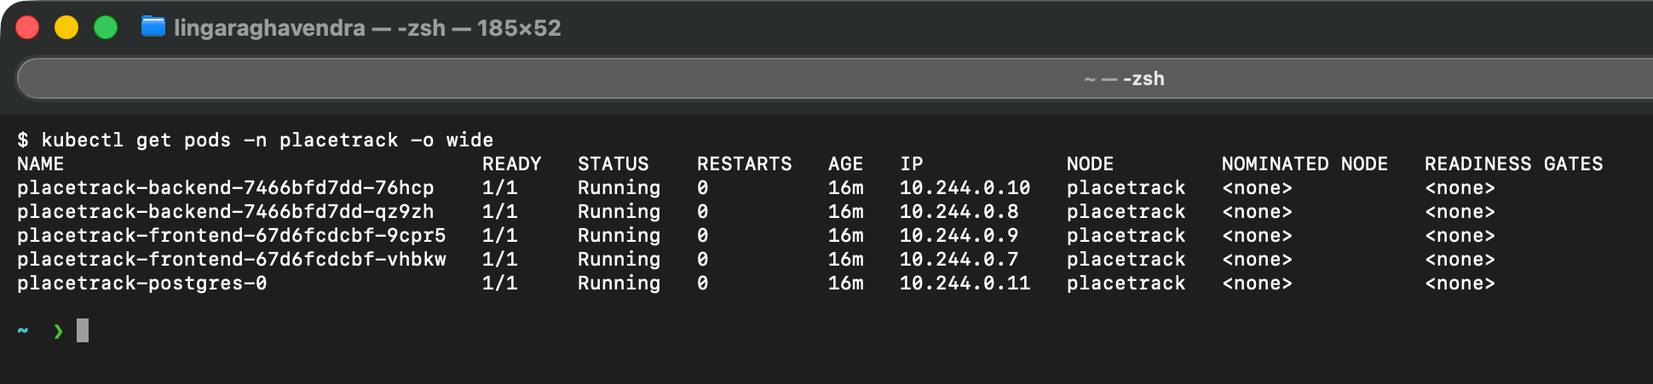
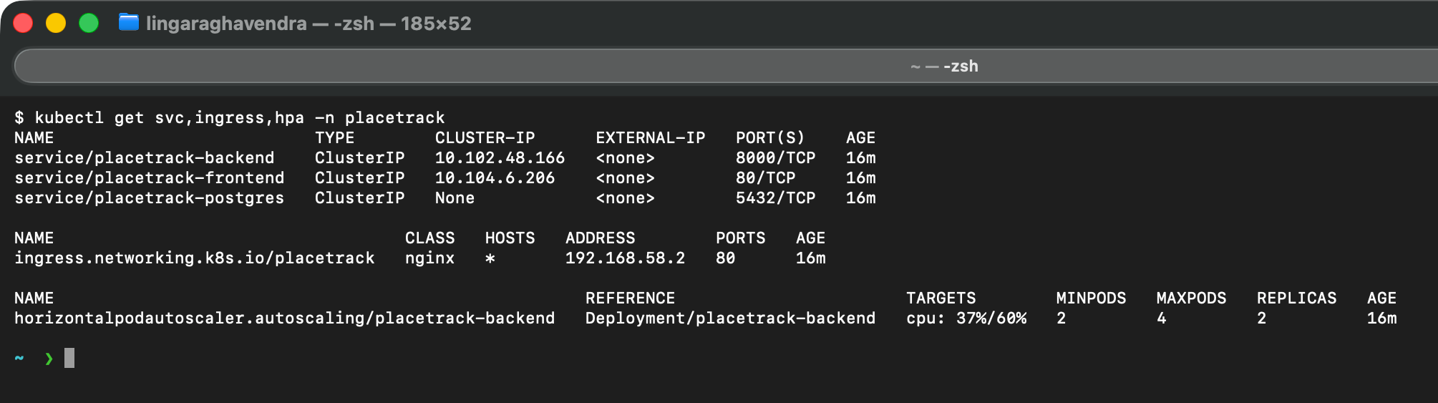
Kubernetes and Helm
M8
Notes:
A single Helm chart deploys everything into the placetrack namespace: two replicas each of the backend and frontend, a Postgres StatefulSet, ClusterIP services, an Ingress that sends slash to the frontend and slash api to the backend, and a horizontal pod autoscaler. A Helm hook job runs the database migration after install. All pods are running with zero restarts.

Slide 11
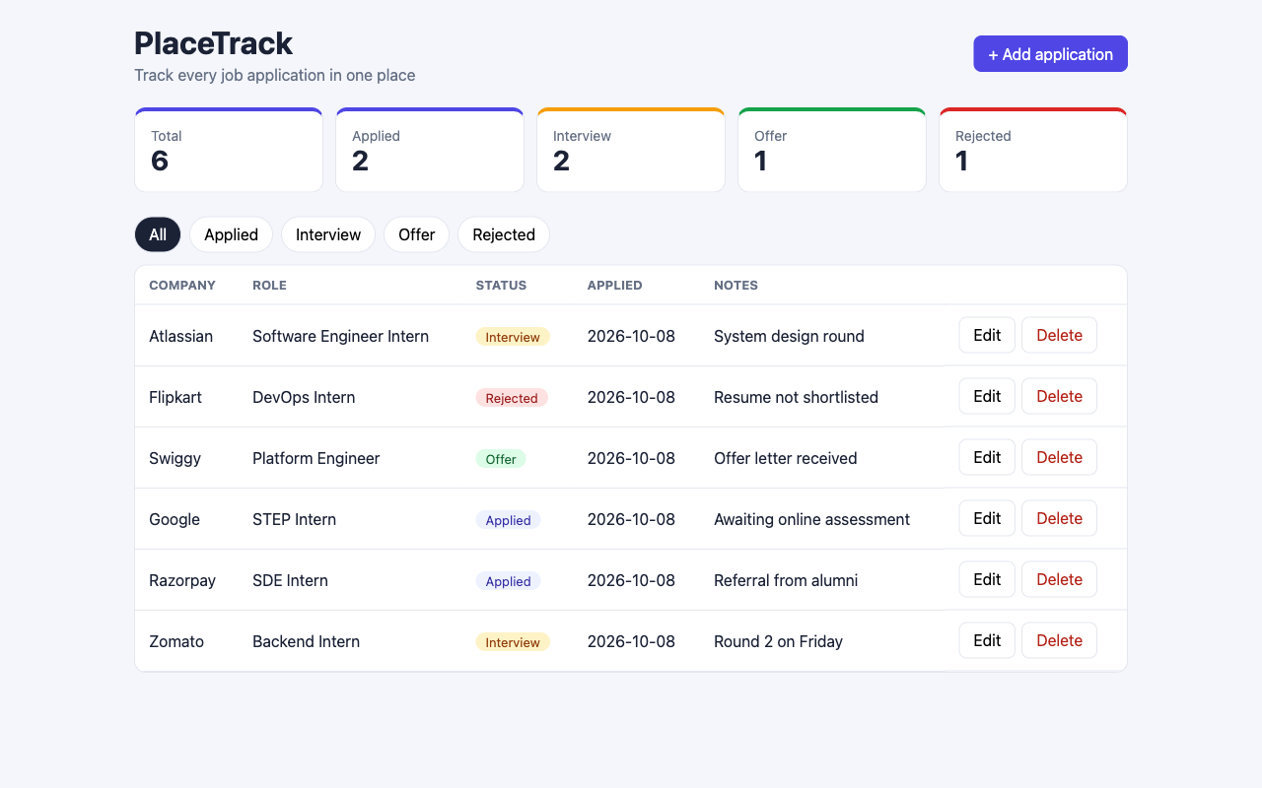
Through the Ingress
M8
Ingress sends / to the frontend and /api to the backend, which uses Postgres
Live data written through /api
Same chart for minikube and EKS (EKS adds a gp3 StorageClass)
Notes:
This is the application loaded in a browser through the Kubernetes Ingress controller. The page comes from the frontend service, and its calls to slash api are routed by the same Ingress to the backend, which talks to Postgres. The chart is the same for minikube and for EKS.

Slide 12
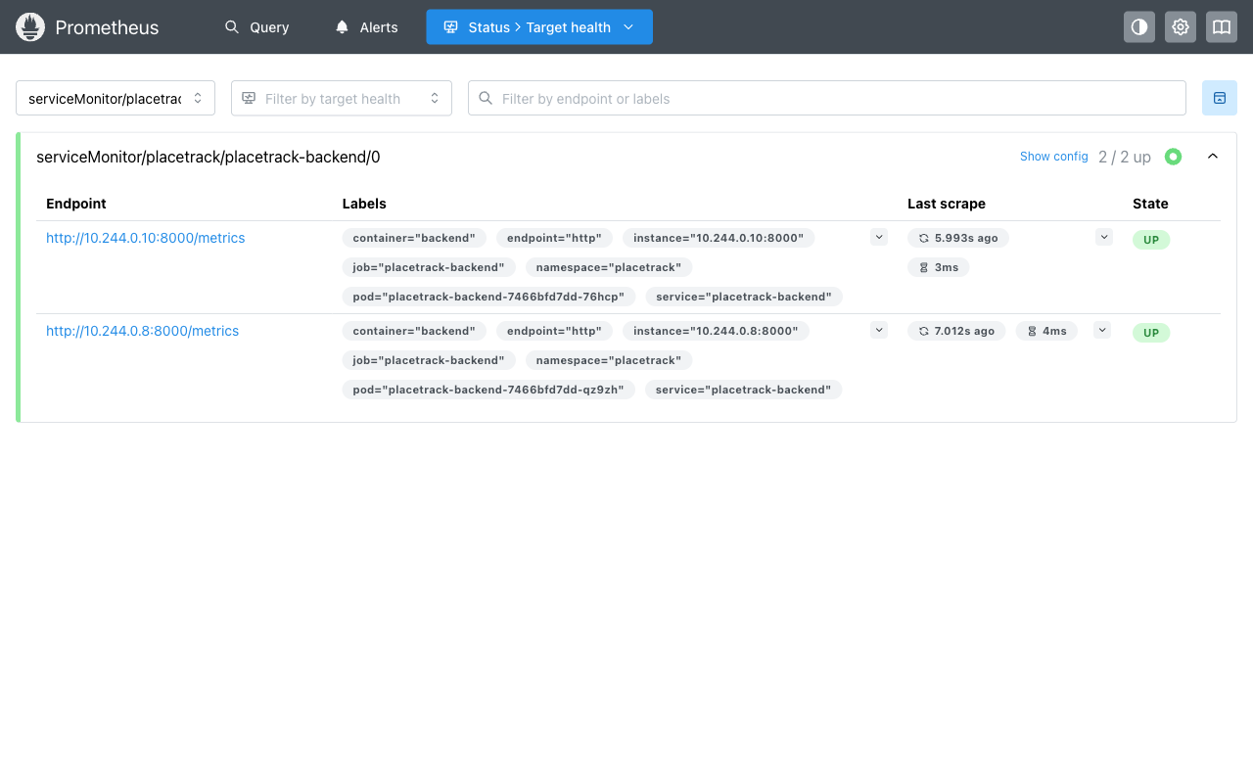
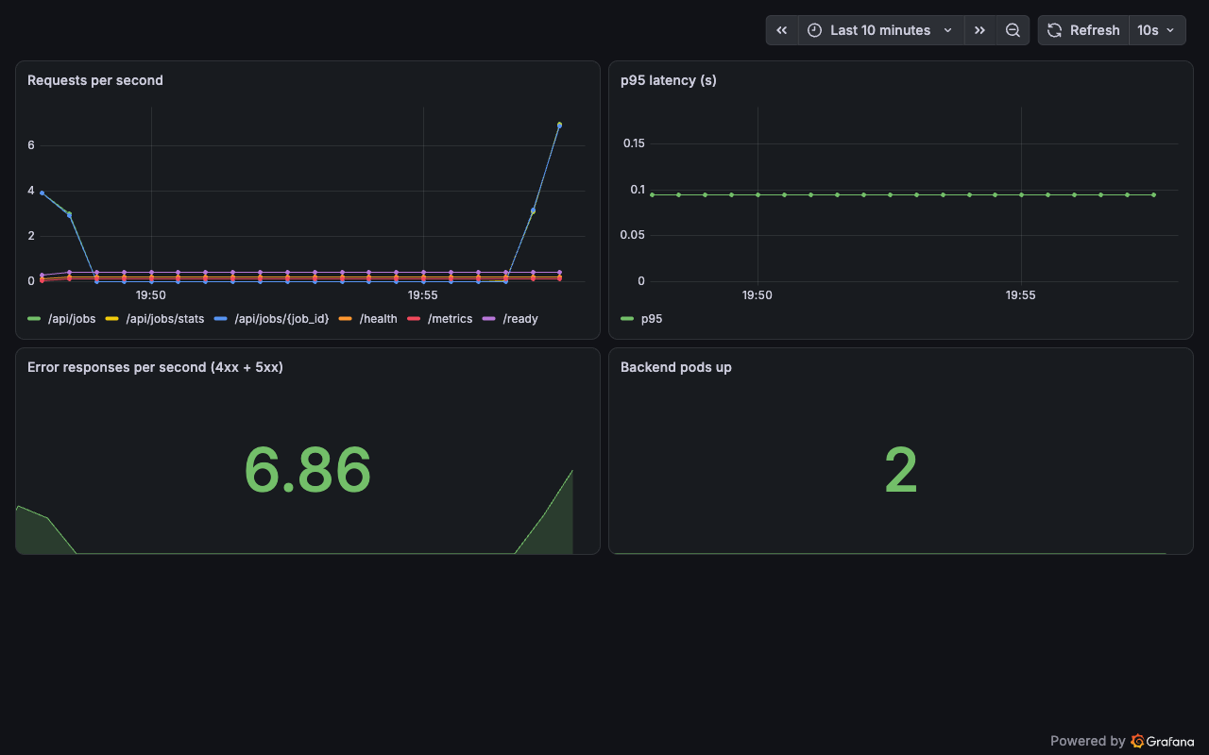
Observability
M9
/metrics exposed by FastAPI; ServiceMonitor makes Prometheus scrape both pods
Dashboard: request rate, p95 latency, error responses, pods up
Notes:
The backend exposes Prometheus metrics. A ServiceMonitor tells Prometheus to scrape both backend pods, and the targets page shows both up. The Grafana dashboard I built shows request rate per endpoint, the ninety-fifth percentile latency, error responses and the number of healthy backend pods. These panels have live data from a load test, not mock data.

Slide 13
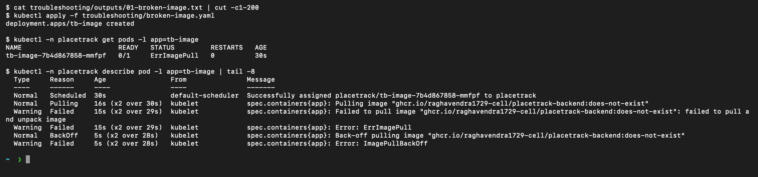
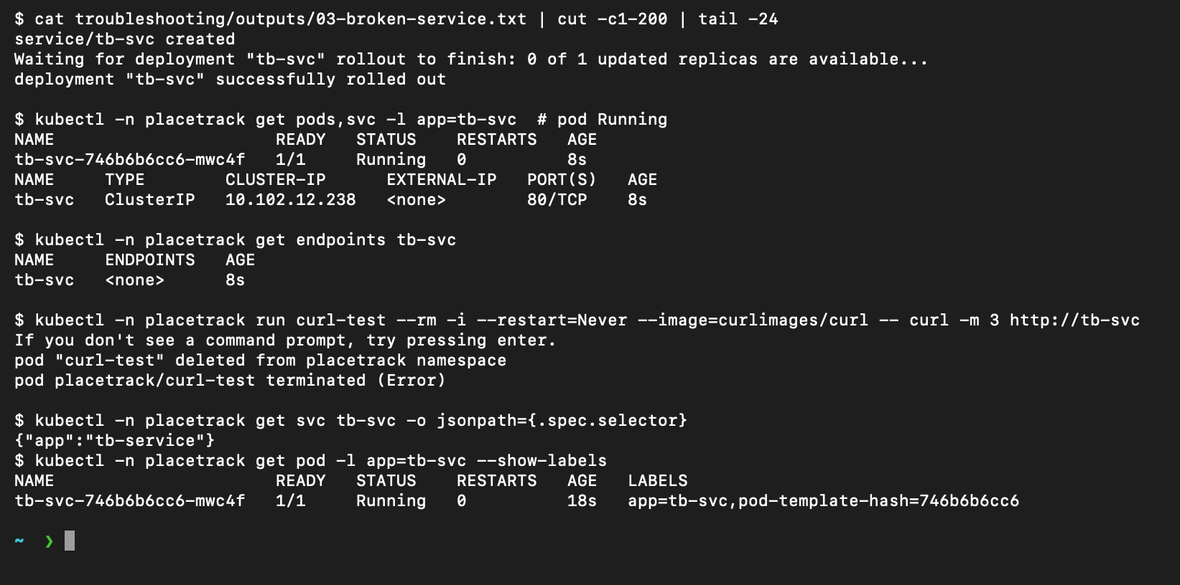
Troubleshooting
FIX
Bad image tag
Selector mismatch
Symptom: ImagePullBackOff
Cause: Tag does not exist in the registry
Fix: Point the Deployment at a real tag
Symptom: Pod Running, endpoints <none>
Cause: Service selector app=tb-service, pod label app=tb-svc
Fix: Patch the selector to match
Notes:
I broke the cluster in two ways and fixed both. First, a deployment with an image tag that does not exist ends in ErrImagePull and ImagePullBackOff; describe pod showed the pull failure and the fix was a valid tag. Second, a service whose selector had a typo: the pod was Running but the service had no endpoints, so nothing was reachable. Comparing the selector with the pod labels revealed it. The full five-step write-ups are in the troubleshooting folder.

Slide 14
Live demo flow
DEMO
1
2
3
4
5
Edit a visible string
git commit and push
Pipeline runs
scripts/deploy.sh <sha>
Refresh the browser
frontend/src/App.jsx
triggers Actions
tests, build, Trivy, push
helm upgrade
new text is live
Commit a change, watch the pipeline run, see the deployment update.
Notes:
For the live demo I change a visible string in the React app, commit and push. GitHub Actions runs the tests, builds, scans and pushes the images tagged with the new commit. Then I run the deploy script with that SHA, Helm rolls out the new pods, and refreshing the browser shows the change.

Slide 15
What I learned
1
A passing build is not a secure build: Trivy failed my first images
2
nginx needs a runtime resolver and the full Service DNS name (502 became 200)
3
Running is not Ready, and Ready is not reachable
4
Secrets are generated, never committed
Thank you
Notes:
Four things I will remember. A passing build is not a secure build: Trivy failed my first images and I had to fix real vulnerabilities. nginx resolves upstream names once at startup, which caused a crash loop until I used a runtime resolver, and a request through the frontend service then showed that the resolver ignores search domains, so I switched to the full service DNS name and the 502 became a 200. Running does not mean ready, and ready does not mean reachable. And secrets are generated at deploy time, never committed. Thank you.

