Slide 1
PlaceTrack
From a laptop to a monitored Kubernetes cluster
DevOps Final Capstone
Raghavendra | Enrollment 24BCS10250
Notes:
Hello, I am Raghavendra. This is my DevOps capstone: PlaceTrack, a job application tracker. The app is small on purpose. The project is everything around it: testing, containers, CI/CD, security scanning, Terraform, Kubernetes with Helm, and monitoring.

Slide 2
What I built
APP
PlaceTrack tracks job applications through applied, interview, offer and rejected. Every change goes through these steps:
Code
React + FastAPI + Postgres
GitHub Actions
test, build, scan
GHCR
SHA-tagged images
Terraform
VPC + EKS
Helm
Kubernetes release
Prometheus + Grafana
live metrics
→
→
→
→
→
All screenshots in this deck are from my own runs.
Notes:
PlaceTrack lets me track every job application. Code goes through GitHub Actions for tests, builds and a security scan, images go to a registry tagged with the commit, Terraform builds the AWS network and cluster, Helm deploys, and Prometheus and Grafana watch it. All screenshots in this deck are from my own runs.

Slide 3
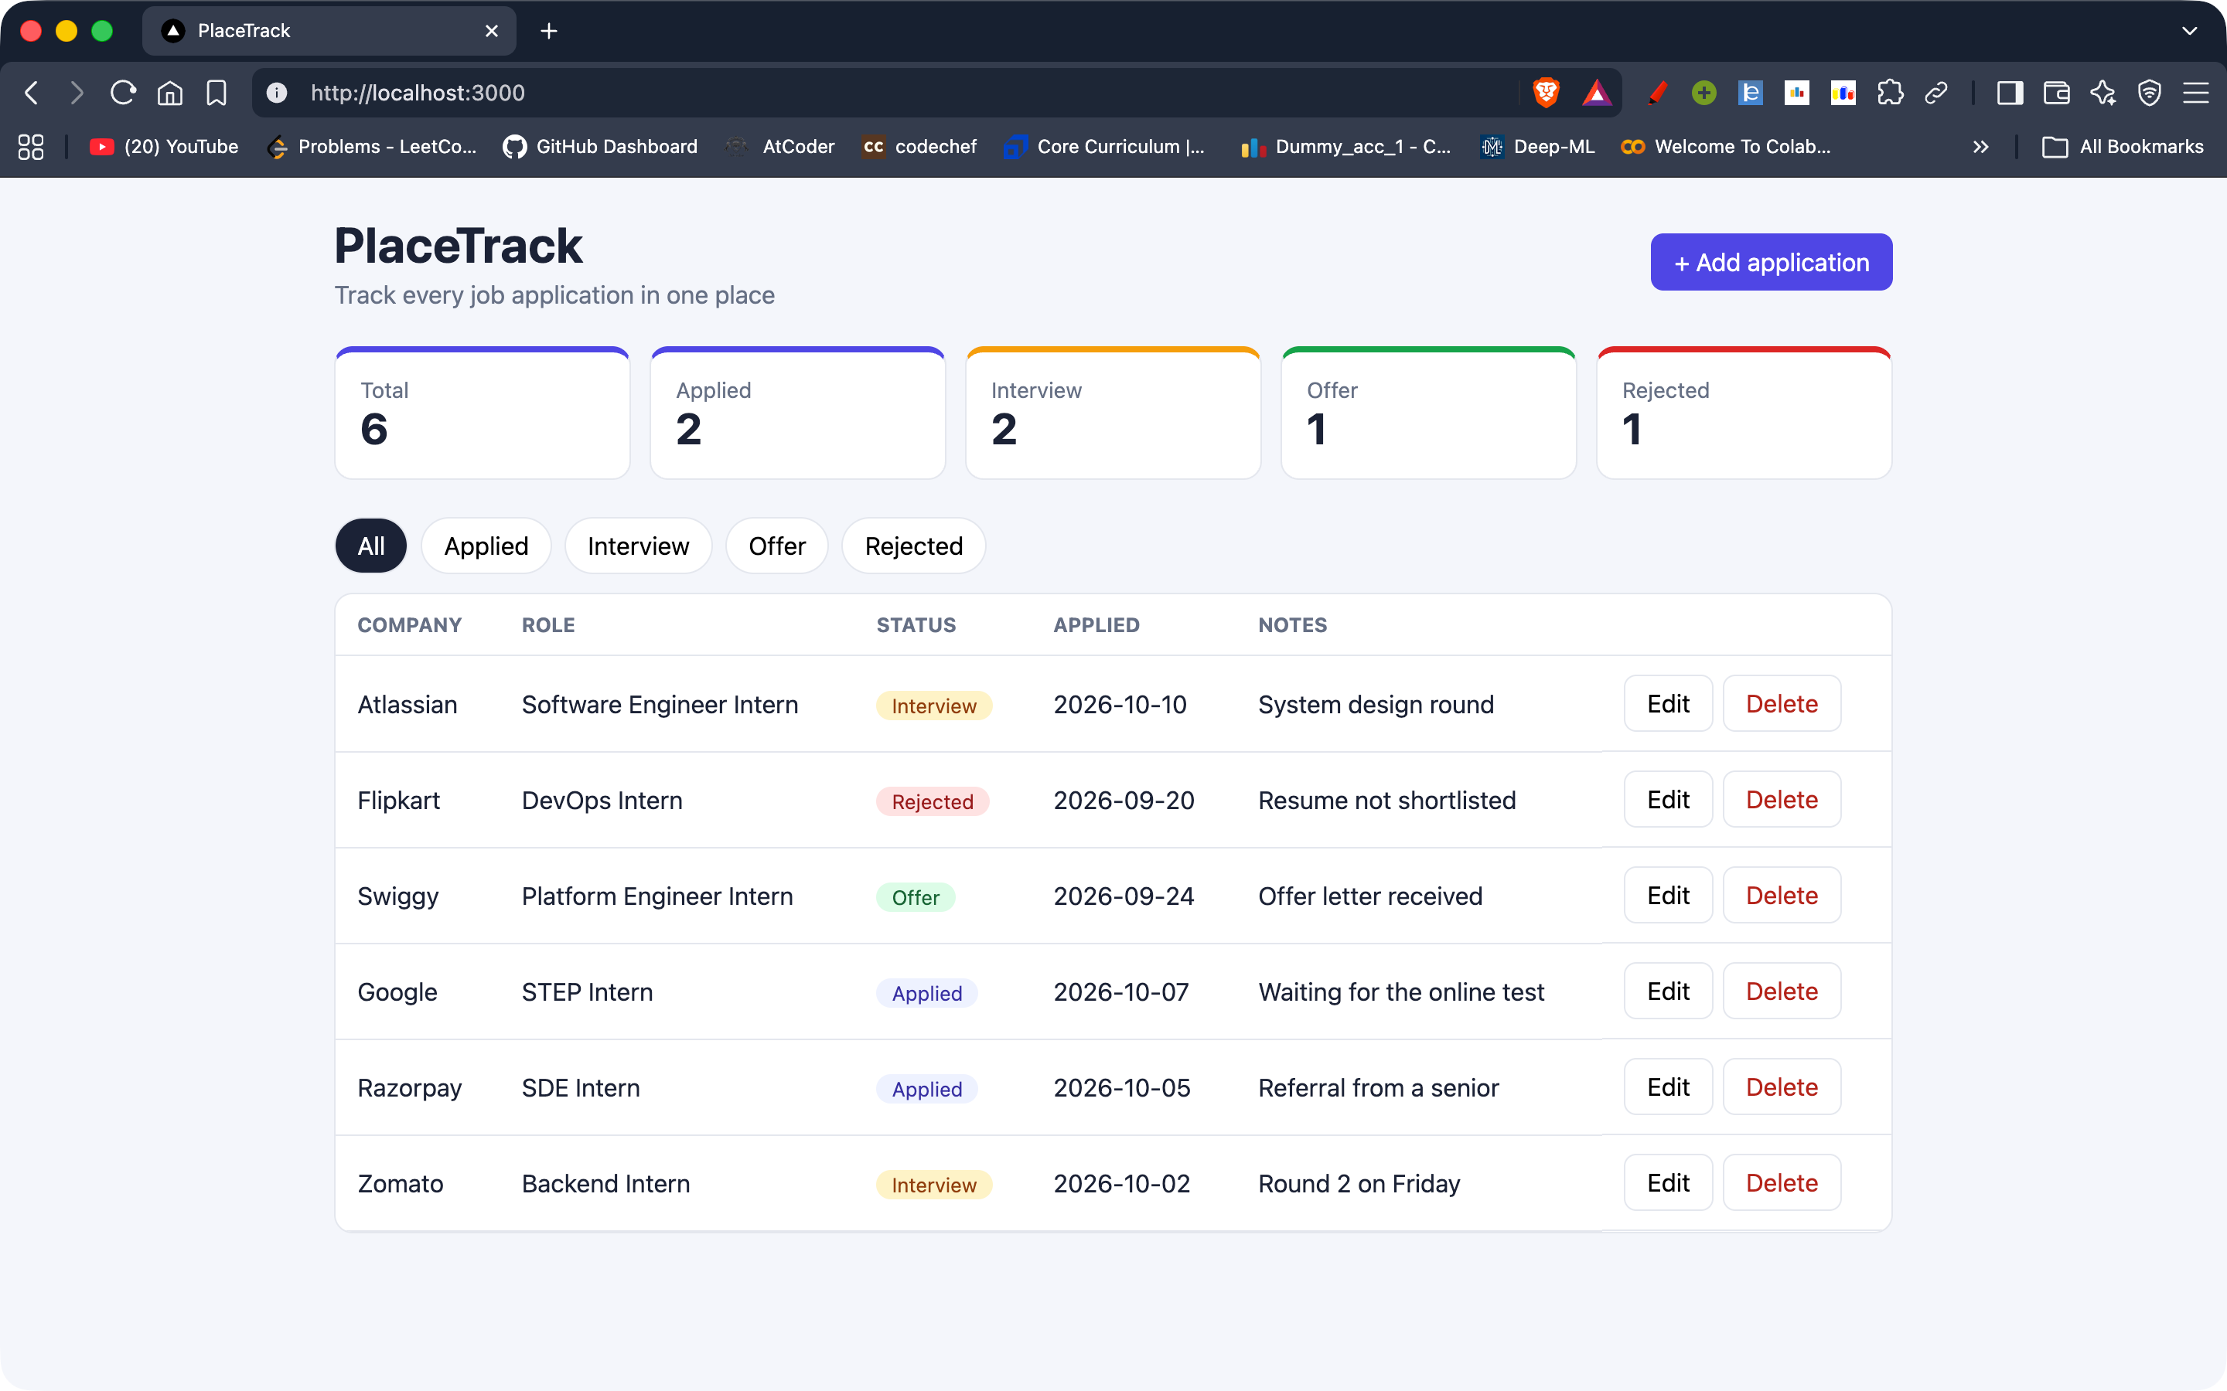
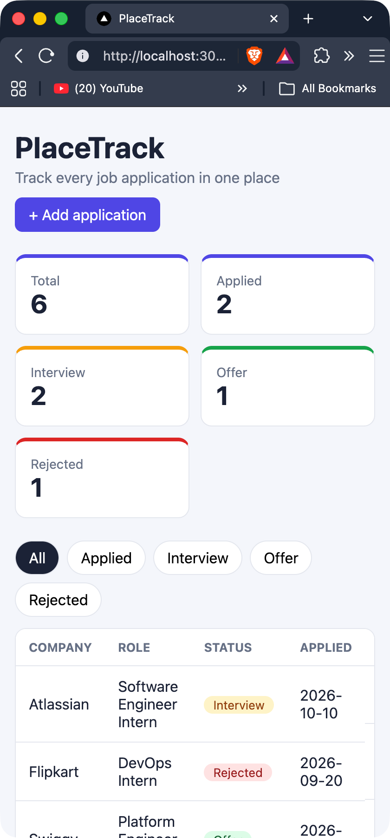
Application
M1
6
REST endpoints under /api, plus health, ready, metrics
1
Alembic migration (jobs table)
FastAPI + Postgres behind a responsive React dashboard
Notes:
The backend is FastAPI with SQLAlchemy and an Alembic migration that creates the jobs table in PostgreSQL. It has full create, read, update, delete endpoints plus a stats endpoint, and health, ready and metrics endpoints for Kubernetes and Prometheus. The React dashboard shows counts, filters and an add and edit form, and it reflows to phone width, as you can see on the right.

Slide 4
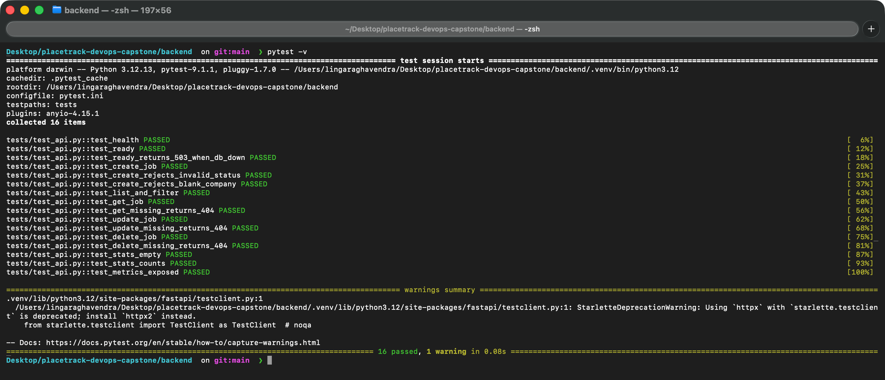
Tests
M2
16
pytest cases, all passing
Test database: in-memory SQLite via dependency override
Covers CRUD, 404, 422 and /metrics
/ready returns 503 when the database is down
pytest.ini in backend/
Notes:
There are sixteen pytest tests. They never touch the real database: FastAPI's dependency override swaps in an in-memory SQLite database. They cover every endpoint, the 404 and validation errors, the metrics endpoint, and the readiness check returning 503 when the database is unavailable. This is the real pytest output from my machine.

Slide 5
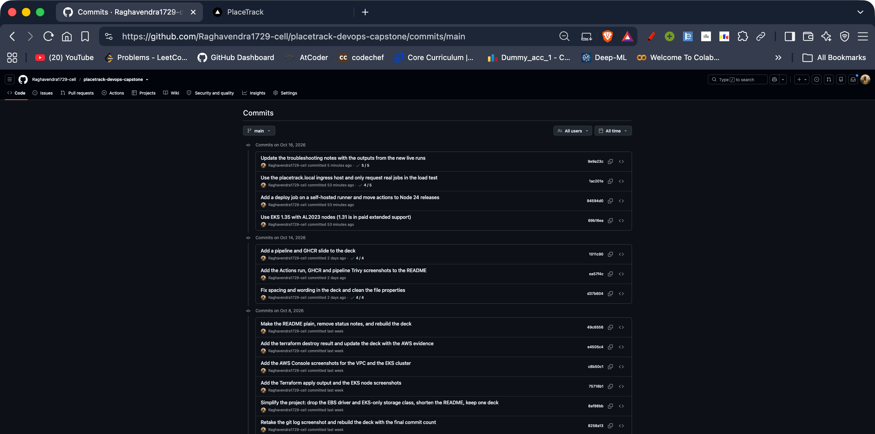
Git and GitHub
M3
38
Imperative, descriptive messages
.gitignore: .env, __pycache__, node_modules, .venv, tfstate, tfvars
Gitleaks: no secrets in history
commits on GitHub
Notes:
Version control is small, descriptive commits, thirty-eight of them on GitHub. The gitignore keeps environment files, caches, node modules, virtual environments and Terraform state out of the repository, and Gitleaks confirms there are no secrets anywhere in the history.

Slide 6
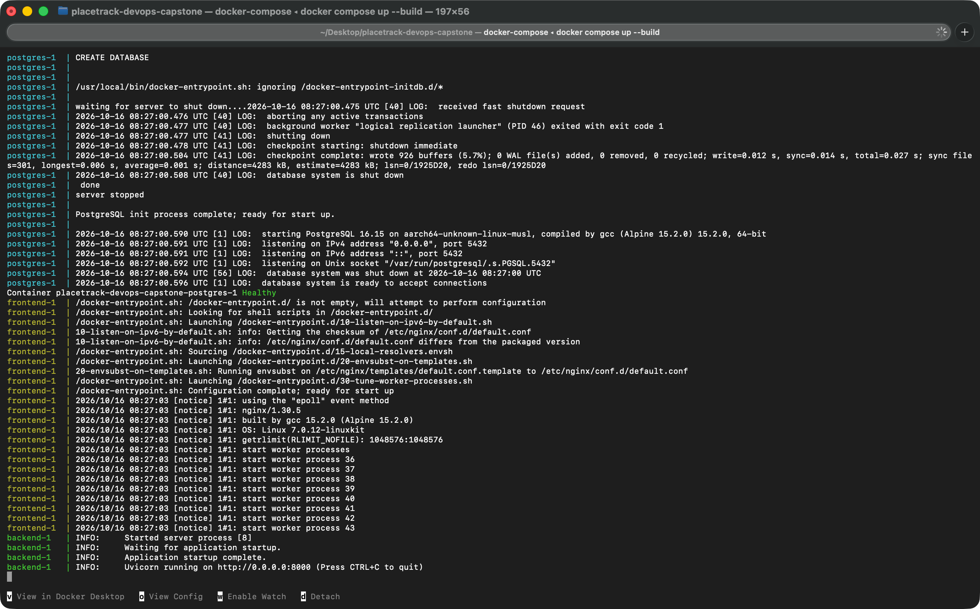
Docker
M4
Backend image: python:3.12-slim, user 10001
Frontend: multi-stage, Node builds, nginx-unprivileged serves, user 101
docker compose up --build starts postgres, backend, frontend
Migrations run before the API starts
Notes:
The backend and frontend images both run as non-root users. The frontend Dockerfile is multi-stage: Node builds the bundle, and an unprivileged nginx image serves it. One command, docker compose up with build, starts Postgres, the backend with its migrations, and the frontend. The screenshot shows the compose output: Postgres healthy, the frontend nginx started and the backend running.

Slide 7
CI/CD pipeline
M5
pytest
frontend build
docker build x2
Trivy gate
push to GHCR
→
→
→
→
Runs on every push to main (and on pull requests)
A failing test or a fixable HIGH/CRITICAL CVE stops the pipeline
Images tagged with the commit SHA, never latest
Deploy job on my laptop runner: Helm upgrade with the commit SHA
Actions pinned to commit SHAs; write access only on the image job
Notes:
The workflow runs on every push to main. It runs pytest, builds the frontend, builds both Docker images, scans them with Trivy, and only then pushes them to GitHub Container Registry, tagged with the commit SHA instead of latest. If a test fails or Trivy finds a fixable high or critical vulnerability, nothing is published. The actions are pinned to exact commits and only the image job can write packages. After the push, a deploy job runs on a self-hosted runner on my laptop and does a Helm upgrade with the same commit SHA.

Slide 8
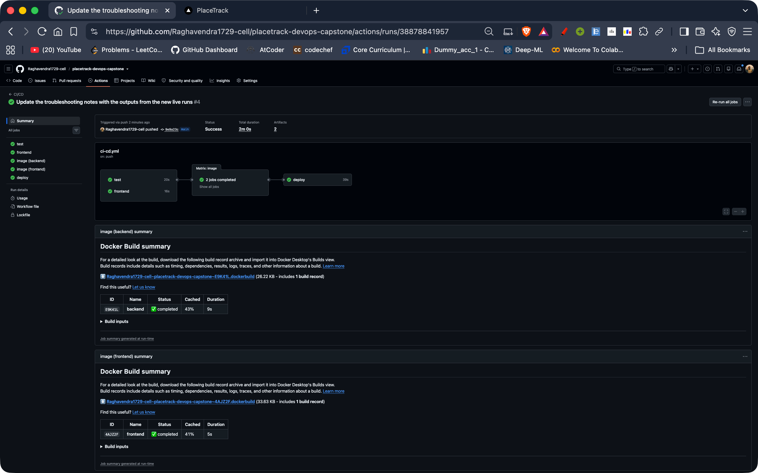
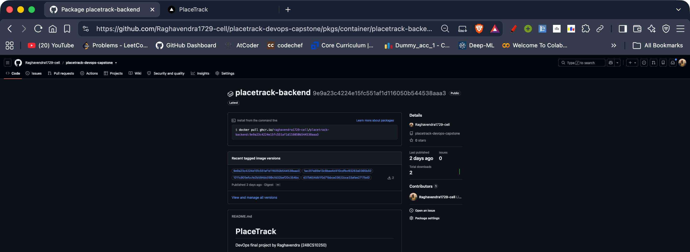
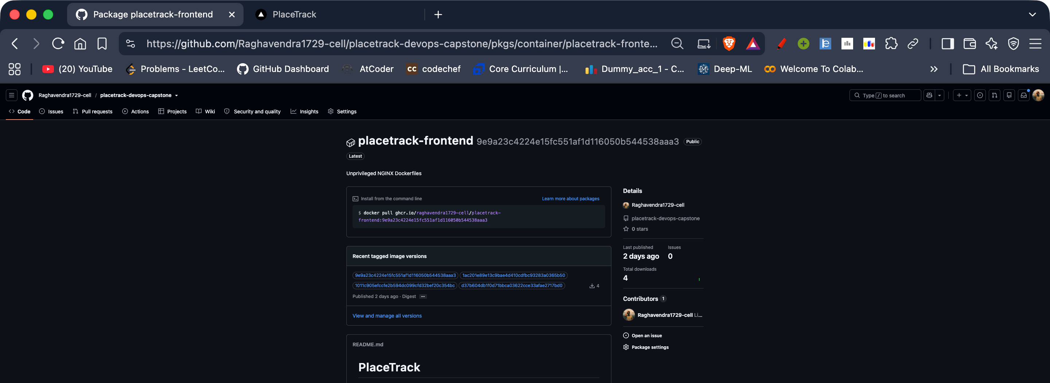
Pipeline run and GHCR
M5
Run #4: tests, frontend build, both image builds with Trivy, and the deploy job all passed
Both images are public in GHCR and tagged with the commit SHA
Notes:
This is run four of the pipeline on GitHub. All five jobs passed: the tests, the frontend build, the backend and frontend images, each one built, scanned by Trivy and pushed, and the deploy job on my laptop runner, which rolled the new images out with Helm. On the right are the two images in GitHub Container Registry. They are public and tagged with the commit SHA instead of latest, so every image can be traced back to the exact commit.

Slide 9
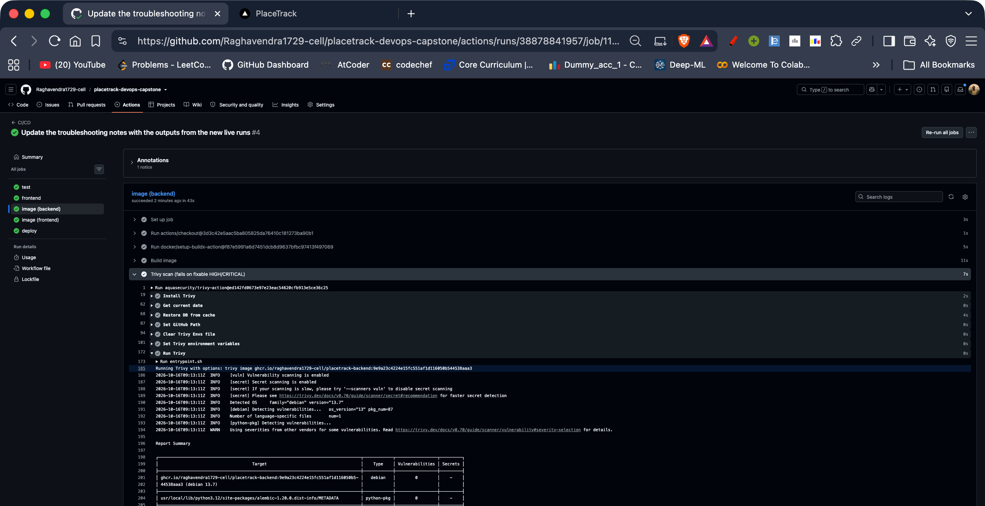
Security scan
M6
3 → 0
backend HIGH findings (Starlette)
42 → 0
frontend HIGH + CRITICAL (Alpine libs)
Example: CVE-2025-62727, Starlette denial of service through crafted Range headers. Fixed by upgrading FastAPI and the nginx base image, then scanning again: exit code 0.
Notes:
Trivy scans both images for fixable high and critical vulnerabilities and fails the pipeline if it finds any. My first scan failed: the backend had three high findings in Starlette, for example CVE-2025-62727, where crafted Range headers can cause denial of service, and the old nginx base image had forty-two high and critical findings in system libraries such as OpenSSL. I fixed them by upgrading FastAPI, which brings a patched Starlette, and moving to a current nginx image. Both scans now exit with zero. The screenshot is the Trivy step from the pipeline run on GitHub, with zero vulnerabilities in the backend image. A clean scan means no fixable high or critical vulnerability exists in the image at scan time, which is why it runs on every build.

Slide 10
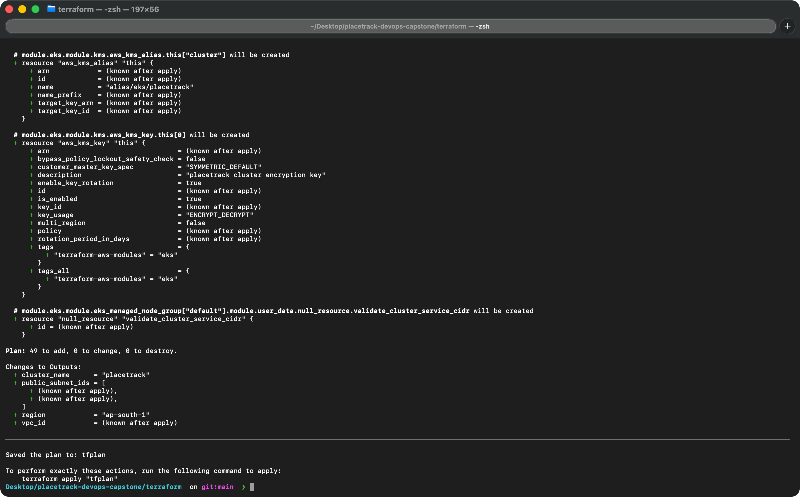
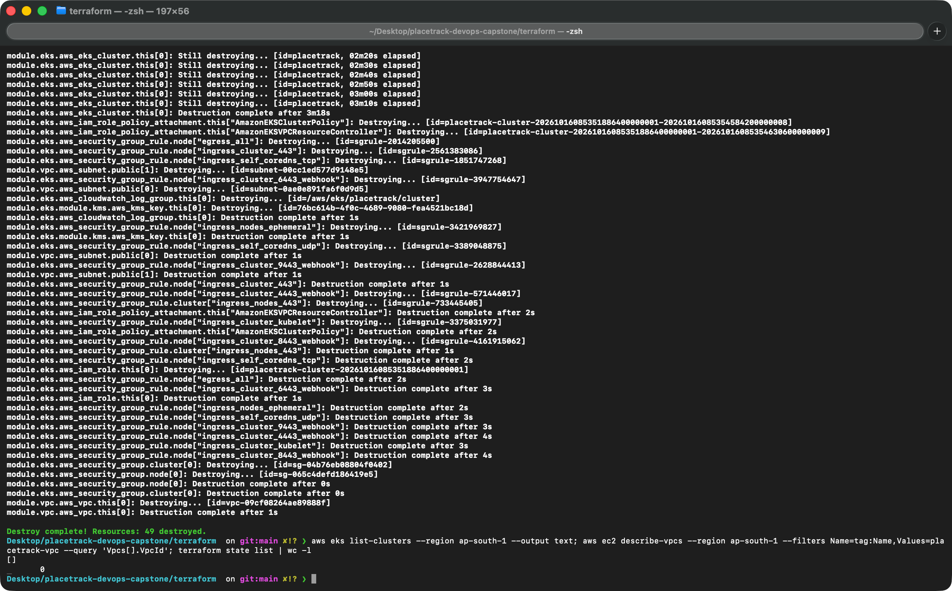
Terraform on AWS
M7
VPC with 2 public subnets in 2 availability zones
EKS 1.35 cluster + managed node group, 2 x t3.small, API limited to my IP
Plan: 49 to add. Apply created all 49, destroy removed all 49
Notes:
Terraform builds a VPC with two public subnets in two availability zones and an EKS 1.35 cluster with a managed node group of two t3.small nodes. I limited the cluster API to my own IP address. The plan shows forty-nine resources to add. The apply created all forty-nine, and terraform destroy removed all forty-nine afterwards, so nothing is left running.

Slide 11
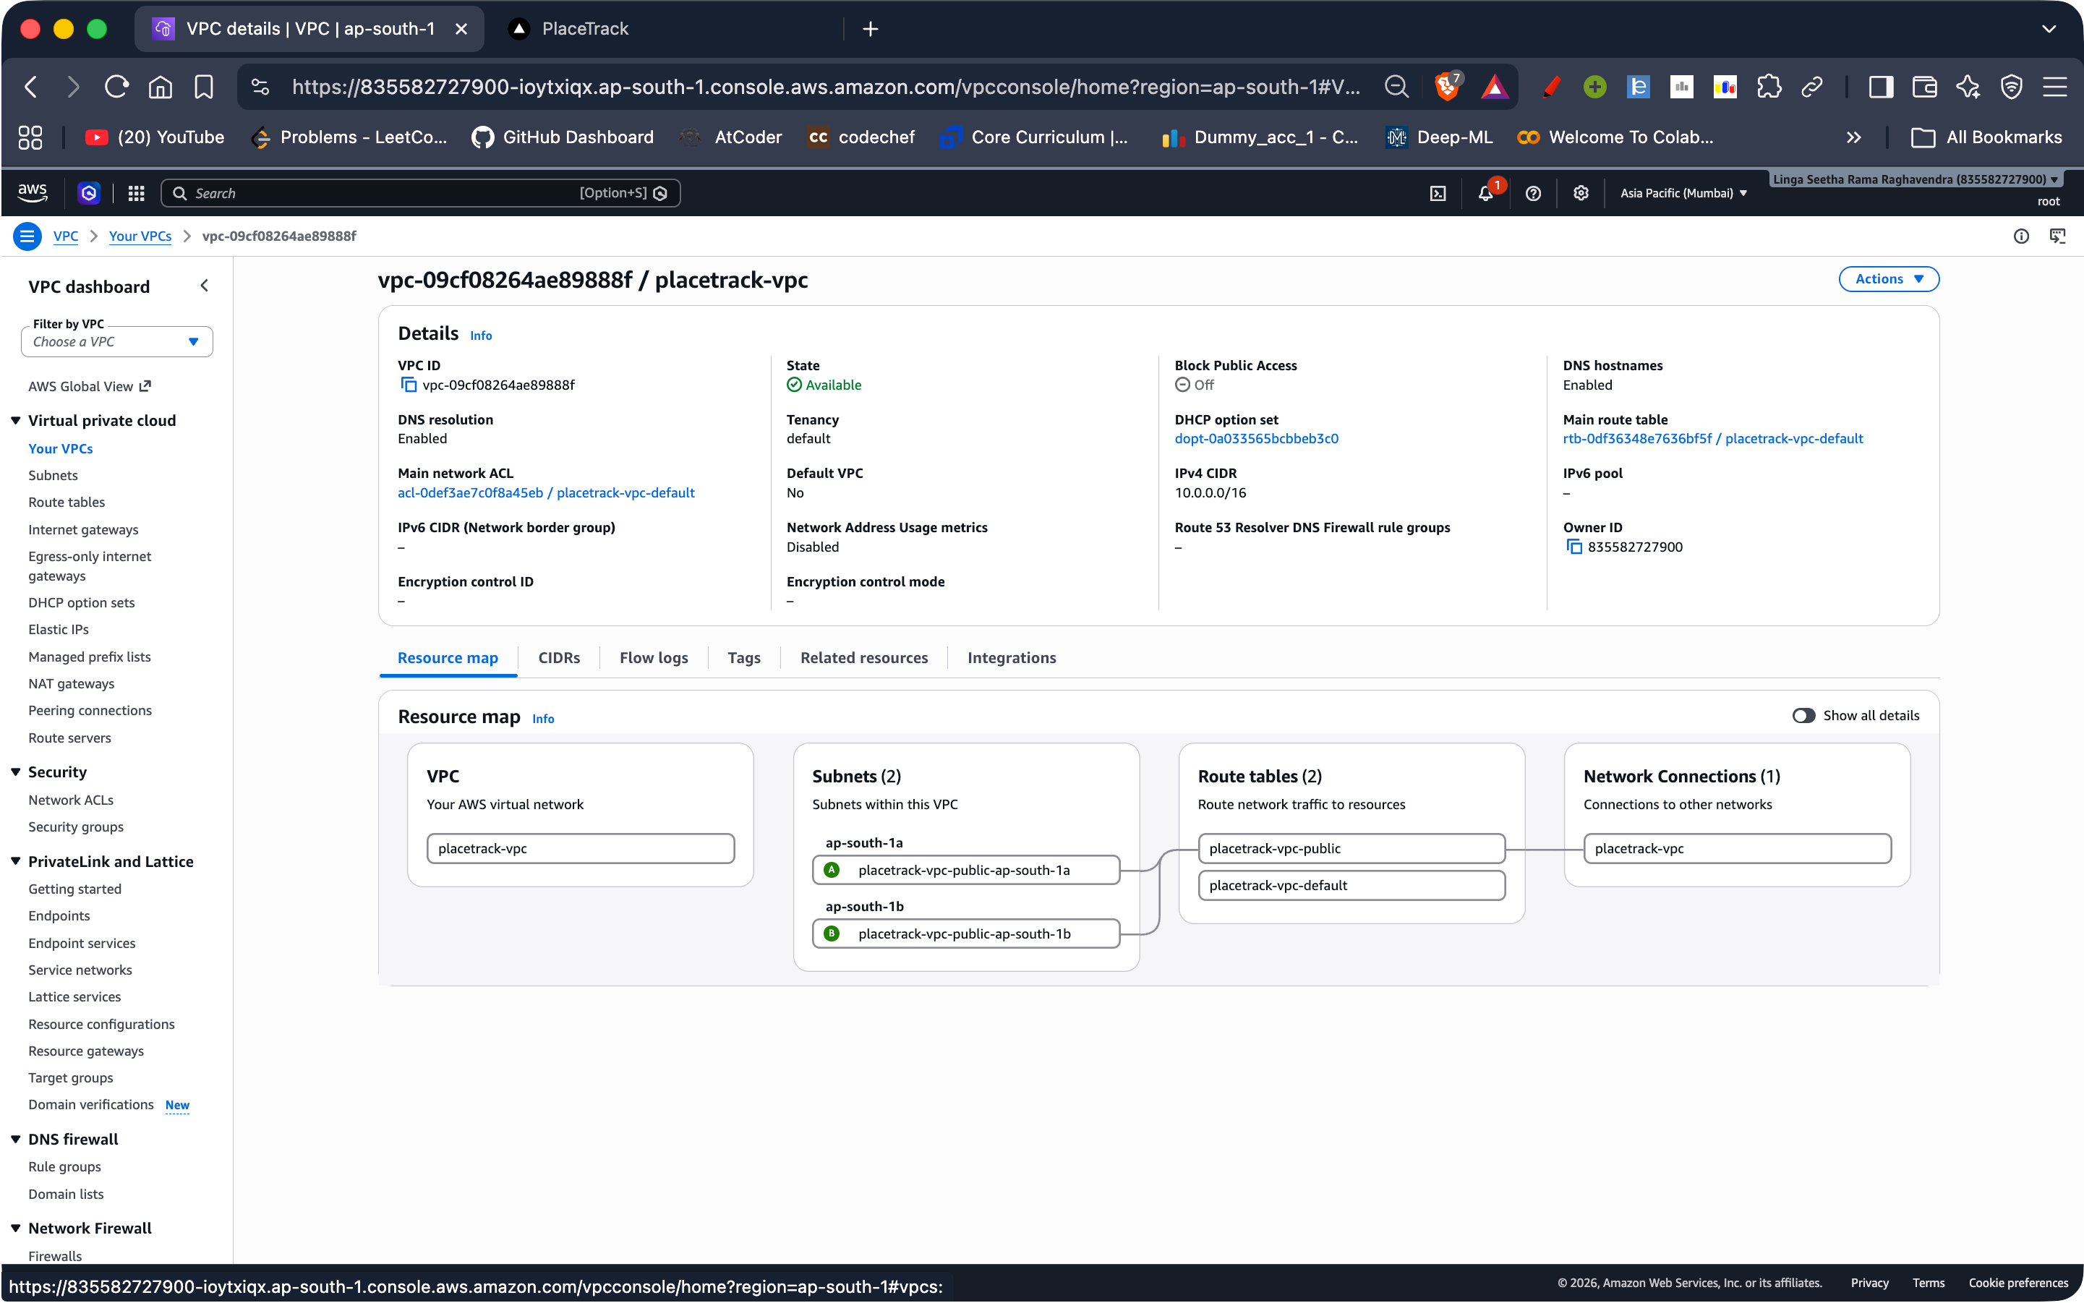
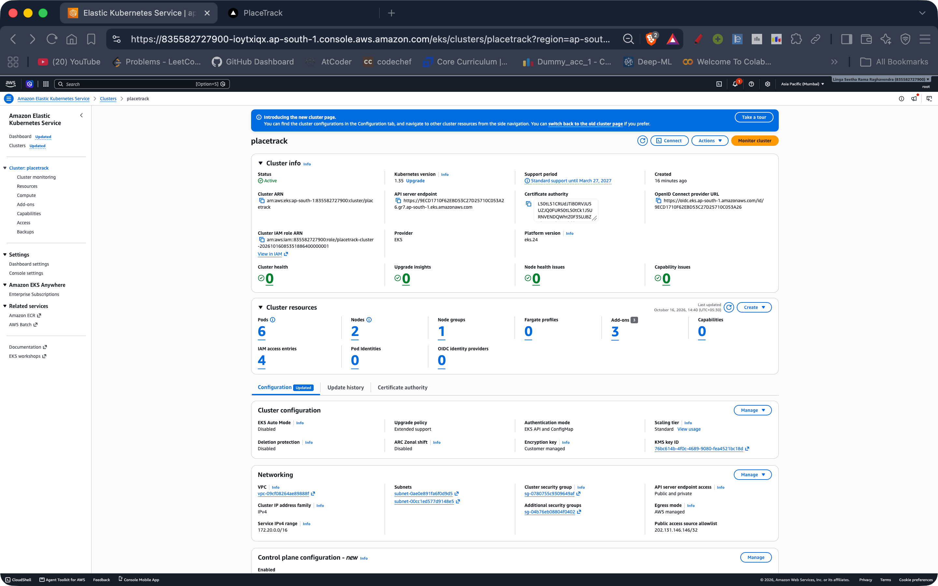
AWS Console
M7
VPC placetrack-vpc with subnets in ap-south-1a and ap-south-1b
EKS 1.35 cluster Active, 1 node group, 2 nodes Ready
terraform destroy removed everything, so nothing is left to bill
Notes:
The console shows the VPC with its two public subnets and the EKS 1.35 cluster as Active with one node group and two nodes. After taking the screenshots I ran terraform destroy. It removed all forty-nine resources, and a check afterwards showed no cluster, no VPC and an empty Terraform state, so nothing is left to bill.

Slide 12
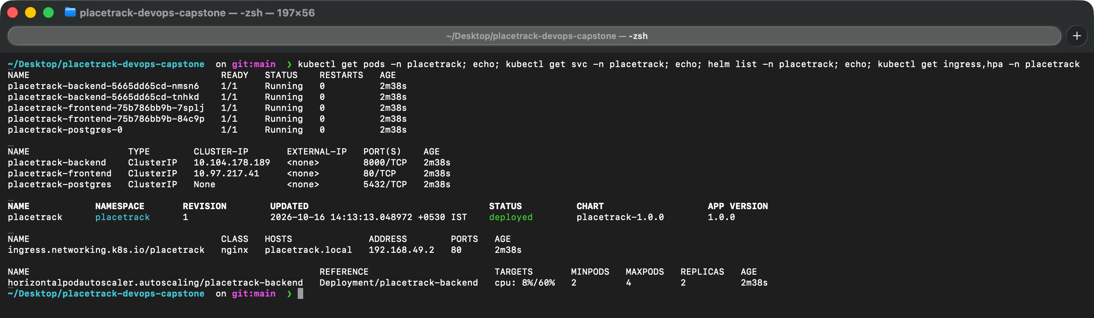
Kubernetes and Helm
M8
Notes:
A single Helm chart deploys everything into the placetrack namespace: two replicas each of the backend and frontend, a Postgres StatefulSet, ClusterIP services, an Ingress that sends slash to the frontend and slash api to the backend, and a horizontal pod autoscaler. A Helm hook job runs the database migration after install. The terminal shows the pods, the services, the Helm release, the Ingress and the autoscaler. All pods are running with zero restarts.

Slide 13
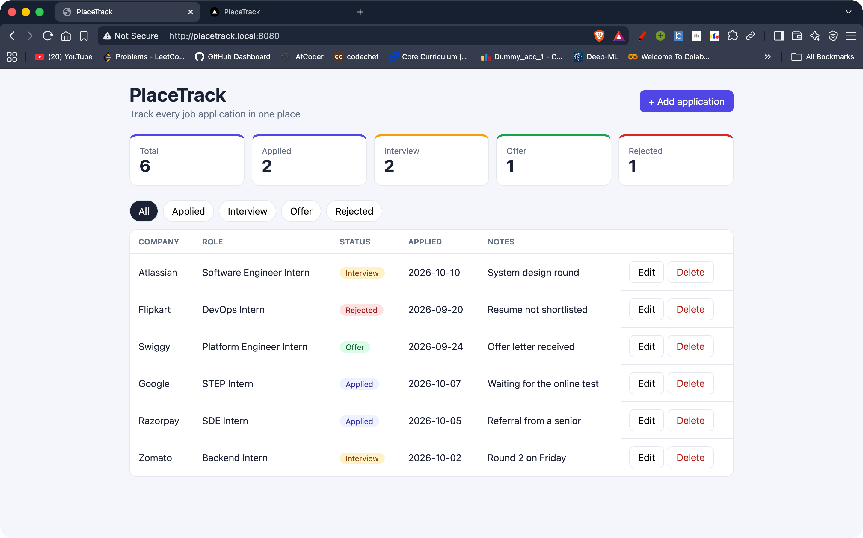
Through the Ingress
M8
Ingress sends / to the frontend and /api to the backend, which uses Postgres
Live data written through /api
Deployed with one helm command
Notes:
This is the application loaded in a browser through the Kubernetes Ingress controller. The page comes from the frontend service, and its calls to slash api are routed by the same Ingress to the backend, which talks to Postgres.

Slide 14
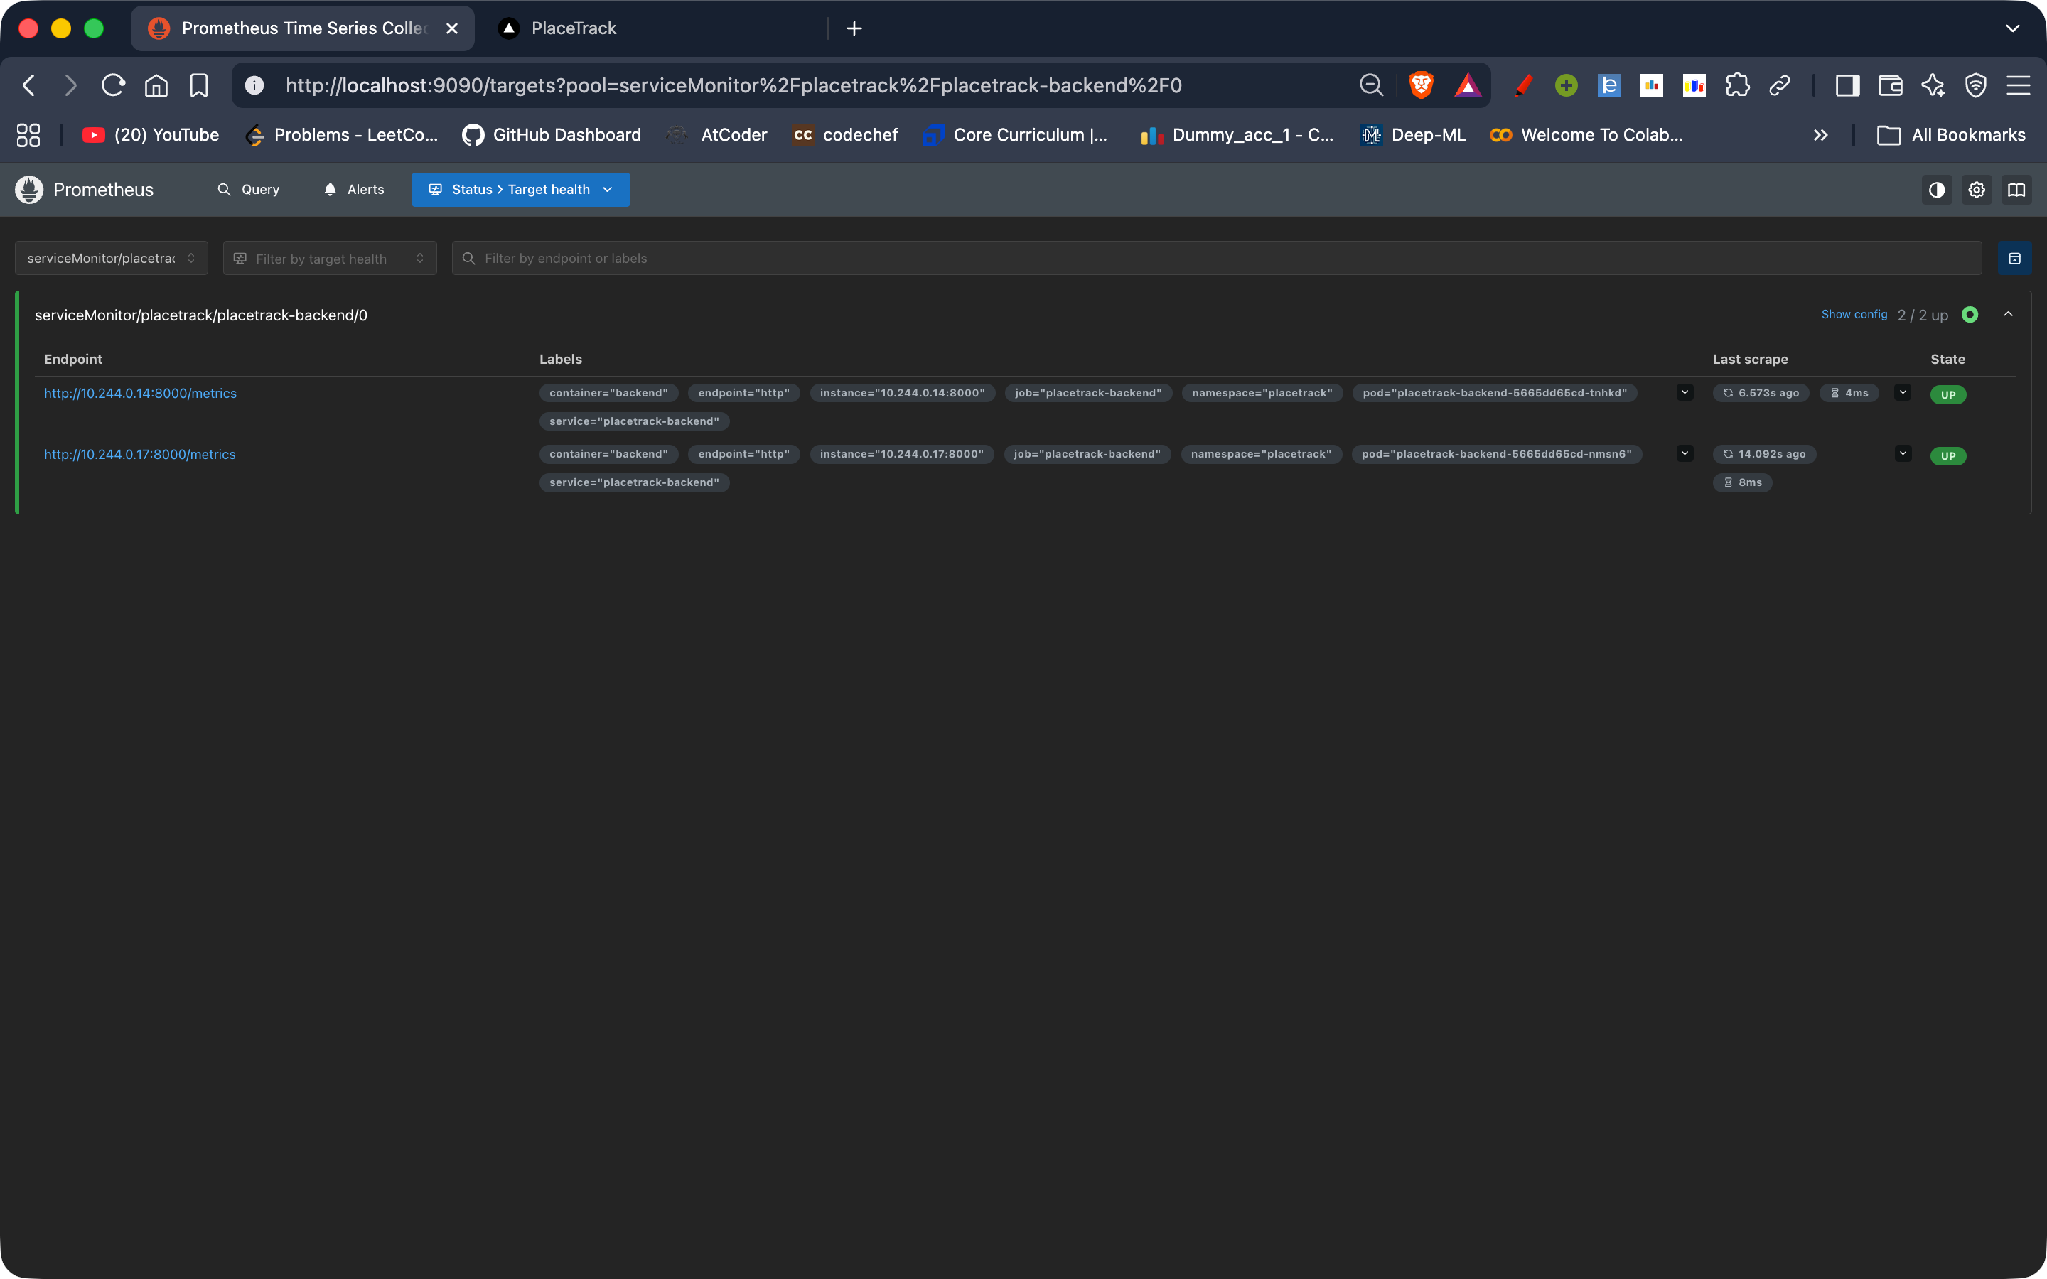
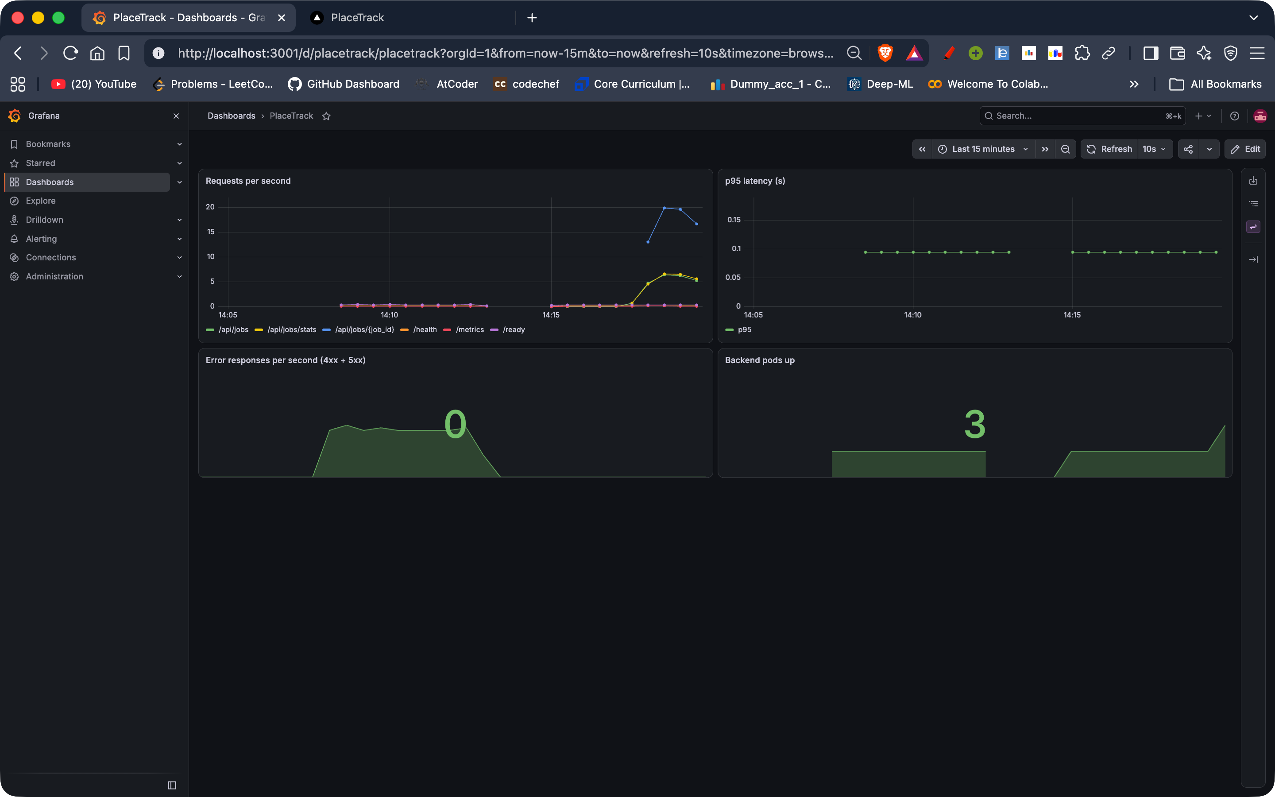
Observability
M9
/metrics exposed by FastAPI; ServiceMonitor makes Prometheus scrape both pods
Dashboard: request rate, p95 latency, error responses, pods up (3 after the HPA scaled out)
Notes:
The backend exposes Prometheus metrics. A ServiceMonitor tells Prometheus to scrape both backend pods, and the targets page shows both up. The Grafana dashboard I built shows request rate per endpoint, the ninety-fifth percentile latency, error responses and the number of healthy backend pods. These panels have live data from a load test, not mock data. The pods up panel shows three because the HPA added a third backend pod during the load test.

Slide 15
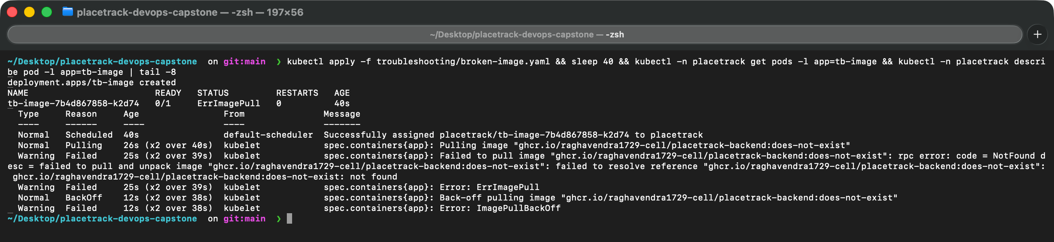
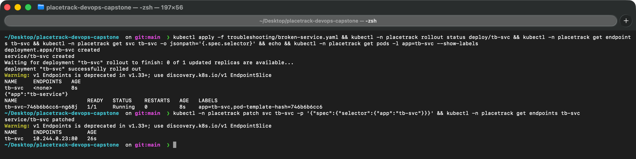
Troubleshooting
FIX
Bad image tag
Selector mismatch
Symptom: ImagePullBackOff
Cause: Tag does not exist in the registry
Fix: Point the Deployment at a real tag
Symptom: Pod Running, endpoints <none>
Cause: Service selector app=tb-service, pod label app=tb-svc
Fix: Patch the selector to match
Notes:
I broke the cluster in two ways and fixed both. First, a deployment with an image tag that does not exist ends in ErrImagePull and ImagePullBackOff; describe pod showed the pull failure and the fix was a valid tag. Second, a service whose selector had a typo: the pod was Running but the service had no endpoints, so nothing was reachable. Comparing the selector with the pod labels revealed it. The full five-step write-ups are in the troubleshooting folder.

Slide 16
Live demo flow
DEMO
1
2
3
4
5
Edit a visible string
git commit and push
Pipeline runs
Deploy job runs
Refresh the browser
frontend/src/App.jsx
triggers Actions
tests, build, Trivy, push
laptop runner: helm upgrade with the SHA
new text is live
Commit a change, watch the pipeline run, see the deployment update.
Notes:
For the live demo I change a visible string in the React app, commit and push. GitHub Actions runs the tests, builds, scans and pushes the images tagged with the new commit. Then the deploy job on my laptop runner runs helm upgrade with that SHA, the new pods roll out, and refreshing the browser shows the change.

Slide 17
What I learned
1
A passing build is not a secure build: Trivy failed my first images
2
nginx needs a runtime resolver and the full Service DNS name (502 became 200)
3
Running is not Ready, and Ready is not reachable
4
Secrets are generated, never committed
Thank you
Notes:
Four things I will remember. A passing build is not a secure build: Trivy failed my first images and I had to fix real vulnerabilities. nginx resolves upstream names once at startup, which caused a crash loop until I used a runtime resolver, and a request through the frontend service then showed that the resolver ignores search domains, so I switched to the full service DNS name and the 502 became a 200. Running does not mean ready, and ready does not mean reachable. And secrets are generated at deploy time, never committed. Thank you.

