Slide 1
MINI PROJECT : 2020-21
Report Presentation

Slide 2
Student AI Assistant using Python
Group No: F9
Name of the Guide: Prof. Shiva Kumar R Naik
Designation: Assistant professor
School: School of C & IT, REVA University
Group Members:
A Raghavendra (R18CS317)
Samarth D Valmiki (R18CS364)
R Hemanth Kumar (R18CS311)
S Rohan (R18CS348)

Slide 3
Contents
Abstract
Introduction
Motivation (if any)
Literature Survey
Objectives and Problem Definition
System Requirements
Methodology (Expected implementation)
Applications
Conclusion
References

Slide 4
Abstract
Communication and technology have a long history but still are constantly and actively growing and changing. The technology changes so fast that today everybody has an AI Personal assistant. Most of us have it on our phones in the form of Google Assistant or Siri or Bixby. The use of voice-based personal assistants is increasing day by day and helps in making our life simple. This paper presents an intelligent voice assistant with the ability to organize and maintain information. It also includes the management of emails, calendar events, files, and to-do lists. An attempt is being made to develop an “Intelligent Student Personal Voice Assistant using Python Programming Language.” which helps Students to control devices with their voice(speech), extract information, and perform tasks on their Desktop/Web application.

Slide 5
Introduction
The advent of software assistants has been a significant event in the history of computing.
Software assistants are useful for helping the users of a computer system automate tasks and accomplish tasks with minimum human Interaction with a machine.
The Interaction that takes place between a user and a software assistant seems natural; the user communicates using their voice, and the software responds in the same way.
If you have seen the movie Iron Man, you can perhaps imagine having a software assistant like Tony Stark’s Jarvis.

Slide 6
Introduction
But in the paper, we only confine it to educational usage to only Students.
Following are some software assistants that are already available in the market:
Google Now: Developed by Google for Android and iOS mobile operating systems. The best thing about this software is its voice-recognition ability.
Siri: Developed by Apple and runs only on iOS, watchOS, and tvOS. Siri is a very advanced personal assistant with lots of features and capabilities.
6

Slide 7
Literature Survey
Fatema Ghadiali, Vinit Mahajan, Bhargavi Patawardhan, Prithvi Rao, “Personal AI Assistant with Emotion Recognition with Python” in International Journal of Research in Engineering, Science and Management Volume-3, Issue-5, May-2020.
In this paper, the system focuses on designing a system that provides basic assistant capabilities using open source programming language along with emotion recognition using suitable algorithms related to ML and AI. The paper majorly focuses on emotion recognition which may require extra hardware for the just the purpose of helping a student to understand a concept regarding his education.

Slide 8
Literature Survey
Nataliya Shakhovska, Oleh Basystiuk, Khrystyna Shakhovska, “Development of the Speech-to-Text Chatbot Interface Based on Google API” Published in MoMLeT 2019.
The proposed system is of a chat bot with the help of Google API, NLP, Python, Flask which satisfies its basic purpose. The system covers almost all aspects from speech to result of the application. But the system does not fully satisfy the need of a person when it comes to learning a concept or a subject.
Vmnssvkr Gupta, R. Shiva Shankar, Harika Devi Kotha, J. Raghaveni, “Voice Identification in Python Using Hidden Markov Model” in International Journal of Advanced Science and Technology Vol. 29, No. 6, (2020), pp. 8100-8112.
This paper deals with recognizing speech of human by computer and
producing output in written sequence format. The system helps physically disabled people with a voice assistant with continuous interaction feature.The system provides a base for our proposed system but cannot satisfy the need of a student with concept related material, links and videos, and information.

Slide 9
Literature Survey
Tushar Bansal, Ritik Karnwal, Vishal Singh, Hardik Bansal, “GENESIS-THE DIGITAL ASSISTANT(PYTHON)” in International Journal of Engineering Applied Sciences and Technology, 2020.
This paper proposes a voice assistant called ‘Genesis’, which is a virtual assistant. It is an application program that understands voice commands and completes tasks for the user.The system confines itself to web-searches, reading news and providing basic answers to the user.
Ankit Pandey, Vaibhav Vashist, Prateek Tiwari, Sunil Sikka, Priyanka Makkar, “Smart Voice Based Virtual Personal Assistants with Artificial Intelligence” in Artificial & Computational Intelligence / Published Online: March 2020.
This paper tells about building a voice assistant that is able to perform content extraction, speech recognition, text-to-speech translation and system calls.The scope of extending the application of this system is huge and that is the reason this system is preferred as a base for our proposed system/application
9

Slide 10
Objectives and Problem Definition
The assistant will act as a learning platform for students on a particular topic with doubt solving and problem-solving included.
At first, a student will use our AI voice assistant for a specific concept.
After that, we will produce three options called full learning, overview learning, and quick learning.
The Full learning option will provide links like:
YouTube lectures (which includes most of the video content for any concept).
Wikipedia link.
geeks for geeks/stack overflow links.

Slide 11
Objectives and Problem Definition
The next option will be solving some problems related to that and make sure that we understood the concepts.
Overview learning deals with only by giving lectures and notes for study.
Our final goal is to make sure that the student will understand the concepts better and make better progress.
11

Slide 12
System Requirements
Software Requirements | Hardware Requirements
Flask, SQL, Html, CSS, JavaScript, C++, Selenium, pyttsx3, NLP, TensorFlow, Pandas, NumPy, OpenCV, Flutter etc. | PC with Proper internet connection. Windows 7 , 8, 10 with 64-bit operating system architecture. Minimum 2 GB Ram and Minimum of 5 GB of space.

Slide 13
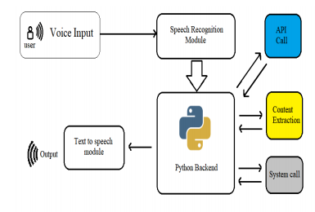
Methodology (Expected implementation method)
Components of the proposed System

Slide 14
Methodology (Expected implementation method)
Speech Recognition module. The system uses Google’s speech recognition system for converting speech input to text. This module uses the library of Speech-Recognition 3.8.1 for performing speech recognition, with support for several engines and APIs, online and offline.
Python backend get the output from the speech recognition module and then identifies whether the command or the speech output is an API Call, Context Extraction, and System Call then the output is sent back to the python backend to give the required output to the user.
API Calls. It allows two applications to talk to each other. API is working as a messenger that delivers request to the provider that are requesting it from and then delivers the response back.
Context Extraction is the function of automatically or robotic extracting structured information from unstructured or semi-structured or both machine-readable documents. In majority of the instance this task concerns processing of human language texts by the method of natural language processing (NLP).
System Calls , is the programmatic method in which a computer program(function)appeal a service from the kernel of the operating system it is executed on. It include hardware related assistant and services like access of hard disk drive, creation and execution of new processes, and interacting with integral kernel services like process scheduling. It delivers an essential interface between a process and the operating system.
Text-To-Speech Text-to-Speech (TTS) engine refers to the ability of computers to read text. The engine converts written text into a phonemic representation, then it will converts the phonemic representation to a waveforms and that can be output as sound.

Slide 15
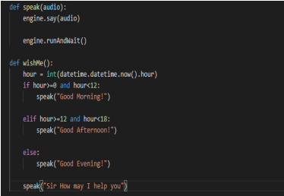
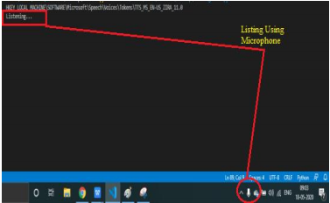
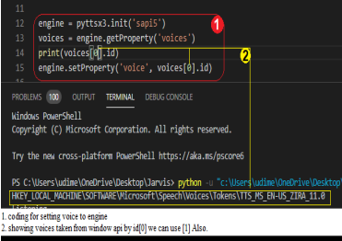
Methodology (Expected implementation method)
Modules to implement speech recognition and greeting.

Slide 16
Applications
The Assistant could be modified and used for educational purposes in educational institutions.
As the Proposed System is for the personnel need of a Student, it satisfies the urge of a student to understand the concept in depth.
The code written for the assistant is basic and could be modified as per application without disturbing the main purpose of getting work done only with the help of a voice assistant.

Slide 17
Conclusion
The whole point of the project is to make an assistant application that would satisfy the student's urge to learn and provide all the necessary tools required to achieve mastery in any concept. The project also holds a motive to make the student understand how exciting the process of self-learning is. The very intention of this project would succeed if it can bring the thought of getting self-educated in a student.

Slide 18
References
Fatema Ghadiali, Vinit Mahajan, Bhargavi Patawardhan, Prithvi Rao, “Personal AI Assistant with Emotion Recognition with Python” in International Journal of Research in Engineering, Science and Management Volume-3, Issue-5, May-2020.
Nataliya Shakhovska, Oleh Basystiuk, Khrystyna Shakhovska, “Development of the Speech-to-Text Chatbot Interface Based on Google API”.
Vmnssvkr Gupta, R. Shiva Shankar, Harika Devi Kotha, J. Raghaveni, “Voice Identification in Python Using Hidden Markov Model” in International Journal of Advanced Science and Technology Vol. 29, No. 6, (2020), pp. 8100-8112.
Tushar Bansal, Ritik Karnwal, Vishal Singh, Hardik Bansal, “GENESIS-THE DIGITAL ASSISTANT(PYTHON)” in International Journal of Engineering Applied Sciences and Technology, 2020.
Ankit Pandey, Vaibhav Vashist, Prateek Tiwari, Sunil Sikka, Priyanka Makkar, “Smart Voice Based Virtual Personal Assistants with Artificial Intelligence” in Artificial & Computational Intelligence / Published Online: March 2020.

Slide 19
THANK YOU

