Slide 1
PROJECT ON SOCIAL AND RURAL ISSUES
“Opportunities and Challenges Faced by
Rural Farmers in Marketing Agricultural Products”
Submitted by
Under the Guidance of
Raghavendra S
USN: 1SI25BA069
Department of MBA
Dr. Anitha B. R.
Assistant Professor
Department of MBA
Department of MBA
Siddaganga Institute of Technology, Tumakuru

Slide 2
Introduction
Research background and context
Agriculture is the backbone of the Indian economy and a major source of livelihood for rural communities.
Agricultural marketing connects farmers with consumers and ensures fair price realization.
Rural farmers face transportation issues, inadequate storage, price fluctuations, limited market information, and dependence on intermediaries.
Direct marketing and digital marketing offer new opportunities to improve market access and farmer income.
This study examines the opportunities and challenges faced by rural farmers in marketing agricultural products in selected rural areas of Tumakuru district.
VALUE CHAIN
Farmer
Produces agricultural goods
Market
Aggregation & price discovery
Consumer
Final purchase & demand

Slide 3
Theoretical Background & Conceptual Framework
THEORETICAL BACKGROUND
Agricultural marketing facilitates the movement of products from producers to consumers.
Efficient marketing systems improve price realization, profitability, and rural economic development.
Digital marketing, direct marketing, market information, storage facilities, and reduced intermediary influence drive better outcomes.
CONCEPTUAL FRAMEWORK
Agricultural Marketing Practices
Independent Factors
Direct Marketing Awareness
Digital Platform Usage
Market Price Information
Storage Facilities
Middlemen Influence
Fair Price Realization
Improved Farmer Income

Slide 4
Sustainable Development Goals
How the research contributes to sustainable development
ALIGNED SDGs
PRIMARY GOAL
Contribution of the Study
SDG 2 Zero Hunger
SDG 1
No Poverty
SDG 8
Decent Work & Economic Growth
Improves agricultural marketing efficiency
Enhances farmer income
Promotes digital agricultural marketing
Supports sustainable rural development
SDG 9
Industry, Innovation & Infrastructure
SDG 12
Responsible Consumption & Production

Slide 5
Literature Review
Summary of previous research and the research foundation
Representative Literature
Overall Findings from Previous Studies
Author | Topic
Negi et al. (2018) | Agricultural Marketing
Aparajita Goyal (2010) | Direct Marketing
Kamilaris et al. (2019) | Supply Chain
Bertoglio et al. (2021) | Digital Agriculture
Chowdhury et al. (2023) | Rural Development
Direct marketing improves farmer income.
Digital platforms enhance market accessibility.
Market information supports better pricing decisions.
Digital technologies improve marketing efficiency.
Infrastructure limitations remain a major challenge.
Literature Review Summary
Previous studies consistently highlight the importance of direct marketing, digital agriculture, market information, and technology adoption in improving agricultural marketing. However, challenges related to infrastructure and market access continue to affect rural farmers.

Slide 6
Research Gap, Problem, Need & Scope
Research Gap
Problem Statement
Limited district-level studies on agricultural marketing in Tumakuru.
Few studies integrate both opportunities and challenges together.
Limited use of advanced statistical and predictive techniques.
Rural farmers face transportation issues, inadequate storage, middlemen influence, price fluctuations, and limited market information — reducing their ability to receive fair prices.
Need of the Study
Scope of the Study
Understand existing agricultural marketing practices.
Evaluate digital marketing adoption.
Identify factors influencing fair price realization.
Support evidence-based marketing improvements.
Selected rural areas of Tumakuru District.
Rural farmers engaged in agricultural marketing.
Covers traditional and digital marketing practices.
Includes statistical and predictive analysis.

Slide 7
Research Objectives & Hypotheses
Research Objectives
Hypotheses
H₁: Awareness of D
H₁: Awareness of Direct Marketing Methods ↔ Use of Digital Platforms for Selling
H₂: Use of Digital Platforms for Selling ↔ Perception that Digital Platforms Help Promote Agricultural Products
H₃: Market Price Information ↔ Fair Price Realization
H₄: Middlemen Influence on Pricing ↔ Fair Price Realization
H₅: Customer Interest in Purchasing Directly from Farmers ↔ Preference for Digital Platforms
1
Understand the existing marketing methods used by rural farmers.
2
Analyze the marketing opportunities available for rural farmers.
3
Analyze the role of digital marketing in promoting agricultural products.
4
Identify the challenges faced by rural farmers in marketing.
5
Develop and evaluate a predictive model identifying factors influencing fair price realization.
Detailed Null (H₀) and Alternative (H₁) hypotheses were tested using the Chi-Square Test of Independence.

Slide 8
Research Methodology
Research Methodology | Details
Research Design | Descriptive
Research Approach | Quantitative
Study Area | Rural Areas of Tumakuru District
Sample Size | 115 Rural Farmers
Sampling Technique | Convenience Sampling
Primary Data | Structured Questionnaire
Secondary Data | Journals, Govt. Reports, NABARD & FAO
Software | MS Excel & Python (Jupyter)
RESEARCH WORKFLOW
Questionnaire
Excel
Python
Statistical Analysis
Predictive Analysis
Findings
Analytical Techniques
Descriptive Stats · Chi-Square · Pearson Correlation · VIF · Logistic Regression · Decision Tree

Slide 9
Respondent Profile
Demographic profile of the survey respondents
Demographic Variables
Age
Gender
Land Holding
Farming Experience
115 Respondents
Rural farmers from selected areas of Tumakuru District with diverse demographic and farming backgrounds.

Slide 10
Objective 1 — Existing Marketing Methods
To Understand the existing marketing methods used by rural farmers to sell agricultural produce.
Valid | Frequency | Percent | Valid Percent | Cumulative Percent
APMC market | 24 | 20.9 | 20.9 | 20.9
Digital platforms (WhatsApp, Facebook etc.) | 22 | 19.1 | 19.1 | 40.0
Direct to consumers | 22 | 19.1 | 19.1 | 59.1
Retail shops | 15 | 13.0 | 13.0 | 72.1
Through middlemen | 32 | 27.9 | 27.9 | 100.0
Total | 115 | 100.0 | 100.0 | —

Slide 11
Objective 2 — Marketing Opportunities
To analyze the marketing opportunities available for rural farmers in agricultural marketing practices.
Valid | Frequency | Percent | Valid Percent | Cumulative Percent
Better demand | 1 | 0.9 | 0.9 | 0.9
Better demand; Higher profit | 15 | 13.0 | 13.0 | 13.9
Better price control | 2 | 1.7 | 1.7 | 15.6
Better price control; Direct customer relationship | 2 | 1.7 | 1.7 | 17.3
Better price control; Immediate payment | 3 | 2.6 | 2.6 | 19.9
Direct customer relationship | 7 | 6.1 | 6.1 | 26.0
Direct customer relationship; Immediate payment | 16 | 13.9 | 13.9 | 39.9
Higher profit; Better demand | 13 | 11.3 | 11.3 | 51.2
Higher profit; Better price control | 8 | 7.0 | 7.0 | 58.2
Higher profit; Direct customer relationship | 8 | 7.0 | 7.0 | 65.2
Higher profit; Immediate payment | 7 | 6.1 | 6.1 | 71.3
Immediate payment | 27 | 23.5 | 23.5 | 94.8
Immediate payment; Better demand | 6 | 5.2 | 5.2 | 100.0
Total | 115 | 100.0 | 100.0 | —

Slide 12
Objective 3 — Role of Digital Marketing
To analyze the role of digital marketing in promoting agricultural products.
Valid | Frequency | Percent | Valid Percent | Cumulative Percent
No | 34 | 29.6 | 29.6 | 29.6
Yes | 81 | 70.4 | 70.4 | 100.0
Total | 115 | 100.0 | 100.0 | —
Valid | Frequency | Percent | Valid Percent | Cumulative Percent
Facebook | 13 | 11.3 | 11.3 | 11.3
Instagram | 27 | 23.5 | 23.5 | 34.8
Others | 34 | 29.6 | 29.6 | 64.4
UPI/PhonePe/GPay | 13 | 11.3 | 11.3 | 75.7
WhatsApp | 28 | 24.3 | 24.3 | 100.0
Total | 115 | 100.0 | 100.0 | —

Slide 13
Objective 4 — Challenges Faced
To identify the challenges faced by rural farmers in marketing agricultural products.
Valid | Frequency | Percent | Valid Percent | Cumulative Percent
Delayed payments; Storage problems | 5 | 4.3 | 4.3 | 4.3
Delayed payments; Transport issues | 2 | 1.7 | 1.7 | 6.0
Lack of awareness; Transport issues | 10 | 8.7 | 8.7 | 14.7
Lack of market information; Transport issues | 6 | 5.2 | 5.2 | 19.9
Low price; Delayed payments | 4 | 3.5 | 3.5 | 23.4
Low price; Delayed payments; Storage problems | 1 | 0.9 | 0.9 | 24.3
Low price; Storage problems | 13 | 11.3 | 11.3 | 35.6
Low price; Transport issues | 2 | 1.7 | 1.7 | 37.3
Middlemen control; Delayed payments | 4 | 3.5 | 3.5 | 40.8
Middlemen control; Low price | 13 | 11.3 | 11.3 | 52.1
Middlemen control; Low price; Delayed payments | 2 | 1.7 | 1.7 | 53.8
Middlemen control; Low price; Storage problems | 6 | 5.2 | 5.2 | 59.0
Middlemen control; Low price; Transport issues | 7 | 6.1 | 6.1 | 65.1
Storage problems; Delayed payments | 7 | 6.1 | 6.1 | 71.2
Storage problems; Low price | 5 | 4.3 | 4.3 | 75.5
Transport issues; Lack of awareness | 21 | 18.3 | 18.3 | 93.8
Transport issues; Lack of market information | 7 | 6.2 | 6.2 | 100.0
Total | 115 | 100.0 | 100.0 | —

Slide 14
Chi-Square Test of Independence – Hypothesis Testing
Hypothesis (H₄)
Middlemen Influence on Pricing | Fair Price (No) | Fair Price (Yes) | Total
No | 0 | 44 | 44
Yes | 71 | 0 | 71
Total | 71 | 44 | 115
Variables:
Middlemen Influence on Pricing
Receiving a Fair Price for Agricultural Products
Null Hypothesis (H₀)
There is no significant association between middlemen influence on pricing and receiving a fair price for agricultural products.
Alternative Hypothesis (H₁)
There is a significant association between middlemen influence on pricing and receiving a fair price for agricultural products.
Statistical Measure | Value
Chi-Square Statistic (χ²) | 110.806
Degrees of Freedom (df) | 1
p-value | < 0.001
Sample Size (N) | 115
Decision | Reject the Null Hypothesis (H₀)

Slide 15
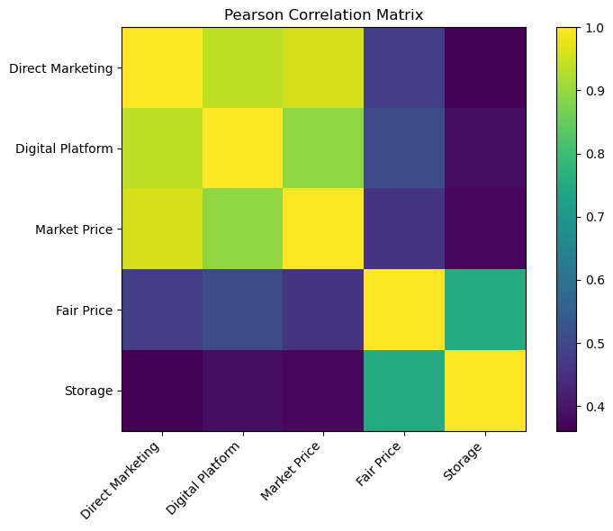
Pearson Correlation Analysis
Variables | Direct Marketing Awareness | Digital Platform Usage | Market Price Information | Fair Price Received | Storage Facilities
Direct Marketing Awareness | 1.000 | 0.938 | 0.958 | 0.478 | 0.361
Digital Platform Usage | 0.938 | 1.000 | 0.895 | 0.510 | 0.385
Market Price Information | 0.958 | 0.895 | 1.000 | 0.460 | 0.377
Fair Price Received | 0.478 | 0.510 | 0.460 | 1.000 | 0.755
Storage Facilities | 0.361 | 0.385 | 0.377 | 0.755 | 1.000

Slide 16
Multicollinearity Assessment (VIF) & Binary Logistic Regression
Model Variables
Variable | VIF Value | Interpretation
Direct Marketing | 20.06 | Severe Multicollinearity
Digital Platform | 8.47 | High Multicollinearity
Market Price Information | 12.25 | Severe Multicollinearity
Storage Facilities | 1.19 | No Multicollinearity
Dependent Variable:
Fair Price Realization
Independent Variables:
Direct Marketing Awareness
Digital Platform Usage
Market Price Information
Storage Facilities
Middlemen Influence
Customer Interest
Preference for Digital Platforms
Model Statistic | Value
Number of Observations | 115
Dependent Variable | Fair Price Received
Independent Variable | Market Price Information
Method | Maximum Likelihood Estimation (MLE)
Log-Likelihood | -61.222
Pseudo R² | 0.1998
Likelihood Ratio (LLR) p-value | 3.201 × 10⁻⁸
Model Convergence | Converged Successfully
Variable | Coefficient (β) | Standard Error | z-value | p-value | 95% Confidence Interval
Constant | -3.466 | 1.016 | -3.413 | 0.001 | -5.456 to -1.475
Market Price Information | 3.563 | 1.039 | 3.429 | 0.001 | 1.526 to 5.600

Slide 17
Objective 5 — Predictive Model Development
To develop and evaluate a predictive model for fair price realization using machine learning techniques.
Dependent Variable:
Fair Price Realization
Independent Variables:
Direct Marketing Awareness
Digital Platform Usage
Market Price Information
Storage Facilities
Middlemen Influence
Customer Interest
Preference for Digital Platforms
Performance Measure | Value
Training Accuracy | 87.0%
Testing Accuracy | 91.3%
Overall Accuracy | 91.3%
Model Variables
Class | Precision | Recall | F1-Score
No Fair Price | 0.95 | 0.95 | 0.95
Fair Price | 0.75 | 0.75 | 0.75
Variable | Importance Score | Rank
Storage Facilities | 0.775 | 1
Digital Platform Usage | 0.196 | 2
Market Price Information | 0.029 | 3
Direct Marketing Awareness | 0.000 | 4

Slide 18
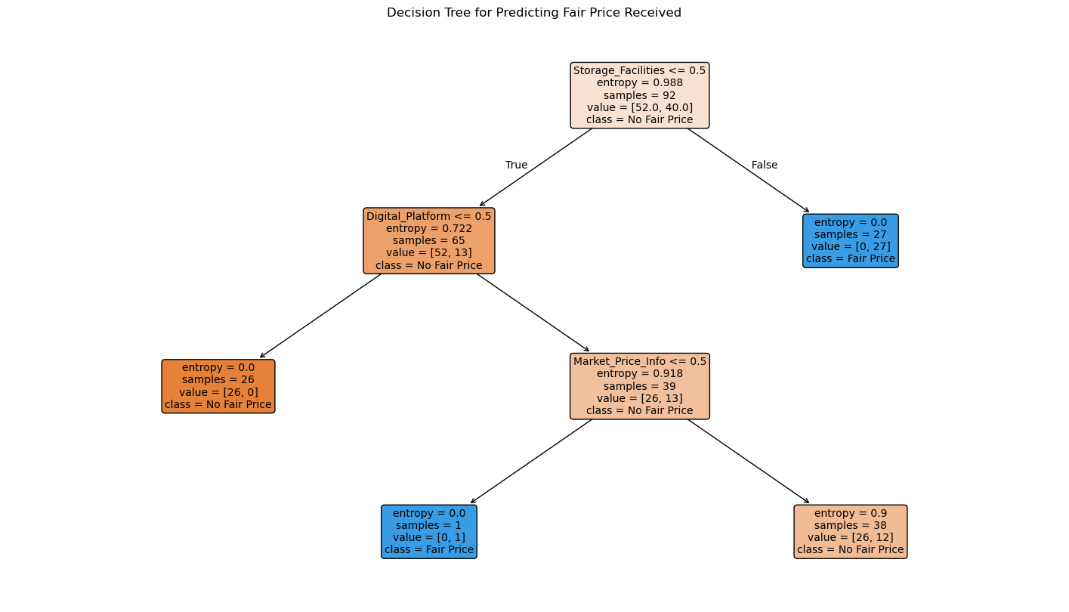
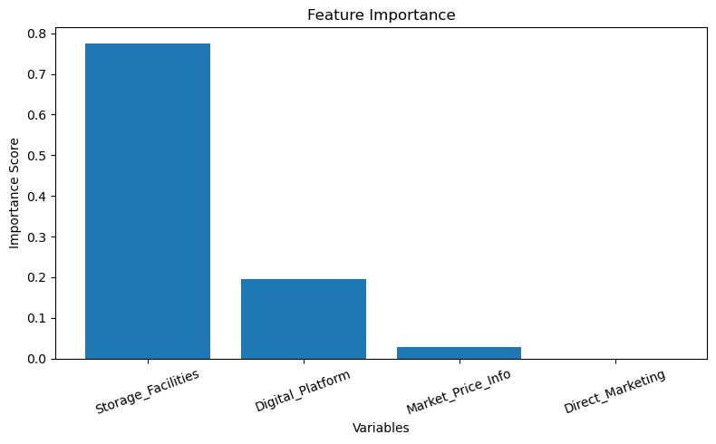
Decision Tree & Feature Importance

Slide 19
Major Statistical Findings
Objective 1 – Existing Marketing Methods
Objective 2 – Marketing Opportunities
Farmers continue to use a combination of traditional and direct marketing channels, with growing interest in direct selling.
Diversified agricultural production and marketing practices provide multiple income opportunities while reducing production risk.
Farmers identified opportunities through direct marketing, better market connectivity, technological adoption, and institutional support.
Most respondents believe direct marketing improves market access and contributes to better income generation.
Objective 3 – Role of Digital Marketing
Objective 4 – Marketing Challenges
Rural farmers are increasingly adopting digital platforms for product promotion, communication, and digital payments.
Digital marketing has improved market visibility, customer reach, and confidence in technology-based agricultural marketing.
Farmers continue to face transportation issues, storage limitations, market information gaps, delayed payments, and middlemen influence.
These interconnected challenges reduce marketing efficiency and affect fair price realization.

Slide 20
Major Statistical & Predictive Findings
Chi-Square Analysis
Pearson Correlation Analysis
Significant associations were identified among key agricultural marketing variables, confirming relationships between direct marketing awareness, digital platform adoption, market price information, middlemen influence, customer interest, and marketing preferences.
Strong positive relationships were observed among direct marketing awareness, digital platform usage, market price information, storage facilities, and fair price realization, indicating that improvements in one factor support improvements in others.
Binary Logistic Regression
Decision Tree Classification
Purpose: To identify the statistically significant factors influencing fair price realization.
Market Price Information emerged as the significant predictor (β = 3.563, p = 0.001), showing that timely and reliable market information substantially increases the likelihood of farmers receiving a fair price.
Purpose: To develop and evaluate a predictive model for fair price realization.
The model achieved 91.3% testing accuracy and identified Storage Facilities as the most influential predictor, followed by Digital Platform Usage and Market Price Information, demonstrating the usefulness of predictive analytics in agricultural marketing.

Slide 21
Suggestions & Recommendations
Strengthen Market Information Systems
Improve Storage & Post-Harvest Infrastructure
Promote Digital Agricultural Marketing
Improve access to real-time market prices through digital platforms and extension services.
Develop warehouses, cold storage, and village-level storage facilities to reduce losses and improve price realization.
Encourage the use of digital platforms, online marketplaces, and social media for agricultural marketing.
Encourage Direct Farmer-to-Consumer Marketing
Expand Farmer Awareness & Capacity Building
Strengthen direct marketing channels and Farmer Producer Organizations (FPOs) to improve market access and reduce dependence on intermediaries.
Organize training on direct marketing, digital technologies, pricing strategies, and financial literacy.

Slide 22
Conclusion
RESEARCH IMPACT
The study identified both opportunities and challenges in agricultural marketing, highlighting the importance of direct marketing, digital adoption, and market access in improving farmers' marketing practices.
Statistical and predictive analyses confirmed that market price information, storage facilities, and digital platform usage play a significant role in achieving fair price realization for rural farmers.
The findings provide practical insights for farmers, policymakers, and agricultural institutions to strengthen marketing systems, improve income opportunities, and promote sustainable agricultural development.
Fair Prices
Improved price realization for farmers
Digital Shift
Greater adoption of digital marketing
Evidence Base
Data-driven policy and decisions

Slide 23
PROJECT ON SOCIAL AND RURAL ISSUES
Thank You
Questions & Discussion
Opportunities and Challenges Faced by Rural Farmers in Marketing Agricultural Products
Raghavendra S.
Department of MBA, Siddaganga Institute of Technology, Tumakuru

