Slide 1
Aspect Based Sentiment Analysis with Gated Convolutional Networks
Team-49

Slide 2
Introduction
Aspect based sentiment analysis(ABSA) is used to analyse the text it categorizes opinions by aspect and identifies the sentiment related to each aspect
There are previously two different approaches to the ABSA one is Aspect Category sentiment analysis(ACSA) and the other is the Aspect term sentiment analysis.
To solve ABSA many models are proposed some using LSTM layers(ATAE-LSTM, TD-LSTM, RAM-LSTM). These models are not efficient and time consuming.

Slide 3
Introduction
In this paper the model proposed uses gated convolutional neural networks. The architecture in this model is much simpler compared to that of the other models which uses LSTM.
Computation for this model can be easily parallelized during the training since convolutional layers do not have time dependency as in LSTM layers, and gating units also work independently.
The model is tested on the semeval datasets, which showed efficiency and effectiveness of this model when compared to the previous models.

Slide 4
ACSA
The goal of ACSA is to predict the sentiment polarity with regard to
the given aspect, which is one of a few predefined categories.
Consider an example in the semeval dataset of restaurants.
“Average to good Thai food, but terrible delivery”; category: “Service”
Here the category service is predefined in the data. ACSA would ask
the sentiment polarity of the aspect “service”.

Slide 5
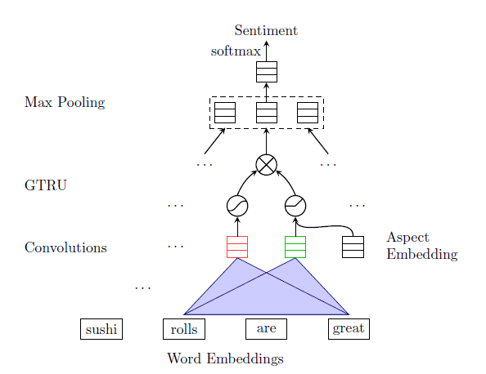
ACSA-GCAE(Architecture)

Slide 6
ACSA-GCAE(Architecture)
Model is built on convolutional layer and gated units.
The Gating units on the top of convolutional layer are also independent from each other. This implies that the model is more suited towards the parallel computing.
The model has two kind of filtering mechanisms one is the gating units on the top of convolutional layer and the other is the max pooling layer.

Slide 7
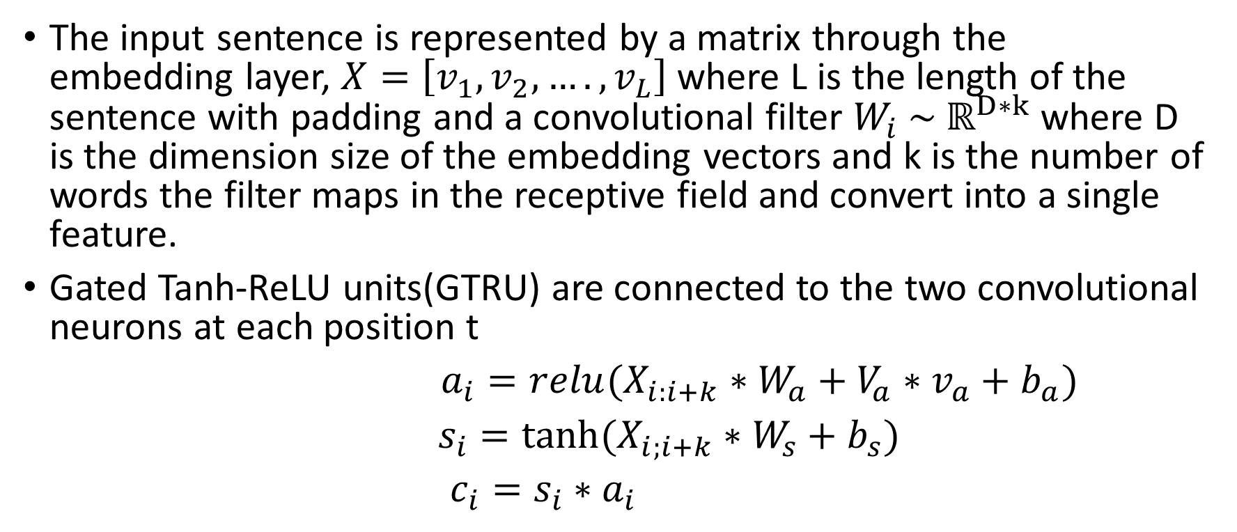
ACSA-GCAE(Architecture)
The input sentence is represented by a matrix through the embedding layer, $X=\left[v_{1},v_{2},….,v_{L}\right]$ where L is the length of the sentence with padding and a convolutional filter $W_{i} \sim ℝ^{D∗k}$ where D is the dimension size of the embedding vectors and k is the number of words the filter maps in the receptive field and convert into a single feature.
Gated Tanh-ReLU units(GTRU) are connected to the two convolutional neurons at each position t
$a_{i}=relu(X_{i:i+k}∗W_{a}+V_{a}∗v_{a}+b_{a})$
$s_{i}=tanh⁡(X_{i;i+k}∗W_{s}+b_{s})$
$c_{i}=s_{i}∗a_{i}$

Slide 8

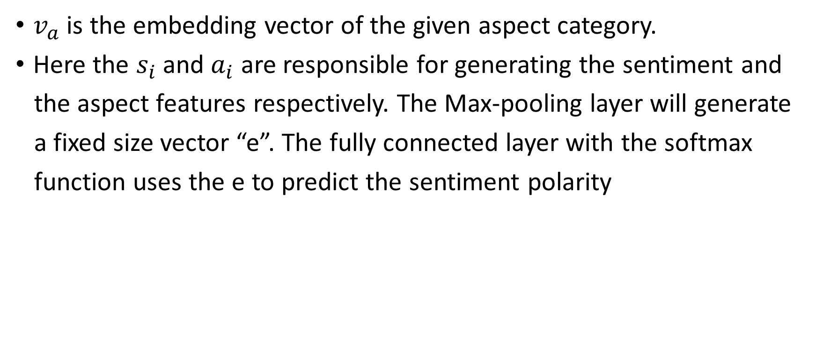
ACSA-GCAE
$v_{a}$ is the embedding vector of the given aspect category.
Here the $s_{i}$ and $a_{i}$ are responsible for generating the sentiment and
the aspect features respectively. The Max-pooling layer will generate
a fixed size vector “e”. The fully connected layer with the softmax
function uses the e to predict the sentiment polarity

Slide 9


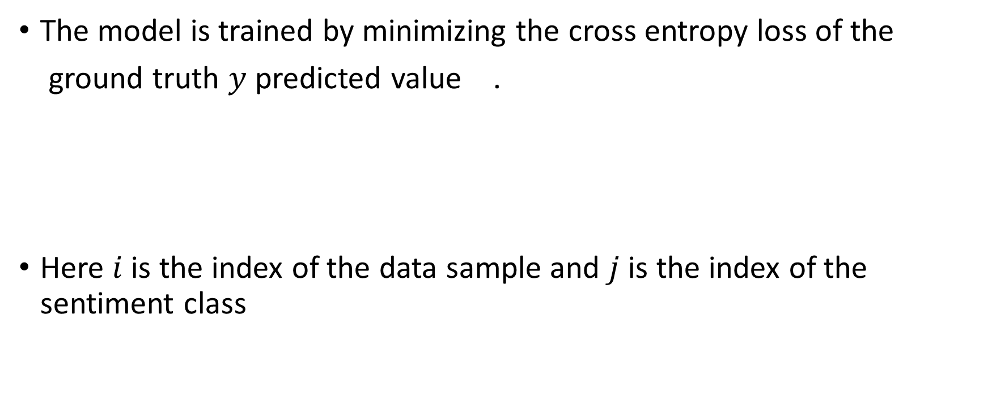
ACSA-GCAE
The model is trained by minimizing the cross entropy loss of the
ground truth $y$ predicted value .
Here $i$ is the index of the data sample and $j$ is the index of the sentiment class

Slide 10
ATSA-GCAE
The model here predicts the sentiment polarity of the aspect terms in
the given sentence(the terms or words appeared in the given
sentence). If we take the same example in the ACSA task which is
“Average to good Thai food, but terrible delivery”; category: “Service”
Here ATSA will predict the sentiment polarity towards the word “Thai
food”. Whereas ACSA will focus in the “Service”.

Slide 11
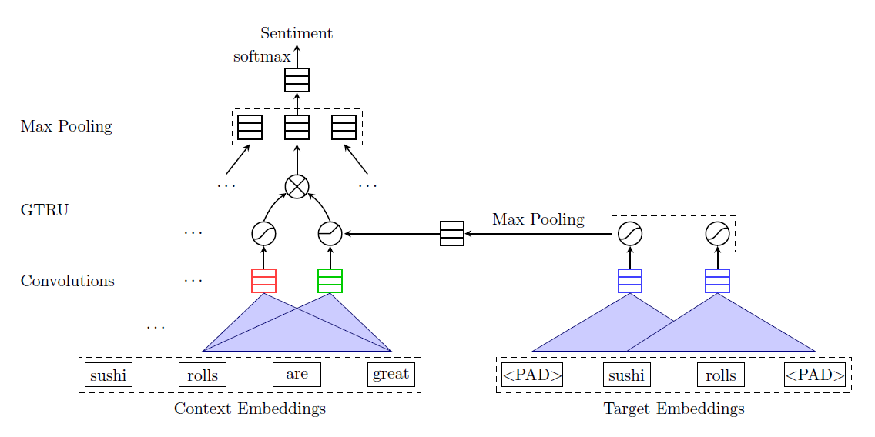
ATSA-GCAE(Architecture)

Slide 12
ATSA-GCAE(Architecture)
ATSA model is an extension for the ACSA model discussed above in here we will add a small convolutional layer on the aspect terms.
In ACSA the aspect information is one single word; while in the ATSA such information is provided by the CNN on the aspect terms.
The additional CNN extracts the important features from multiple words.
Then there is GTRU followed by maxover polling and softmax at the last

Slide 13
Dataset
Here the dataset used was acsa_hard_train and acsa_hard_test for the ACSA part and atsa_hard_train and atsa_hard_test for ATSA part. All these are SemEval datasets which contains restaurants reviews with labels on aspect level.
All the datasets consist of three columns namely “sentence”, “aspect”, and “sentiment”. The “aspect” in atsa part represent aspect terms. Sentiment can any of the four “positive”, “negative”, “neutral”, “conflict”.

Slide 14
Loss and Accuracy
For ACSA
Train loss = 0.6802543120936344 Train accuracy = 0.6986301369863014
Test loss = 1.9121916090671935 Test accuracy = 0.3033707865168539
For ATSA
Train loss = 0.982821518738318 Train accuracy = 0.5876685934489403
Test loss = 1.9724740042978404 Test accuracy = 0.15510204081632653
The code for ACSA was written in acsa.ipynb and ATSA was written in atsa.ipynb file. Before running the code, we need to have the glove.6B.50d file in the same folder as the code.

