Slide 1
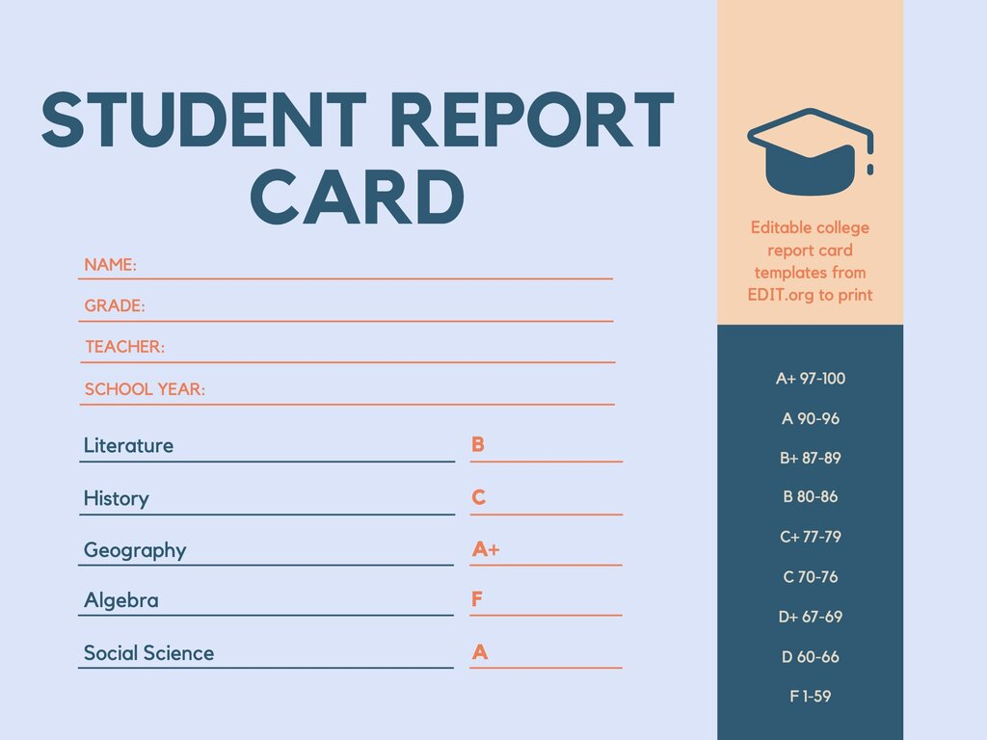
Group 6
C. Sanjana
Ch. Sai Nath
Ch. Naresh
J. Pranay Kumar
K. Raghavendra

Slide 2
Student Report Card Management
Abstract - The Student Report Card System is an application designed to automate the traditional report card. Student data can be managed using this application. The administrator can create, view, and modify individual student data. Administrators and students can access the site through their login credentials and view the marks of students by providing the necessary information. This data is stored in a Text file for future reference.

Slide 3
Introduction-
The project student report card management is aimed at efficiently storing and retrieving student examination reports.
This project is a simple console application built without any graphical interface.
Data Structures have been effectively used to perform all these operations.
This data is stored in a Text file for future reference.

Slide 4
Student Report Card Management
II. HEADER FILES USED :
#include<stdio.h>:The stdio.h header stands for Standard Input Output. It has the information related to input/output functions.
#include<stdlib.h>:The stdlib.h header defines four variable types, several macros, and various functions for performing general functions
#include<string.h>:The header file stdio.h stands for Standard Input Output. It has the information related to input/output functions.
#include"sturepo.h”:This is a user defined header file to implement various report card functions

Slide 5
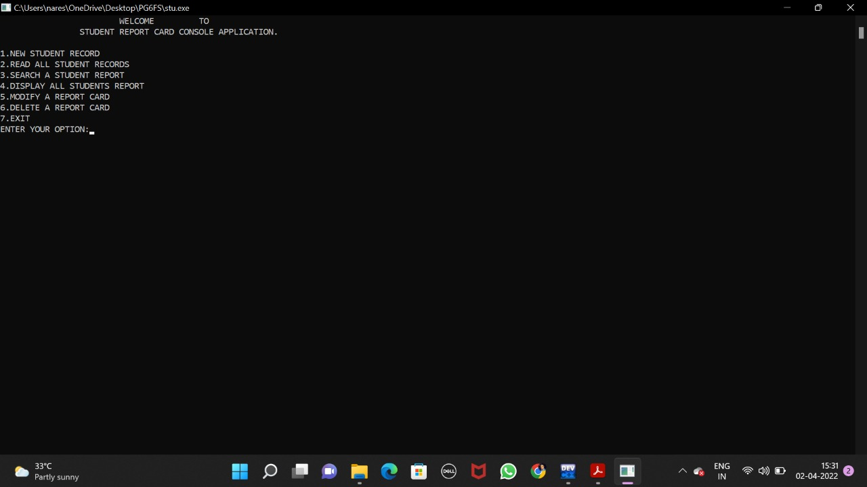
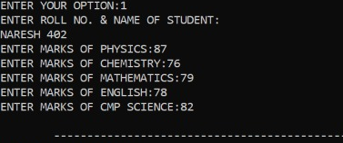
1. Create student report card record: This will add the details of a new student into the binary file
2. Read all students report card record: Can retrieve all the records present in the file.

Slide 6
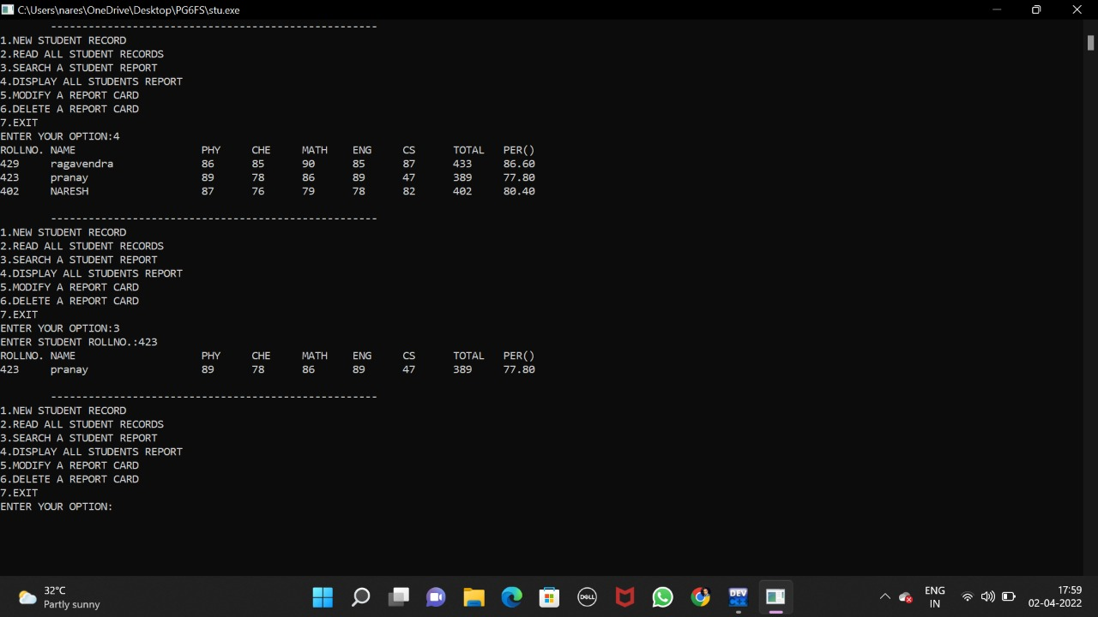
3. Read specific student’s report card record: We can use this to retrieve a single student data
4. Display all students’ grade report: This feature enlists all the students’ record saved in file.

Slide 7
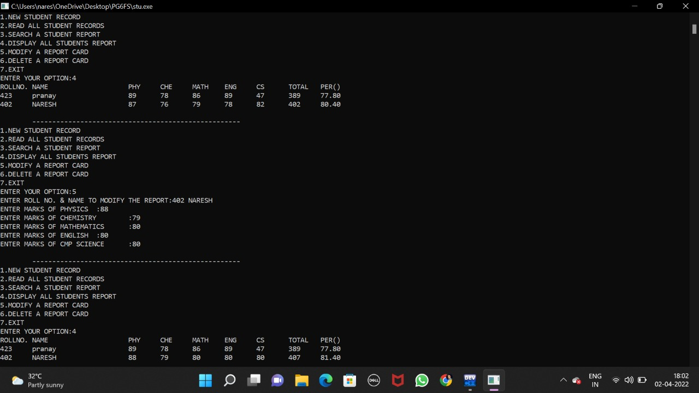
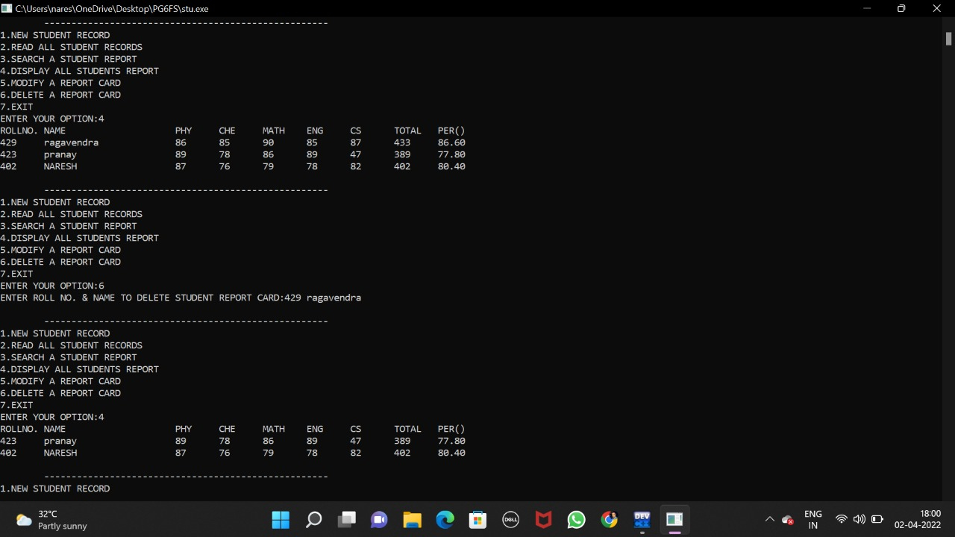
5. Modify student’s report card record: In student report card system project in C++, this feature is used to edit the report card record of a particular student.
6. Delete student record: This feature deletes the report card record of a particular student; it first of all asks for the name and roll no. of the student whose record is to be deleted.

Slide 8

C. Sanjana
Ch. Naresh
Ch. Sai Nath
J. Pranay Kumar
K. Raghavendra

