Slide 1
Azure Kubernetes Service (AKS)
Karthick Selvam

Slide 2
Azure Kubernetes Service (AKS)
Azure Kubernetes Service (AKS) manages your hosted Kubernetes environment, making it quick and easy to deploy and manage containerized applications without container orchestration expertise. It also eliminates the burden of ongoing operations and maintenance by provisioning, upgrading, and scaling resources on demand, without taking your applications offline.

Slide 3
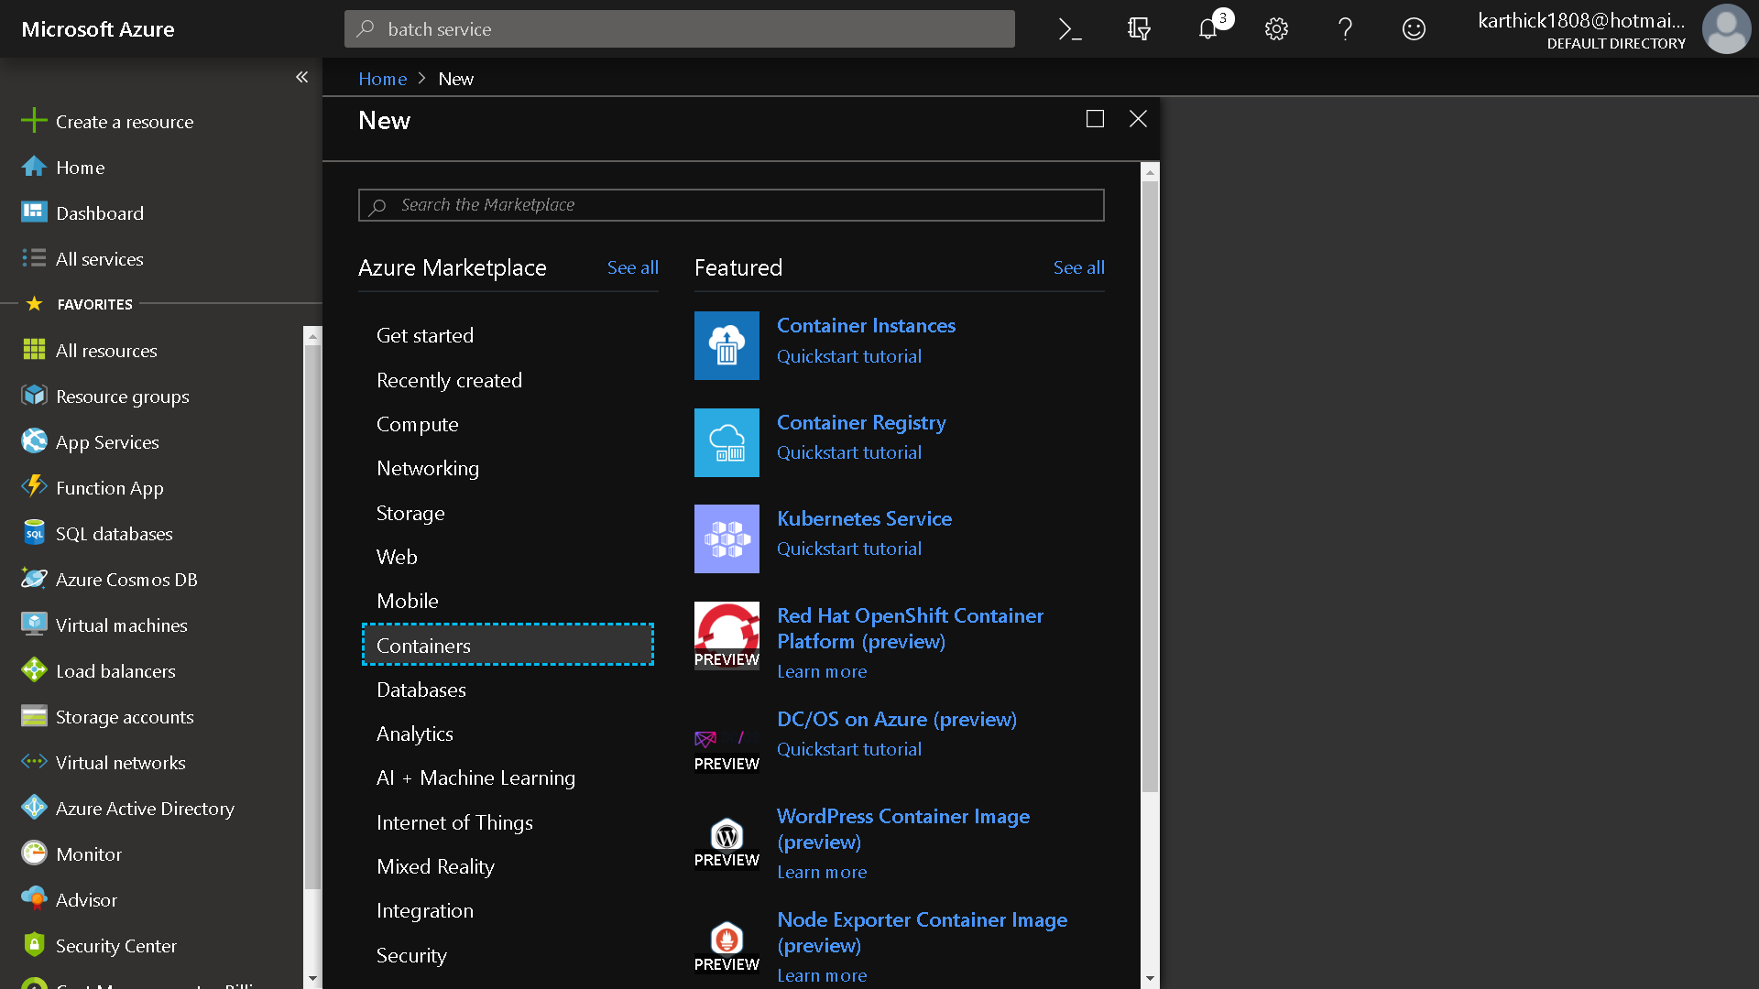

Slide 4
What is Container?
A container is a standard unit of software that packages up code and all its dependencies so the application runs quickly and reliably from one computing environment to another.
A Docker container image is a lightweight, standalone, executable package of software that includes everything needed to run an application: code, runtime, system tools, system libraries and settings.

Slide 5
Kubernetes
Kubernetes (K8s) is an open-source system for automating deployment, scaling, and management of containerized applications.
It groups containers that make up an application into logical units for easy management and discovery. Kubernetes builds upon 15 years of experience of running production workloads at Google, combined with best-of-breed ideas and practices from the community.

Slide 6
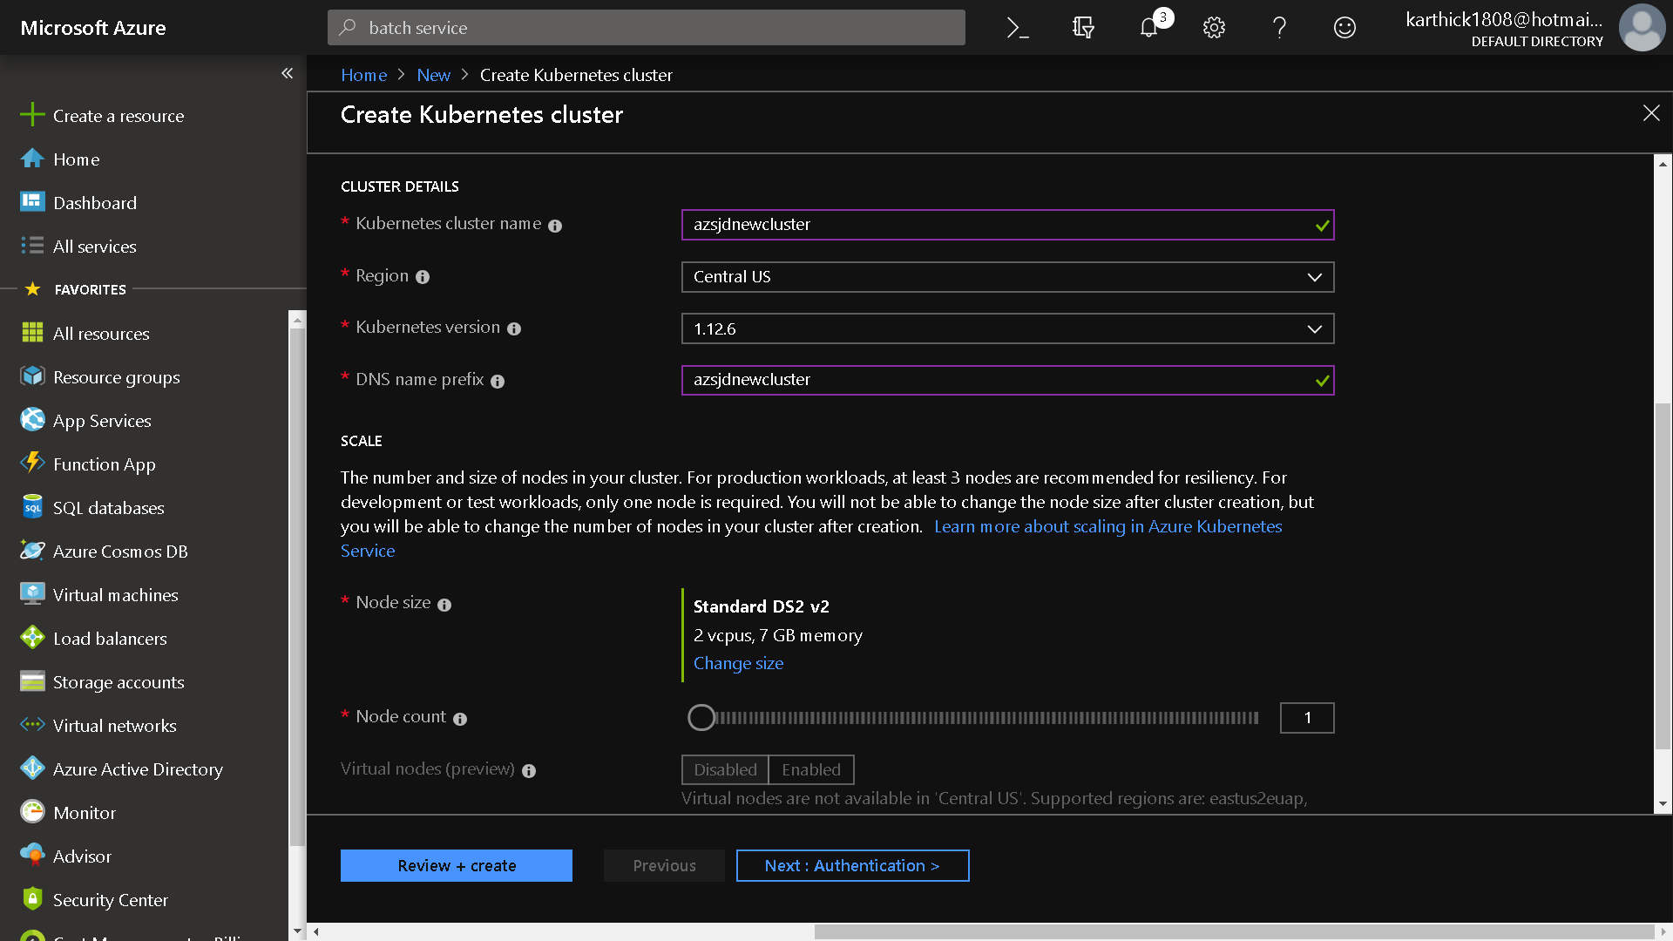

Slide 7
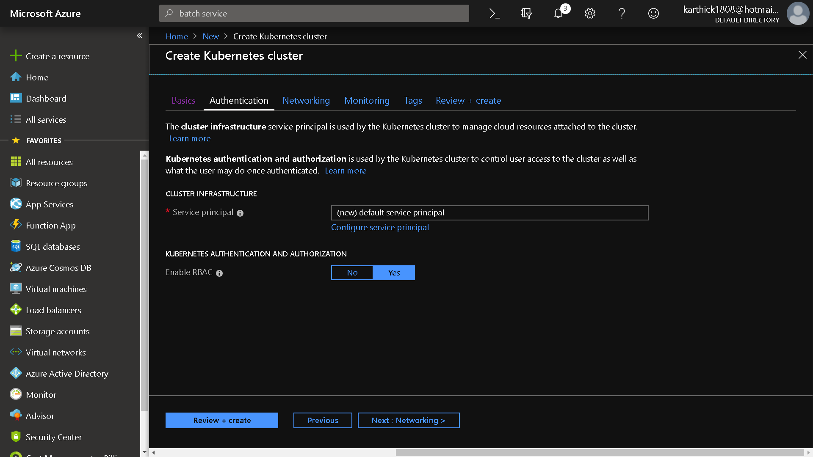

Slide 8
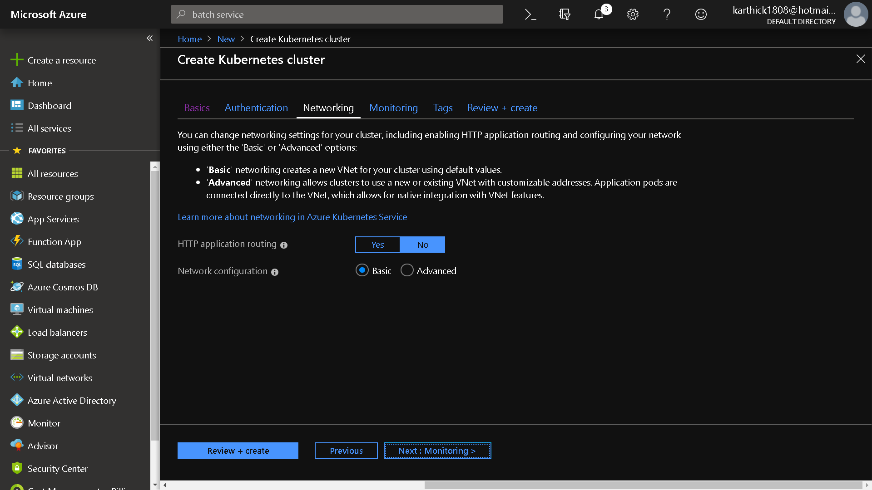

Slide 9
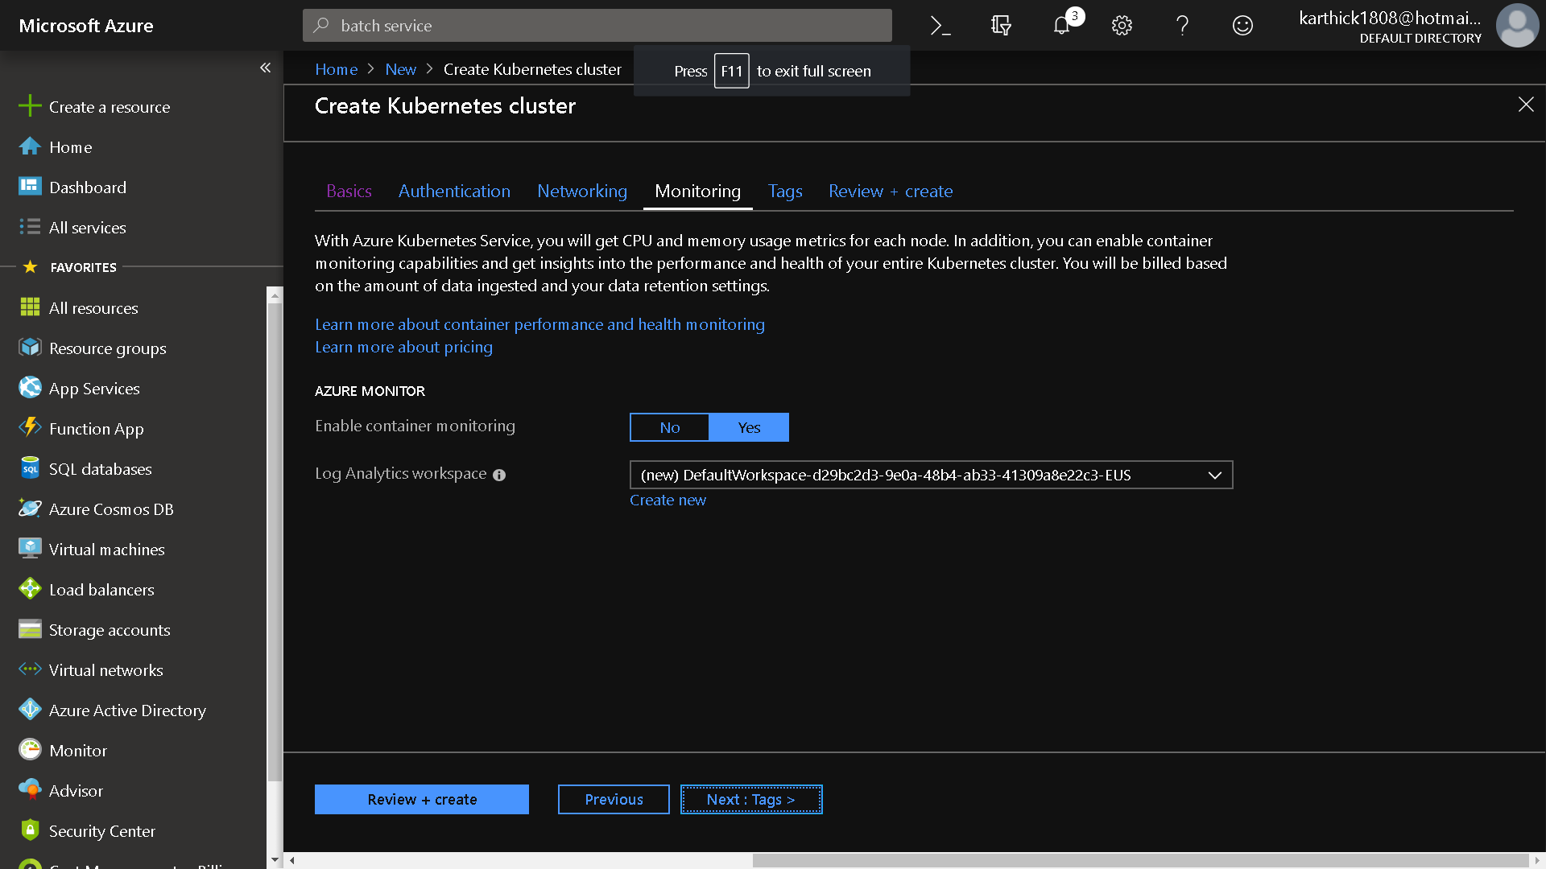

Slide 10
bash
az aks get-credentials --resource-group az203newvm --name azsjdnewcluster
kubectl get nodes
https://docs.microsoft.com/en-us/azure/aks/kubernetes-walkthrough-portal
kubectl apply -f azure-vote.yaml
Kubectl get service

Slide 11
Powershell
az aks get-credentials --resource-group az203newvm --name azsjdnewcluster
az aks browse --resource-group az203newvm --name azsjdnewcluster

Slide 12
Azure App Service
Azure App Service enables you to build and host web apps, mobile back ends, and RESTful APIs in the programming language of your choice without managing infrastructure. It offers auto-scaling and high availability, supports both Windows and Linux, and enables automated deployments from GitHub, Azure DevOps, or any Git repo. Learn how to use Azure App Service with our quickstarts, tutorials, and samples.

