Slide 1
App Service
Karthick SElvam

Slide 2
App Service
Webapps have lot in common with containers
Essentially you r going to create and package your code on your local machine and then going to publish that code / upload that code in to your web app service
Microsoft Azure will take care of running the web app its in control of the infra structure, you don not have ssh no rdp in to that machine, and infect you don't have a lot of insights into the hardware itself now you should keep in mind that,
Microsoft is sharing the hardware between yourself and other clients in a tenant scenario

Slide 3
App Service
Azure App Service is a service for hosting web applications, REST APIs, and mobile back ends. You can develop in your favorite language, be it .NET, .NET Core, Java, Ruby, Node.js, PHP, or Python. Applications run and scale with ease on both Windows and Linux-based environments. For Linux-based environments, see App Service on Linux.
App Service not only adds the power of Microsoft Azure to your application, such as security, load balancing, autoscaling, and automated management. You can also take advantage of its DevOps capabilities, such as continuous deployment from Azure DevOps, GitHub, Docker Hub, and other sources, package management, staging environments, custom domain, and SSL certificates.

Slide 4
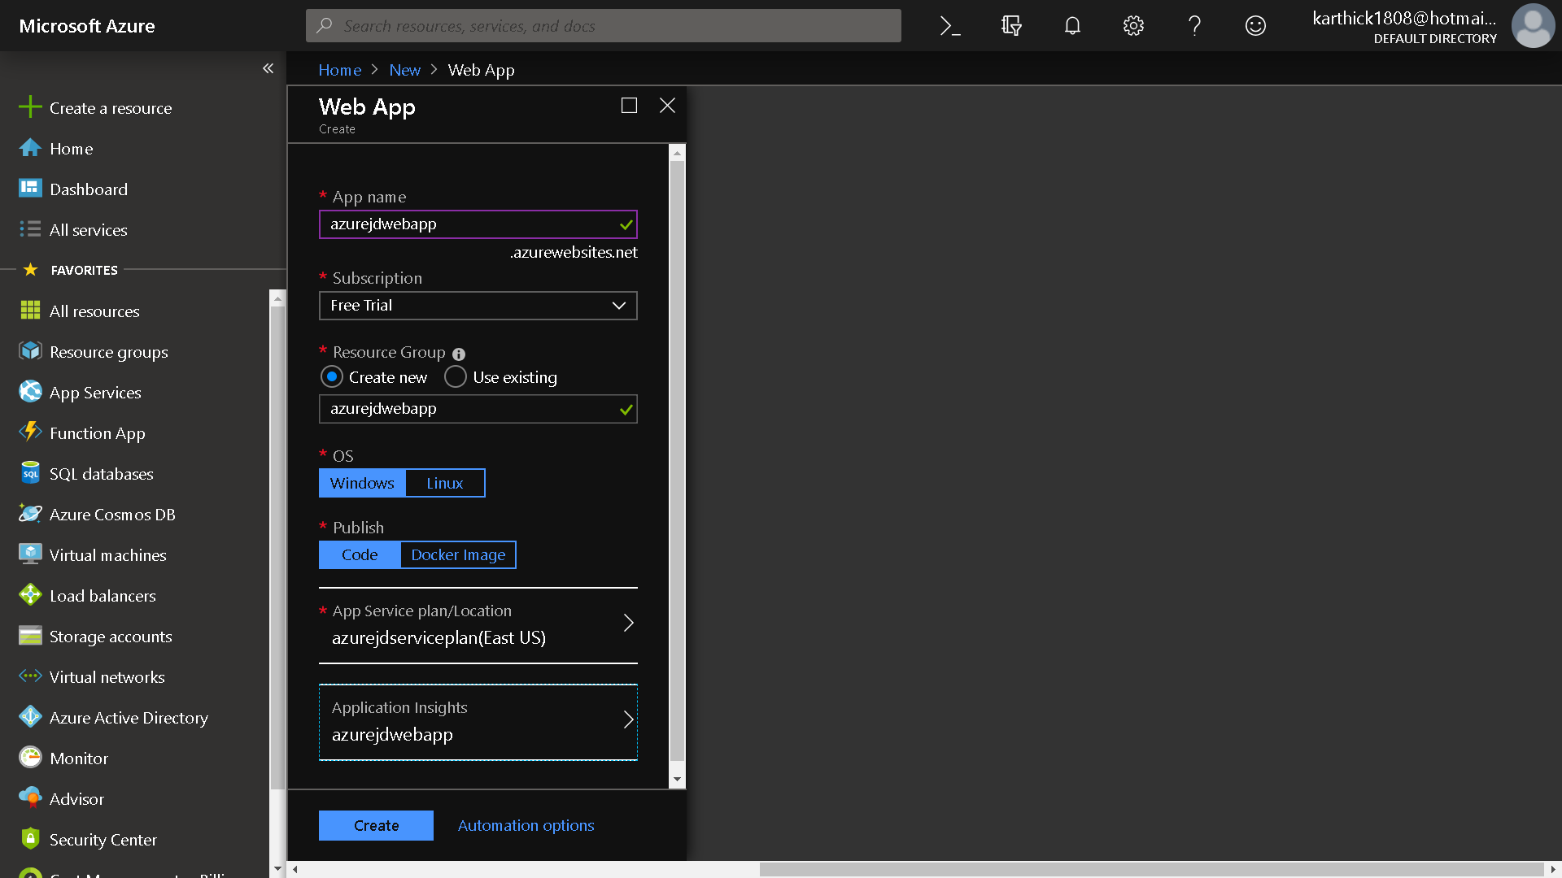

Slide 5
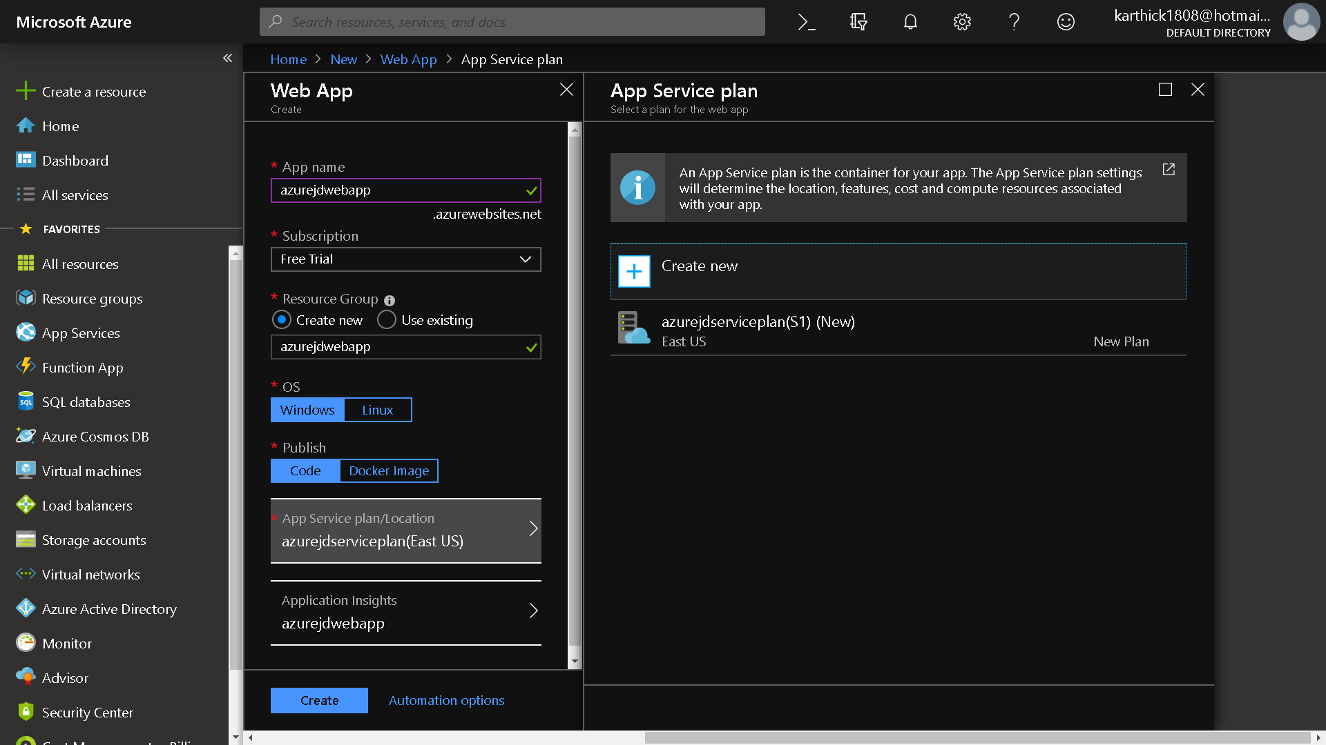

Slide 6
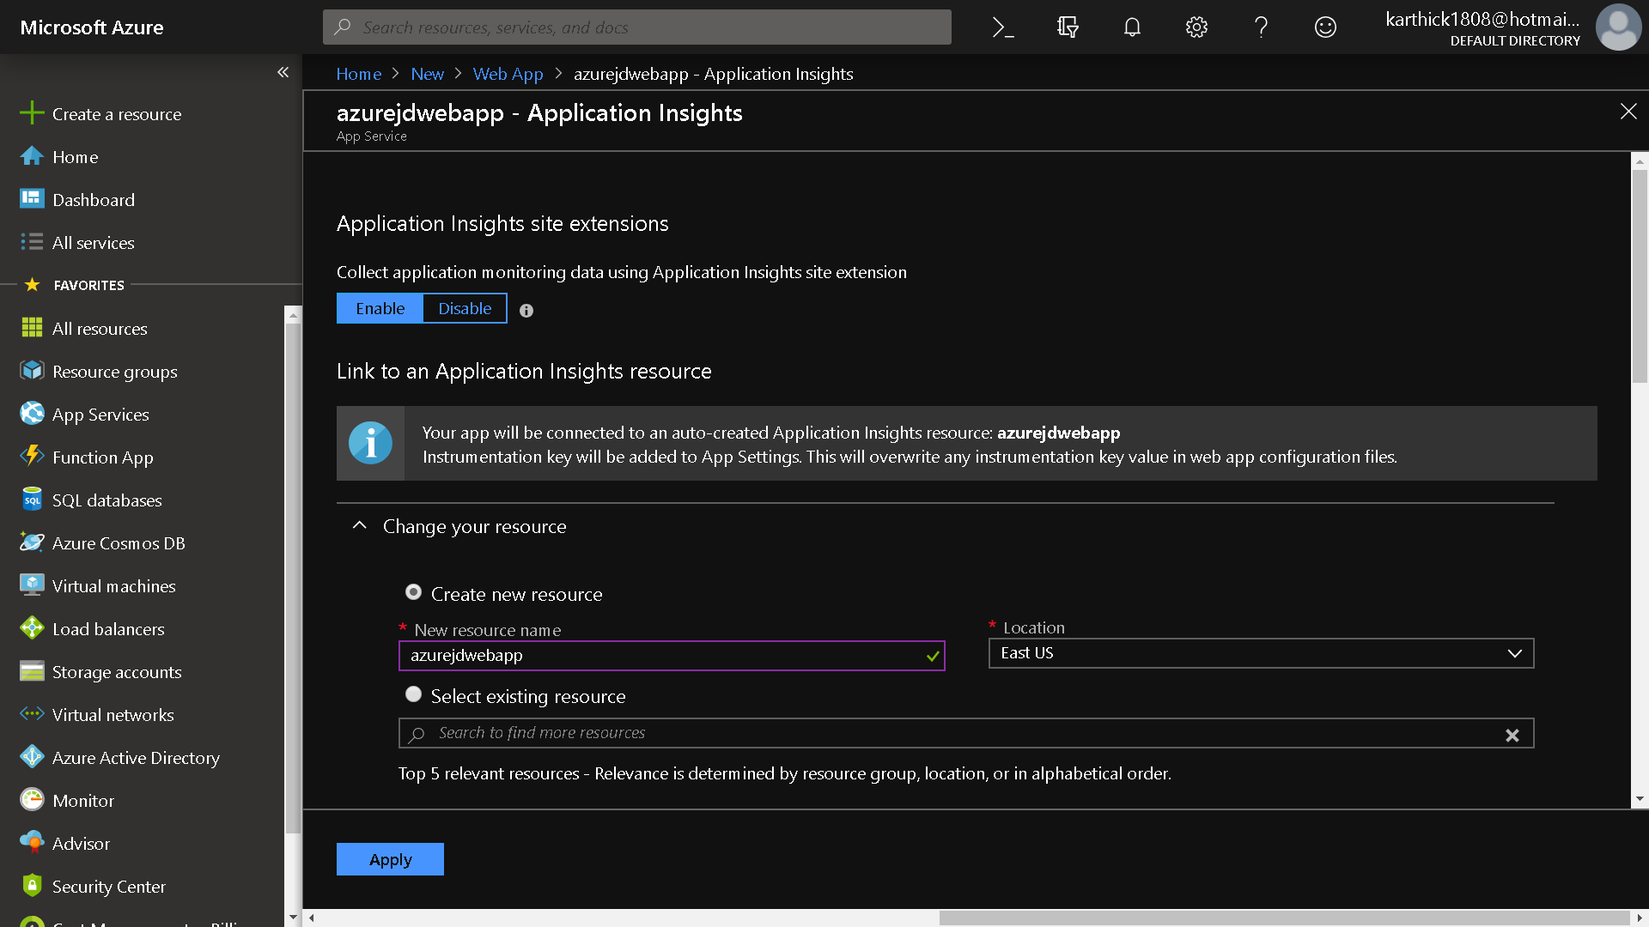

Slide 7
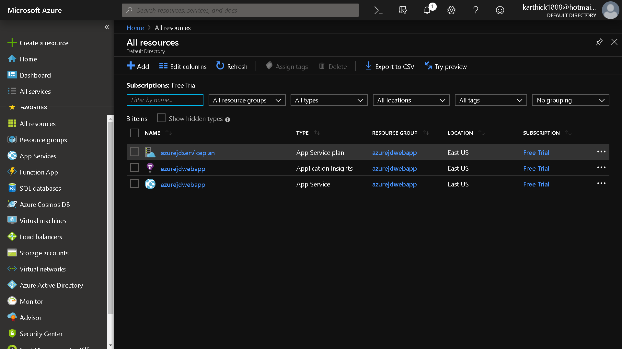

Slide 8
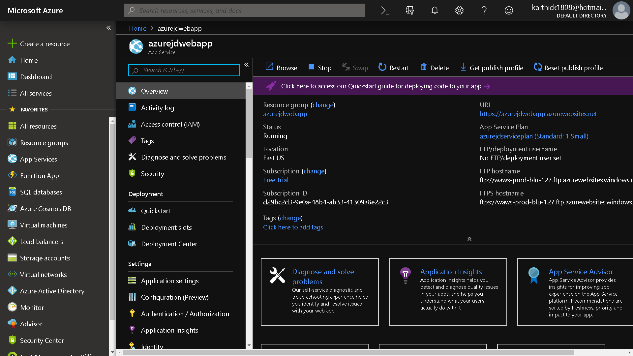

Slide 9
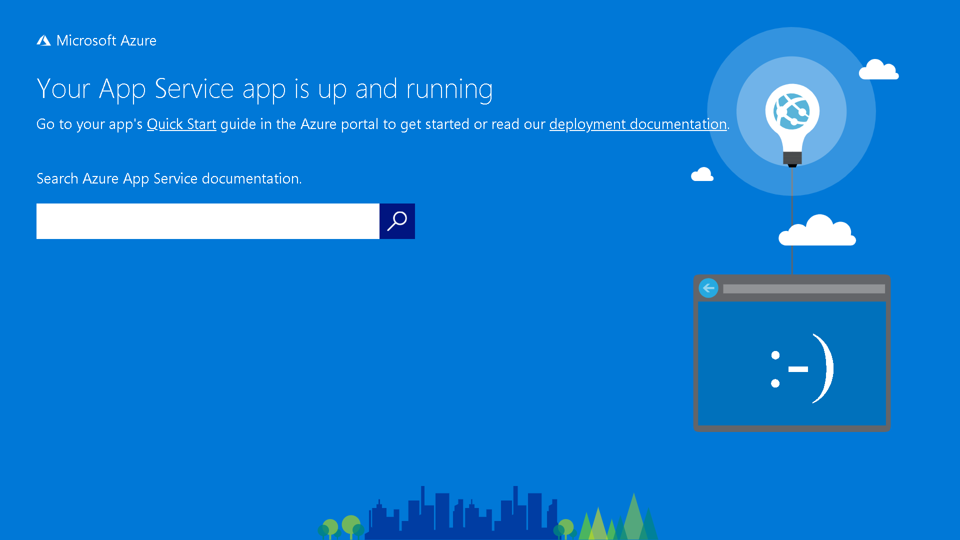

Slide 10
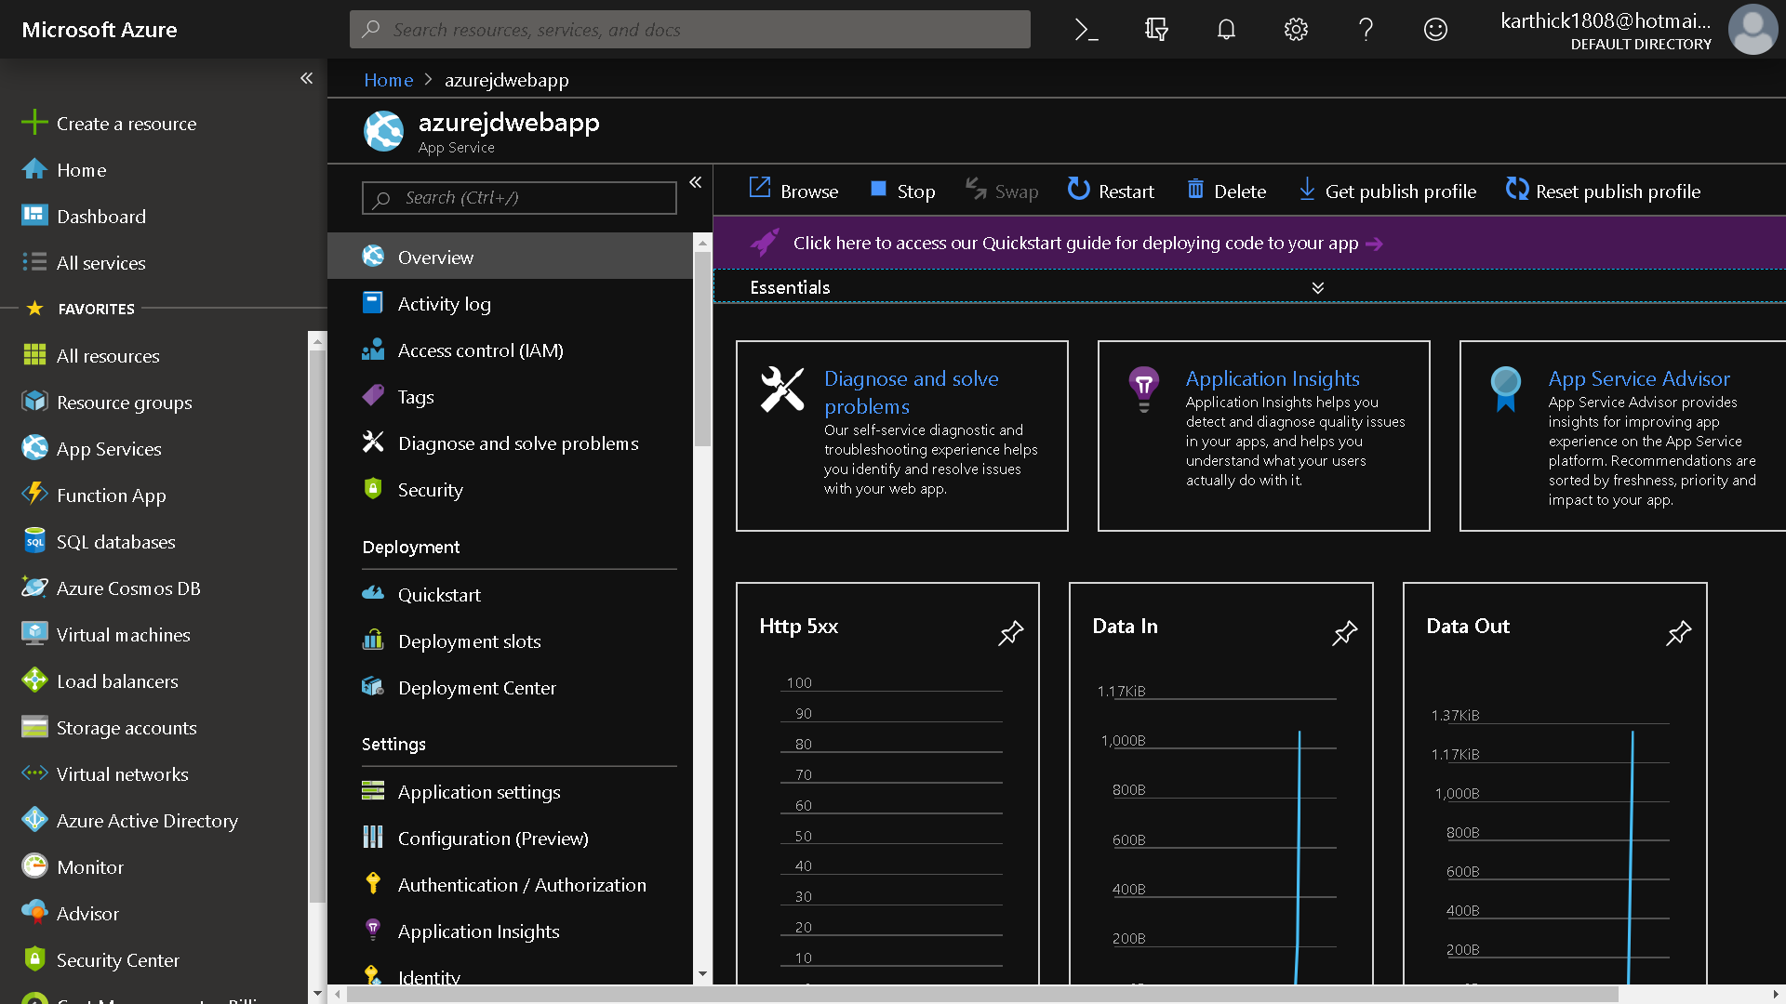

Slide 11
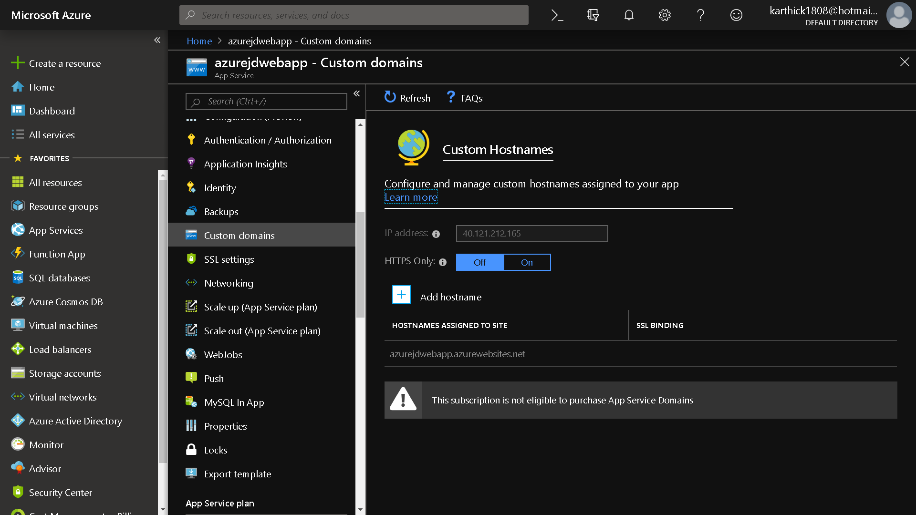

Slide 12
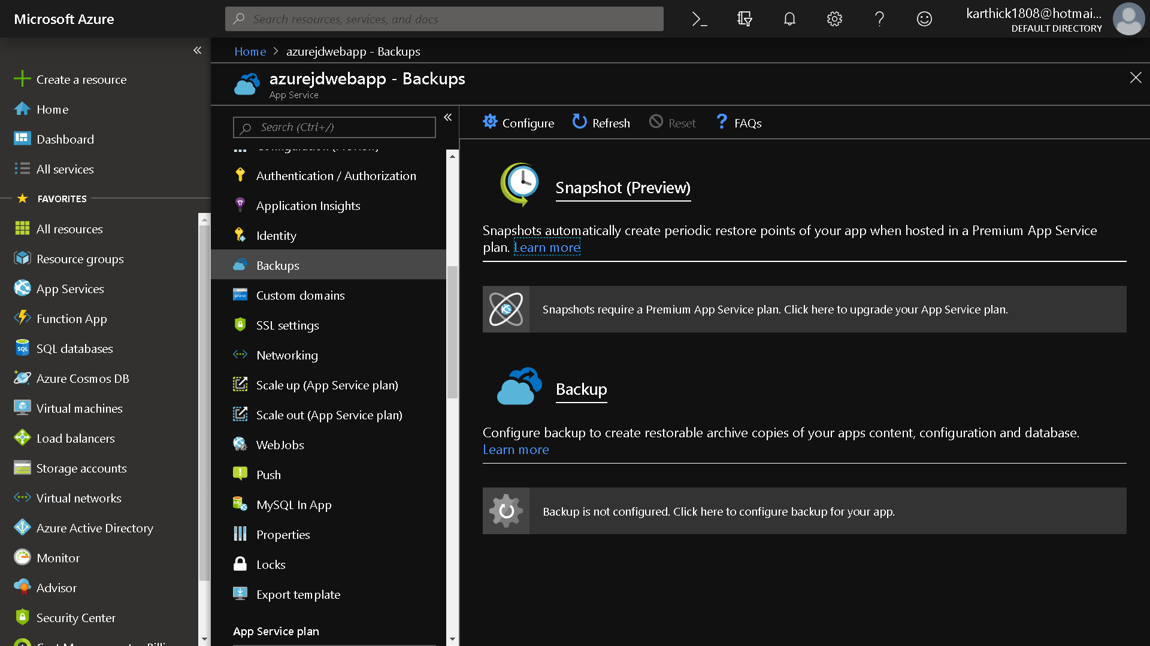

Slide 13
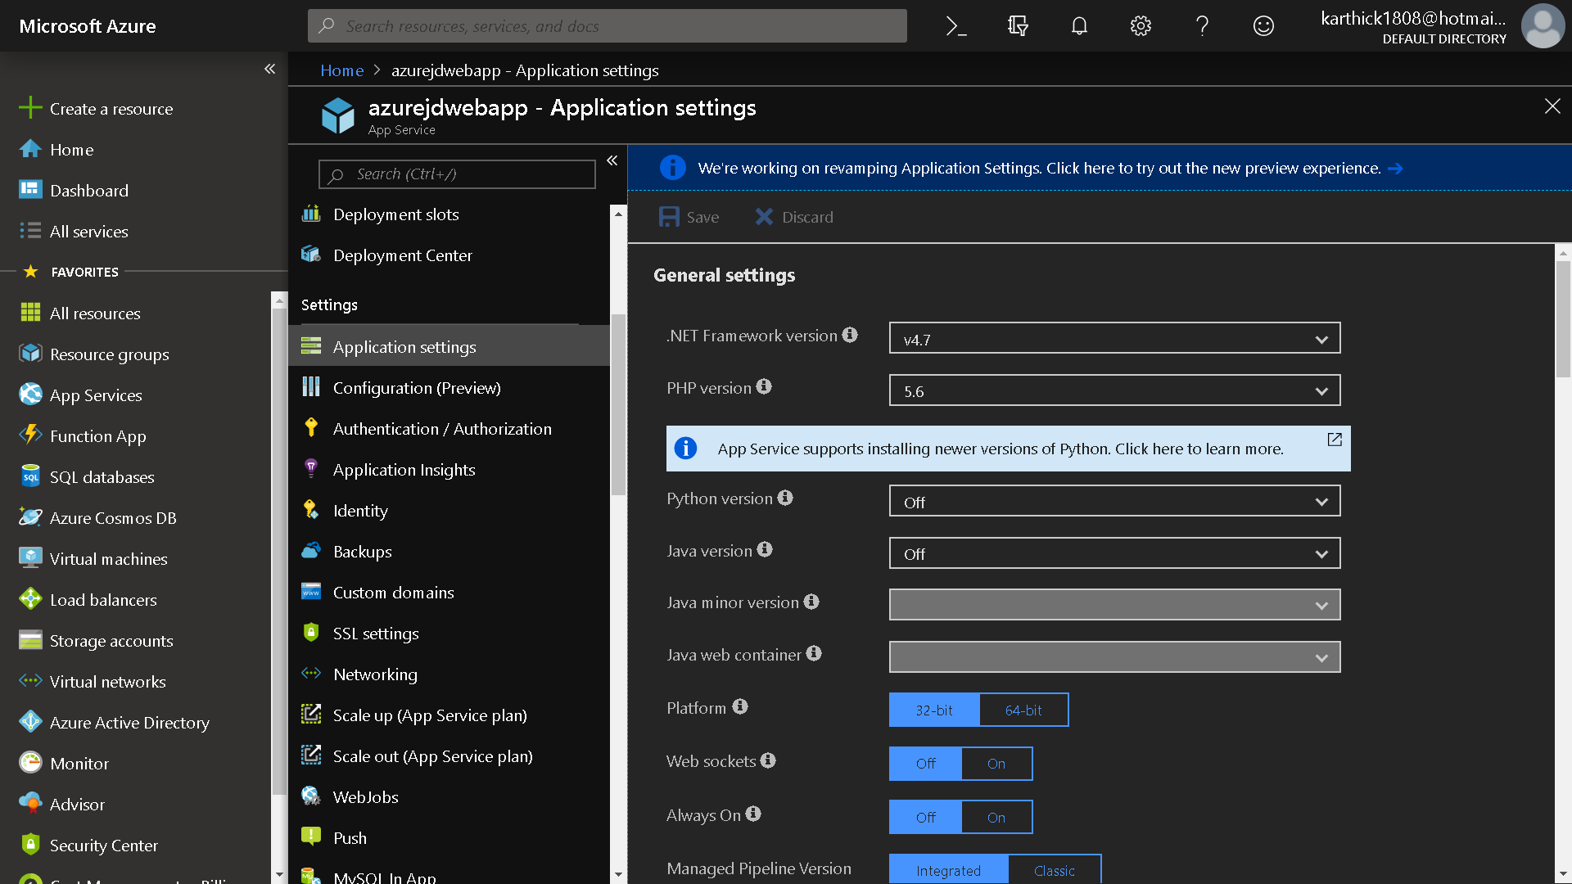

Slide 14
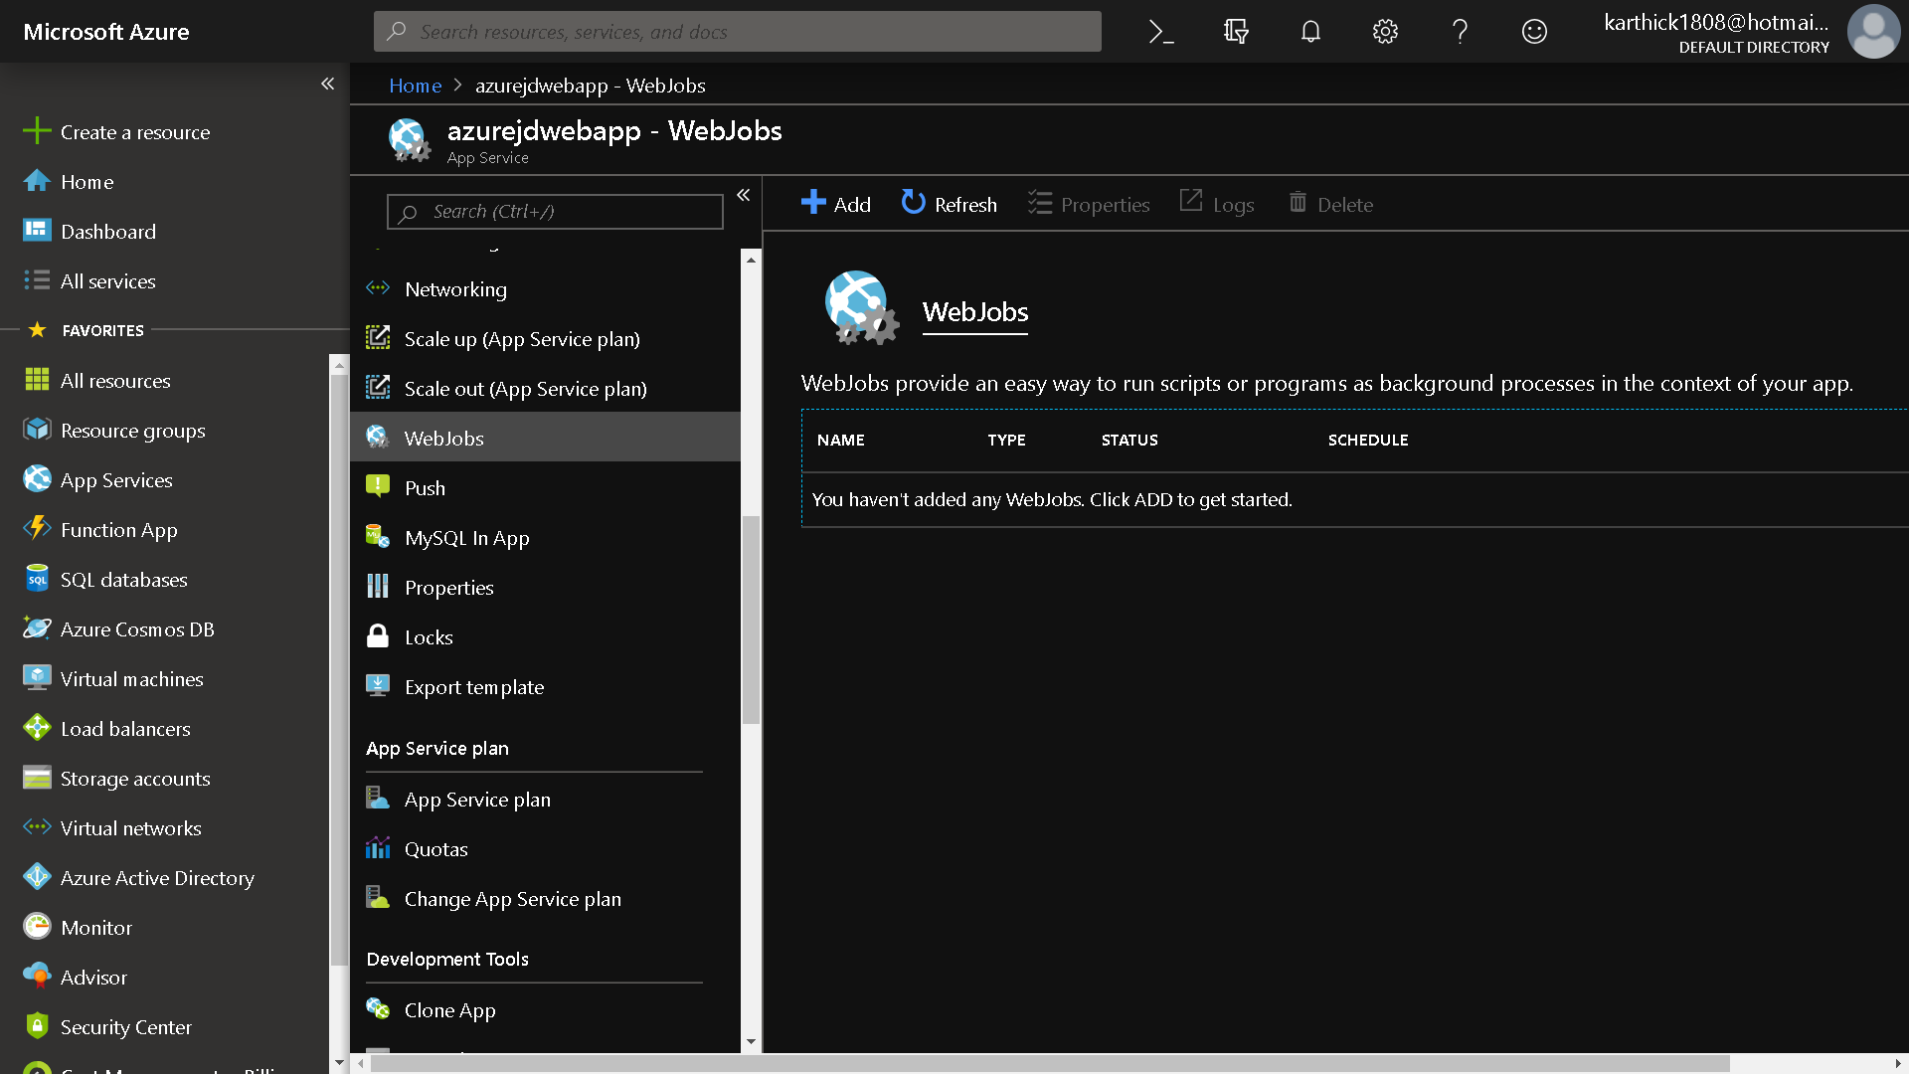

Slide 15
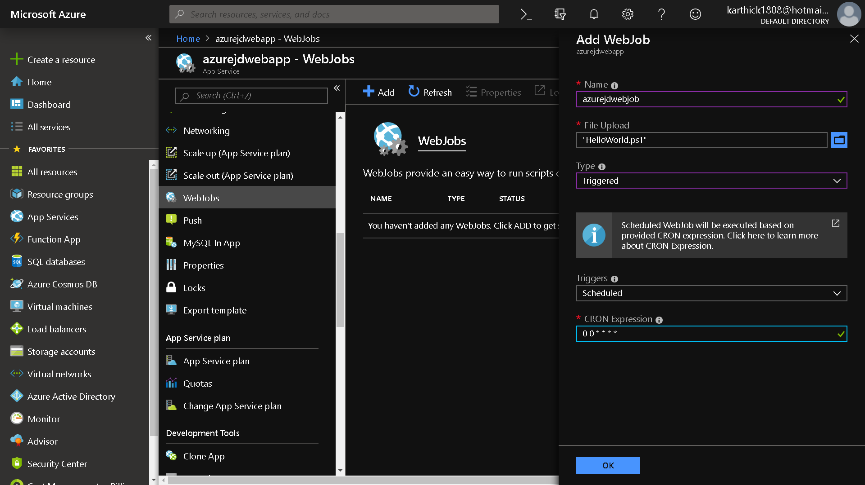

Slide 16
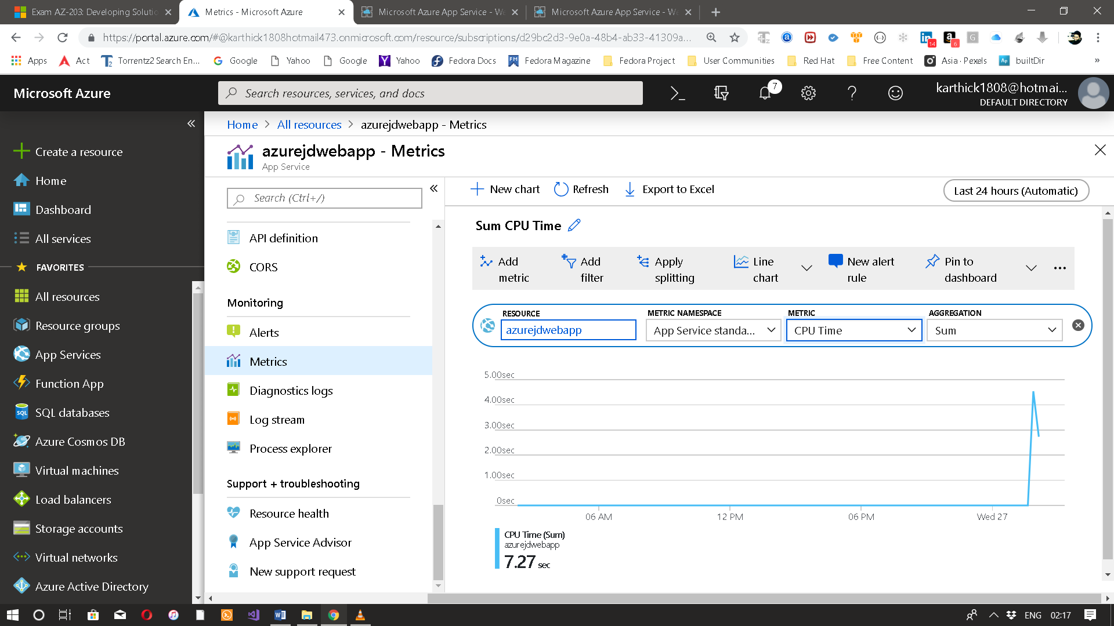

Slide 17
Azure Notification Hubs
Azure Notification Hubs provide an easy-to-use and scaled-out push engine that allows you to send notifications to any platform (iOS, Android, Windows, Kindle, Baidu, etc.) from any backend (cloud or on-premises). Notification Hubs works great for both enterprise and consumer scenarios. Here are a few example scenarios:
Send breaking news notifications to millions with low latency.
Send location-based coupons to interested user segments.
Send event-related notifications to users or groups for media/sports/finance/gaming applications.
Push promotional contents to applications to engage and market to customers.
Notify users of enterprise events like new messages and work items.
Send codes for multi-factor authentication.

Slide 18
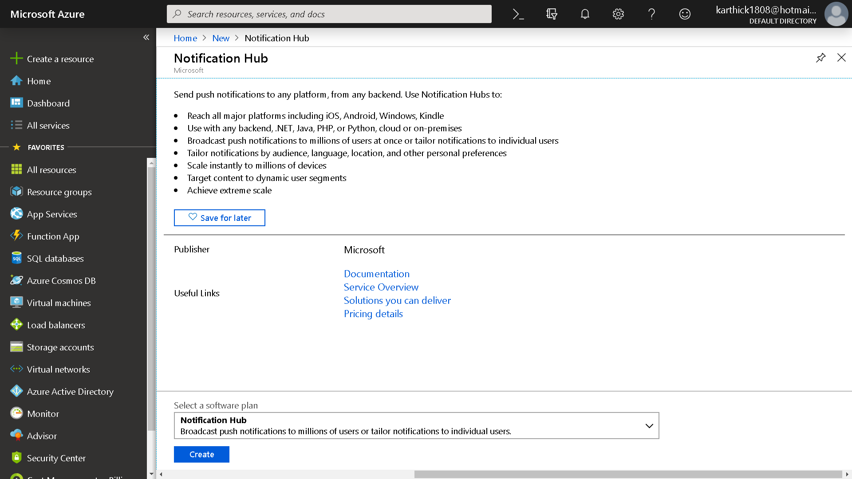

Slide 19
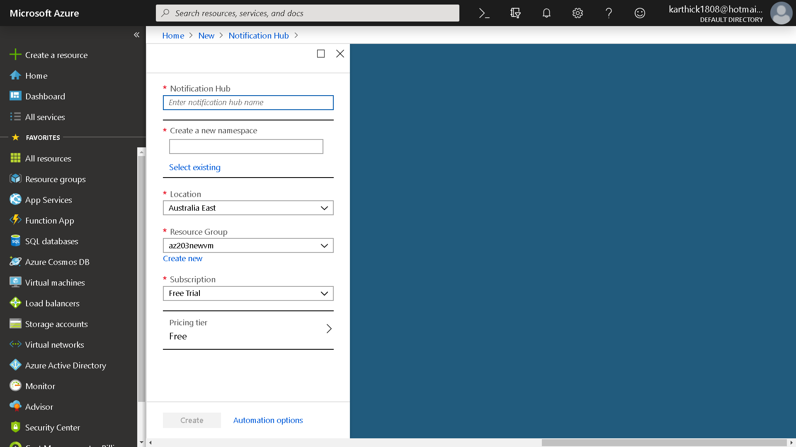

Slide 20
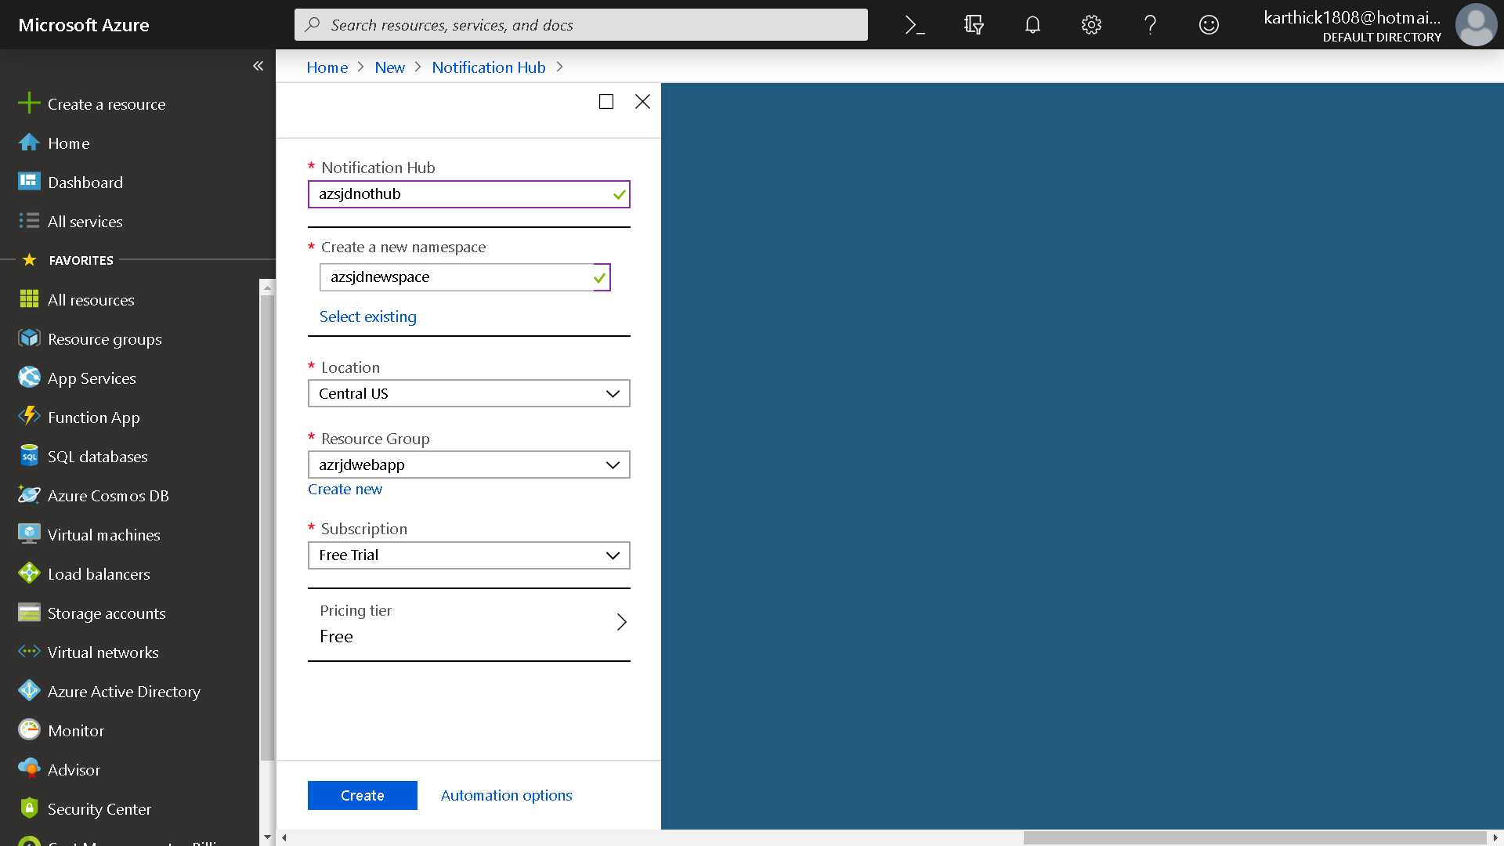

Slide 21
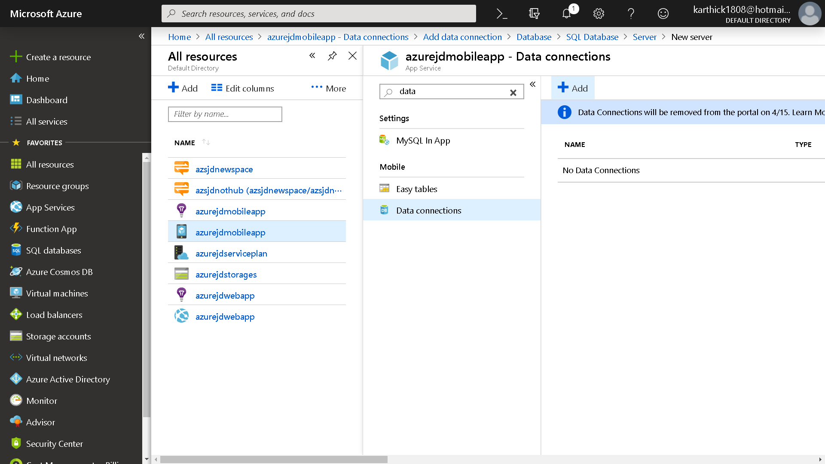

Slide 22
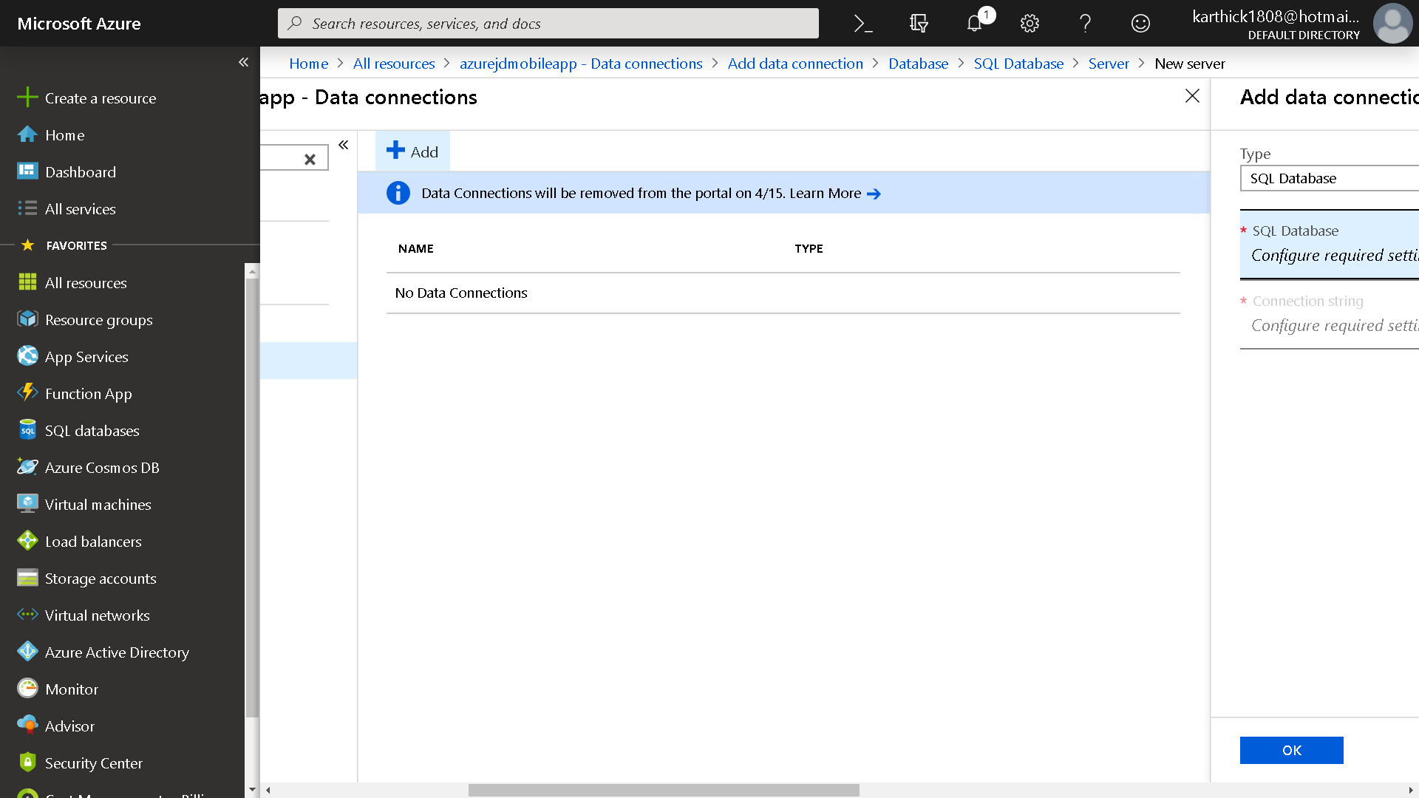

Slide 23
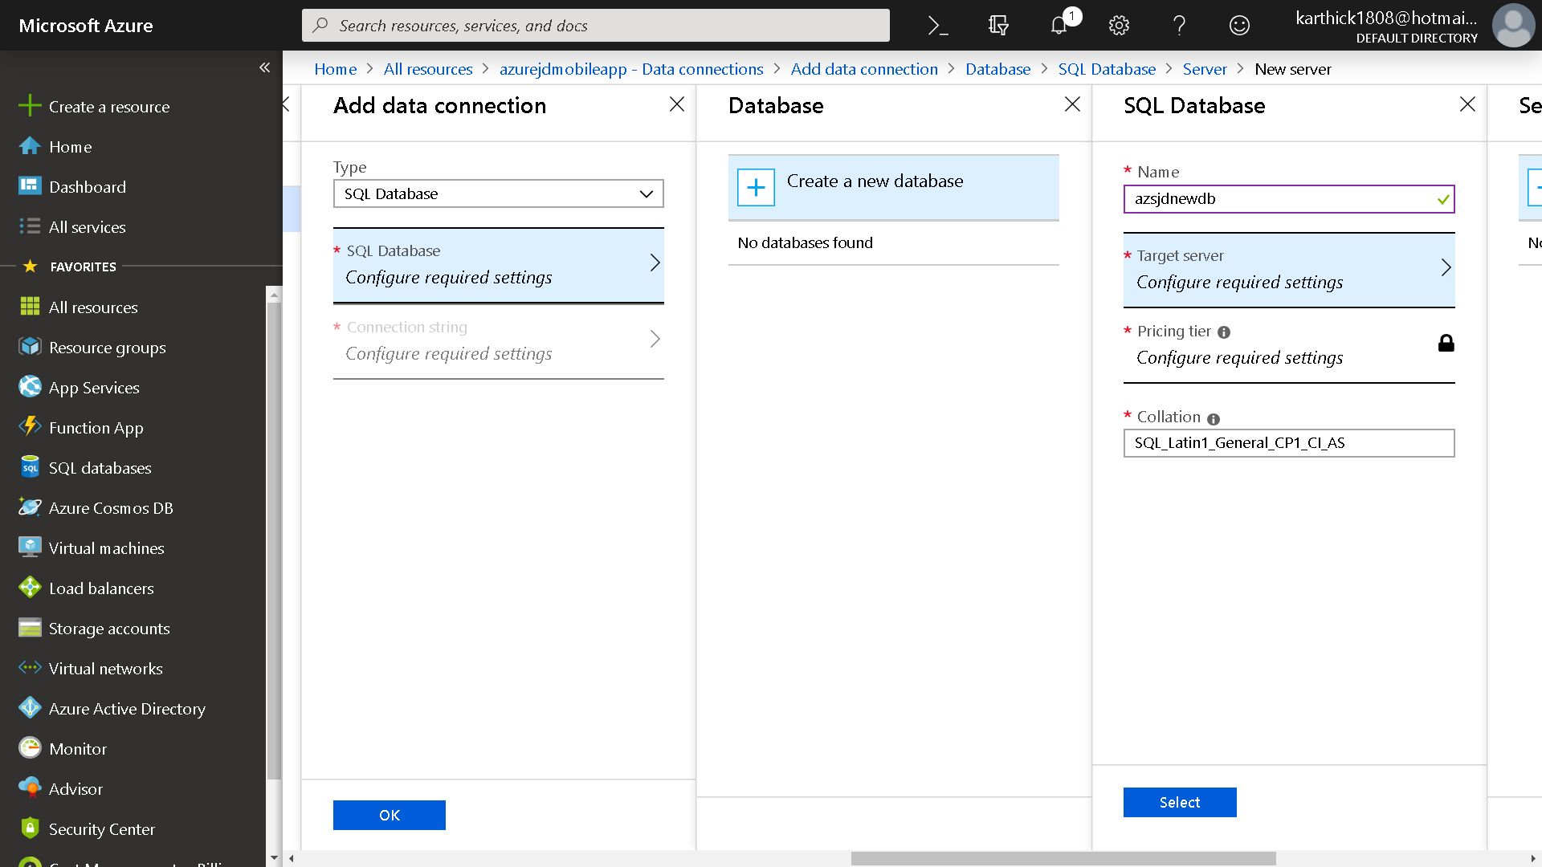

Slide 24
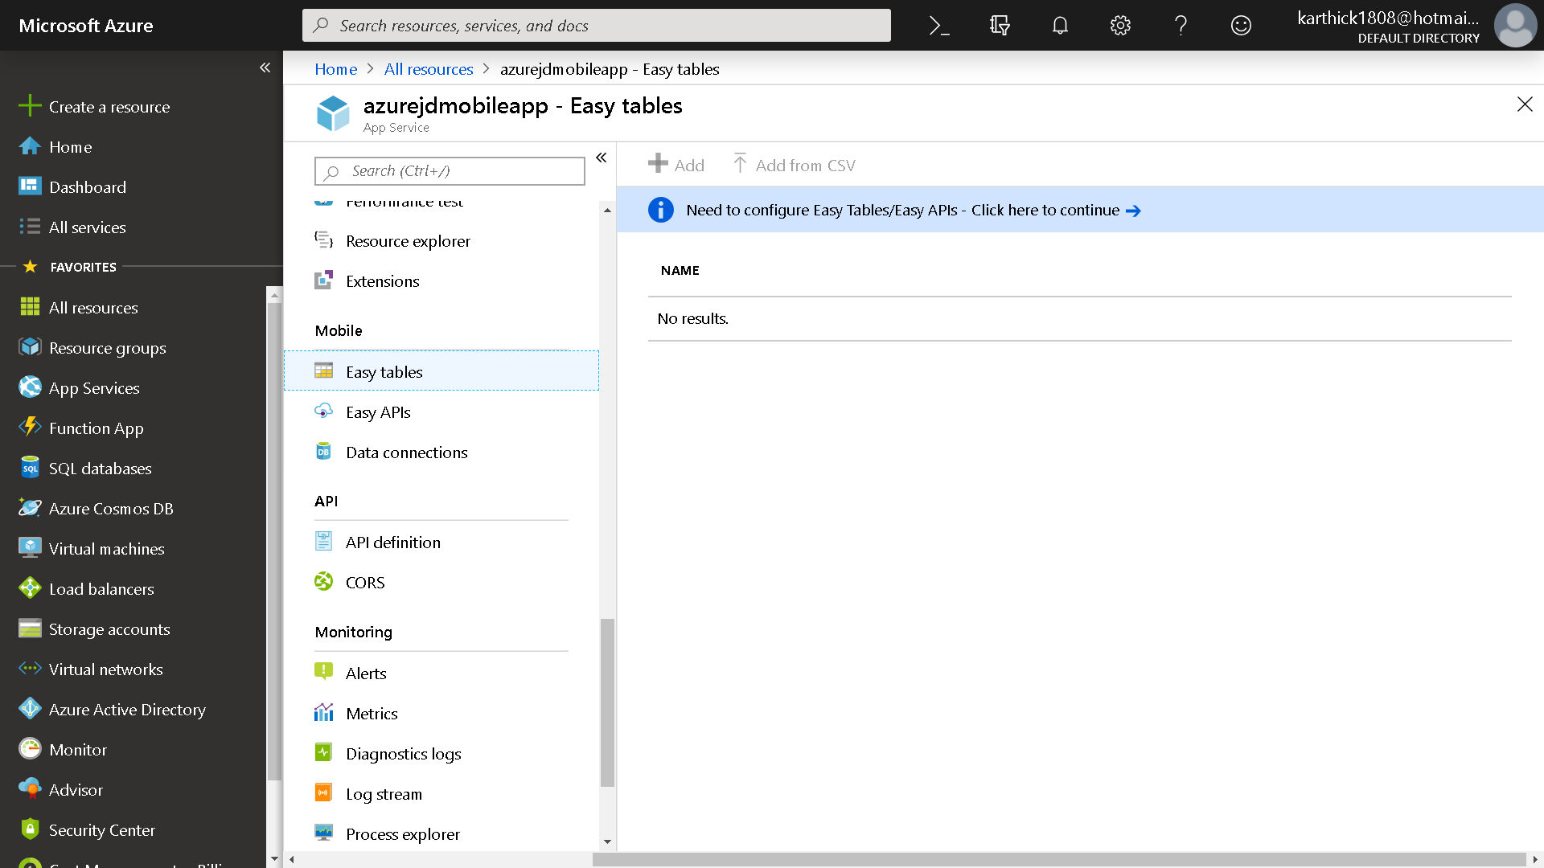

Slide 25


Slide 26
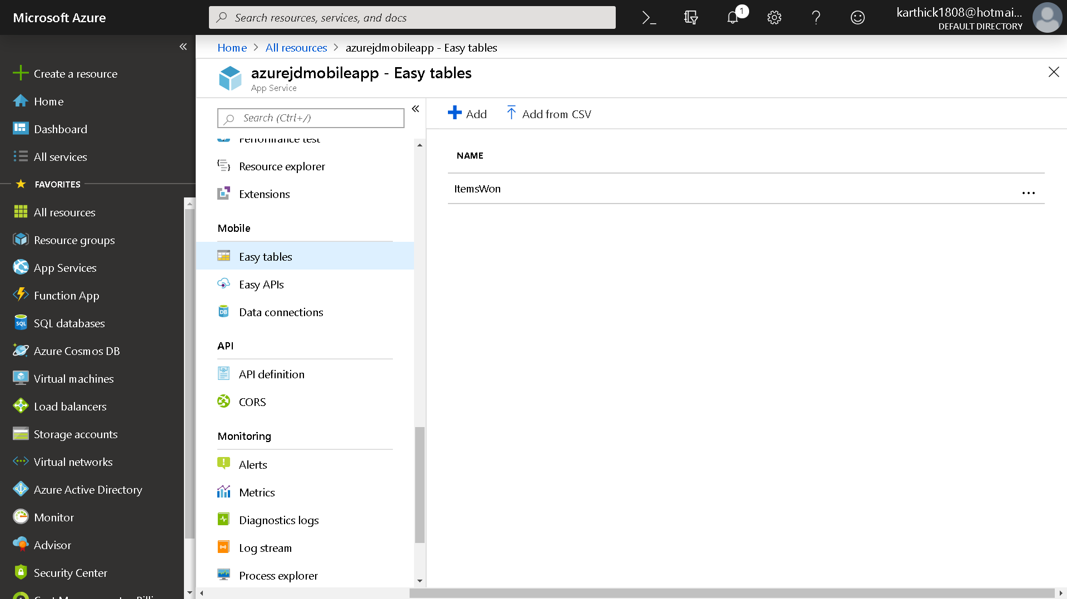

Slide 27
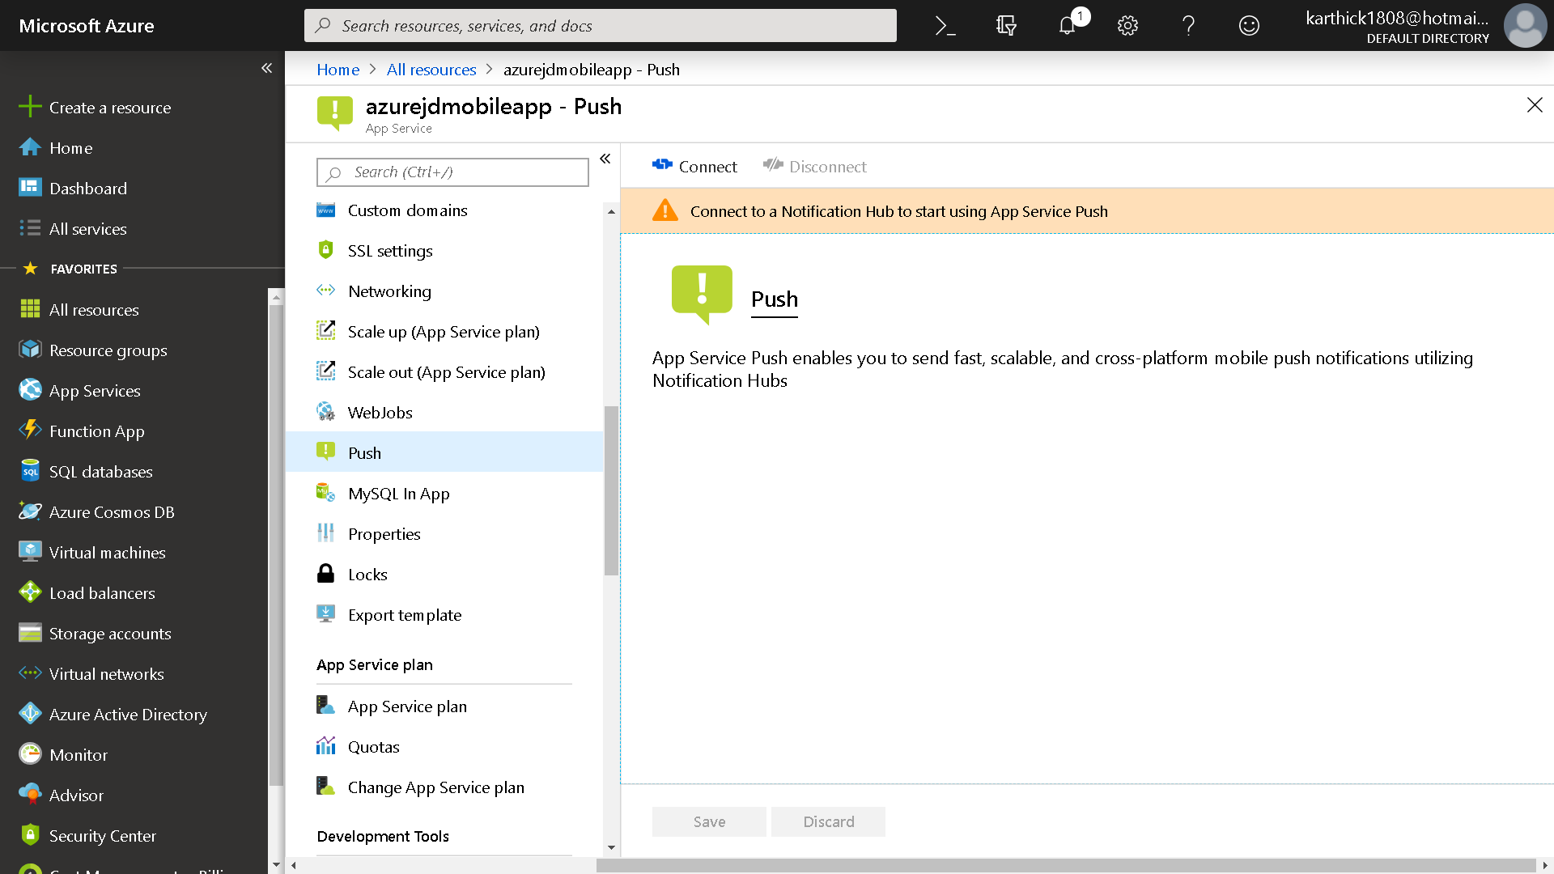

Slide 28
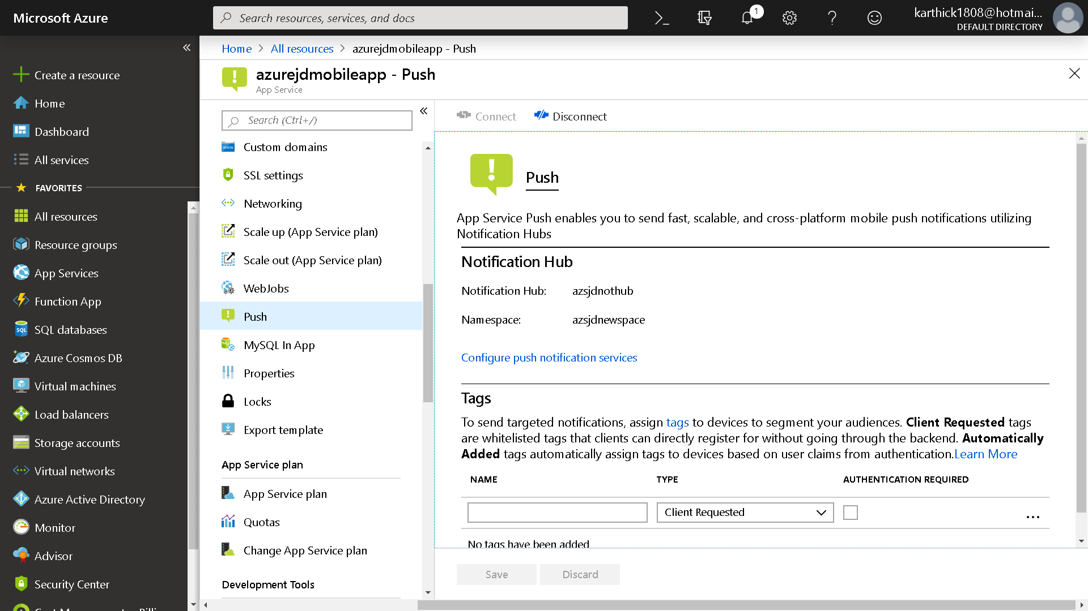

Slide 29
Function App
Azure Functions is a solution for easily running small pieces of code, or "functions," in the cloud. You can write just the code you need for the problem at hand, without worrying about a whole application or the infrastructure to run it. Functions can make development even more productive, and you can use your development language of choice, such as C#, F#, Node.js, Java, or PHP. Pay only for the time your code runs and trust Azure to scale as needed. Azure Functions lets you develop serverless applications on Microsoft Azure.

Slide 30
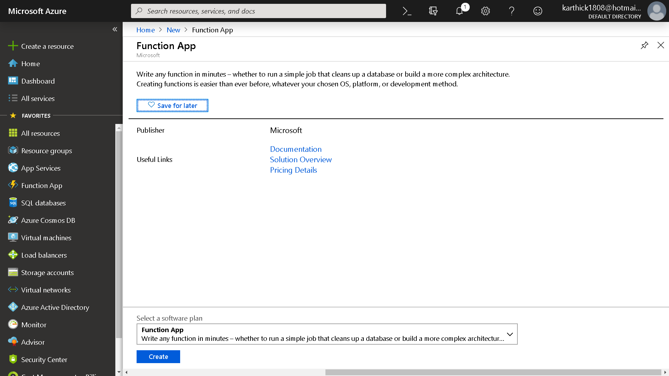

Slide 31
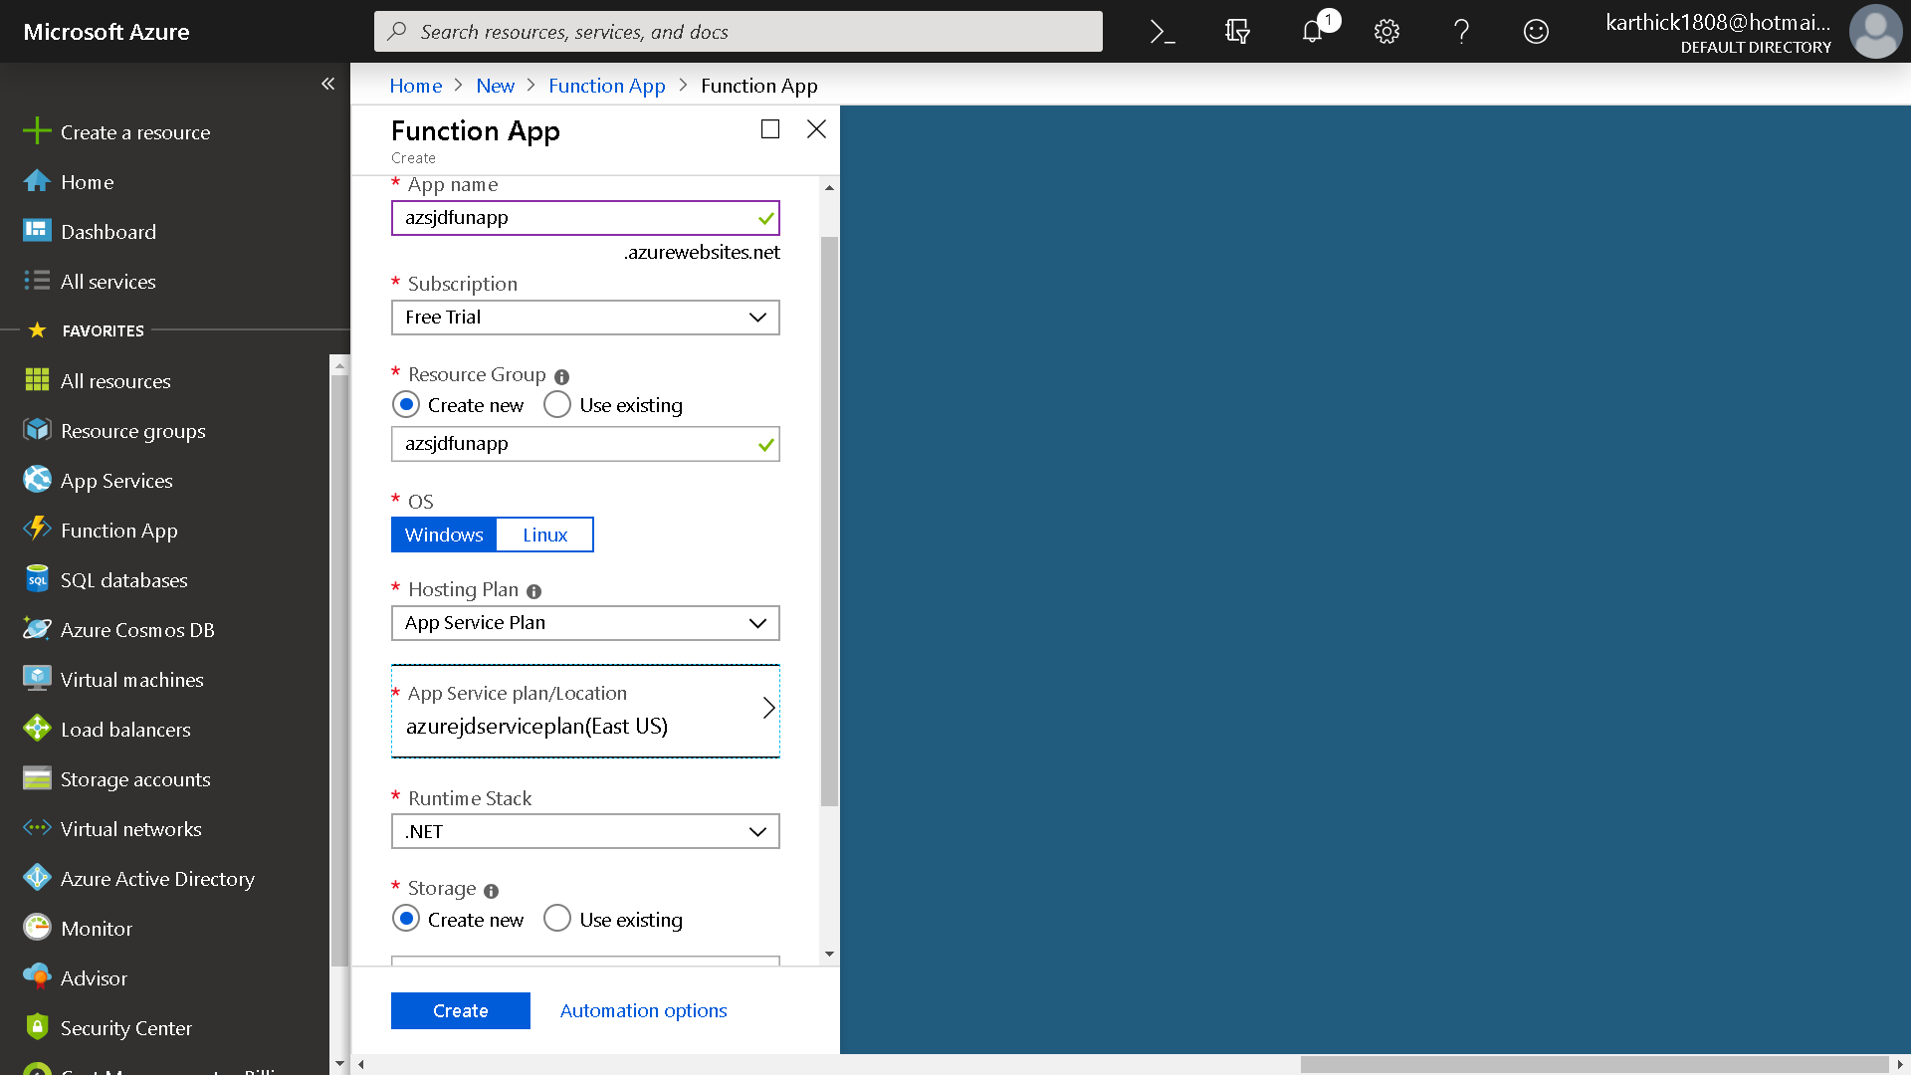

Slide 32
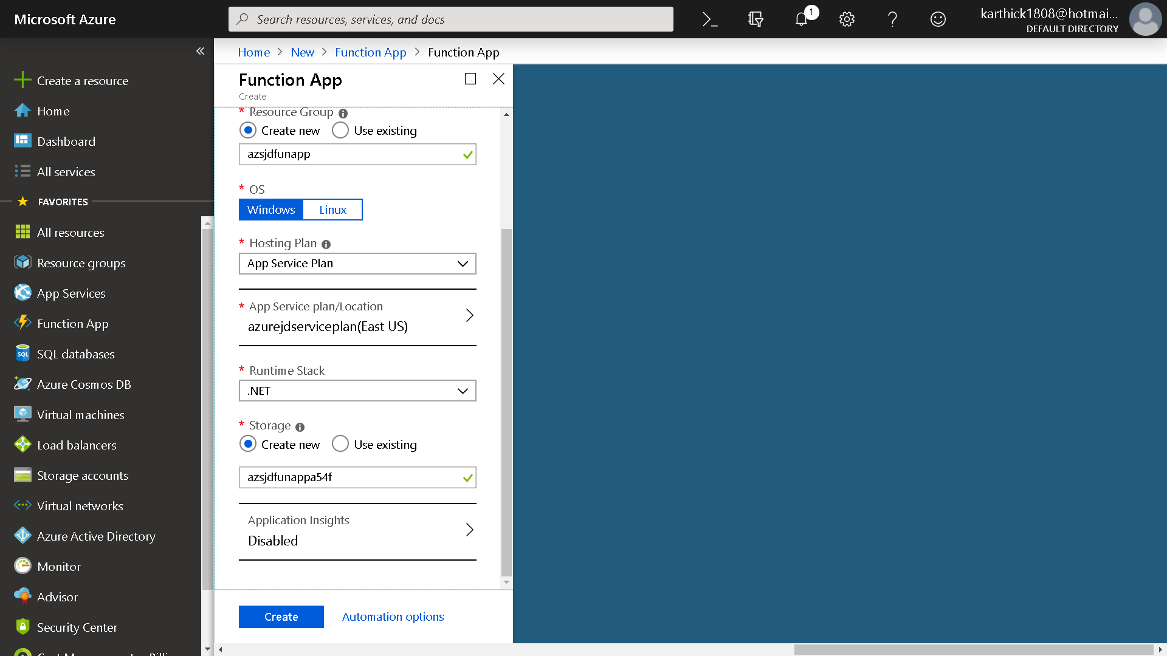

Slide 33
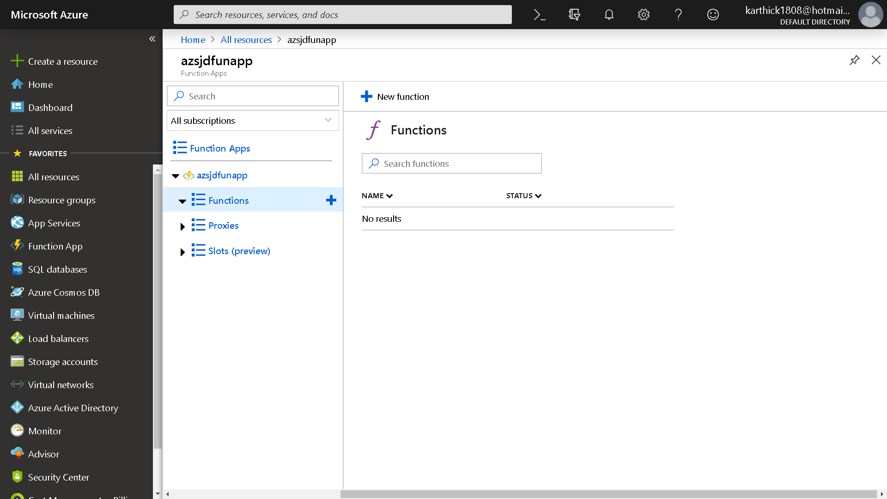

Slide 34
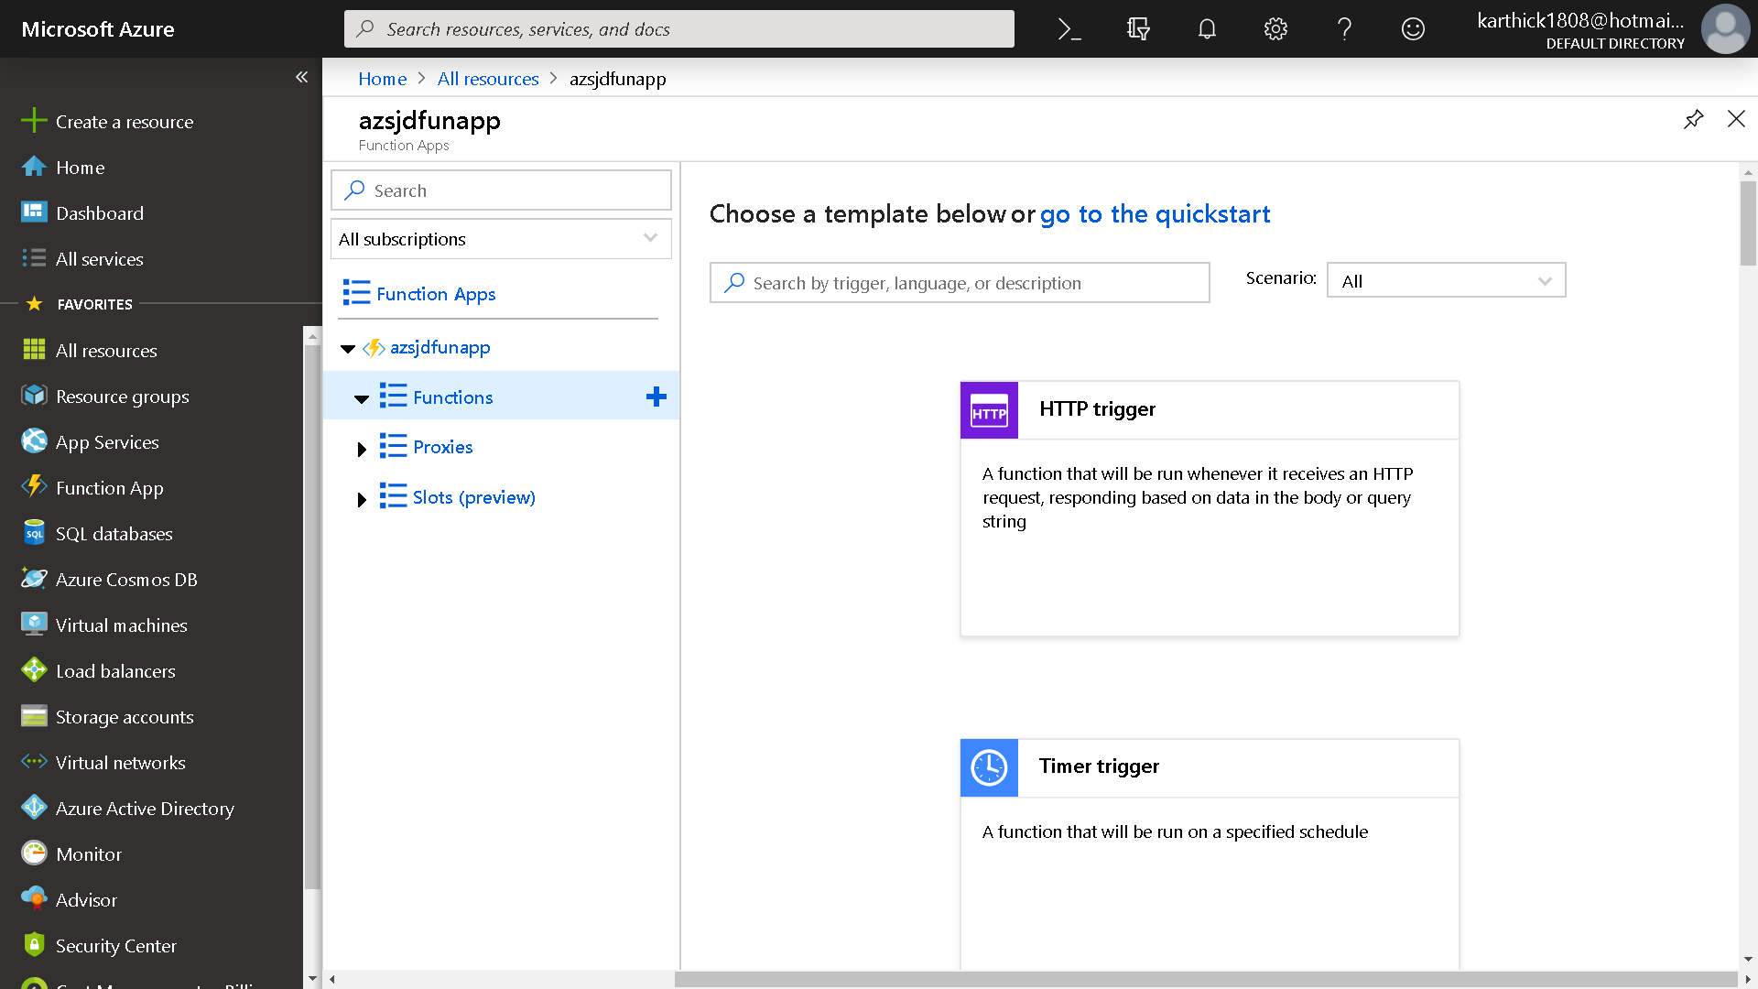

Slide 35
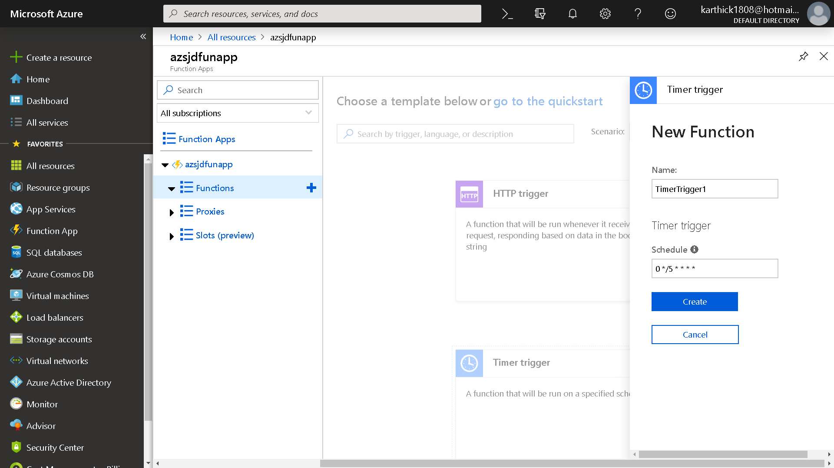

Slide 36
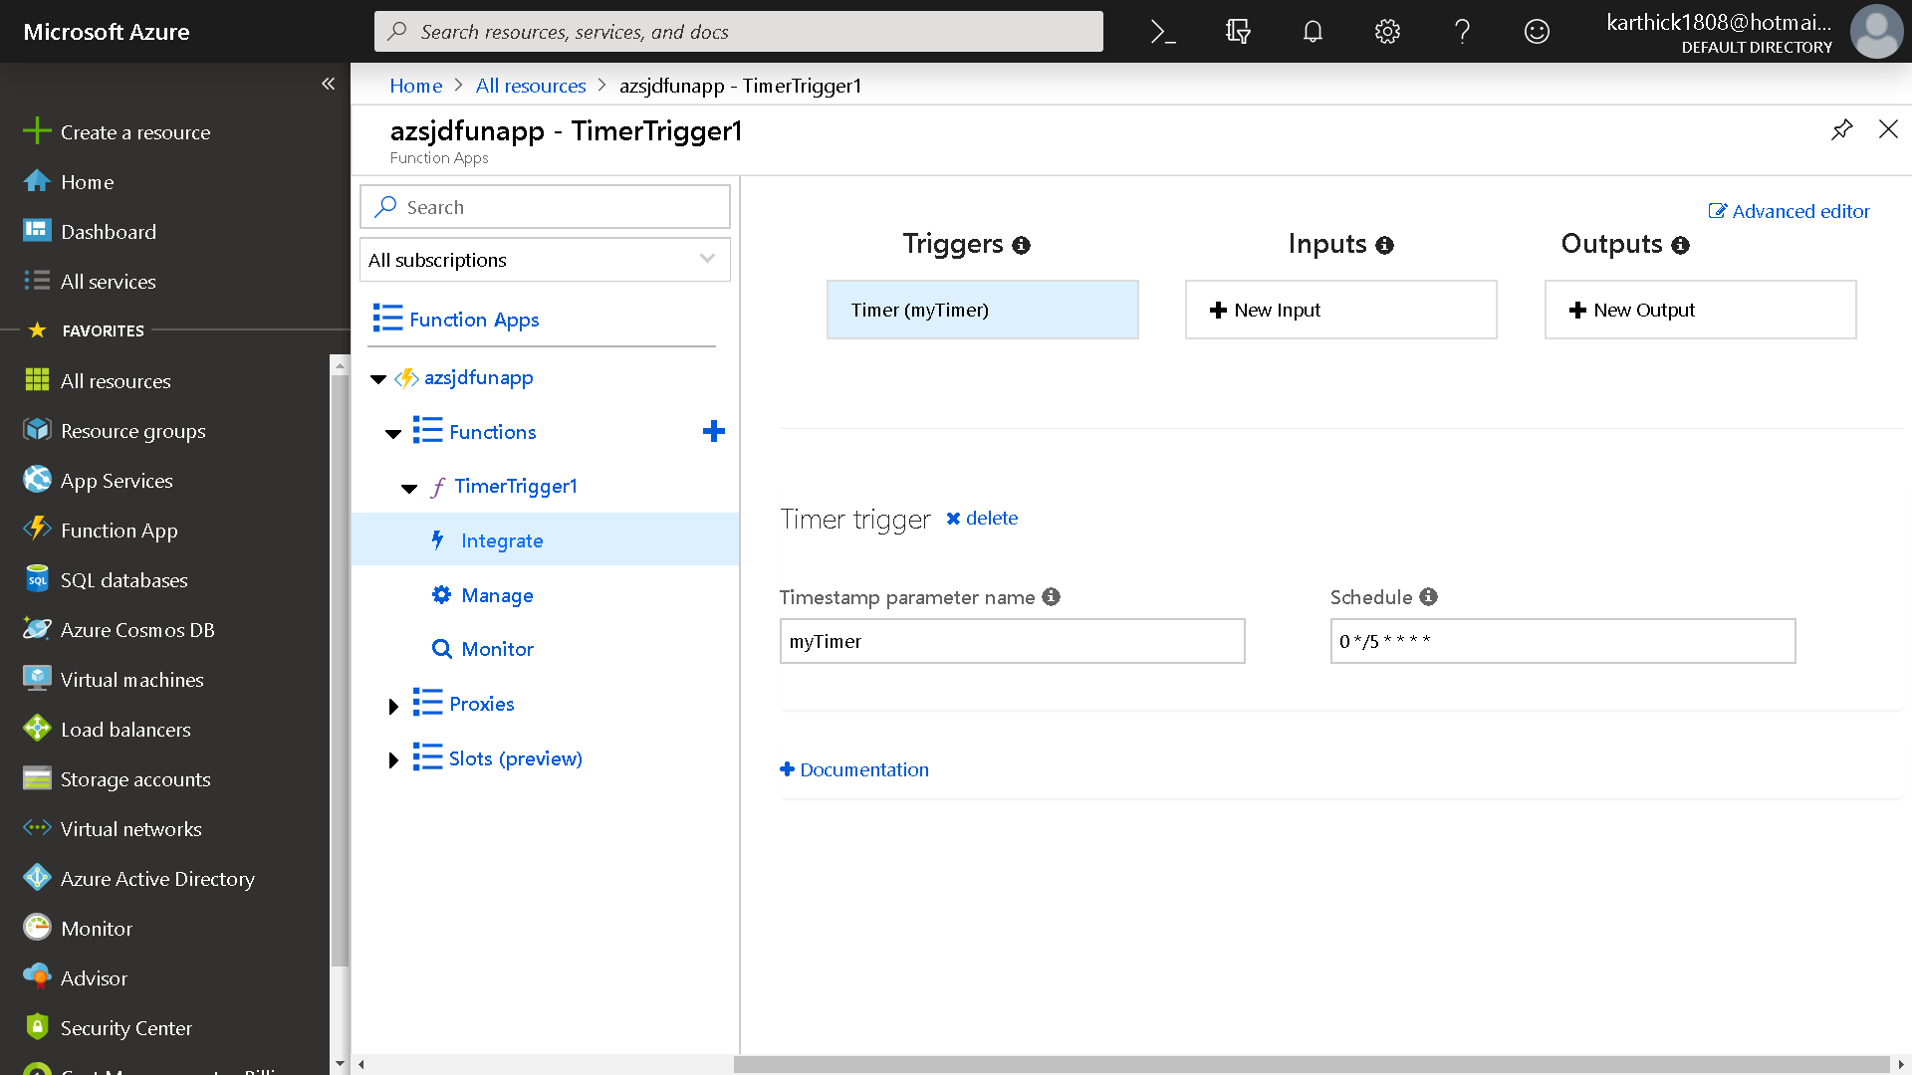

Slide 37
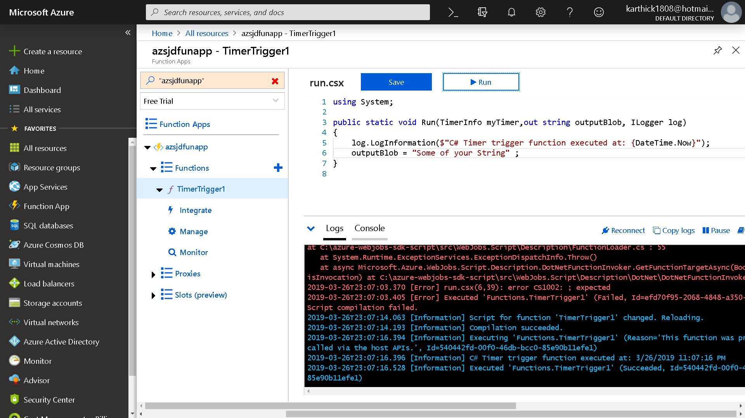

Slide 38
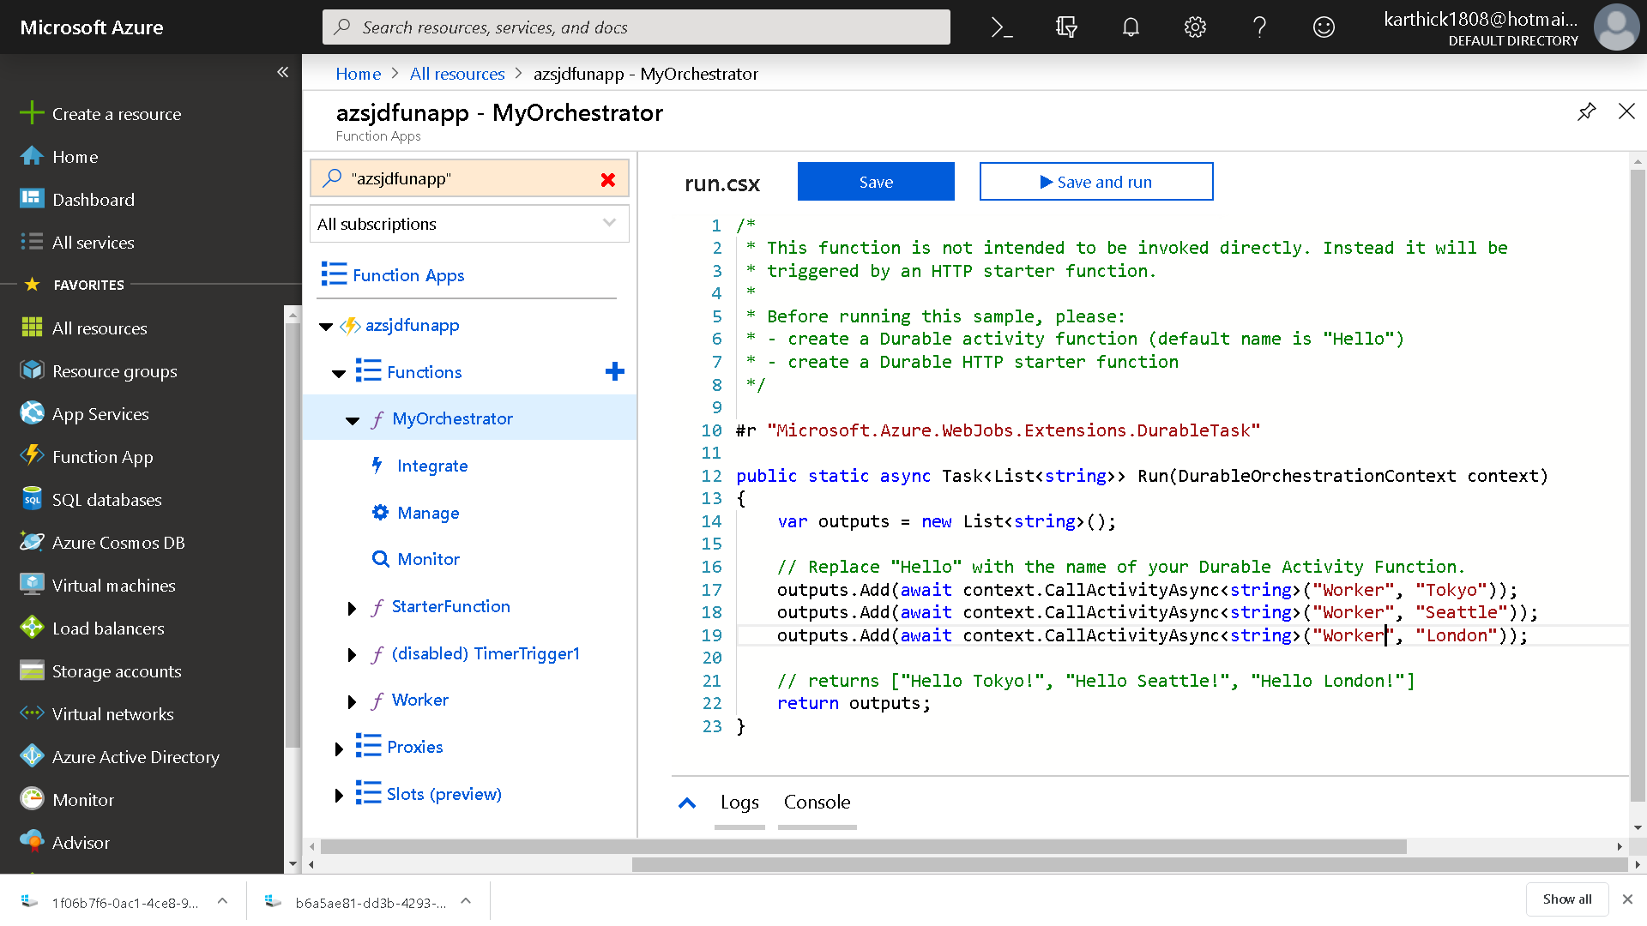

Slide 39
