Slide 2
What is Agile Methodology?
An agile methodology is an iterative approach to software development.
Each iteration of agile methodology takes a short time interval of 1 to 4 weeks.
The agile development process is aligned to deliver the changing business requirement.
It distributes the software with faster and fewer changes.

Slide 3
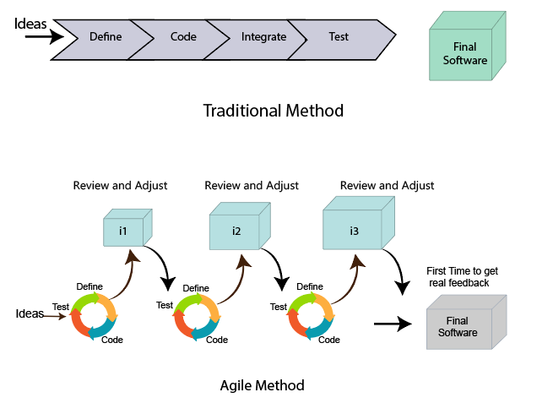

Slide 4

Roles in Agile-Scrum Master

Slide 5
Roles in Agile
They enable the close co-operation between all the roles and functions.
They remove all the blocks which occur.
They safeguard the team from any disturbances.
They work with the organization to track the progress and processes of the company.

Slide 6
They ensure that Agile Inspect & Adapt processes are leveraged correctly which includes
Planned meetings
Daily stand-ups
Demo
Review
Retrospective meetings, and
Facilitate team meetings and decision-making process.

Slide 7
Product Owner
The Product Owner is one who runs the product from a business perspective.
He defines the requirements and prioritizes their values.
He sets the release date and contents.
He takes an active role in iteration and releasing planning meetings.
He ensures that the team is working on the most valued requirement.
He represents the voice of the customer.
He accepts the user stories that meet the definition of done and defined acceptance criteria.

Slide 8
Cross-functional team
Every agile team contains self-sufficient team with 5 to 9 team members.
The average experience of each member ranges from 6 to 10 years.
The agile team contains 3 to 4 developers, 1 tester, 1 technical lead, 1 scrum master and 1 product owner.

Slide 9
The Scrum master and Product owner are considered as a part of Team Interface, on the other hand remaining members are the part of Technical Interface.

Slide 10
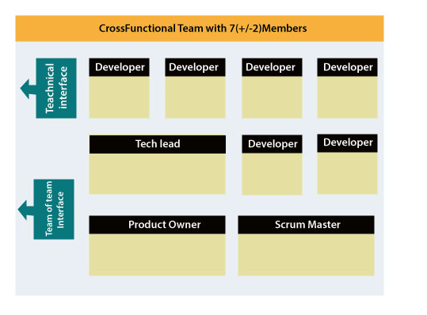

Slide 11
How an Agile Team plan their work?
An Agile team works in iterations to deliver the customer requirement, and each iteration takes 10 to 15 days.
However, the original Agile Manifesto didn't set the time period of two-week iterations or an ideal team size.
Each user requirement is a planned based and their backlog prioritization and size.
The team decides, how much scope they have and how many hours available with each team to perform their planed task.

Slide 12
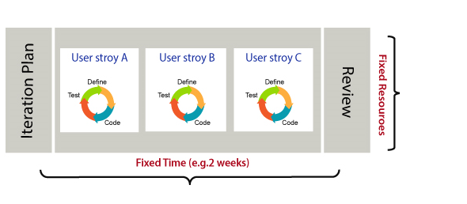

Slide 13
Relation between User requirement and Task
User requirement talks about what is to be done. It defines the needs of users.
Task talks about how it is to be done. It defines how functionality is implemented.
User requirements are implemented by tasks. Every requirement is gathering as the task.
User requirement is divided into different tasks when it is planned in current iteration.
User tasks are estimated in hours based, generally it is between 2 to 12 hours.
Requirements are validated using acceptance test.

Slide 14
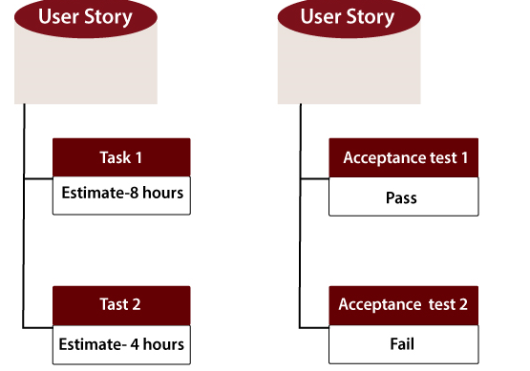

Slide 15
When the requirement is completed
The Agile team decides the meaning of task done based on
When the entire task (development, testing) are completed.
When all the acceptance tests are running and are passed.
When no defects found.
Product owner has accepted the requirement.
When the software product is delivered to the end user.

Slide 16
Advantages of Agile Methodology
Customer satisfaction is rapid, continuous development and delivery of useful software.
Customer, Developer, and Product Owner interact regularly to emphasize rather than processes and tools.
Product is developed fast and frequently delivered (weeks rather than months.)
A face-to-face conversation is the best form of communication.
It continuously gave attention to technical excellence and good design.
Daily and close cooperation between business people and developers.
Regular adaptation to changing circumstances.
Even late changes in requirements are welcomed.

Slide 17
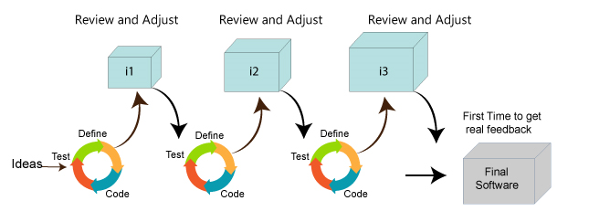

Slide 18
Disadvantages of Agile methodology
It is not useful for small development projects.
There is a lack of intensity on necessary designing and documentation.
It requires an expert project member to take crucial decisions in the meeting.
Cost of Agile development methodology is slightly more as compared to other development methodology.
The project can quickly go out off track if the project manager is not clear about requirements and what outcome he/she wants.

Slide 19
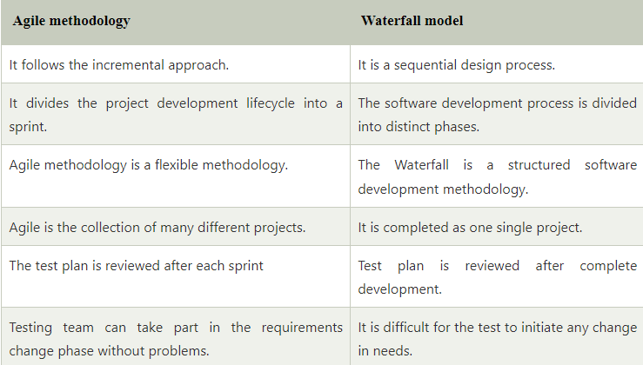

Slide 20
The Twelve Principle of Agile Manifesto
Customer Satisfaction: Manifesto provides high priority to satisfy the costumer's requirements. This is done through early and continuous delivery of valuable software.
Welcome Change: Making changes during software development is common and inevitable. Every changingrequirement should be welcome, evenin the late development phase. Agile process works to increase the customers' competitive advantage.
Deliver the Working Software: Deliver the working software frequently, ranging from a few weeks to a few months with considering the shortest timeperiod.
Collaboration: Business people (Scrum Master and Project Owner) and developers must work together during the entire life of a project development phase.
Motivation: Projects should be build around motivated team members. Provide such environment that supportsindividual team members and trust them. It makes them feel responsible for gettingthe job donethoroughly.
Face-to-face Conversation: Face-to-face conversation betweenScrum Master anddevelopment team and between the Scrum Master and customers for the most efficient and effective method of conveying information to and within a development team.

Slide 21

Measure the Progress as per the Working Software: The working software is the key and primary measure of the progress.
Maintain Constant Pace: The aim of agile development is sustainable development. All the businesses and users should be able to maintain a constant pace with the project.
Monitoring: Pay regular attention to technical excellence and good design to maximize agility.
Simplicity: Keep things simple and use simple terms to measure the work that is not completed.
Self-organized Teams: The Agile team should be self-organized. They should not be depending heavily on other teams because the best architectures, requirements, and designs emerge from self-organized teams.
Review the Work Regularly: The work should be reviewed at regular intervals, so that the team canreflect on how to become more productive and adjust its behavior accordingly.

Slide 22
Agile Software Development Life Cycle (SDLC)
Software development life cycle (SDLC) is a phenomenon to design, develop and, test high-quality software.
Agile Software Development Life Cycle (SDLC) is the combination of both iterative and incremental process models. It focuses on process adaptability and customer satisfaction by rapid delivery of working software product.
Agile SDLC breaks down the product into small incremental builds. These builds are provided into iterations.

Slide 23
Agile SDLC Process Flow
Concept: Project are imagined and prioritized.
Inception: Team members are created, funding is put in place, and basic environments and requirements are discussed.
Iteration/Constriction: The software development team works to deliver working software. It is based on requirement and feedback.
Release: Perform quality assurance (QA) testing, provides internal and external training, documentation development, and final version of iteration into the product.
Production: It is ongoing support of the software.

Slide 24
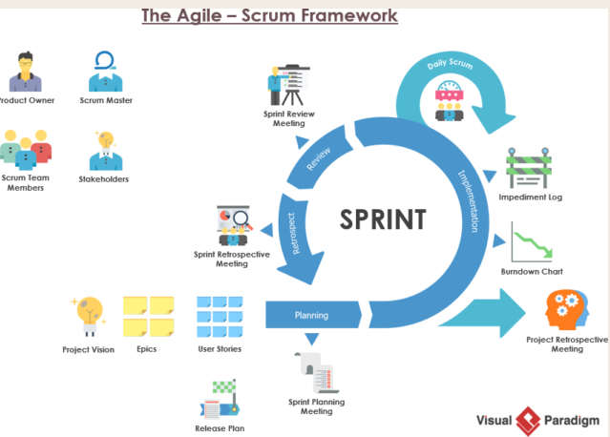

Slide 25
What is Scrum?
Scrum is a framework that helps agile teams to work together. Using it, the team members can deliver and sustain the complex product.
It encourages the team to learn through practice, self-organize while working on the problem.
Scum is a work done through the framework and continuously shipping values to customers.

Slide 27
What are sprints?
With scrum, a product is built in a series of repetition called sprints.
It breaks down big complex projects into bite-size pieces.
It makes projects more manageable, allows teams to ship high quality, work faster, and more frequently.
The sprints give them more flexibility to adapt to the changes.

Slide 28
Sprints are a short, time-boxed period for Scrum team that works to complete a set amount of work.
Sprints are the core component of Scrum and agile methodology.
The right sprints will help our agile team to ship better software.

Slide 29
Factors affecting Sprint planning
The What: The product owner describes the goal of the sprint and the backlog items which contribute to achieve that goal.
The How: Agile development team plans its necessary work on how to achieve and deliver the sprint goal.
The Who: The product owner defines the goal based on the value that the customers seek. And the developer needs to understand how they can or cannot deliver that goal.
The Inputs: The product backlog provides the list of input stuff that could potentially be part of the current sprint. The team looks over the existing work done in incremental ways.
The Outputs: The critical outcome of sprint planning is to meet described team goal. The product set the goal of sprint and how they will start working towards the goal.

Slide 30
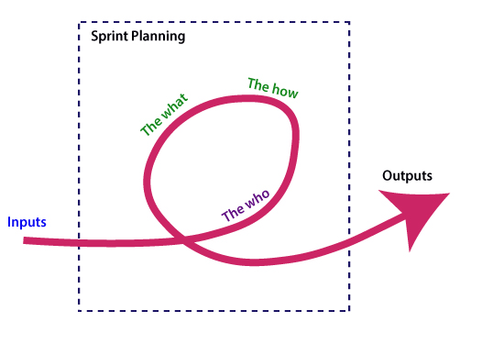

Slide 31
