Slide 1
SQL JOINS

Slide 2
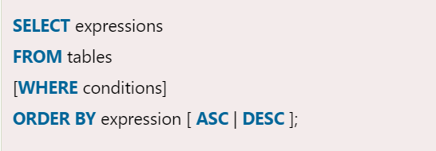

Slide 3
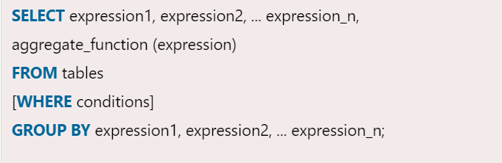

Slide 4
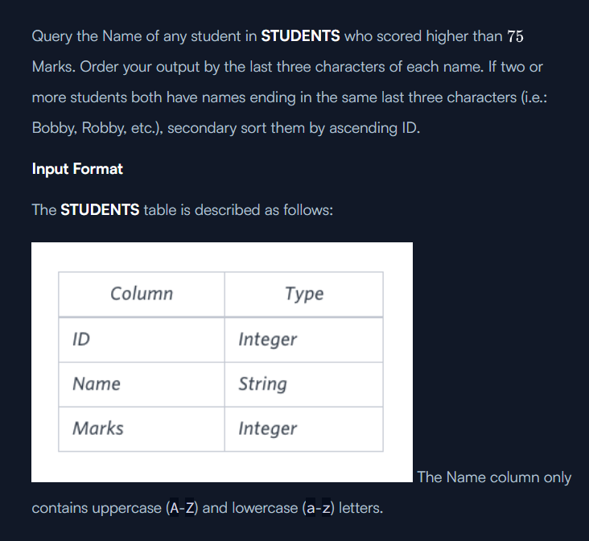

Slide 5
select Name from Students where marks > 75 order by right(Name, 3), ID

Slide 6
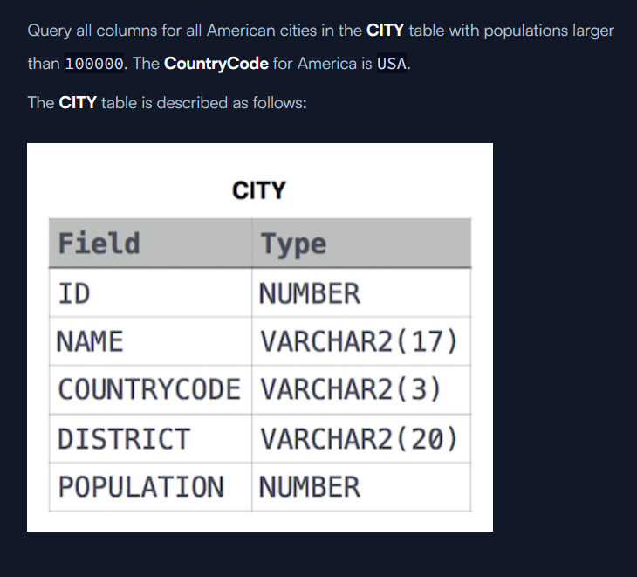

Slide 7
select * from CITY where COUNTRYCODE='USA' and POPULATION > 100000

Slide 8
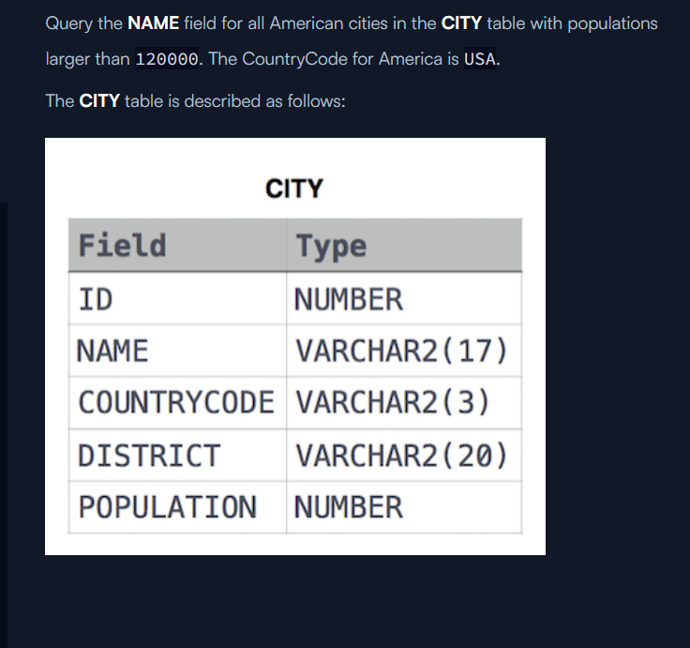

Slide 9
SELECT NAME FROM CITY WHERE COUNTRYCODE='USA' AND POPULATION>120000

Slide 10
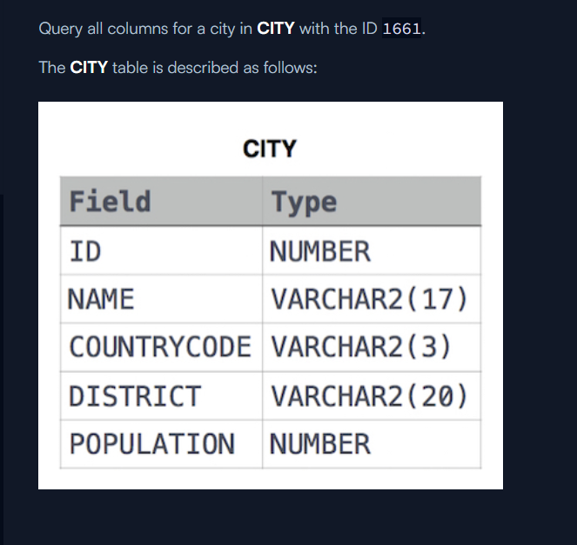
IN

Slide 11
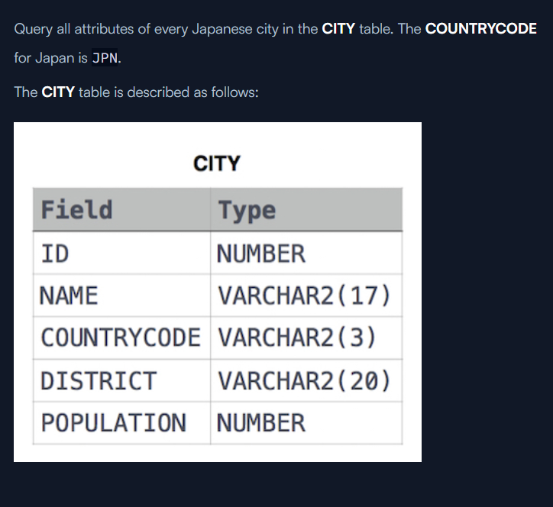

Slide 12
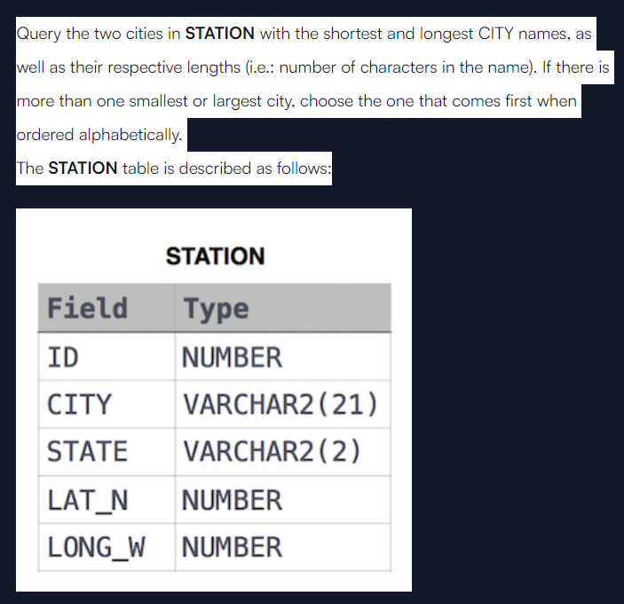

Slide 13
select CITY, length(CITY) from STATION order by length(CITY), CITY limit 1; select CITY, length(CITY) from STATION order by length(CITY) desc, CITY limit 1;
(select CITY, length(CITY) as city_len from STATION order by city_len asc, CITY asc limit 1) union (select CITY, length(city) as city_len from STATION order by city_len desc, CITY asc limit 1);

Slide 14
(select CITY, length(CITY) as city_len from STATION order by city_len asc, CITY asc limit 1) UNION (select CITY, length(city) as city_len from STATION order by city_len desc, CITY asc limit 1);

Slide 15
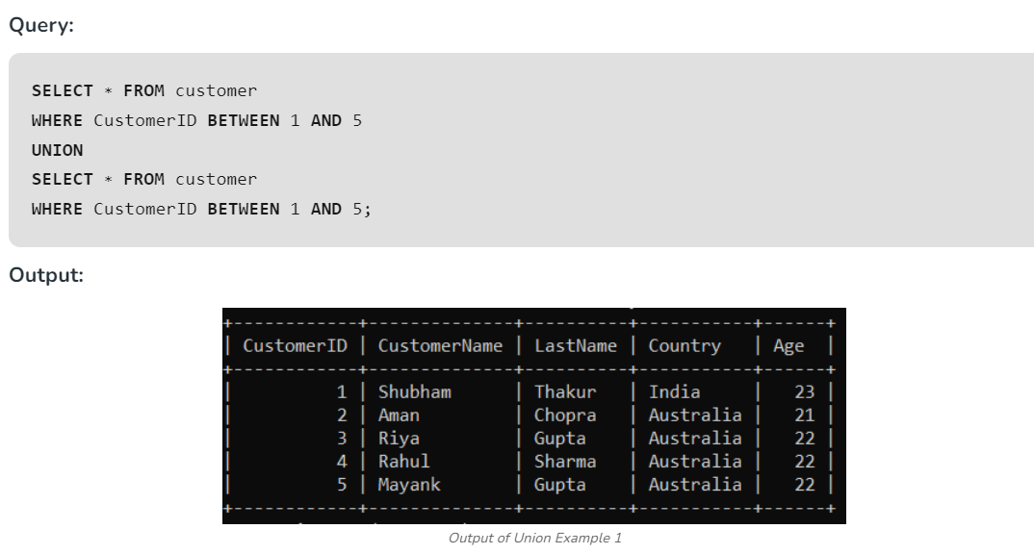

Slide 16
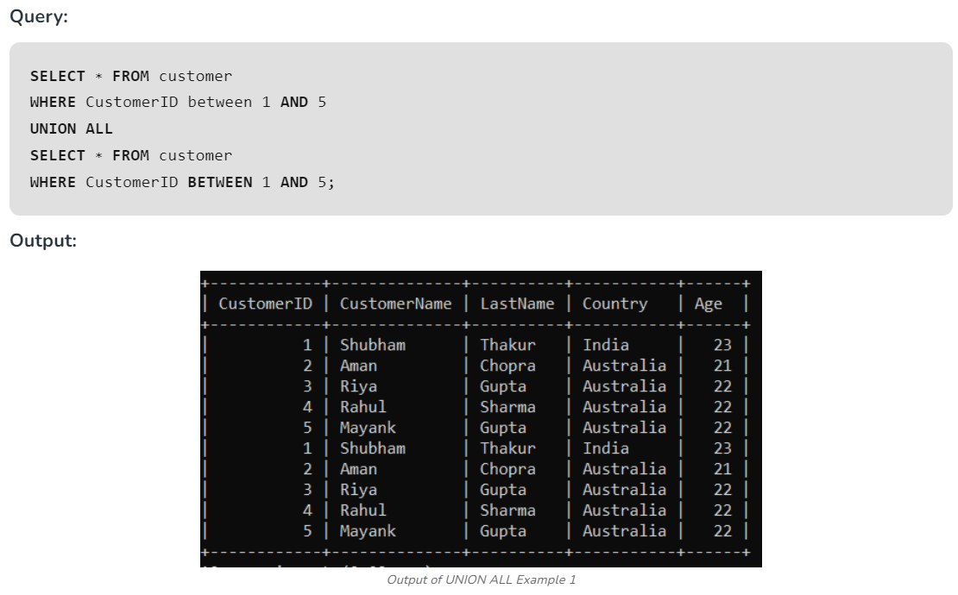

Slide 17
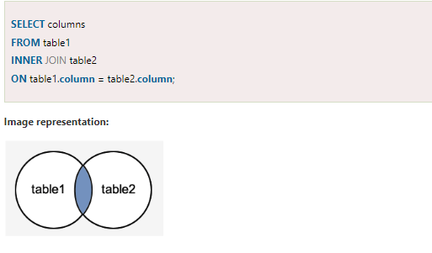

Slide 18
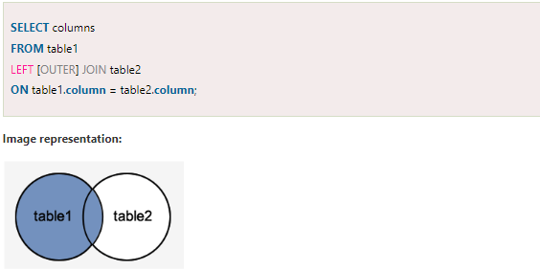

Slide 19
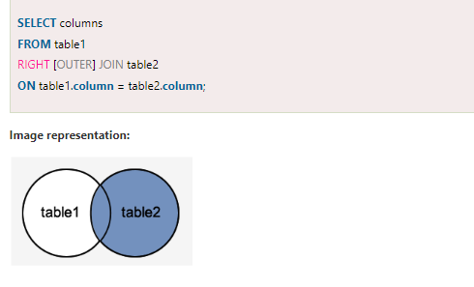

Slide 20
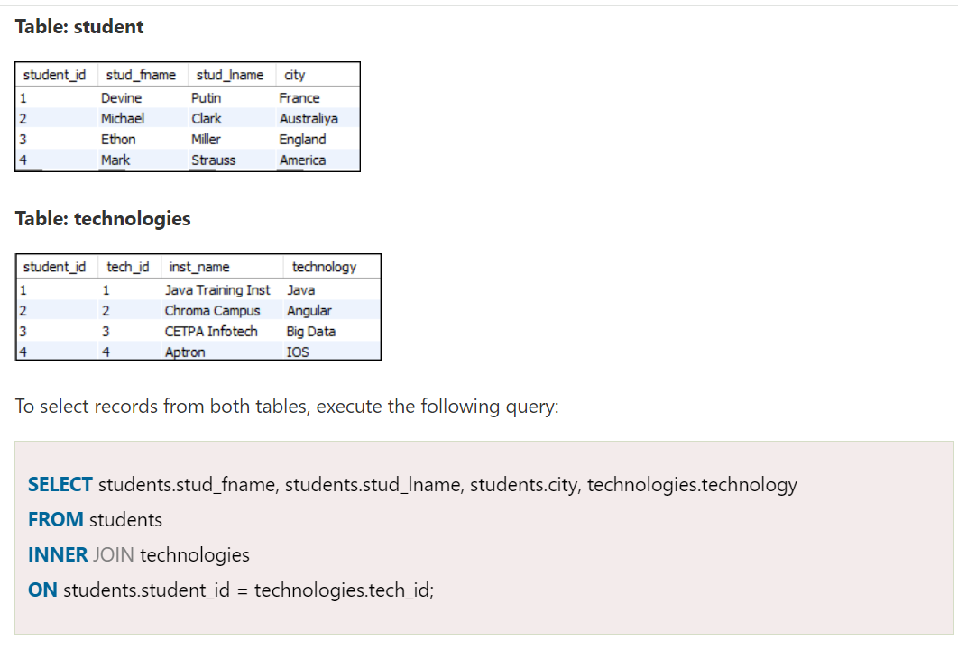

Slide 21


Slide 22
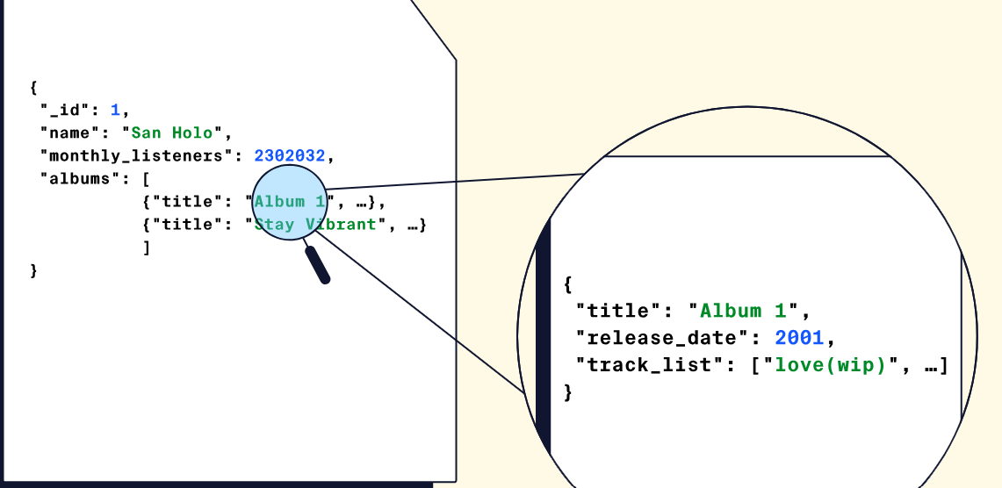
No sql document data base
Non-Relational Databases
The second most common class of databases is non-relational databases. A non-relational database, commonly referred to as a NoSQL database, is any database that does not follow the relational model.

Slide 23
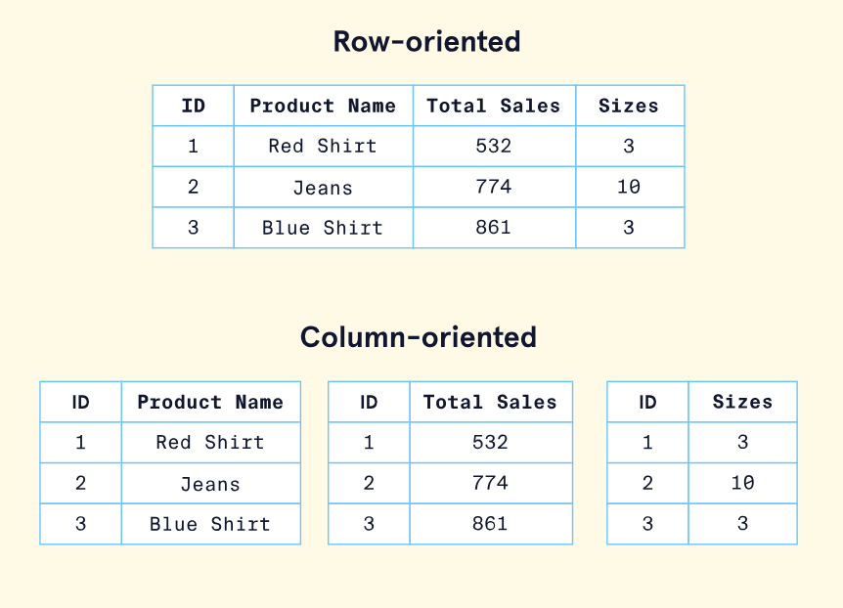

Slide 24
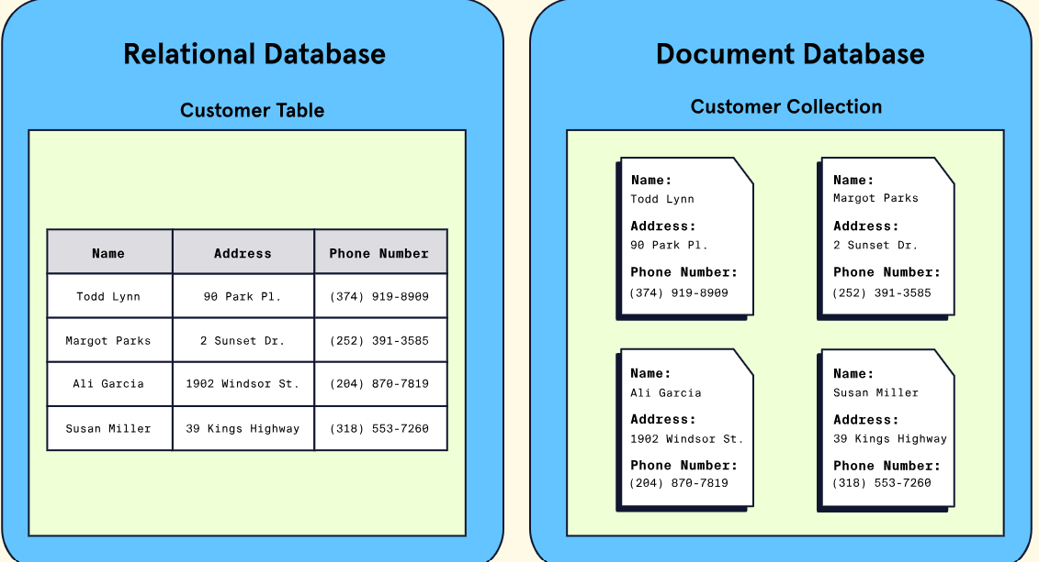

Slide 25
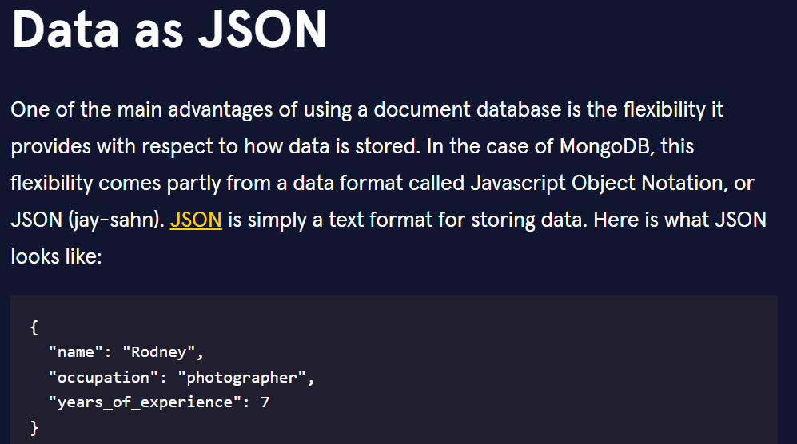

Slide 26
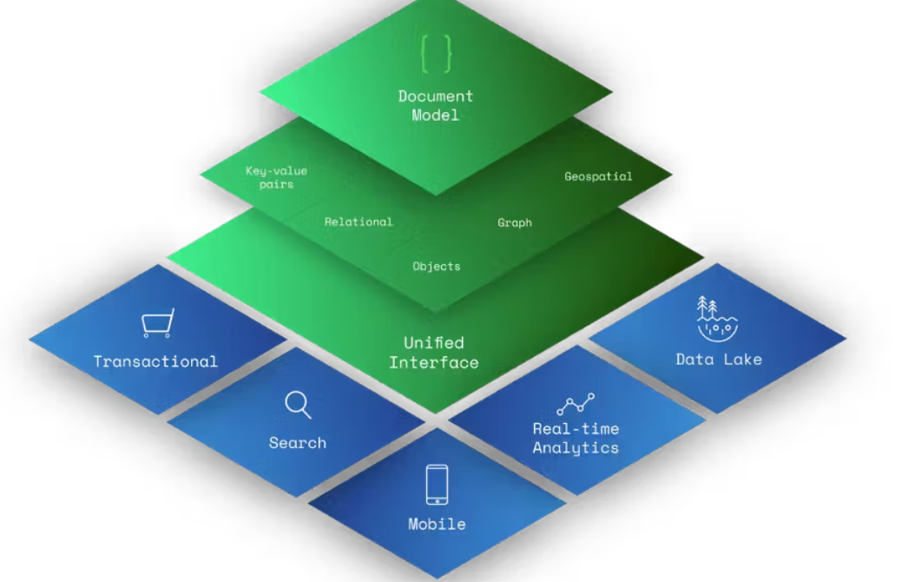

Slide 27
NoSQL Data Architecture Patterns
1. Key-Value Store Database
2. Column Store Database
3. Document Database
4. Graph Database

Slide 28
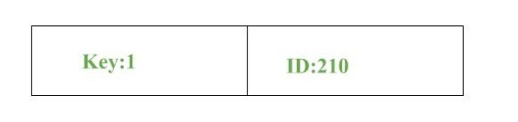
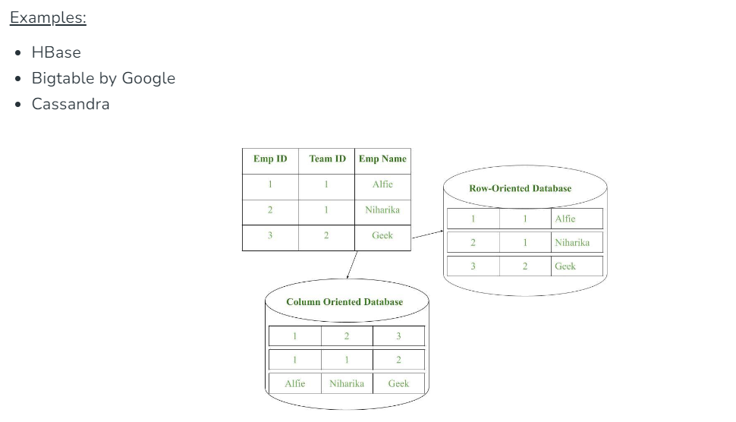

Slide 29
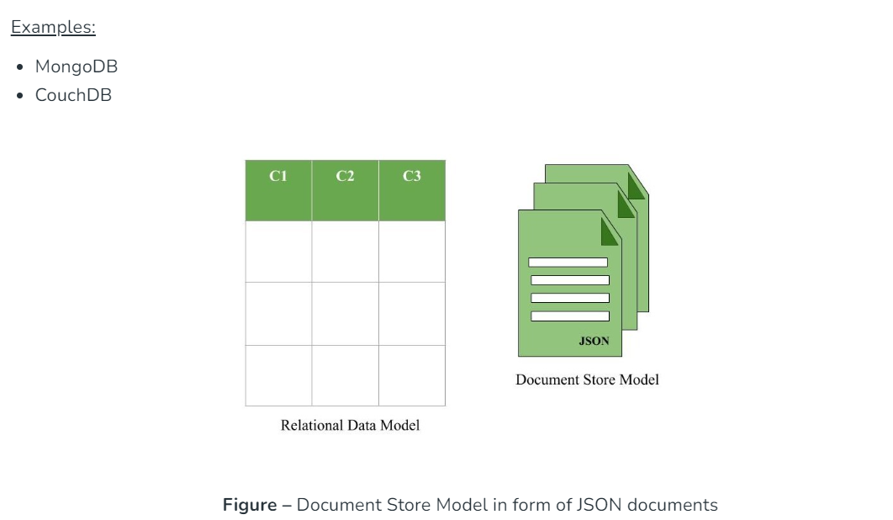
Document here can be a form of text, arrays, strings, JSON, XML or any such format

Slide 30
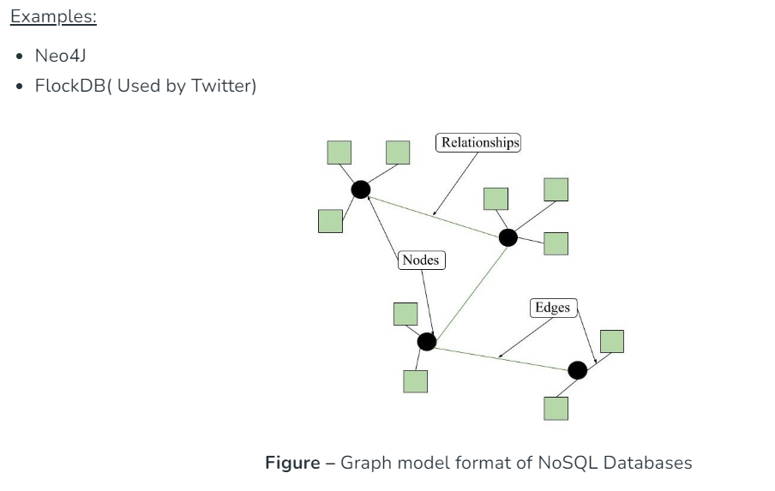

Slide 31
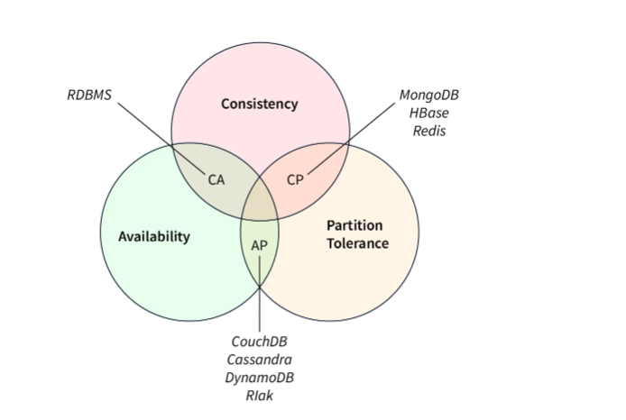
consistency "C", availability "A", and partition tolerance "P".

Slide 32
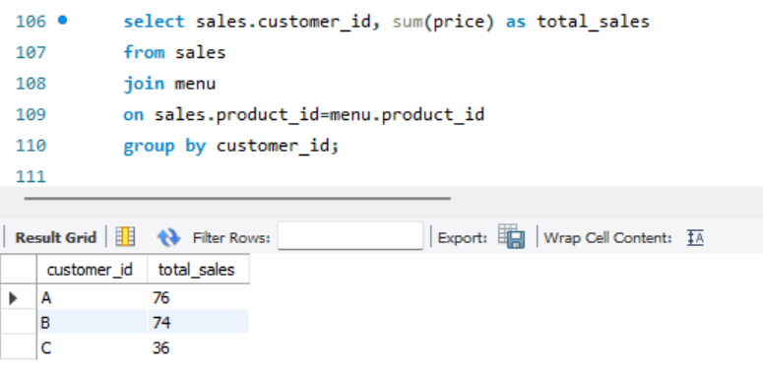
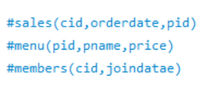
#1. What is the total amount each customer spent at the restaurant?

Slide 33
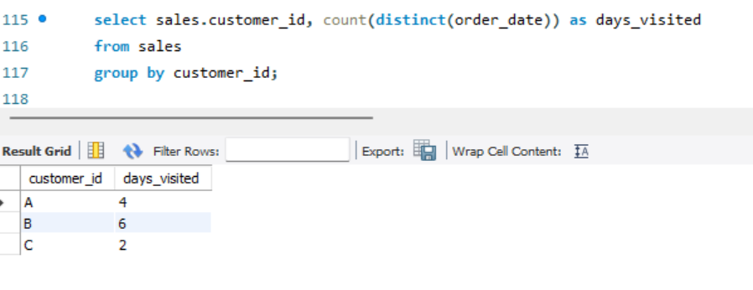
#How many days has each customer visited the restaurant?

Slide 34
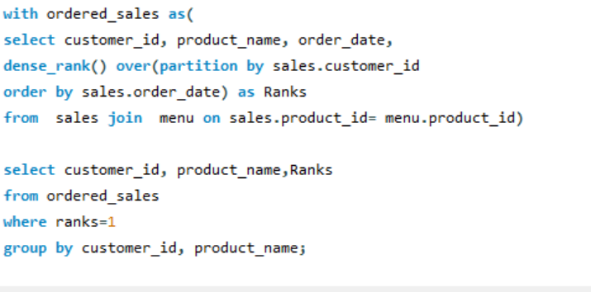
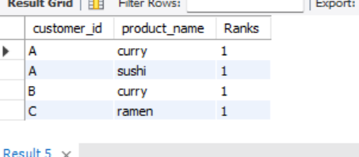
#3. What was the first item from the menu purchased by each customer?

Slide 35
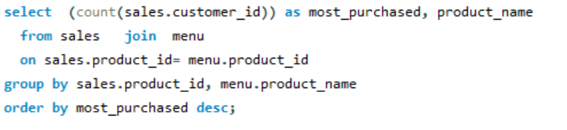
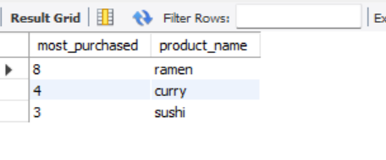
#4. What is the most purchased item on the menu and how many times was it purchased by all customers?

Slide 36
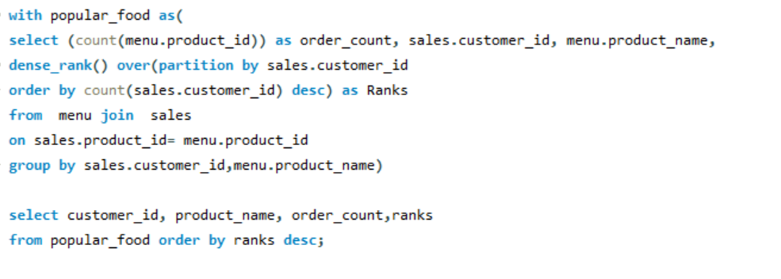
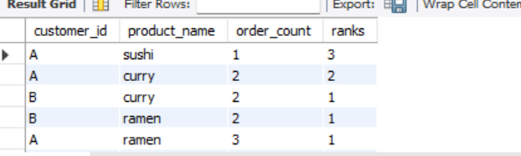
#5. Which item was the most popular for each customer?

Slide 37
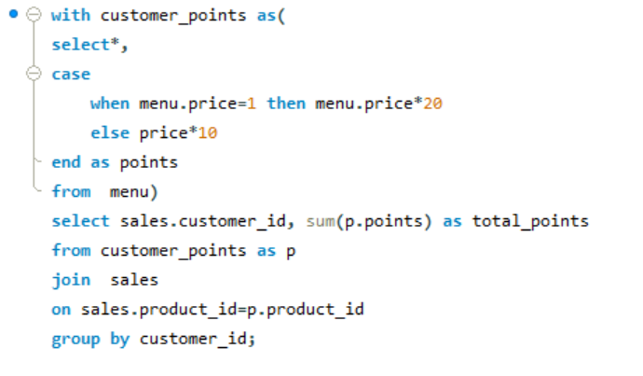
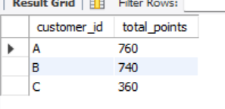
#9. If each $1 spent equates to 10 points and sushi has a 2x points multiplier- #how many points would each customer have? #To create conditional statement use- case when

Slide 38
How to optimize SQL Queries using Indexes
CREATE INDEX index_name ON table_name (column_name);
Index in SQL is a lookup table that enables us to quickly retrieve data from the database. The index is applied to column(s) in a table.
Indexes help us by making search and data retrieval queries faster. SQL can easily identify the row(s) using the index and quickly fetch the data we need.

Slide 39
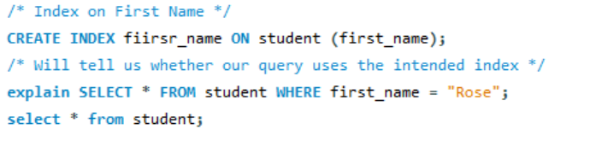

Slide 40
Indexes help us by making search and data retrieval queries faster. SQL can easily identify the row(s) using the index and quickly fetch the data we need.
However, on every INSERT/UPDATE query on the table, the indexes associated with that table are also updated, which make the writes to the table slower. With multiple indexes, things can become pretty bad.

Slide 41
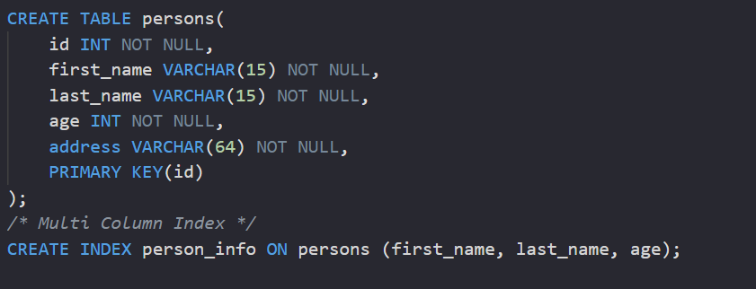
Composite index
INDEX(col_1, col_2, col_3 ... col_n)

Slide 42
