Slide 1



Disease Prediction Using Machine Learning
Mohammed Taeef Memon 21BEC0580
Kartik kumar Singh 21BEC2172
Khushi Priya 21BEC0885
B Tharun 21BEC2063
Raghavendran Ganesan 21BEC0996

Slide 2

TABLE OF CONTENTS
Abstract,
Introduction
Problem Statement
Objectives
Literature Survey
Modelling /Design
Flow Chart/Block Diagram
Methodology
Results
Conclusion & References.

Slide 3
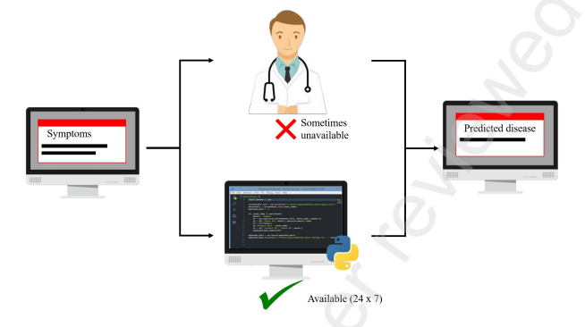

Abstract
Accurate and on-time analysis of any health-related problem is important for the prevention and treatment of the illness. The traditional way of diagnosis may not be sufficient in the case of a serious ailment. Developing a medical diagnosis system based on machine learning (ML) algorithms for prediction of any disease can help in a more accurate diagnosis than the conventional method.
We have designed a disease prediction system using multiple ML algorithms. The dataset used had more than 41 diseases for processing. Based on the 132 symptoms, age, and gender of an individual, the diagnosis system gives the output as the disease that the individual might be suffering from. We have used Naive Bayes, svm and random forest algorithms for prediction.
Our diagnosis model can act as a doctor for the early diagnosis of a disease to ensure the treatment can take place on time and lives can be saved.

Slide 4

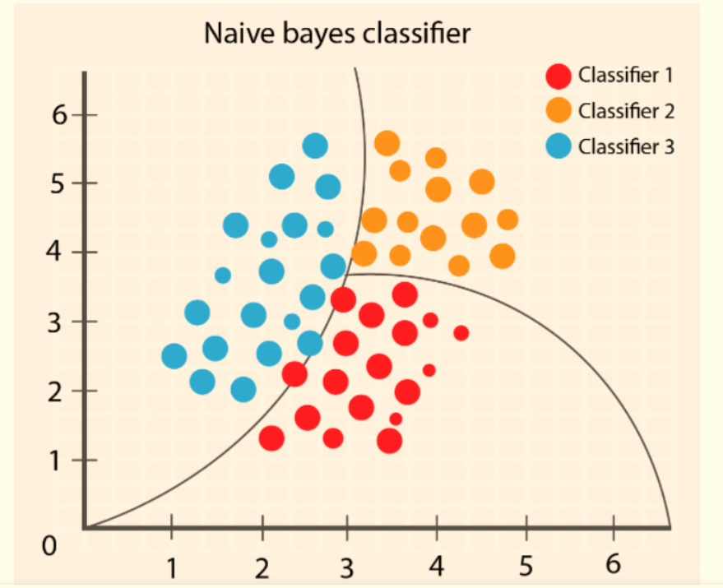
Introduction
In healthcare, the role of doctors and nurses is vital, especially with the rise of virtual care. While virtual doctors offer remote assistance, they may not suffice for emergencies. Yet, advancements like disease predictors show promise for better healthcare access, notably in remote areas. These predictors, devoid of human error, prove valuable during outbreaks like COVID-19 and Ebola by diagnosing without physical contact.
Existing virtual doctor models often lack accuracy due to incomplete parameters. To tackle this, we've developed and assessed multiple models, leveraging machine learning techniques like Decision Trees, Naive Bayes, SVM, and Random Forest. Our goal is to enhance prediction accuracy by categorizing raw data by gender, age, and symptoms.
Our project addresses the need for improved disease detection using machine learning algorithms such as Naive Bayes, SVM, and Random Forest. By analyzing patient symptoms and history, we aim to identify chronic illnesses accurately. We'll compare our model's performance against conventional methods to showcase its effectiveness, contributing to healthcare technology advancement and better public health outcomes.

Slide 5
Problem Statement
The healthcare sector faces a significant challenge in timely disease detection and prevention, leading to increased morbidity and mortality rates. Despite advancements in medical science, there is a lack of efficient systems to predict diseases based on reported symptoms, thereby hindering preventive measures. Therefore, the objective of this project is to develop an accurate and reliable disease prediction system that utilizes reported symptoms to prevent the onset or progression of diseases. This system aims to provide early detection and personalized preventive strategies, ultimately improving overall health outcomes and reducing the burden on healthcare systems.in medical sciences

Slide 6
Objectives
Developing a Predictive Model: Build machine learning models capable of predicting diseases based on symptoms.
Evaluation of Models: Assess the performance of different models to determine which one provides the most accurate predictions.
Creating a User Interface: Develop an interface where users can input symptoms, and the system will provide predictions.
Scalability: Ensure that the system can handle a large number of symptoms and diseases efficiently.
Interpretability: Make the system interpretable so that users can understand how predictions are made.

Slide 7

Literature Survey
Common Diseases
Dahiwade et al. [9] proposed an ML-based system for predicting common diseases using a dataset from the UCI ML repository. They employed CNN and KNN classification techniques, supplemented by patient lifestyle data, to assess disease risk. Comparing CNN and KNN, CNN demonstrated higher accuracy (84.5%) and faster processing time (11.1 seconds). Their findings align with Chen et al. [10], who also found CNN outperformed KNN, NB, and DT due to its ability to detect complex nonlinear relationships and important features. However, the study lacked detailed model parameters and evaluated performance solely based on accuracy, overlooking potential biases and opportunities for feature enhancement. Including more variables could improve underperforming algorithms [11].
Parkinson’s Disease
Chen et al. [22] developed a diagnosis system for Parkinson's disease (PD) using Fuzzy k-Nearest Neighbor (FKNN) and compared it with SVM. They utilized PCA to select discriminating features for FKNN construction, achieving superior sensitivity, accuracy, and specificity over SVM.
Behroozi [23] proposed a PD classification framework with enhanced accuracy (up to 15%) through filter-based feature selection. They applied independent classifiers like KNN, SVM, Discriminant Analysis, and NB, with SVM demonstrating the best performance.

Slide 8
Eskidere [24] focused on PD progression tracking, comparing SVM with LS-SVM, GRNN, and MLPNN. LS-SVM emerged as the top-performing model, supported by comprehensive decoder comparison.While the authors provide detailed frameworks, model calibration was lacking. Caruana [26] highlights the importance of calibration to enhance classification performance, especially for models like NB, SVM, and RF.
Heart Diseases
Marimuthu et al. [16] conducted research to predict heart diseases using supervised machine learning techniques. They structured the data attributes such as gender, age, chest pain, and others. Employing machine learning algorithms including Decision Trees (DT), K-Nearest Neighbors (KNN), Logistic Regression (LR), and Naive Bayes (NB), they found that LR achieved the highest accuracy rate of 86.89% among all tested algorithms.
In a similar vein, Dwivedi [17] aimed to improve the precision of heart disease prediction by incorporating additional parameters like Resting blood pressure and Serum Cholesterol. Using a dataset from the UCI Machine Learning repository comprising 120 heart disease-positive and 150 heart disease-negative samples, Dwivedi evaluated the performance of several machine learning algorithms including Artificial Neural Networks (ANN), Support Vector Machines (SVM), KNN, NB, LR, and Classification Trees. Through tenfold cross-validation, the results indicated that LR exhibited the highest classification accuracy and sensitivity, showcasing its reliability in detecting heart diseases.

Slide 9

Design
1. Data Handling:
- Collect diverse dataset of symptoms and diseases, ensuring quality and avoiding biases.
- Preprocess data by handling missing values, encoding categorical variables, and splitting into training and testing sets.
2. Model Selection and Training:
- Choose ML algorithms based on interpretability and performance, experimenting with SVM, Naive Bayes, Random Forest, etc.
- Train selected models on training data, optimizing hyperparameters for accuracy.
3. Evaluation and Validation:
- Assess model performance using metrics like accuracy and precision, conducting cross validation for robustness.
- Thoroughly test prediction function and user interface, validating predictions with synthetic and real-world cases.
4. Prediction Function and User Interface:
- Develop modular prediction function for symptom input and disease prediction.
- Design user-friendly interface for symptom input, integrating prediction function for clear disease predictions, and incorporating error handling and feedback features.
5. Deployment and Maintenance:
- Deploy system with focus on scalability, reliability, and security.
- Monitor performance and gather user feedback for iterative improvements.
- Provide documentation, support, and regular maintenance to ensure long-term usability.

Slide 10
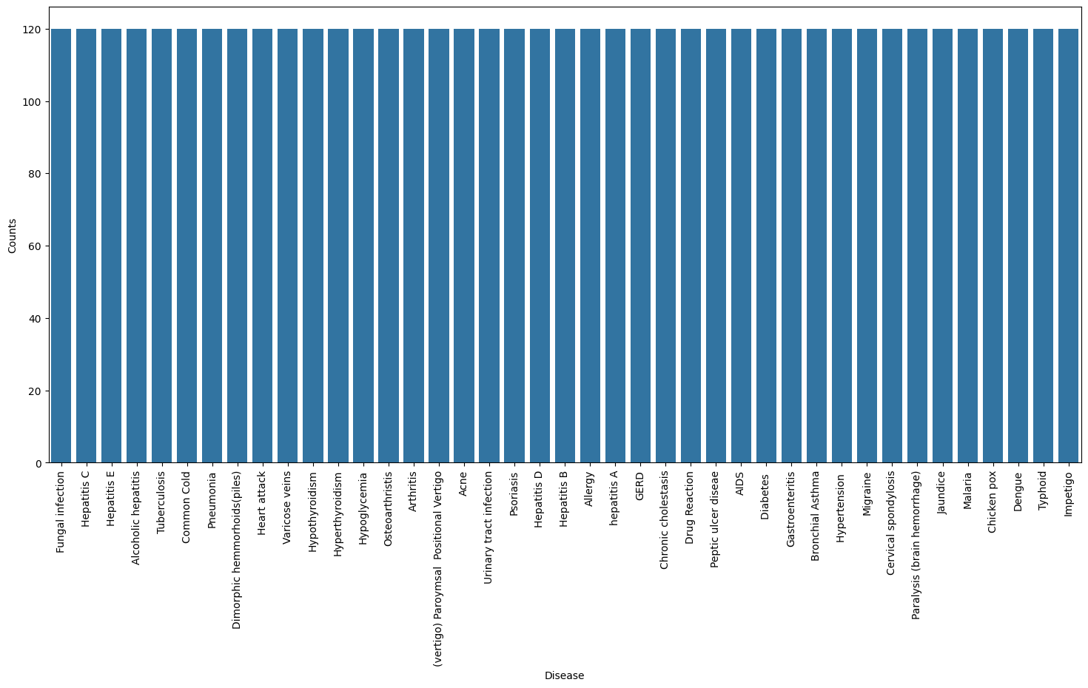

Slide 11
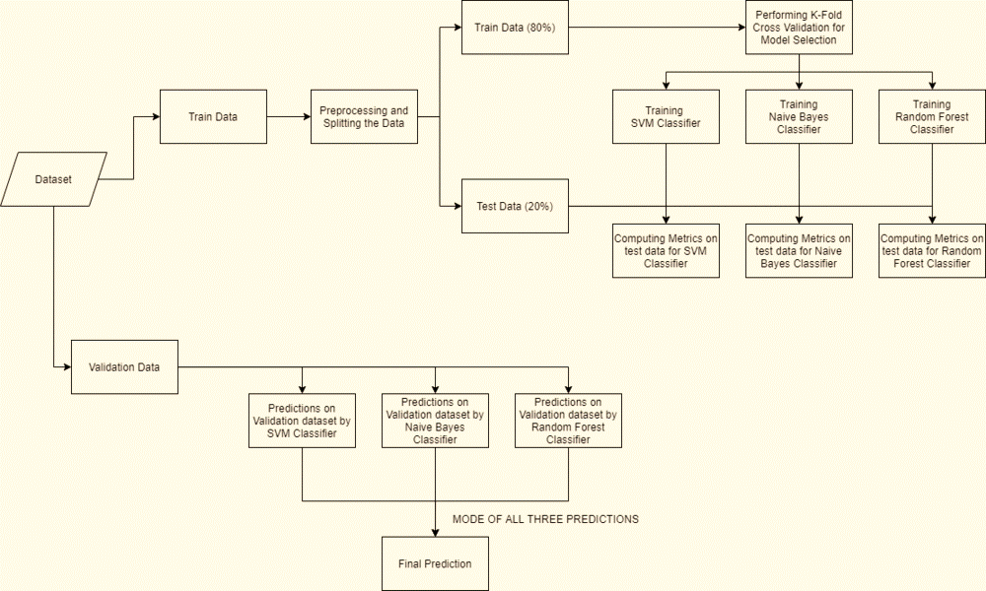
Flowchart-Modelling using SVC, Naive Bayes, random forest

Slide 12
Methodology
1. Data Exploration: Perform exploratory data analysis (EDA) to understand the distribution and relationships between symptoms and diseases. Visualize data using techniques such as histograms, scatter plots, and correlation matrices to gain insights into the dataset.
2. Preprocessing: Clean the dataset by handling missing values and outliers appropriately. Standardize or normalize numerical features to ensure consistency across different scales. Split the dataset into training and testing sets using stratified sampling to maintain class distribution.
3. Model Training and Evaluation: Train multiple machine learning models using the training dataset. Evaluate each model's performance using cross-validation techniques and metrics like accuracy, precision, recall, and F1-score.Compare the results to identify the best-performing model(s) for further analysis.
4. Hyperparameter Tuning: Fine-tune hyperparameters for selected models using techniques like grid search or random search. Optimize model parameters to improve performance and generalizability.
5. Prediction Function Development: Develop a function to preprocess input symptoms, make predictions using trained models, and return disease predictions. Test the function with sample inputs to ensure correctness and reliability.

Slide 13
Result
Different machine learning models were used to examine the prediction of disease for available input dataset
By leveraging Naive Bayes, SVM, Random Forest ,CNN and other algorithms on a comprehensive dataset encompassing over 41 diseases, our project aims to revolutionize disease diagnosis.
Our system, designed to analyze symptoms, age, and gender, provides accurate and timely predictions, acting as a virtual doctor for early disease detection and also addresses challenges in healthcare access, particularly in remote areas.
The rigorous process of data handling, including collecting diverse datasets of symptoms and diseases while ensuring quality and avoiding biases, sets a solid foundation for our predictive model.
Through meticulous preprocessing techniques such as handling missing values, encoding categorical variables, and splitting data into training and testing sets, we ensure the reliability and accuracy of our predictions.
In the current situation, doctors and medical professionals are always needed in emergencies. Given the challenges posed by COVID-19, where resources may be limited, our prediction system proves to be helpful and can be used for disease diagnosis.

Slide 14
Conclusion
The manuscript presented the technique of predicting the disease based on the symptoms, age, and gender of an individual patient. The Weighted KNN model gave the highest accuracy of 93.5 % for the prediction of diseases using the above-mentioned factors. Almost all the ML models gave good accuracy values. As some models were dependent on the parameters, they couldn’t predict the disease and the accuracy percentage was quite low. Once the disease is predicted, we could easily manage the medicine resources required for the treatment. This model would help in lowering the cost required in dealing with the disease and would also improve the recovery process.

Slide 15
The use of different ML algorithms enabled the early detection of many maladies such as heart, kidney, breast, and brain diseases. Throughout the literature, SVM, RF and LR algorithms were the most widely used at prediction, while accuracy was the most used performance metric. The CNN model proved to be the most adequate at predicting common diseases. Furthermore, SVM model showed superiority in accuracy at most times for kidney diseases and PD because of its reliability in handling high-dimensional, semi-structured and unstructured data. For Breast cancer prediction, RF showed more superiority in the probability of correct classification of the diseases because of its ability to scale well for large datasets and its susceptibility to avoid overfitting. Finally, the LR algorithm proved to be the most reliable in predicting heart diseases. In future work, the creation of more complex ML algorithms is much needed to increase the efficiency of disease prediction. In addition, learning models should be calibrated more often after the training phase for potentially a better performance. Moreover, datasets should be expanded on different demographics to avoid overfitting and increase the accuracy of the deployed models. Finally, more relevant feature selection methods should be used to enhance the performance of the learning models.

Slide 16
Reference:
9.D. Dahiwade, G. Patle, and E. Meshram, “Designing disease prediction model using machine learning approach,” Proceedings of the 3rd International Conference on Computing Methodologies and Communication, ICCMC 2019, no. Iccmc, pp. 1211–1215, 2019.
11. 1] R. Saravanan and P. Sujatha, “A state of art techniques on machine learning algorithms: A perspective of supervised learning approaches in data classification,” in 2018 Second International Conference on Intelligent Computing and Control Systems (ICICCS), 2018, pp. 945– 949.
[22] H. L. Chen, C. C. Huang, X. G. Yu, X. Xu, X. Sun, G. Wang, and S. J. Wang, “An efficient diagnosis system for detection of Parkinson’s disease using fuzzy k-nearest neighbor approach,” Expert Systems with Applications, vol. 40, no. 1, pp. 263–271, 2013. [Online]. Available: http://dx.doi.org/10.1016/j.eswa.2012.07.014
[23] M. Behroozi and A. Sami, “A multiple-classifier framework for Parkinson’s disease detection based on various vocal tests,” International Journal of Telemedicine and Applications, vol. 2016, 2016.
[24] O. Eskidere, F. Ertas¸, and C. Hanilc¸i, “A comparison of regression ¨ methods for remote tracking of Parkinson’s disease progression,” Expert Systems with Applications, vol. 39, no. 5, pp. 5523–5528, 2012.

Slide 17
[16] M. Marimuthu, M. Abinaya, K. S., K. Madhankumar, and V. Pavithra, “A Review on Heart Disease Prediction using Machine Learning and Data Analytics Approach,” International Journal of Computer Applications, vol. 181, no. 18, pp. 20–25, 2018.
[17] A. K. Dwivedi, “Performance evaluation of different machine learning techniques for prediction of heart disease,” Neural Computing and Applications, vol. 29, no. 10, pp. 685–693, 2018. [18] K.
Project Link:
https://drive.google.com/drive/u/0/folders/1Gq5t7SBVBhKAEkTFuZtO9WNMMTmkdroq

Slide 18
THANK YOU

