Slide 1

Cross-selling recommendations for a credit union
Internship Case Study by
RAGHAVI GURURAJAN

Slide 2
Process in this Data Analysis
Defined the business task
Collected the data from the data source
Cleaned the data thoroughly and created Master data
Analyzed the Data
Interpret the results and gave the final insight

Slide 3
Problem Statement: Increasing cross-selling can take quite a lot of research and business understanding. The credit union is looking for the best strategy suggested by the Data analyst to excel in the cross-selling part of the business.
Business statement: ABC analytics company aims to perform Exploratory data analysis on the dataset provided and analyze the results. As a Data analyst intern, my job was to perform EDA on the credit union’s dataset and create visualizations to analyze the data. My job is to provide valuable insights to the company to increase effective cross-selling of banking products.
Client Background

Slide 4

Data Exploration
Train_data.csv
Test_data.csv
Total number of files-1
Total number of features-48
Base format of the file-CSV
Size of the data- 2.1 GB
Total number of observations-13,647,309
Total number of observations-929,615
Total number of files-1
Total number of features-24
Base format of the file-CSV
Size of the data- 108 MB

Slide 5
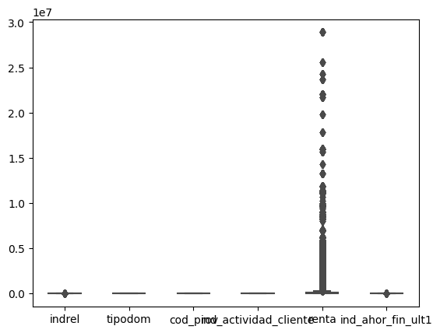
We can see that there are outliers in the data frame

Slide 6
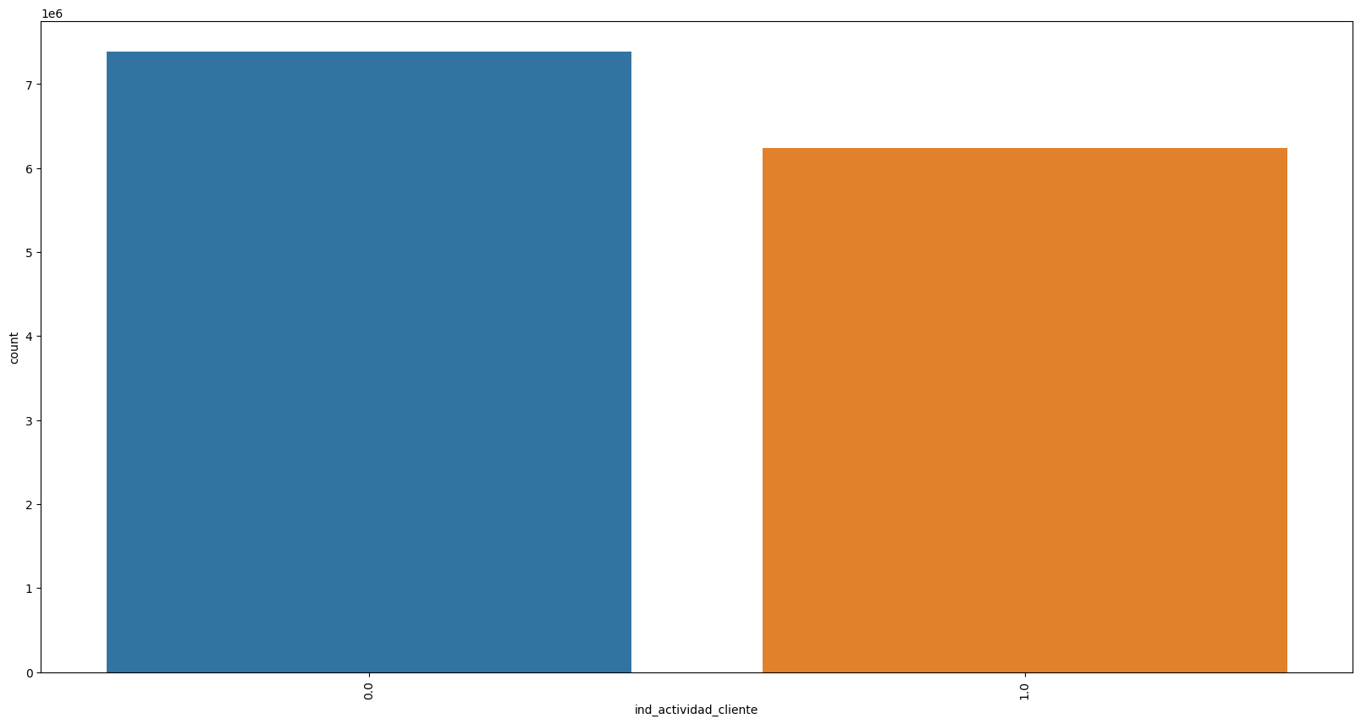
From the above graph, we can infer that there is a greater number of inactive customers than active customers.

Slide 7
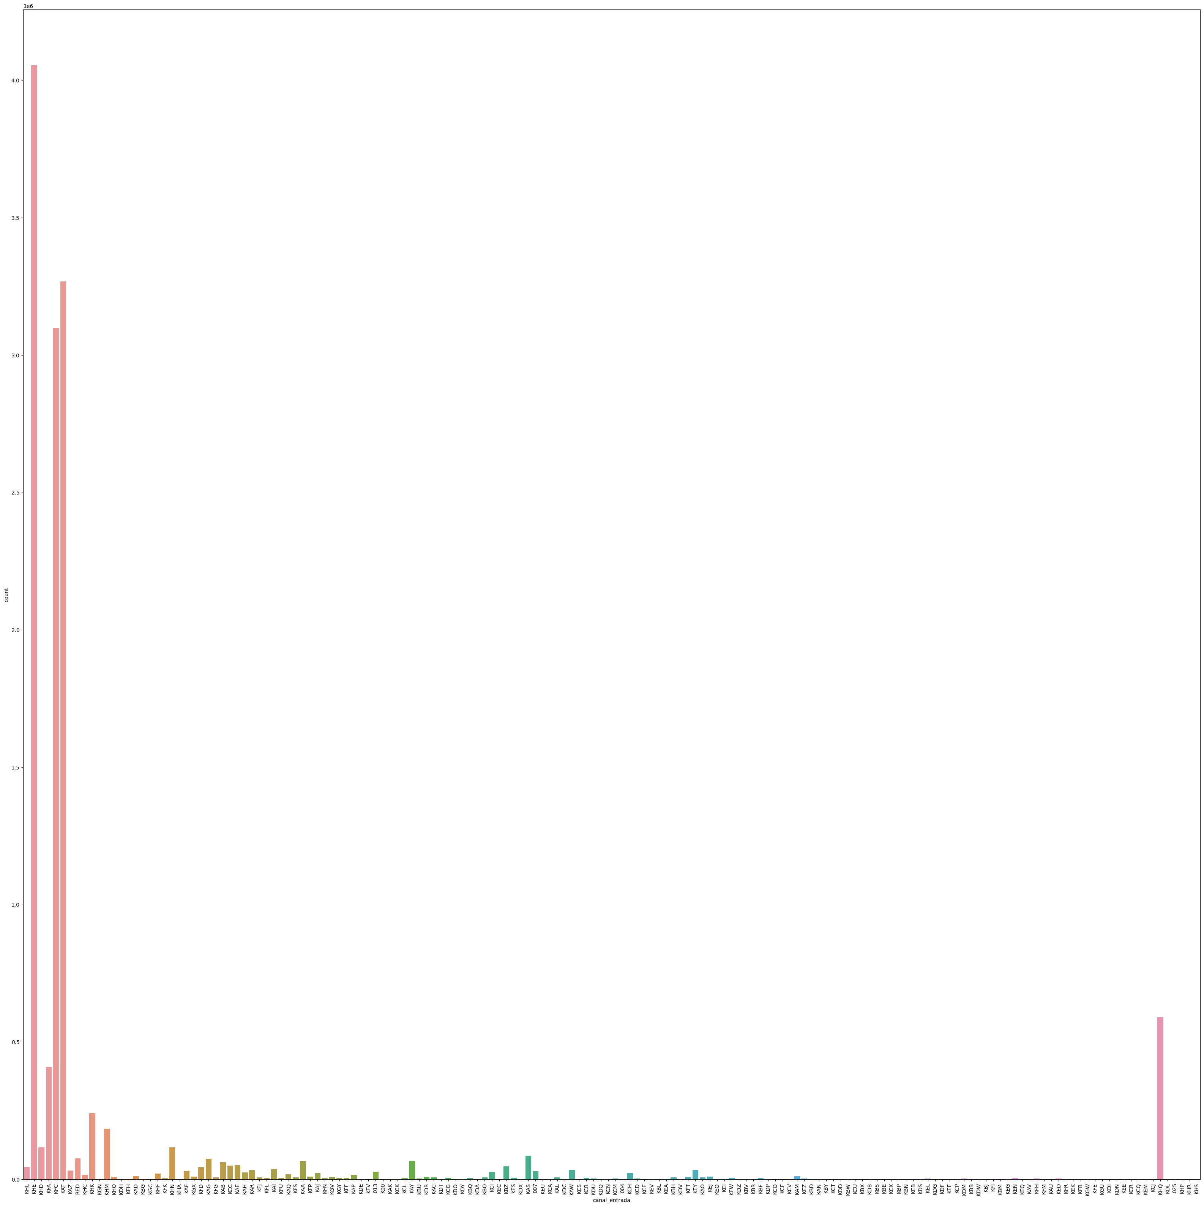
From the above graph, we can infer that KHA, KFE, and KFC were the most frequently used channels by customers to join.

Slide 8
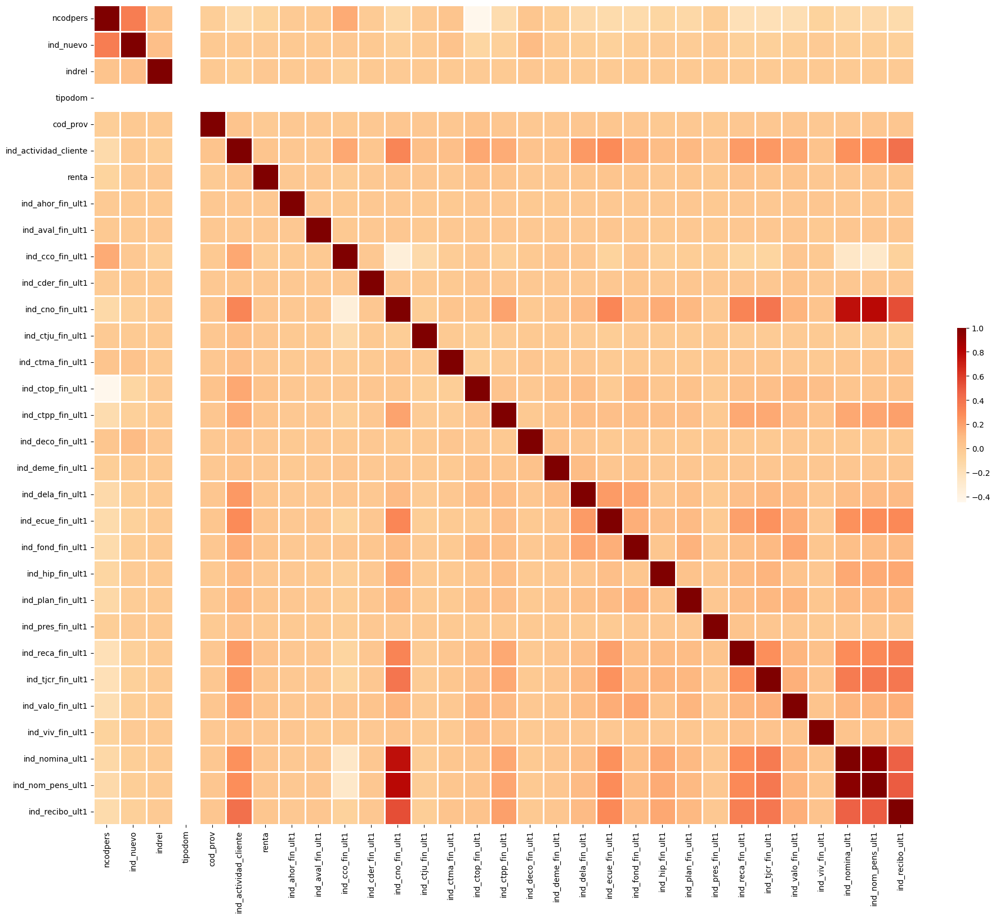

Slide 9
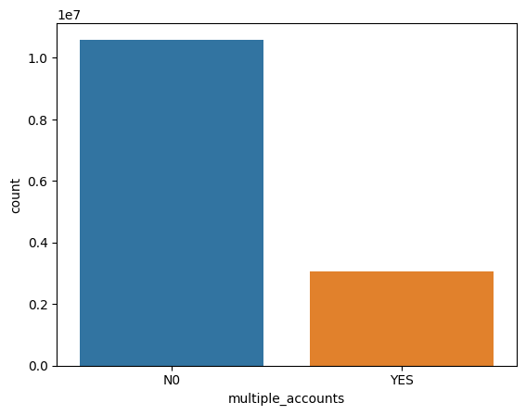
There were very few customers who no multiple accounts

Slide 10
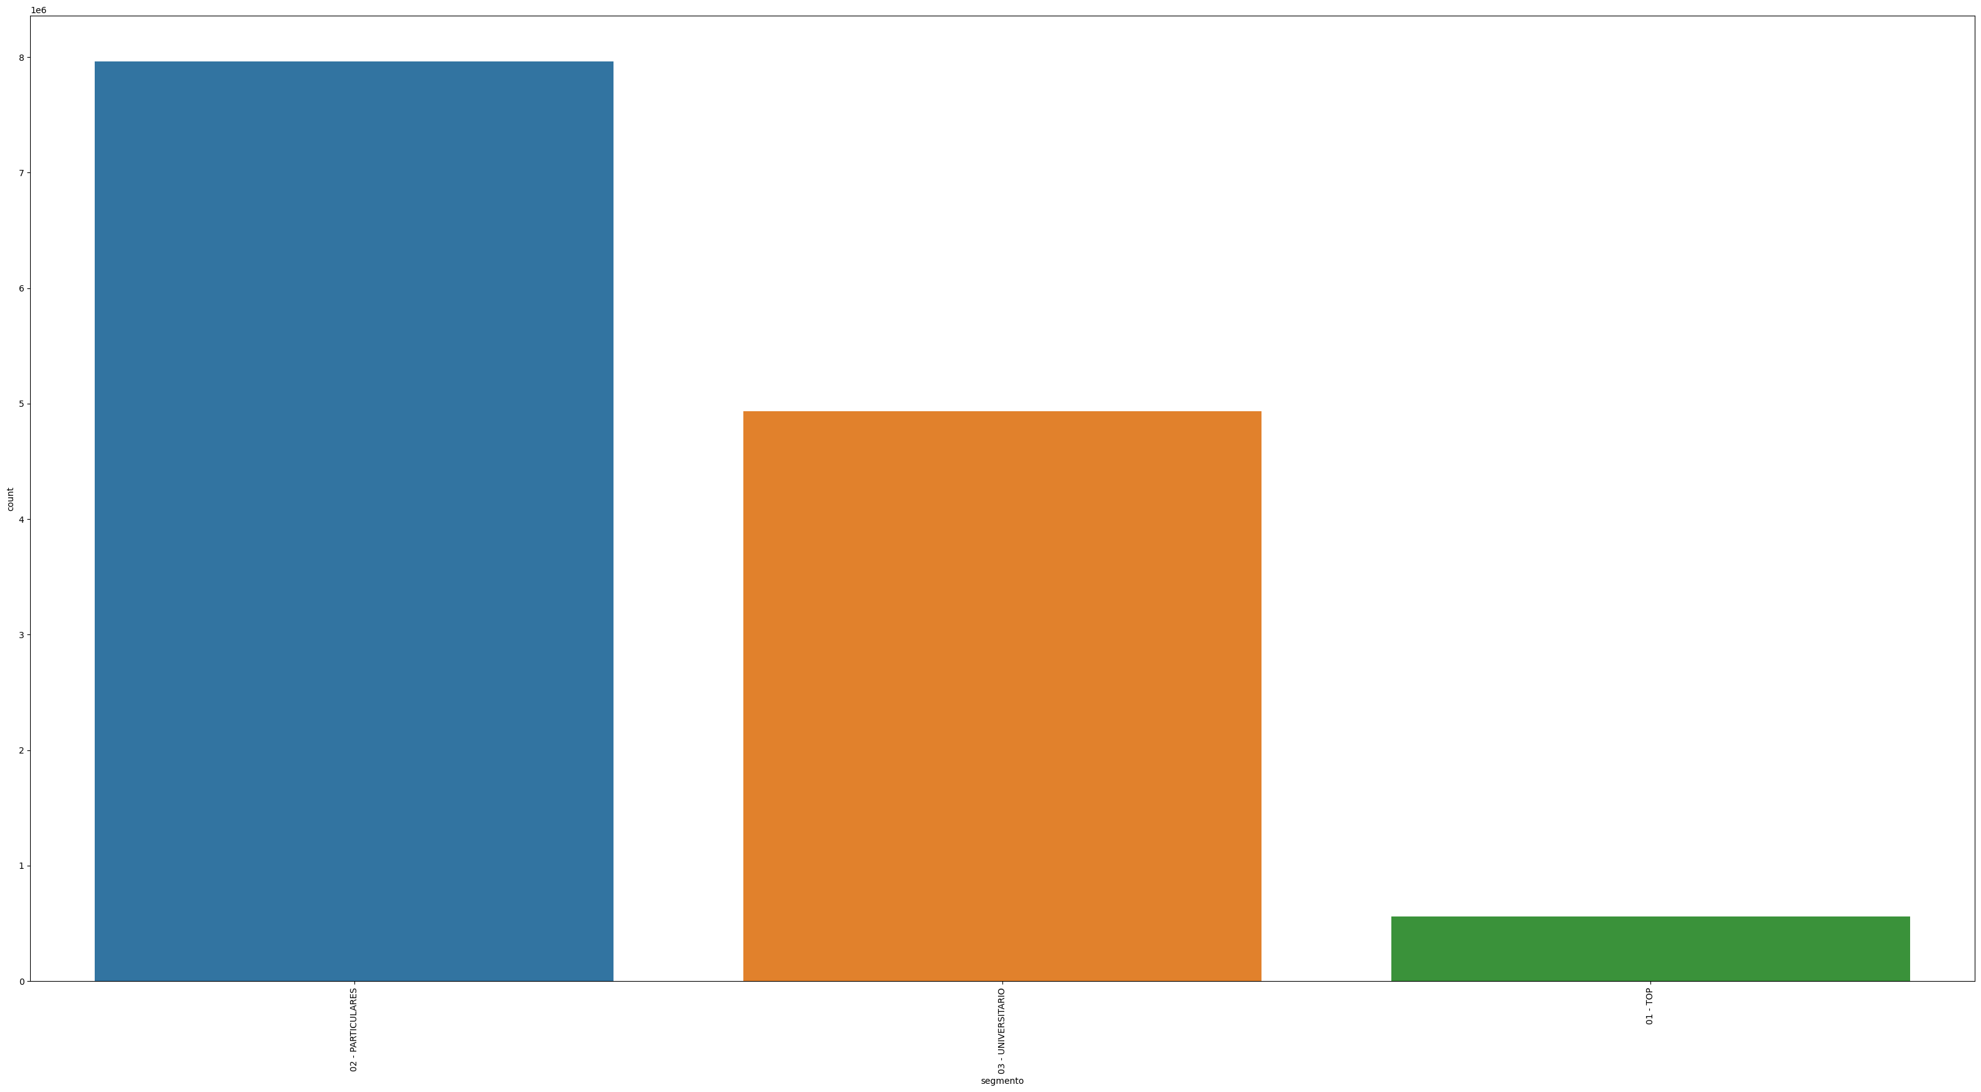
The above graph infers that there is a greater number of customers in the individual 'Particulares' segment.

Slide 11
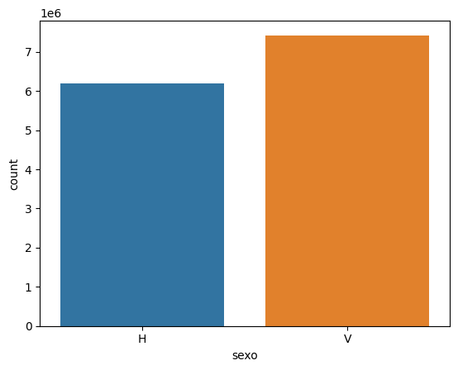
The above graph we infer that there are a greater number of female customers

Slide 12
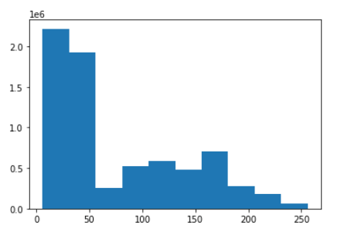

Slide 13
Insights from the EDA
Final insights:
Based on the Exploratory data analysis performed, the Data analysts at ABC company produced the following recommendations to help the Credit union increase its cross-selling amongst its customers.
More attention can be provided to customers who have single accounts. Address their needs and increase the number of products they require by knowing their needs.
Design ads that properly help the customers understand the new product launched/services so that XYZ Credit union can reach their customers at a better reach.
Provide complimentary gifts/services to its existing/new customers because it attracts existing customers and helps in networking.
Go back and forth into the most frequently used channels to join by the customers and design ads/ provide new services

