Slide 1
Cybersecurity Incident Investigation Widget Co
EAS 596: Cybersecurity Analytics
GROUP 05
Notes:
Good [morning/afternoon], everyone. My name is [Your Name], and I’d like to welcome you to our final presentation for EAS 596: Cybersecurity Analytics. Our project involved investigating a suspected cybersecurity incident at Widget Co., a fictional company that experienced strange activity during October 2022. As consultants, our task was to analyze logs from various systems—including DNS, VPN, MFA, and others—and determine if a breach occurred, how it happened, and what should be done about it. We used Splunk as our core investigation tool, which helped us analyze thousands of log events and build a timeline of what actually happened

Slide 2
Problem Statement & Scope
Suspicious activity reported – possible breach in October 2022
Questions to answer:
Was there a breach?
How did it happen?
What systems were impacted?
How to stop it from happening again?
Used IOCs (malicious domains, flagged IPs) for investigation
Splunk used for log correlation and analysis
Notes:
“Widget Co. came to us because they observed suspicious activity. We were given access to their October 2022 log files and asked four core questions: Was there really a breach? If so, how did it happen? What systems were affected? And how do we make sure it doesn’t happen again? We used Indicators of Compromise—or IOCs—which include malicious IP addresses and domain names—to guide our investigation. Splunk helped us filter and connect thousands of log entries to trace attacker activity

Slide 3
What’s Next in This Presentation
Our Splunk-based forensic methodology
Full timeline of the breach
Dashboards we created for threat detection
Technical & strategic recommendations
Notes:
Now that you know what we found, here’s what we’ll cover next: We’ll walk you through the timeline of events, showing how the attacker moved through the system. Then we’ll explain our Splunk-based forensic methods and how we built dashboards to help detect threats faster. Finally, we’ll share our recommendations—both for IT teams and executive leadership—on how Widget Co. can avoid future attacks. By the end of this presentation, you’ll get a complete view of how the attack worked, how we detected it, and how to prevent it in the future

Slide 4
METHODOLOGY

Slide 5
TOOL AND DATA SOURCES
Primary Tool: Splunk
IOC Lookup Files: Contained known malicious IP addresses and URLs to match against internal activity.
Primary Logs: DNS Logs, VPN Logs, MFA Logs, Password Vault Logs and Admin Logs.
Analytical Advantages of Using Splunk:
Splunk allowed us to unify data from all logs.
SPL (Search Processing Language) helped us filter specific behaviors.
Log correlation enabled us to link activities across services, users, and timestamps, revealing patterns of movement.
Dashboards provided visibility into user behavior and enabled us to monitor and pivot during the investigation.

Slide 6
INVESTIGATION APPROACH
Initial Indicators
IOC match detected in DNS logs.
Log Review and Focused Analysis
Investigated BDRVLS across MFA, VPN and Password Vault Logs.
Outcome
Correlated events across all logs.
Identified user BDRVLS accessed a flagged malicious URL and was also linked to a known malicious IP.
Detected suspicious login activity.
Then expanded Log Scope.
Second User of Interest
Detected new compromised user: DDDXUB.
DDDXUB had admin access and multiple login attempts from malicious IP.
Constructed a detailed timeline.
1st User of Interest: BDRVLS
DDDXUB

Slide 7
FINDINGS

Slide 8
Initial Compromise & Escalation (Oct 12–18)
Initial Compromise
Oct 12, 4:57 PM – User BDRVLS accesses malicious domain (glasslu.com) → Likely phishing vector
Oct 12, 4:59 PM – Logs into Billing Software from IOC IP: 180.76.54.93 → MFA: Not enforced (N/A)
Later that evening – 10+ failed WidgetApp logins from same IP → Indicates attacker probing
Escalation
Oct 13, 9:05 AM – BDRVLS accesses Password Vault from same IOC IP → Sensitive data likely compromised
Oct 14–18 – Multiple failed Password Vault logins from various IPs → Attempts to reuse/test stolen credentials

Slide 9
Further Compromise & Persistent Access (Oct 15–31)
Second Compromise & MFA Bypass
Oct 15, 10:49 AM – User DDDXUB logs into IT Admin Portal from IOC IP → Confirms second user compromise
Oct 15, 3:06 PM – Cloud access from same IP → MFA bypass detected
Oct 24 – MFA bypass events continue on Cloud & IT Admin Portal → Confirms ongoing attacker access
Infrastructure Shift
Oct 25–31 – Attacker switches to new IP: 104.227.59.62 → Multiple successful & failed logins → Suggests persistent, adaptive access attempts

Slide 10
DASHBOARDS

Slide 11
DASHBOARDS
Network was broken into 3 Dashboards.
Highlights common Indicators of Compromise (IOCs).
Used by building off the previous dashboard.
Can also be used independently.

Slide 12
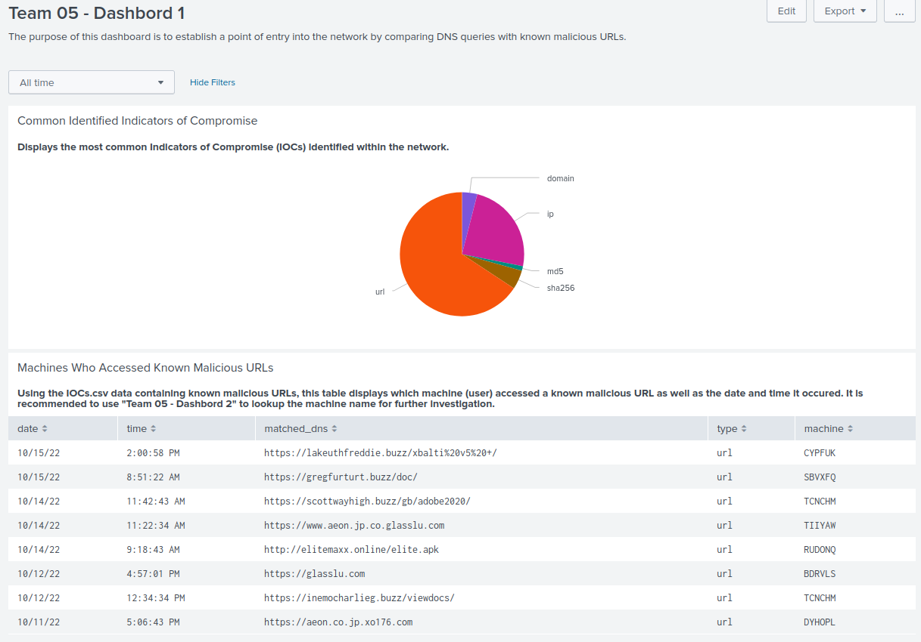
Initial compromise

Slide 13
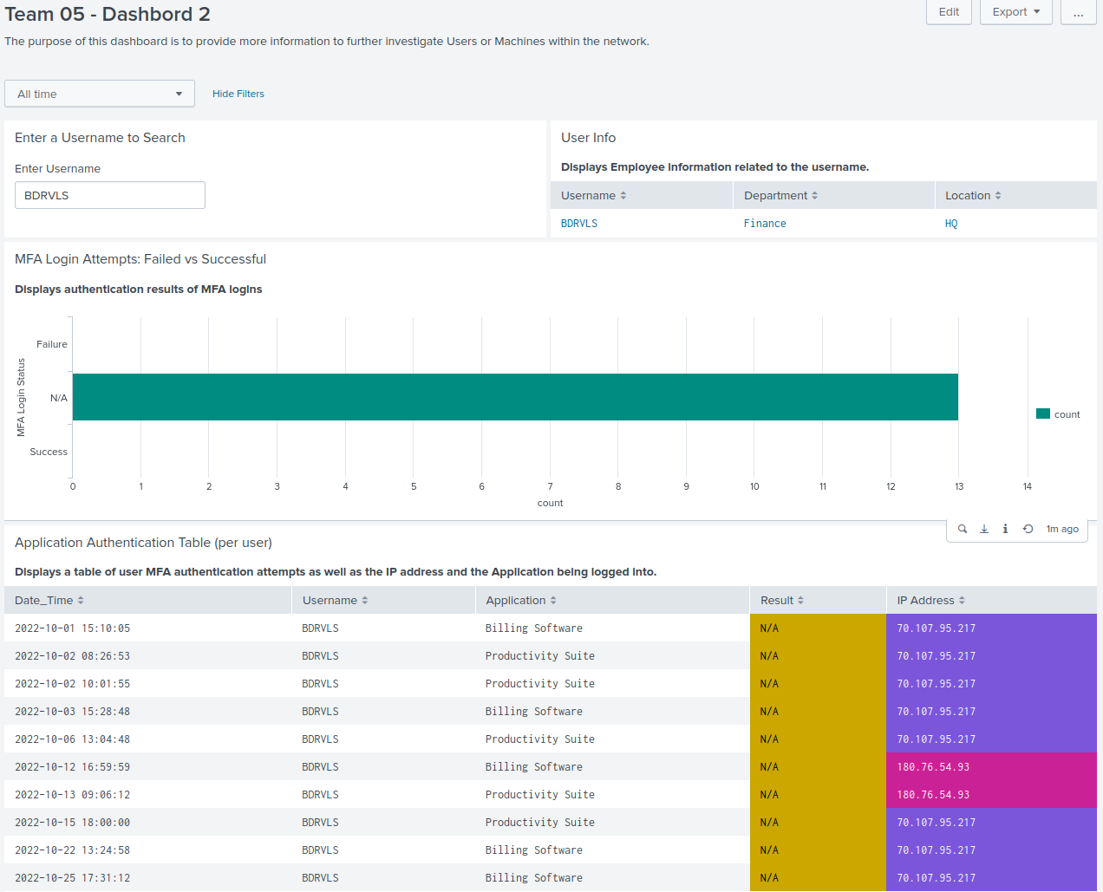
Note: Results are N/A which suggests MFA was not enforced.

Slide 14
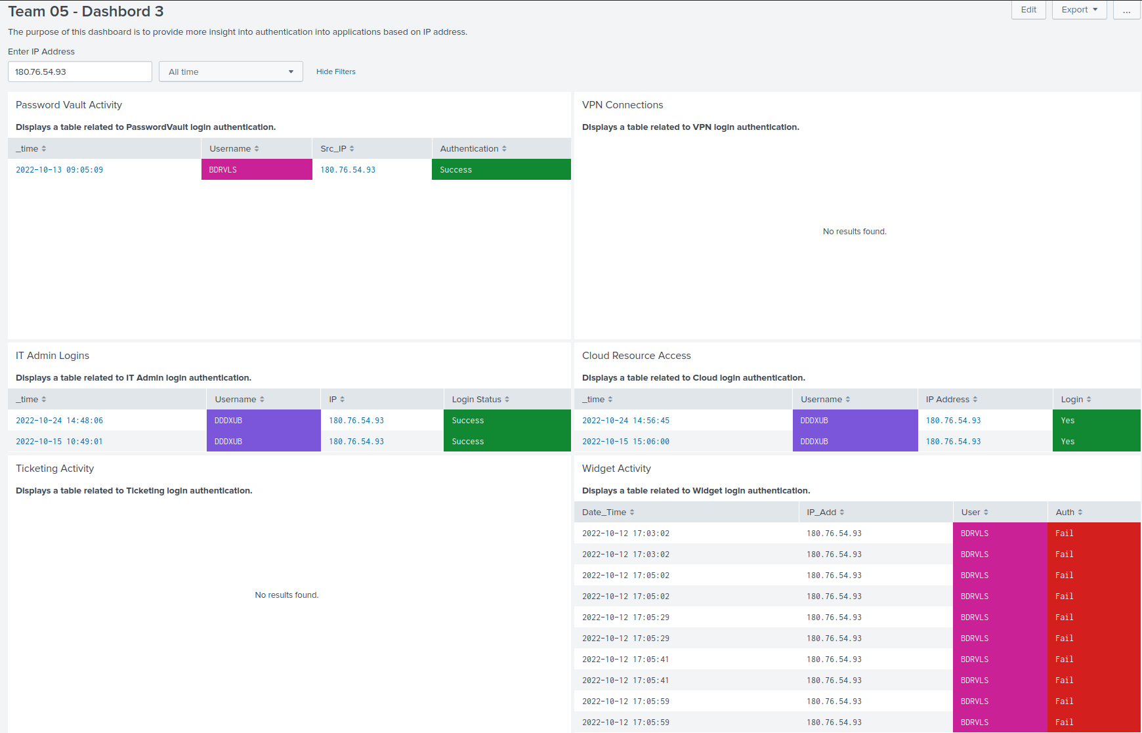
Evidence of brute force attack

Slide 15
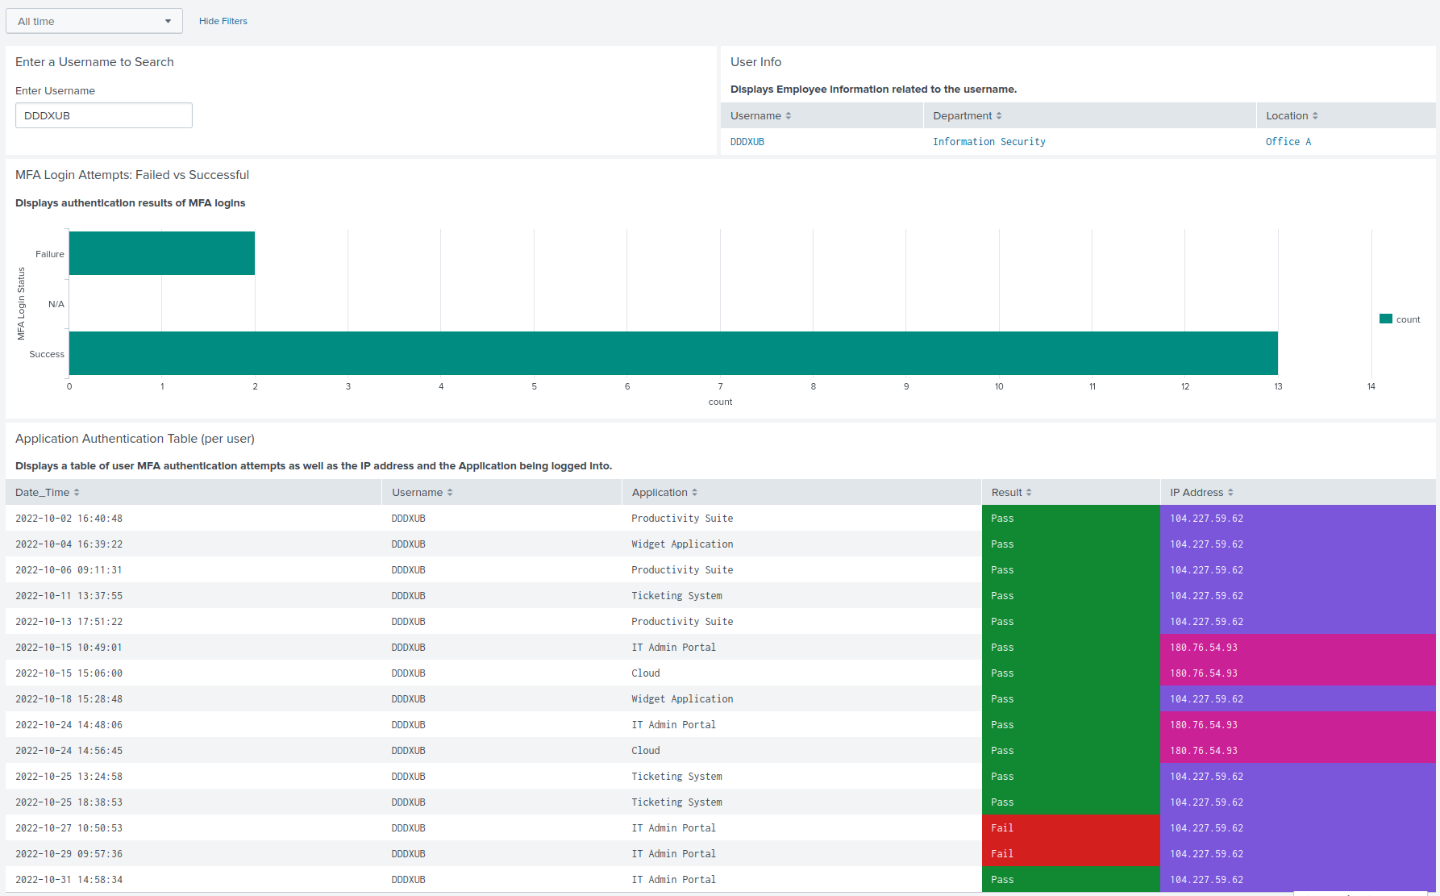
Suggests evidence of persistence

Slide 16
STRATEGIC RECOMMENDATIONS

Slide 17
Recommendations
What needs to be fixed?
Who needs to act?
Notes:
Now that we’ve gone through the breach timeline and how the attacker moved through Widget Co.’s environment, let’s talk about what needs to be done next. Our recommendations are divided into two key parts: technical fixes for the IT and security teams, and policy and process changes for leadership and management.
Both are important. Technical changes close the doors the attacker walked through. Policy changes build a culture where those doors are harder to open in the first place.

Slide 18
Technical Remediation-IT & Security Team
Create Splunk alerts for MFA bypass & failed logins
Fix MFA setup across all critical accounts
Review user roles & rotate credentials for accounts like DDDXUB
Update IOC threat feeds weekly
Notes:
Let’s begin with the technical recommendations.
Enable Behavioral Alerts: We recommend configuring Splunk to generate alerts when MFA results are marked as “N/A” or “Bypass,” or when an unusual number of failed logins occur. These alerts can help detect attacks earlier.
Patch MFA Configuration: Some users were not even enrolled in MFA. Others had misconfigurations that allowed bypassing. IT should audit and enforce MFA for all accounts—especially those with access to cloud, admin, or vault systems.
Review User Roles and Credentials: We suggest rotating admin passwords and reviewing all user privileges. Accounts like DDDXUB had high access, and attackers took advantage of that. Least privilege should be the standard.
Update IOC Threat Feeds Weekly: Lastly, we recommend integrating updated threat intelligence into firewalls and Splunk blocklists. IOC data like malicious IPs and domains should be refreshed weekly to stay ahead of attackers.

Slide 19
Organizational Policy Reform – Executive Leadership
Mandatory phishing training for all employees
Define executive breach response plan
Report cybersecurity metrics to the board
Run red/blue team simulations every 6 months
Notes:
On the leadership side, the changes focus on awareness, planning, and accountability.
Security Training for Employees: The attack began with a phishing link. This is why every employee should go through phishing and social engineering training at least twice a year. These simulations should include realistic scenarios.
Executive Breach Response Plan: We recommend developing a response plan that defines roles and escalation procedures during a breach. This helps avoid confusion during high-stress situations and speeds up response time.
Board-Level Security Reporting: Security is not just a technical issue—it’s a business risk. We suggest including cybersecurity metrics in quarterly board meetings, just like financial updates. This keeps leadership informed and involved.
Red & Blue Team Exercises: Twice a year, Widget Co. should run simulations of attacks. Red teams simulate attackers. Blue teams try to detect and respond. These drills help test the system and improve both tools and teamwork

Slide 20
Conclusion
Phishing led to credential theft
MFA was bypassed or not enabled
Access gained to Vault, Admin, and Cloud
Infrastructure switch helped attacker remain hidden
Logs + Splunk helped trace everything
Notes:
So, what happened at Widget Co. wasn’t a simple mistake. It was a multi-step, organized attack that used phishing, MFA bypass, credential abuse, and lateral movement. The attacker carefully escalated their access and persisted over several weeks.
What allowed us to uncover all of this was log data—and Splunk. By combining DNS queries, VPN logs, MFA results, and application access, we could trace the full story. Without visibility across systems, this breach might have gone completely undetected.
The lessons here are clear: detection needs to be smarter. Systems need tighter configuration. People need to be trained. And leadership needs to stay involved

Slide 21
THANK YOU

