Slide 1

DEPARTMENT OF COMPUTER SCIENCE AND ENGINEERING
PNEUMONIA DETECTION USING DEEP LEARNING
Under the Guidance of
E.SUSMITHA
M.Tech, (Ph. D),Assistant Professor
M.P.RAGHAVI[R190327]
A.SAMATHA[R190427]

Slide 2
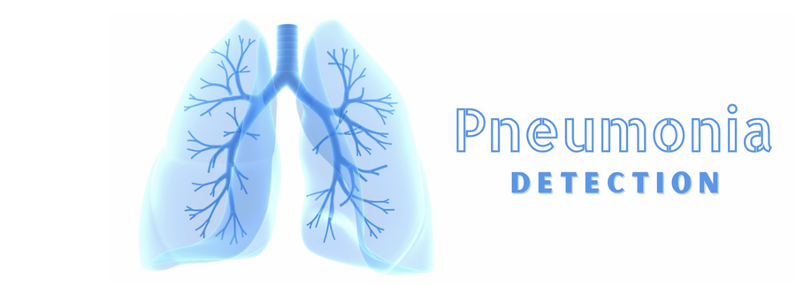
OUTLINE
Abstract
Introduction
Objective
Literature
Motivation
Methodology
Results and Discussions
Conclusion and Future Enhancements
References

Slide 3
ABSTRACT
Pneumonia remains one of the leading causes of death worldwide, and early detection is crucial for effective treatment. Chest X-rays are commonly used for diagnosing pneumonia, but their interpretation requires trained radiologists, often leading to delays in diagnosis. This project proposes an automated system for pneumonia detection from chest X-ray images using the VGG19 deep learning model. The model leverages transfer learning on the VGG19 architecture, pre-trained on the ImageNet dataset, and fine-tuned on a dataset of chest X-ray images to classify them as Normal ,Pneumonia or
Non-Chest Xray.

Slide 4
INTRODUCTION
Pneumonia is a leading cause of death, especially in children and the elderly.
Chest X-rays are reliable but require radiologist expertise, which is time-consuming and error-prone.
Resource-limited settings face challenges due to fewer medical professionals.

Slide 5
Key Features
Utilizes pre-trained VGG19 with transfer learning.
User-friendly web application for real-time deployment.
Provides confidence scores for better interpretability.
Automates detection to assist healthcare professionals and save lives globally.

Slide 6
OBJECTIVE
Develop an automated pneumonia detection system using the VGG19 deep learning model for chest X-rays.
Improve diagnosis speed and accuracy while reducing reliance on radiologists.
Provide a user-friendly web interface for real-time detection, particularly in resource-limited settings.

Slide 7
Pneumonia is a major global health issue, and chest X-rays are commonly used for diagnosis.
Deep learning models, especially CNNs like VGG19, have proven effective in automating X-ray interpretation.
Transfer learning improves model performance, enabling faster and more accurate pneumonia detection, particularly in resource-limited settings.
LITERATURE

Slide 8
S.No | Author(s) | Objective | Methodology | Findings | Limitations
1. | Kermany et al. | Automated detection of pneumonia using CNNs | Used CNNs trained on a large chest X-ray dataset | Achieved high accuracy for pneumonia and other datasets | Model performance dependent on dataset quality
2. | Rajpukae et al. | Pneumonia detection with Densenet | Developed CheXNet a 121 layer DenseNet on fine-tuned on 100,000+labeled X-rays | Outerperformed radiologists in identifying pneumonia | Lack of interpretability for decision-making
3. | Stephen et al | Comparative analysis of pretrained models | Fine-tuned VGG19 ,Resnet,and InceptionV3 models | VGG19 provided balanced performance in accuracy and computational efficiency | Dataset imbalance and limited diversity in X-rays
4. | Wang et al. | Multi-disease detection in chest X-rays | Introduced ChestX-ray8 dataset; trained a CNN for detecting multiple thoracic diseases | High performance across several diseases, including pneumonia | Dataset biases and limited validation across global population

Slide 9
S.NO | Author | objective | Methods used | Findings | Limitations
5. | Rahman et al. | Robust pneumonia detection | Used data augmentation and ensemble methods to improve CNN performance | Increased robustness against overfitting and improved accuracy | Computationally expensive; results dependent on augmentation strategies
6. | Selvaraj et al. | Explainability in pneumonia detection | Incorporated Grad-CAM for visualizing CNN decision regions | Improved interpretability of AI predictions | Interpretability methods can still be subjective

Slide 10
MOTIVATION
Manual interpretation of chest X-rays is time-consuming and prone to errors, especially in underserved regions.
Limited access to skilled radiologists in resource-limited settings delays diagnosis and treatment.
Advancements in deep learning, like VGG19, offer an opportunity to automate and improve diagnostic accuracy.
Developing an efficient, user-friendly system can enhance healthcare accessibility and save lives globally.
Pneumonia remains a leading cause of mortality, particularly in children and the elderly.

Slide 11
CONTRIBUTION
Developed a user-friendly web appliation for real-time pneumonia detection with confidence scores.
Automated medical diagnostics to assist healthcare professionals, improving efficiency and accessibility.
Implemented robust data preprocessing techniques to enhance model performance and reliability.
Demonstrated the scalability of AI for healthcare, addressing challenges in resource-limited settings.

Slide 12
METHODOLOGIES
Data Collection
Data Preparation
Data Augumentation
Data Preprocessing
Model Architecture and Training
Model Evaluation

Slide 13
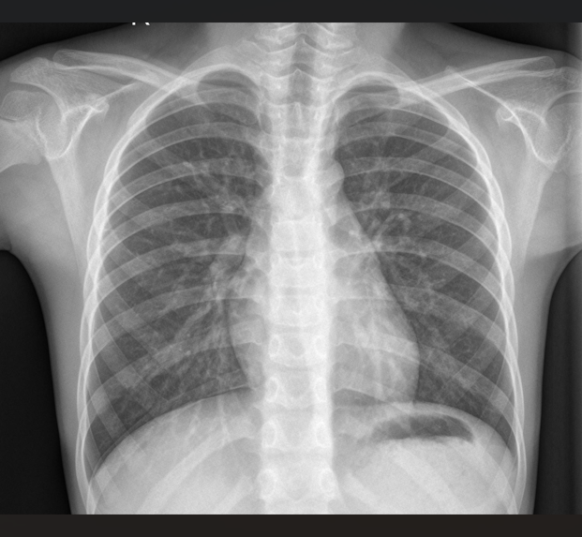
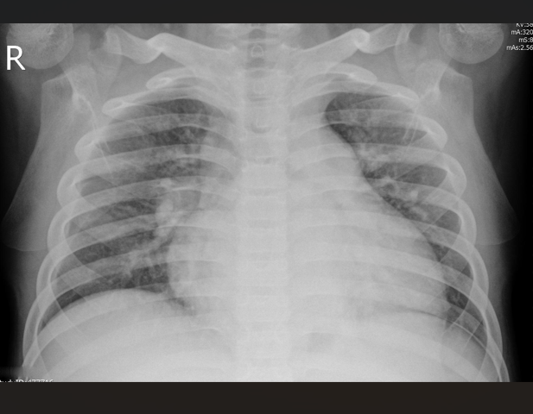
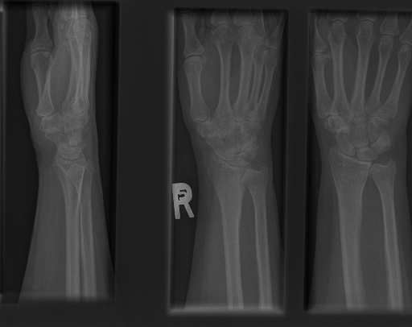
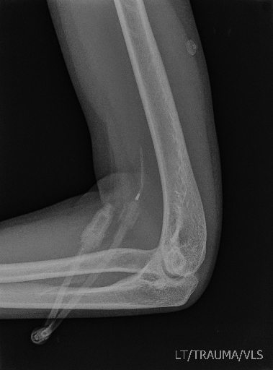
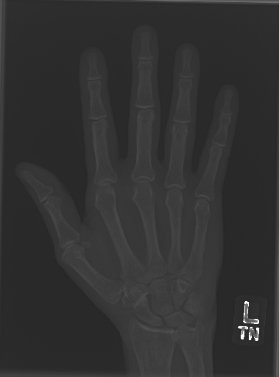
Data Collection
The dataset includes labeled chest X-ray images of healthy individuals and pneumonia patients.
Sourced from publicly available repositories such as Chest X-Ray Images dataset.
The dataset comprises over 5018 X-ray images, ensuring a balance of Normal, Pneumonia and Non-Chest Xray classes for training.
Example Chest X-ray images:
NORMAL PNEUMONIA NON-Chest Xray

Slide 14
Data Preparation:
Divided the dataset into training (80%), validation (2%), and testing (18%) subsets.
Ensured class balance across subsets to avoid model bias during training and evaluation.
Prepared data generators for real-time loading and augmentation during model training, leveraging TensorFlow/Keras utilities.

Slide 15
Data Augumentation
Augmentation Techniques Used:
Rotation Range (20 degrees): Helps the model handle differently angled X-ray scans.
Width and Height Shift (10%): Simulates minor shifts in patient positioning.
Shear Range (0.1): Distorts images slightly to introduce variation.
Zoom Range (0.1): Random zooming helps simulate different zoom levels in X-rays.
Horizontal Flip: Introduces lateral variations to make the model invariant to horizontal orientations.

Slide 16
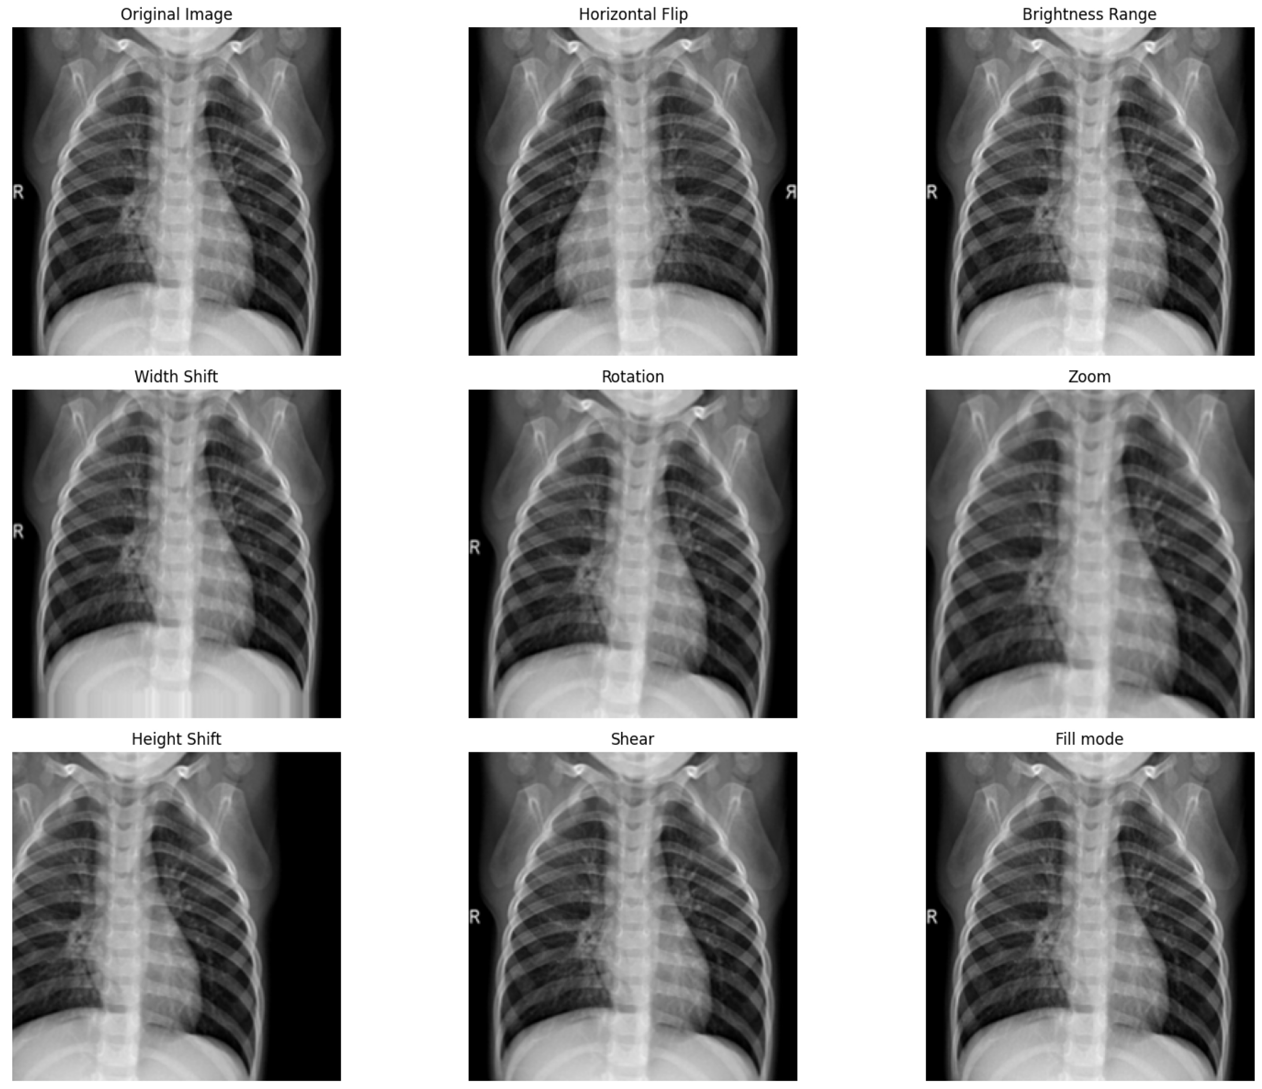

Slide 17
Data preprocessing
Resizing: All images are resized to 224x224 pixels, the required input size for the model.
Normalization: Pixel values are scaled to the range [0, 1] [1,0]by dividing by 255.
Reshaping: Images are reshaped to (224, 224, 3) to match the model’s expected input format.
Data Augmentation: Techniques like rotation, zoom, and horizontal flipping are applied to increase dataset diversity and prevent overfitting.
Categorical Encoding: Labels (Normal/Pneumonia/Non-Chest Xray) are converted into one-hot encoded format.
Data Splitting: The dataset is split into training, validation, and test sets for model evaluation.

Slide 18
Model Architecture and Training:
This project employs a Convolutional Neural Network (CNN) as the backbone for pneumonia detection from chest X-ray images. The architecture leverages the VGG-19 model, a widely used deep learning model known for its effectiveness in image classification tasks and its pre-training on large datasets like ImageNet, which helps in improving feature extraction and enhancing the model’s accuracy.

Slide 19
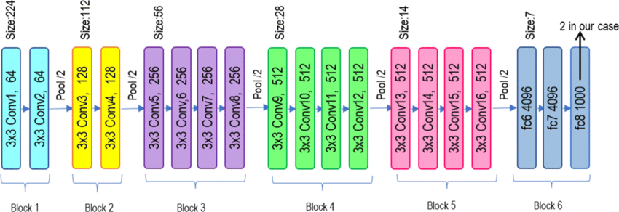
VGG19 MODEL:
Introduction: VGG19 is a deep convolutional neural network architecture that was proposed by the Visual Geometry Group (VGG) at the University of Oxford. It is widely used for image classification tasks and has 19 layers, including 16 convolutional layers and 3 fully connected layers.

Slide 20
Model Design
Activation Functions:
ReLU: Introduces non-linearity in intermediate layers.
Softmax: Used in the output layer for multi-class classification.
Dropout Layers:
Added to prevent overfitting and improve generalization.
Image Data Generator:
Augments data with transformations like rotation, scaling, and flipping to enhance model robustness.

Slide 21
Model Evaluation
Accuracy Plot:
Training Accuracy: The training accuracy steadily increased over the epochs, ultimaely . This shows that the model was effectively learning from the training data and improving its predictive capability.
Validation Accuracy: The validation accuracy plateaued indicating the model's ability to generalize well to the unseen validation data. The stable validation accuracy suggests that the model didn't overfit, which is for good generalization.
Loss Plot:
Training Loss: The training loss showed a consistent decrease throughout the training process, reflecting effective learning and the model’s ability to reduce its error on the training set.
Validation Loss: Similar to the validation accuracy, the validation loss stabilized without significant increases, further supporting that the model did not overfit to the training data.

Slide 22
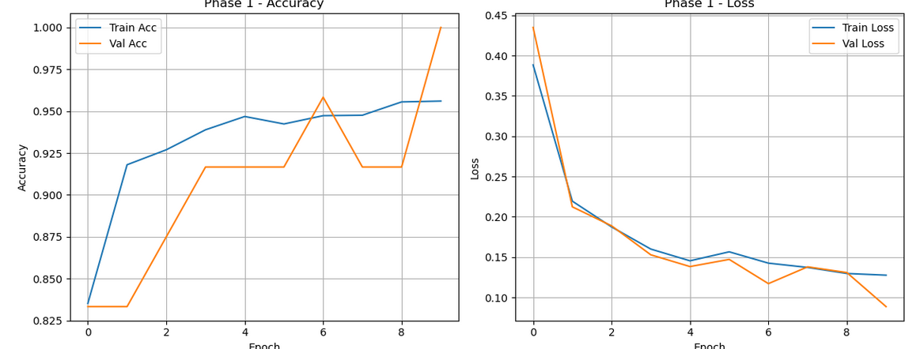
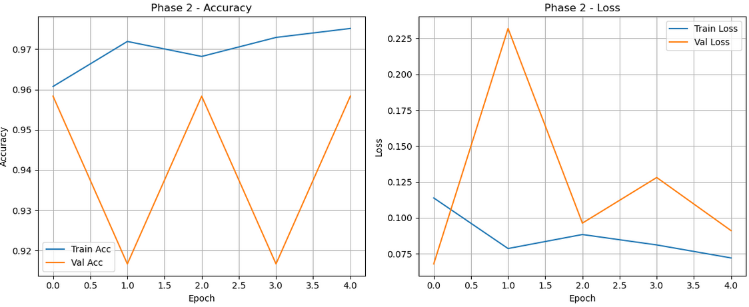
Phase1 Accuracy and Loss Graph
Phase2 Accuracy and Loss Graph

Slide 23
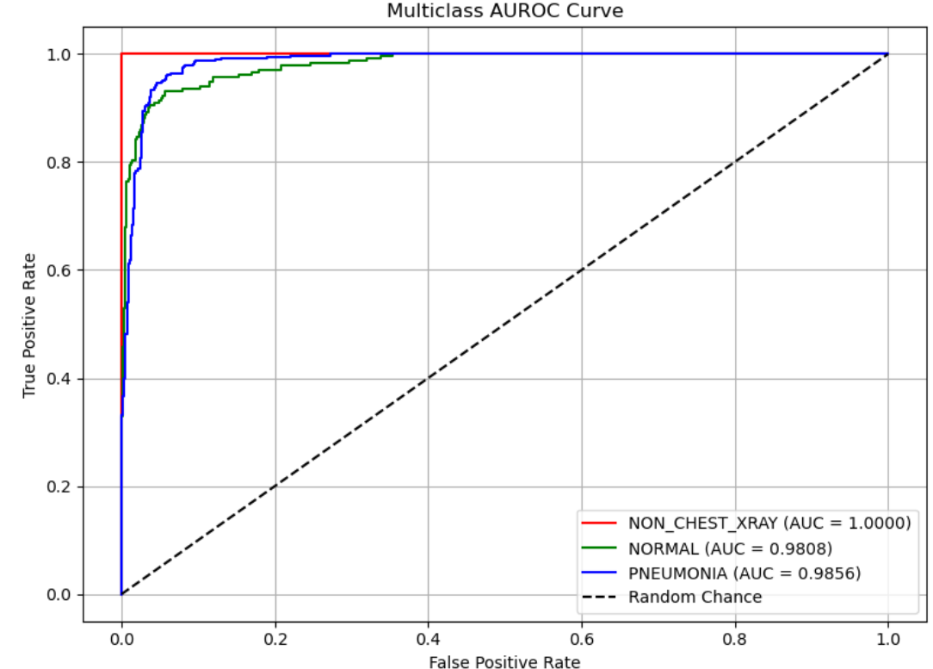
AUROC
AUROC is a useful metric for evaluating the overall discriminative power of the model. A value closer to 1 indicates excellent model performance

Slide 24
RESULTS AND DISCUSSIONS
The model was evaluated on a separate test set consisting of chest X-ray images to assess its generalization performance.
The model achieved 94% test accuracy, indicating that it performs well on unseen data and can accurately classify Normal, Pneumonia,Non-ChestXray cases.

Slide 25
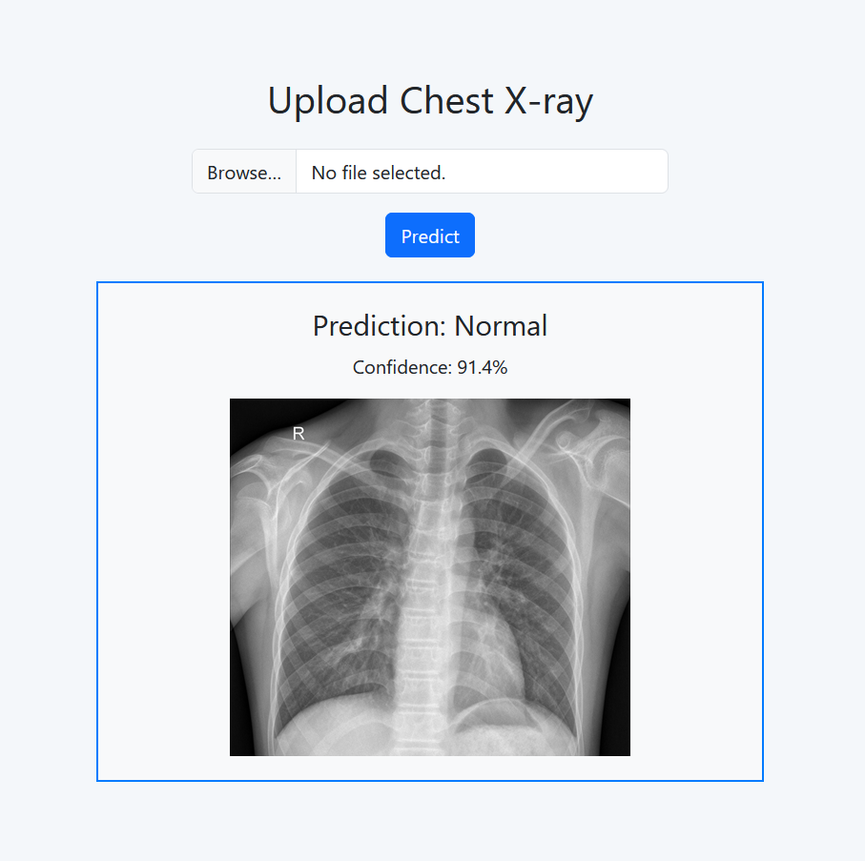
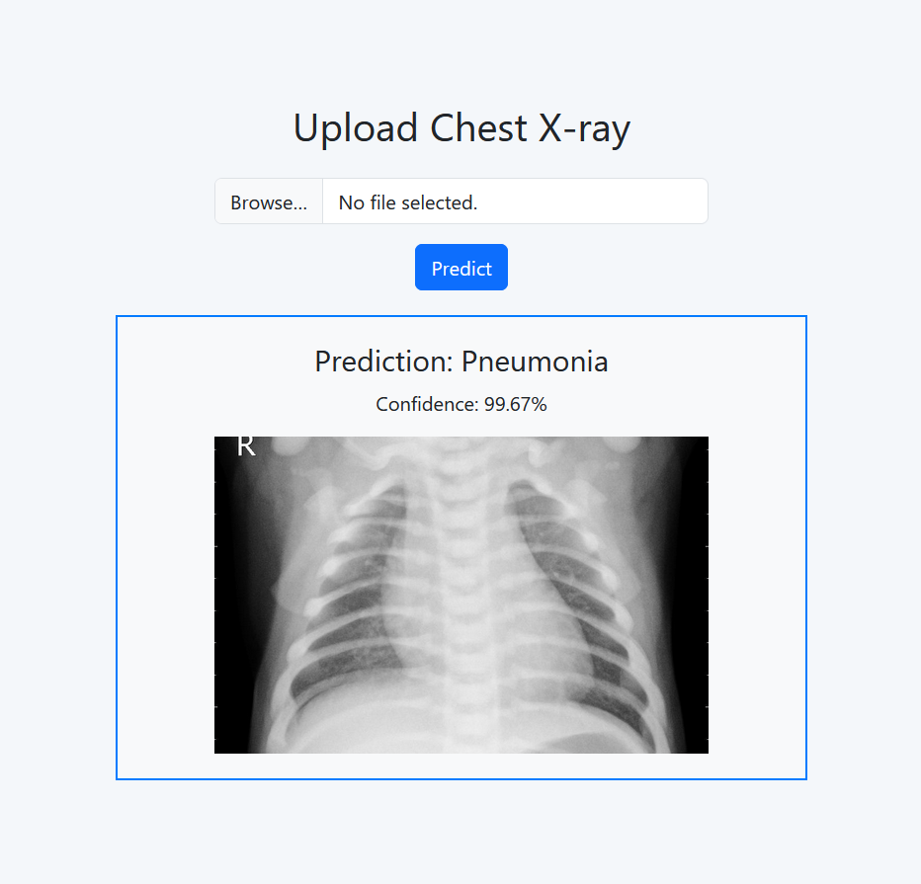

Slide 26
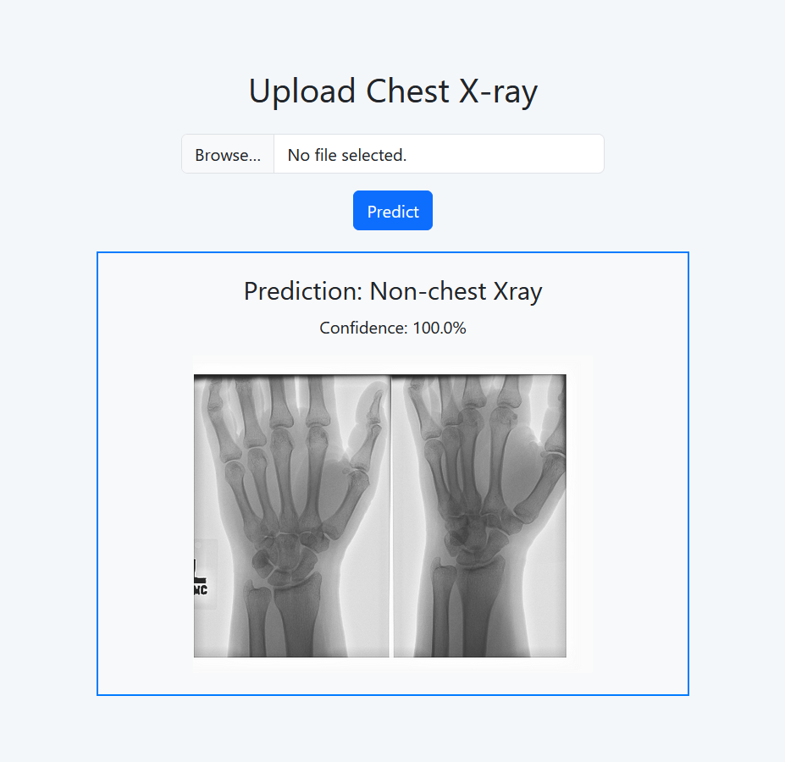
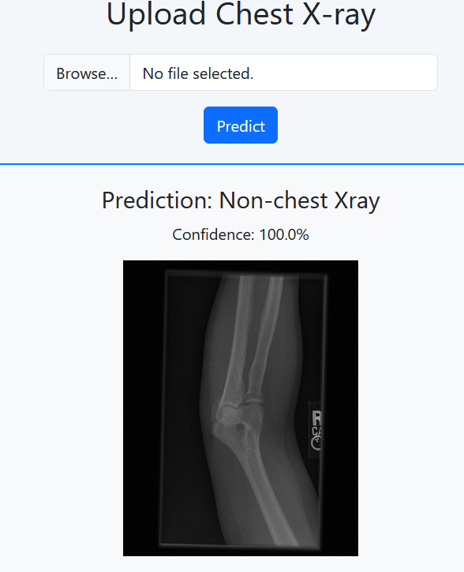
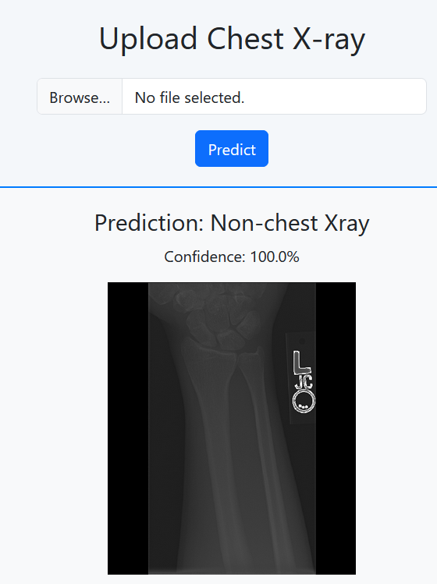

Slide 27
Precision for the pneumonia class was 89%, and recall was 97%, which means the model was highly effective in identifying pneumonia cases. For the normal class, the precision 94% and recall were both 80%, Non-ChestXray precision was 100% and recall was 100% indicating good performance
Final Testing Accuracy: 94%
"The model demonstrated excellent performance, accurately classifying X-ray images as either Normal, Pneumonia or Non-ChestXray."
The model achieved high precision in detecting pneumonia in chest X-rays, showcasing its reliable classification capability across test samples.

Slide 28
Integration with Flask Frontend: The model is integrated with a Flask-based web application for real-time pneumonia detection from chest X-ray images.
Real-Time User Interaction: Users can upload chest X-ray images, and the Flask application instantly processes the image to predict whether it indicates Normal ,Pneumonia,Non-ChestXray.
Applications: This interface is well-suited for medical diagnostics, providing rapid assistance in clinical settings to support healthcare professionals in identifying pneumonia cases efficiently.

Slide 29
Optimize the model with advanced hyperparameter tuning for better accuracy.
Expand the dataset for improved generalization across diverse conditions.
Implement explainable AI tools like Grad-CAM for enhanced transparency.
Develop a mobile application for remote diagnostics.
Integrate the system with healthcare platforms for streamlined patient management.
Extend the model to detect multiple respiratory conditions.
CONCLUSION AND FUTURE ENHAMCEMENT

Slide 30
Conclusion:
The pneumonia detection model leverages VGG19 and advanced techniques to provide accurate diagnostics. Its notable performance demonstrates potential for real-world applications, with future enhancements aimed at improving accessibility, reliability, and clinical integration.

Slide 31
REFERENCES
Krizhevsky, A., Sutskever, I., & Hinton, G. E. (2012). ImageNet Classification with Deep Convolutional Neural Networks. Communications of the ACM, 60(6), 84–90. https://doi.org/10.1145/3065386
He, K., Zhang, X., Ren, S., & Sun, J. (2016). Deep Residual Learning for Image Recognition. Proceedings of the IEEE Conference on Computer Vision and Pattern Recognition (CVPR), 770-778. https://doi.org/10.1109/CVPR.2016.90
Simonyan, K., & Zisserman, A. (2015). Very Deep Convolutional Networks for Large-Scale Image Recognition. arXiv preprint arXiv:1409.1556. https://arxiv.org/abs/1409.1556
Goodfellow, I., Bengio, Y., & Courville, A. (2016). Deep Learning. MIT Press. http://www.deeplearningbook.org
Chollet, F. (2017). Xception: Deep Learning with Depthwise Separable Convolutions. Proceedings of the IEEE Conference on Computer Vision and Pattern Recognition (CVPR), 1251–1258. https://doi.org/10.1109/CVPR.2017.195
Russakovsky, O., Deng, J., Su, H., et al. (2015). ImageNet Large Scale Visual Recognition Challenge. International Journal of Computer Vision (IJCV), 115(3), 211–252. https://doi.org/10.1007/s11263-015-0816-y

Slide 32
THANK YOU

