Slide 1
Lung Cancer Detection using CNN
IBM PROJECT BASED EXPERIENTIAL LEARNING (PBEL) PRESENTATION
Presenter : Raghav Joshi
Batch 8 : Artificial Intelligence (AI)
Registered email with IBM : raghavjoshi200314@gmail.com

Slide 2

Introduction to Project
In this project, I have used CNN to help automate the process of detecting Lung Cancer.
This helps detecting cancer faster, as each CT scan is scanned by the model and not a human, which will lessen the workload of professionals, although they still might need to verify some scans.
I have used CT scans as my model training data, as CT scans are mostly used for determining cancer cases.

Slide 3

Dataset
The dataset I have used contains CT scan images divided into 4 different classes: Adenocarcinoma, Large Cell Carcinoma, Squamous Cell Carcinoma and Normal.
The dataset is further split into train, validation and test folders, with each folder having CT scan images from all 4 classes.

Slide 4
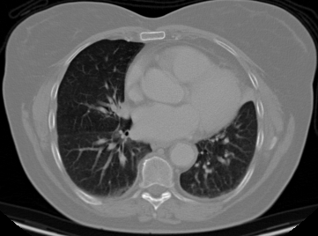
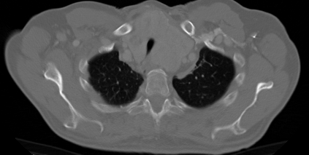
Adenocarcinoma
Large cell carcinoma

Slide 5
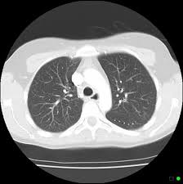
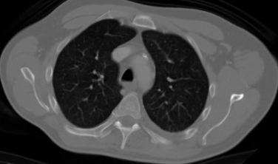
normal
Squamous cell carcinoma

Slide 6
Data Preprocessing
Steps done before training model:
Resized images to 224 × 224 pixels, to reduce size.
Normalize pixel values to 0‑1 by dividing by 255 pixels, which helps the neural network train more efficiently.
Loading dataset using TensorFlow.

Slide 7

CNN Model Architecture
Convolution layers – used for feature extraction
MaxPooling layers – used for dimensionality reduction
Flatten layer – convert features to vector (eg. From 3d to1d), for the dense layer
Dense layers – for classification
Softmax layer – this layer converts output into probability for each class

Slide 8
Model Training
Training performed using TensorFlow / Keras.
Optimizer used: Adam
Loss: Sparse Categorical Crossentropy
Training done for 10 epochs with validation dataset.

Slide 9
Model Performance
Final results obtained:
Training Accuracy ≈ 96%
Validation Accuracy ≈ 94%
Test Accuracy ≈ 93%
Model shows good ability to classify CT scan images.

Slide 10
Added Streamlit Web App Support
I have created a web interface using Streamlit for my project.
Users can upload CT scan images.
The model then predicts the cancer type and the confidence score along with a prediction graph is shown in streamlit app interface.

Slide 11
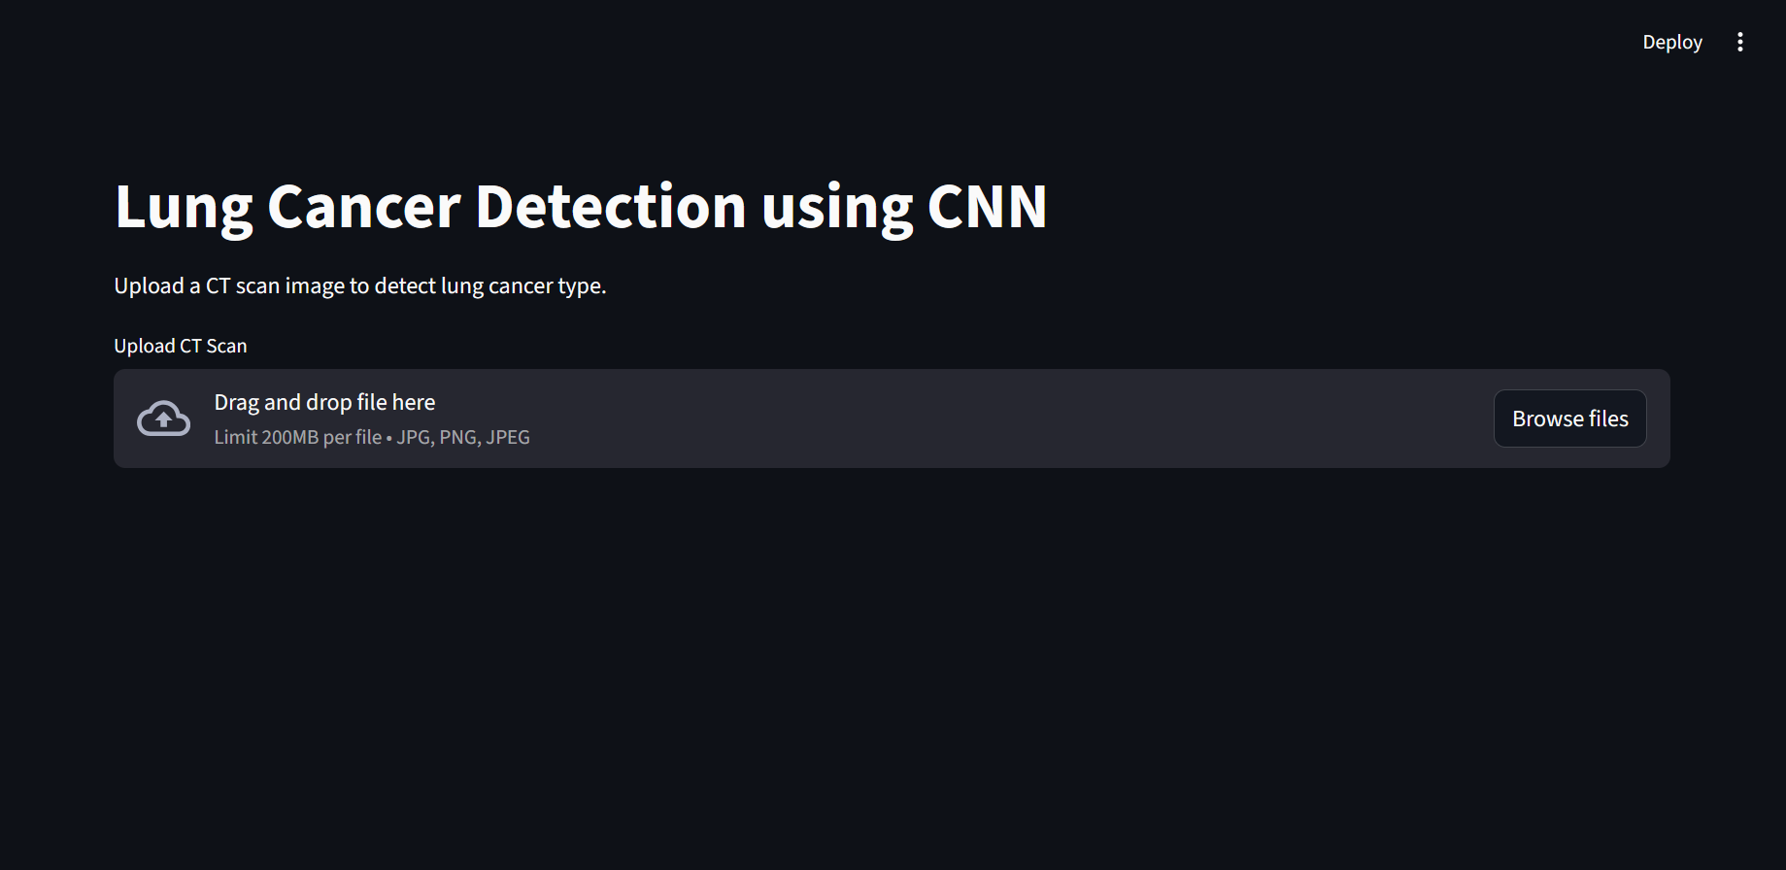
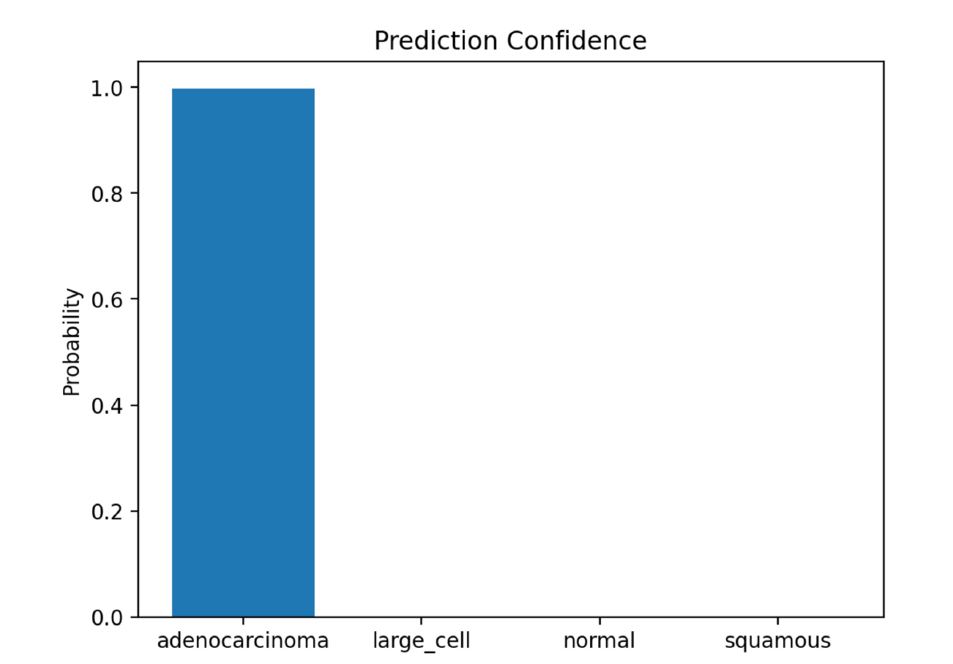
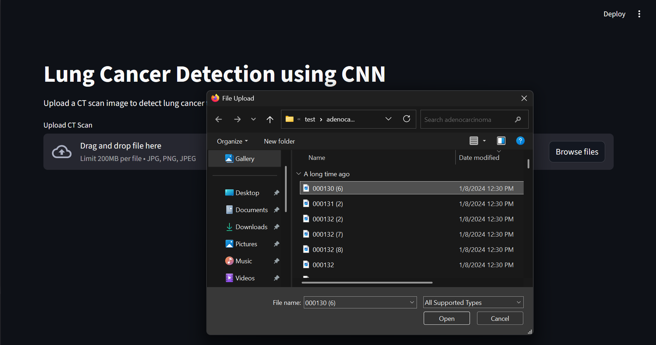
Streamlit App Screenshots and Prediction Graph

Slide 12
Conclusion
CNN can effectively classify lung CT scan images.
The Streamlit app gives an easy to use interface with real‑time predictions.
Future work: larger datasets can be used with improved architectures.

Slide 13
References
Dataset urls: https://www.kaggle.com/datasets/kabil007/lungcancer4types-imagedataset/data https://www.kaggle.com/datasets/ice778/comprehensive-lung-cancer-imaging-dataset-clid https://www.kaggle.com/datasets/mdnafeesimtiaz/ct-scan-images-of-lung-cancer

Slide 14

Thank you!

