Slide 1
Predicting the Walkability of Towns in America
By: Raghav Kamineni & Arnav Gupta
Notes:
-

Slide 2
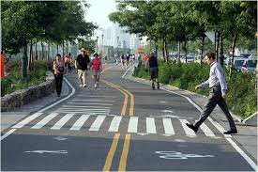
Project Statement
Walkability Index (WI) is the accessibility of amenities by walking, as mostly urban regions should be more than just transportation-dominated pathways.
WI is based on numerous broader factors
Housing Prices
Population and Land Density
Diversity of Land Utilization
Neighborhood Layouts and Designs
Location Accessibility
Transit Service
Employment
Individual Demographics
Knowing the WI of a region is important
Notes:
AG

Slide 3
Description of dataset
Dataset has 220,740 instances, 117 attributes; skewed to the right
Numerous attributes had over 70% missing and/or default values
Class attribute (WI) originally was quantitative continuous data from [1-20)
We plan to discretize and bin the class attribute as shown in the next slide
Dataset
Compiled by U.S. Environmental Protection Agency
Derived from Smart Location Database (Geographical Factors)
Notes:
RK

Slide 4
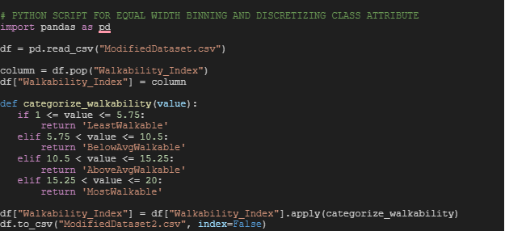
Preprocessing (Python)
Changed the class attribute within Excel to ‘NatWalkInd’
Discretized and binned class attribute
Class Distribution
66,989 instances for AboveAvgWalkable (30.3%)
74,795 instances for BelowAvgWalkable (33.9%)
25,630 instances for MostWalkable (11.6%)
53,326 instances for LeastWalkable (24.1%)
Notes:
AG

Slide 5
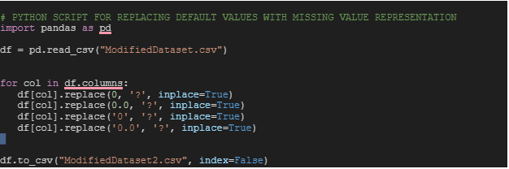
Preprocessing Cont’d (Python)
Changed default values to missing with Python
Removed attributes with more than 70% missing values
Filled in remaining attributes missing values with mean/mode
Left with 55 attributes
Notes:
RK

Slide 6
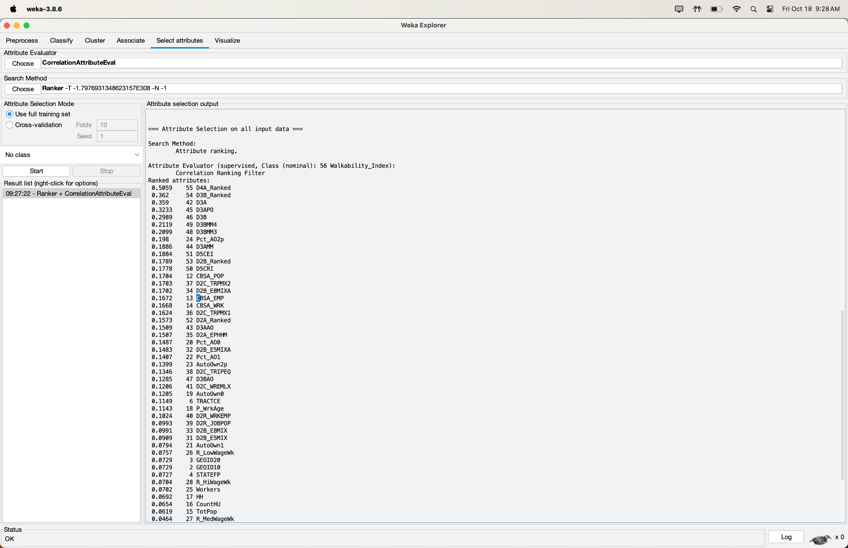
CorrelationAttributeEval
Used Threshold of >= .1
32 instances left
Notes:
AG

Slide 7
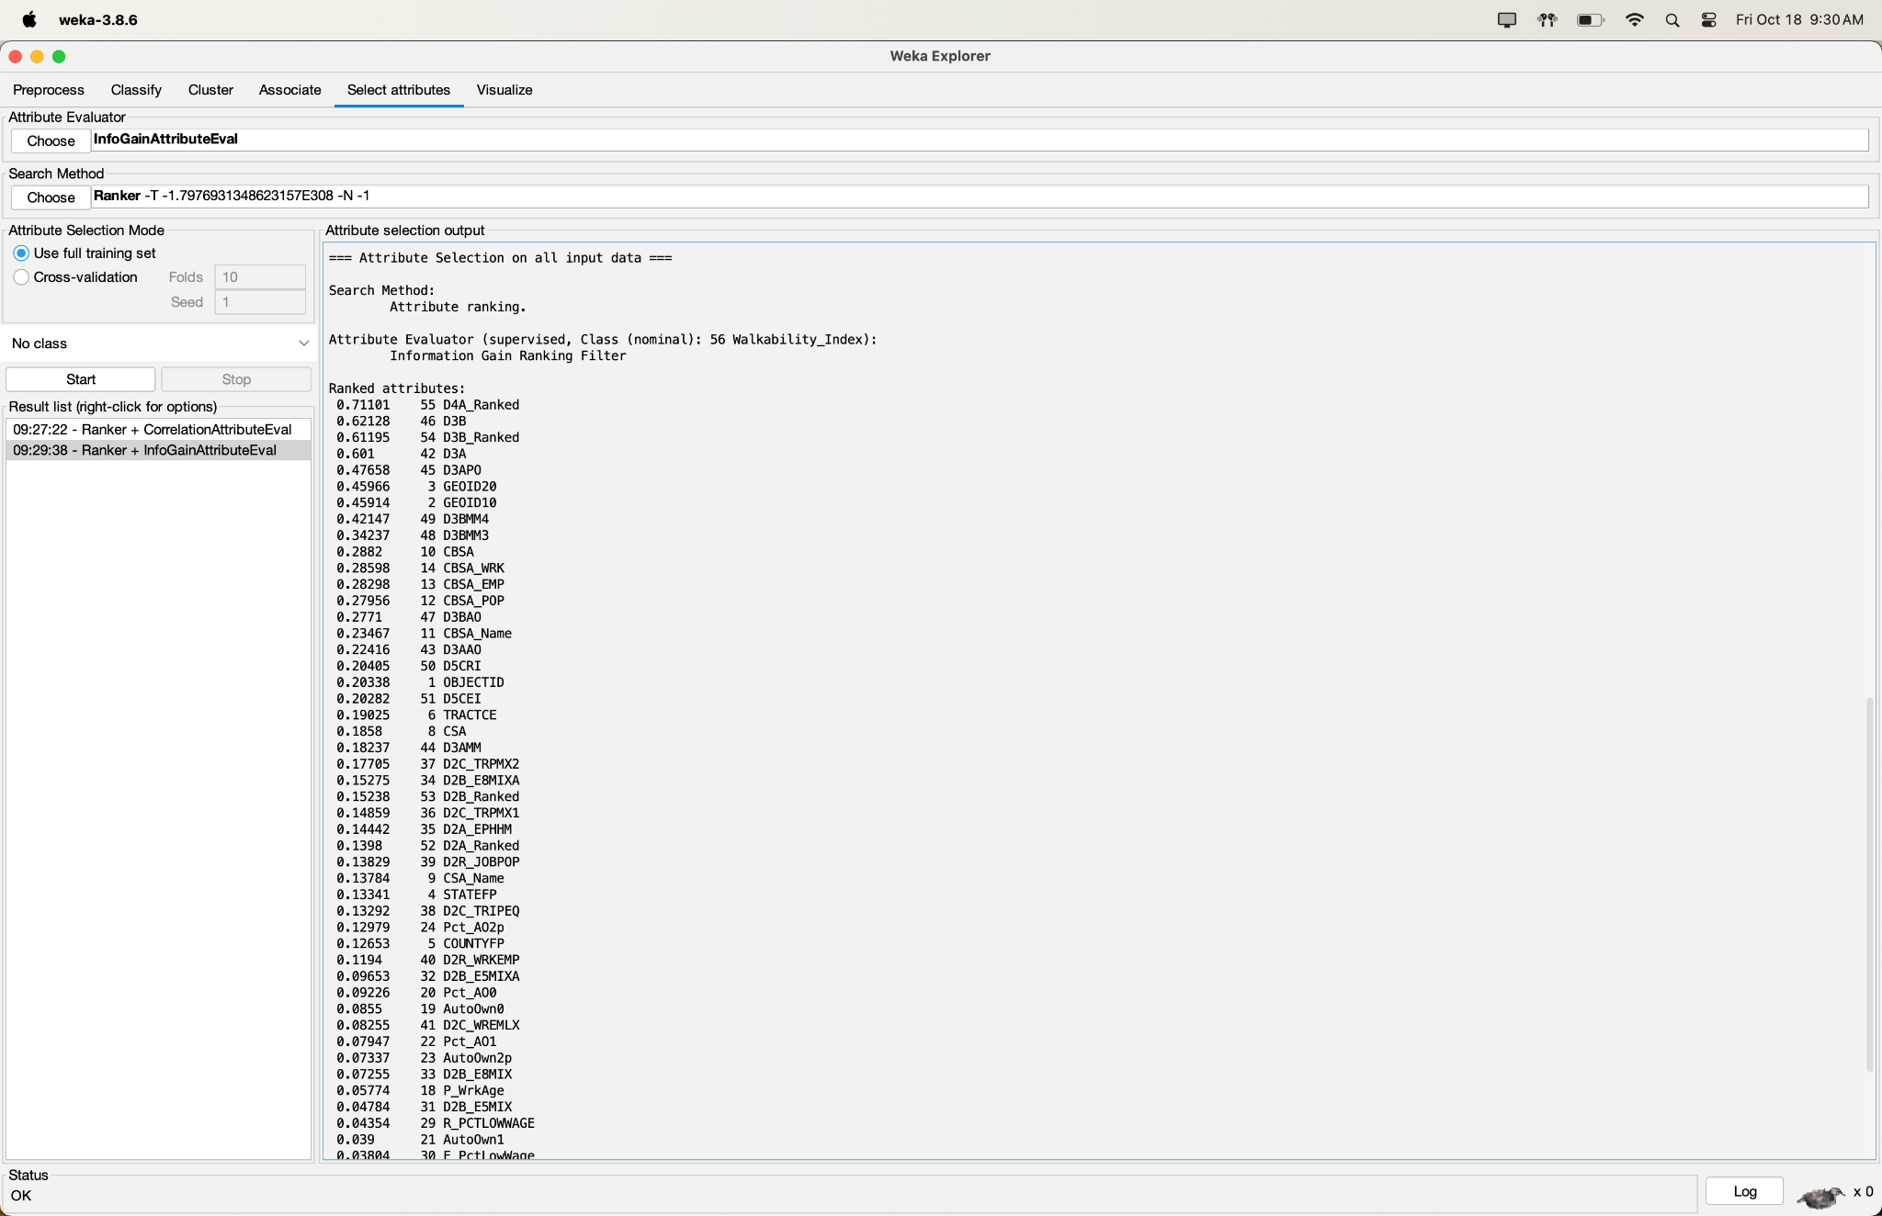
InfoGainAttributeEval
Used Threshold of >= .15
25 instances left
Notes:
RK

Slide 8
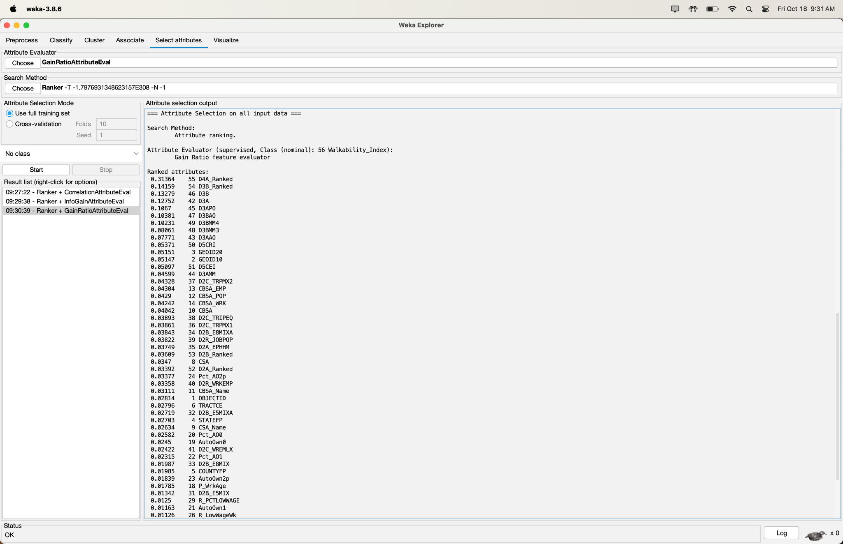
GainRatioAttributeEval
Used Threshold of >= .03
30 instances left
Notes:
AG

Slide 9
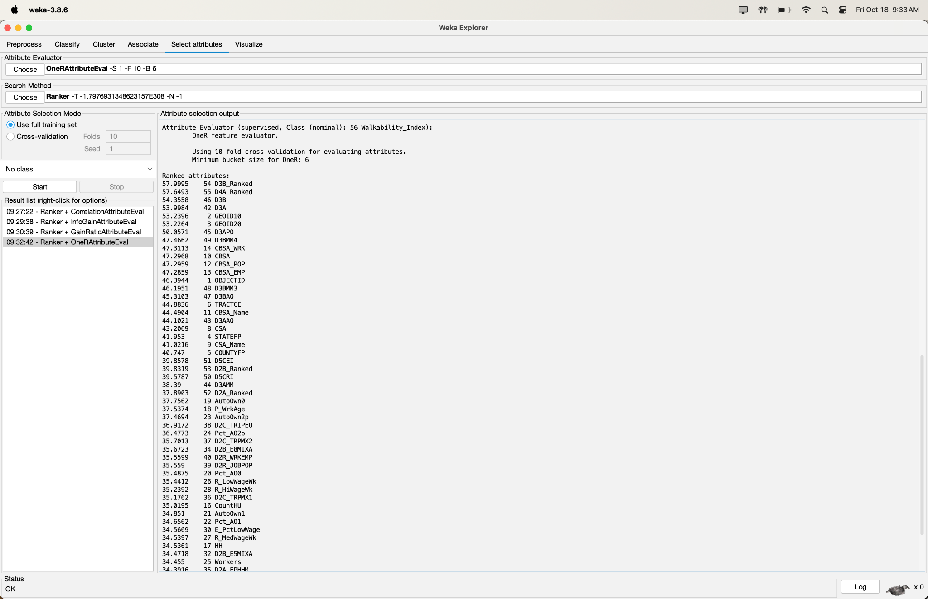
OneRAttributeEval
Used Threshold of >= 36
Min. 6 buckets
32 instances left
Notes:
RK

Slide 10
Independent Analysis
Combined the best attributes based on visual metrics in WEKA, such as value distributions and easily visible trends through a combination of the best attributes of the last four attribute selection algorithms.
Attribute list-> D4A_Ranked, D3B_Ranked, D3B, D3A, D3APO, D3BMM4, D3BMM3, Pct_AO2p, D5CEI, D2B_Ranked, CBSA_POP, D2C_TRPMX2, D2B_E8MIXA, CBSA_EMP, CBSA_WRK, D3BAO, D3AAO, D5CRI, D3AMM, D2C_TRIPEQ, D2R_WRKEMP, TRACTCE, CBSA_Name, CSA, AutoOwn0, and P_WrkAge.
26 instances left
Notes:
RK

Slide 11
Classifier Models
Naive Bayes (Bayes)
Probabilistic classifier model based on Bayes Theorem (Conditional Probabilities) and feature-independent accuracy tests
OneR (Rules)
Simpler probabilistic rule-based classifier model that uses a single rule from only the most informative attribute
J48 (Trees)
Decision tree algorithm that builds tree based on splitting data by attribute values to classify instances through comprehensive training
RandomForest (Trees)
Builds multiple decision trees during long training period and effectively captures general trends to prevent model overfitting
Notes:
AG

Slide 12
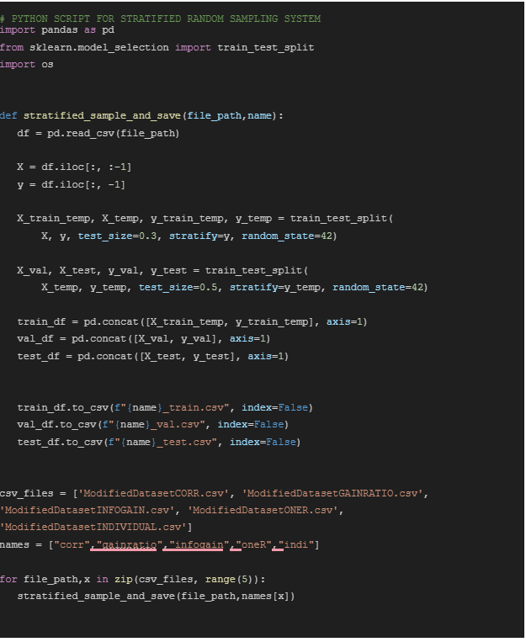
Training/Validation/Test Sets
Utilized Python script to implement the Stratified Random Sampling technique due to uneven class distributions
Split Data into Training/Validation/Testing
Training: 70%
Validation: 15%
Testing: 15%
Created 15 files (five attribute selection algorithms and one training, validation, and testing dataset for each)
Class Distribution preserved
Notes:
RK

Slide 13
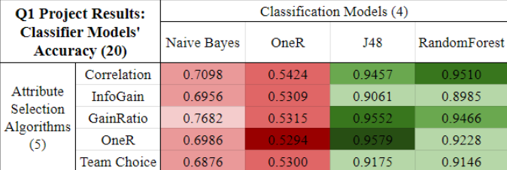
Results (All 20 Models)
Notes:
AG

Slide 14
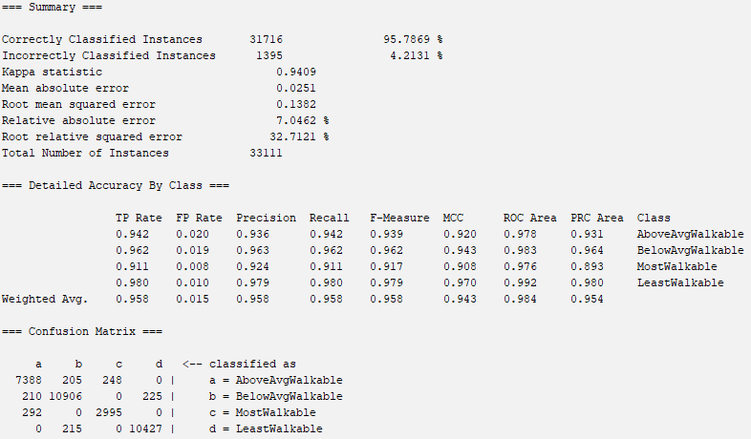
Results (Best Model)
OneR AttributeEval + J48 Classifier Model
Notes:
AG

Slide 15
Discussion and Conclusion
Successes
Preprocessed data through Python and WEKA
Conducted attribute selection algorithms in WEKA
Tested classifier models with high accuracy
Best Model: OneR AttributeEval + J48 Classifier (95.79% accuracy)
Future Improvements
Conduct PCA to reduce attributes
Increase thresholds for attribute selection algorithms
Optimize validation data effectiveness towards models
Research best classifier models for our project type
Notes:
RK

Slide 16
Sources and Acknowledgements
Dataset: https://catalog.data.gov/dataset/walkability-index7 (Walkability Index dataset courtesy of U.S. Environmental Protection Agency)
Softwares: VSCode (Python) and WEKA
We’d like to thank the U.S. Environmental Protection Agency for compiling the dataset, and especially John Thomas for allowing public use of the dataset.
Thank you.
Notes:
AG

