Slide 1


My Data My Story
Name - Raghav Mehta
Reg. No. 12319917
Roll No 11
Section DE237
Submitted for the Mini Project #3 of CAP776

Slide 2
Context Setting
Intuition
Tracking sleep hours helps everyone understand daily rest patterns and reveals differences between weekday and weekend sleep
Objective
Capturing sleep pattern data provides insights into inconsistencies between weekday and weekend rest, enabling adjustments for improved health and energy
Challenges
Missing Values, Date-Time format and Weekend weekday segregation.
Submitted for the Mini Project #3 of CAP776
Name: Raghav Mehta Reg. No. 12319917 Section: DE327

Slide 3
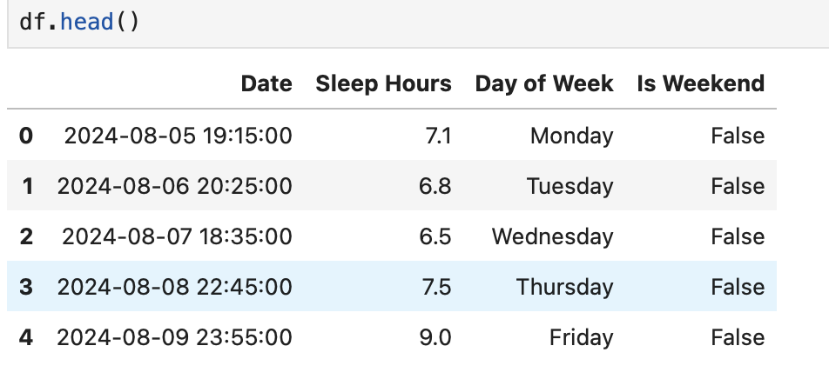
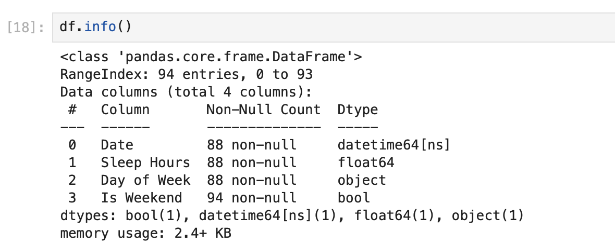
The data captured
Data description
df.head() and df.info()
Submitted for the Mini Project #3 of CAP776
Name: Raghav Mehta Reg. No. 12319917 Section: DE327

Slide 4
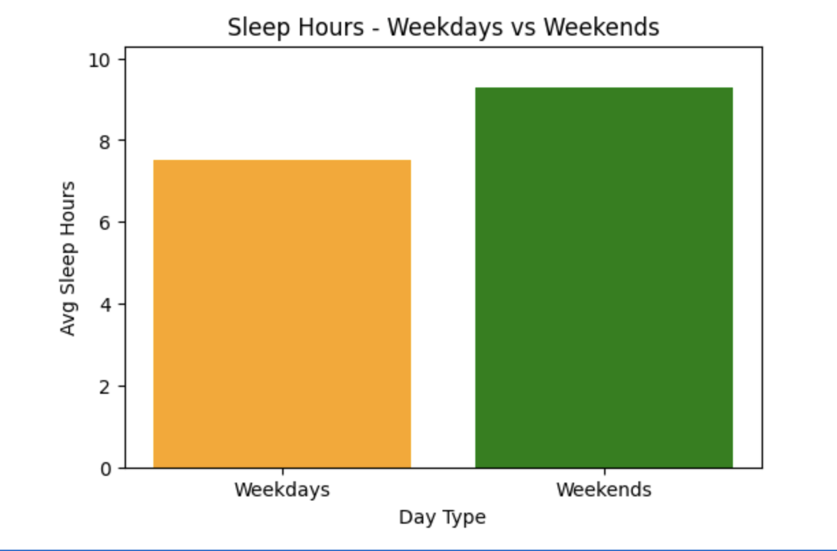
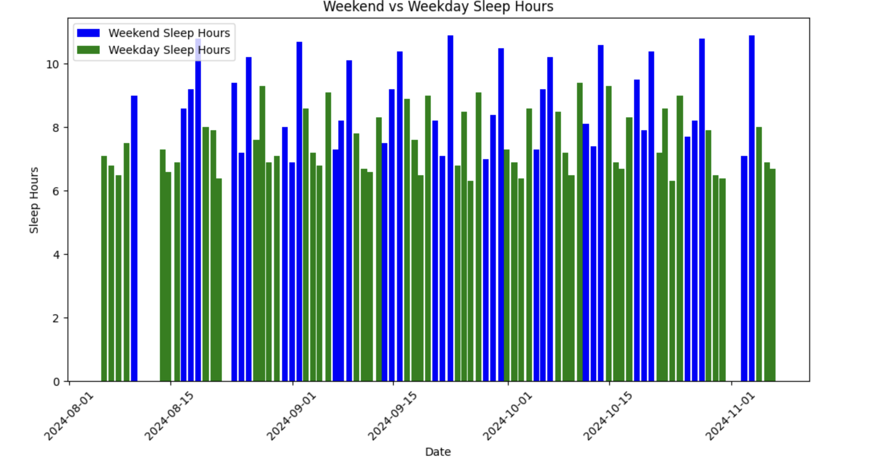
Story board #1
Graphical representation of data
Submitted for the Mini Project #3 of CAP776
Name: Raghav Mehta Reg. No. 12319917 Section: DE327

Slide 5
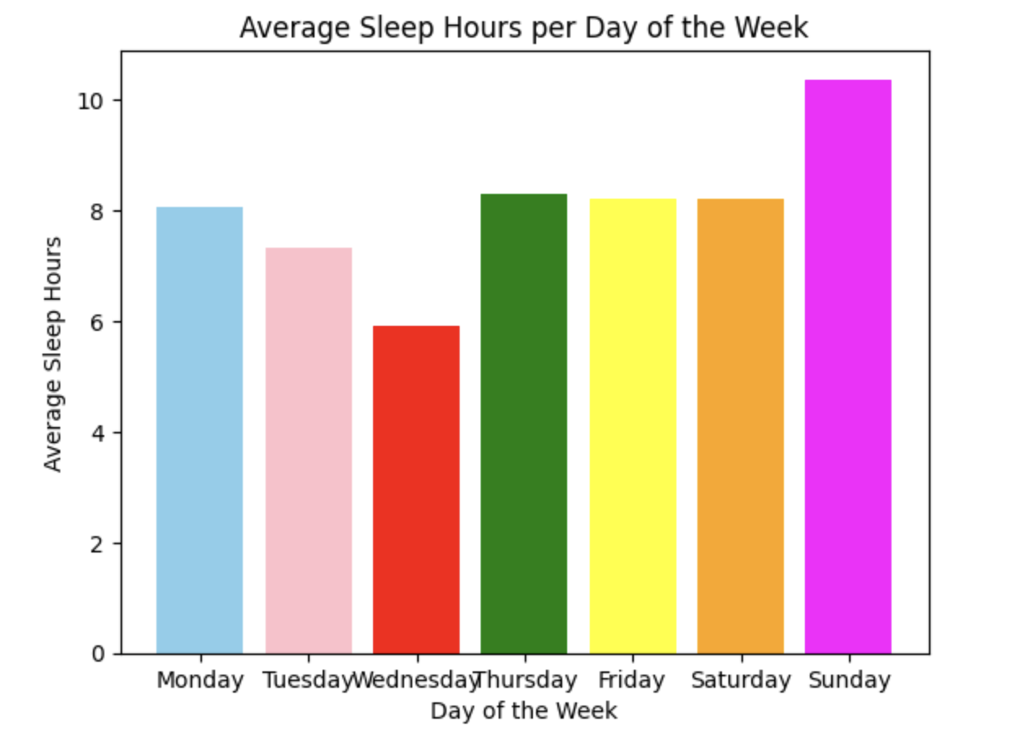
Story board #2
Graphical representation of data
Submitted for the Mini Project #3 of CAP776
Name: Raghav Mehta Reg. No. 12319917 Section: DE327

Slide 6
Inferences drawn
Conclusions:
1.The analysis shows that sleep hours are generally higher on weekends, likely due to reduced work stress.
2.On weekdays, sleep hours tend to fluctuate, reflecting the pressure of work and daily responsibilities.
3.Wednesdays consistently show the least amount of sleep, likely due to a heavier class or work schedule
4.Prioritizing sleep during weekdays is crucial for health and performance
The data underlines the importance of prioritizing sleep during weekdays, as consistent sleep deprivation can have negative effects on health, cognitive function, and overall performance. Balancing work and rest is crucial for long-term well-being.
Submitted for the Mini Project #3 of CAP776
Name: Raghav Mehta Reg. No. 12319917 Section: DE327

Slide 7
Future scope [Optional]
If given an opportunity, how would you utilize this learning in the future?
In the future, I would use the insights from this analysis to better manage my time, prioritize sleep, and improve overall well-being. By recognizing patterns in sleep across weekdays and weekends, I can optimize my schedule for better health and productivity. Additionally, I would apply data-driven decision-making to balance work, study, and rest, ensuring improved performance in both academic and professional settings.
Submitted for the Mini Project #3 of CAP776
Name: Raghav Mehta Reg. No. 12319917 Section: DE327

Slide 8
Thank You!
Submitted for the Mini Project #3 of CAP776
Name: Raghav Mehta Reg. No. 12319917 Section: DE327

