Slide 1
INTERNAL STRATEGY REVIEW · APRIL 2026
Digital Shelf
Impact Measurement
Closing the attribution gap between media spend and shelf outcomes on Walmart
For: Sales Leadership · CXO · Engineering Leads
Agenda: Competitive landscape · GTM plan · Productization roadmap · Risks · Q2–Q3 KRAs
CONFIDENTIAL

Slide 2
The Market Has Moved. Measurement Hasn't.
Retail media crossed $45B in 2025. Most brands still report success with platform-attributed ROAS — a number the platform controls.
$45B+
71%
1 of 3
US retail media
spend in 2025
of advertisers name
incrementality as top KPI
market categories
remains uncontested
Walmart: $4.5B+ of that
Yet most still measure via platform ROAS
Shelf-native diagnostic — DataWeave's space
The structural gap: brands running Walmart Connect campaigns can measure ROAS. They cannot measure whether that ROAS reflects truly incremental sales — or whether an availability issue, low Share of Search, or poor content silently suppressed the lift they paid for.

Slide 3
Three-Way Competitive Split (2026)
Activation-Led
Campaign Measurement
Shelf-Native Diagnostic
CommerceIQ, Pacvue
Incremental.com, Skai
DataWeave DSIM
Optimize bids right now
Did this generate net-new sales?
Why did it work? What constrained it?
DSIM occupies the uncontested quadrant: vendor-neutral measurement where shelf signals (OSA, SoS, content) are first-class inputs alongside media spend — and localized to store clusters, not just channel-level.

Slide 4
Lactalis PoC: Proof of Impact
91%
5.9%
$30K+
R² / Model Fit
MAPE / Accuracy
Daily Reallocation
17
78%
+12%
Store Clusters
Peak OSA
Adult Halo Lift
The PoC validates shelf-signal integration into incrementality models. Kids/Baby category showed +12% incremental lift in Adult segment, proving category halo effect — a lever CommerceIQ and Pacvue cannot decompose.

Slide 5
Incremental ROI by Channel (Lactalis)
Offsite Display shows strongest incremental return. Onsite Search consuming 63% of budget despite weakest iROI — prime reallocation opportunity.

Slide 6
Defensible Positioning vs. Activation Players
Channel Conflict?
DataWeave:
None
Competitors:
Tied to own bids
Shelf Signals as Levers?
DataWeave:
First-class inputs
Competitors:
Secondary signals
Store-Cluster Decomposition?
DataWeave:
Yes — 17 clusters tested
Competitors:
No — channel-level only
CFO-Ready Output?
DataWeave:
Attribution + reallocation recommendations
Competitors:
Optimization suggestions

Slide 7
6-Month GTM: Services-Led, Tableau Delivery
Q2 2026
Q3 2026
Q4 2026
Beta Launch
5 Pilot Accounts
Automated Model Run
Lactalis + 1-2 fast followers
Tableau dashboards, weekly QBRs
Transition to product, scale to 20+ accounts
ICP: RGM personas at CPG brands ($500M+ revenue, active on Walmart). Lead with Lactalis success case; deliver PoC via Tableau before productization.

Slide 8
Four-Phase Productization (P0→P3)
P0: Services-Led
Now–Q3
Lactalis PoC + fast-follower betas
$50–75K per PoC
P1: Automated Model
Q4 2026
Weekly refreshes, zero-touch data ingestion
$150–200K annual
P2: Native Dashboard
Q1–Q2 2027
Built-in Tableau + real-time shelf signals
$250–400K enterprise
P3: Reallocation Simulator
2027+
What-if spend/content/shelf changes
Net-new upsell motion

Slide 9
Risk Register & Mitigations
Data Security / Privacy
HIGH
SOC 2 Type II certification; Walmart data governance review
Walmart API Changes
MEDIUM
Leverage Incremental.com's official API partnership
Brand Buy-in on Methodology
MEDIUM
Lactalis case study + peer references by Q3
Productization Timeline Slip
MEDIUM
Fallback: extend Tableau services model

Slide 10
Q2–Q3 2026 Key Result Areas
Close Lactalis PoC
Land 2 Fast-Follower Betas
Target: Validated model by June 30
Target: Signed pilots by end of Q2
Owner: Product + Eng
Owner: Sales + CS
Productization Design
Build Competitive Case Studies
Target: P1 spec complete by Aug 31
Target: Lactalis + 1 more by Aug 31
Owner: Product
Owner: Marketing

Slide 11
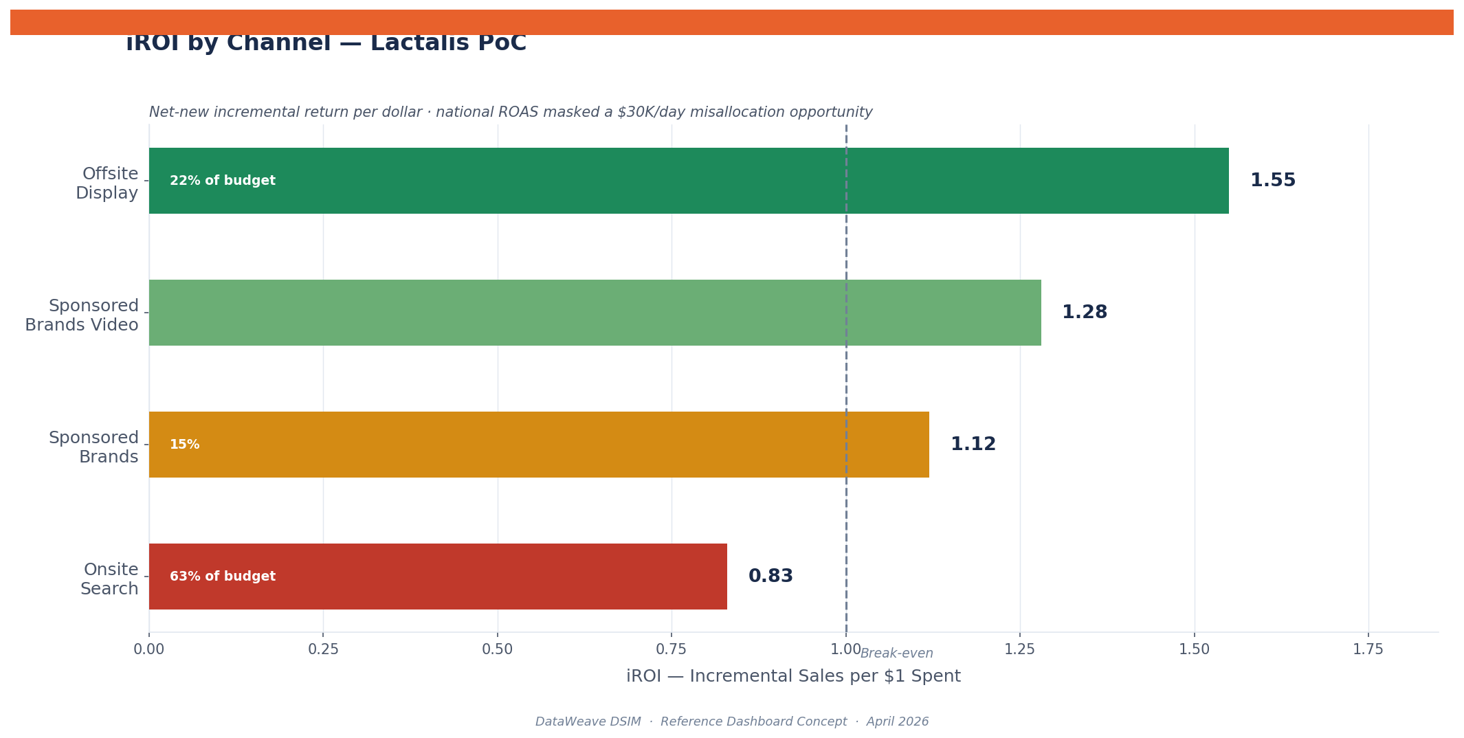
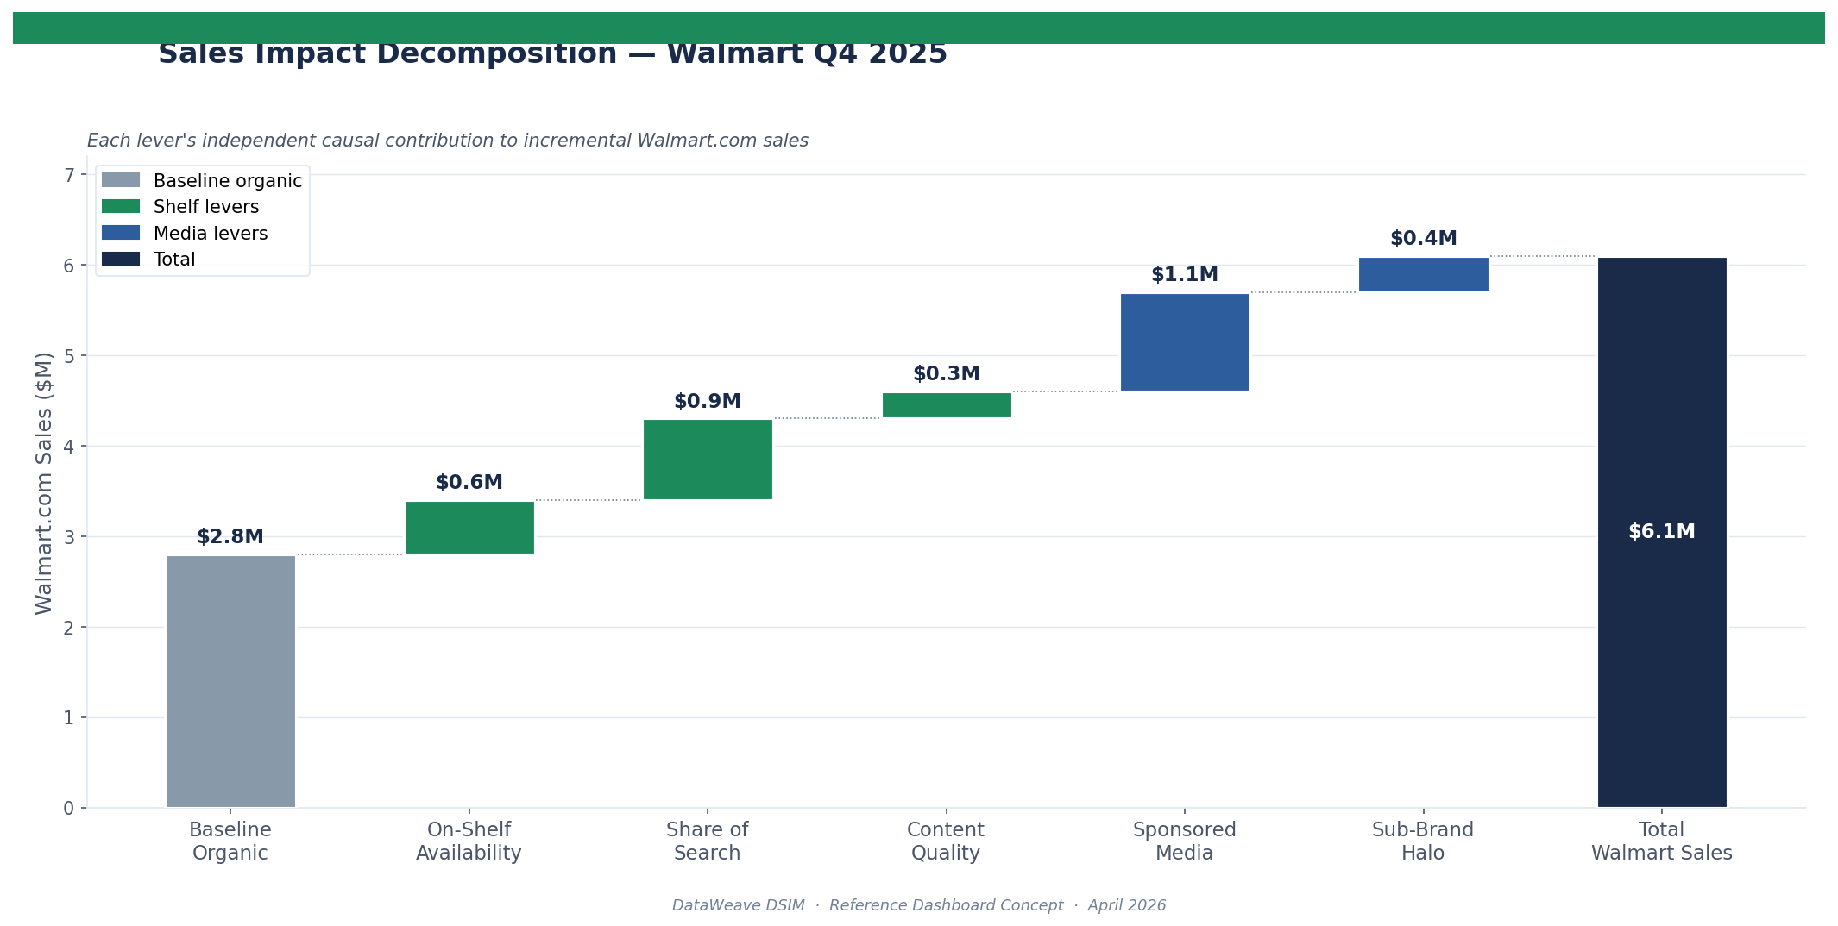
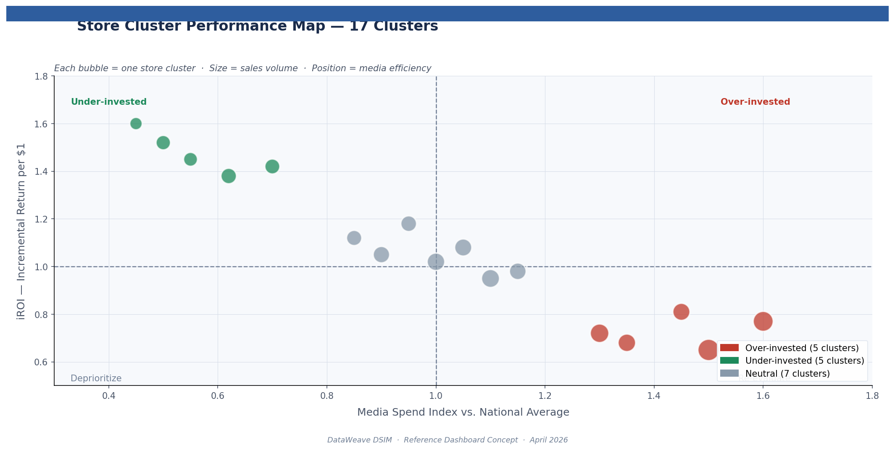
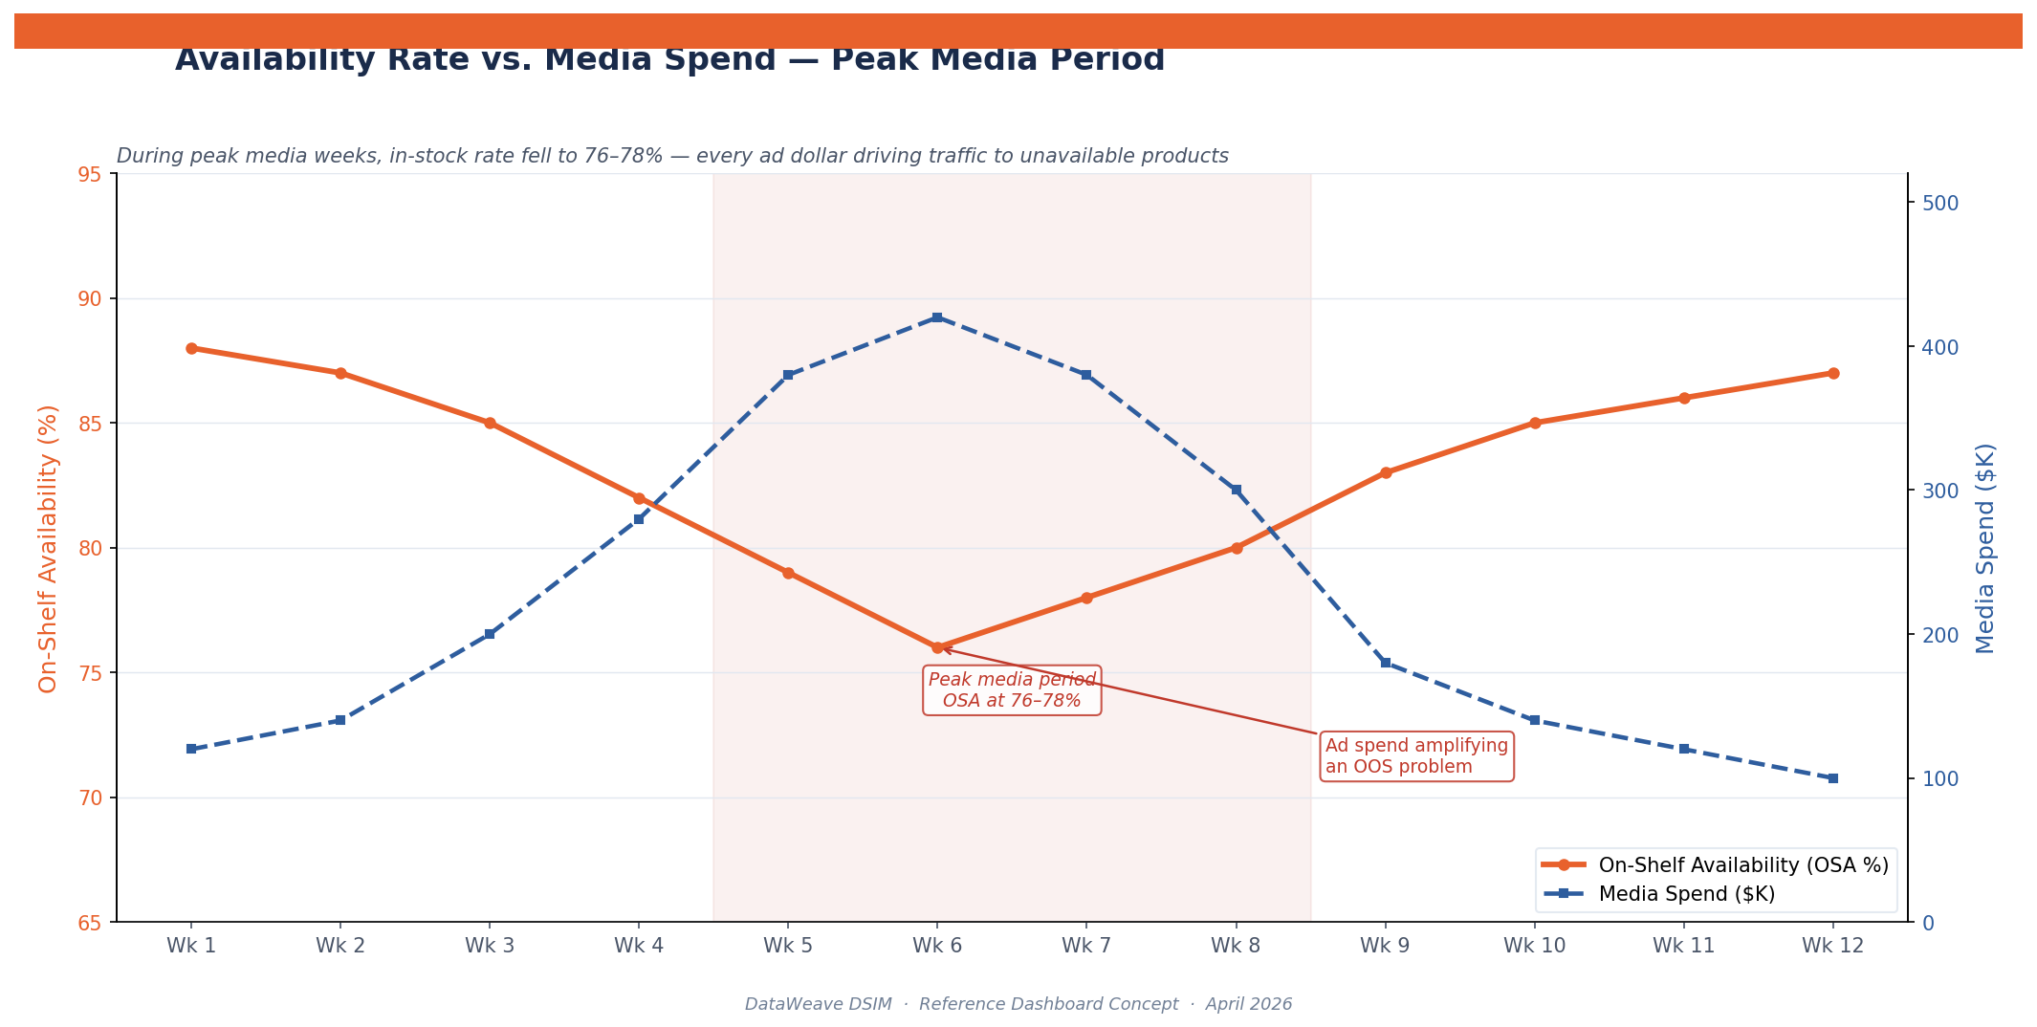
Supplemental: DSIM Model Infographics
Lactalis PoC — Key Visualizations
Incremental ROI by Channel
Impact Waterfall ($2.8M→$6.1M)
Store Cluster Allocation (17 clusters)
Availability vs. Media Spend
CONFIDENTIAL — For internal stakeholder review only

