Slide 1
INTERNAL STRATEGY REVIEW · APRIL 2026
Digital Shelf
Impact Measurement
Closing the attribution gap between media spend and shelf outcomes on Walmart
For: Sales Leadership · CXO · Engineering Leads
Agenda: Competitive landscape · GTM plan · Productization roadmap · Risks · Q2–Q3 KRAs
CONFIDENTIAL

Slide 2
The Market Has Moved. Measurement Hasn't.
Retail media crossed $45B in 2025. Most brands still report success with platform-attributed ROAS — a number the platform controls.
$45B+
75%
1 of 3
US retail media
spend in 2025
of CPG advertisers name
incrementality as #1 challenge
market categories
remains uncontested
Walmart: $4.5B+ of that
Only 20% can actually act on it (Skai 2026 survey)
Shelf-native diagnostic — DataWeave's space
The structural gap: CommerceIQ launched a standalone Incrementality Module in Dec 2025 — observational model, 14-day window, no shelf signals. Pacvue's console is Amazon-first; Walmart store-cluster coverage unconfirmed. Neither can tell a brand whether a 72% in-stock rate or a content gap capped the lift they paid $1M+ to generate.

Slide 3
Three-Way Competitive Split (2026)
Activation-Led
Campaign Measurement
Shelf-Native Diagnostic
CommerceIQ · Pacvue · Skai
Incremental.com · Walmart Connect
DataWeave DSIM (uncontested)
Grade their own media spend. CIQ: observational model, 14-day window, no holdout. Pacvue: Amazon-first, Walmart store-cluster unconfirmed. Conflict: they measure what they sell.
Did media generate net-new sales? Shelf signals used as noise to remove — not as outputs. No store-cluster decomposition. Incremental.com: WPP Connected Partner; Walmart coverage since July 2024.
Why did it work? Which of 6 shelf + media levers drove lift — at the store-cluster level? Shelf signals are the deliverable, not a confounder. No activation stake. Published 5.9% MAPE, R²=91%.
DSIM occupies the uncontested quadrant. No activation platform (CommerceIQ, Pacvue, Skai) offers Walmart store-cluster localization. No measurement platform (Incremental.com, Walmart Connect) surfaces shelf signals as actionable outputs. Profitero monitors — it does not attribute. DSIM is the only model that answers: which shelf lever constrained the lift I paid for, and where?

Slide 4
Who Buys DSIM — Three Entry Points
Positioning: Option B — Sales decomposition (which lever drove Walmart sales, at the store cluster level)
eCommerce /
Retail Media Lead
Finance /
RGM Leader
Brand /
Category Manager
Owns:
Walmart Connect budget
($500K–$5M+/yr)
Owns:
Budget approval, trade spend,
JBP financial commitments
Owns:
Brand P&L, promotional calendar,
competitive response
Pain today:
Pain today:
Pain today:
ROAS dropped. Doesn't know if it's a media problem or a shelf problem (72% in-stock eating impressions).
eCommerce asks for more Walmart Connect budget. No independent data to verify if it's justified or if a shelf fix would cost less.
NielsenIQ tells them a competitor took 2 points of share — 6 weeks after it happened. Can't connect shelf signals to dollar impact.
DSIM gives them:
DSIM gives them:
DSIM gives them:
Shows which lever (availability, SoS, content, media) drove or capped the last campaign — and which clusters to fix first.
Vendor-neutral audit: is the constraint media spend or in-stock rate? The number the CFO can defend — not platform ROAS.
Quantifies what a competitor's SoS gain is worth in weekly lost sales — by store cluster. Early enough to respond.
“Your ROAS is what the platform says happened. DSIM shows what actually drove the sale.”
“Before approving the next Walmart Connect request, know whether the bottleneck is media or shelf.”
“By the time Nielsen tells you a competitor took share, it happened 6 weeks ago. DSIM shows the signal that preceded it.”

Slide 5
Lactalis PoC: Proof of Impact
91%
5.9%
$30K+
R² / Model Fit
MAPE / Accuracy
Daily Reallocation
17
78%
+12%
Store Clusters
Peak OSA
Adult Halo Lift
The PoC validates shelf-signal integration into incrementality models. Kids/Baby category showed +12% incremental lift in Adult segment, proving category halo effect — a lever CommerceIQ and Pacvue cannot decompose, and one that Incremental.com would strip out as a confounder rather than surface as an opportunity.

Slide 6
Incremental ROI by Channel (Lactalis)
Offsite Display shows strongest incremental return. Onsite Search consuming 63% of budget despite weakest iROI — prime reallocation opportunity.

Slide 7
Defensible Positioning vs. Activation Players
Channel Conflict?
DataWeave:
None
Competitors:
Tied to own bids
Shelf Signals as Levers?
DataWeave:
First-class inputs
Competitors:
Secondary signals
Store-Cluster Decomposition?
DataWeave:
Yes — 17 clusters tested
Competitors:
No — channel-level only
CFO-Ready Output?
DataWeave:
Attribution + reallocation recommendations
Competitors:
Optimization suggestions

Slide 8
6-Month GTM: Services-Led, Tableau Delivery
Q2 2026
Q3 2026
Q4 2026
Beta Launch
5 Pilot Accounts
Automated Model Run
Lactalis + 1-2 fast followers
Tableau dashboards, weekly QBRs
Transition to product, scale to 20+ accounts
ICP: RGM personas at CPG brands ($500M+ revenue, active on Walmart). Lead with Lactalis success case; deliver PoC via Tableau before productization.

Slide 9
Four-Phase Productization (P0→P3)
P0: Services-Led
Now–Q3
Lactalis PoC + fast-follower betas
$50–75K per PoC
P1: Automated Model
Q4 2026
Weekly refreshes, zero-touch data ingestion
$150–200K annual
P2: Native Dashboard
Q1–Q2 2027
Built-in Tableau + real-time shelf signals
$250–400K enterprise
P3: Reallocation Simulator
2027+
What-if spend/content/shelf changes
Net-new upsell motion

Slide 10
Risk Register & Mitigations
Data Security / Privacy
HIGH
SOC 2 Type II certification; Walmart data governance review
Walmart API Changes
MEDIUM
Leverage Incremental.com's official API partnership
Brand Buy-in on Methodology
MEDIUM
Lactalis case study + peer references by Q3
Productization Timeline Slip
MEDIUM
Fallback: extend Tableau services model

Slide 11
Q2–Q3 2026 Key Result Areas
Close Lactalis PoC
Land 2 Fast-Follower Betas
Target: Validated model by June 30
Target: Signed pilots by end of Q2
Owner: Product + Eng
Owner: Sales + CS
Productization Design
Build Competitive Case Studies
Target: P1 spec complete by Aug 31
Target: Lactalis + 1 more by Aug 31
Owner: Product
Owner: Marketing

Slide 12
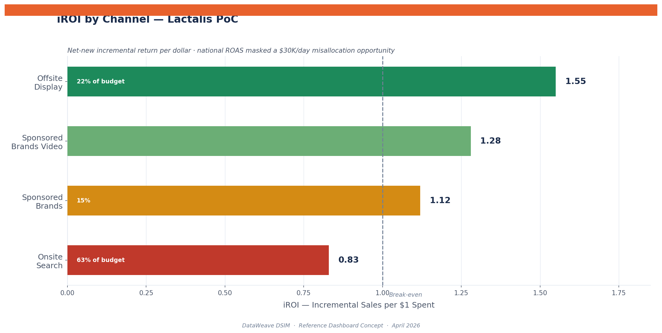
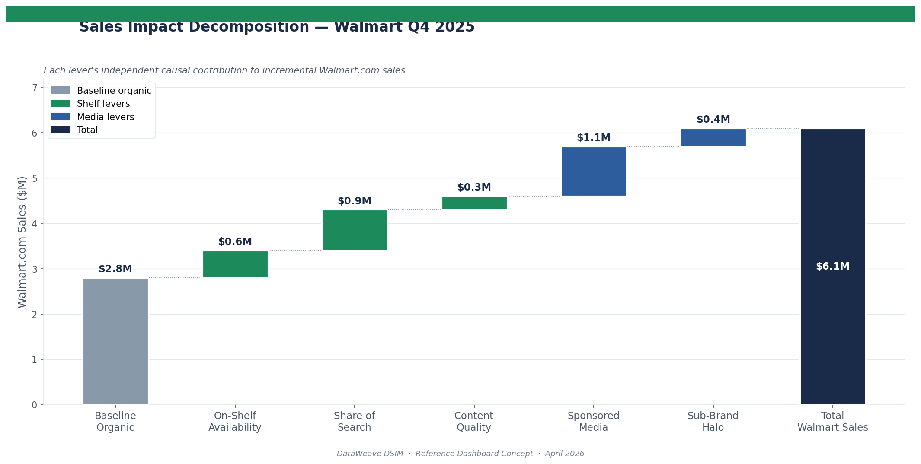
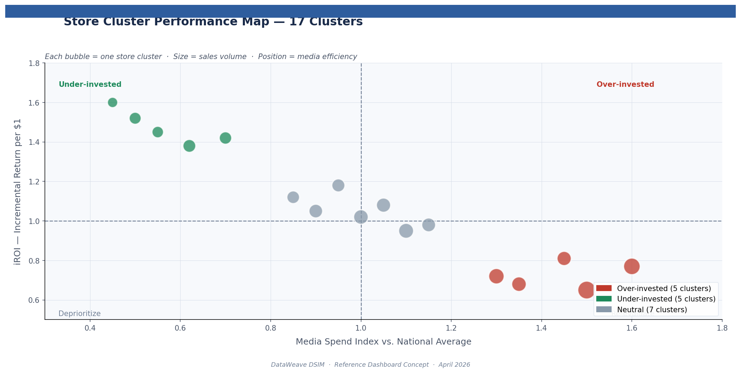
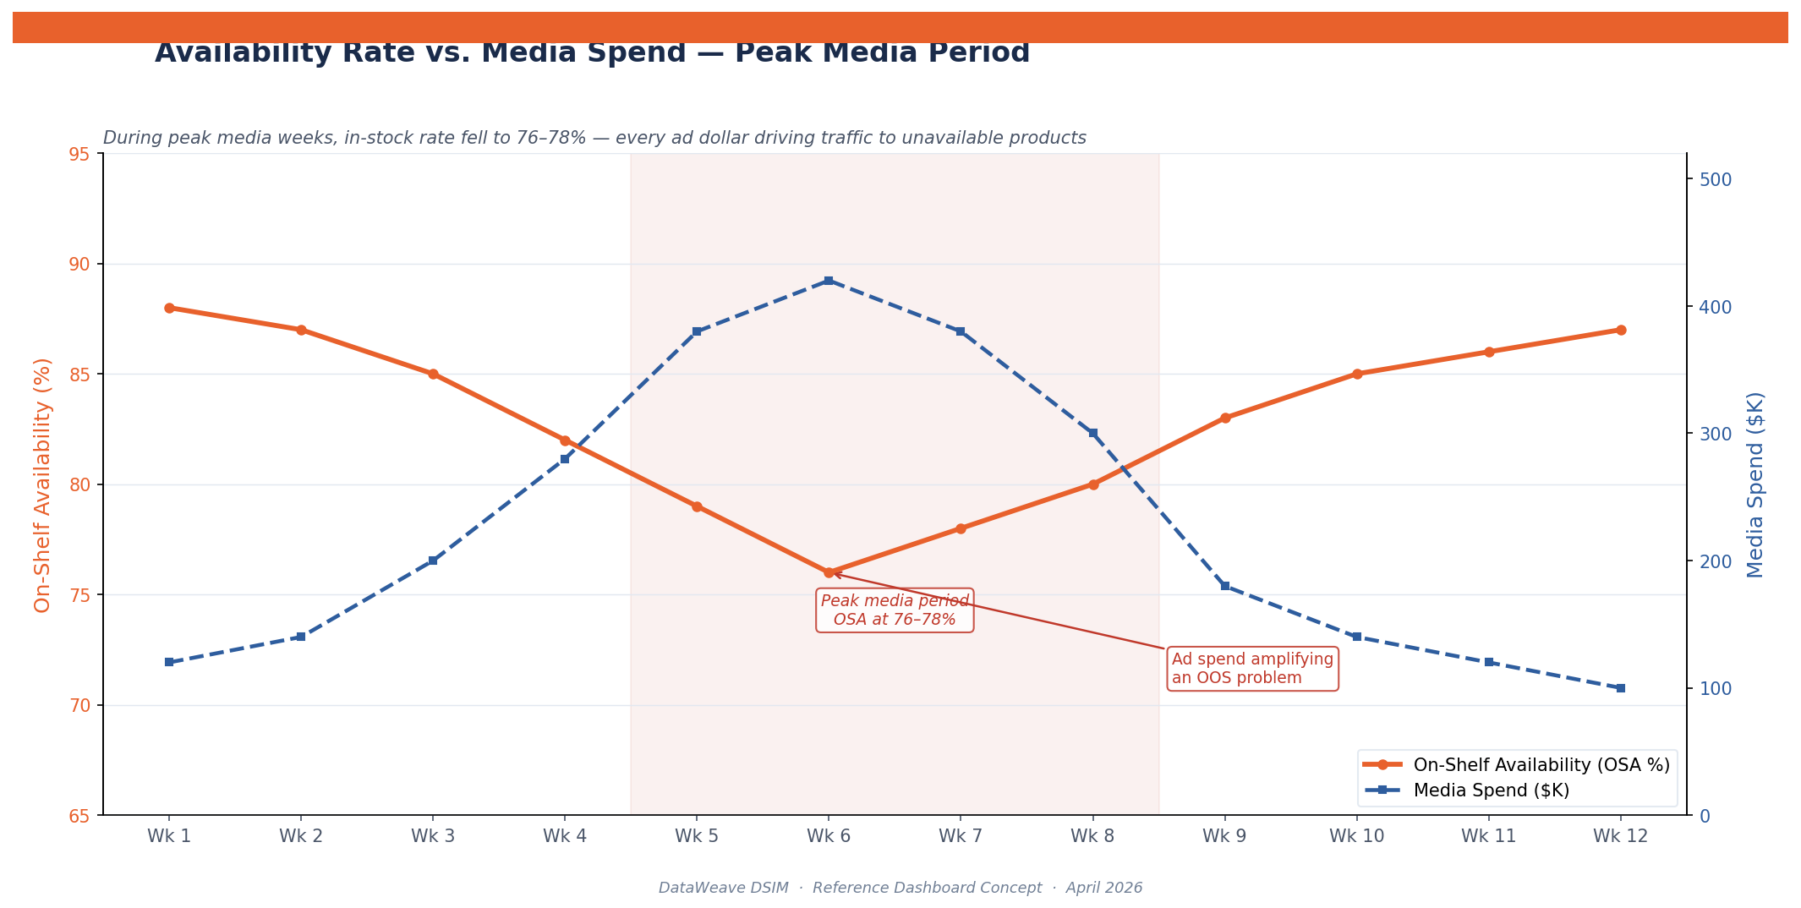
Supplemental: DSIM Model Infographics
Lactalis PoC — Key Visualizations
Incremental ROI by Channel
Impact Waterfall ($2.8M→$6.1M)
Store Cluster Allocation (17 clusters)
Availability vs. Media Spend
CONFIDENTIAL — For internal stakeholder review only

