Slide 1


SMART INDIA HACKATHON 2026
TITLE PAGE
Problem Statement ID:-26060
Problem Statement Title:-Digital Platform for efficient remote management of Indian Antarctic Research Stations
Theme:- Smart Automation
PS Category:- Software/Hardware
Team ID:-T-031
Team Name:- BAHRTI MAITRI

Slide 2
IDEA TITLE
BHARTI
MAITRI
Problems
Extreme Weather → Remote Location → Equipment Failures → Energy Issues → Limited Manpower → Difficult Maintenance
↓
Proposed Solution
IoT + AI/ML + Satellite Communication + Digital Twin
↓
Data Collection
Temperature • Vibration • Energy • Weather • Equipment
↓
Data Transmission
IoT Sensors → Edge Gateway → Satellite/Secure Network
↓
Data Processing
Cleaning → Storage → Real-Time Analysis
↓
AI/ML
Anomaly Detection → Failure Prediction → Energy Forecasting
↓
Digital Twin
Live 3D Station → Equipment Status → Fault Visualization
↓
Dashboard & Alerts
Real-Time Monitoring → Automatic Alert → Remote Diagnosis
↓
Action
Maintenance → Verification → System Update
↓
Expected Outcomes
Fewer Breakdowns • Less Human Intervention • Optimized Energy • Safer Operations • Sustainable Antarctica
IDEA / SOLUTION:-
Antarctic Smart Digital Twin & Autonomous Monitoring System
Create a 3D Digital Twin of Antarctic research stations.
Integrate satellite, IoT, weather and equipment data in real time.
Monitor energy, infrastructure, vehicles and environmental conditions.
Innovation:-
One platform for monitoring + prediction + simulation.
Digital Twin allows testing solutions before physical implementation.
AI-based prediction reduces human exposure to extreme conditions

Slide 3



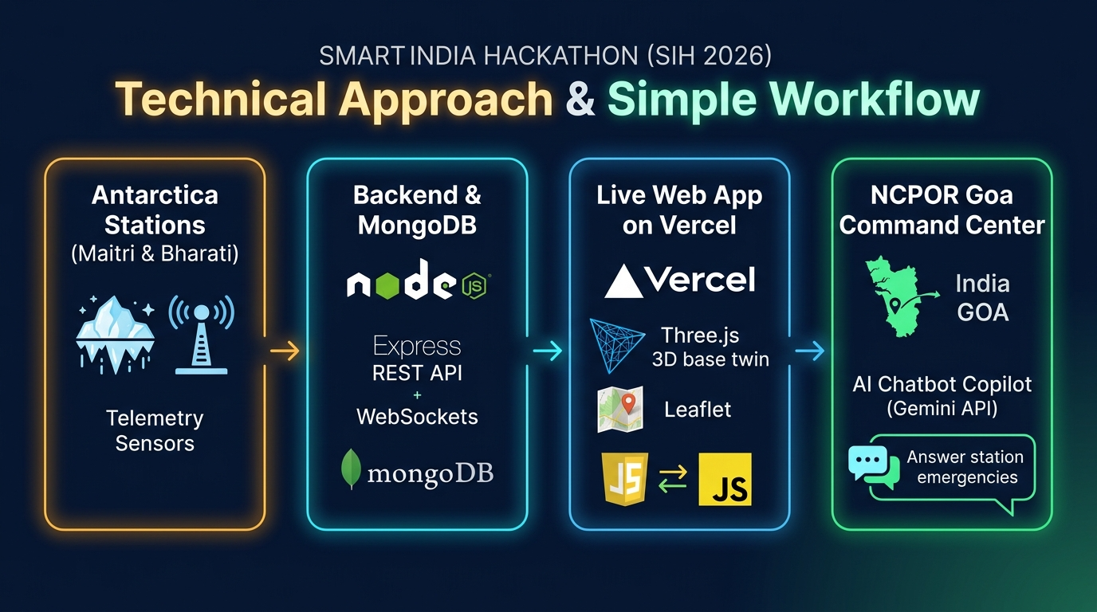

TECHNICAL APPROACH
BHARTI
MAITRI
IoT Sensors
Temperature • Vibration • Energy • Weather
TECHNOLOGY USED:-
Data Collection & Transmission
Edge Gateway • MQTT • Secure/Satellite Communication
Data Processing
Cleaning • Storage • Real-time Analytics
AI / ML
Anomaly & Failure Prediction
Digital Twin
Live 3D Station Model
Central Dashboard
Live Status • Energy • Environment
Alert & Action
Fault Alert → Remote Diagnosis → Maintenance → Verification

Slide 4
FEASIBILITY AND VIABILITY
BHARTI
MAITRI
Feasibility | Challenges | Solution
Uses existing IoT, satellite, GPS and AI technologies. | Extreme weather & sensor failure . | Centralized monitoring and control
Cloud-based architecture enables remote monitoring. | Limited connectivity | Edge computing for critical alerts
Can start with one research station → scale to multiple stations | Harsh operating environment | Predictive maintenance
 | High maintenance difficulty | Solar/wind + battery backup

Slide 5
IMPACT AND BENEFITS
MAITRI BHARTI
Safety:- Reduces unnecessary human exposure.
Energy:- Optimizes renewable energy consumption.
Infrastructure:- Detects faults before breakdown.
Logistics:- Tracks vehicles and supplies efficiently.
Environment:- Continuous monitoring with minimal disturbance.
Cost:- Reduces emergency repairs and operational losses.
Prediction:- Enables early detection of equipment/environmental risks.

Slide 6

RESEARCH AND REFERENCES
Research Areas
Antarctic station infrastructure & daily operations
Energy, generators & heating systems
Logistics and supply management
Weather & environmental monitoring
Convoy, sea-ice and expedition routes
Digital Twin & remote monitoring technologies
References
NCPOR — National Centre for Polar and Ocean Research
Wikipedia — Antarctic & Indian Antarctic research background
GitHub — Open-source mapping, tracking & Digital Twin technologies
Scientific/technical publications — Antarctic environment and remote sensing
Expert Consultation — Project Scientist, Antarctic Cryosphere Division, NCPOR
Anirudha Mahagaonkar Project Scientist | Antarctic Cryosphere Division
Research Approach:
Public Sources → Technical Research → Expert Consultation → System Requirements → Digital Twin
https://drive.google.com/drive/folders/1KBNKIIyHeVeIr--3dNFTLbXYH3wAGE45
Wikipedia.
Research and References.
Git Hub:-

