Slide 1
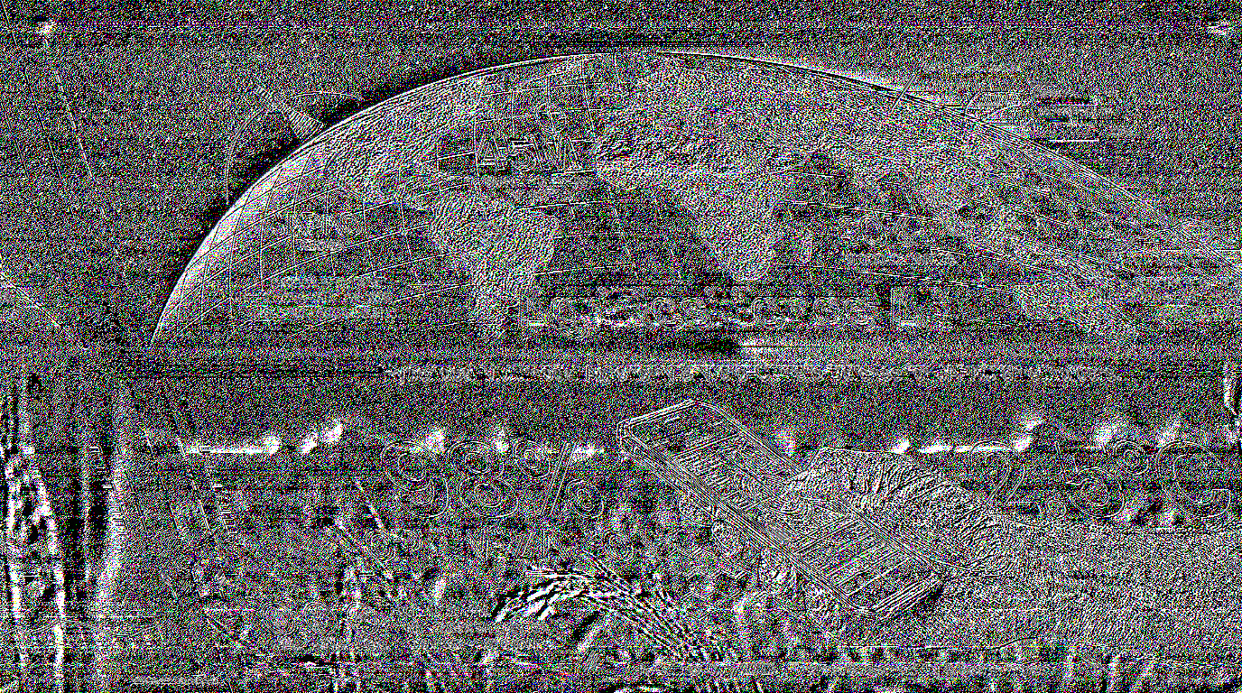
Google Cloud AI Builder Cup 2026 • Singapore

