Slide 1
Car Price Prediction Using Machine Learning
Group name : ace
By: yash srivastava
By: tanishk rana
by: Raghav Sharma
by: lakshay Khandelwal

Slide 2
Project Overview
Predict used car prices using ML.
Utilize historical data for accurate predictions.

Slide 3
Problem Statement
Manual price estimation is inaccurate.
Need for a data-driven approach.

Slide 4
Objective
Build an ML model to predict car prices.
Use regression techniques on Kaggle dataset.

Slide 5
Scope of the Project
Dataset from Kaggle.
Preprocessing, training, evaluation and deployment.

Slide 6
About the Dataset
Source: Kaggle (CAR PRICE PREDICTION)
Includes details of car specs and price.

Slide 7
Feature Description
Columns: name, year, fuel type, mileage, engine, etc.
Target: selling_price.

Slide 8
Target Variable
Target variable: selling_price.
Continuous variable.

Slide 9
Libraries used
pandas
numpy
matplotlib
seaborn
sklearn

Slide 10
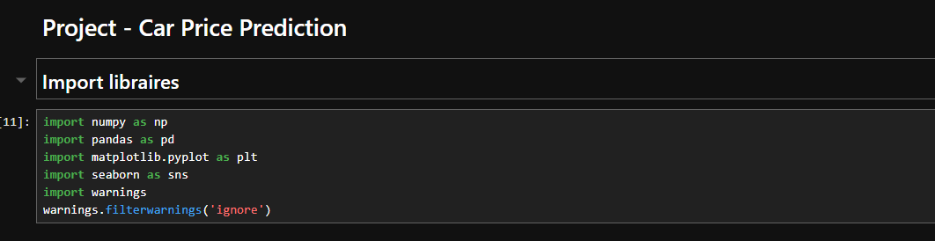
Code

Slide 11
Loading the Dataset
Use pandas to read CSV file.
Basic syntax to load dataset: = “pd.read_csv("filename.csv")”

Slide 12
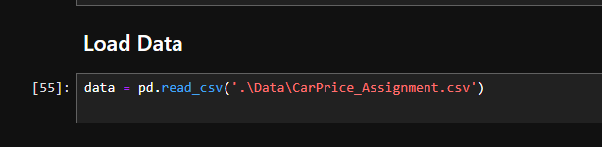
code

Slide 13
EDA ( Exploratory Data Analysis )
EDA (Exploratory Data Analysis) is the first step in the data analysis or machine learning pipeline. It involves understanding the data, uncovering patterns, spotting anomalies, and forming hypotheses using visual and statistical techniques.

Slide 14
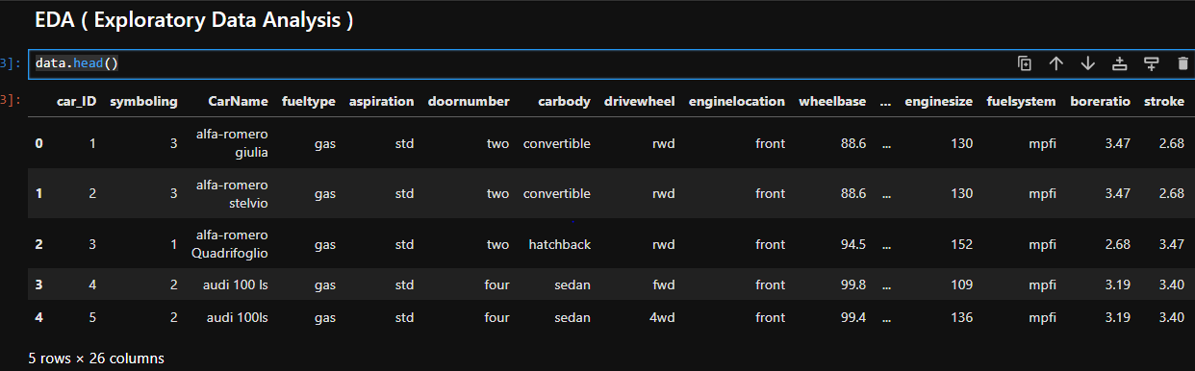
DATA DESCRIPTION

Slide 15
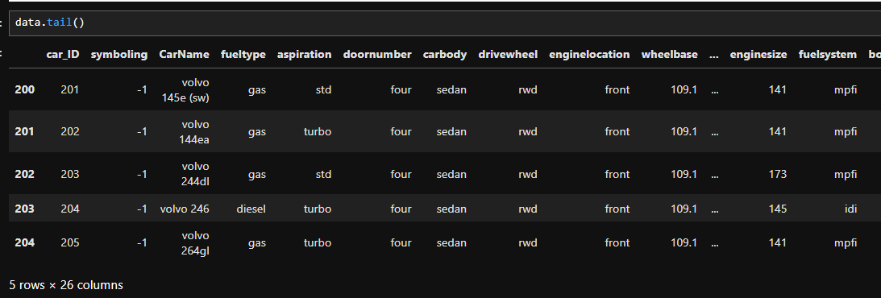
DATA DESCRIPTION

Slide 16
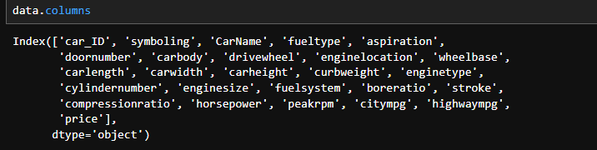
DATA COLUMNS

Slide 17
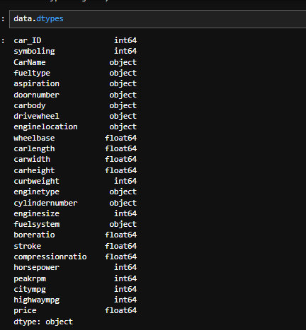

Slide 18
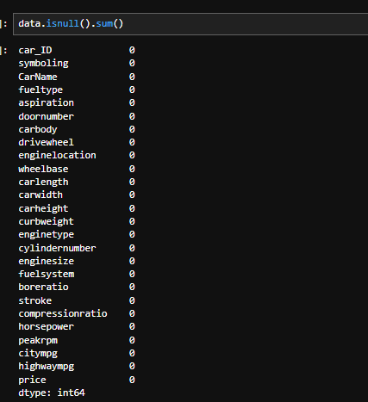

Slide 19
HISTOGRAM
histogram is a graphical representation that shows the distribution of a continuous numerical variable. It divides the data into intervals (called bins) and displays the frequency (count) of data points in each bin.
SYNTAX : “sns.histplot(data['price'], kde = True, bins = 14)plt.title("Distribution of Car prices")plt.xlabel('Price')plt.ylabel('Frequency')plt.show()”

Slide 20
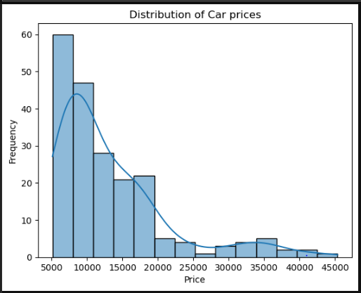

Slide 21
DESCRIPTION
The histogram above illustrates the frequency distribution of car prices within the dataset. Key observations include:
A large concentration of vehicles falls within the ₹5,000 to ₹15,000 price range, as indicated by the tall bars on the left.
The distribution exhibits a positive skew (right-skewed), where fewer vehicles are found in the higher price ranges, especially beyond ₹30,000.
The KDE (Kernel Density Estimate) curve emphasizes this skewness, highlighting a gradual decline in vehicle count as price increases.
The long right tail suggests the presence of high-priced outliers, which could represent premium or luxury car models.

Slide 22
INSIGHT
Due to the skewed nature of the distribution, it may be beneficial to apply a log transformation to the price feature before feeding it into predictive models, as this can help normalize the data and improve model accuracy.

Slide 23
BOX PLOT
A Box Plot (also called a box-and-whisker plot) is a statistical graph that shows the distribution of a dataset based on five summary statistics
SYNTAX: “sns.boxplot(data['price’])”

Slide 24
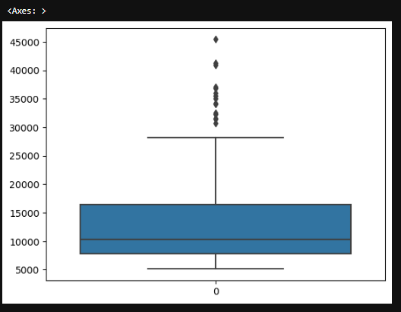

Slide 25
DESCRIPTION
The box plot provides a summary of the distribution of car prices in the dataset using five key statistics:
The box represents the interquartile range (IQR), where the middle 50% of the car prices lie — roughly between ₹8,000 and ₹18,000.
The line inside the box indicates the median price, which appears to be around ₹11,000, suggesting that half of the cars cost less than this amount.
The "whiskers" extend to the lowest and highest values within 1.5×IQR — beyond this range, data points are considered outliers.
The dots above the upper whisker represent outliers — these are high-priced vehicles exceeding ₹27,000, likely premium or luxury cars.
.

Slide 26
INSIGHT
This visualization highlights that while most cars are priced in a moderate range, there are a few significantly higher-priced outliers that may need special handling during model training.

Slide 27
SCATTER PLOT
A scatter plot is a type of data visualization used to show the relationship between two numerical variables. Each point on the graph represents one observation.
SYNTAX: “sns.scatterplot(x = 'horsepower', y = 'price', data=data)”

Slide 28
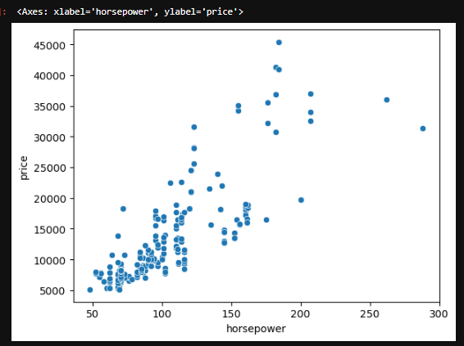

Slide 29
DESCRIPTION
The scatter plot visualizes the relationship between horsepower (x-axis) and car price (y-axis) in the dataset.
Each dot represents a single car, with its horsepower and corresponding price.
The points exhibit a positive linear trend, indicating that as horsepower increases, car price tends to rise.
The plot shows a strong correlation between the two variables — higher horsepower cars generally cost more.
A few points toward the top-right corner represent high-performance, high-cost vehicles, which may be outliers or luxury models.

Slide 30
INSIGHT
There is a clear positive correlation between horsepower and price, suggesting that horsepower is a strong predictor of car price and should be included in the regression model.

Slide 31
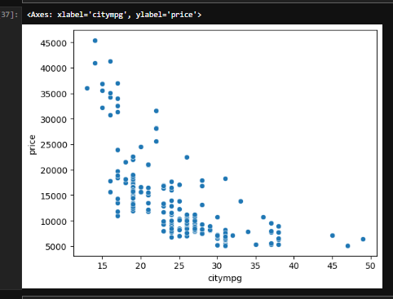

Slide 32
DESCRIPTION
This scatter plot illustrates the relationship between a car’s city mileage (mpg) and its price:
The x-axis represents city miles per gallon (citympg), while the y-axis represents the car price.
There is a clear negative correlation: as city mileage increases, the price of the car tends to decrease.
Cars with lower mileage (10–20 mpg) are generally more expensive, suggesting they are high-performance or luxury models.
Conversely, cars with higher mileage (above 30 mpg) are mostly lower-priced, which is typical of economy vehicles.
The pattern also reveals clusters of lower-priced, fuel-efficient cars, and a few high-cost low-mileage outliers.

Slide 33
INSIGHT
This inverse relationship indicates that fuel efficiency is a significant factor in pricing — higher efficiency usually comes with lower cost. City mileage can be a useful feature in predicting car prices.

Slide 34
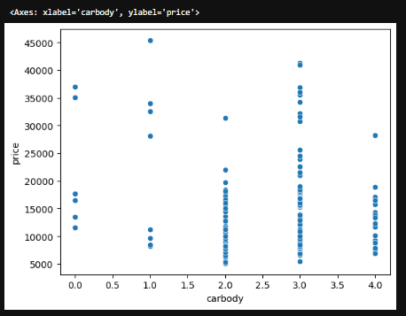

Slide 35
DESCRIPTION
This scatter plot explores the relationship between different car body types and car prices:
The x-axis represents the encoded car body types (e.g., sedan, hatchback, wagon, convertible, hardtop), which have been converted to numerical form for analysis.
The y-axis represents the price of the cars.
Each point represents a car and its corresponding body type and price.

Slide 36
INSIGHT
Car body type has some influence on car price, but the relationship is not strictly linear. It may be more useful when combined with other features (like brand or horsepower) for accurate price prediction.

Slide 37
HEAT MAP
A heatmap is a data visualization tool that uses color to represent values in a matrix format. It's commonly used to show the relationship (correlation) between multiple variables in a dataset.
SYNTAX: “plt.figure(figsize = (15,10))sns.heatmap(data.corr(), annot = True, cmap = 'coolwarm', fmt = '.2f’)”

Slide 38
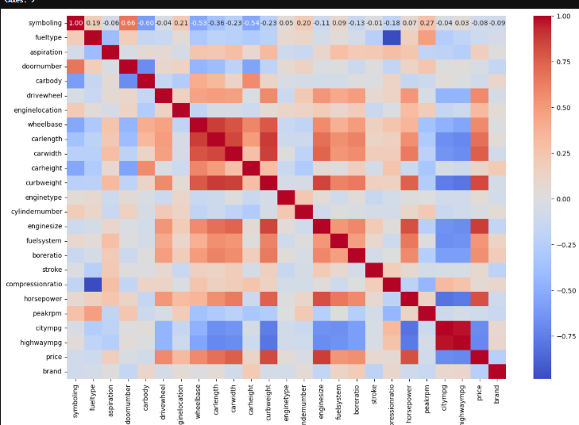

Slide 39
DESCRIPTION
The heatmap above displays the correlation coefficients between pairs of numerical features in the car dataset.
Red squares indicate positive correlations (closer to +1), meaning as one feature increases, the other tends to increase.
Blue squares indicate negative correlations (closer to -1), meaning as one feature increases, the other tends to decrease.
Lighter colors (near white) represent weak or no correlation (around 0).
The diagonal shows a perfect correlation (value = 1.00) since every feature is perfectly correlated with itself.

Slide 40
INSIGHT
This heatmap helps identify which features have the strongest relationships with car price — useful for feature selection in building regression models.

Slide 41
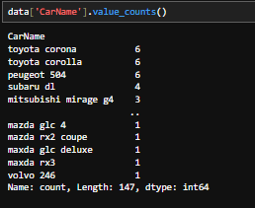
Extract Car NAMES

Slide 42
Splitting Data: Train and Test Sets
Splitting your dataset into training and testing sets is a core step in machine learning to evaluate how well your model performs on unseen data.
training Set: Used to train the machine learning model (the model learns patterns here).
Testing Set: Used to evaluate the model's performance (how well it generalizes to new data).

Slide 43
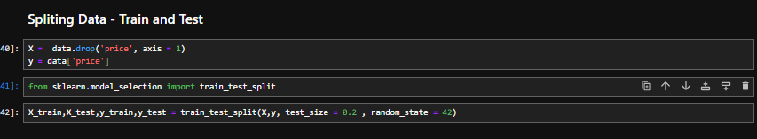
Code

Slide 44
Why linear regression?
1. Predicting Continuous Values
Car prices are continuous numbers (like ₹8,500, ₹13,200, ₹22,000 etc.), and linear regression is designed to predict such numerical outputs.
2. Simple and Interpretable
Linear regression gives a clear understanding of how each feature affects price.
Example: “For every 10 units increase in horsepower, price increases by ₹2,000.”
It's mathematically simple, easy to explain to stakeholders or in a report.

Slide 45
3. Assumes Linear Relationships
Many features like engine size, horsepower, or curb weight often have a direct (linear) relationship with car price.
Linear regression captures such relationships efficiently.
4. Good Baseline Model
Linear regression is fast to train and serves as a baseline to compare more complex models later (like decision trees, random forests, etc.).
5. Low Complexity (Low Variance)
It's less prone to overfitting on small/medium datasets.
Works well if the data is not too noisy or nonlinear.

Slide 46
EvaluatION matrix
Metric | Description
R² Score (r2_score) | Measures how well the model explains the variability of the target variable. Ranges from 0 to 1.
MAE (Mean Absolute Error) | Average of the absolute differences between actual and predicted prices. Lower is better.
RMSE (Root Mean Squared Error) | Similar to MAE, but penalizes large errors more heavily.

Slide 47
INSIGHT
In this project, we successfully developed a Car Price Prediction Model using Linear Regression, a supervised machine learning technique well-suited for predicting continuous numeric outcomes.
The dataset, sourced from Kaggle, was preprocessed through steps such as exploratory data analysis (EDA), null value handling, encoding categorical features, and feature selection. The cleaned dataset was then split into training and testing sets, and the linear regression model was trained on the training data.
Upon evaluation, the model yielded performance metrics such as:
R² Score – indicating how well the model explains the variance in car prices.
MAE (Mean Absolute Error) – measuring the average prediction error.
RMSE (Root Mean Squared Error) – quantifying the magnitude of errors.
These metrics demonstrate that the model performs reasonably well in capturing linear relationships between features (e.g., horsepower, engine size, mileage) and the car price.

Slide 48
Possible Improvements
Feature Engineering Add new features or transform existing ones (e.g., log of price, interactions between features).
Outlier Handling Detect and remove or cap outliers to reduce prediction errors.
Model Tuning Use GridSearchCV or RandomizedSearchCV for optimal hyperparameters.
Use Advanced Models Try Ridge, Lasso, Random Forest, or XGBoost for better accuracy.

Slide 49
References
Kaggle dataset (car price prediction)
sklearn docs
pandas docs.

Slide 50
Thank You!

