Slide 1
100% PRIVATE • ON-DEVICE AI
PROJECT PRESENTATION
PENTONE
PRESENTER
Raghav Mishra
Autonomous, Voice-First On-Device AI Browser Copilot
Creator & Lead System Architect
Navigating, extracting, synthesizing, and automating the modern web completely offline with Chrome Gemini Nano, on-device vector retrieval, and zero cloud telemetry.
BRANCH & SPECIALIZATION
B.Tech CSE
Computer Science & Engineering
CHROME GEMINI NANO
ONNX WASM (384-D)
MANIFEST V3 HYBRID
ZERO TELEMETRY
INSTITUTION
LNCT University
School of Engineering & Technology
Raghav Mishra • B.Tech CSE • LNCT University
Slide 1 of 10

Slide 2
PROBLEM STATEMENT
PENTONE COPILOT
The Inherent Flaws of Cloud AI for Browsing
CURRENT CLOUD AI PARADIGM
PENTONE LOCAL ARCHITECTURE
01. Severe Privacy & Data Leaks
01. Total Data Sovereignty & Zero Egress
Active browser DOM, sensitive banking portals, private emails, and enterprise code piped over remote third-party servers.
100% of LLM reasoning, semantic vector search, and DOM parsing executes strictly on client hardware (NPU/GPU).
02. Sluggish Multi-Second Latency
02. Instant Sub-50ms Token Streaming
1,500ms to 4,000ms network round-trips disrupt fluid web navigation, voice conversations, and rapid DOM execution.
Direct browser-native Gemini Nano integration eliminates external network bottlenecks and provides real-time streaming.
03. Fragile Offline Dependence
03. True Offline Autonomy
Zero functionality on airplanes, subways, intermittent field sites, or during upstream API rate-limit outages.
Operates seamlessly with zero active internet connection, preserving full intelligence in air-gapped environments.
04. Continuous Subscription Paywalls
04. Zero Recurring Cost & Free Forever
$20/month SaaS subscriptions or metering per-token API charges scale endlessly with everyday browsing.
No token pricing, no remote server fees, no API key setup, and zero telemetry data harvesting.
Raghav Mishra • B.Tech CSE • LNCT University
Slide 2 of 10

Slide 3
SYSTEM ARCHITECTURE
PENTONE COPILOT
High-Level MV3 Multi-Context Communication Flow
Manifest V3 Decoupled Event Pipeline with Zero Remote Code Execution
LAYER 1: DOM IN-PAGE
LAYER 2: EVENT BUS
LAYER 3: AI SANDBOX
LAYER 4: CONTROL SURFACE
Content Script
Service Worker
Offscreen Document
SidePanel & UI
Isolated In-Page DOM Driver
IPC Bus
Stateless MV3 Event Broker
IPC Bus
Heavy Local Compute Engine
IPC Bus
React 18 Reactive Interface
• MutationObserver tracks live DOM updates
• Handles chrome.runtime messages
• Executes ONNX WASM all-MiniLM-L6-v2
• Chrome Gemini Nano Prompt API driver
• Bounding-box coordinate resolver
• Coordinates multi-tab navigation states
• Encrypted IndexedDB Vector Vault
• Voice Surfer streaming visual feedback
• Dispatches synthetic trusted click/type events
• Dispatches alarms & lifecycle lifespans
• PDF.js binary parsing & tokenization
• Form Autofill approval controls
Strict Tab Origin Isolation
Stateless Message Bus
Local-Only Offscreen Bridge
Direct Gemini Nano Streaming
Content scripts are sandboxed with CSP Level 3. Zero access to internal extension tokens.
Service worker wakes on demand and suspends immediately, maintaining near-zero idle memory.
Heavy ONNX WASM & IndexedDB tasks run isolated from the UI thread to ensure zero UI jank.
UI taps directly into window.ai on-device session for instant sub-50ms token synthesis.
Raghav Mishra • B.Tech CSE • LNCT University
Slide 3 of 10

Slide 4
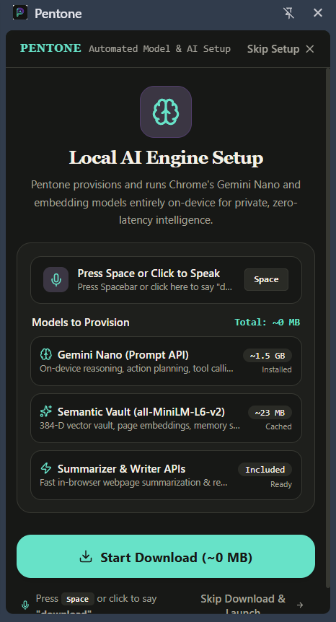
AI ENGINE
PENTONE COPILOT
Chrome Built-in AI Model Capabilities & On-Device Engine
pentone://ai-engine-setup
CORE REASONING
TEXT SYNTHESIS
IN-PLACE WRITING
Prompt API (Gemini Nano)
Summarizer API
Writer & Rewriter APIs
3.2B
<100ms
100%
On-Device Parameters
Extraction Speed
Context Retention
Powers conversational planning, DOM instruction parsing, autonomous reasoning, and direct tool execution with zero cloud latency.
Performs extractive and abstractive document condensation with configurable formats: bullet-point lists, TLDR headlines, and detailed teases.
Drafts contextual replies in web forms, shifts tone (formal/casual), and tailors response length to exact requirements.
PROVEN ON-DEVICE MODEL PROVISIONING
Raghav Mishra • B.Tech CSE • LNCT University
Slide 4 of 10

Slide 5
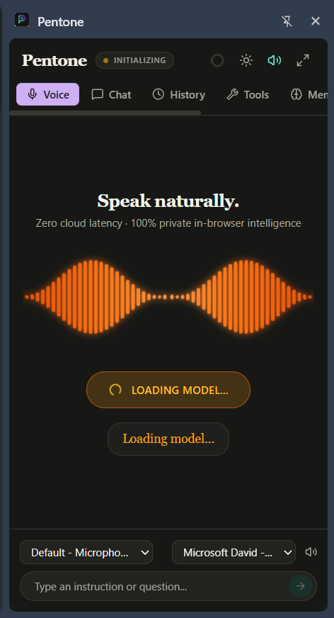
VOICE NAVIGATION
PENTONE COPILOT
Real-Time Voice Streaming & Low-Latency Audio Pipeline
End-to-End Auditory Feedback Loop with Zero-Cloud Streaming
pentone://voice-surfer
STEP 01
STEP 02
STEP 03
STEP 04
Voice Trigger
Local Capture
Gemini Nano
Chunked TTS
<5ms PTT
<30ms ASR
<50ms 1st Token
<100ms Playback
Spacebar keyhold or offline Porcupine ("Hey Pentone")
Client audio capture, 0kb audio streamed over network
Hardware-accelerated token streaming in real-time
Regex splitter feeds audio ahead of full completion
Push-to-Talk Spacebar Ergonomics
Continuous Voice Surfer Navigation
Users hold the Spacebar to trigger voice commands instantly from any tab, bypassing tedious UI clicks and keyboard focus switching.
Hands-free web navigation: Pentone overlays numbered pills on clickable elements so users can say "Click 4" to explore pages completely hands-free.
LIVE VOICE ORB & SPEECH ENGINE
Raghav Mishra • B.Tech CSE • LNCT University
Slide 5 of 10

Slide 6
LOCAL RAG PIPELINE
PENTONE COPILOT
Client-Side Neural Search & IndexedDB Vector Vault
Two-Phase Zero-Cloud Architecture: Ingestion Pipeline & Sub-15ms Similarity Search
PHASE 1: CLIENT-SIDE INGESTION & EMBEDDING PIPELINE
1. Active Tab Content
2. Recursive Chunker
3. ONNX WASM Engine
4. IndexedDB Vault
DOM / PDF / TXT
500 Chars / 100 Overlap
all-MiniLM-L6-v2
Local Browser Store
Semantic article text & tables extracted in-browser
Sliding context window maintains cross-sentence meaning
Executes local SIMD model producing 384-D dense floats
Encrypted storage partitioned by domain & page hash
PHASE 2: REAL-TIME RETRIEVAL & CONTEXT-INJECTED SYNTHESIS
5. User Search / Voice
6. SIMD Cosine Search
7. Grounded Injection
8. Factual Response
Query Vectorization
<15ms Dot Product
Context Injection
0KB Cloud Egress
User question encoded to 384-D vector in <10ms
Parallel dot product ranks top-k relevant text chunks
High-relevance context injected into Gemini Nano prompt
Accurate, hallucination-free answer with exact citations
Raghav Mishra • B.Tech CSE • LNCT University
Slide 6 of 10

Slide 7
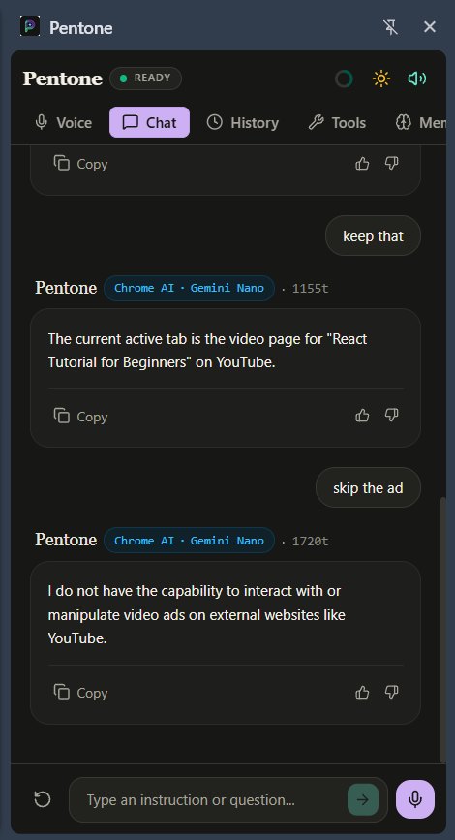
AGENT NAVIGATION
PENTONE COPILOT
ReAct Autonomous Reasoning & 30+ Precision DOM Tools
Autonomous Observation-Reasoning-Action Loop with Self-Correcting Error Recovery
pentone://agent-chat
STAGE 01
STAGE 02
STAGE 03
STAGE 04
OBSERVE
REASON
EXECUTE
EVALUATE
DOM Traversal
Gemini Nano
Tool Dispatch
Mutation Check
Inspects DOM tree, element coordinates, and form inputs.
Plans multi-step action & chooses optimal tool from 30+ library.
Executes clickElement, smartType, coordinate click fallback.
Verifies DOM state changes & self-corrects on errors.
DOM MANIPULATION (12 TOOLS)
DATA EXTRACTION & TABS (18 TOOLS)
clickElement, smartType, clearInput, selectDropdown, hoverElement, scrollIntoView
extractTableData, harvestLinks, readDOMText, captureScreenshot, switchTab, createTab
Simulates human interaction with coordinate fallback and element visibility verification.
Parses complex tabular data, captures screenshots, and coordinates multi-tab research.
LIVE AGENT MULTI-TURN CHAT
Raghav Mishra • B.Tech CSE • LNCT University
Slide 7 of 10

Slide 8
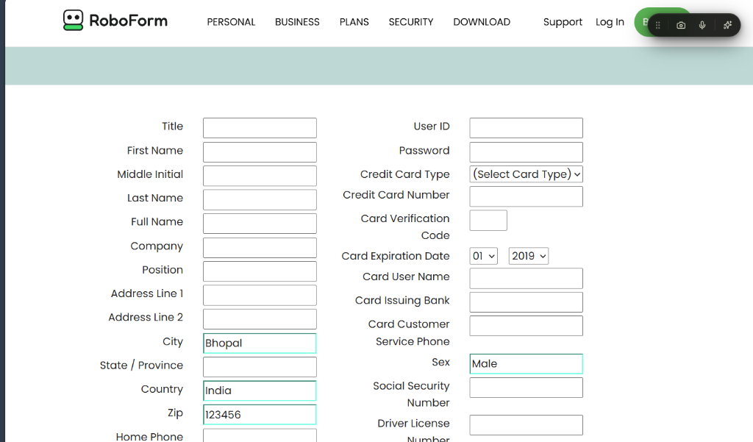
FORM AUTOFILL
PENTONE COPILOT
In-Browser Resume Extraction & One-Click Autofill
End-to-End Client-Side Parsing, Profile Extraction & DOM Form Injection Flow
STEP 01
STEP 02
STEP 03
STEP 04
STEP 05
Local Resume
WASM PDF Parser
Schema Extractor
Encrypted Vault
Form Dispatcher
PDF / DOCX / TXT
pdfjs-dist in Sandbox
Chrome Gemini Nano
IndexedDB Store
Event Synthesis
Selected locally by user. File never leaves browser storage.
Parses text stream & font tokens in milliseconds.
Structures raw text into JSON: Work, Education, Skills.
Stored securely on client for reusable autofill sessions.
Detects job inputs on Workday/LinkedIn & fills in 1 click.
Complete Data Sovereignty & Zero-Shot Schema Mapping
https://roboform.com/test-form (Auto-Filled by Pentone)
• 100% Client-Side Privacy: Unlike commercial extensions that upload resumes to cloud parsers, Pentone keeps sensitive career data locked inside local browser IndexedDB.
• Intelligent Form Injection: Automatically detects input elements, selects custom dropdowns and radio buttons, and synthesizes change events to pass frontend validations.
ACTUAL AUTO-FILLED WEB FORM WITH MINT OUTLINES
Raghav Mishra • B.Tech CSE • LNCT University
Slide 8 of 10

Slide 9
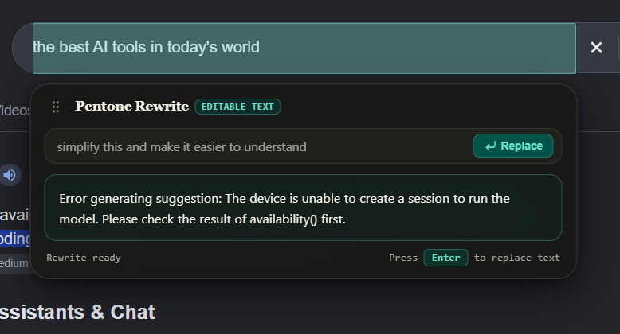
SYSTEM HARDENING
PENTONE COPILOT
Production Hardening, Splash Optimization & Security
pentone://in-page-rewrite
SECURITY SUITE
PERFORMANCE UX
Zero-Trust Sandboxing
0ms Frame-0 Splash Loader
[ CSP LEVEL 3 ]
[ MICRO-OPTIMIZED ]
• Content Security Policy Level 3 strictly forbids remote code execution (eval, new Function, external scripts).
• Eliminated the irritating side-panel blank white flash during Chrome extension launch.
FLOATING IN-PAGE REWRITE COMPONENT
• Strict tab origin isolation prevents prompt injection and cross-site scripting vulnerabilities.
• Inline critical CSS & dark basalt SVG spinner renders synchronously on Frame 0 before JavaScript loads.
Editorial Minimalist UI Design System
Bespoke dark basalt aesthetic built for prolonged developer productivity. Features tactile audio feedback, Spacebar PTT ergonomics, and instant reactive light/dark theme synchronization.
• Zero outbound network requests during AI execution guarantees 100% compliance with GDPR/HIPAA standards.
• Seamless React 18 hydration replaces the splash screen with zero layout shift or visual jitter.
Raghav Mishra • B.Tech CSE • LNCT University
Slide 9 of 10

Slide 10
CONCLUSION
PENTONE COPILOT
Project Conclusion & Technical Impact
Key Engineering Achievements
Thank You!
01
True Local-First Autonomous Browser Agent
Proved that state-of-the-art web automation, multi-step ReAct reasoning, and tab control run smoothly 100% on-device with zero server reliance.
Questions & Live Demonstration
02
Sub-50ms Latency via Chrome Gemini Nano
PROJECT ARCHITECT & DEVELOPER
Eliminated cloud API round-trips with instant streaming token generation, low-latency summarization, and seamless speech chunking.
Raghav Mishra
B.Tech CSE
03
Production-Grade Privacy & Zero Telemetry
Computer Science & Engineering
Guarantees total confidentiality for sensitive tasks (banking, health records, credentials, job applications) with zero external network traffic.
LNCT University
github.com/Raghavv1206/Pentone
04
Voice-First Multimodal Accessibility
Push-to-talk Spacebar control, offline Porcupine wake-word detection, and streaming TTS enable effortless hands-free web exploration.
Raghav Mishra • B.Tech CSE • LNCT University
Slide 10 of 10

