Slide 1
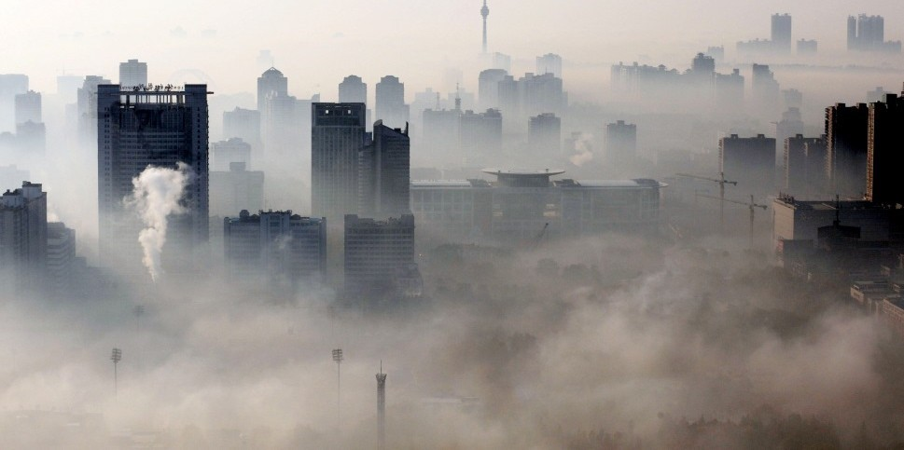
Air Purifier Market Fit Using AQI Data
P Raghavendra

Slide 2
Business Problem
Airborne Innovations is a startup aiming to tackle rising air pollution in cities by launching air purifiers. However, before investing in R&D, the company needs clarity on four key areas:
Whether there is real demand for air purifiers in the market.
Which pollutants should be targeted for maximum effectiveness.
The most essential features customers expect in an air purifier.
The cities with the highest demand and market size, and how product R&D can be tailored to localized pollution patterns.

Slide 3
Goal of the Project
The goal of this project is to analyze AQI data and provide insights to determine the real demand for air purifiers, identify the key pollutants that should be targeted, define the essential features to include, and highlight the regions of the country with the highest market potential.

Slide 4
Let’s get into the insights
Primary Analysis

Slide 5
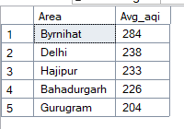
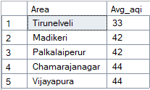
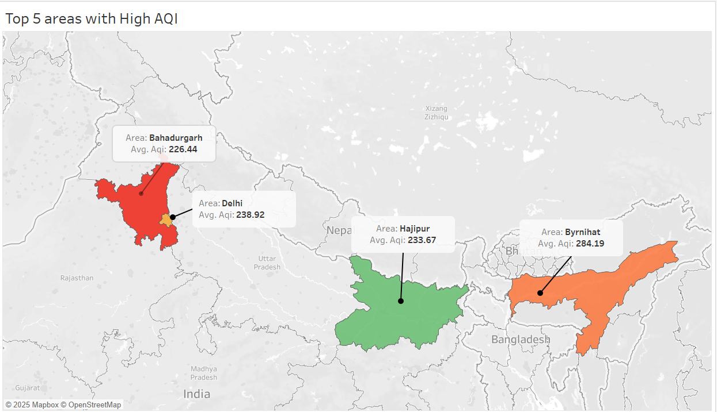
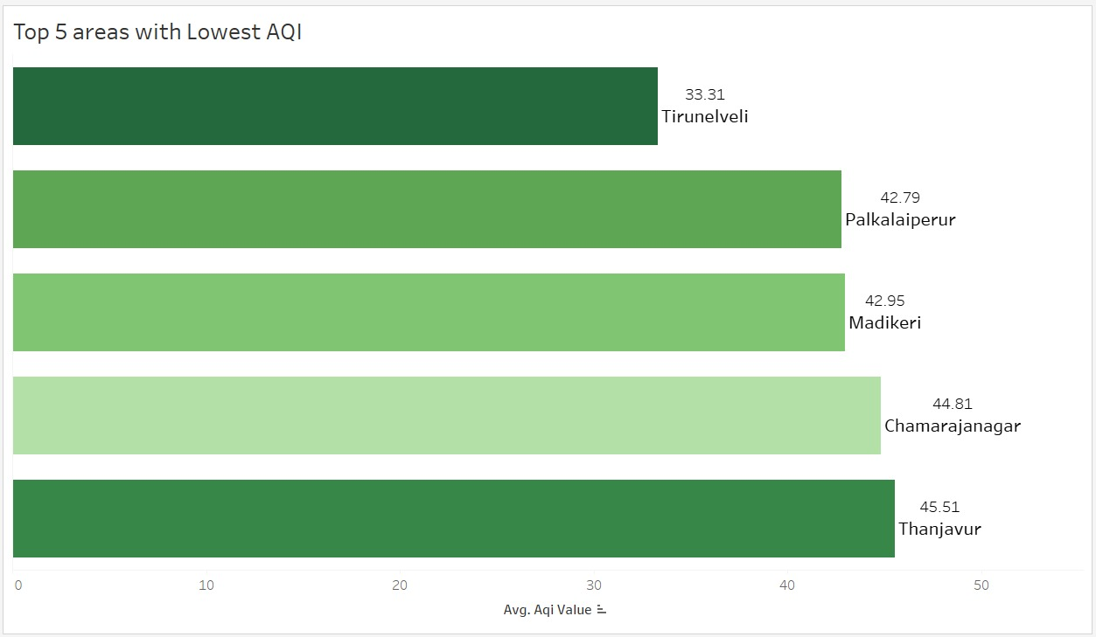
1) List the top 5 and bottom 5 areas with highest average AQI. (Consider areas which contains data from last 6 months: December 2024 to May 2025)

Slide 6
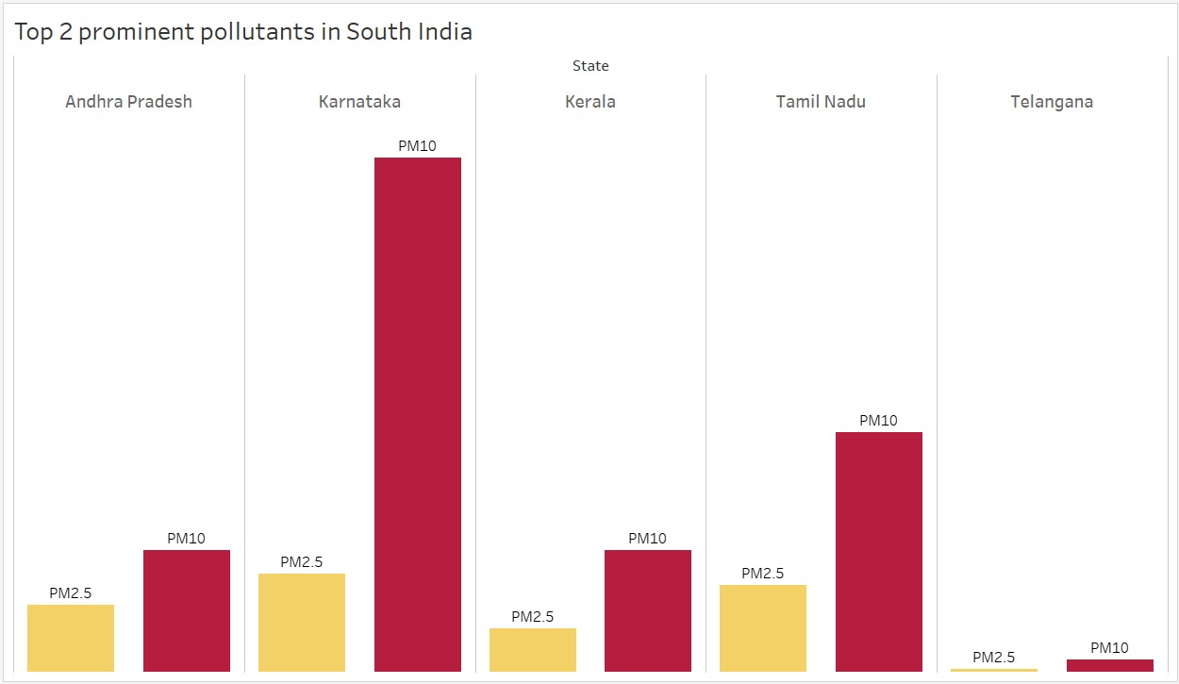
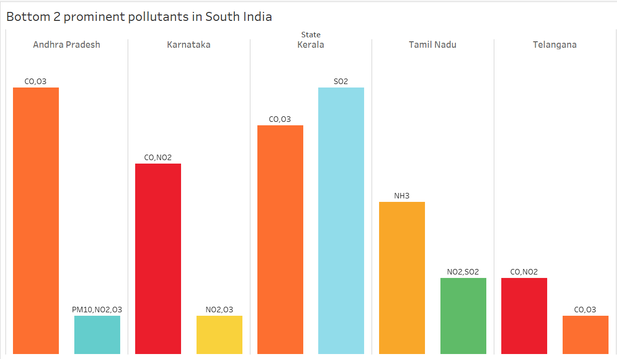
2) List out top 2 and bottom 2 prominent pollutants for each state of southern India. (Consider data post covid: 2022 onwards)

Slide 7
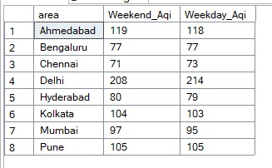
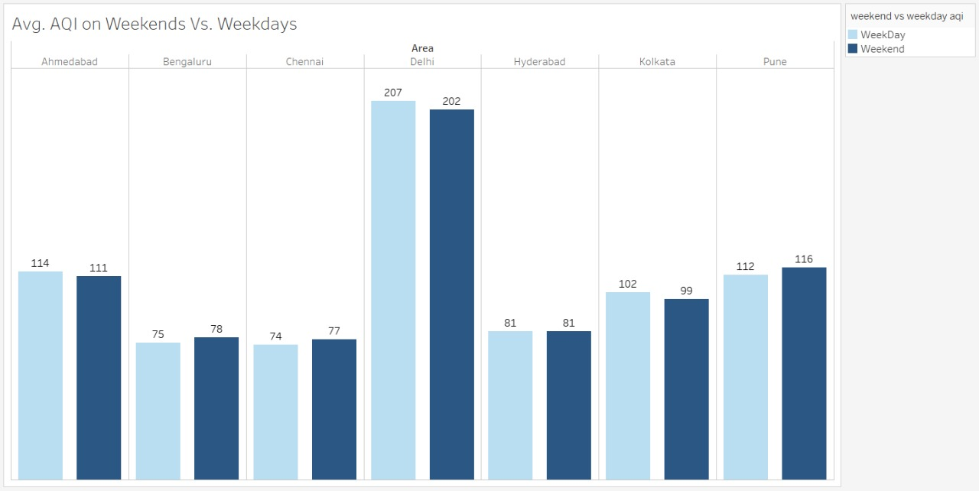
3) Does AQI improve on weekends vs weekdays in Indian metro cities (Delhi, Mumbai, Chennai, Kolkata, Bengaluru, Hyderabad, Ahmedabad, Pune)? (Consider data from last 1 year)
The difference between weekend AQI and weekday AQI is minimal, and in some cases, the values remain almost the same.
This implies that pollution sources are fairly consistent throughout the week.
Weekday Weekend

Slide 8
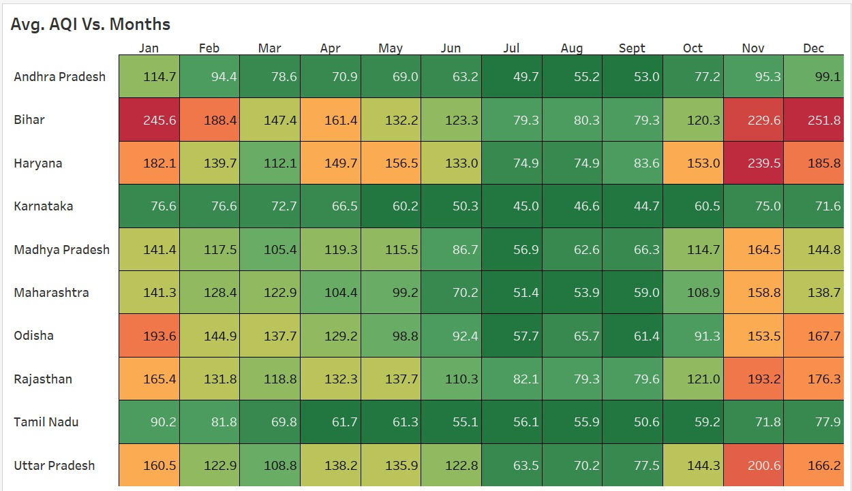
4) Which months consistently show the worst air quality across Indian states — (Consider top 10 states with high distinct areas)
We can observe that winter months ( Nov, Dec, Jan, Feb) are consistently showing worst AQI index reaching up to 200+ Avg. AQI across Indian States.

Slide 9
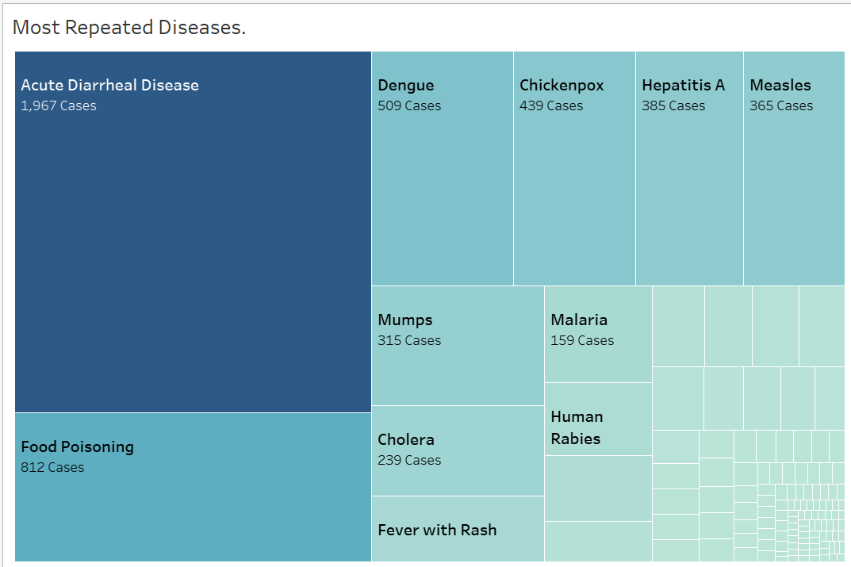
5) List the most repeated diseases.
Observation: The top 5 repeatedly occurring diseases are
1) Acute Diarrheal Disease 2) Food Poisoning 3) Dengue 4) Chickenpox 5) Hepatitis A.
Implication: These should be the primary focus areas for prevention and control efforts, since they represent the most frequent public health risks and have the greatest impact on the population.

Slide 10
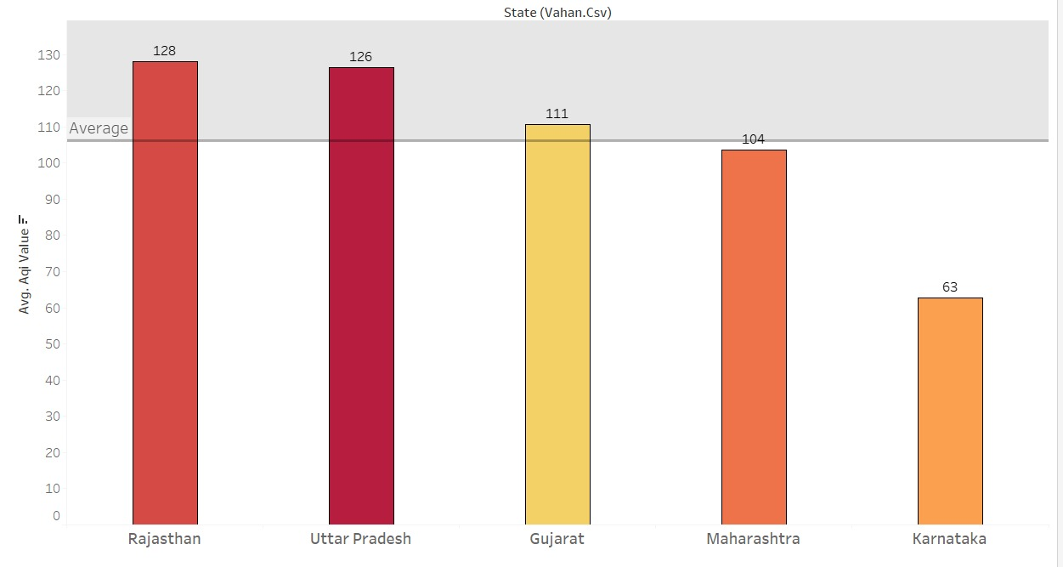
6) List the top 5 states with high EV adoption and analyze if their average AQI is significantly better compared to states with lower EV adoption
We have the top 5 states with High EV adoption but the AQI for some states is still higher than the Avg. AQI.

Slide 11
Secondary Analysis

Slide 12
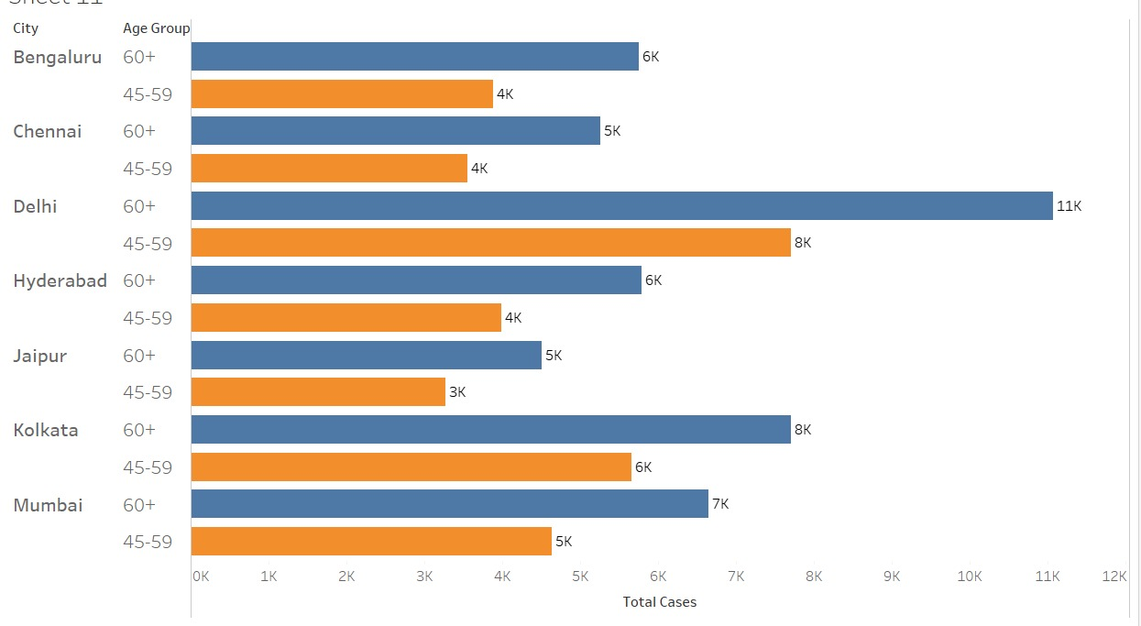
1) Which age group is most affected by air pollution-related health outcomes — and how does this vary by city?
h
We observe that 60+ and 45-59 are most affected by the air pollution and every city follows the same trend. Thus shifting our focus more to the elderly aged people.

Slide 13
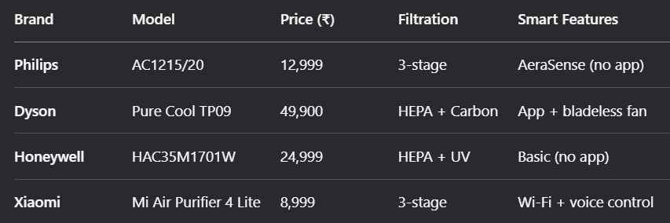
2) Who are the major competitors in the Indian air purifier market, and what are their key differentiators (e.g., price, filtration stages, smart features)?
Honeywell and Dyson target the expensive segment while Xiaomi and Philips target the budget segment. No company has it’s own app except Dyson. Hence we need to develop our air purifier in such a way that it has a running app and HEPA filter installed which is mostly used in the expensive filters. We need to price the filter in middle category 20,000-30,000 and provide all these features because no one player is present in the middle price segment and providing all the features.

Slide 14
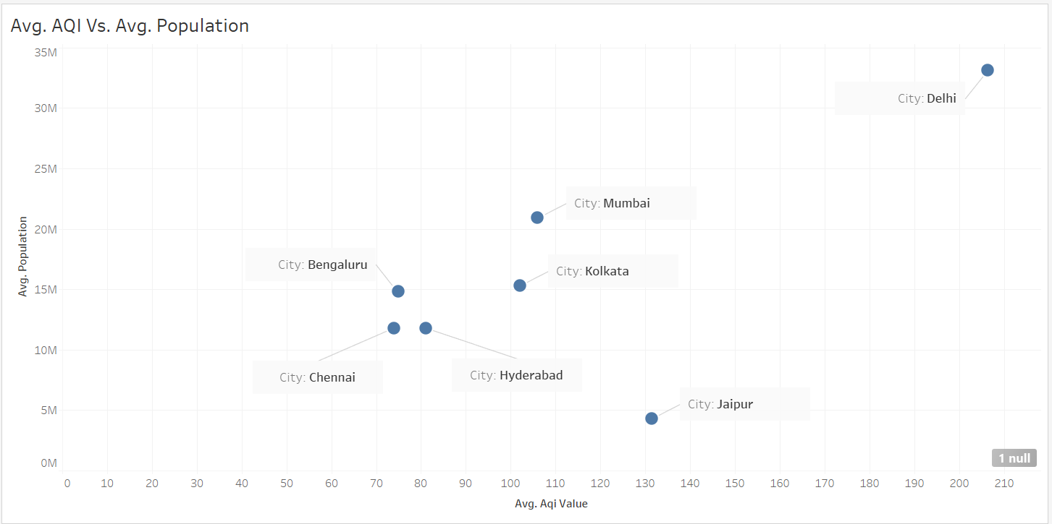
3) What is the relationship between a city’s population size and its average AQI — do larger cities always suffer from worse air quality?
The data shows that larger cities with higher populations generally record higher AQI levels compared to smaller cities. This indicates the need to promote air purifier adoption in bigger cities through targeted marketing campaigns.

Slide 15
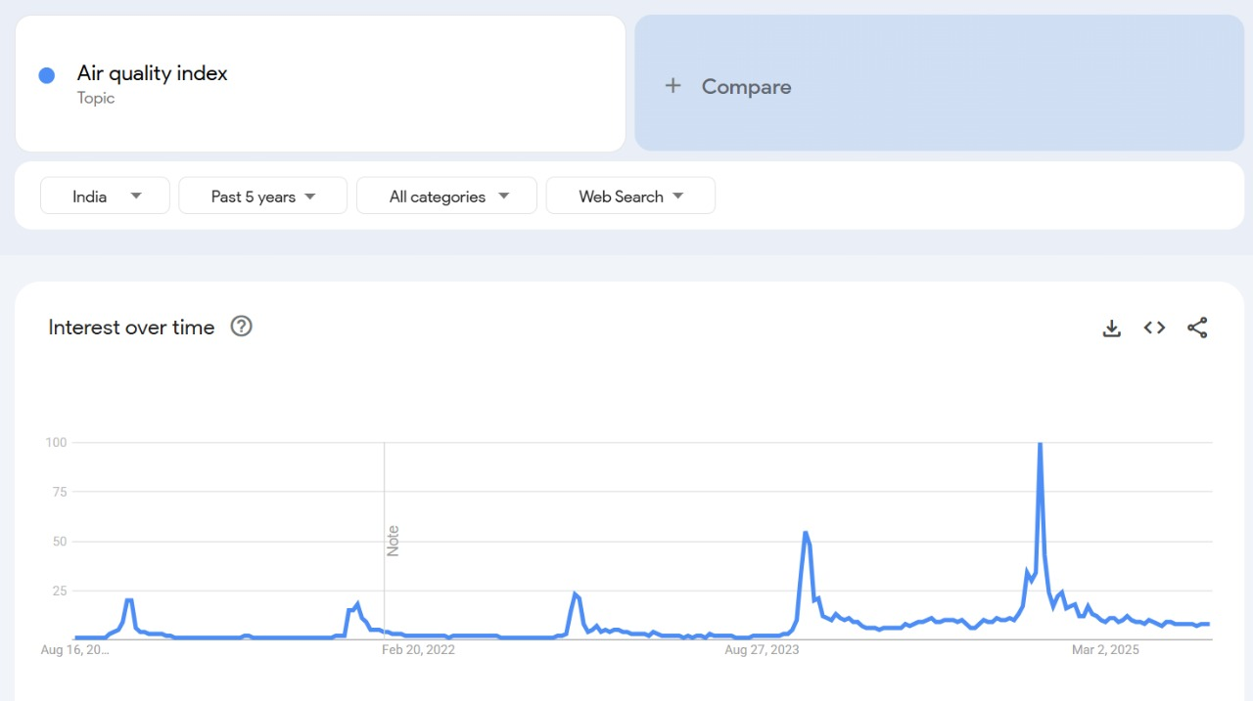
4) How aware are Indian citizens of what AQI (Air Quality Index) means
I extracted Google Trends data, and the spikes clearly show that people are interested in learning about AQI and its effects. Noticeable surges appear at the end and beginning of each year, which aligns with the winter season when air quality typically worsens.

Slide 16
5) Which pollution control policies introduced by the Indian government in the past 5 years have had the most measurable impact on improving air quality — and how have these impacts varied across regions or cities?
NCAP (National Clean Air Programme) Impact: Brought down PM10 in cities like Chennai, Bengaluru, Mumbai, Pune, Ahmedabad by 10–20% between 2019–23. Variation: Worked better in coastal + southern/western cities; Indo-Gangetic belt cities (Delhi, Lucknow, Patna, Kolkata) barely improved.
Brick-kiln “Zig-Zag” technology conversion Impact: Cut coal use + PM emissions by 30–40%. Variation: Strongest in UP, Bihar, West Bengal kiln clusters where adoption was high; negligible in regions with poor enforcement.
BS-VI vehicle norms (2020 onwards) Impact: Reduced tailpipe PM and SO2 from new cars/buses/trucks. Variation: Cities with faster fleet turnover (Delhi, Bengaluru, Mumbai, Pune) gained more; smaller cities with older diesel fleets saw limited benefit.
Odd–Even scheme (Delhi, temporary) Impact: Short-term drop (10–13%) in PM2.5 during enforcement days. Variation: Only visible in Delhi; impact vanished once scheme ended.

Slide 17
Top Key Insights
Northern India and large cities face higher AQI, while South India has lower levels.
PM10 and PM2.5 are the primary pollutants driving poor air quality.
AQI values peak during the winter months of November to February
The 60+ and 45-59 age groups are the most affected by illness due to poor air quality.
Policies to improve air quality are more effective in South Indian cities compared to those in North India.
High EV adoption does not consistently lead to lower AQI, with Karnataka being the only exception.
People are aware about AQI index but they are not aware about the health effects caused by High AQI.

Slide 18
Actionable Recommendations
Promote products in Northern India: Since AQI is consistently higher in northern regions, we should prioritize marketing and sales in those cities to target a high-demand market.
Focus on specific pollutants: Our filters must be designed to effectively control the most common pollutants, PM10 and PM2.5. This should be a core selling point in our product design and marketing.
Capitalize on seasonal demand: Given that AQI values spike in winter (November to February), we should launch our most intensive marketing campaigns during this period to boost sales.
Target key demographics: The 45-59 and 60+ age groups are most affected by high AQI. Our messaging should be tailored to appeal directly to their health concerns.
Position products in the mid-range: We should launch a new product that fills the gap between premium and budget brands, offering a balance of features like an app and multi-stage filtration at a competitive price.
Run educational campaigns: We should run campaigns to educate people on the health effects of AQI, as this will help convert awareness into sales.
Expand into underserved markets: Since government policies have had limited impact in rural areas and Tier 2/3 cities, we should target these customers to capture a new market.

Slide 19

Thank You!

