Slide 1
smartFLY- ai powered Travel assistant
ArangoDB Hackathon – Building the next-Gen Agentic App with GraphRAG & Nvidia cuGrapgh
Raghu MS

Slide 2
contents
Background and Motivation
What is SmartFly?
Architecture
Working of the application
Demo
Further Improvements

Slide 3
Background and motivation
Background
Name – Raghu MS
Education – MSc Intelligent systems.
University – University of Ulm, Germany
Current Occupation – Research Assistant
Motivation
Cutting Edge Technology (GraphRAG, cuGraph, etc.)
Challenging
Hobby and career perspective

Slide 4
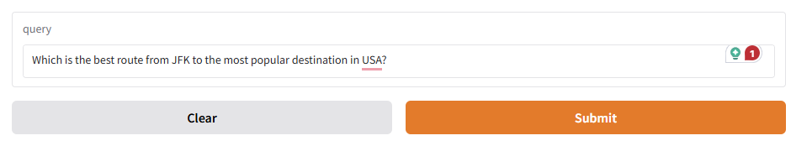
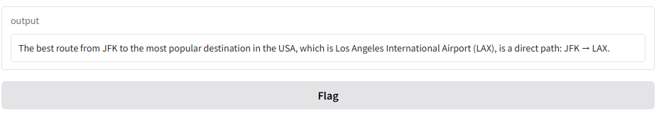
What is smartfly?
A simple chat application that assists users with flight and airport-related queries.
Sample Queries
Number of airports in USA?
How can I travel from JFK to HNL?
Find flights departing from ATL.
Busiest airport in the US.

Slide 5
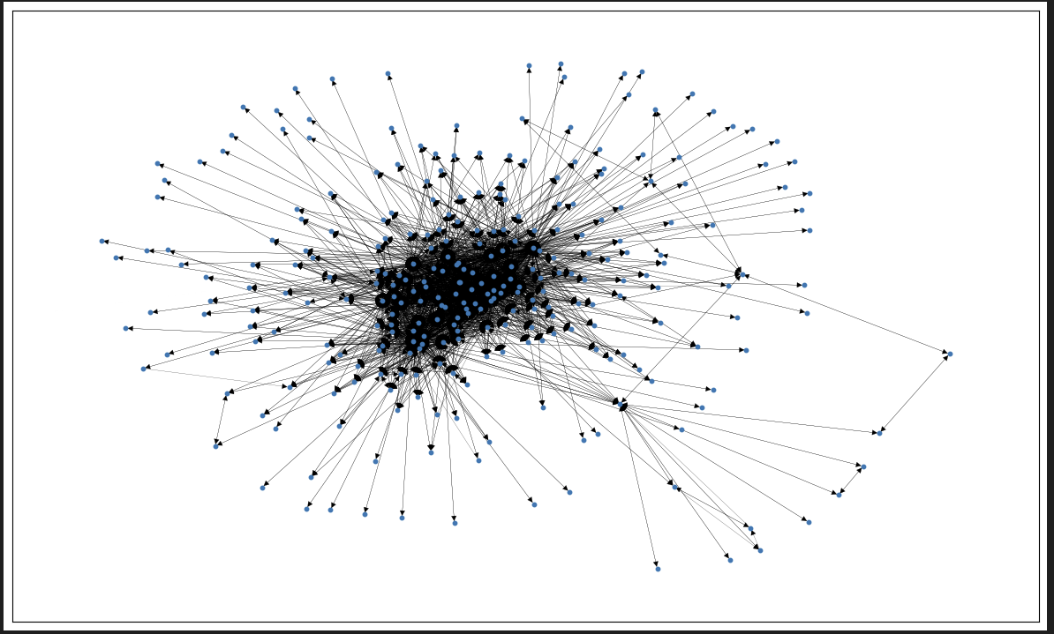
‘Flights’ dataset
3375 Nodes (Airports)
286463 Edges (Flights)
Directed Graph
Possible a Multigraph
(Considering possibility of
multiple flights at the same time)

Slide 6
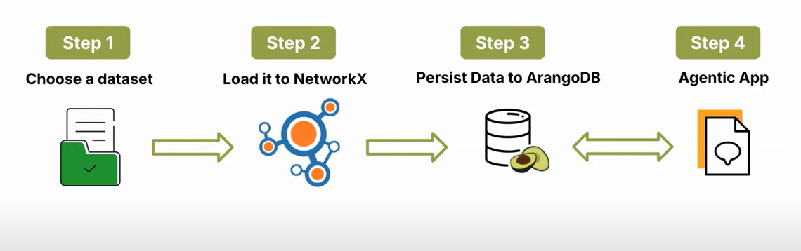
architecture

Slide 7
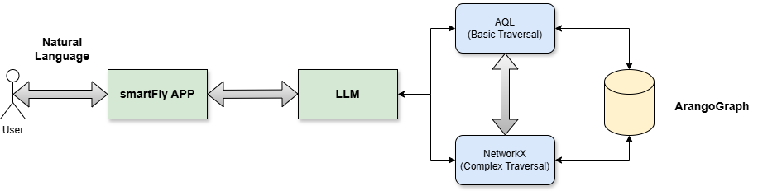
Architecture continued

Slide 8
demo

Slide 9
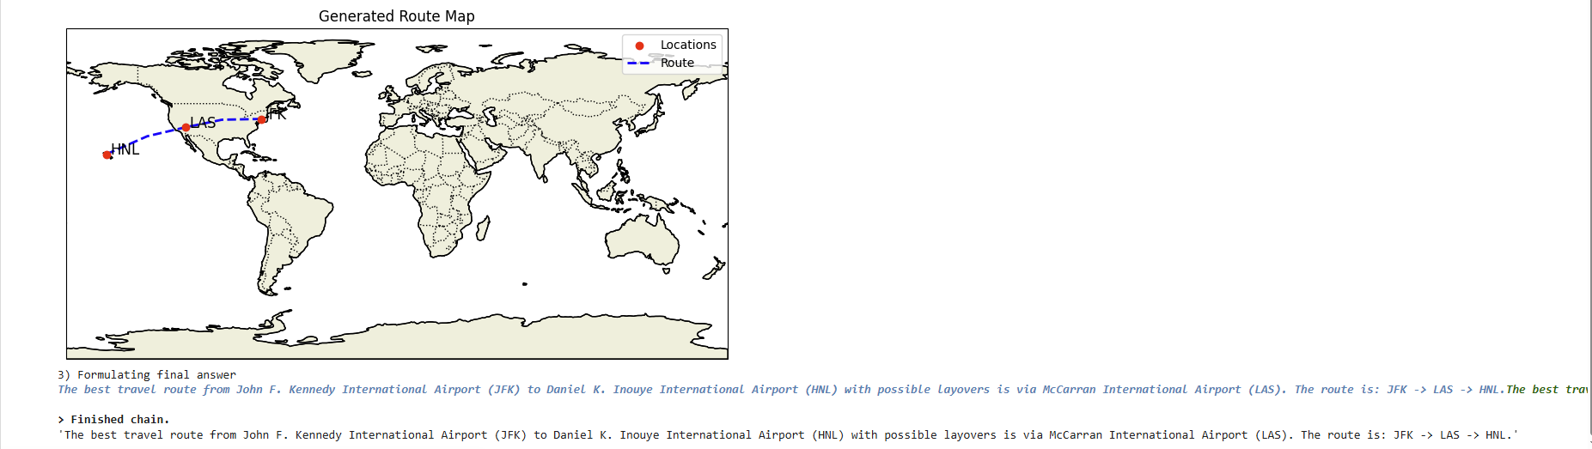
Further improvements
1) Use a MultiGraph and increase the complexity of queries.
2) Pictorial representation of the output and not just the text.

Slide 10
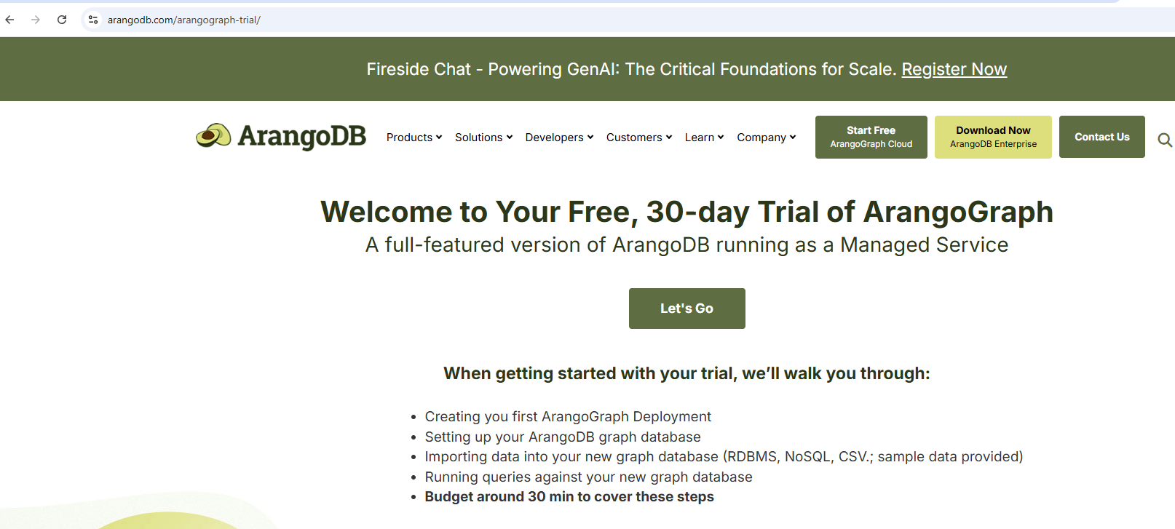
Additional slides
Steps to connect to the ArangoDB client.
1) Click on the ArangoDB trial version (https://arangodb.com/arangograph-trial/)
2) Select the Let’s GO option.

Slide 11
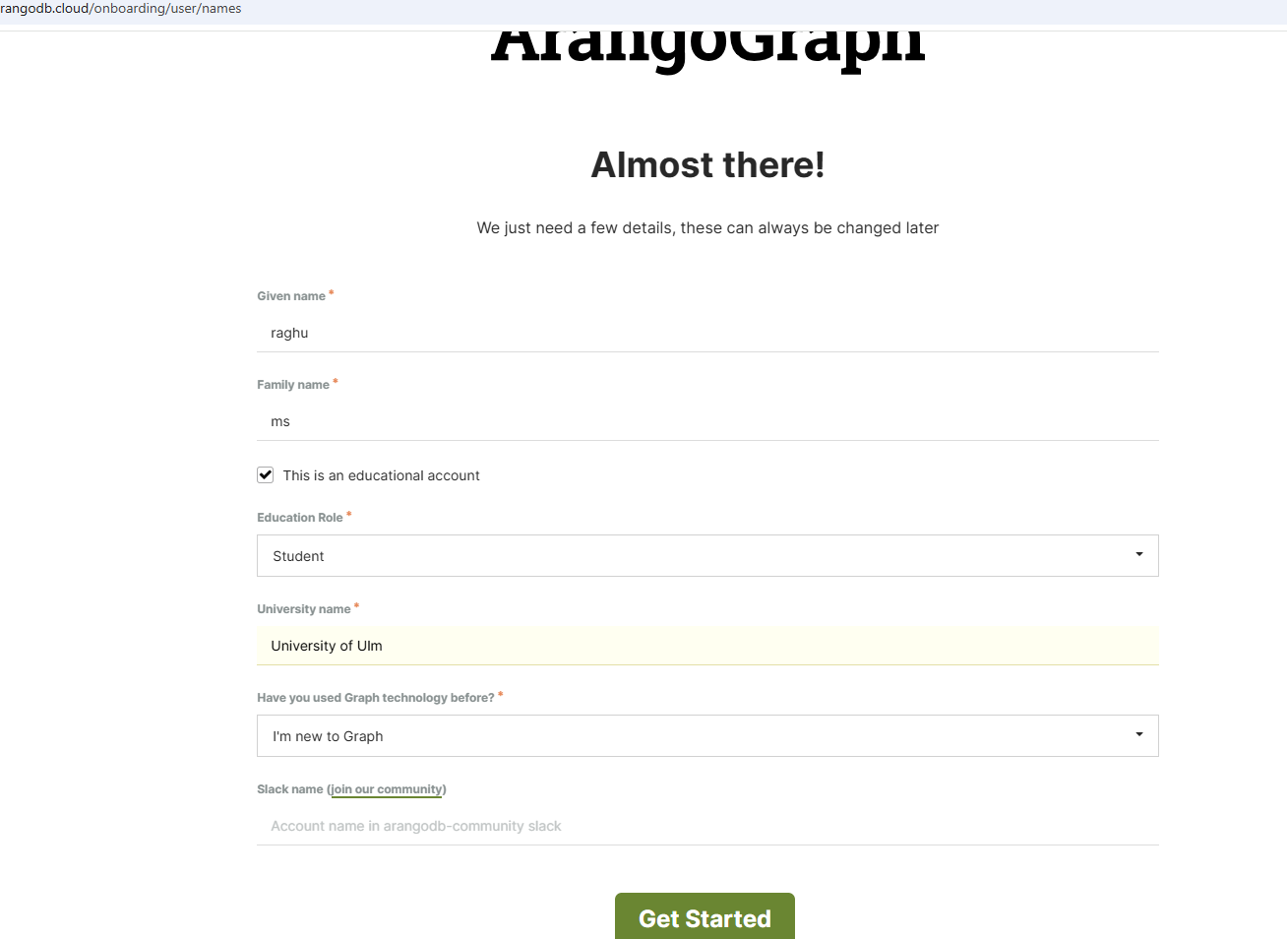
3) Then sign-in with your email or with github.
4) Fill in the details and then click on Get Started.

Slide 12
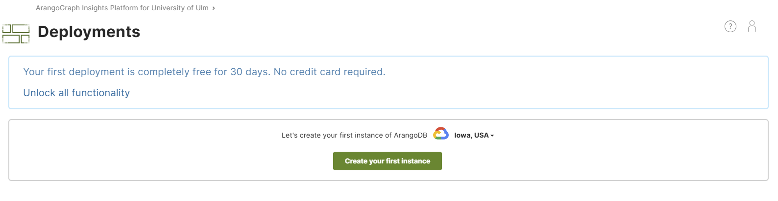
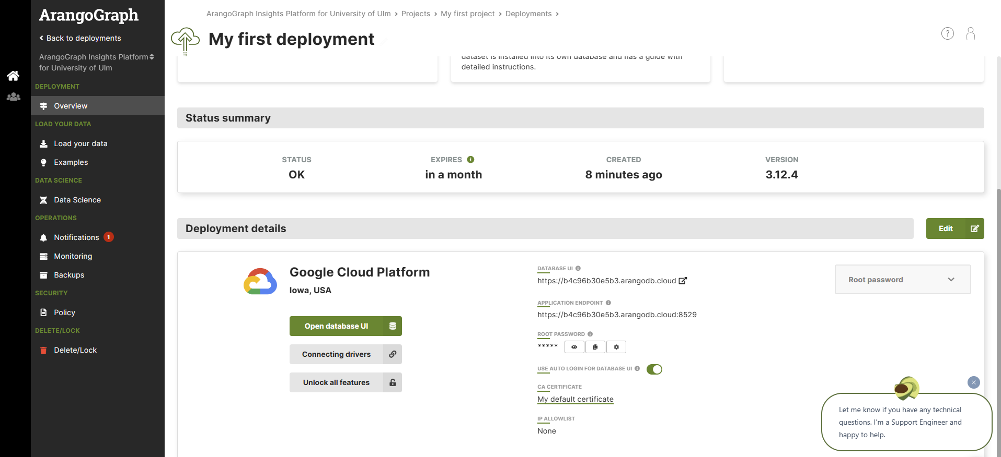
5) Select Create your first instance.
After which you will be redirected to a page with username and password which can be used to connect to the ArangoDB client.

Slide 13
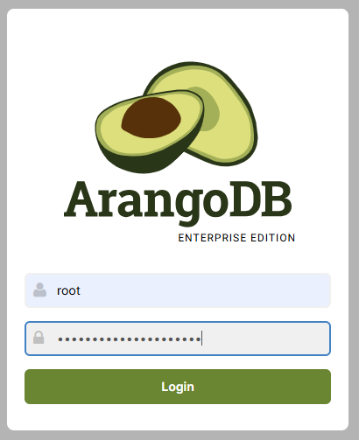
Arango search configuration
1) Connect to your ArangoDB client, for example in my case (https://51ab851a7096.arangodb.cloud:8529)
2) Login with your username and password.

Slide 14
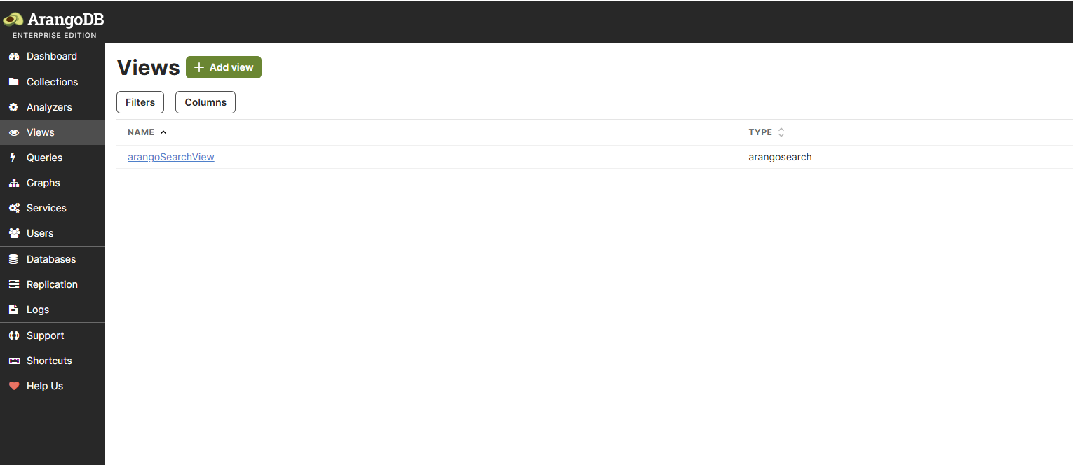
3) Click on view and select add view as shown in the below snapshot.

Slide 15
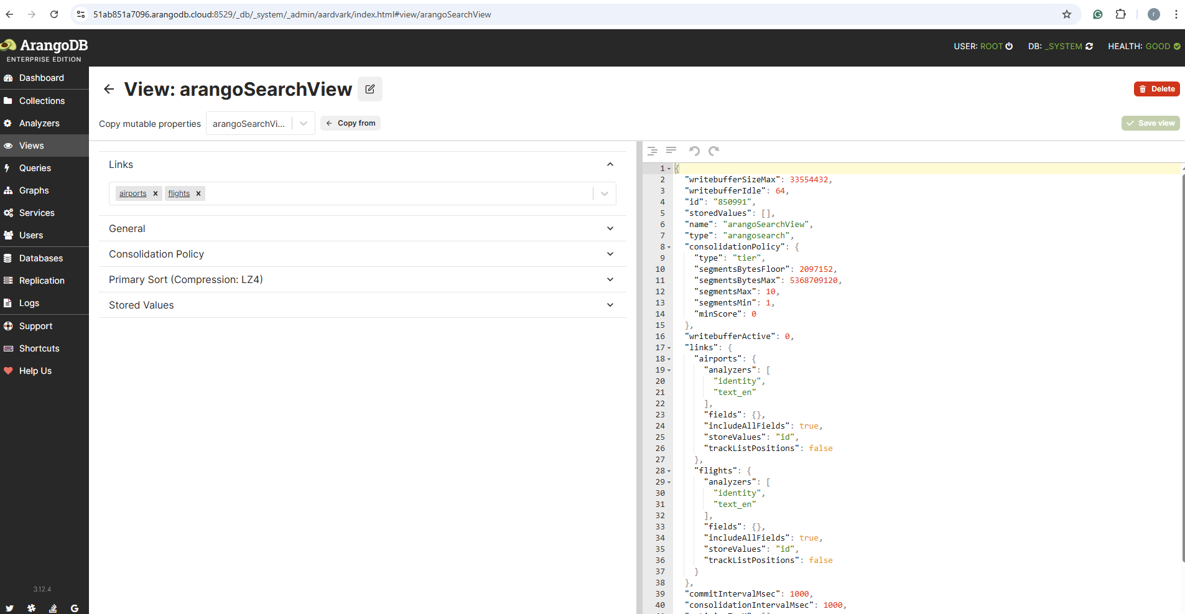
4) Give a suitable name to the view (e.g :- arangoSearchView)
5) Link that with the collections which you have in your Graph and the view would appear somewhat as shown in the snapshot below.

Slide 16
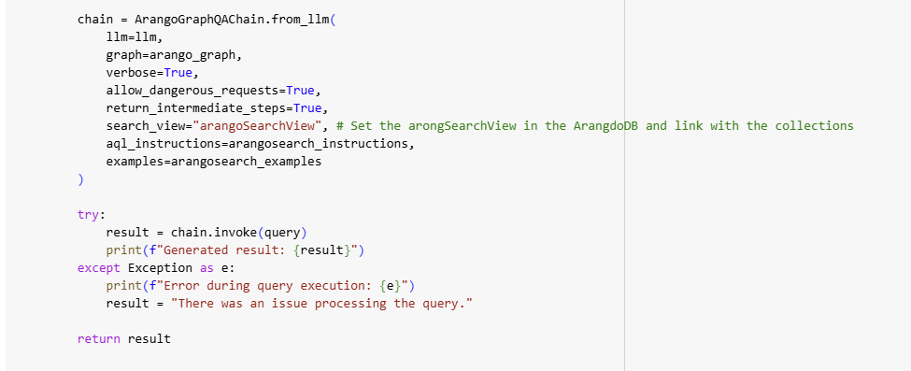
6) Use this in the code implementation as shown below.

Slide 17
The end

