Slide 1
Secrets of the Supermarket CS63018 & CS 73018 Probabilistic Data Management Professor :- Xiang Lian
Raghunath Male – 811257226

Slide 2



Introduction
The OpenFoodFacts app assembles user-contributed data to offer detailed food product information, empowering informed dietary choices. However, data inaccuracies, inconsistencies, and a lack of robust validation hinder its reliability. This project employs advanced techniques like the Gaussian Mixture Model (GMM) to identify anomalies, improve data integrity, and enhance the app’s usability, making it a more trustworthy resource for users.

Slide 3
DataSet Description
This dataset contains food product information from Open Food Facts, including user contributions and USDA imports.
The main columns are Product ID, Product URL, Product Description, and Data Source.
Product ID provides a unique number for each item, ensuring easy tracking and reference.
Product URL links to detailed information about each product on the Open Food Facts website.
The dataset includes Availability Probability, showing the chance a product is available globally (e.g., USDA products have higher probabilities).
Source Reliability Probability measures the accuracy of the data. USDA entries generally score higher than user-contributed ones.
Category Classification Probability indicates the likelihood a product belongs to a specific category (e.g., banana chips likely being classified as snacks).
These probabilistic features help analyze product trends, assess availability risks, and evaluate data reliability more effectively.

Slide 4

Problem Statement
Poor data quality in the OpenFoodFacts dataset stems from inconsistent and erroneous user-contributed data.
Lack of robust validation processes undermines the app’s reliability and integrity.
Compromised data quality affects the app’s ability to provide accurate and timely food product information.
The research employs Gaussian Mixture Model (GMM) to identify anomalies, correct errors, and enhance data quality.

Slide 5
Background
OpenFoodFacts was created to provide transparent, user-contributed food information.
Focuses on nutritional content, allergy information, and ethical concerns.
Challenges: Inconsistent and error-prone user data reduce reliability.
Maintaining data integrity is essential for credible and accurate information.
Solution: Employ Gaussian Mixture Model (GMM) to enhance data quality and usability.

Slide 6
METHODS
Get_outliers:
The function compares the components of a probability distribution to a dynamically defines threshold, enabling you to find outliers in a dataset.
Make_word_cloud:
Based on the word frequencies in the text, the function creates a word cloud from text data linked to a certain cluster and shows it on a subplot with a designated title.
Split_data_by_nan:
We can use the function to filter the dataset such that only columns with a proportion of missing values below a predetermined threshold are included.
Scale_and_log:
The function enables a numerical characteristic to be transformed by combining standardization, Box-Cox transformation, and Min-Max scaling.

Slide 7
Proposed Technique
Anomaly detection:
By utilizing the Gaussian Mixture Model's capacity to recognize departures from the dataset's natural structure, the model improves data quality by detecting errors, including minute anomalies, in OpenFoodFacts data.
Automatic Categorization:
Product classification is streamlined and less dependent on user input thanks to the app's use of the Gaussian Mixture Model for automated categorization. The app's objective is to enhance user experience and overall efficiency in handling a variety of product information by suggesting categories on its own and asking users to confirm or modify them.

Slide 8
GMM Methodology
What is the Gaussian Mixture Model?
The Gaussian Mixture Model is a clustering technique that groups data based on similarities. It assumes the data is made up of multiple overlapping groups, called "clusters," each of which follows a bell-shaped curve (Gaussian distribution). GMM tries to identify these groups and their characteristics, such as the center (mean) and spread (variance).

Slide 9
GMM Methodology
Key Concepts:
Clusters as Gaussian Distributions: Each cluster is represented as a Gaussian distribution (like a 3D hill or a 2D curve).
Soft Clustering: Unlike hard clustering methods (e.g., K-Means), GMM gives each data point a probability of belonging to multiple clusters, allowing for more flexibility.
Iterative Process: GMM uses the Expectation-Maximization (EM) algorithm:
E-Step: Calculates the probability of each data point belonging to each cluster.
M-Step: Updates the clusters based on these probabilities.

Slide 10
GMM Methodology
Gaussian Mixture Model (GMM) finds groups in data based on hidden categories like "cheese", assuming these categories influence data patterns.
GMM uses latent variables like "pasta" or "vegetables" to explain data distribution, with each variable generating a multidimensional gaussian (foggy ellipsoid).
The number of gaussians corresponds to assumed product categories (e.g., 7 for the nutrition pyramid), each gaussian covering data points in its high-dimensional space.

Slide 11
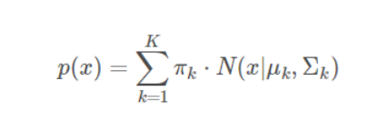
Strategy of Approach
A Gaussian Mixture Model (GMM) is a probabilistic framework employed for data clustering and density estimation. The GMM posits latent variables for product categories within 200,000 nutrition tables, each characterized by a multivariate Gaussian distribution encompassing carbohydrates (C), sugars (S), fat (F), proteins (P), energy (E), and salt (S). The observed data distribution (x) is expressed as a summation of these Gaussians, with each Gaussian (k) denoting a product category:
The k-th Gaussian's weight is represented by πk, while N(x∣μk,Σk) denotes the multivariate distribution

Slide 12

E- Step
Initially random gaussians calculate their responsibility for each data point, which sums to 1, and the winner with highest responsibility predicts the cluster for that point..

Slide 13
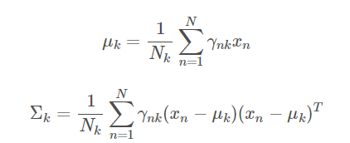
M-Step
Unlike K-Means, GMM updates cluster centers and shapes using the weighted responsibility of all data points, giving more weight to those most likely explained by the cluster.

Slide 14
Data Cleaning and Preprocessing
1. Remove Duplicates
Eliminate duplicate rows or values to avoid biased results. Use functions like drop_duplicates() in Python to clean redundant data.
2. Handle Errors
Check for missing, invalid, or inconsistent data (e.g., non-numeric or impossible values like negative energy). Replace errors with NaN, impute values (e.g., mean), or drop faulty rows.

Slide 15
Data Cleaning and Preprocessing
Apply Scaling:
Normalize data to a range (e.g., 0 to 1) or standardize it (mean = 0, variance = 1) to ensure consistency in analysis.
Perform Transformations:
Transform skewed data using techniques like logarithms or square roots for better distribution.

Slide 16
Data Cleaning and Preprocessing
Eliminating obvious error sources:
Eliminating obvious error sources in datasets means identifying and fixing mistakes or inaccuracies in the data that are clearly wrong or make no sense. This step ensures that the data is accurate, consistent, and reliable for analysis or machine learning.

Slide 17
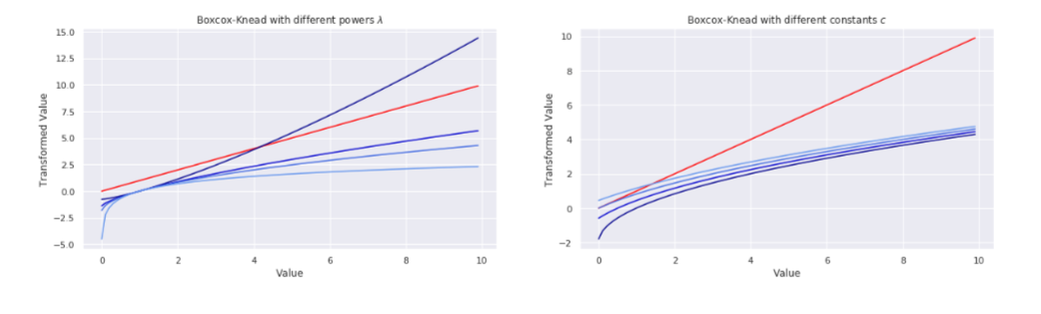
Data Cleaning and Preprocessing
Removal Of Outliers

Slide 18
Training and Model Selection
This code uses GMM to determine the ideal number of clusters (components) in a nutrition dataset while taking into account both qualitative (feature correlations) and quantitative (log-likelihood, BIC, and AIC) metrics.
It looks for clusters that capture underlying patterns for efficient decision-making and tackles the problem of over/underfitting brought on by possible user errors.
Iterating through different cluster numbers, the code assesses each one both numerically and qualitatively before choosing the best balance based on both viewpoints.

Slide 19
Clustering Results
Interactive 3D scatter plot: Visualizes product clusters based on 3 chosen features (carbs, proteins, fat), with options to explore other features.
Flexible feature selection: Allows switching between original and transformed features for deeper analysis.
Limited data for plot stability: Uses 10,000 data points (common practice for large datasets) to ensure smooth and responsive visualization.

Slide 20
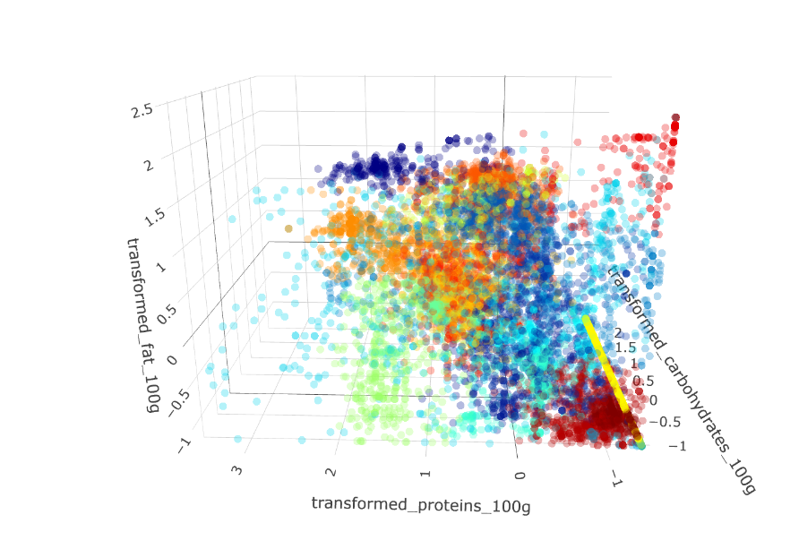

Slide 21
Certainty Analysis
Certainty Analysis: Using responsibilities, GMM determines the certainty of product cluster allocations and displays the distribution, indicating a break point at 0.5. Uncertainty is defined as data with less than 95% certainty.
Uncertainty Exploration: The model displays competing clusters and their contributions as a heatmap of potential cluster assignments for each category when identifying uncertain points.
Visualization & Insights: While uncertainty suggests possible overlaps or mixed types, high certainty frequently implies related items. Uncertainty in the feature space is graphically represented by a 3D scatter plot.

Slide 22
Anomaly Detection
Data points are scored by GMM according to how dense they are in the distribution as a whole. Potential abnormalities, including mistakes or uncommon products, are indicated by lower density scores.
A threshold based on a p-quantile, which establishes the proportion of data items deemed anomalous (e.g., 7%), is used to characterize anomalies.
A product is represented by each point in the 3D space, and the point's location is dictated by its values for the three nutritional characteristics. Each point's color is based on the "anomaly" values from the "nutrition_table," with abnormalities perhaps being highlighted in a different color.

Slide 23
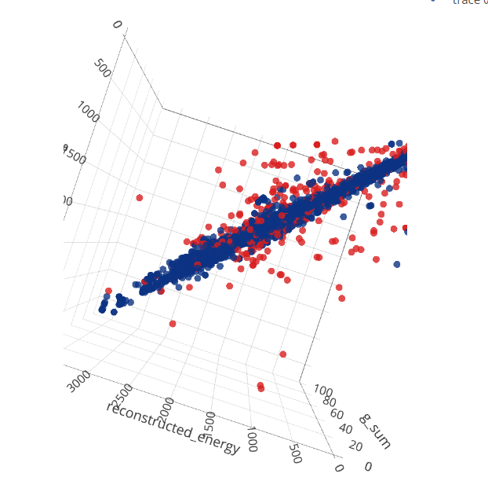

Slide 24
Estimating Nutrition Scores
Predicting the nutrition score of items in the database has been made possible by the analysis, which has also effectively clustered similar products based on the nutrition table.
Scores are grouped for food and drink, adding predictions to the nutrition table.
The nutrition content makes 91.55% of the missing scores predictable, with 8.45% of them addressed.

Slide 25
Future Work and Conclusion
Future Work:
Refine GMM with new features.
Integrate real-time anomaly detection.
Improve user feedback systems.
Conclusion:
Identifies several product categories within these clusters.
Evaluates the degree of certainty in cluster designations, exposing possible overlaps and mixed kinds.
Detects anomalies, such as incorrect values, uncommon entries, and a special "outlier cluster."

