Slide 1
Bank Marketing Data Analysis using Logistic Regression
By
Raghu

Slide 2
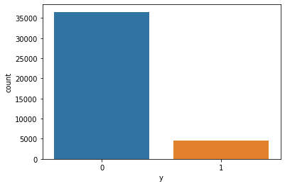
Find the counts in each class

Slide 3
Step 1:
Find the categorical variables
Convert categorical variable to numerical using LabelEncoder

Slide 4
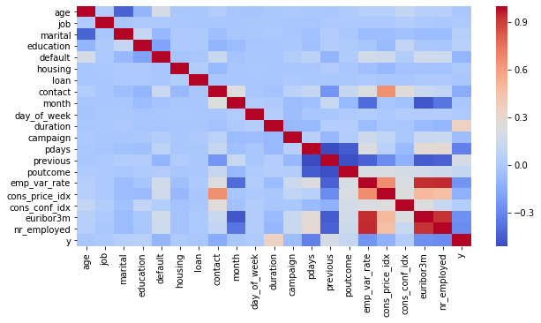
Step 2: Heat map for Correlation coefficient

Slide 5
Step 3:
find the variable/features greater than a threshold values (say 0.2, 0.1)
Drop the remaining features from the dataset

Slide 6
Step 4: classification
Split the data for train and test
Set up the logistic regression model
Train and test the logistic regression

Slide 7
Step 6:
Change the correlation threshold and add new features
Train and test using logistic regression

Slide 8
Classification results using different scenario

Slide 9
Inference
Highest accuracy of 0.9002 can be achieved using only two features.
Further adding new features (based on correlation coefficient) slightly increases the accuracy
The highest accuracy 0.9132 can be achieved using all the features

