Slide 1
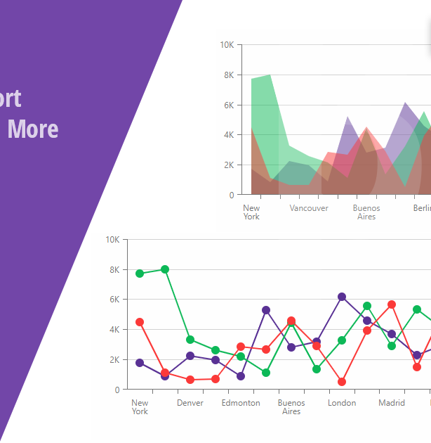

Exploring store and product performance
Guided By : Hemant Purohit
Team Members : Tanvi Dhankecha
Raghu dharavath

Slide 2

Content
Introduction
Motivation
Project Roadmap
Data
Visualization
Conclusion
References

Slide 3
Introduction
Objectives
Scope
Context
The primary objective is to identify the factors that contribute to the success or failure of a particular store or product.
This analysis can provide insights into customer behavior, market trends and many more.
By understanding these factors, businesses can make decisions to improve performance and increase profitability.
Scope is depending on the needs of the business
Some areas of focus include
Sales Performance
Inventory Management
Supply Chain efficiency
This analysis is relevant in a wide range of industries, including retail, e-commerce, manufacturing .
Businesses can get an edge over competitors by identifying areas for improvement and taking action to address them using data analysis tools like R Studio.

Slide 4
Motivation
Data Analysis Skills
Explore Potential Career Paths
Real World Problem
We will have the opportunity to develop skills in data visualization, statistical modeling, and programming that are highly valued in many industries.
Analyzing store and product performance is a key skill set in many industries, including retail, e-commerce, marketing, and logistics.
By working on a project in this area, we can gain exposure to different career paths and industries.
By applying concepts from this course work to a real-world problem, we can gain a deeper understanding of how those concepts are used in practice and develop a more well-rounded skill set.

Slide 5
Roadmap
Define The Project Scope
Collect And Pre-Process Data
1
Data analysis
2
Use R Studio to explore the data and identify patterns and trends.
This could include generating visualizations such as scatterplots, histograms, and box plots
Identify the specific problem or question we want to address through our analysis.
Clean and preprocess the data to ensure it is in a format that is suitable for analysis.

Slide 6
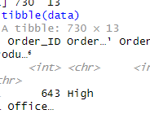
Over View of Dataset
Importing the data set
“tibble” function.

Slide 7
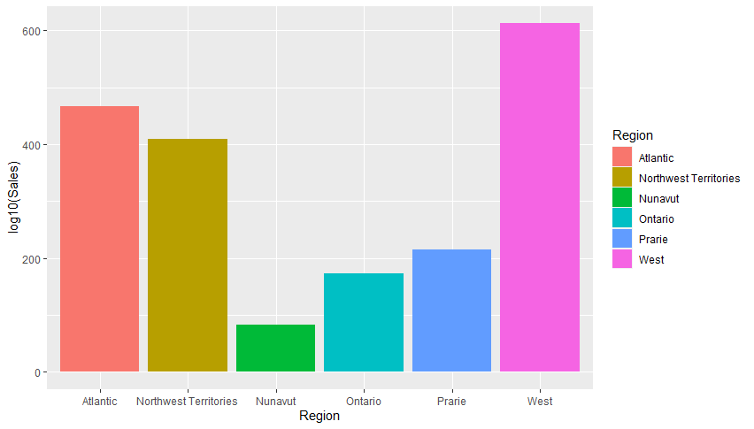
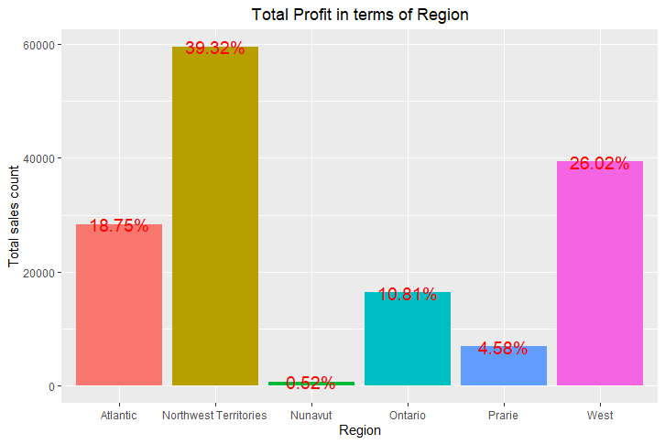
Visualization Part- 1
Sales Vs Region
Profit Vs Region

Slide 8
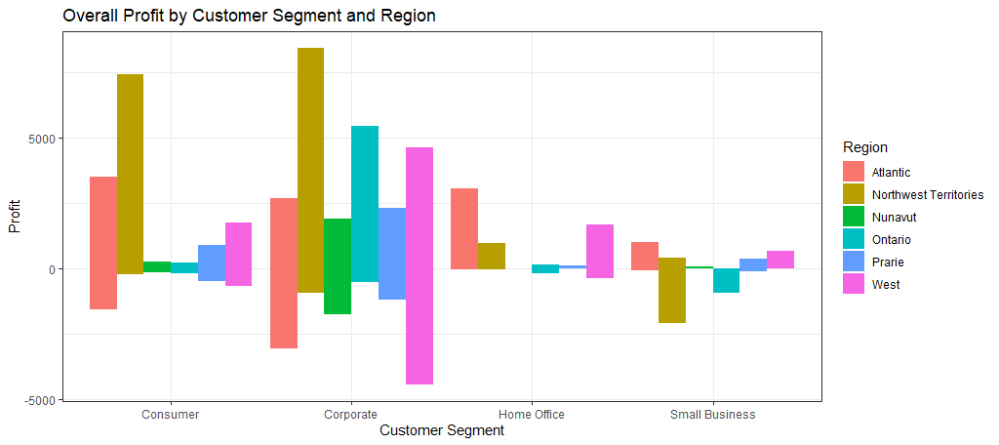
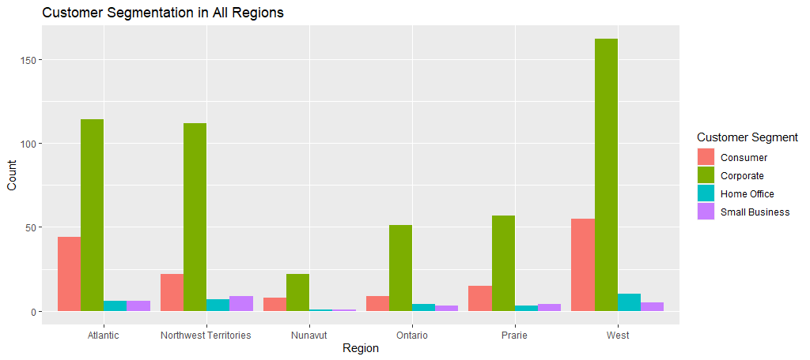
Visualization Part- 2
Customer Segmentation
Over view of Profit

Slide 9
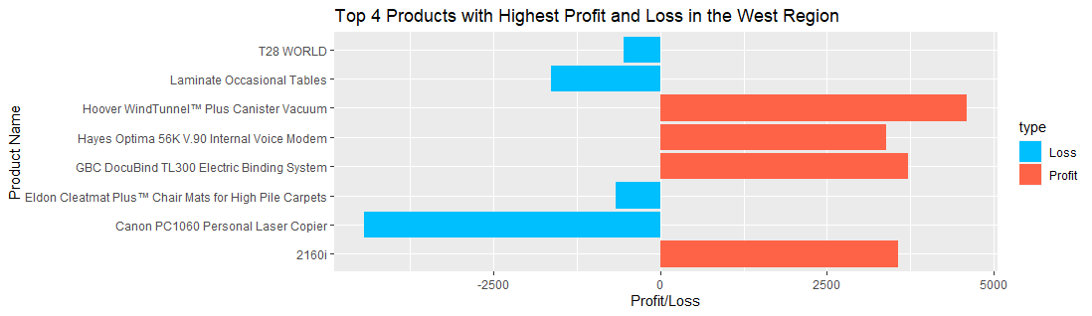
Visualization Part- 3

Slide 10
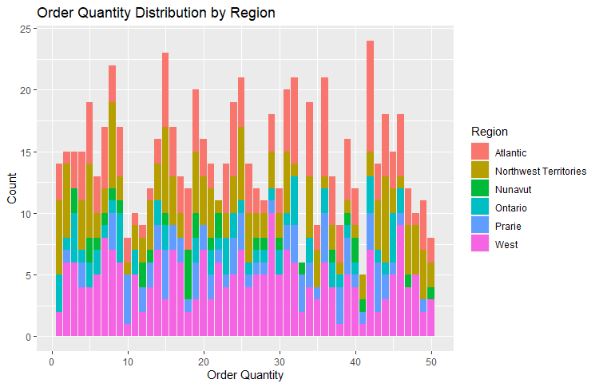
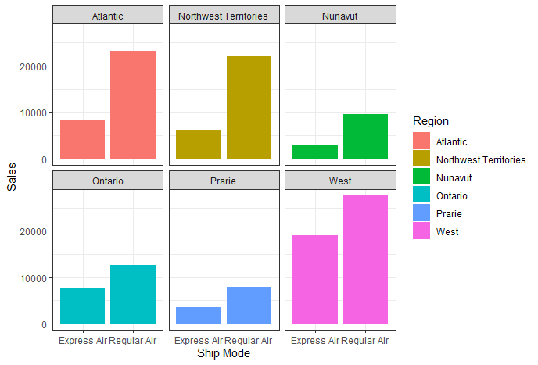
Visualization Part- 4
Shipment Vs Region
Order Quantity among the Regions

Slide 11
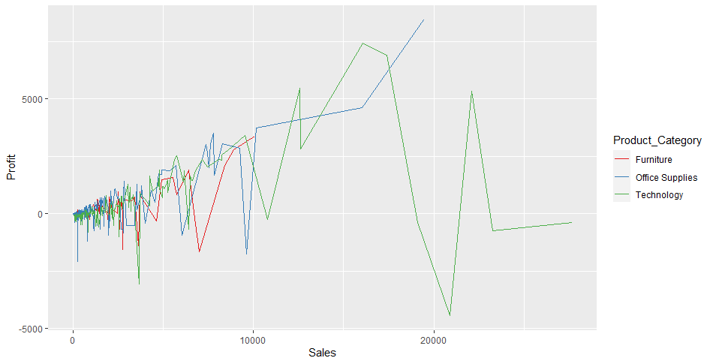
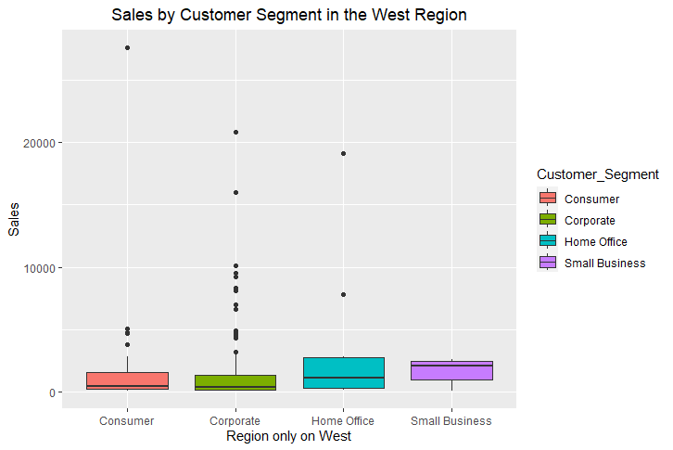
Visualization Part- 5
Sales Vs Cost.Seg
Sales vs Profit

Slide 12
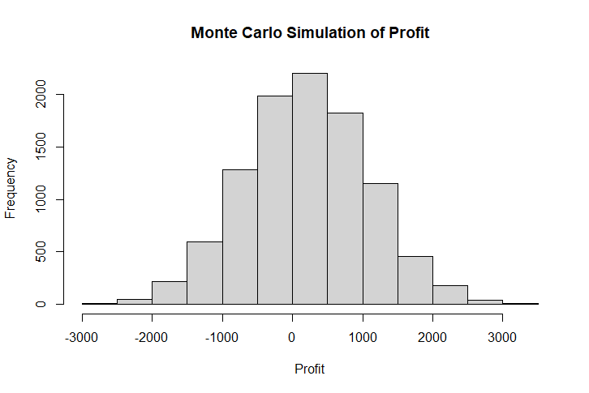
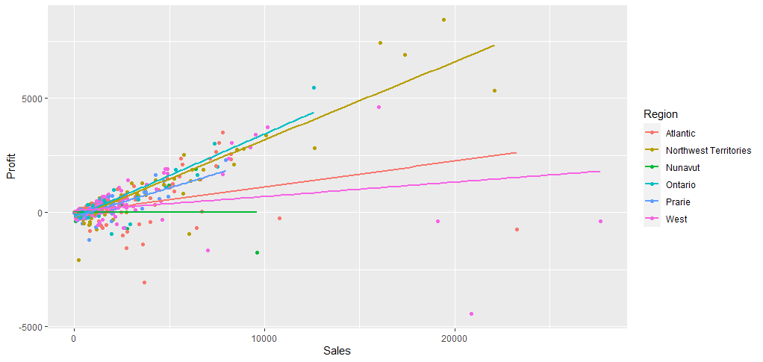
Visualization Part- 6
n samples for profit
Correlation of Profit and Sales

Slide 13
CONCLUSION
The insights gained from this analysis can help businesses to make informed decisions about product offerings,and store locations, Profit Or loss in particular product category, inventory management in store and many more in order to maximize performance and profitability.
We can also consider different factors such as Supply Chain, Brand recognition, Marketing efforts, Economic factors, Culture factors and many more.

Slide 14
References
https://www.kaggle.com/datasets/anuvagoyal/sales-store-product-details
http://rafalab.dfci.harvard.edu/dsbook/ggplot2.html

Slide 15

QUESTIONS?

Slide 16
Thank You

